Slide 1


Vulnerability of the Day
Concrete Vulnerability Demonstrations for Software Engineering Undergraduates
Andy Meneely and Samuel Lucidi
Department of Software Engineering
Rochester Institute of Technology

Slide 2
Software Must Be Secure!
Security matters today
Google pays $200-$20,000 per vulnerability¹. …recently² paid $31,336 for 3.
Vulnerabilities permanently damages your brand
Can cause irreversible damage to us as users, customers, patients, citizens, etc.
This burden hits developers hard
On-time, within budget, functional, what the customer wants, AND SECURE?!??
Requires a breakers, but we teach them to be builders
[1] http://www.google.com/about/appsecurity/reward-program/
[2] http://www.h-online.com/security/news/item/Google-pays-out-record-31-336-to-researcher-1853049.html

Slide 3
Avoiding Too Much Functionality
what the system should be
what the
system is
Typical Bugs
Vulnerabilities
Just to find a vulnerability, you need to…
Know the system
Think like an attacker: abuse not use
Know common techniques
Know fundamental security principles
So how should we teach this?

Slide 4
Engineering Secure Software @RIT
Department of Software Engineering
Engineering Secure Software is now required for SE majors
Typically a 3rd year course
Pre-req: Intro to SE, which requires CS1 and CS2
“Everything a software engineer needs to know about security”
Principles: Confidentiality, Integrity, Availability, Assets, Defense in Depth, Secure by Default, Insider Threat, etc.
Methodologies: Threat Modeling, Abuse Cases, Risk-Driven Planning, Test-Driven Development, Applied Crypto, etc.
Defensive Coding: Vulnerability of the Day!

Slide 5
Vulnerability of the Day
Self-contained 10-minute demonstration at the beginning of class
Code:
Execute an exploit using “make” on our servers
Commented to highlight the vulnerability
Projector-friendly: no scrolling, big fonts
Website:
Description links to the Common Weakness Enumeration
Historical examples from case studies, with patches (CVEs)
Mitigation of how people usually fix or avoid this
Other notes about wrong mitigations, historical notes, relation to other vulnerabilities, interesting assets being compromised

Slide 6
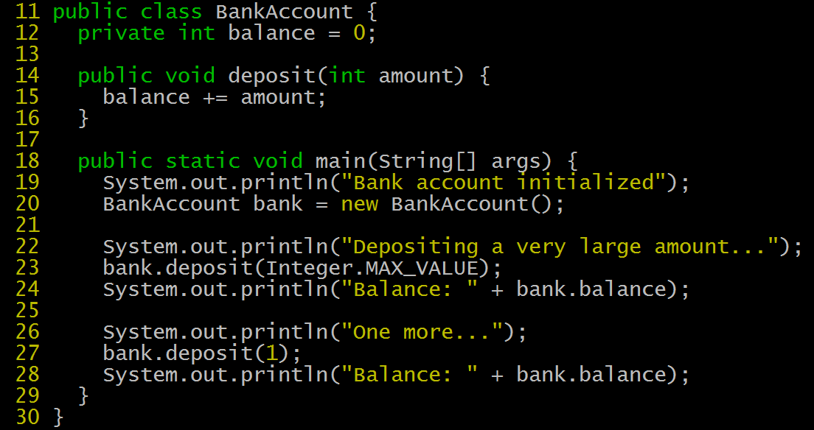
Integer Overflow

Slide 7
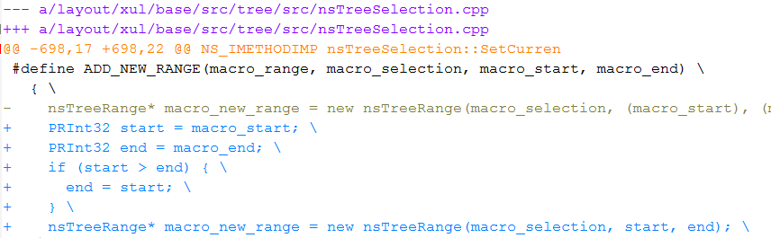
Integer Overflow Mitigations
Mitigations
Recognize important integers
Use libraries for large numbers
Build integrity checks into your design
Checking after every operation is usually not reasonable

Slide 8
VotDs We Cover
Integer Overflow
Buffer Overflow
Path Traversal
OS Command Injection
SQL Injection
Hardcoded Credentials
Cross-Site Scripting
Log Overflow
XML Embedded DTDs
Log Neutralization
Hashing without Salt
Insecure PRNGs
Open Redirect
Cache Poisoning
Java Reflection Abuse
Cross-Site Request Forgery
Uncontrolled Format String
Double Free
Motivation for this coverage
Diversity in technologies (don’t just pick on C! or webapps!)
Diversity in easy or hard mitigations
Diverstiy in types of mitigations (not just input validation!)
Diversity in principles: injection, algorithm, input-related

Slide 9
Keep it Concrete
Complement the vague principles
Example-driven learners as well as global learners, every day
Provides a vocabulary and example for today’s lecture
e.g. what is the integrity violation of a CSRF in Wordpress?
Historical examples should show the patch
Students need persuading
Some will not believe you that this is a real problem
Some do not believe they have ever made that mistake themselves
Show is more persuasive than tell

Slide 10
Keep it Relevant
Cover vulnerabilities that matter today
Sometimes vulnerabilities will be largely fixed by the industry, e.g. HTTP Response Splitting
Even the trivially easy ones e.g. Uncontrolled Format String
Cover modern technologies
Adds to the persuasiveness
Recent historical examples projects students see
Counter the belief that security is a problem of the past

Slide 11
Keep it Simple
Easy to run on the projector with no prep
Keep the description short and sweet
Describe the VotD verbally in your own words
Let students do more research by linking to the Common Weakness Enumeration
Keep the example code easy to digest
As minimal context as possible
But keep a realistic domain
Vulnerability-focused instead of Exploit-focused
Yes, we always show a simple exploit
Emphasize finding and fixing, otherwise the material is overwhelming to students

Slide 12
A Healthy Dose of Paranoia
Students often report that VotD scares them
“I did that at my internship!!”
“Everything we’ve learned until now is wrong!!”
Meneely’s Maturity Model: New and Naïve → Paranoid and Perplexed → Maturely Mitigating
Fear-mongering and alarmism is not necessary here.
They will need to deliver software in their careers
Show them the mitigations, have discussions of the risks
VotD is the most popular part of the class
Taught this class 3 times and always highlighted on course evals
In a survey, this ranked the highest of all course materials as being the most effective

Slide 13
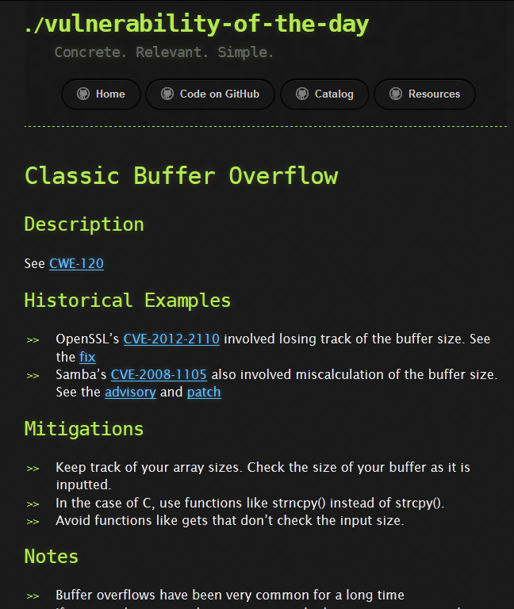
http://votd.github.io
Let’s keep this going!
Code is on Github
Website descriptions are online
Feel free to use and contribute!
Thank you!!
Questions?

