Slide 1
Employee manager project
Presenter: Vo Tran Viet Anh

Slide 2
I. Requirements of project
Building a website has 3 pages
  Employees(display,CRUD employee in the table)
  Employees detail(display avatar, some general info)
    - It has 4 tabs
    Information: display age,gender,name and avatar
    Working:CRUD hourly working
    Advances :CRUD the advances money
    Statics: displays the number of working days, salary advance
    and net pay for one month.
  Teams(List of team and number of employees in the team)

Slide 3
II. Key deliverables
1. Employee Management System: Building an employee management system using Java to handle employee information, including creating, viewing, updating, and deleting employee records.
2. Employee Search Feature: Implementing a search functionality to allow users to search and filter employee lists based on criteria such as name, position, or department.
3. Add/Update/Delete Employee Functionality: Providing the ability for users to add new employees, update existing employee details, or delete employee records.
4. Security and Authentication: Ensuring security and authentication through access control, login mechanisms, and user authentication.

Slide 4
III. Results achieved according to the project
Finished the requirement of project.
Adding additional functionalities:
  Changing password.
  Upload avatar’s user.
  Validation form.
  Authorize and authenticate.
  Multi-language.

Slide 5
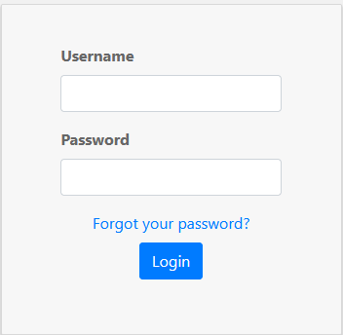
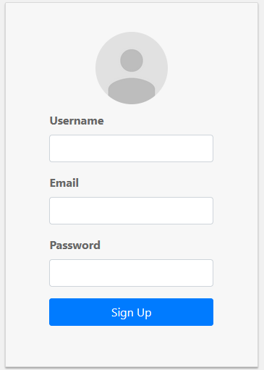
This is the interface for users to login or register

Slide 6
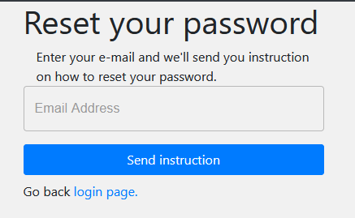

Slide 7
When the user logs in with the ADMIN role

Slide 8
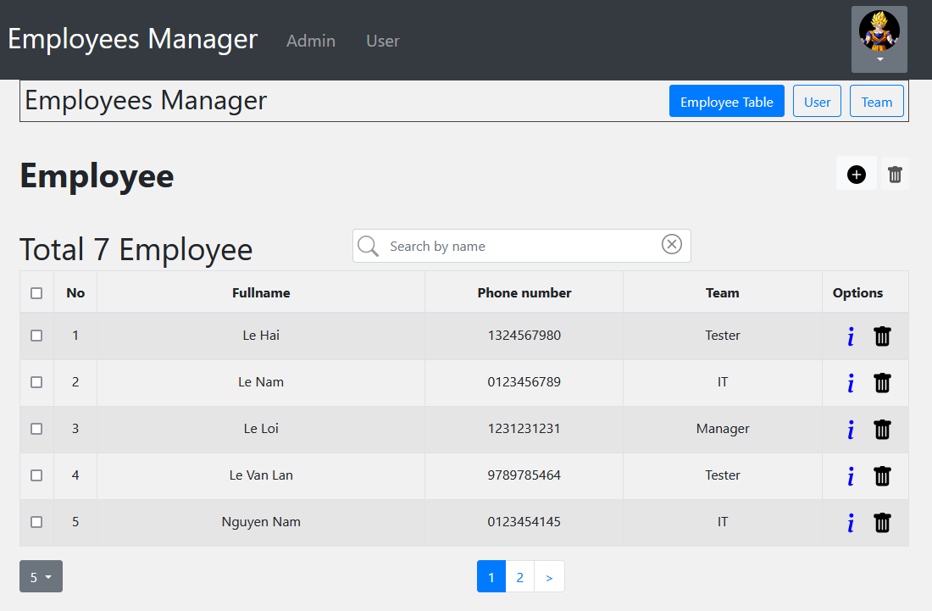
Employee management interface as admin role

Slide 9
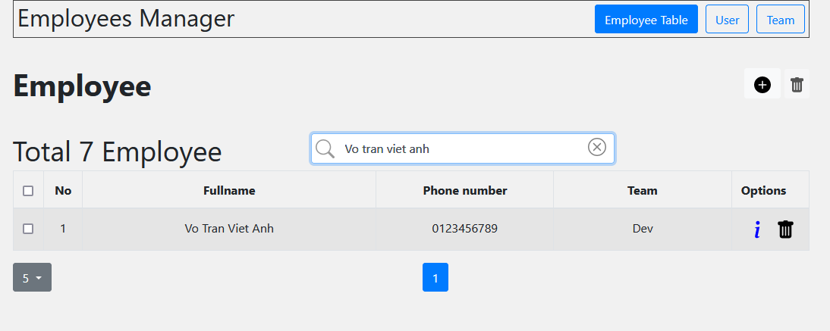
Search function by employee’s name in the management table.

Slide 10
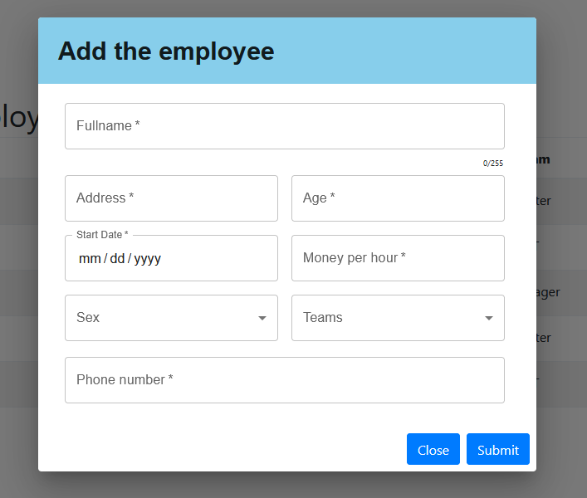
Add new employee dialog.

Slide 11
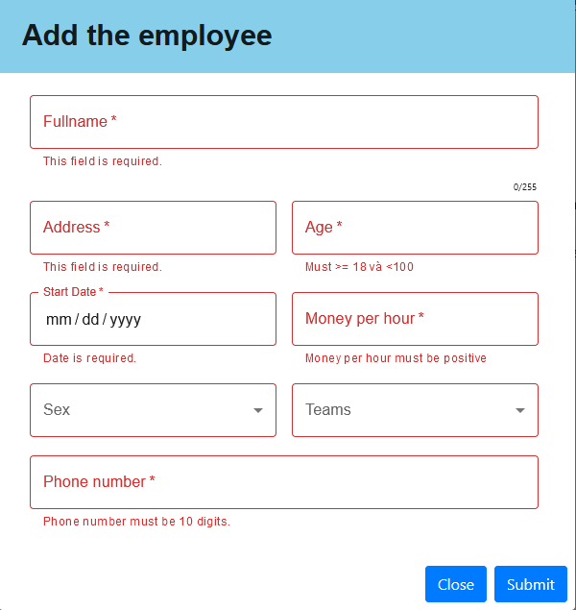
When the input field is empty, a warning dialog message will be displayed

Slide 12
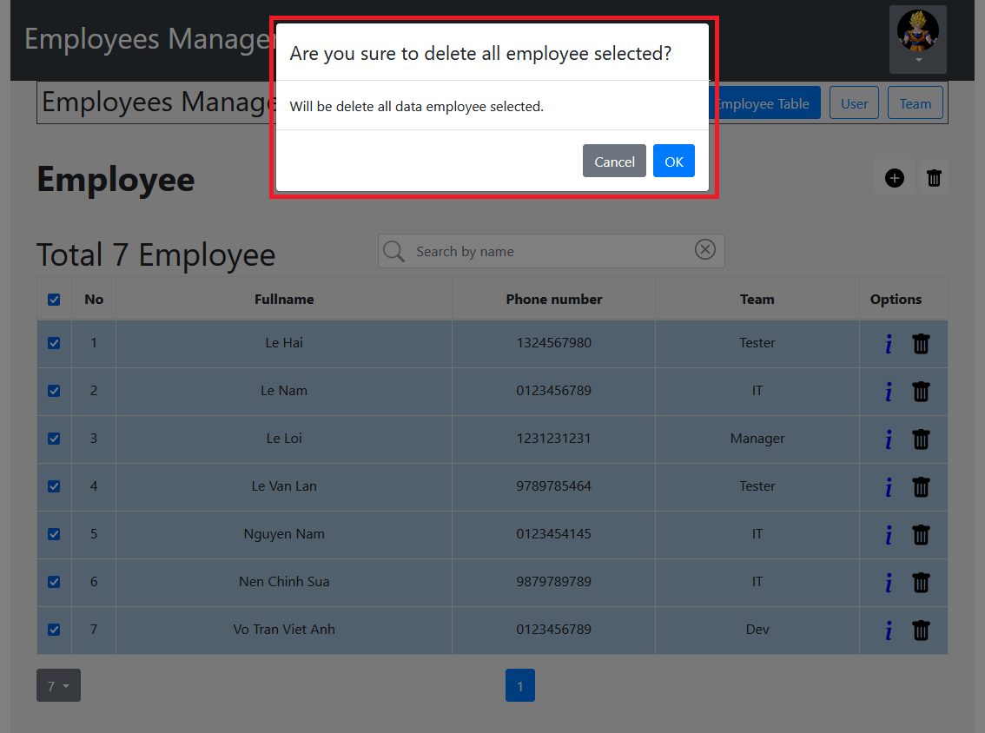
Dialog alert when delete list employees selected.

Slide 13
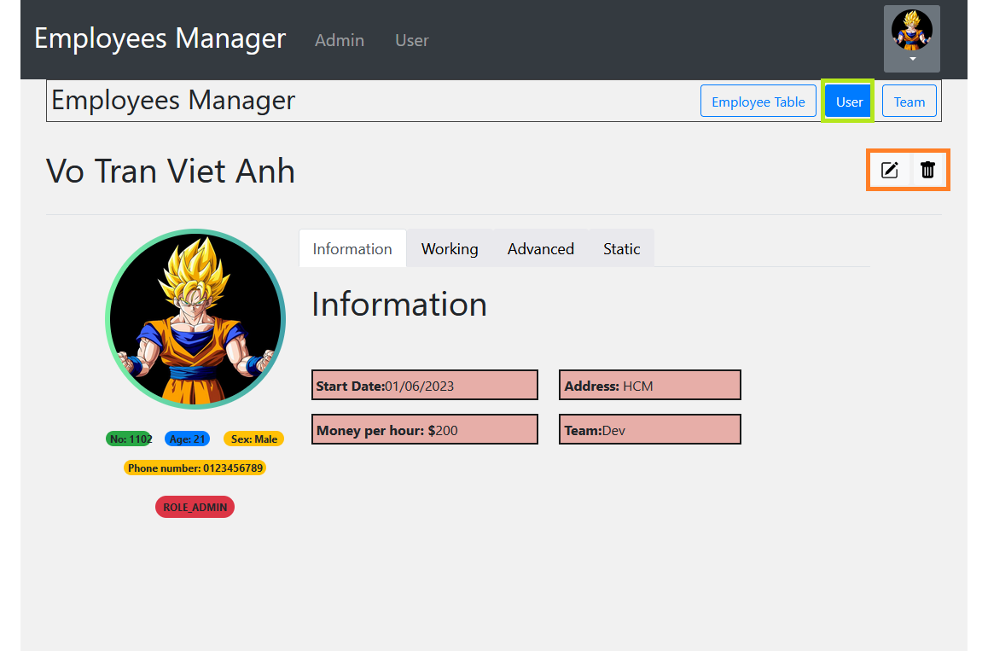
The user interface displays additional information the user tab when the user clicks on the "i" icon or “USER” button.
"Update and delete employee information" button.
Click to update avatar’s employee

Slide 14
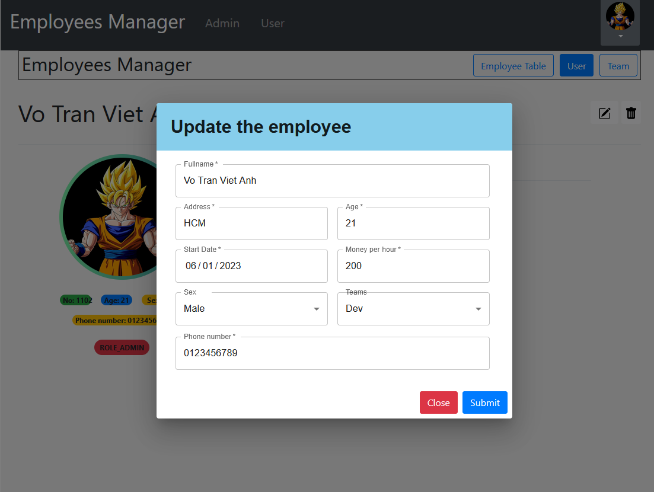
The dialog is displayed when the user clicks on the update icon.

Slide 15
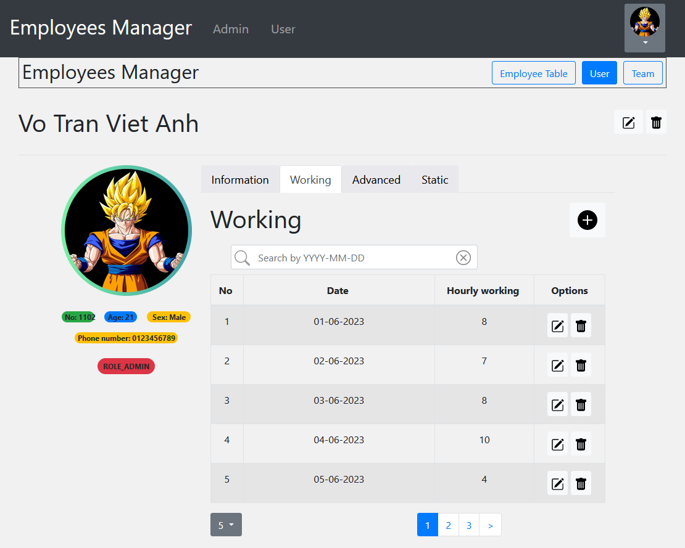
Add button used for adding new working hourly
The interface changes to the "working" tab when the user switches to it.

Slide 16
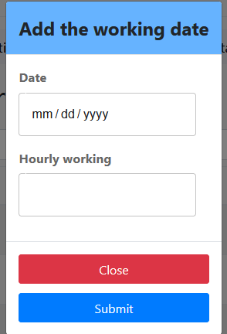
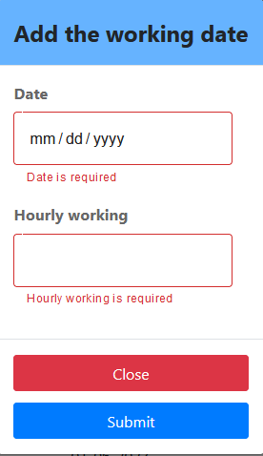
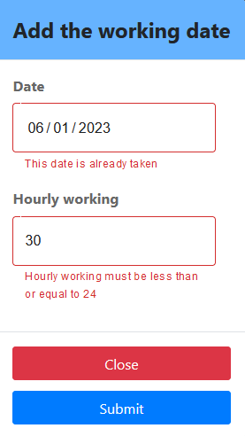
After clicking the add button, the following dialog will be displayed.
The filed Input is empty
The filed Input is invalid

Slide 17
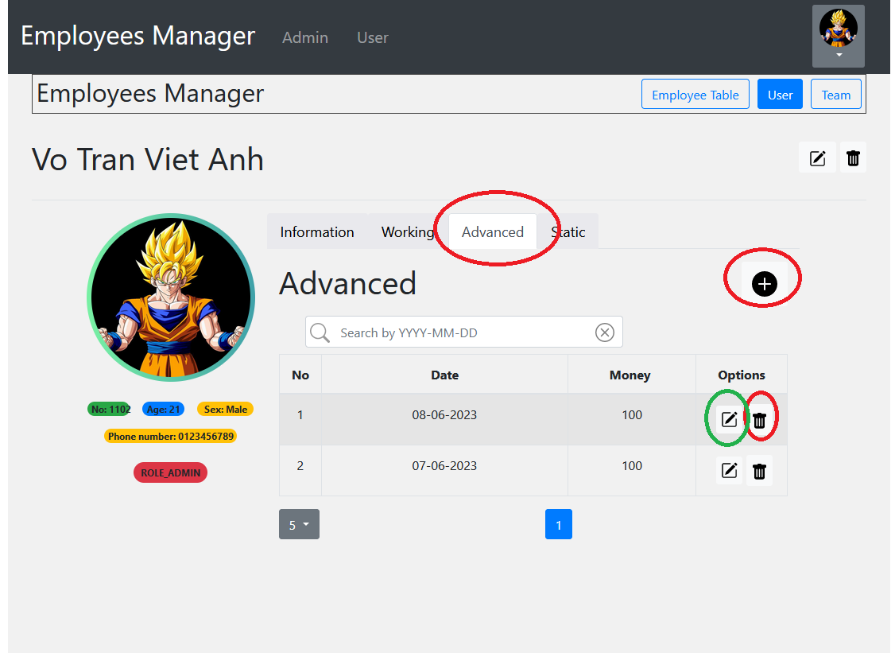
The interface changes to the "Advanced" tab when the user switches to it.
Add “the advanced” button.
Update and delete

Slide 18
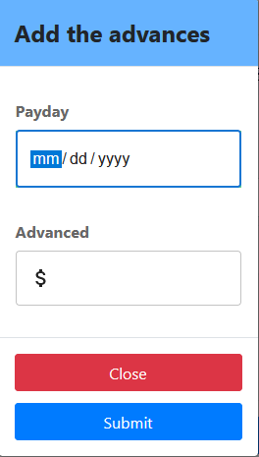
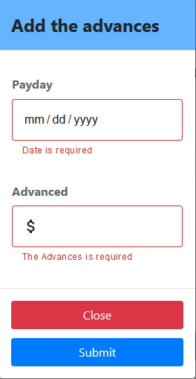
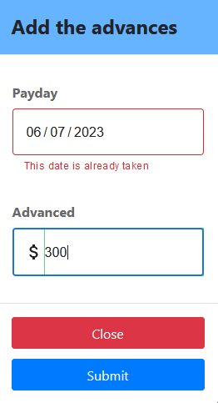
After clicking the add button, the following dialog will be displayed.
The filed Input is empty
The filed Input is invalid

Slide 19
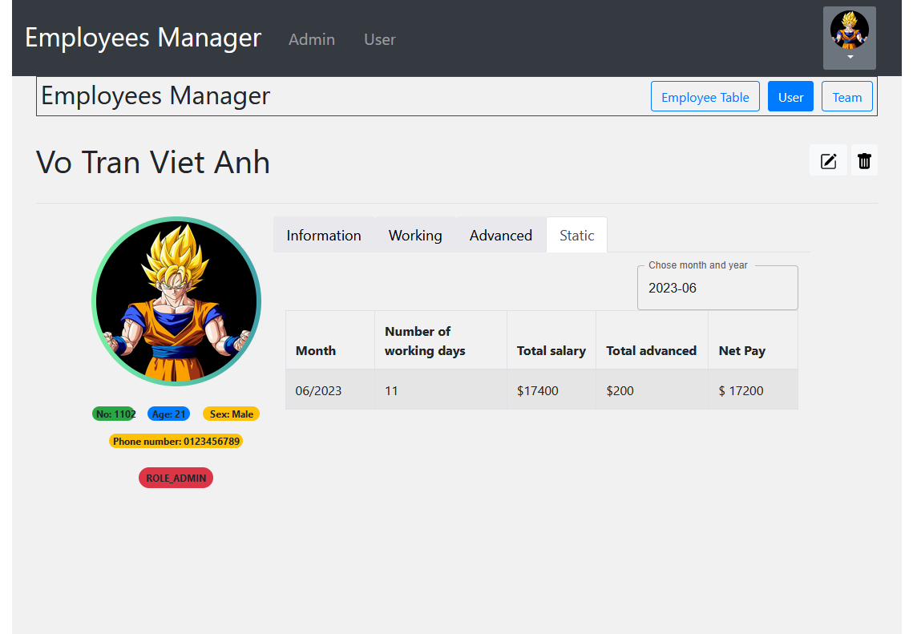
This is the static interface that displays the number of working days, salary advance, and net pay for one month.

Slide 20
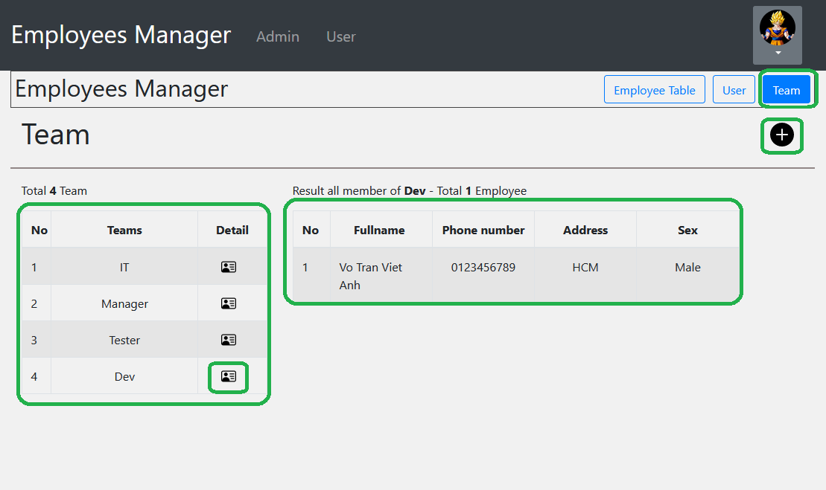
Add new team
List team and list employee when click on icon detail.

Slide 21
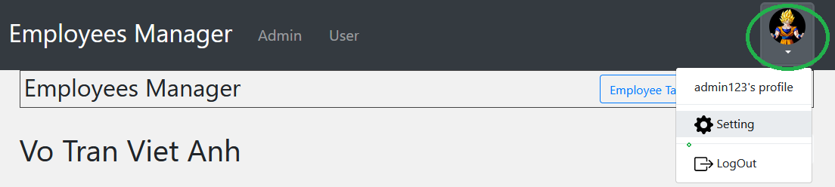
When the user clicks on the drop-down icon located at the right-hand side, a menu will appear with options for "Settings" and "Logout".

Slide 22
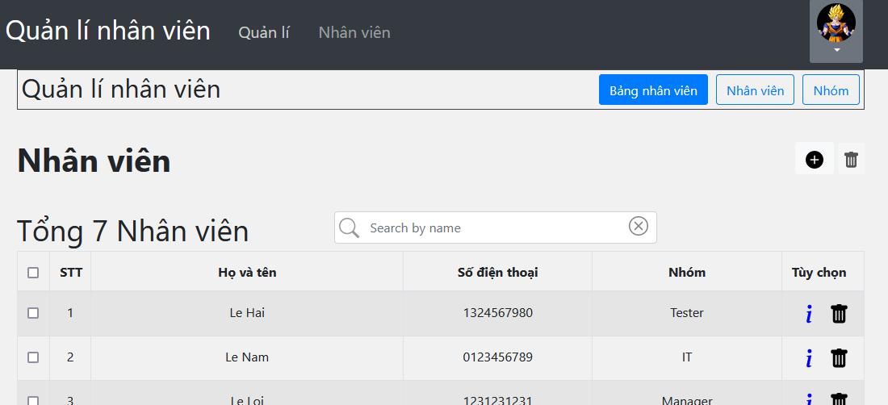
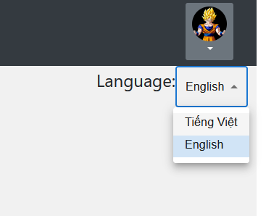
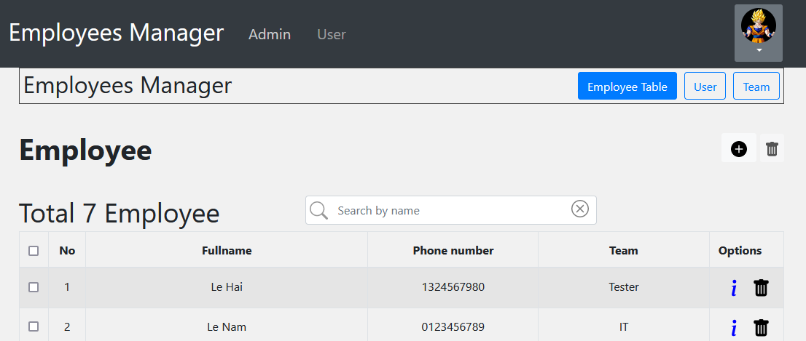

Slide 23
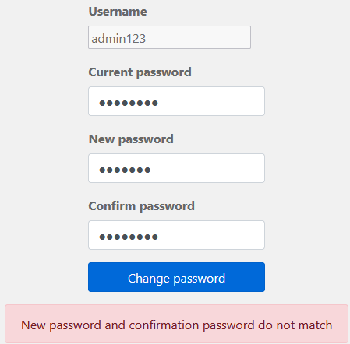
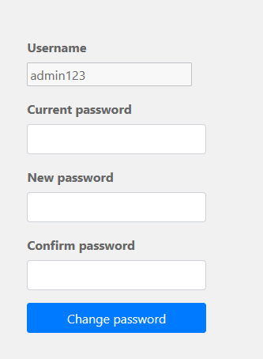

Changing password interface

Slide 24
When the user logs in with the USER role
Some functions such as delete and add will be disabled to avoid affecting the data.

Slide 25
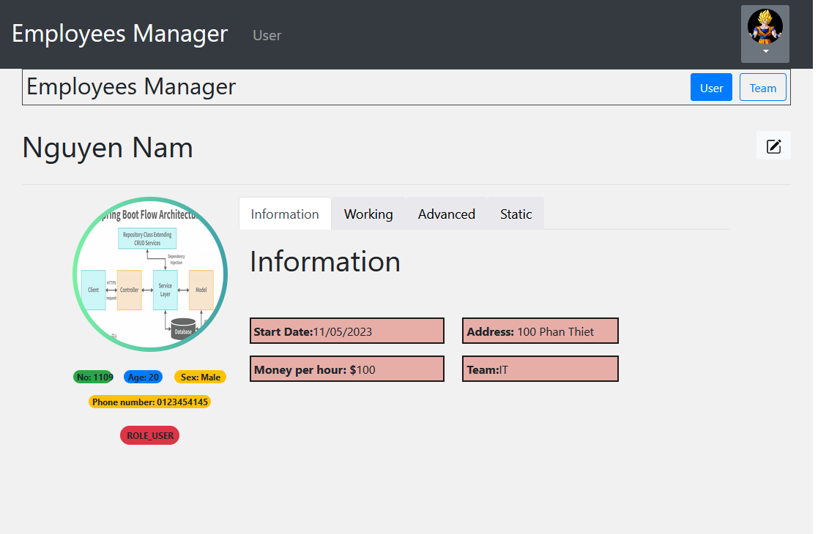
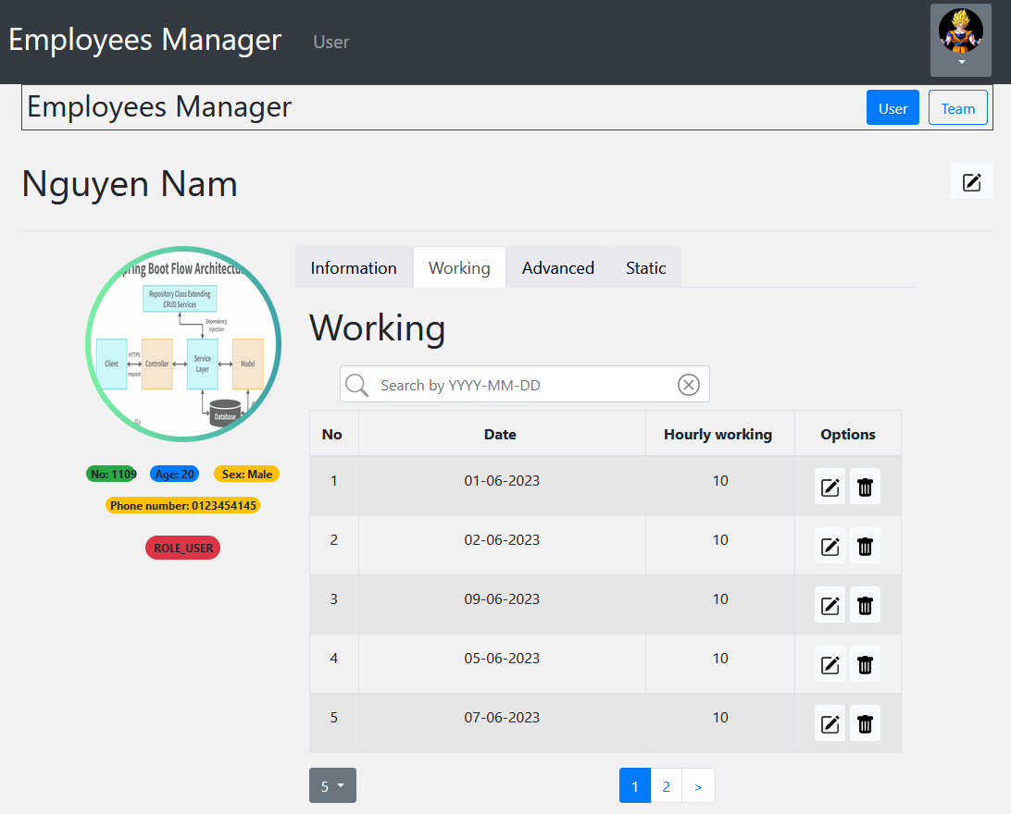

Slide 26
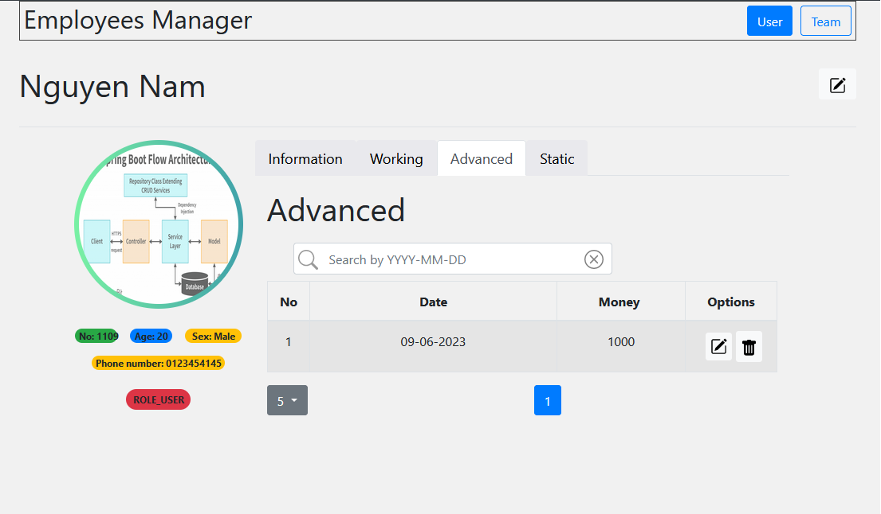
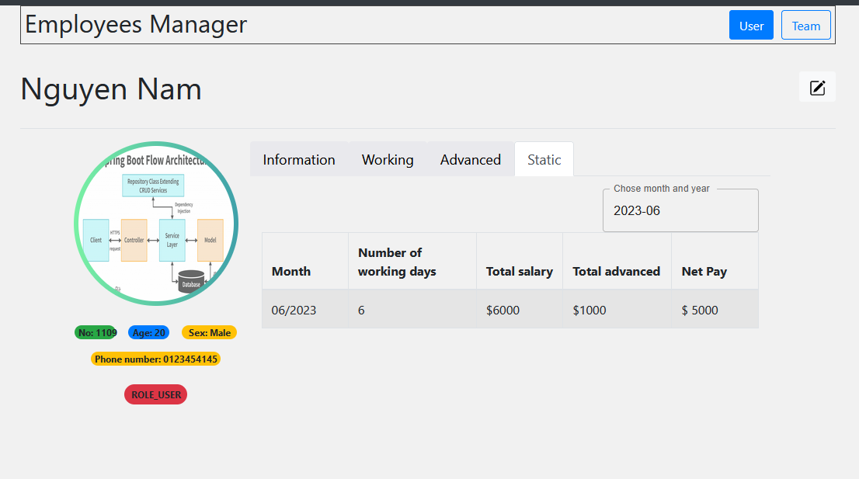

Slide 27
IV. Lessons learned during internship
Self-Development: Internships offer a chance for personal growth and self-reflection.
Hands-on Experience: I can apply experience my knowledge and skills to actual projects and tasks.

