Slide 1
Võ Tuấn Huy
44.01.104.097

Slide 2
LAB 1
Create new 5 Test Case
Add 5 TestCase to TestSuite

Slide 3
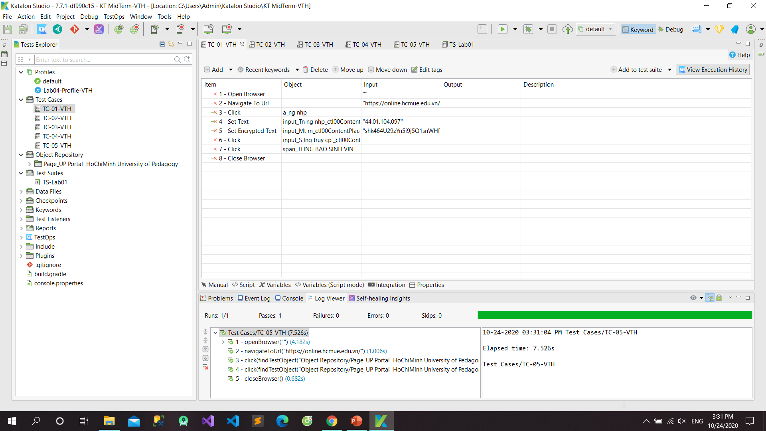

Slide 4
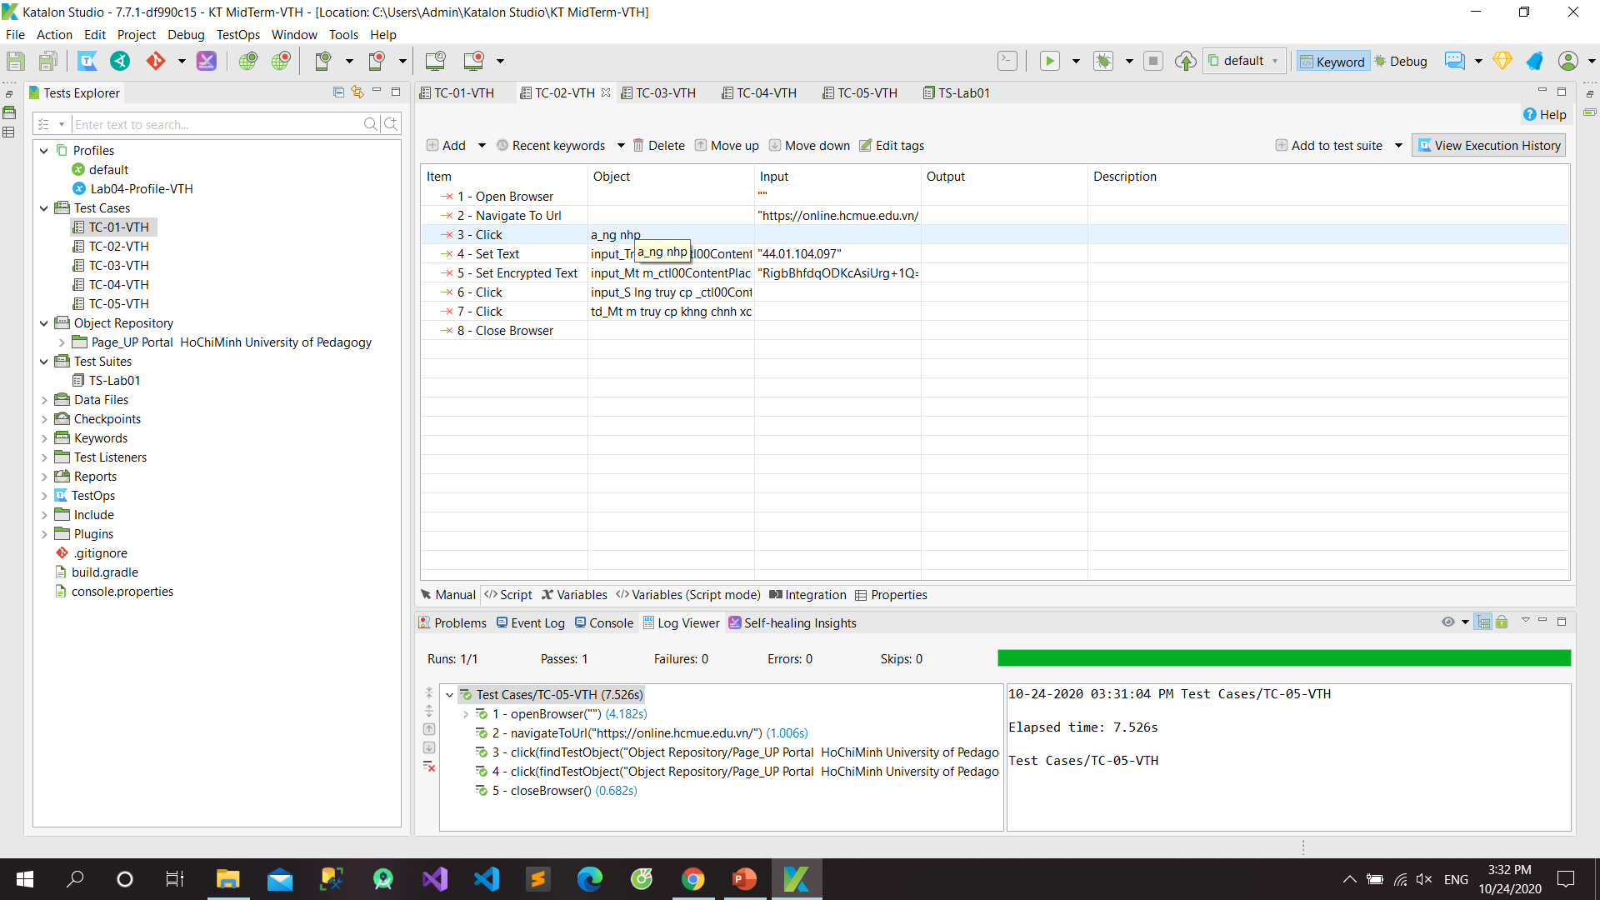

Slide 5
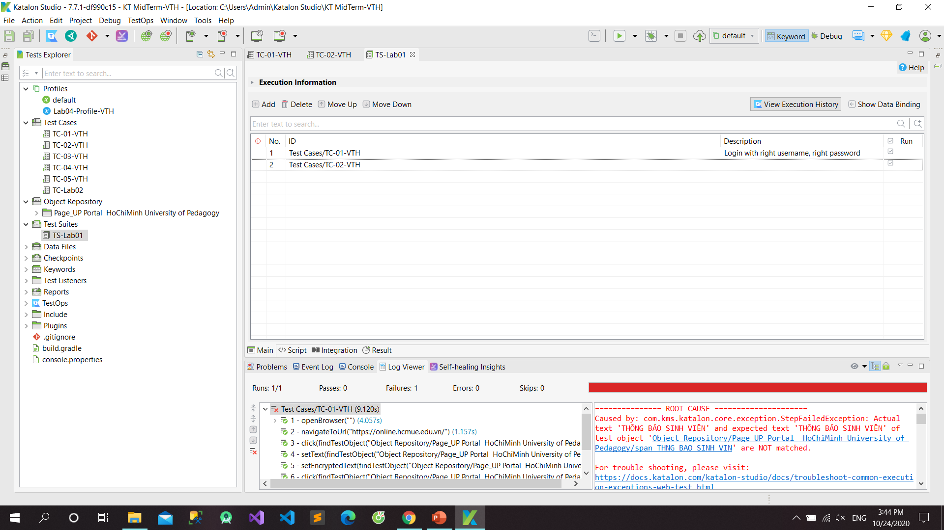

Slide 6
LAB 2
Wait for element present
Verify element text

Slide 7
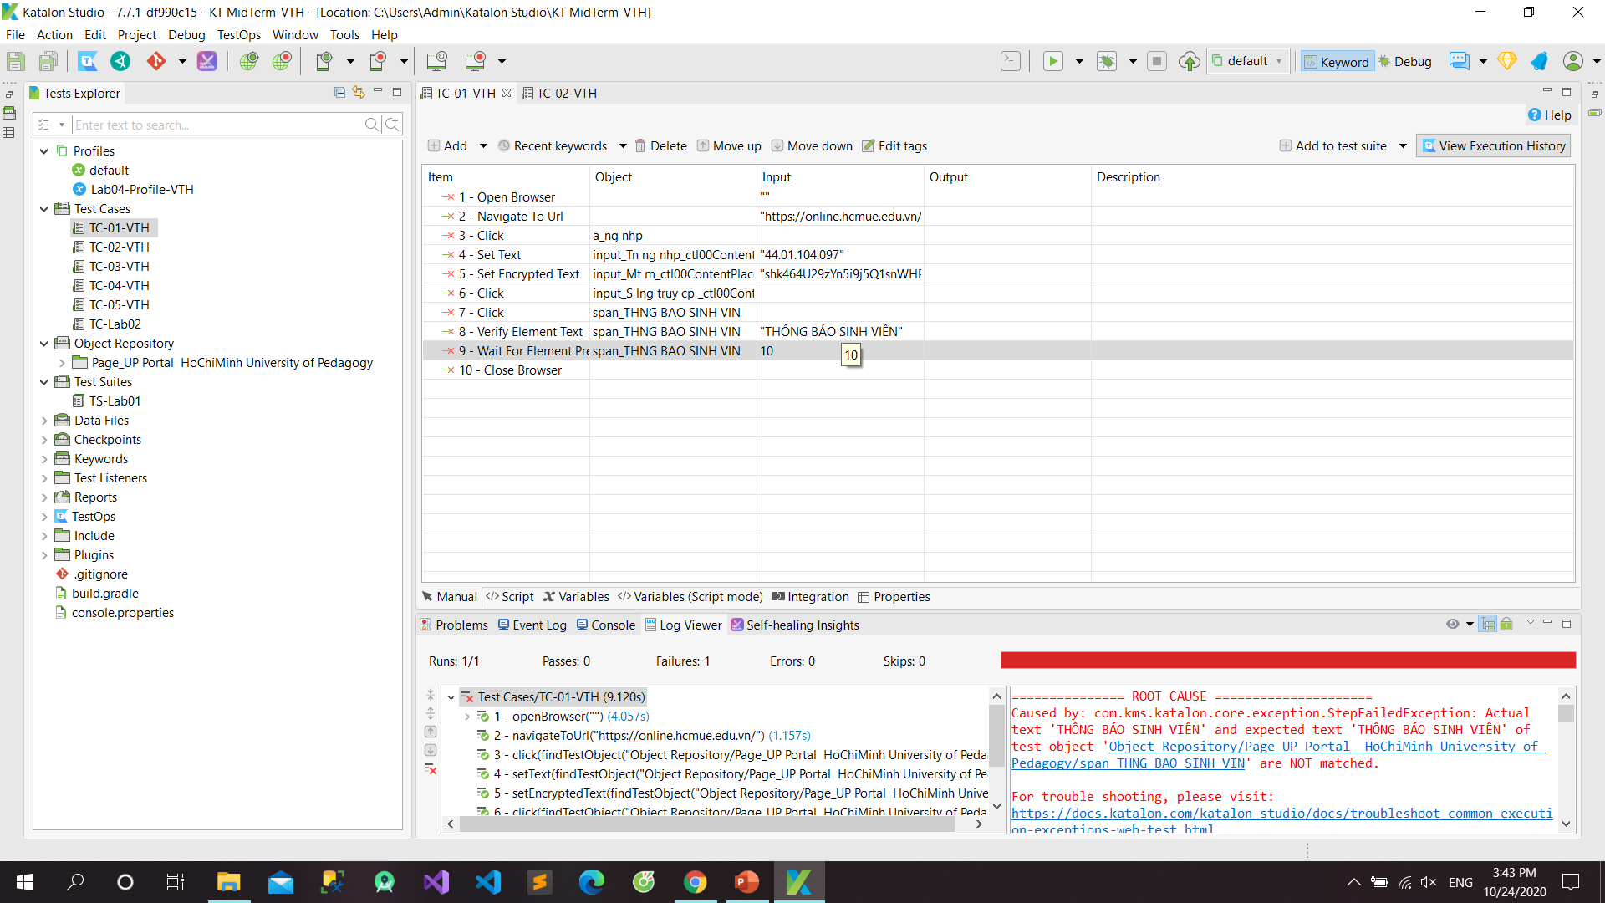

Slide 8


Slide 9
LAB 4
Create profile
Create variable

Slide 10
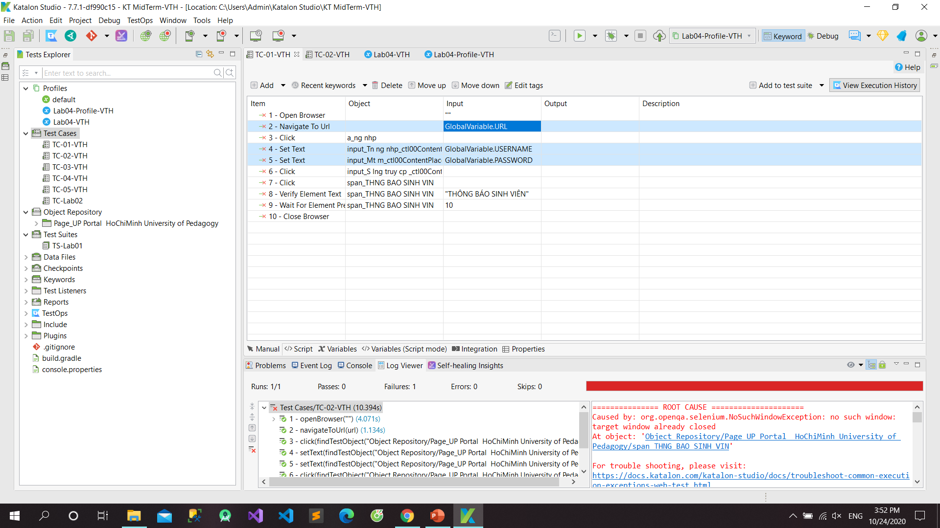

Slide 11
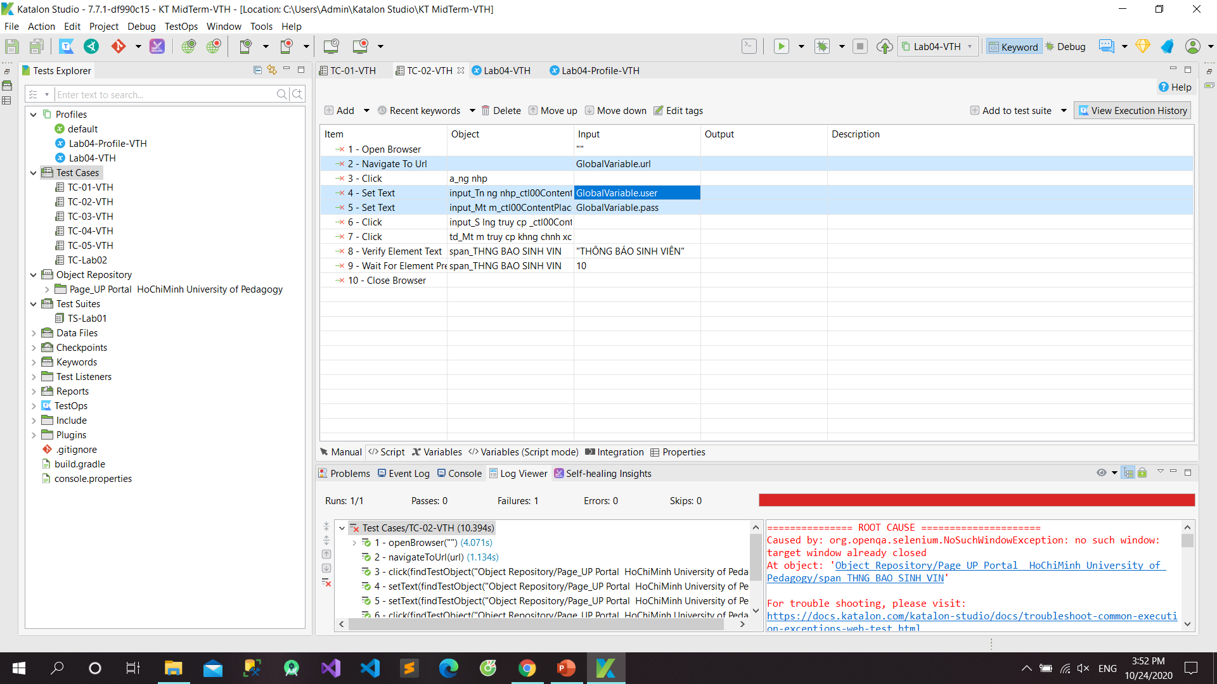

Slide 12
LAB 5
Create Email
Project -> Settings -> Email

Slide 13
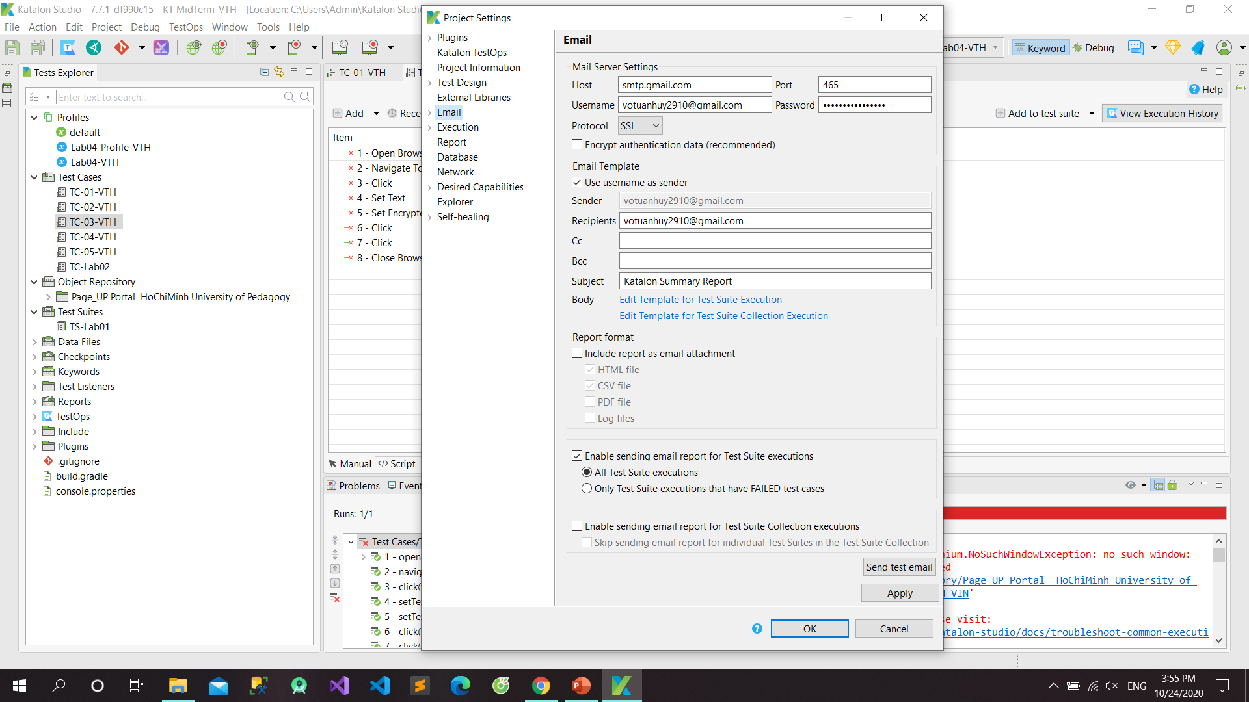

Slide 14
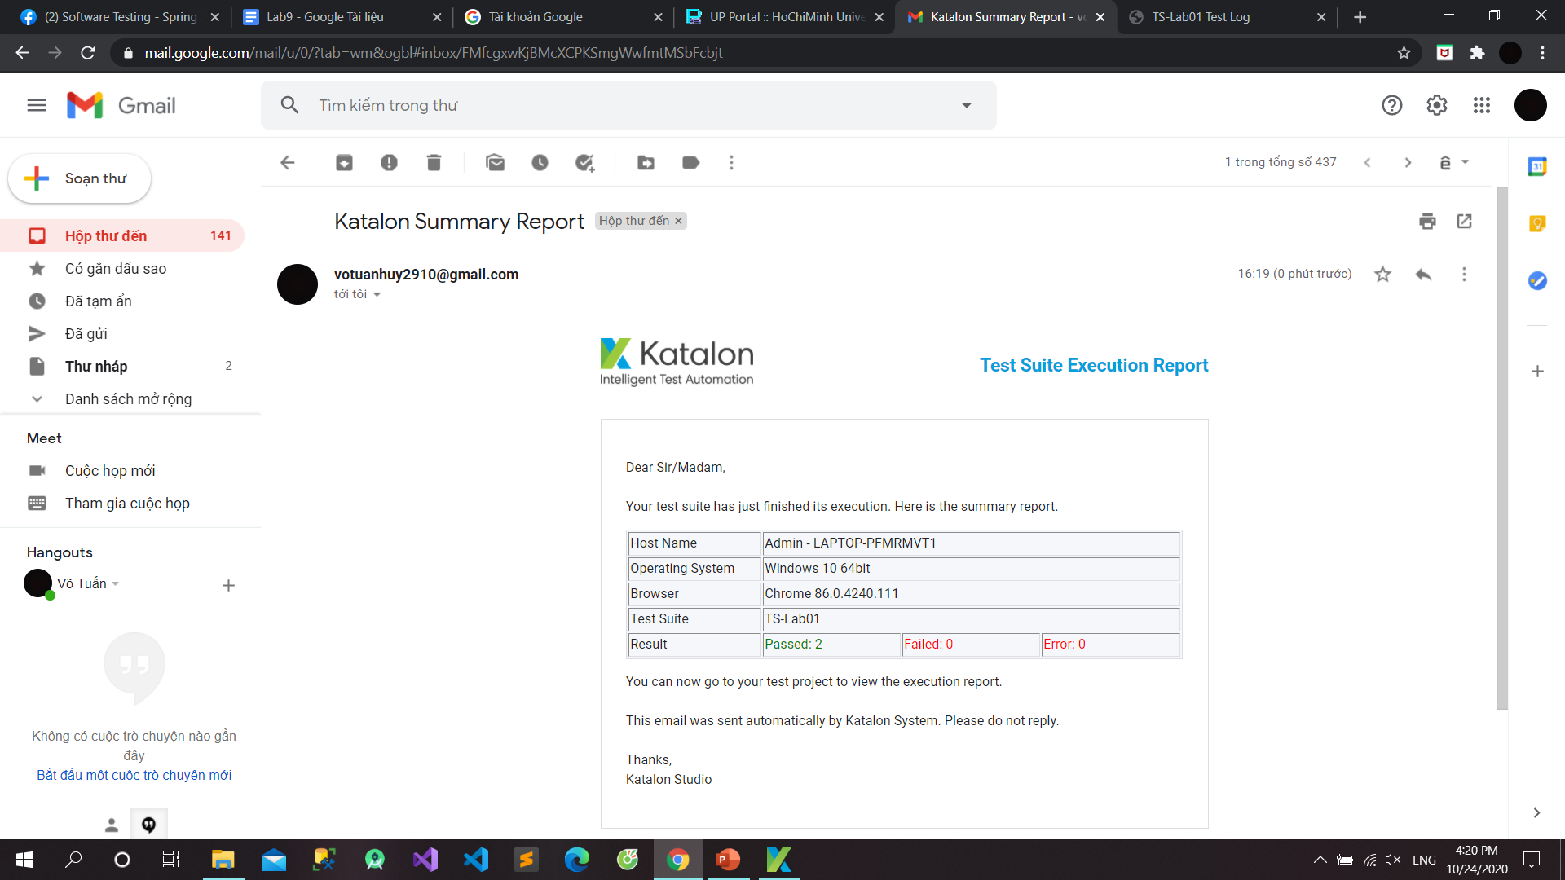

Slide 15
LAB 6
Run Test Suite
Export Report

Slide 16
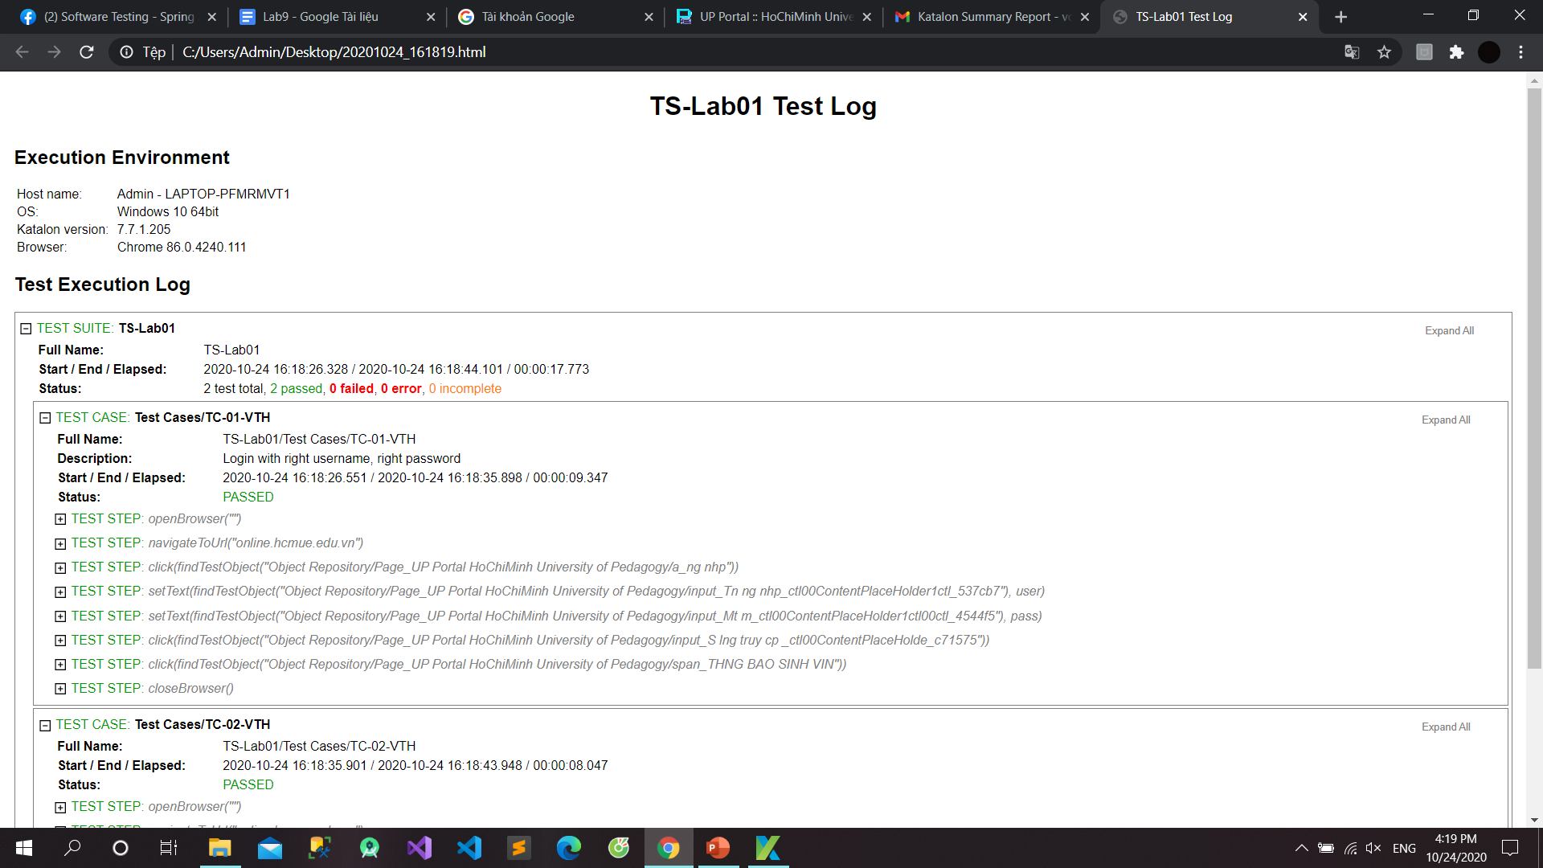

Slide 17
LAB 7
Create SPY

Slide 18
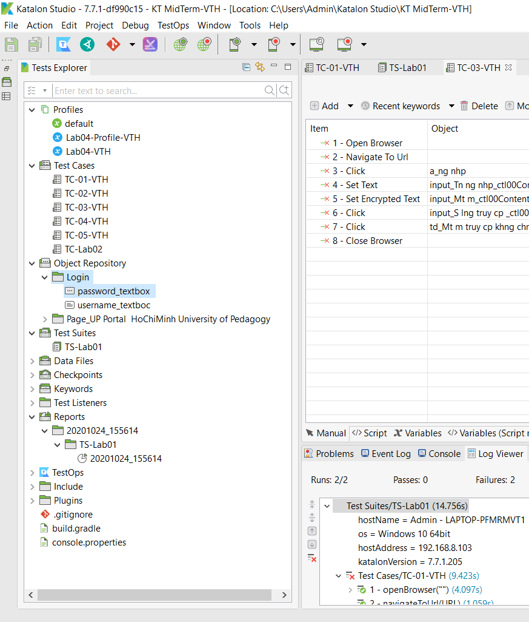

Slide 19
LAB 8
Create excel
Run testsuite

Slide 20
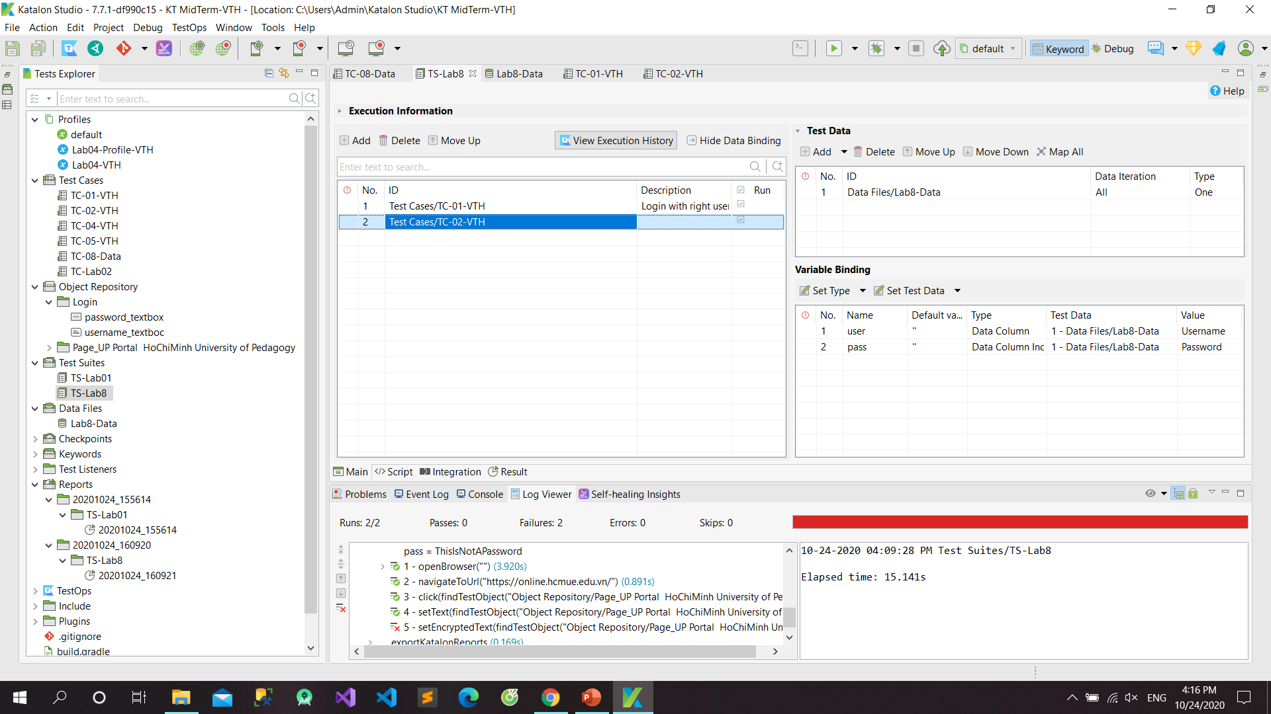

Slide 21
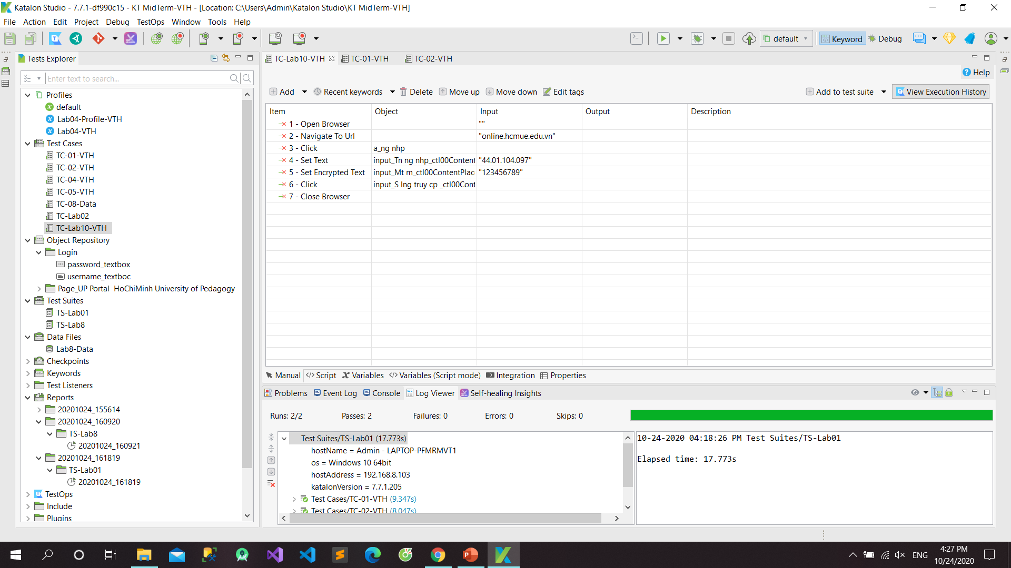
LAB 10:

