Slide 1
Non-blocking Binary Search Trees
Vouisaskis Charalabos

Slide 2
what is the binary tree that is leaf-oriented
The tree has a root
Each node has two children
The leafs have not children
The information save in leaf

Slide 3
Each node knows
The two children
The key it has
In which state it is

Slide 4
There are four state
Clean
Iflag
Dflag
Mark

Slide 5
The tree makes three operations
Insert
Delete
Find

Slide 6
Find
It doing search the tree
If there is keys then correct
Else uncurect

Slide 7
Insert
Initially all the nodes are clean
Find the leaf that it has key near in the new key. It is done insert
Create new node with parent the biggest key
The new internal node has children the existing key and new key
Change the state of the parent from clean to iflag
Finally parent shows the new node and the state become clean

Slide 8
Insert example
Insert 14
10
5
13
10
13

Slide 9
Insert example
10
5
13
iflag
14
10
13
14
13
14

Slide 10
Insert example
10
5
13
10
13
14
13
14

Slide 11
Delete
Finds the leaf we want to delete
If there is it then
Change the state grandparent from clean to dflag
Change the state parent from clean to Mark
We deleted the leaf shows grandparents int the another child
When the state changed then the grandparent become clean again

Slide 12
Delete example
20
Delete 24
10
22
20
26
24
26

Slide 13
Delete example
20
22
10
20
26
Delete 24
24
26

Slide 14
Delete example
20
22
dflag
10
20
26
mark
Delete 24
24
26

Slide 15
Delete example
20
Delete 24
22
10
20
26
mark
24
26

Slide 16
If I do not use state
P1
Insert 25
P2
delete26
20
10
22
20
26
24
26

Slide 17
If I do not use state
P1
Insert 25
P2
Delete 26
20
20
Insert 25
10
10
22
22
20
20
26
26
24
24
26
26

Slide 18
If I do not use state
P1
Insert 25
P2
Delete 26
20
20
delete 26
10
10
22
22
20
20
26
26
25
24
24
26
26

Slide 19
If I do not use state
P1
Insert 25
P2
Delete 26
20
20
10
10
22
22
20
20
26
26
26
25
25
24
24
26
26
24
25

Slide 20
If I do not use state
P1
Insert 25
P2
Delete 26
20
20
10
10
22
22
20
20
26
26
25
24
26
26
24
25

Slide 21
With state in node
P1
Insert 25
P2
Delete 26
20
20
Insert 25
10
10
22
22
20
20
26
26
24
24
26
26

Slide 22
With state in node
P1
Insert 25
P2
Delete 26
20
20
10
10
22
22
20
20
26
26
25
24
24
26
26

Slide 23
With state in node
P1
Insert 25
P2
Delete 26
20
20
delete 26
10
10
22
22
20
20
26
26
iflag
25
24
24
26
26

Slide 24
With state in node
P1
Insert 25
P2
Delete 26
20
20
22
10
10
22
26
20
20
26
26
iflag
25
25
24
24
26
26
24
25

Slide 25
With state in node
P1
Insert 25
P2
Delete 26
20
20
22
dflag
10
10
22
20
20
26
26
mark
25
26
26
24
25

Slide 26
With state in node
P1
Insert 25
P2
Delete 26
20
20
22
10
10
22
20
20
26
26
mark
25
26
26
24
25

Slide 27
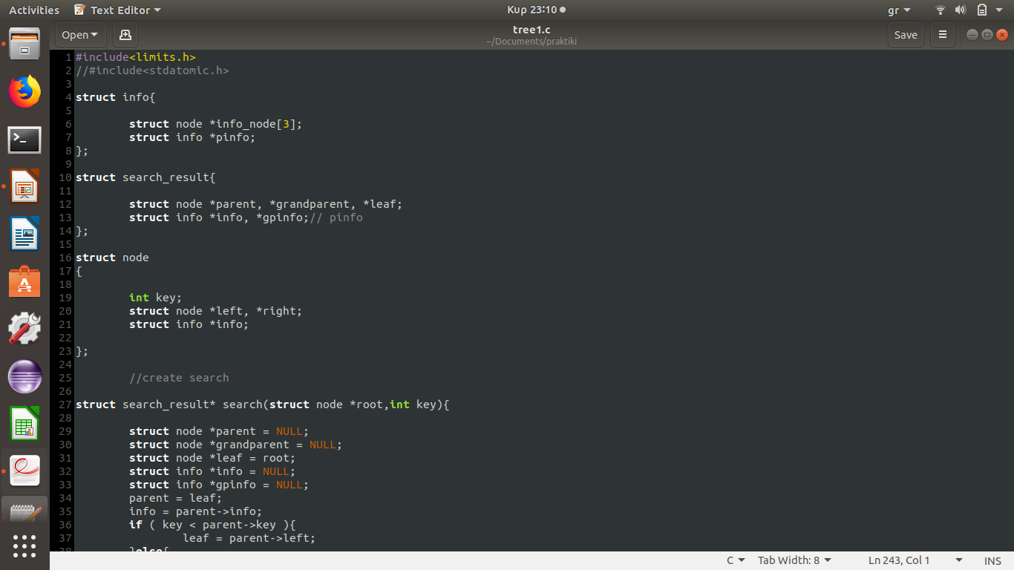
Struct code
I have struct node for the nodes
I have struct info for the Dinfo,Iinfo and update
The update has state clean iflag dflag mark
If all data of the info is null then I have clean
If the first three data of the info isn’t null and pinfo is null then I have iflag
If the first three data of the info isn’t null and pinfo isn’t null then I have dflag or mark. This depends on another treaty

Slide 28
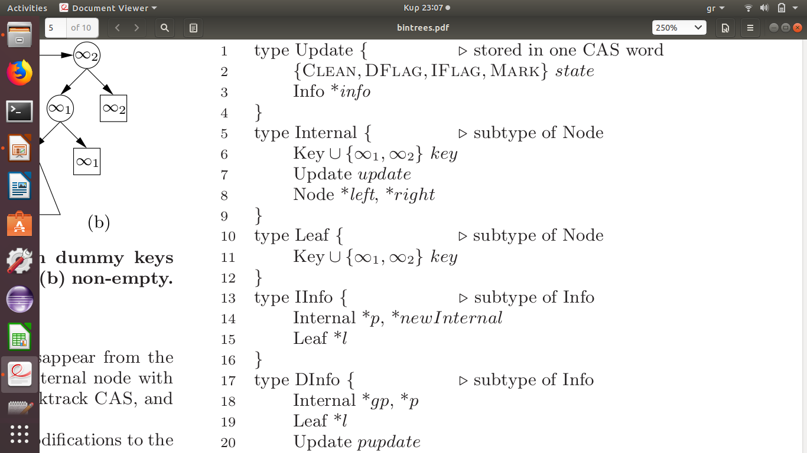
Struct paper

Slide 29
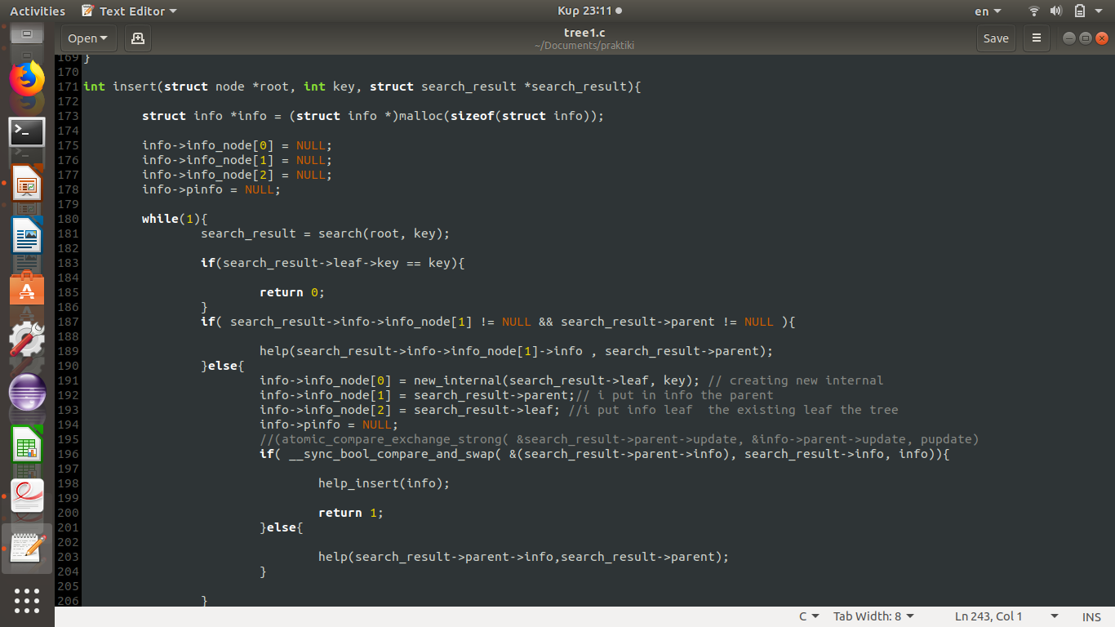
Insert code
Create new info that it is clean
The program doing search
If existing the key then the insert stop
Else the program check the state parent
If state parent is not clean call the help
Else the program create new node,marks the parent and call help_insert

Slide 30
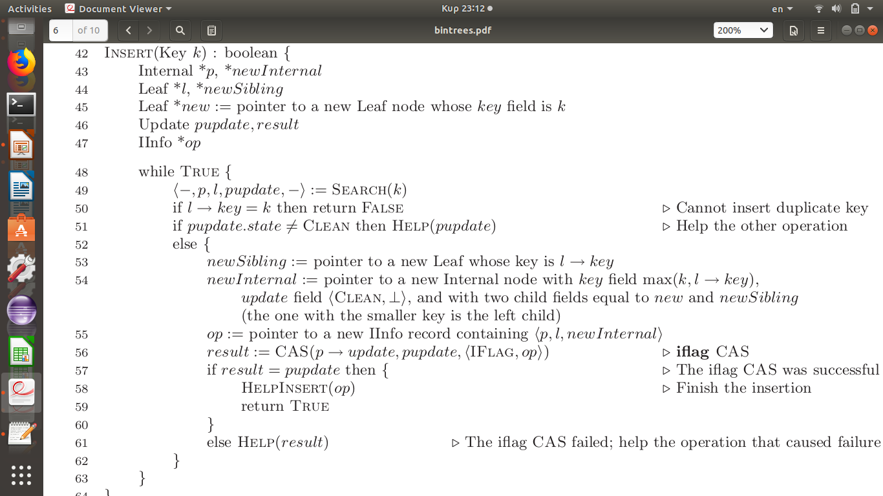
Insert paper

Slide 31
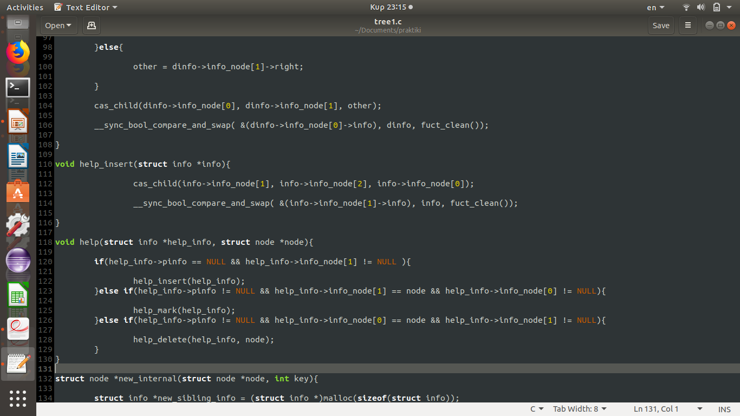
Help insert
Call the function cas_child which has as a definition the parent ,leaf and new internal
The end this doing the state parent clean

Slide 32
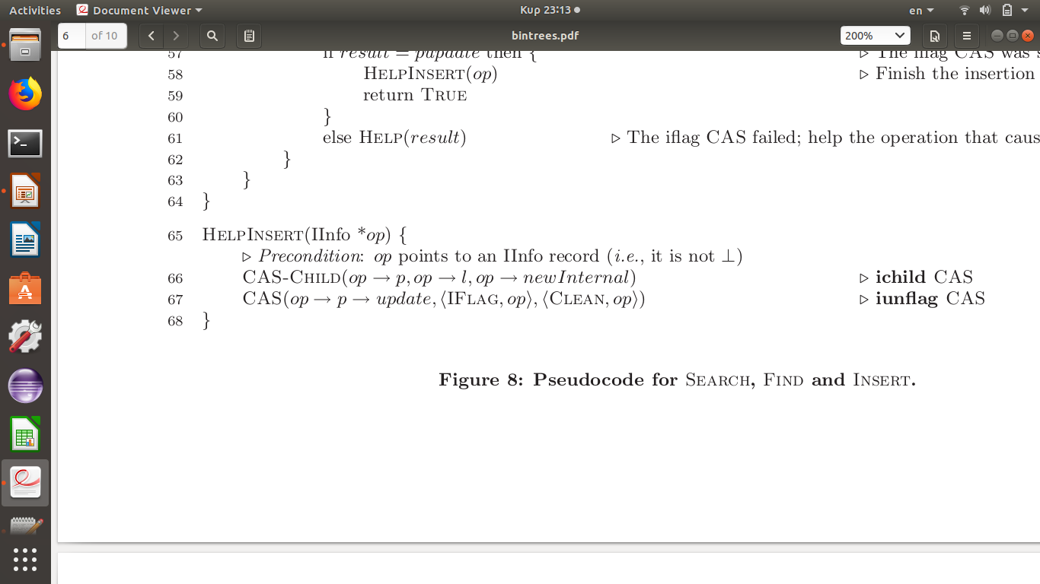
Help_insert paper
which has as a definition

Slide 33

Delete
Create new info that it is clean
I doing search the tree to see if it exists the key
If don’t exist then stop delete
Else I check state grandparent and parent
If don’t clean then I call help
Else I add up the info information for grandparent parent and pinfo
I doing the state grandparent dflag and call the help_delete

Slide 34
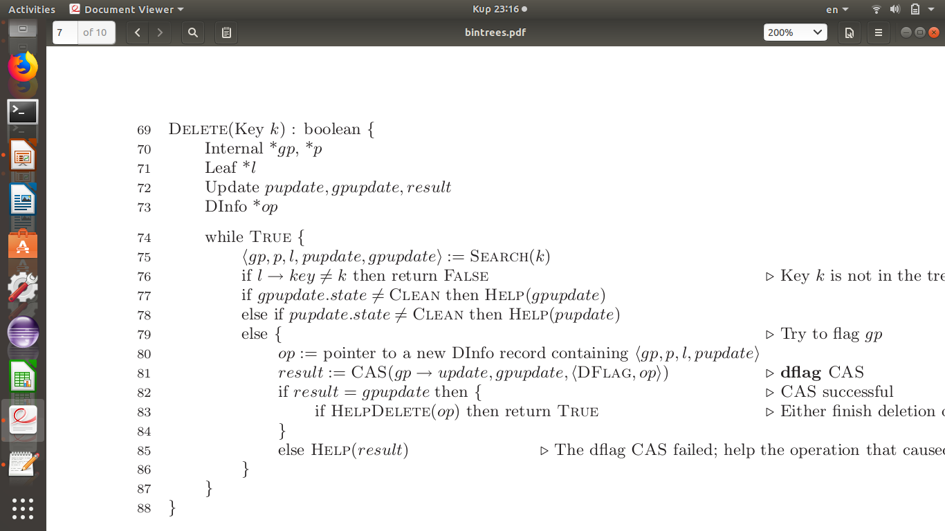
Delete paper

Slide 35
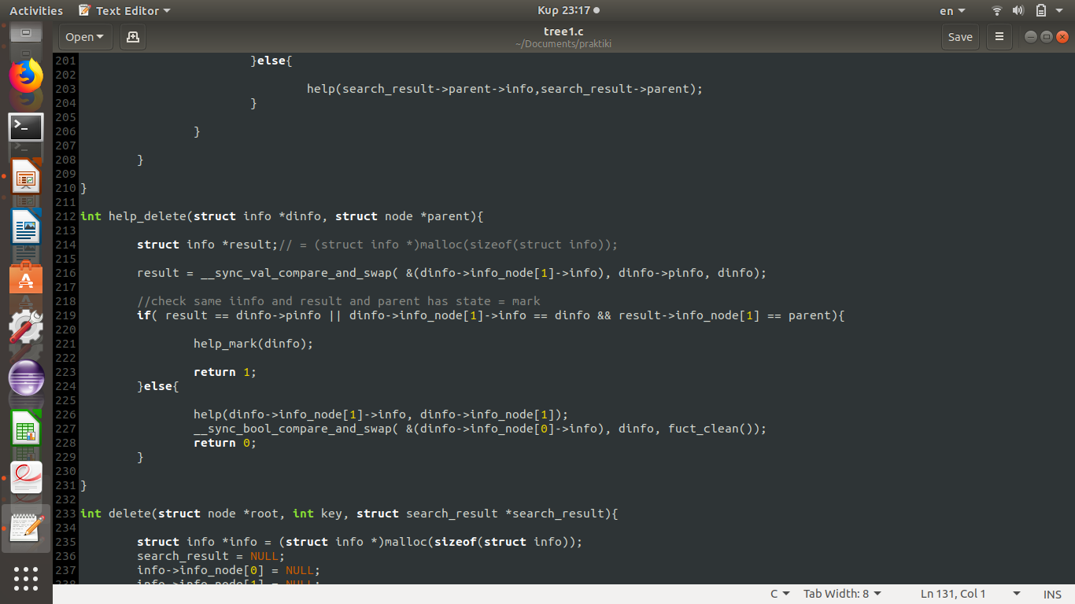
Help delete
Firstly I check if the info parent is same with pinfo then the state parent become mark
if the first is true or pinfo isn’t null and the second node of the info is same with parent then call the help_mark
Else the program call the help
The state grand parent become from dflag to clean

Slide 36
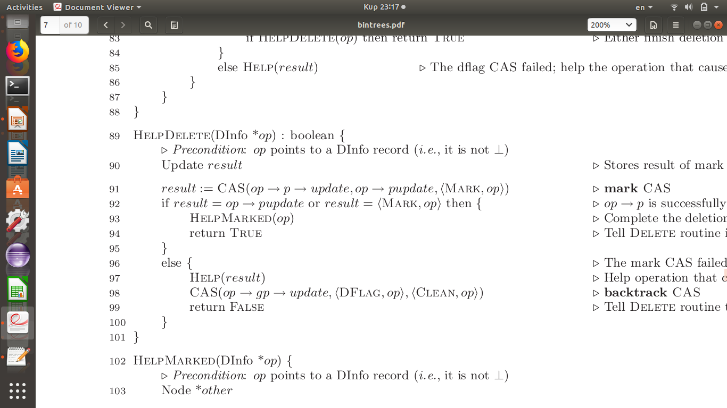
Help delete paper

Slide 37
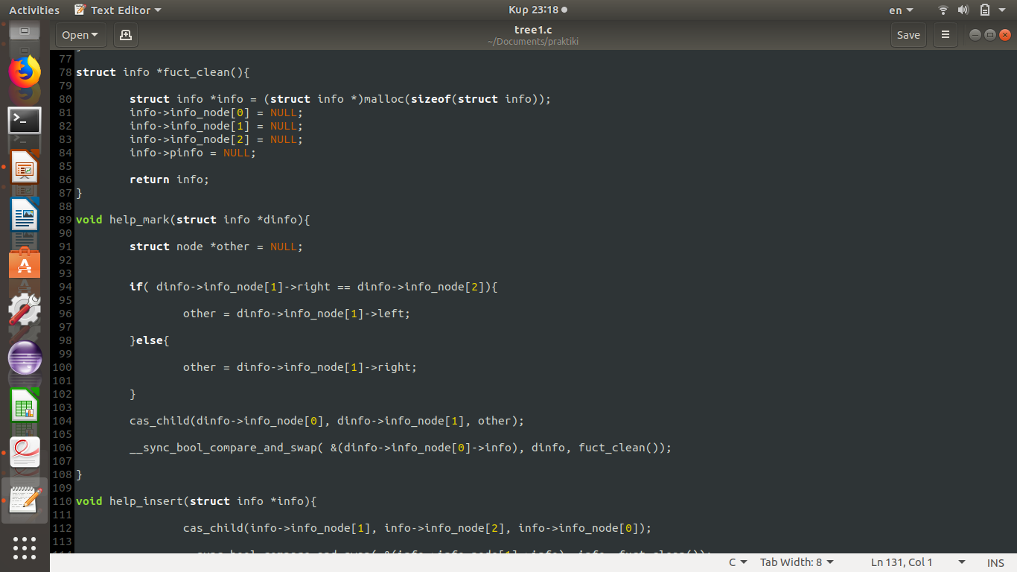
Help mark
Crate a new node and new node equals with the brother of the leaf where the program wants delete
The help_mark call the cas_child
At the end the state grandparent became clean again

Slide 38
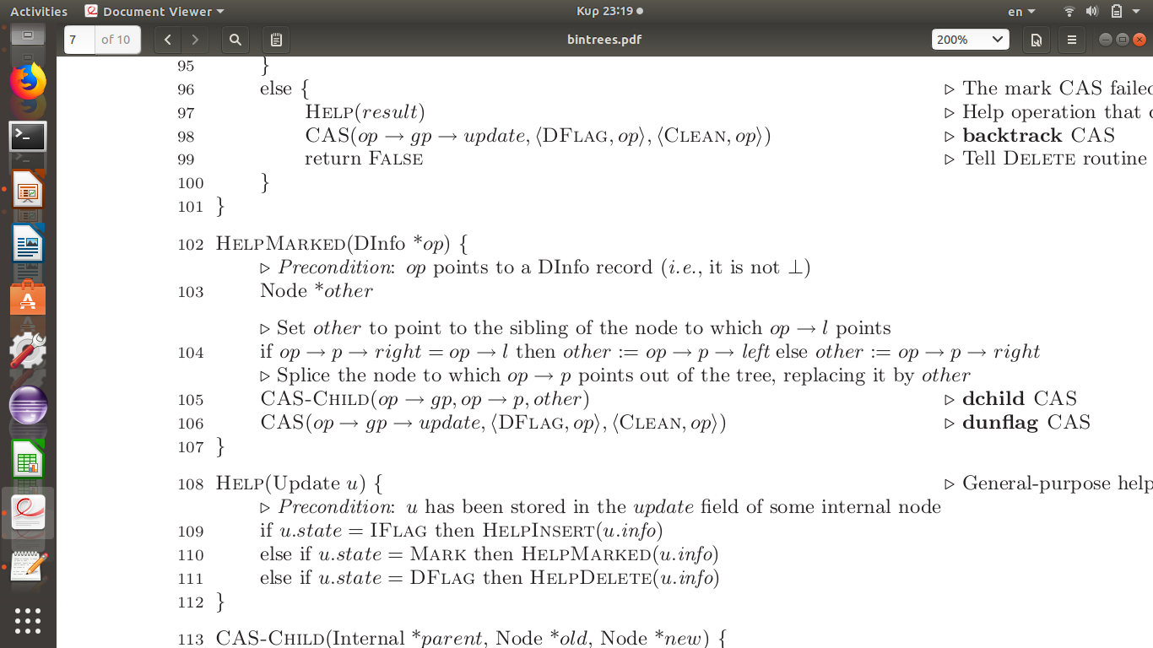
Help mark paper

Slide 39
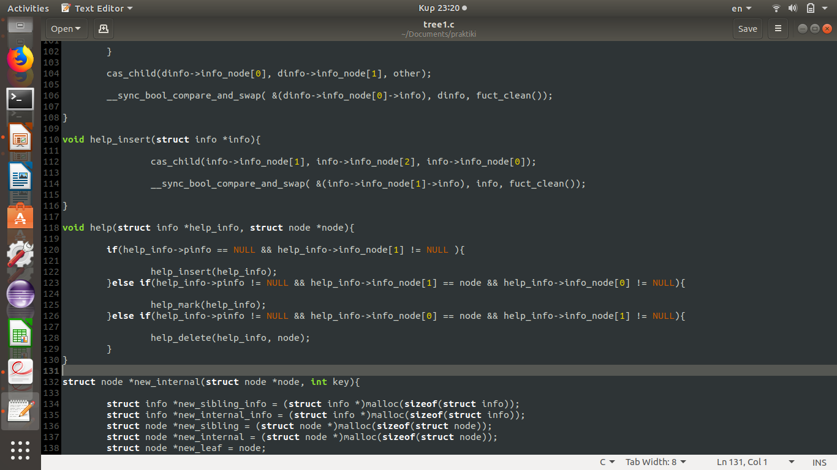
help
If the pinfo is null and the second part of the info isn’t null then call help_insert because if second part of info is null then the state is clean
If the pinfo isn’t null and the seconf part of the info is same with node then call help_mark because if I have delete then the first part I put the parent then the info is state mark
If the pinfo isn’t null and the first part of the info is same with nade then call help_delete because if I have delete then the first part I put the grandparent then the info is state iflag

Slide 40
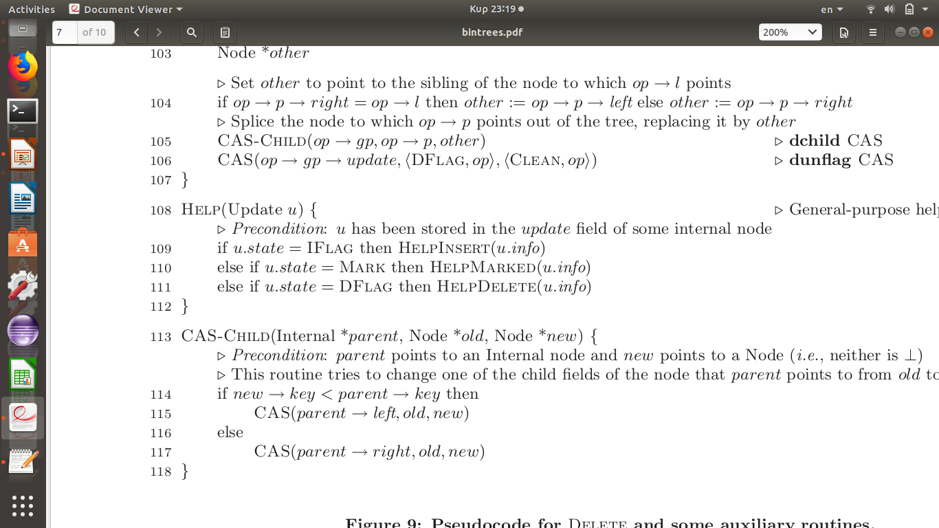
Help paper

Slide 41
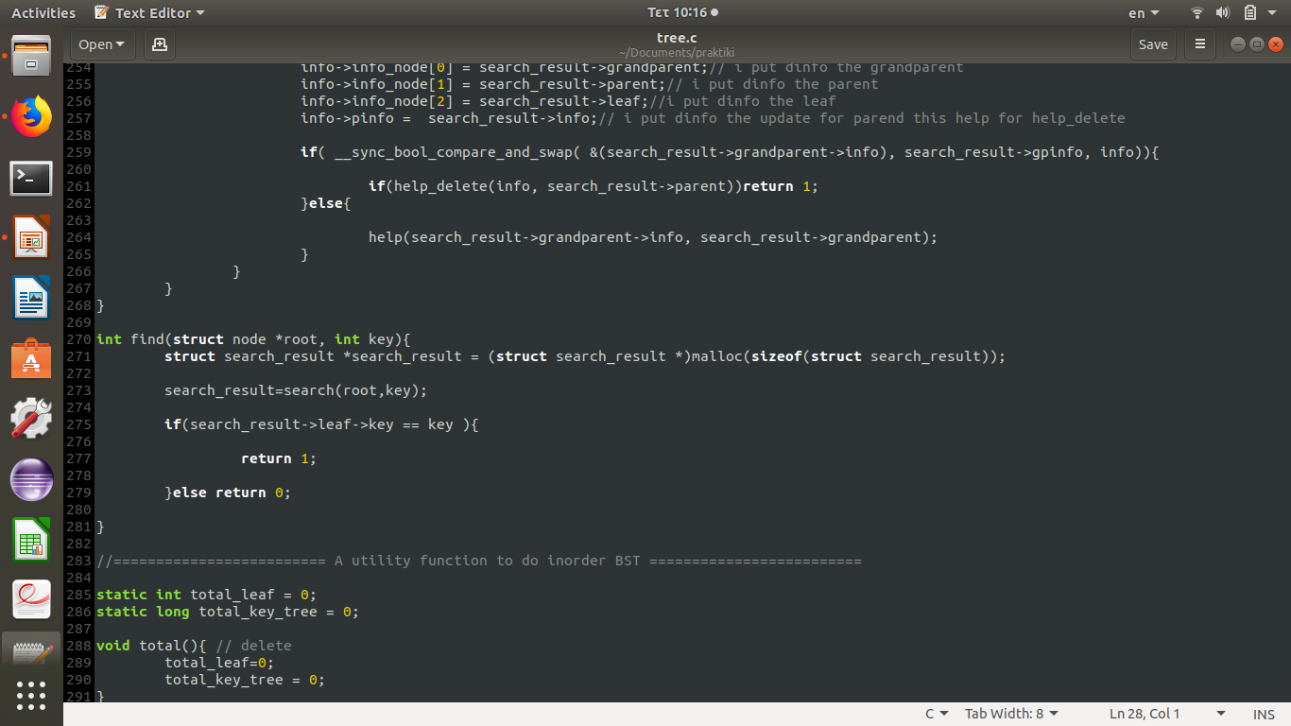
Find

Slide 42
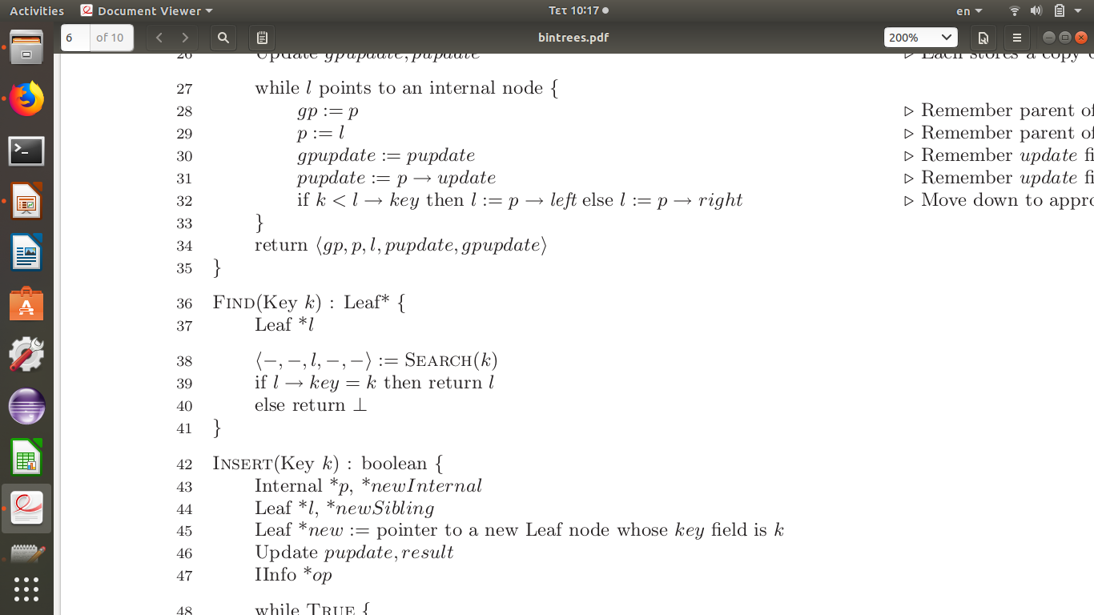
Find paper

Slide 43
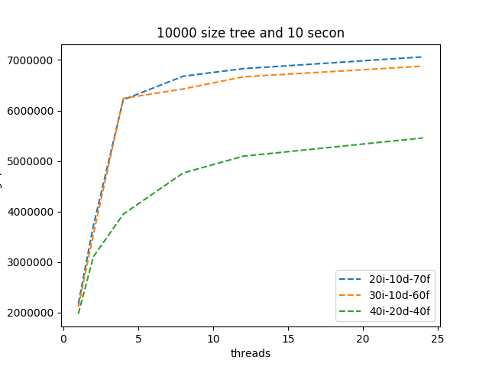

Slide 44
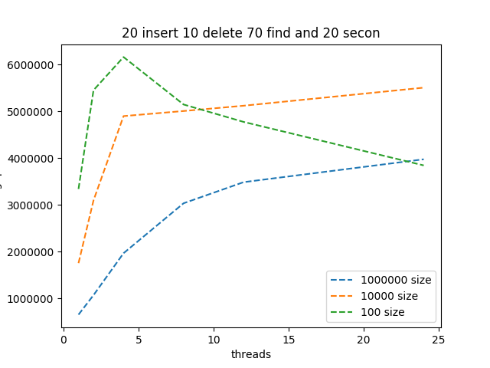

Slide 45
