Slide 1
INTRODUCTION PHP APTECH COURSE

Slide 2
BEFORE WE GET STARTED
Install Git (required).
Install Docker (required).
Install VS Code (recommend), Atom (optional) , PHP Storm(optional).
Install Workbench (optional).
Using Windows (10 is better), Ubuntu (16.4 is better), Mac OS.
Install LEMP/LAMP (on Ubuntu) or XAMPP/WAMPP (on Windows/Ubuntu/Mac OS – optional) - no need it you can using Docker.
Postman (optional).
Chrome Web Browser (optional).
* Note it on your paper then we move on to next slide, install it immediately.

Slide 3



HELLO, I’M NAM.
Full-Stack Web Developer at Pageworth.com.
Bachelor Of Finance Management.
Bachelor Of Software Technology ( late 2018 ).
Text to me : 0932 578 992 or connect to me via social network below.
/namnh06
namnh.developer@gmail.com
hainamdng
/hainam37k16.1

Slide 4
SOME RULES
Slide and Exercise 100% English, speaking by Vietnamese.
No Facebook, no YouTube, no Twitch, no connect to people outside if it’s not an emergency …
Google first is the best, notebook, pen, thinking, do by your self, search by your self, drawing on your paper.
Feel free to ask me, but make sure you searched at least 5 minutes.
/namnh06
namnh.developer@gmail.com
hainamdng
/hainam37k16.1

Slide 5
YOUR TURN
Come over here, one by one and speak loudly to the class :
What’s your name ?
What’re you doing?
Describe your programming experience.
What’re you looking for from this class?

Slide 6
WEB DEVELOPER 2018 ROADMAP
FOR WHAT YOU ARE LOOKING FOR
AND YOUR EXPERIENCE
FROM github.com/kamranahmedse/developer-roadmap

Slide 7
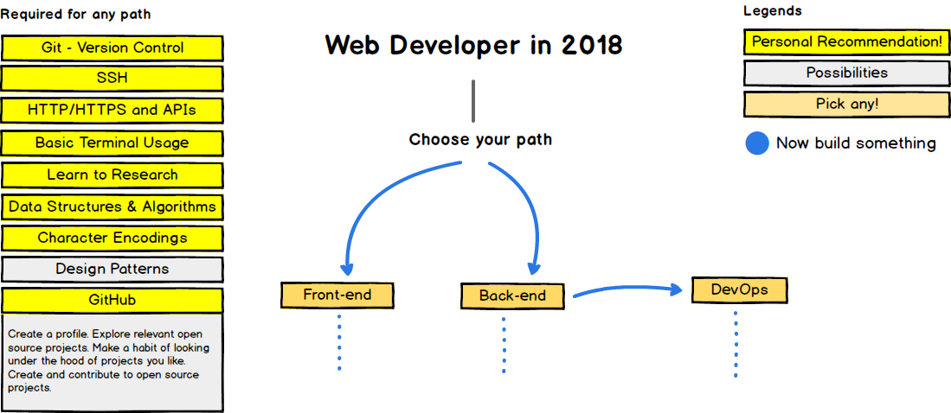
FROM WHAT YOU ARE LOOKING FOR

Slide 8
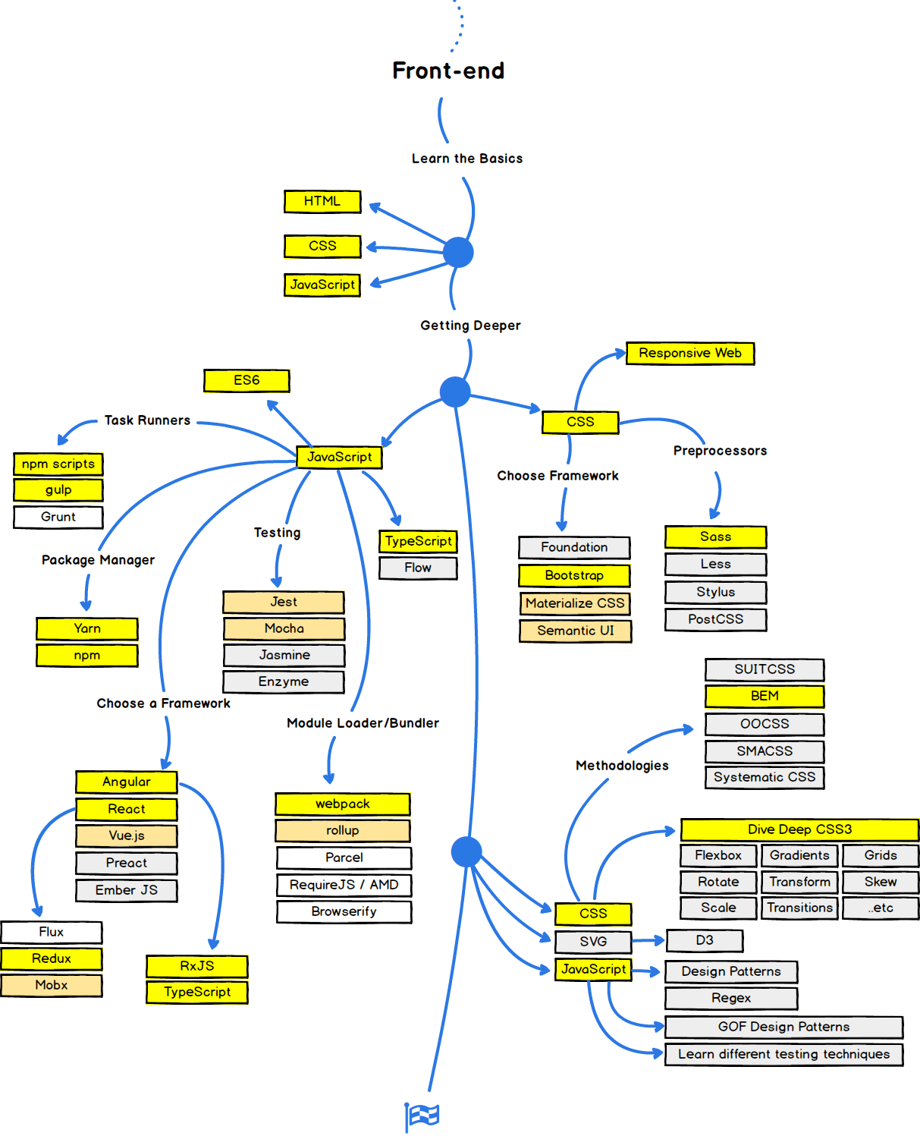
FROM WHAT YOU ARE LOOKING FOR

Slide 9
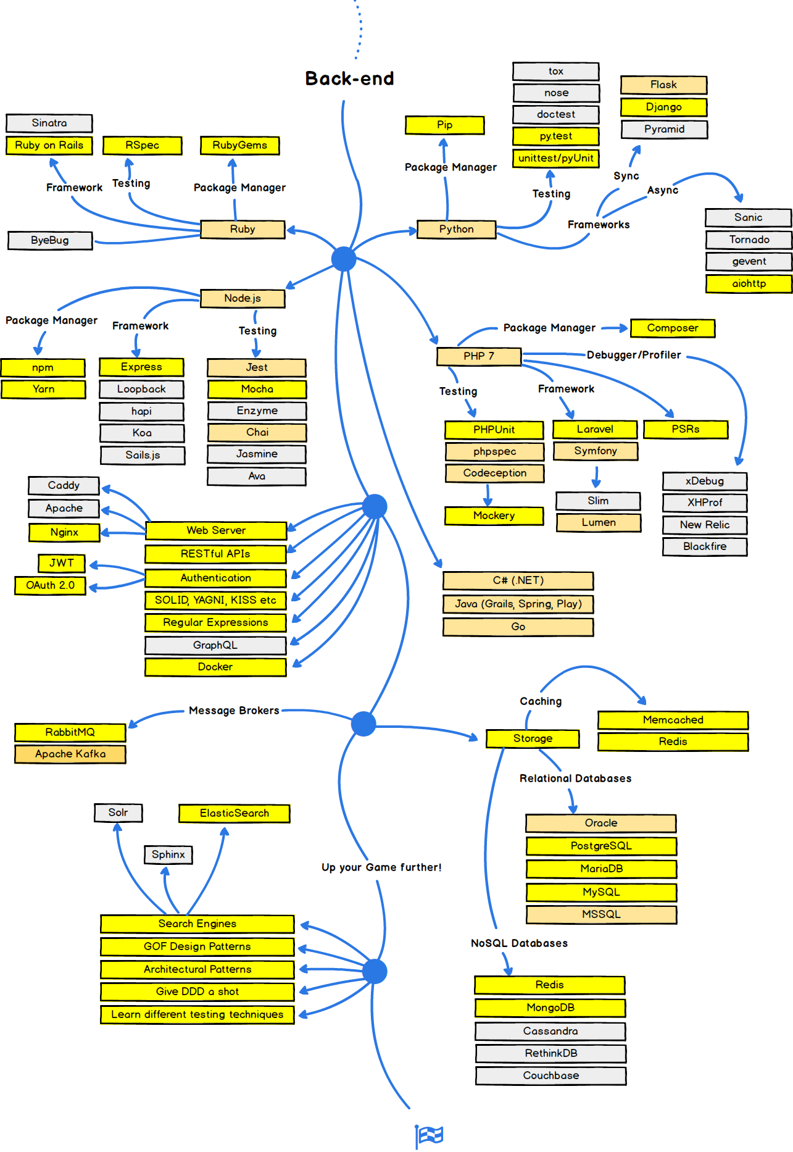
FROM WHAT YOU ARE LOOKING FOR

Slide 10
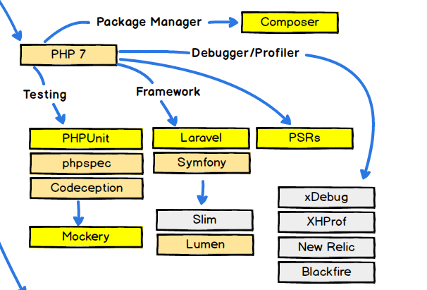
FROM WHAT YOU ARE LOOKING FOR

Slide 11
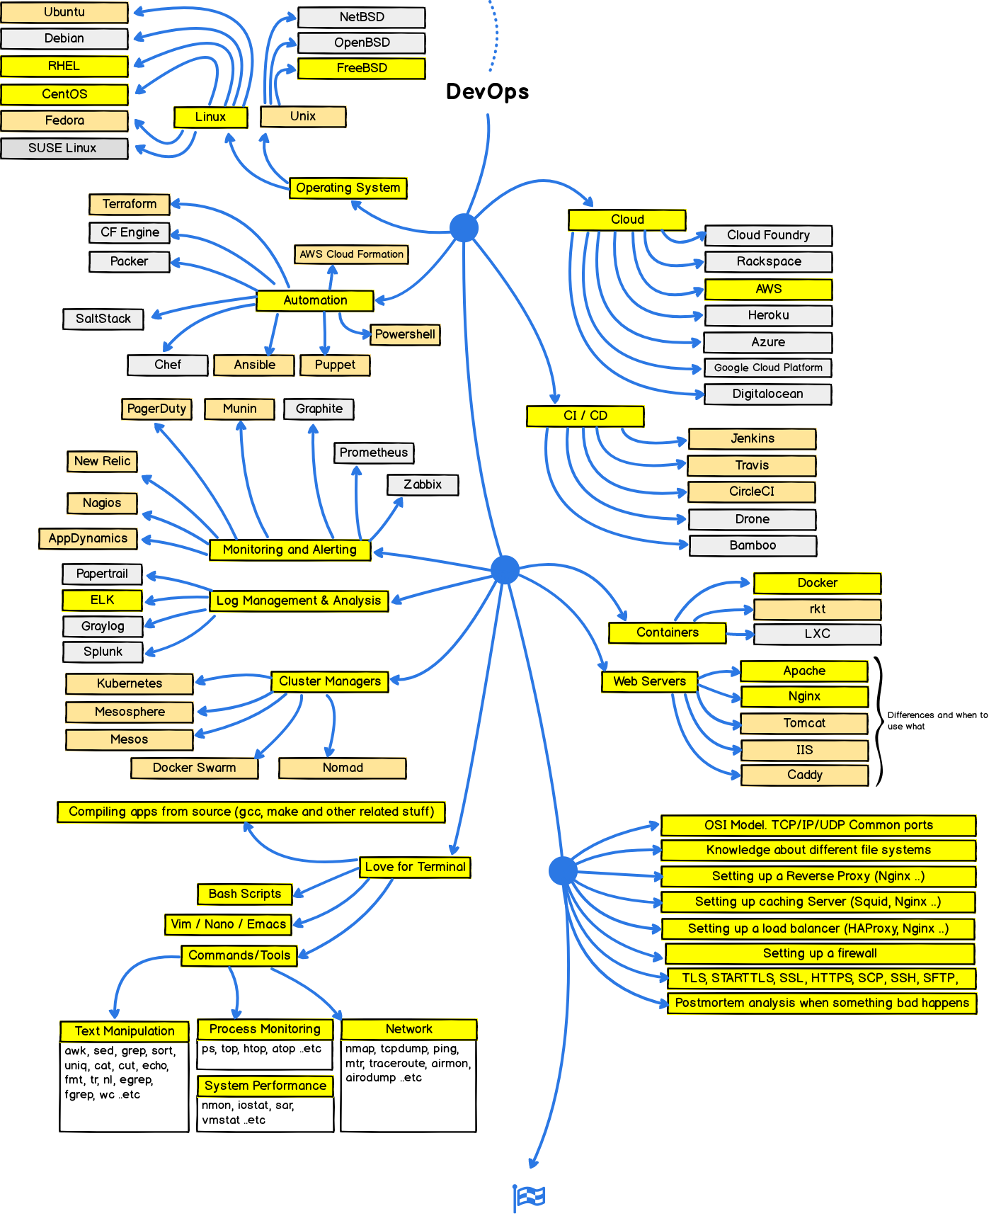
FROM WHAT YOU ARE LOOKING FOR

Slide 12
OUR SCHEDULE
We only have 60 hours – 15 sessions :
Introduction & PHP Basic & PHP Advanced : 8 hours – 2 sessions.
MySQL & PHP connect to Database : 8 hours – 2 sessions.
PHP OOP & PHP MVC : 12 hours – 3 sessions.
Using Laravel Framework and MySQL to build Blog Website : 32 hours – 8 sessions.
* Git, Docker, IDE plugin, LEMP/LAMP stack, RESTFUL API and some stuff will be additional in each session.

Slide 13
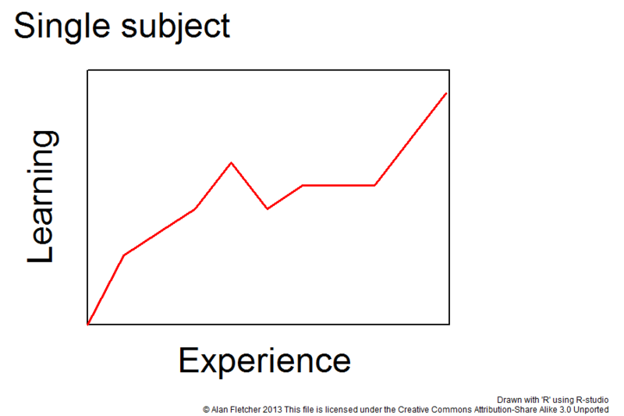
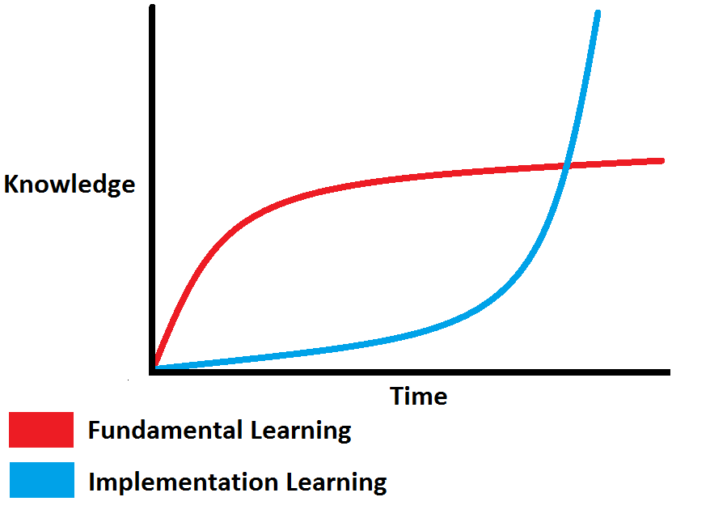
HOW TO GET ALL OF IT ?
Do one by one.
From zero to hero.
Cost by time.
Learn from friends.
Learn from games.
Learn everytime and every sources you have.

Slide 14
MY RESOURCES
Php.net
Laravel.com
W3schools.com
Udemy.com
Lynda.com
Laracasts.com
Medium.com
Viblo.asia
Kipalog.com
Tutorialspoint.com
Freetuts.net
Vietjack.com

Slide 15
LET’S DO IT TOGETHER !!!

