Slide 1
PHP ADVANCE

Slide 2
BEFORE WE GET STARTED
Make sure you done all of PHP basic exercise at
https://github.com/namnh06/aptech-php-course

Slide 3
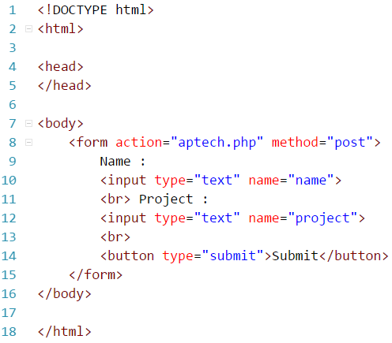
FORM HANDLING
Form data is HTML form.
Using PHP superglobals $_GET and $_POST to collect data from a Form.
Methods using in form is GET or POST.
Information sent from a form with the GET method visible to everyone and invisible to others with the POST method.
Should use POST method for security data.

Slide 4
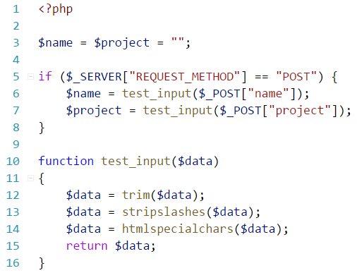
FORM VALIDATION
Security is one of the most important in PHP forms.
Using superglobals variable $_SERVER[“PHP_SELF”], built-in function htmlspecialchars(), trim(), stripslashes(), preg_match(), filter_var() of PHP to secure and protect your data of PHP form.

Slide 5
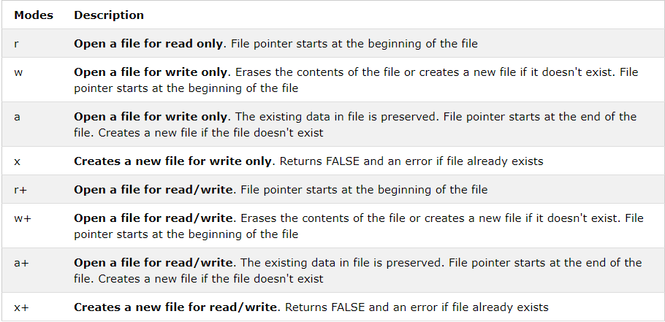
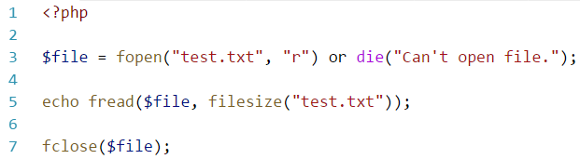
FILE OPEN/READ/CLOSE
Can use readfile() to open files, but another way is better is using fopen().
Open it, have to close it.

Slide 6
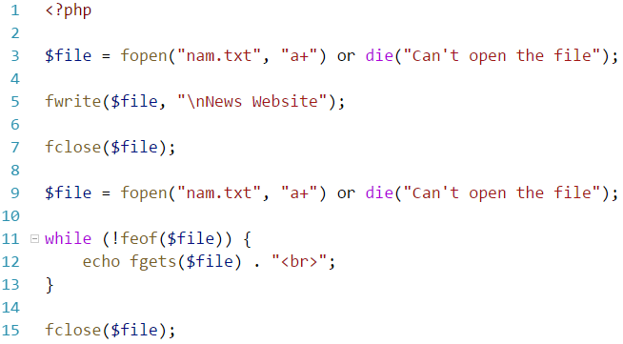
FILE CREATE/WRITE
Open and create a file is using the same function fopen().
Writing the file depend on mode of fopen().
Carefully with permission of the file.
Changes file mode by built-in function chmod().

Slide 7
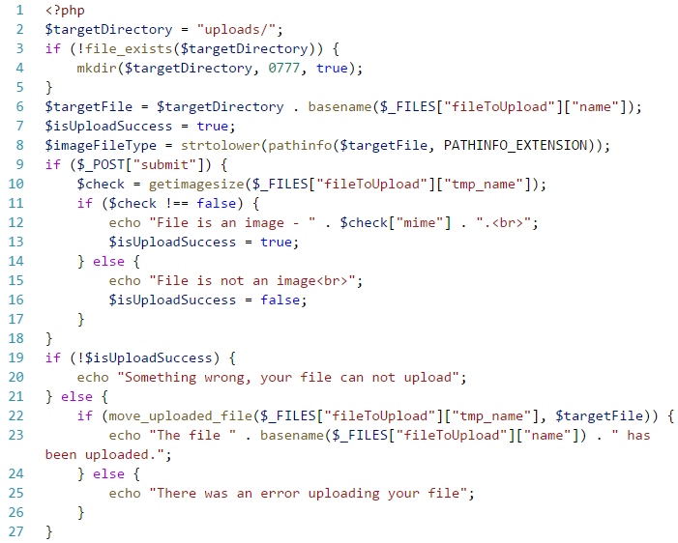
FILE UPLOAD
Carefully with your server config at “php.ini” file, remember turn on “file_uploads”.
HTML form upload file have a attribute is enctype=“multipart/form-data”.
Strict data is the best.

Slide 8
FILE INCLUDE/REQUIRE
Include or require statment takes all the text/code/markup that exists in the specified file and copies it into the file that uses the include or require statment.
Include will import the file if it’s already, if it’s not, move on.
Require will import the file if it’s already, if it’s not, stop.
Require should be using for the core files like connect database or enviroment files.
Recommend is using include_once or requrie_once, it’s maxization the code.

Slide 9
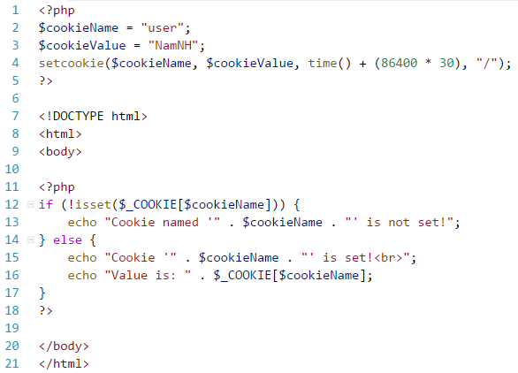
COOKIES
Cookie is using for the user’s computer. It’s exists in front-end.
Remember do the setcookie() function to create or update cookie before <html> tag.

Slide 10
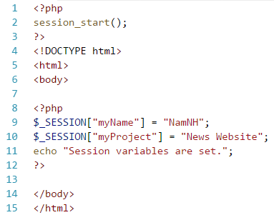
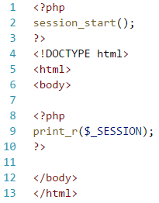
SESSIONS
Session is store in server, not in the front-end.
Users have permission can get it from server my using PHP global variable $_SESSION.
Session_start() must in the top of the file. Before any html tags.

Slide 11
TIME TO PRACTICE.

