Slide 1
PHP OOP & MVC

Slide 2
BEFORE WE GET STARTED
Make sure you done all of PHP MYSQL exercise at
https://github.com/namnh06/aptech-php-course
Searching on Google : PHP OOP.

Slide 3
OOP
OOP stand for Object-Oriented Programming.
A programming language model organized around objects rather than “actions” and data rather than logic.
There are 4 major principles of Object-Oriented Programming : Inheritance, Polymorphism, Encapsulation and Abstraction.
Easy to learn, hard to handle.

Slide 4
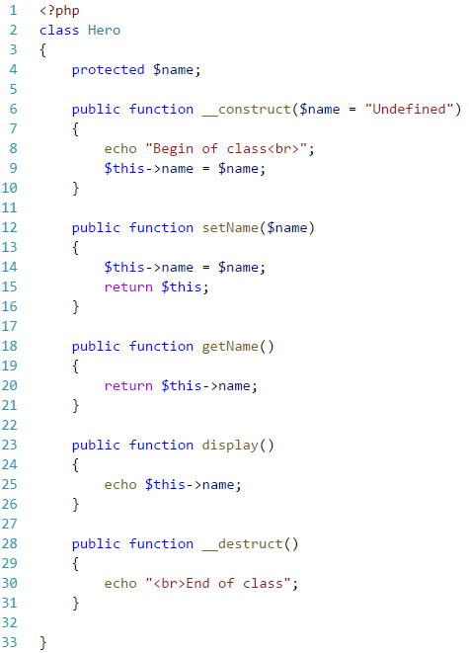
CLASS
This is a programmer-defined data type, which includes local functions as well as local data.
It’s a template for making many instances of the same kind (or class) of object.
Class has properties and methods.
Magic methods can do something useful.

Slide 5
VISIBILITY
Each method and property has its visibility.
Three types of visibility declared by keywords “public”, “protected” and “private”.
Can use “static” keyword to declared a static function.
 | Inside | Children | Outside
Public | YES | YES | YES
Protected | YES | YES | NO
Private | YES | NO | NO

Slide 6
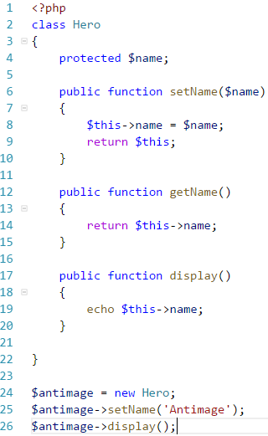
OBJECT
An individual instance of the data structure defined by a class. Object also known as instance.
Using “new” keyword to create object from class.
It’s an instance of a Class.
Object is specific.

Slide 7
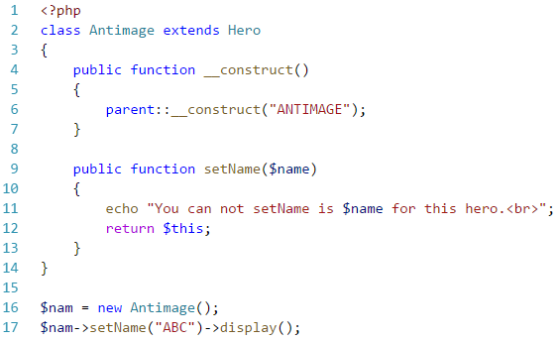
INHERITANCE
It lets subclass inherits characteristics of the parent class.
Using keyword “extends” to inherit from its parent class.
All of property and methods will be inherit by its child class, except the one has keyword “private”.

Slide 8
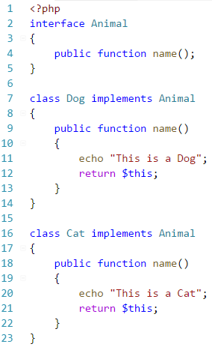
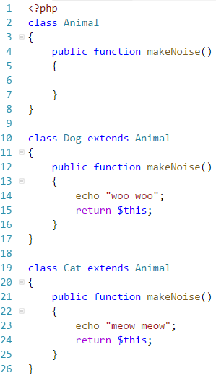
POLYMORPHISM
The provision of a single interface to entities of different types.
It’s able to process objects differently depending on their data type or class.
Can use “interface” keyword to make interface class, use “implements” to implement an interface.
Interfaces are skeletons.

Slide 9
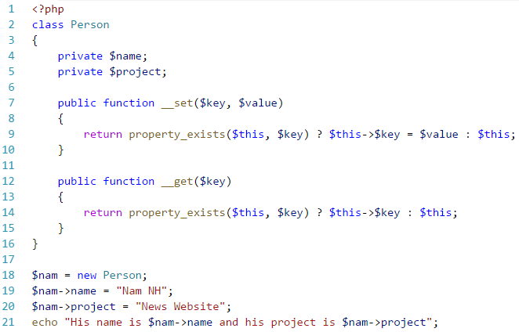
ENCAPSULATION
Encapsulation is used to hide the values or state of a structured data object inside a class, preventing unauthorized parties’ direct access to them.
Using “private”, “protected” and magic methods to set and get its property is better.

Slide 10
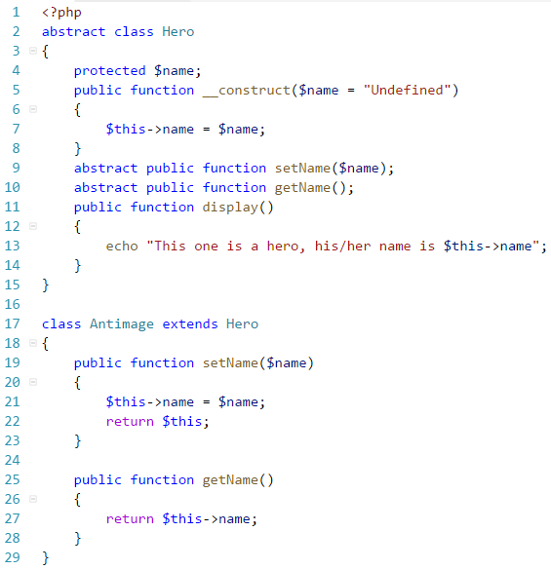
ABSTRACTION
Abstraction is the concept of moving the focus from the details and concrete implementation of things, to the types of things.
Making the programming simpler, more general and more abstract.
It’s like a generalization instead of a specification
Can use “abstract” keyword to declared abstract class.

Slide 11
INTERFACE & ABSTRAC CLASS
Interface declares what methods a class must have without having to implement them, the one is inherit from abstract class must implement the method its declared as abstract in abstract class.
Interface is not a class, can not instantiate an interface because it’s do not have any property or method can use immediately. Abstract class is a class, can have normal properties and methods as a normal class, it can be instantiated as a normal class.
Interface is 100% abstraction, abstract can be or can be not.

Slide 12
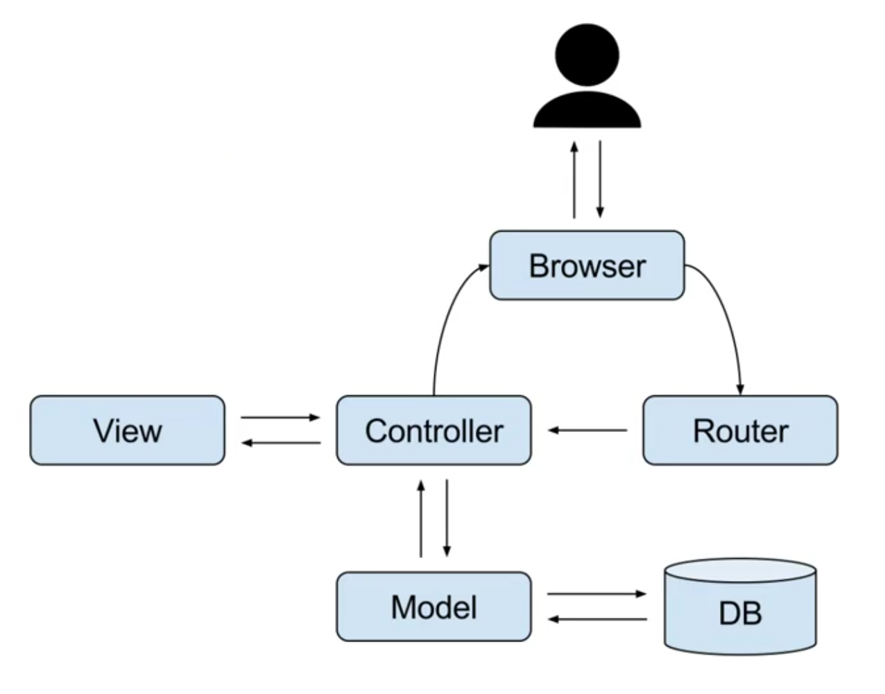
MVC ARCHITECTURE
MVC stand for Model View Controller, is a software design pattern
Model − The lowest level of the pattern which is responsible for maintaining data.
View − This is responsible for displaying all or a portion of the data to the user.
Controller − Software Code that controls the interactions between the Model and View.

Slide 13
TIME TO PRACTICE.

