Slide 1
PHP MYSQL

Slide 2
BEFORE WE GET STARTED
Make sure you done all of PHP Advance & MySQL exercise at
https://github.com/namnh06/aptech-php-course
Have some knowledge about Database.

Slide 3
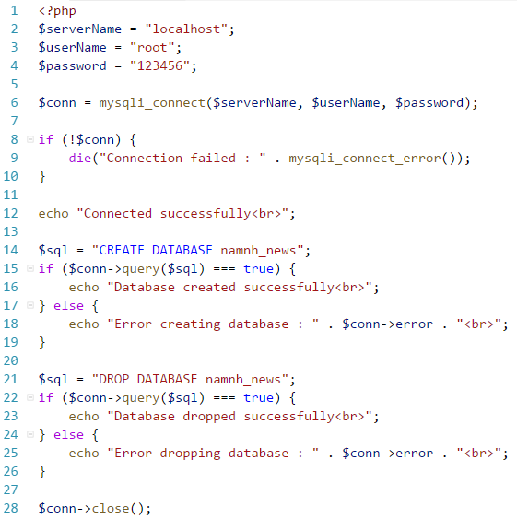
DATABASE CONNECT/CREATE/DROP
Connecting to the database from PHP can use MySQLi extension or PDO (PHP Data Objects).
Make sure you have admin privilege before dropping any database
Can use TRUNCATE alter DROP, it’s deleted the data, not whole database, it’s safer than DROP.
Remember, open it, have to close it.

Slide 4
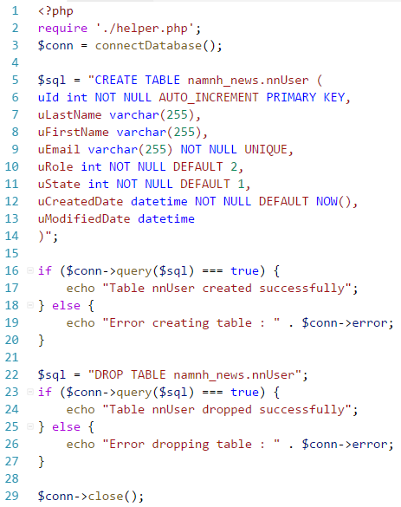
TABLE CREATE/DROP/MODIFIED
Can use TRUNCATE alter DROP.
Do not forget the data types when create table, it’s very important.
Using ALTER TABLE to Modified column, name or data type of table.

Slide 5
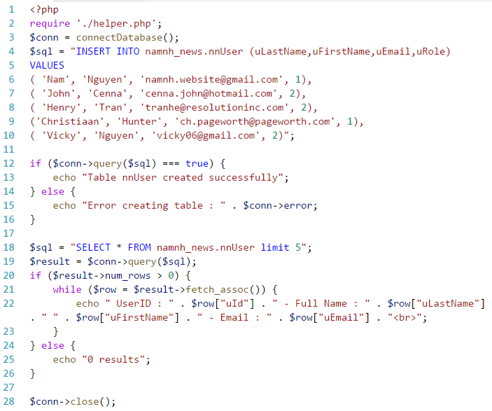
DATA INSERT/SELECT/DELETE/UPDATE
Like using MYSQL command, but have some rules :
The SQL query must be quoted in PHP
String values inside the SQL query must be quoted
Numeric values must not be quoted
The word NULL must not be quoted

Slide 6
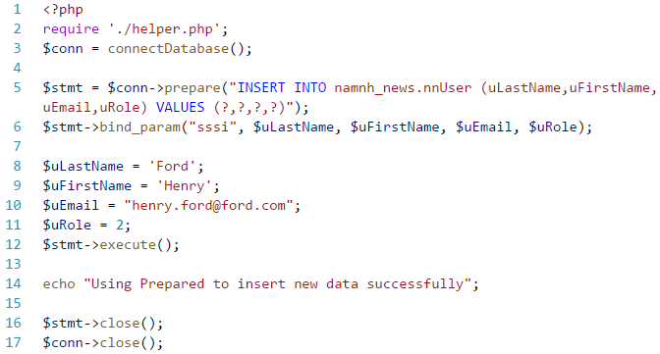
PREPARED STATEMENTS
Very useful against SQL injections.
Execute the same SQL statements repeatedly with high efficiency.
Faster, take less resource from server than normal query.

Slide 7
TIME TO PRACTICE.

