Slide 1
Supply Chain Performance Analysis
Using Power BI

Slide 2
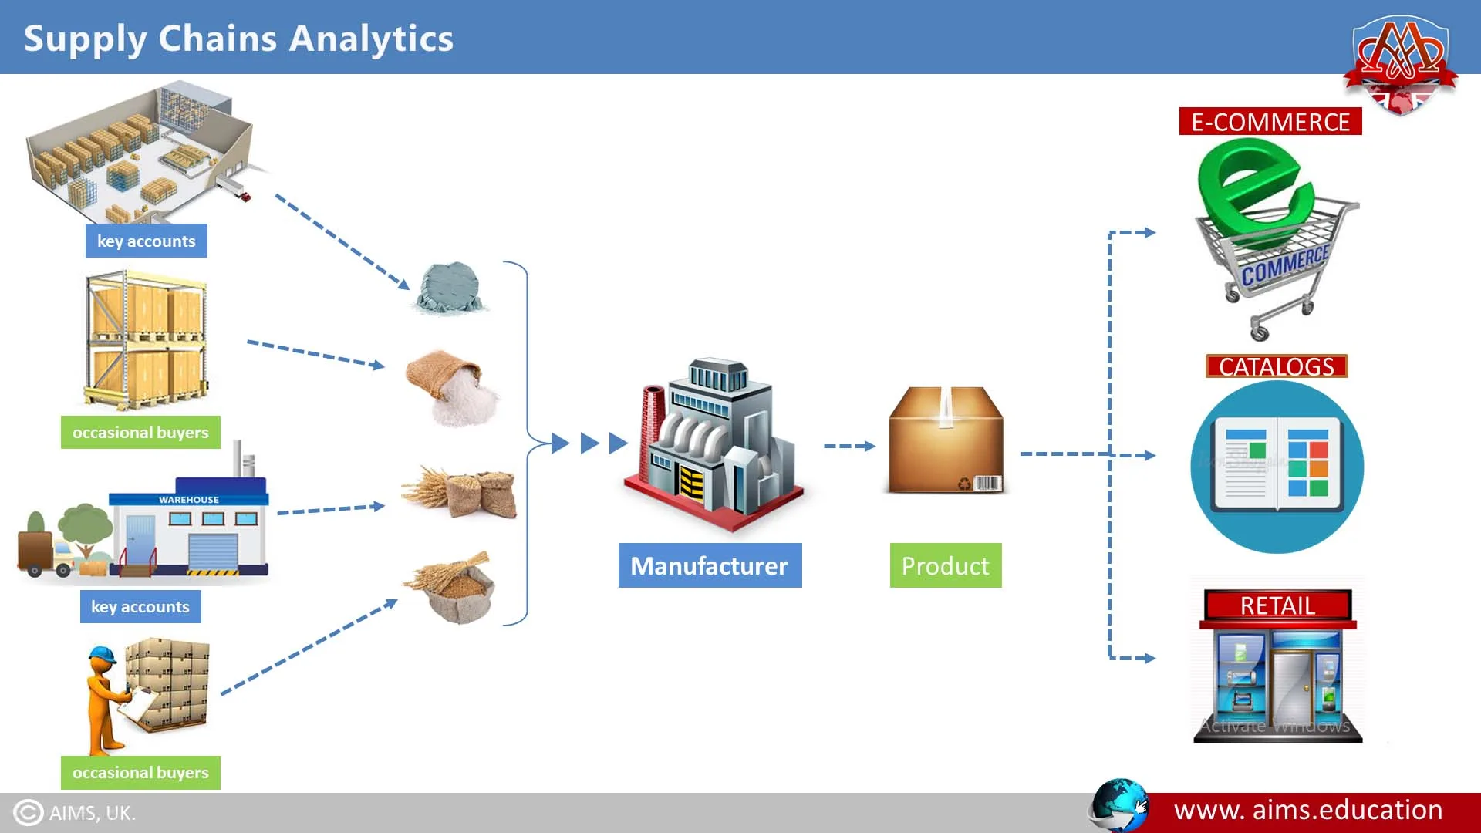
Project Objective
• Analyze supply chain performance using order data • Identify key factors affecting sales, profit, and delivery performance • Build Power BI dashboard

Slide 3

Data Source
Dataset: DataCo Global Supply Chain Dataset
• Source: Kaggle
• Records: ~180,000
• Columns: 58
Includes information about:
• Orders • Customers • Products • Shipping and delivery

Slide 4
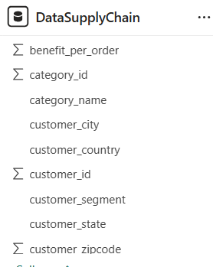
Dataset Overview
Key columns used in the analysis: • order_id • order_date • shipping_mode • order_region • category_name • sales • order_profit_per_order • is_late_flag

Slide 5



Data Preprocessing
Raw data issues
• Missing values
• Inconsistent data types
• Some irrelevant columns
Processing steps
• Data cleaning
• Data type standardization
• Feature engineering
New features created
• Shipping Delay Days
• Late Delivery Flag

Slide 6
EDA
EDA was conducted to understand the data distribution and relationships.
Types of analysis:
• Univariate analysis • Bivariate analysis • Multivariate analysis
Goal:
Identify patterns and potential business insights.
Raw Data -> Data Inspection -> Data Preprocessing -> EDA -> Dashboard Visualization -> Business Insights

Slide 7
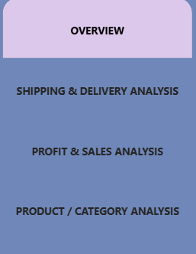
Dashboard
Power BI Dashboard
The dashboard consists of four main pages:
• Overview
• Shipping & Delivery Analysis
• Profit & Sales Analysis
• Product / Category Analysis

Slide 8
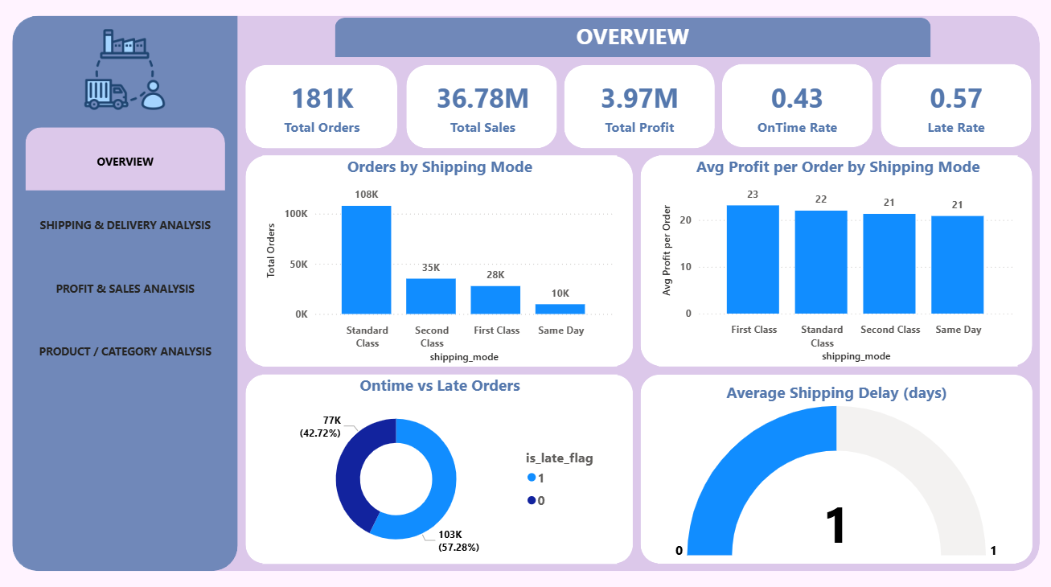
Page 1: Overview
Key KPIs displayed:
• Total Orders • Total Sales • Total Profit • On-time Delivery Rate • Late Delivery Rate

Slide 9
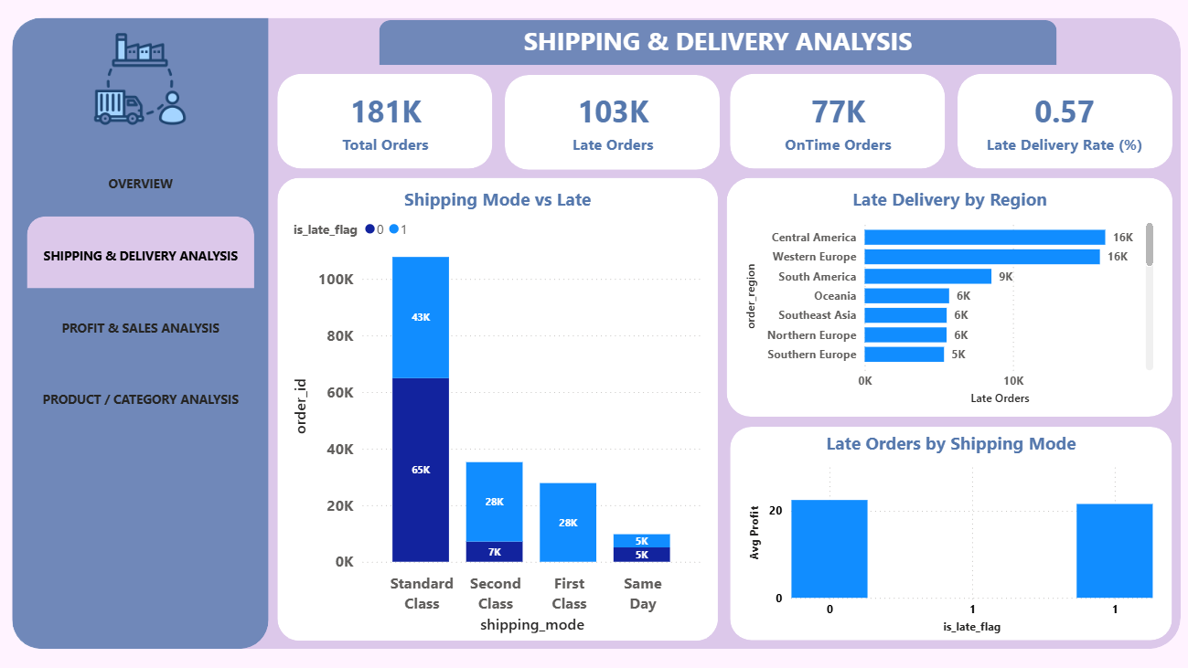
Page 2: Shipping & Delivery Analysis
Key insights:
• Analyze late deliveries by shipping mode • Identify regions with the highest late deliveries • Evaluate shipping performance

Slide 10
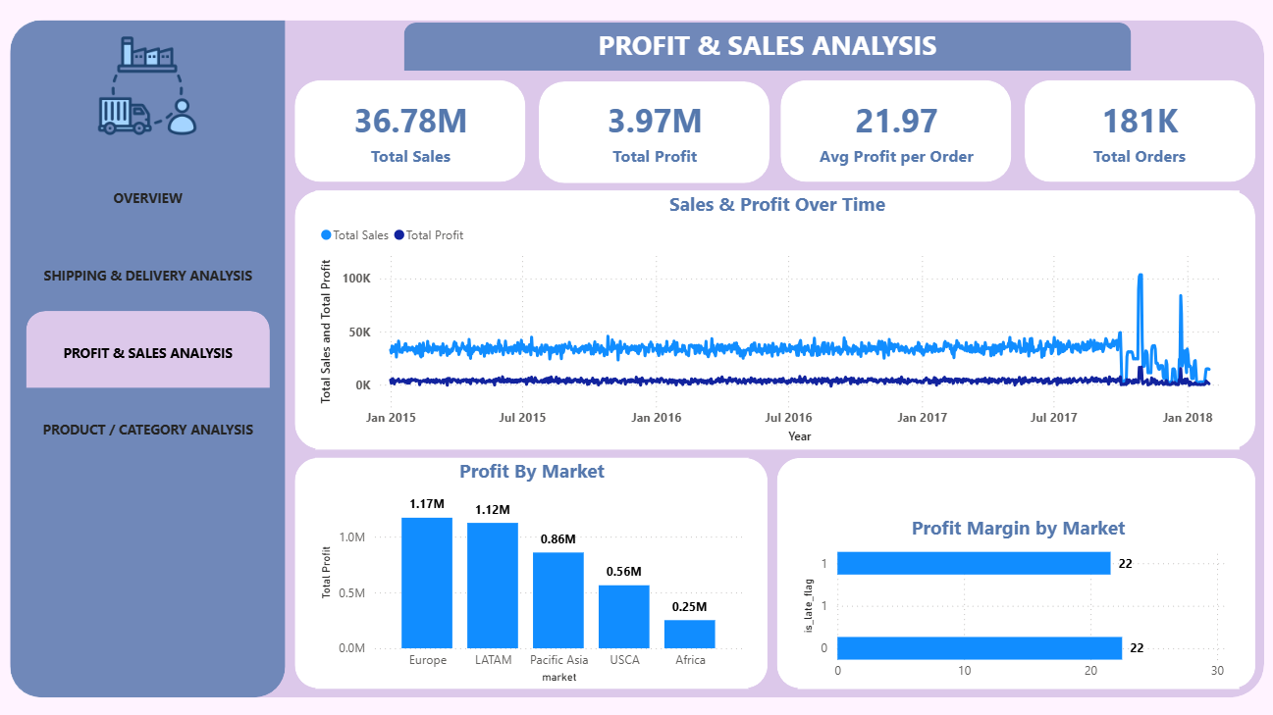
Page 3: Profit & Sales Analysis
Key insights:
• Analyze sales and profit trends over time • Identify the most profitable markets • Evaluate average profit per order

Slide 11
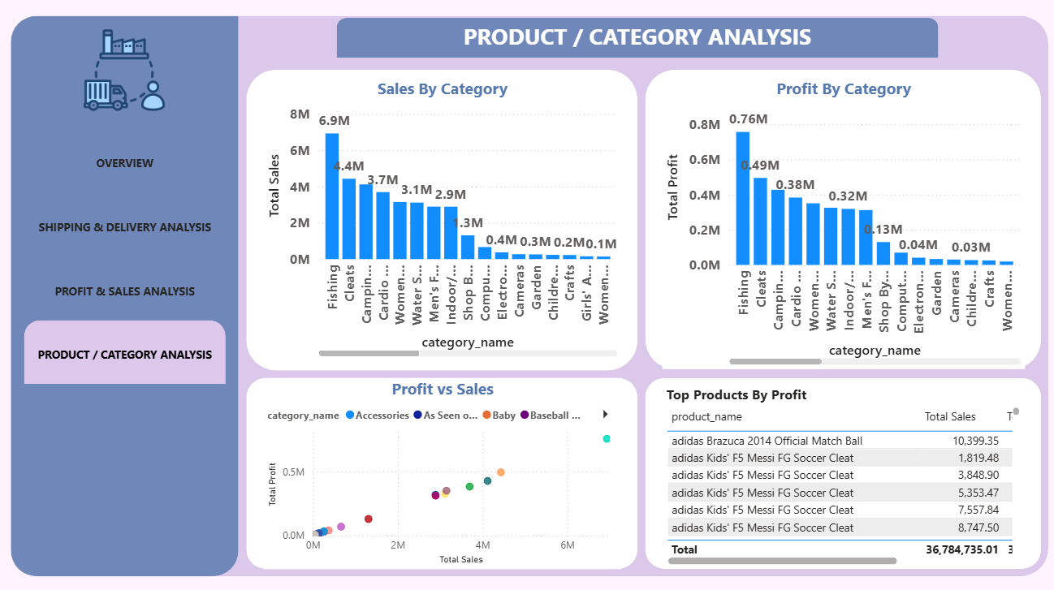
Page 4: Product / Category Analysis
Key insights:
• Identify top-performing product categories • Compare sales and profit across categories • Discover the most profitable products

Slide 12


