Slide 1
Introduction to DSpace
September 4, 2014 | Uh clear lake
Kristi park, texas digital library
Laura mcelfresh, texas a&m galveston

Slide 2
Topics
Introduction: About DSpace and the Texas Digital Library
DSpace Basics
Ingesting Content
Workflows and Roles
Metadata
Other things that are good to know

Slide 3
Introduction
DSpace and the TDL

Slide 4
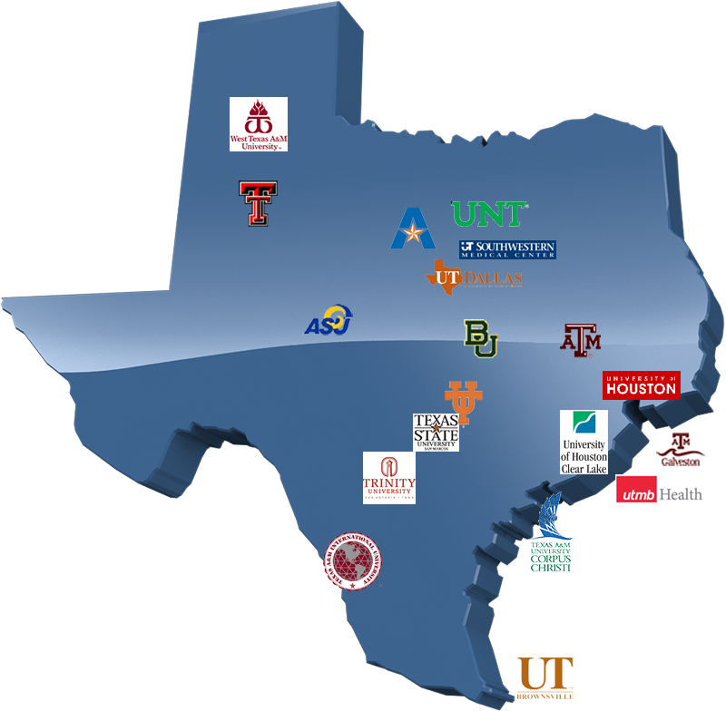
The Texas Digital Library is a consortium of libraries
that works together to support greater access to the riches of Texas academic institutions.
Notes:
2005: TDL formed by four Texas members of the Association of Research Libraries
20 member institutions currently
Offer services for repositories, ETD management (Vireo), online journals, online conference management, and WordPress sites

Slide 5
Infrastructure
Community
Notes:
Our work in the Texas Digital Library falls into two broad categories: building infrastructure and fostering community. These two areas are mutually reinforcing.
As a consortium, we can build infrastructure at scale (more efficiently) that will benefit all our members. We work on large-scale projects that will do the most good for the most members. We lay the foundation that facilitates digital work at our member institutions.
Secondly, we build community around that infrastructure to maximize its value. This community takes many forms, for instance:
- working groups that develop standards, recommend policies, and develop pilot projects for new services
- users groups that provide forums for mutual support and knowledge-sharing
- training opportunities
- conferences (like the Texas Conference on Digital Libraries) and other professional development events
Community informs the decisions that the TDL makes about infrastructure projects. And the infrastructure we build lets the community it serves maximize the resources of their home institution.

Slide 6


DSpace
Open source software for digital repositories
Started in 2002 from developers at MIT and HP Labs
Active development community
Over 1000 organizations use DSpace
Primarily research/higher education
The TDL is a Platinum Member of DuraSpace, the sponsoring organization of DSpace.
Notes:
Out of the box solution
Dspace is part of DuraSpace (Fedora Commons and Dspace)
The most popular open source repository software in USA

Slide 7
DSpace Basics
Communities and collections, logging in, navigating the admin interface

Slide 8

Features
Full-text searchable (any text-based file)
Discovery: search/browse in the DSpace interface, handles (Faceted browse)
Can handle any type of file (file=bitstream); best known for text-based files
Optimized for indexing in Google and Google Scholar
Persistent URLs (Handle system)
Notes:
Descriptive Metadata: DSpace can support multiple flat metadata schemas for describing an item. A qualified Dublin Core metadata schema loosely based on the Library Application Profile set of elements and qualifiers is provided by default. The set of elements and qualifiers used by MIT Libraries comes pre-configured with the DSpace source code. However, you can configure multiple schemas and select metadata fields from a mix of configured schemas to describe your items. Other descriptive metadata about items (e.g. metadata described in a hierarchical schema) may be held in serialized bitstreams. Communities and collections have some simple descriptive metadata (a name, and some descriptive prose), held in the DBMS.
Administrative Metadata: This includes preservation metadata, provenance and authorization policy data. Most of this is held within DSpace's relational DBMS schema. Provenance metadata (prose) is stored in Dublin Core records. Additionally, some other administrative metadata (for example, bitstream byte sizes and MIME types) is replicated in Dublin Core records so that it is easily accessible outside of DSpace.
Structural Metadata: This includes information about how to present an item, or bitstreams within an item, to an end-user, and the relationships between constituent parts of the item. As an example, consider a thesis consisting of a number of TIFF images, each depicting a single page of the thesis. Structural metadata would include the fact that each image is a single page, and the ordering of the TIFF images/pages. Structural metadata in DSpace is currently fairly basic; within an item, bitstreams can be arranged into separate bundles as described above. A bundle may also optionally have a primary bitstream. This is currently used by the HTML support to indicate which bitstream in the bundle is the first HTML file to send to a browser. In addition to some basic technical metadata, a bitstream also has a 'sequence ID' that uniquely identifies it within an item. This is used to produce a 'persistent' bitstream identifier for each bitstream. Additional structural metadata can be stored in serialized bitstreams, but DSpace does not currently understand this natively.

Slide 9
Examples of DSpace
http://repositories.lib.utexas.edu
http://repository.tamu.edu/
http://repositories.tdl.org/ttu
http://repositories.tdl.org/utmb
https://repositories.tdl.org/uh-ir/
http://repositories.tdl.org/tamug/

Slide 10
Repository Structure:
Communities and Collections
Community – highest level of DSpace hierarchy; can contain sub-communities and/or collections
Sub-Community (optional) – if used, contain collections or additional nested sub-communities
Collection – Contain items
Item – Contain bitstreams (i.e. files), metadata, and license
Notes:
Communities and Collections are used within DSpace to provide the repository with an easily navigable structure often representing an institutions organizational makeup. (see: http://cadair.aber.ac.uk/dspace/handle/2160/638)
As a result the DSpace repository structure is largely hierarchical.

Slide 11
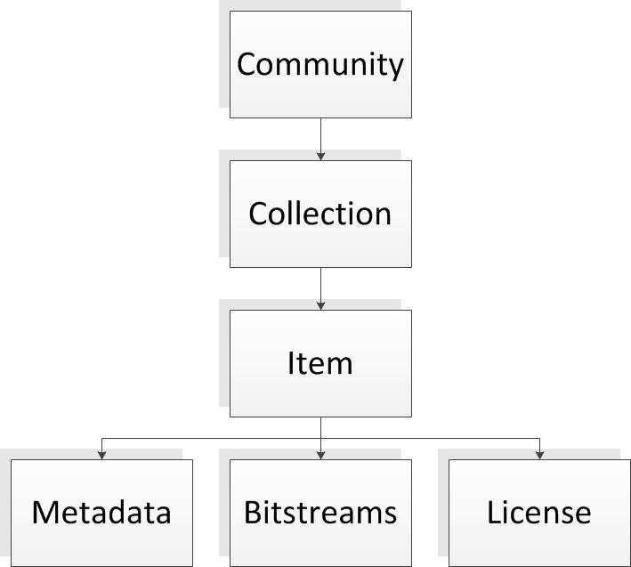
Repository structure: Example #1

Slide 12
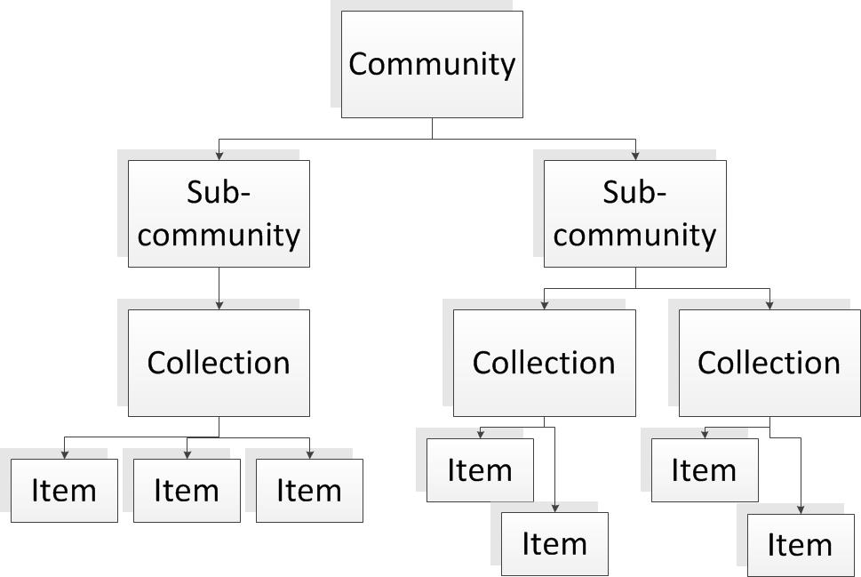
Repository structure: Example #2

Slide 13
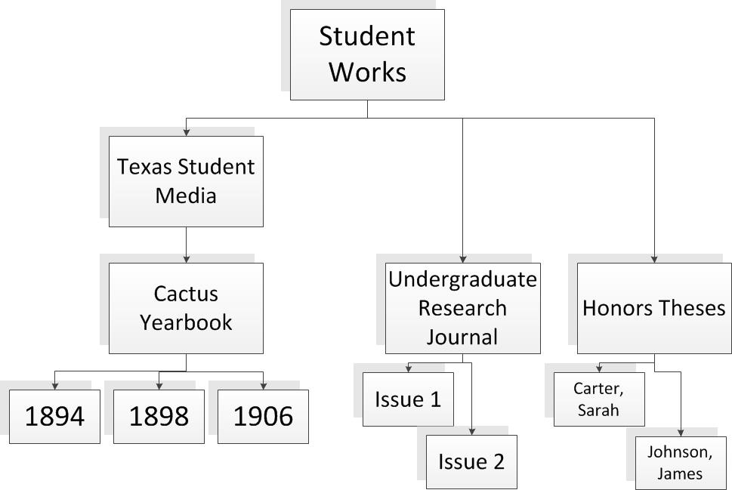
Example from UT Digital Repository
Community
Sub-Community
Collection
Collections
Items
Items

Slide 14
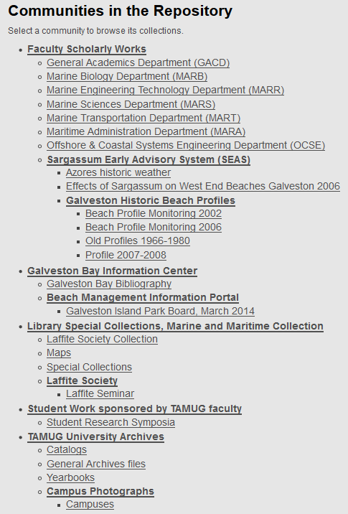
Community Structure in TAMUG Repository
Community
Sub-Community
Collections
Above: Communities and Collections in the Texas A&M at Galveston Repository

Slide 15

Logging into DSpace
The TDL uses “Shibboleth” to manage authentication with our services.
Shibboleth lets you log in using your university credentials.
Training DSpace installation: https://dspace41-demo.tdl.org/demo-ir/
There’s no Shibboleth on the training box. Log in using provided student login credentials: tdl.studentX@gmail.com where X is the number on the yellow sticky note (password: tdlstudent)
Notes:
Everybody has the highest level of user access: Repository Administrator

Slide 16
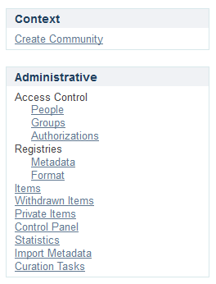
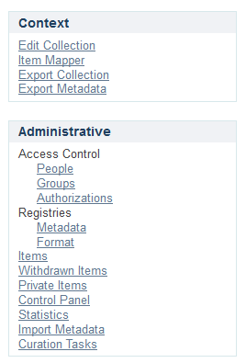
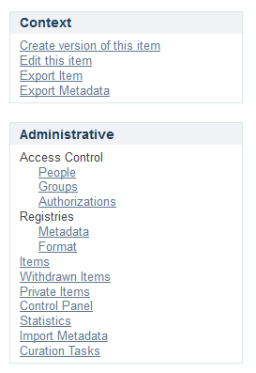
Context Clues
Available actions change as you navigate through the interface.
On the DSpace homepage
On a Collection page
On an item page
Notes:
Everybody has the highest level of user access: Repository Administrator

Slide 17
How To:
Go to https://dspace41-demo.tdl.org/demo-ir/ (Make sure you are logged in to DSpace.)
Navigate to the “UHCL Training Community”
Click on Create Sub-community
Give your Sub-community a name, provide introductory text, and click on Create.
Click on the Assign Roles tab
Click on Create to assign Administrators
Add kristipark@yahoo.com as an Administrator.
Note: Addition of the administrative user automatically creates a “Group” called “COMMUNITY_X_ADMIN.”
Create a Sub-community.
Assign an Administrator to your Sub-community.
Notes:
For now, ignore “Edit authorization policies.”

Slide 18
How To:
Navigate to the Sub-Community you just created.
Click on Create Collection.
Give your collection a name, provide some introductory text, and click on Create.
On “Assign Roles” tab, click Create next to Administrators.
Add [username} as an Administrator for the Collection.
Note: Initially, when you add a user as Administrator, the user will appear as “Pending” until you click SAVE.
Create a new Collection within your Sub-Community.
Assign an Administrator to your Collection.

Slide 19
How To :
Return to DSpace Home
Navigate to the Collection you just created.
Under Context, click on Edit Collection.
Edit any metadata for the collection and upload an image under “Upload new logo.”
Click Save updates.
Edit an existing Collection.
Notes:
Ignore “Item template” for now.
Things you can change when editing

Slide 20
Case Study: SEAS Community
Sargassum Early Awareness System Community in the Texas A&M at Galveston Repository

Slide 21
Ingesting Content
Submission workflow

Slide 22
Ingest Process
Web Submit UI
In Progress Submission
Item Installer
Archived Item
External SIP
Batch Item Importer
Workflow
(optional)
Notes:
Image Adapted from DSpace 4.x User Documentation:https://wiki.duraspace.org/download/attachments/34640877/ingest.gif?version=1&modificationDate=1262060007225&api=v2
NOTE: This course will focus on the Web Submit UI process, rather than the Batch Importer.
- Batch Import requires command line access and will require support from TDL systems administration.
- Limited to large collections of items (200+) or very large files
The batch item importer is an application, which turns an external SIP (an XML metadata document with some content files) into an "in progress submission" object. The Web submission UI is similarly used by an end-user to assemble an "in progress submission" object.
Depending on the policy of the collection to which the submission in targeted, a workflow process may be started. This typically allows one or more human reviewers or 'gatekeepers' to check over the submission and ensure it is suitable for inclusion in the collection.
When the Batch Ingester or Web Submit UI completes the InProgressSubmission object, and invokes the next stage of ingest (be that workflow or item installation), a provenance message is added to the Dublin Core which includes the filenames and checksums of the content of the submission. Likewise, each time a workflow changes state (e.g. a reviewer accepts the submission), a similar provenance statement is added. This allows us to track how the item has changed since a user submitted it.
Once any workflow process is successfully and positively completed, the InProgressSubmission object is consumed by an "item installer", that converts the InProgressSubmission into a fully blown archived item in DSpace. The item installer:
Assigns an accession date
Adds a "date.available" value to the Dublin Core metadata record of the item
Adds an issue date if none already present
Adds a provenance message (including bitstream checksums)
Assigns a Handle persistent identifier
Adds the item to the target collection, and adds appropriate authorization policies
Adds the new item to the search and browse index
Taken from: https://wiki.duraspace.org/display/DSDOC4x/Functional+Overview#FunctionalOverview-UserManagement

Slide 23
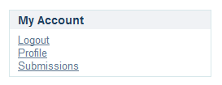
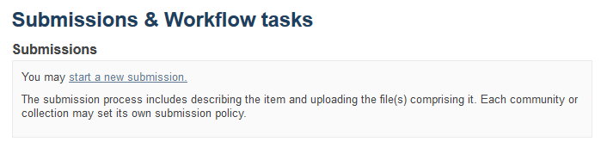
Starting a new submission
Users with “submit” privileges will see a “Submissions” link under My Account.
Click “Start a New Submission” to begin.

Slide 24
Submission Steps
Select a Collection
Describe the item (3 screens)
Determine access
Upload file(s)
Review
Agree to license
Complete submission
Only collections on which you have “submit” privileges will appear.
Title and Date of Publication are required.
Make item private? – Item will not be searchable.
Set up limited embargo? – Provide future date for access
Upload one or multiple files
Edit metadata specific to each bitstream, including embargo info.
Review information and make corrections.
Agree to license
Click “Complete submission.”.
If Collection has no workflow steps, and you did not replace any restrictions on access, the item will be immediately available in DSpace

Slide 25
Practice
Click “Submissions”
Click “start another submission.”
Select a collection and click Next.
Proceed through the workflow. Upload one or multiple files from desktop folder.
Submit an Item to your Collection.

Slide 26
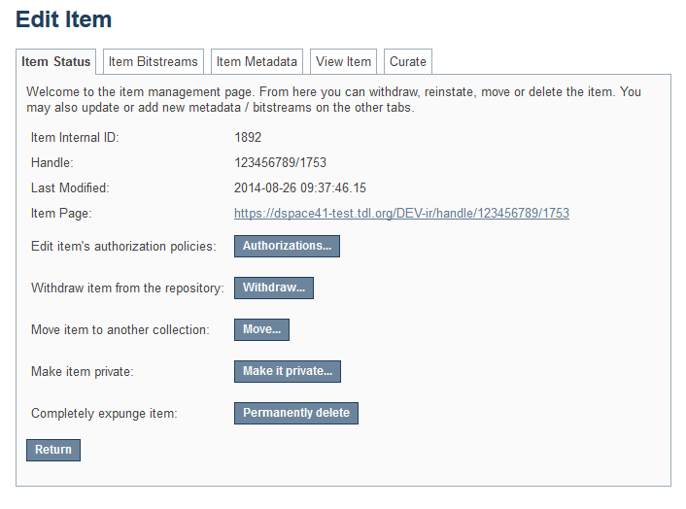
Editing Items
Moving items to a different collection
Making an item private
Replacing or modifying bitstreams
Reordering bitstreams
Editing item metadata

Slide 27
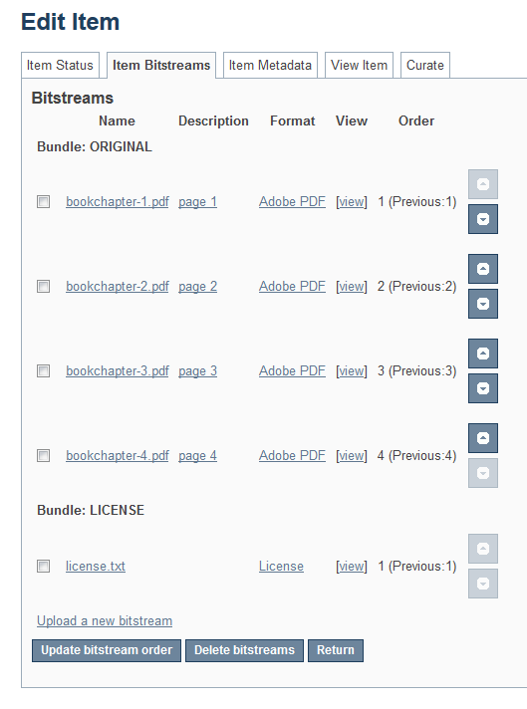
Reorder bitstreams
In items with multiple files (i.e. bitstreams), an administrator can reorder the files after submission.
Complete submission of item.
Navigate to collection and item just submitted.
“Edit this item.” => Item Bitstreams tab
Use arrows on right side to reorder the files

Slide 28
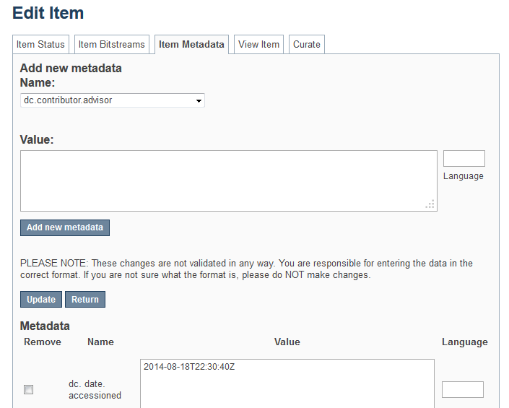
Editing Item Metadata
Navigate to the Item
Click “Edit this item” under “Context.”
Go to “Item Metadata” tab.
Edit existing metadata, or add new fields.

Slide 29
Roles and Workflows
e-people, groups, Authorization

Slide 30
Roles within DSpace
More privileges
Fewer privileges
Repository Administrator
Community Administrator
Collection Administrator
Reviewer OR
Submitter
Reader
Notes:
User accounts are required in order to grant privileges to different users
Not logged in = Anonymous
Users with accounts can be granted privileges to allow you to interact with DSpace
Repository Administrators have access to all functions in DSpace.
Important Note: Reviewer is a role specific to Workflows

Slide 31
E-People and Groups
E-People and Groups are the way DSpace identifies users for the purpose of granting privileges.
E-Person = User Account
An E-Person can be granted certain privileges within DSpace.
In TDL-hosted systems, an E-Person is created when a user logs in for the first time.
Groups = a list of E-People
Groups can be granted permissions.
Anyone listed in the group gets the permissions granted to the group.
Two default groups in DSpace: Administrator and Anonymous
Notes:
Two built-in/default groups: 'Administrators', who can do anything in a site, and 'Anonymous', which is a list that contains all users. Assigning a policy for an action on an object to anonymous means giving everyone permission to do that action. (For example, most objects in DSpace sites have a policy of 'anonymous' READ.)

Slide 32
Roles and Groups
More privileges
Fewer privileges
Repository Administrator
Community Administrator
Collection Administrator
Reviewer OR
Submitter
Reader
Anonymous
(by default)
COLLECTION_X_SUBMIT
COLLECTION_X_WORKFLOW_STEP_1
Administrator
COMMUNITY_X_ADMIN
COLLECTION_X_ADMIN
COLLECTION_X_WORKFLOW_STEP_2
COLLECTION_X_WORKFLOW_STEP_3
Notes:
Each role in DSpace is associated with a named Group.
Important Note: Reviewer is a role specific to Workflows (see later slides)
The default Group for Reader in “Anonymous,” meaning that by default, a Collection can be viewed and read by any user, whether logged in or not. Restricted groups CAN be created for the Reader role – i.e. access to items in the repository can be restricted to a specific group.

Slide 33
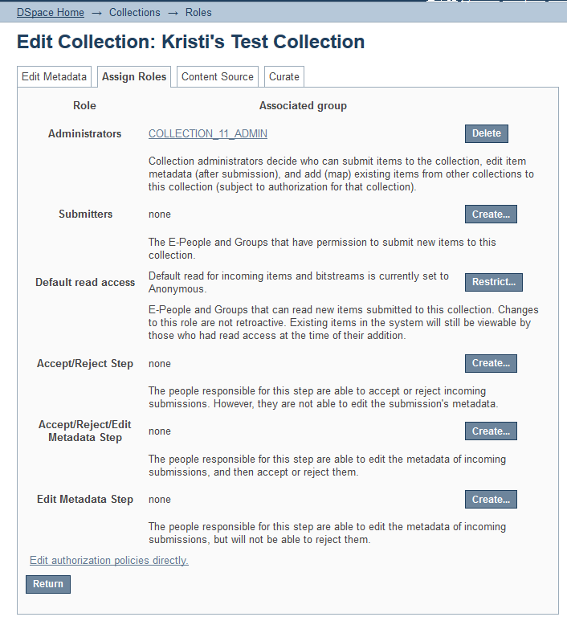
Managing Groups Method #1
Edit Collection => Assign Roles
Create a group of Collection Administrators
Create a group of Submitters
Create a specified Group who can access materials (default is “anonymous”)
Create Workflow Steps (more on this later)
To create a Group: Click “Create” (or “Restrict”), search for and add E-People to the group, click SAVE.

Slide 34
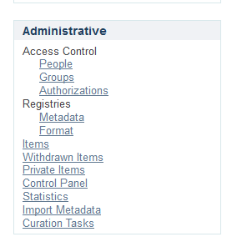
Managing Groups (Method #2)
Access Control => Groups
To create a Group: Click “Click here to add a new Group,” give new Group a name, search for and add E-People to the group, click SAVE.
Note: No privileges are attached to any groups created through this method. But groups created here are available to be authorized in other parts of the interface.

Slide 35
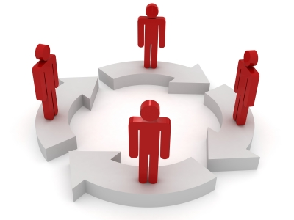
Workflows
Without a Workflow in place, items submitted to a Collection in DSpace will automatically be archived and published.
Workflows allow for one, or multiple, steps for reviewing submissions and editing metadata prior to publication.
A Workflow can have 1, 2, or 3 steps.
Each step will have an E-Person Group attached.

Slide 36
Available Workflow Steps
Step 1
Step 2
Step 3
Can accept or reject submission
Edit metadata; accept or reject submission
Edit metadata and publish; cannot reject
Notes: A collection might have one or all of these steps. It could have any one of these steps but not the other two.
Notes:
The sequence is this: The collection receives a submission. If the collection has a group assigned for workflow step 1, that step is invoked, and the group is notified. Otherwise, workflow step 1 is skipped. Likewise, workflow steps 2 and 3 are performed if and only if the collection has a group assigned to those steps. (https://wiki.duraspace.org/display/DSDOC4x/Functional+Overview)

Slide 37
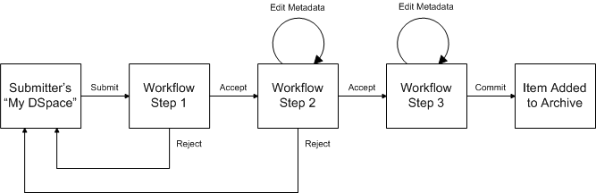
A Workflow with all three steps
Notes:
Image location: https://wiki.duraspace.org/download/attachments/34640877/workflow.gif?version=1&modificationDate=1262060007223&api=v2

Slide 38
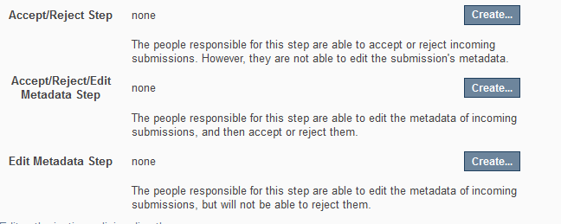
Creating a Collection Workflow
Edit Collection => Assign Roles
Create a Group for the Workflow step(s) you want.
A Step without a Group does not exist.

Slide 39
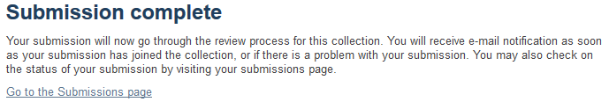
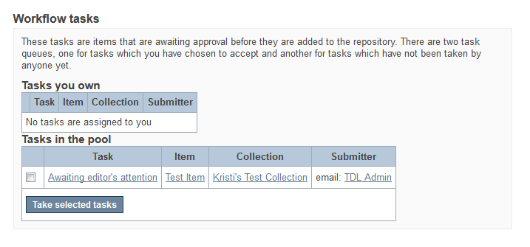
Working within a Workflow
Submitter submits item to a Collection with “Step 2” in place. Submitter gets this message:
An email is sent to every E-Person in the Workflow/Reviewer Group.
Reviewer Group also sees this on their Submissions page:

Slide 40
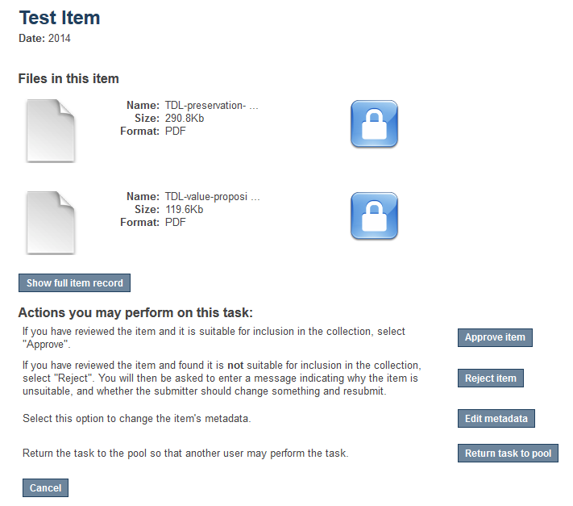
Workflow, cont.
Review takes the task and reviews submitted item.
Reviewer can edit the item’s metadata, approve or reject the item, or return the item to the pool for another Reviewer to pick up.

Slide 41

Authorization Policies
VERY specific permissions can be created for e-persons and groups by creating authorization policies at the Collection, Item, or Bitstream Level.
Notes:
“Authorization” refers to an even more granular level of permissions that can be controlled at the Collection, Item, or Bitstream Level.

Slide 42
Collection-Level Authorization Policies
COLLECTION LEVEL
ADD/REMOVE | add or remove items (ADD = permission to submit items)
DEFAULT_ITEM_READ | inherited as READ by all submitted items
DEFAULT_BITSTREAM_READ | inherited as READ by Bitstreams of all submitted items. Note: only affects Bitstreams of an item at the time it is initially submitted. If a Bitstream is added later, it does not get the same default read policy.
COLLECTION_ADMIN | collection admins can edit items in a collection, withdraw items, map other items into this collection.

Slide 43
Other Authorization Policies
Item-Level
ADD/REMOVE | add or remove bundles
READ | can view item (item metadata is always viewable)
WRITE | Can modify item
Bundle-Level
ADD/REMOVE | add or remove bitstreams to a bundle
Bitstream-Level
READ | view bitstream
WRITE | modify bitstream

Slide 44
Metadata

Slide 45
Refresher: Editing Item Metadata
Navigate to the Item
Click “Edit this item” under “Context.”
Go to “Item Metadata” tab.
Edit existing metadata, or add new fields.
Notes:
Covered this back in the first section. After submitting an item, you can always go back and edit/add to metadata.

Slide 46

DSpace and Dublin Core
Dublin Core is at the heart of DSpace
2 mandatory elements when submitting thru UI:
Title (dc.title) and
Date of Publication (dc.date.issued)
7 automatic elements created by the software without any need for contributor input.
3 date elements
2 format elements
Identifier
Provenance.
Notes:
See Dublin Core, DSpace, and a Brief Analysis of Three University Repositories: doi: 10.6017/ital.v29i1.3157
Provenance: identity of the contributor (derived from the sign-in identity and password) and places this information into a dc.provenance element field. This information becomes a permanent part of the DSpace record; however, this field is a hidden to users. Typically only community and network/systems administrators may view provenance information.
Descriptive Metadata: DSpace can support multiple flat metadata schemas for describing an item. A qualified Dublin Core metadata schema loosely based on the Library Application Profile set of elements and qualifiers is provided by default. The set of elements and qualifiers used by MIT Libraries comes pre-configured with the DSpace source code. However, you can configure multiple schemas and select metadata fields from a mix of configured schemas to describe your items. Other descriptive metadata about items (e.g. metadata described in a hierarchical schema) may be held in serialized bitstreams. Communities and collections have some simple descriptive metadata (a name, and some descriptive prose), held in the DBMS.
Administrative Metadata: This includes preservation metadata, provenance and authorization policy data. Most of this is held within DSpace's relational DBMS schema. Provenance metadata (prose) is stored in Dublin Core records. Additionally, some other administrative metadata (for example, bitstream byte sizes and MIME types) is replicated in Dublin Core records so that it is easily accessible outside of DSpace.
Structural Metadata: This includes information about how to present an item, or bitstreams within an item, to an end-user, and the relationships between constituent parts of the item. As an example, consider a thesis consisting of a number of TIFF images, each depicting a single page of the thesis. Structural metadata would include the fact that each image is a single page, and the ordering of the TIFF images/pages. Structural metadata in DSpace is currently fairly basic; within an item, bitstreams can be arranged into separate bundles as described above. A bundle may also optionally have a primary bitstream. This is currently used by the HTML support to indicate which bitstream in the bundle is the first HTML file to send to a browser. In addition to some basic technical metadata, a bitstream also has a 'sequence ID' that uniquely identifies it within an item. This is used to produce a 'persistent' bitstream identifier for each bitstream. Additional structural metadata can be stored in serialized bitstreams, but DSpace does not currently understand this natively.

Slide 47
Creating Metadata Templates
When you should use metadata templates:
Use metadata templates when you have one or more metadata elements whose value is the same across the whole collection
What you should know about metadata templates:
The value you enter in the template will automatically be applied to each work submitted to that collection.
If you create a metadata template for a collection that already has items in it, the template value will only be applied to future submissions.
Go to: Collection => Edit Collection => Edit Metadata => Item Template
Notes:
You can also create a template for a collection that will add certain information automatically to any item submitted to a collection.
E.g….provenance information, rights information, etc.

Slide 48
How To:
Navigate to the desired Collection.
Click Edit Collection
On the “Edit Metadata” tab, scroll down to the bottom of the page and click the Create button next to Item template
Click the Work Metadata tab
Select the metadata element in the pulldown menu
Enter the value for this metadata element in the provided field.
Click the Add new metadata button.
Create a Metadata Template

Slide 49
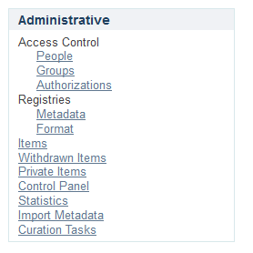
Adding Items to Metadata Registry
The metadata registry maintains a list of all metadata fields available in the repository.
These fields may be divided amongst multiple schemas. However, DSpace requires the qualified Dublin Core schema.
You may extend the Dublin Core schema with additional fields or add new schemas to the registry.
Notes:
Local Fields
You may encounter situations in which you will require an appropriate place to store information that does not immediately fit with the description of a field in the default registry. The recommended practice in this situation is to create new fields in a separate schema. You can choose your own name and prefix for this schema such as local. or myuni.
It is generally discouraged to use any of the fields from the default schema as a place to store information that doesn't correspond with the fields description. This is especially true if you are ever considering the option to open up your repository metadata for external harvesting.
From: https://wiki.duraspace.org/display/DSDOC4x/Metadata+Recommendations

Slide 50
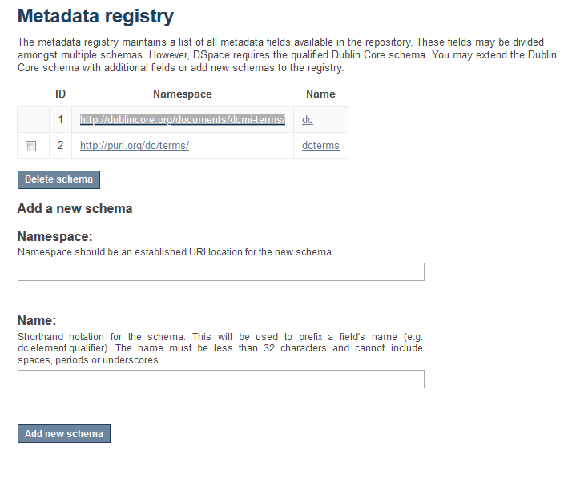
New metadata schema
Add the web address of the new schema
Add a prefix to be used for each term.
Notes:
A common addition is the addition of some thesis elements from the NDTLD’s ETD-MS schema.
https://sites.google.com/a/ndltd.org/ndltd/standards/metadata#thesis.degree
E.g. Prefix = thesis

Slide 51
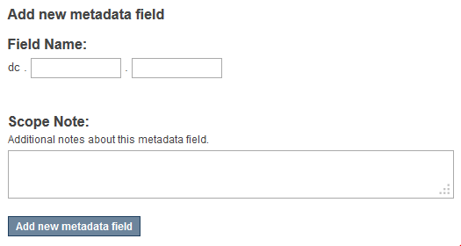
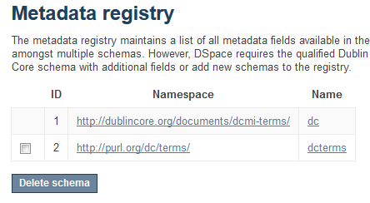
Add fields to an existing schema
Click on the namespace link.
Add new field.

Slide 52
Good to Know

Slide 53
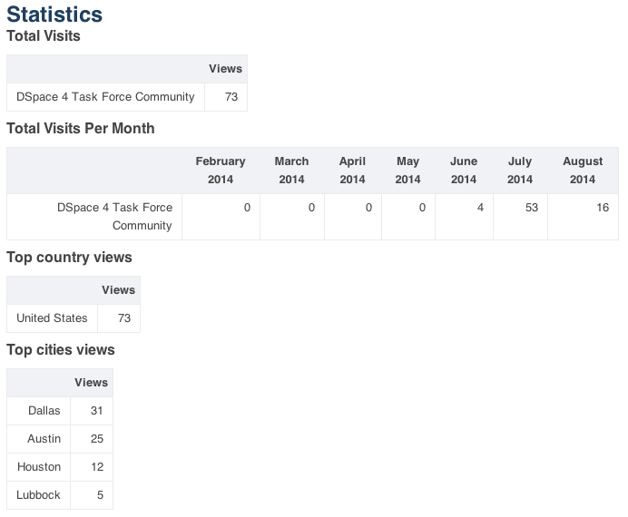
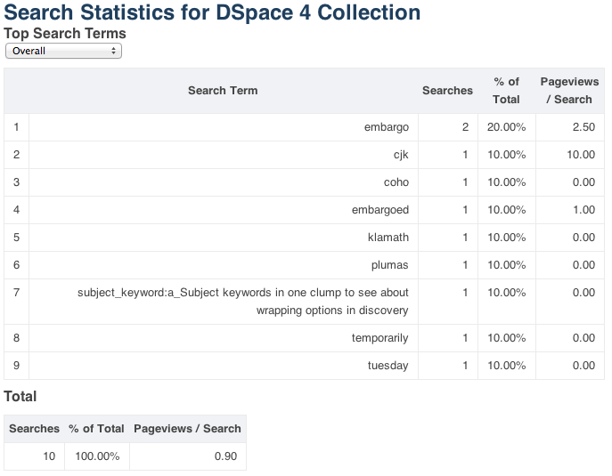
Statistics
Usage statistics can be retrieved from individual item, collection and community pages. These Usage Statistics pages show:
Total page visits (all time)
Total Visits per Month
File Downloads (all time)*
Top Country Views (all time)
Top City Views (all time)

Slide 54
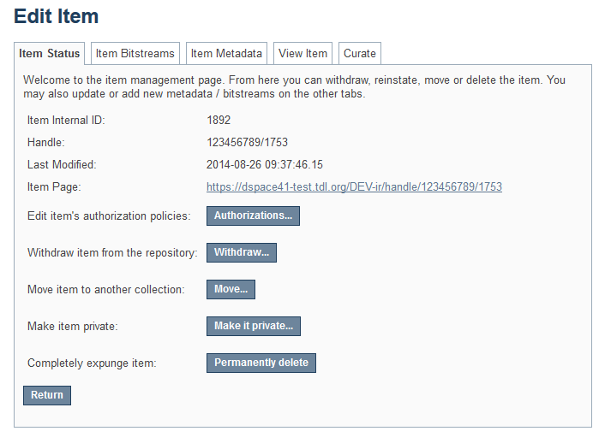
Withdrawing and Deleting Items
Withdraw an item = item is hidden from view, leaves a “tombstone,” can be reinstated
Expunge an item = item is completely erased from the archive, cannot be retrieved.
Notes:
Items can be removed from DSpace in one of two ways: They may be 'withdrawn', which means they remain in the archive but are completely hidden from view. In this case, if an end-user attempts to access the withdrawn item, they are presented with a 'tombstone,' that indicates the item has been removed. For whatever reason, an item may also be 'expunged' if necessary, in which case all traces of it are removed from the archive.
Collection admins (or community/repository admins) can withdraw and/or expunge items.

Slide 55
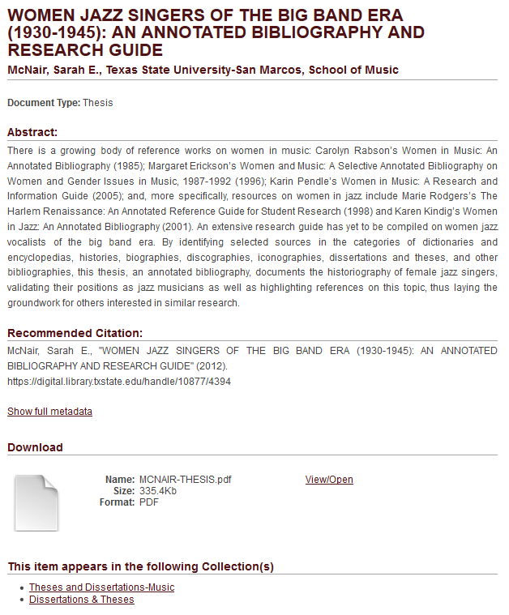
Mapping items
One item may be displayed in multiple Collections simultaneously.
“Owned” by the original Collection to which it was submitted. “Mapped” to additional Collections. (Think of a desktop “shortcut” to an application or file on your computer.)
The “mapped” item inherits all the permissions, licenses, etc. of the original item.

Slide 56
How To:
Navigate to the Collection where you want the work to appear (i.e. the “mapped” collection).
Click Item Mapper under CONTEXT in the right-hand navigation bar
In the search box, enter the title of the item you want to map into the new collection
Click Search works
Click the check box next to the work you want to map
Click the Map selected items button at the top of the page
Use the Item Mapper

Slide 57

Batch Metadata Editing
Might be useful for:
Batch editing of metadata (e.g. perform an external spell check)
Batch additions of metadata (e.g. add an abstract to a set of items, add controlled vocabulary such as LCSH)
Batch find and replace of metadata values (e.g. correct misspelled surname across several records)
Mass move items between collections
Mass deletion, withdrawal, or re-instatement of items
Enable the batch addition of new items (without bitstreams) via a CSV file
Re-order the values in a list (e.g. authors)
3 Steps:
Export CSV file
Edit values in CSV file
Re-import CSV file
Good documentation: https://wiki.duraspace.org/display/DSDOC4x/Batch+Metadata+Editing

Slide 58
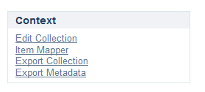
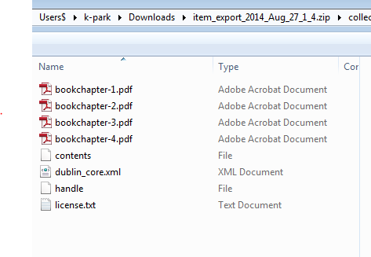
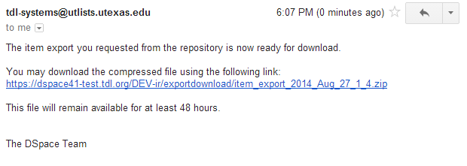
Exporting Collections
1) Export Collection (or Community)
Export Collection or Community via UI
2) Receive email, click on link to access exported files.
3) Download zip file containing all items.
Notes:
May not work for very large collections and require system administrator support.

Slide 59
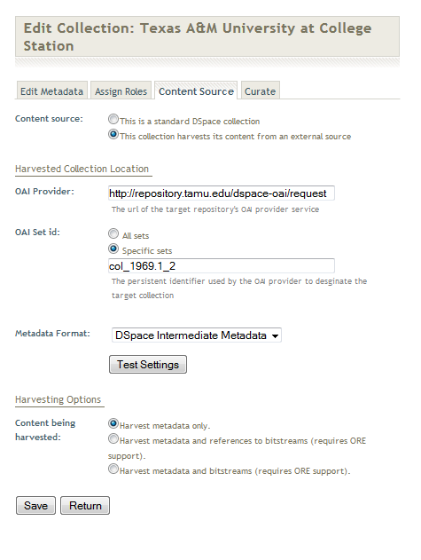
Harvesting
DSpace exposes metadata for collection by harvesters using the OAI-PMH protocol.
DSpace can also harvest metadata and/or objects from other OAI-compliant repositories.
Harvesting of another collection is configured under “Content Source.”
Documentation: https://wiki.duraspace.org/display/DSDOC4x/OAI

Slide 60
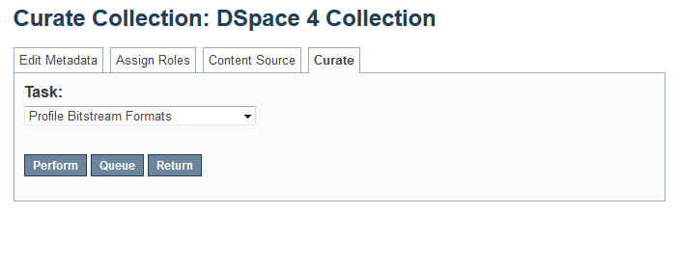
Curation Tasks
DSpace provides a framework, which it calls a “Curation System” for building programs that do routine repository management tasks.
Several out-of-the-box “curation tasks.”
- Profile bitstream formats
- Check for required metadata
Where to find Curation Tasks:
Edit Collection (or Edit Community) => Curate

Slide 61
Resources
TDL Helpdesk: support@tdl.og
http://www.Tdl.org/support/
1-855-495-4317
DSpace Documentation: https://wiki.duraspace.org/display/DSDOC4x/DSpace+4.x+Documentation
TDL DSpace Users Group: https://utlists.utexas.edu/sympa/info/tdl_dspace_users_group (Click “subscribe”)

Slide 62
Contact info
Kristi Park
512.495.4417
kristi.park@austin.utexas.edu
Laura McElfresh
409.741.7179
mcelfrel@tamug.edu

