Slide 1
Configurable Submission System For DSpace
Open Repositories
January 23, 2007
Tim Donohue
IDEALS Research Programmer
University of Illinois

Slide 2
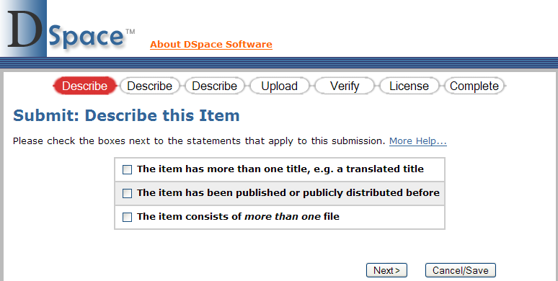
How it all began
DSpace submission process (v. 1.4.1)
  Limited configuration of steps in submission
Configurable in input-forms.xml

Slide 3
Submission Concerns
Do we even want those “initial questions”?
Users dislike License as final step

Slide 4
Submission Goals
What do we want to be able to do?
  Reorder existing steps
  Remove existing steps
  Create new, custom steps
  Create non-interactive steps (processing only)
  Different submission processes for different collections

Slide 5
Programming Goals
Separate the flow from the processing code!
  Remove any “hard coding” of flow
DSpace
DSpace + CS
Step
Step
Step
JSP
Step
JSP
Step
JSP
Step
JSP
Step
Processing
Class
…
Next step…
Submit
SubmitServlet
Submit
SubmitController
config
Processing + Flow
(hard coded!)
Flow only!

Slide 6
Dissecting Submission
Split process into conceptual “steps”
  Each step should be as standalone as possible
Some steps may have multiple “pages”
  e.g. Describe (Metadata) step above
    # pages configurable in existing input-forms.xml
Initial Ques.
Describe (Metadata)
Upload
Verify
License

Slide 7
Dissecting Submission
Oddities & complexities begin to emerge
  (1) “Select a collection” as a step?
  (2) “Initial Questions” step just gathers info to configure both “Describe” and “Upload”
  (3) “Verify” step depends on all preceding steps
Initial Ques.
Describe (Metadata)
Upload
Verify
License

Slide 8
Dissecting Submission
Decisions, decisions, decisions
  (1) “Select a collection” is an implied step, which cannot be removed or reordered
  (2) To serve its purpose, “Initial Questions” should always proceed “Describe” and “Upload” steps
  (3) Every step will have to report to the “Verify” step (so its interface can be built dynamically)
Initial Ques.
Describe (Metadata)
Upload
Verify
License

Slide 9
How to configure?
XML config file (e.g. input-forms.xml) versus Database driven
XML route
  Quicker/easier to modify without need for an entire Administrative UI
  Consistent with current input form configuration (input-forms.xml)
  However, DSpace admin must be comfortable with XML to do basic reconfigurations

Slide 10
item-submission.xml
<item-submission>
<submission-map>
<name-map collection-handle="default" submission-name=“traditional" />
</submission-map>
<submission-definitions>
<submission-process name="traditional">
…
<step>
        <heading>jsp.submit.progressbar.describe</heading>
        <processing-class>
        org.dspace.submit.step.DescribeStep</processing-class>
        <review-jsp>/submit/review-metadata.jsp</review-jsp>
        <workflow-editable>true</workflow-editable>
</step>
…
</submission-process>
</submission-definitions>
</item-submission>

Slide 11
<step> ordering matters
<submission-process name=“custom”>
<!-- 1) License Step -->
<step>
  <heading>jsp.submit.progressbar.license</heading>
  <processing-class>org.dspace.submit.step.LicenseStep</processing-class>
  <workflow-editable>false</workflow-editable>
</step>
<!-- 2) Describe Step -->
<step>
  <heading>jsp.submit.progressbar.describe</heading>
  <processing-class>org.dspace.submit.step.DescribeStep</processing-class>
  <review-jsp>/submit/review-metadata.jsp</review-jsp>
  <workflow-editable>true</workflow-editable>
</step>
  …

Slide 12
<step> definition
<step>
<heading>jsp.submit.progressbar.describe</heading>
<processing-class> org.dspace.submit.step.DescribeStep</processing-class>
<review-jsp>/submit/review-metadata.jsp</review-jsp>
<workflow-editable>true</workflow-editable>
</step>
  heading : text in messages.properties (I18N)
  processing-class : Java processing class (required)
  review-jsp : JSP which displays inputs to “verify”
  workflow-editable : can workflow approval steps edit inputs?

Slide 13
<step> definition (Manakin)
<step>
<heading>jsp.submit.progressbar.describe</heading>
<processing-class>
org.dspace.submit.step.DescribeStep</processing-class>
<xml-ui-class>
org.dspace.app.xmlui.submit.step.DescribeStep</xml-ui-class>
<workflow-editable>true</workflow-editable>
</step>
  review-jsp → obsolete
  xml-ui-class : Manakin XML Transformer class
  Still a work in progress

Slide 14
Custom Step – Overview
(1) Custom processing step class
  extends abstract SubmissionStep class
    Just two required methods: doProcessing(), getNumberOfPages()
(2) <step> definition in item-submission.xml
Step
Step
UI
Step
Processing
Class
Next step…
Submit
SubmitController
…
<step>
…
item-submission.xml

Slide 15
Custom Step – Overview
(3-a) If step uses JSP UI
  Custom JSP to build form for user input
  Custom “review” JSP (if step can be reviewed)
Step
Review
JSP
“Verify” step
Step
JSP
Step
Processing
Class
Next step…
Submit
SubmitController
…
<review-jsp>
…
item-submission.xml

Slide 16

Custom Step – Overview
(3-b) If step uses Manakin UI
  Custom Transformer class
    extends abstract StepTransformer class
      corresponding <xml-ui-class> entry within <step>
Step
XML
UI
Class
Step
Processing
Class
XML
Next step…
Submit
SubmitController
…
<xml-ui-class>
…
item-submission.xml

Slide 17


Configurable Submission in IDEALS
Processing Step
Processing Step (future?)

Slide 18
Configurable Submission in IDEALS
  Post-License processing
    Fill out IDEALS defaults for “initial questions”
  Post-Upload processing (future)
    Auto-extract / populate some basic metadata?
    Potentially “customize” input forms based on file uploaded?
Processing Step
Processing Step (future?)

Slide 19
Demo
http://ideals.uiuc.edu
or
Screenshots

Slide 20

For More Information
Configurable Submission System
http://wiki.dspace.org/ConfigurableSubmissionSystem
Tim Donohue
IDEALS Research Programmer
tdonohue@uiuc.edu
http://ideals.uiuc.edu/
© 2007, Tim Donohue
This work is licensed under Creative Commons Attribution-NonCommercial-ShareAlike 2.5 License.
To view a copy of this license, visit http://creativecommons.org/licenses/by-nc-sa/2.5/

Slide 21
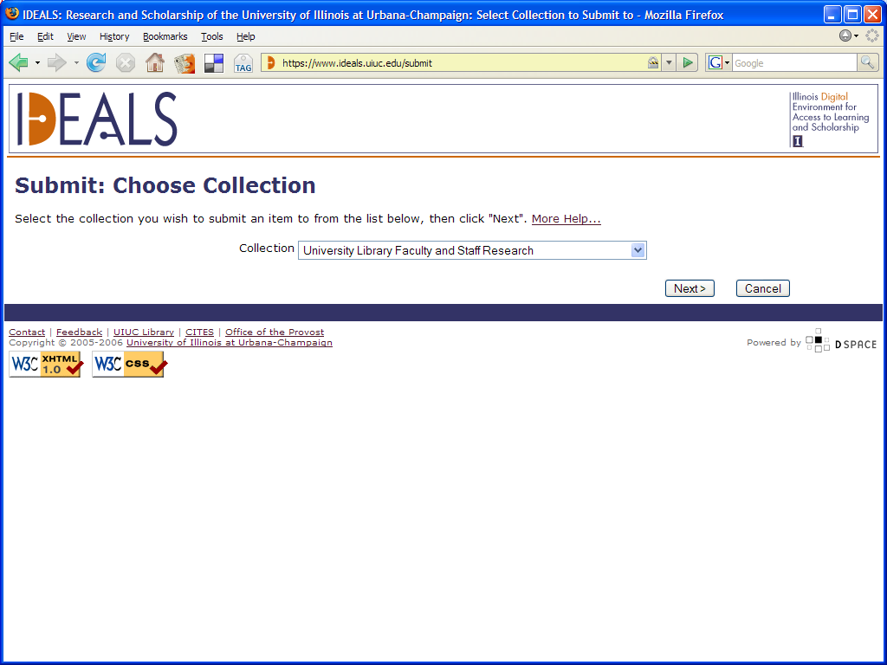
Select a Collection
Back

Slide 22
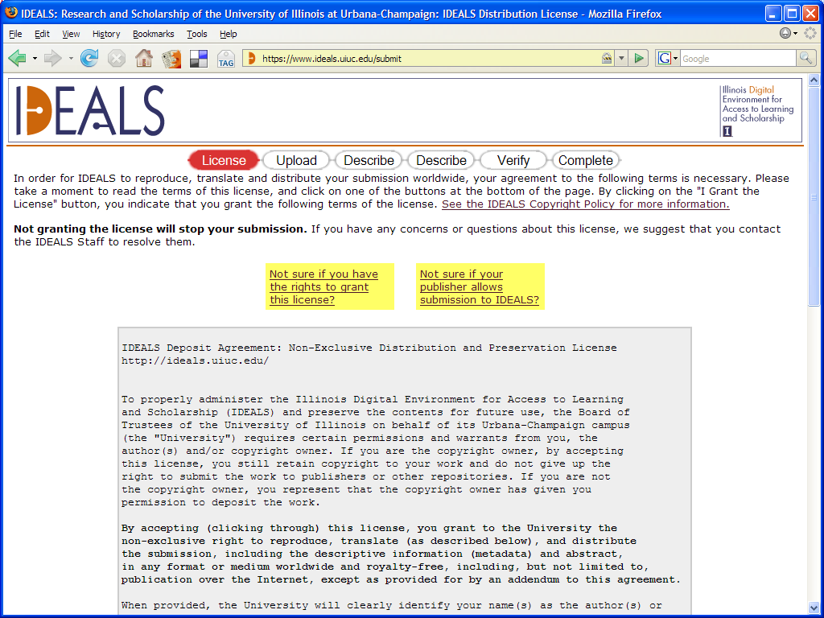
License
Back

Slide 23
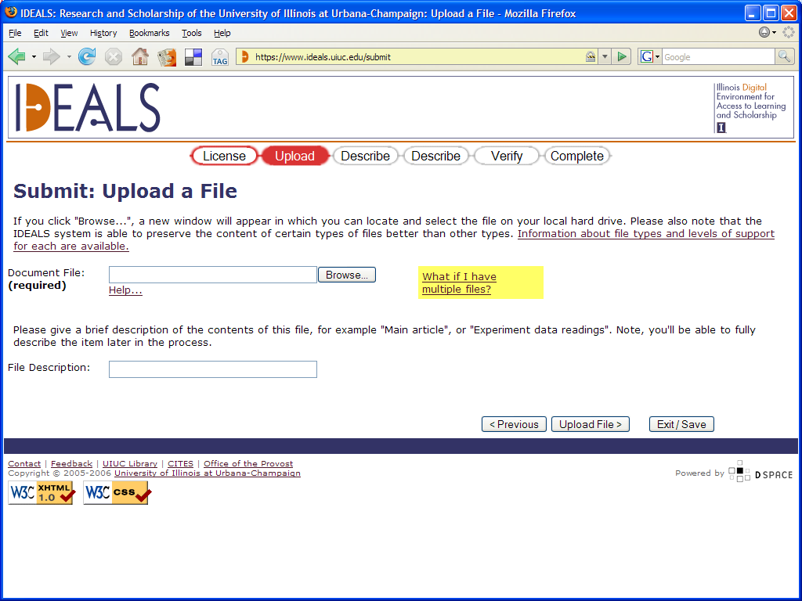
Upload
Back

Slide 24
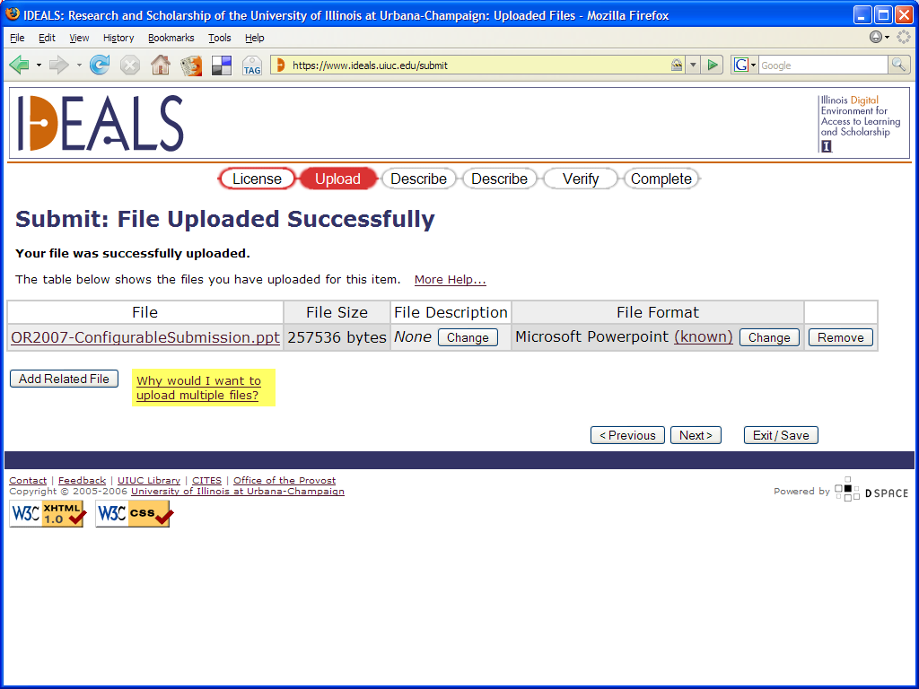
Upload (Confirmation)
Back

Slide 25
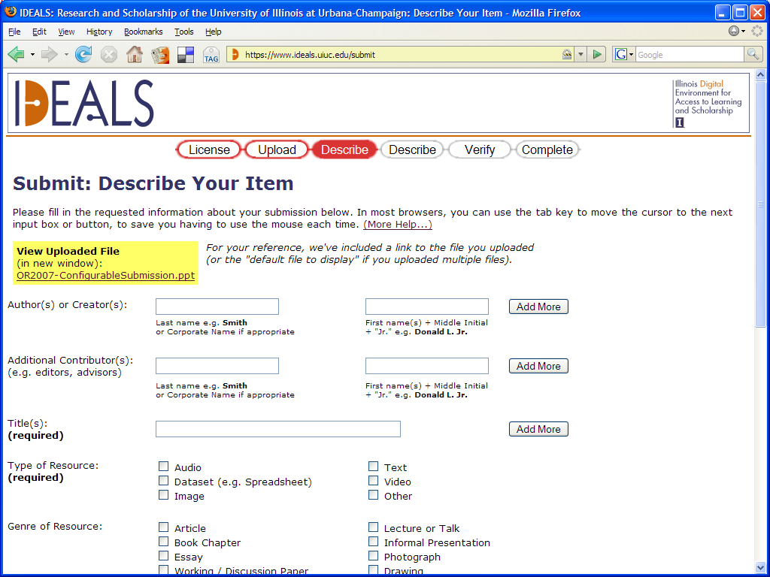
Describe (#1)
Back

Slide 26
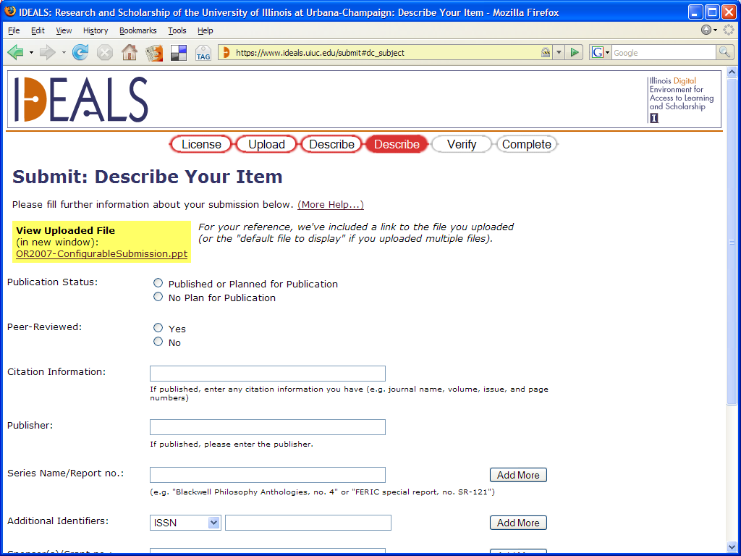
Describe (#2)
Back

Slide 27
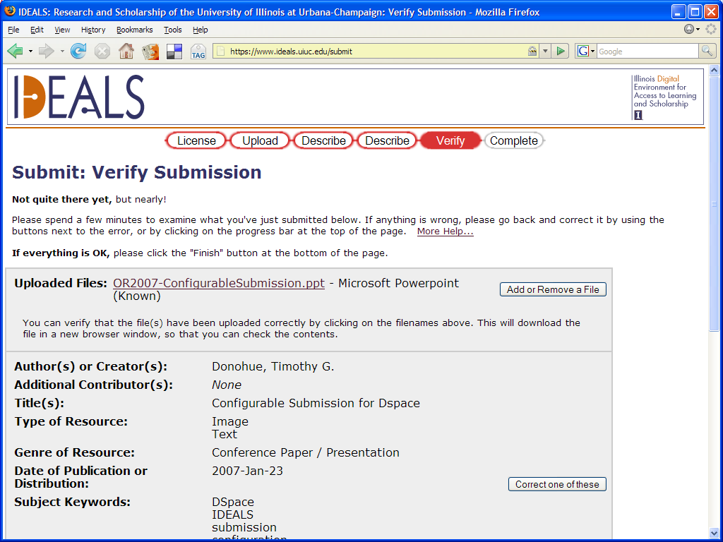
Verify
Back

