Slide 1


Ministerul Educației, Culturii și Cercetării al Republicii Moldovei
Text Autocomplete Engine
Android Application using Trie Data Structure
Created by: Sajin Vladimir
Stratan Constantin
Verificator: Metreniuc Alexandru

Slide 2
Project Idea:
Text Autocomplete Engine is an Android application developed in Kotlin that provides real-time text suggestions based on typed prefixes.
The application uses the Trie Data Structure to perform fast searches and efficient autocomplete operations.
The project demonstrates:
autocomplete systems
prefix searching
text processing
data structure implementation in Android

Slide 3
Motivation:
The project was created to:
improve programming skills in Kotlin
understand how autocomplete systems work
learn the Trie data structure
create a useful and interactive Android application
Autocomplete systems are used in:
search engines
keyboards
messaging apps
browsers
AI assistants

Slide 4






Technologies Used:
Kotlin
Android Studio
XML Layouts
RecyclerView
Trie Data Structure
Material Design Components
GitHub

Slide 5
What is Trie?
A Trie is a special tree-like data structure used for:
fast word searching
prefix matching
autocomplete systems
Advantages:
very fast search operations
efficient prefix detection
optimized for dictionaries and text suggestions
Example:
typing “ho”
results:
home screen
host name
html parser

Slide 6
Main Features:
Real-time autocomplete suggestions
Prefix-based searching
Frequency-based sorting
Add new words or phrases
Delete dictionary entries
Exact word search
Save dictionary to file
Load dictionary from file
Clean and modern UI

Slide 7

Application Overview:
The application contains several sections:
Project Statistics
Displays:
total entries
total popularity
top keyword
Autocomplete Demo
Shows live suggestions while typing.
Dictionary Operations
Allows adding, searching, and deleting entries.
Current Dictionary
Displays all stored phrases and words.

Slide 8
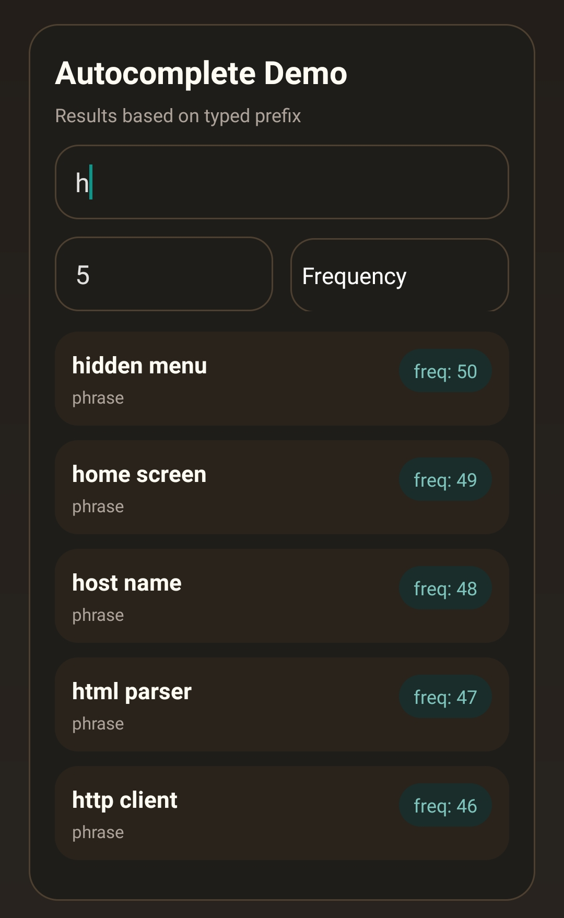
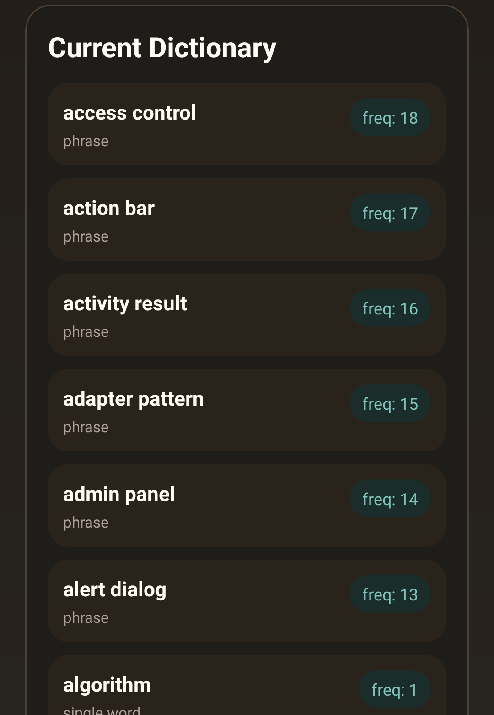
Autocomplete Demo:
When the user types a prefix:
the application searches the Trie
matching words are found instantly
results are sorted by popularity frequency Example: Typing:
‘h’
Suggestions:
hidden menu
home screen
host name
html parser
http client

Slide 9
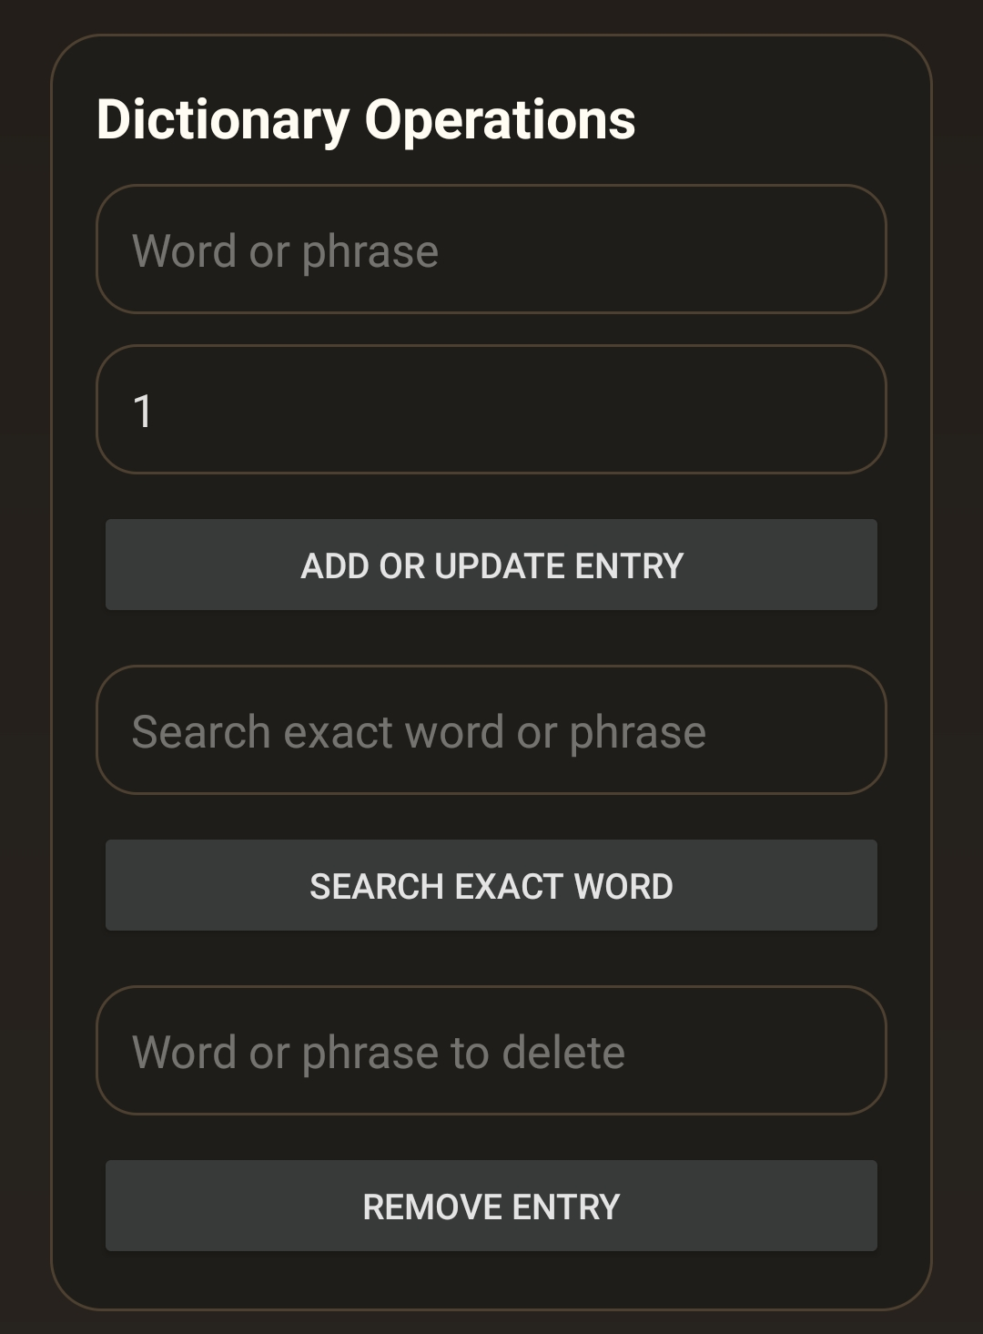
Dictionary Operations:
The application allows users to:
Add or Update Entry
Insert new words and phrases with frequency values.
Search Exact Word
Find exact matches inside the dictionary.
Remove Entry
Delete words or phrases from the Trie structure.

Slide 10
File Operations:
File Operations
The application supports:
loading data from files
saving dictionary data to files
Benefits:
persistent storage
reusable dictionaries
easier testing and management

Slide 11
Challenges:
Challenges Faced
During development:
implementing Trie correctly
optimizing search speed
updating suggestions in real time
managing RecyclerView efficiently
handling large dictionaries

Slide 12
Conclusion:
Text Autocomplete Engine demonstrates:
efficient text searching
real-time autocomplete
practical use of Trie data structure
Android development with Kotlin
The project combines:
algorithms
UI design
mobile development
data structures

Slide 13
Future Improvements:
Possible future upgrades:
AI-based suggestions
typo correction system
voice input support
cloud synchronization
multilingual dictionaries
user learning behavior

Slide 14

Thank You!

