Slide 1
Flowdesk
2017.04.15

Slide 2
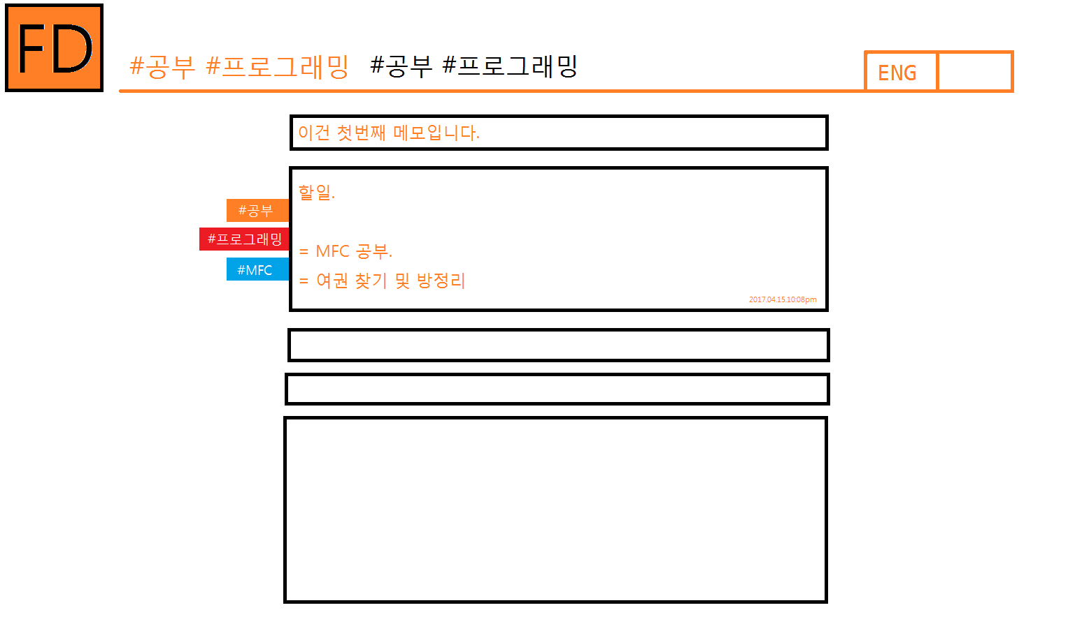
Ver 1.0.0

