Slide 1
ForgeAI Cost Analysis
Money is good. And the more , the better.
Hendrith Vanlon Smith Jr

Slide 2
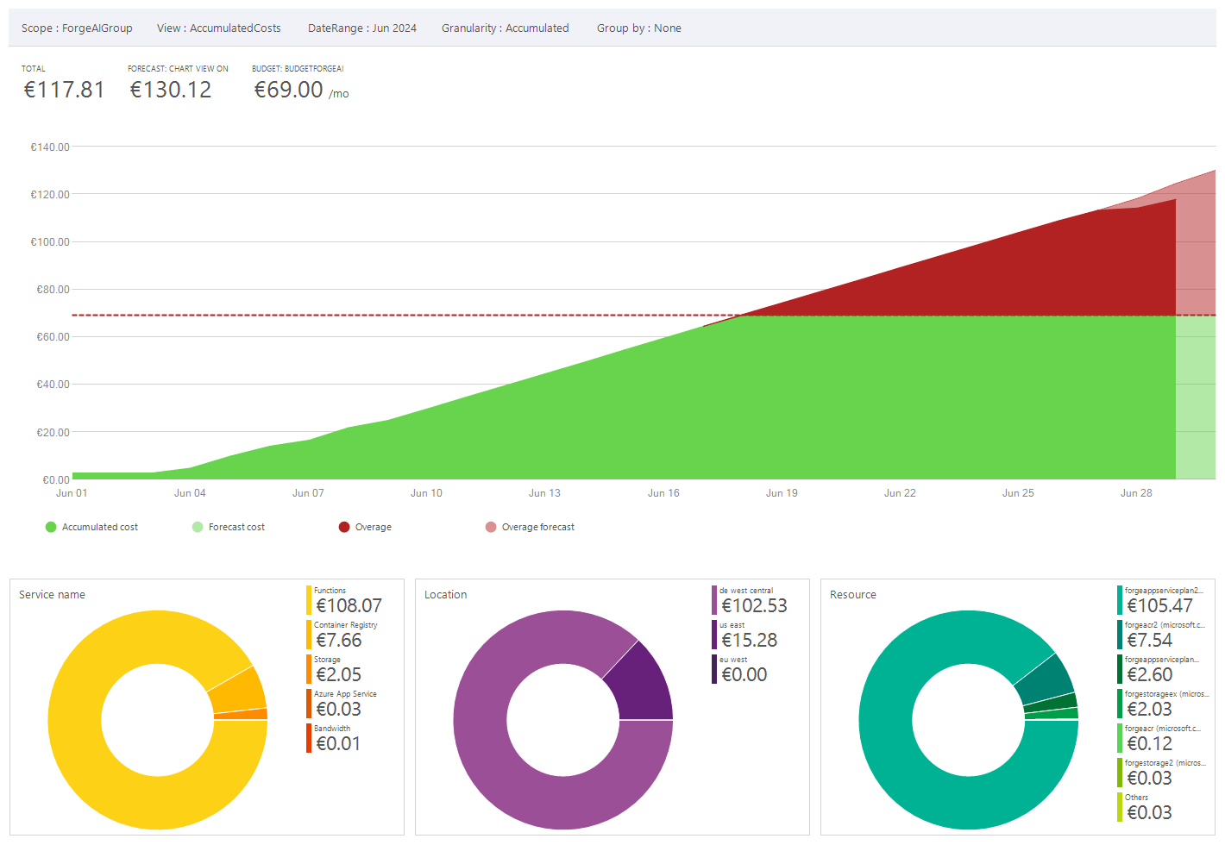
Cost Analysis Overview

Slide 3
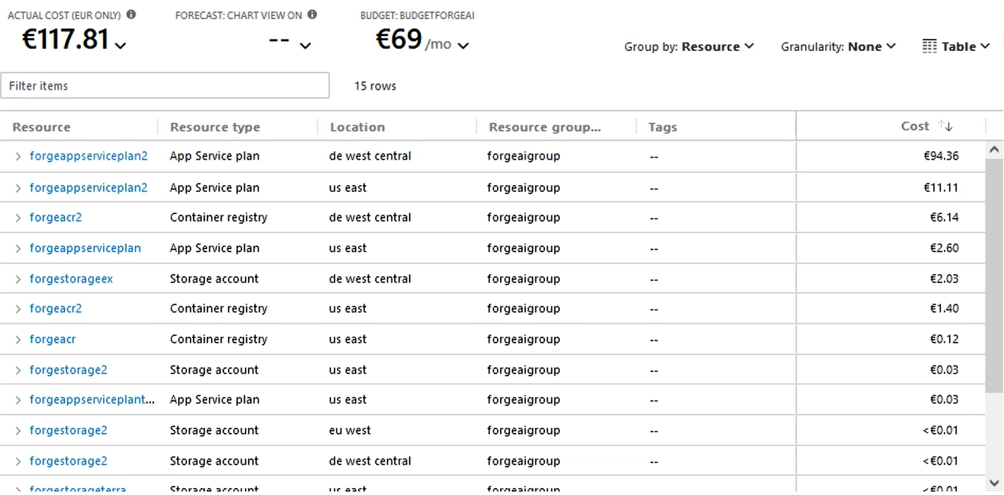
Cost Analysis By Resource

Slide 4
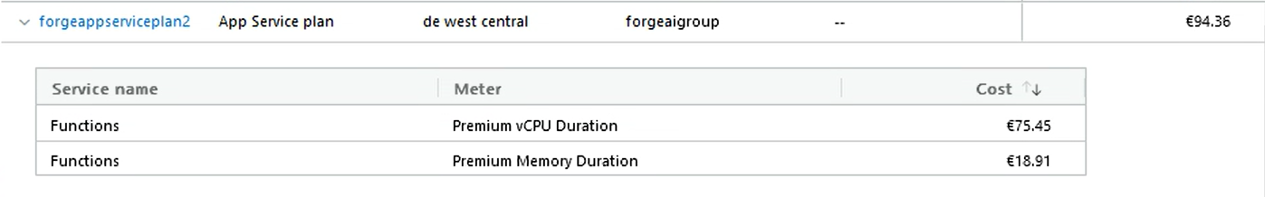
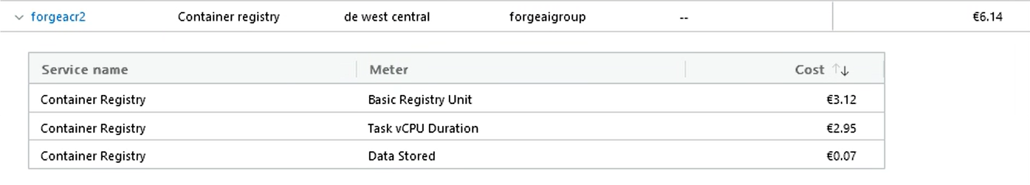
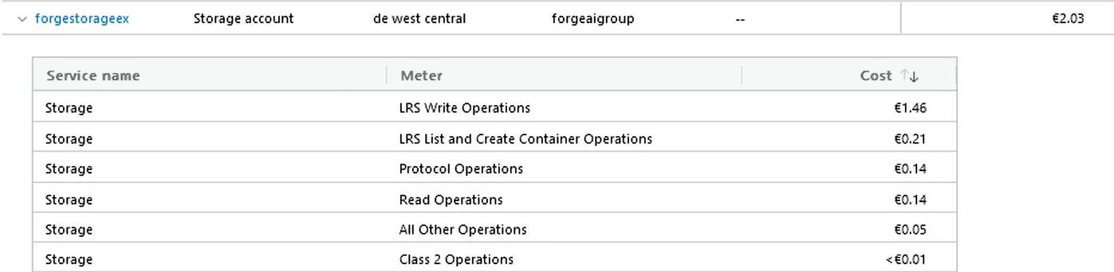
Cost Analysis By Resource

