Slide 1


Forge AI
2nd July – Final Presentation

Slide 2







Agenda
Team and Roles
Motivation
Implementation
Live Demo
Conclusion
Future Prospects

Slide 3


Team and Roles
Gabriel Witte
Ulriche Tankeu
Josue Martinez
Frontend + API developer
Azure Storage developer
Video Captioning developer
Shaheryaar Zia
Victor Owolabi
Frontend developer
API + CI/CD developer

Slide 4



Motivation – Problem Introduction
AI platforms typically offer only a single product type, focusing on either text, image, audio, or video.
This process is inefficient and bothersome, requiring multiple accounts and subscriptions across various platforms.
That goes without saying the need to learn a whole new User Interface or how to use their API!

Slide 5



Introducing Forge AI
All-in-one AI platform that allows users to do the basics of each area: Text, Audio, Image, and Video.
Users can access it via a Web Interface or calling services via Rest API.
Users can upload files, get results, and retrieve their past queries (persistence).

Slide 6




Motivation – MVP Requirements
Users can upload audio files and receive a transcription of the contents.
Users can ask questions and receive answers (text generation).
Users can upload movies/videos and receive a summary (video captioning).
Users can upload images and receive an explanation of the content (image captioning).
Users interact through a web application or HTTP requests, offering all services.
Users are able to retrieve their past queries and responses from Forge AI.

Slide 7
Motivation – Use Cases
Audio
Text Generation
Subtitle/Script Generation for e.g Netflix.
Automatic email replies (Virtual Assistant).
Movie
Image
Movie / Video Summarizer.
Automatic data generation + Accessibility for blind people.

Slide 8



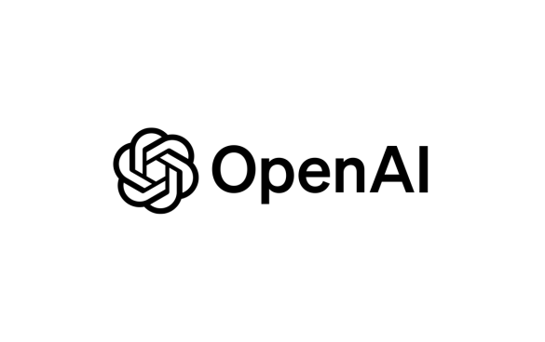

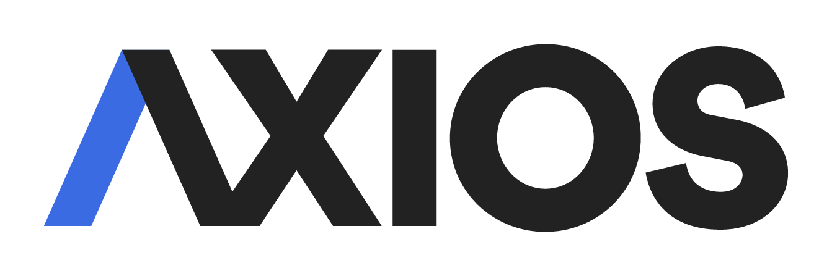
Implementation – Technologies used
Azure Video Indexer
Azure Storage Account
Azure Function App
OpenAI + g4f
React
Axios Requests

Slide 9

Implementation – The Architecture.
We use the web-worker and serverless architecture.
This allows the asynchronous handling of requests, allowing the main
application to remain responsive while processing things in the background.
It also separates the core logic from the frontend, making the system easier
to maintain and update.
This also enhances security, as users do not have direct access to the
backend or its data.

Slide 10
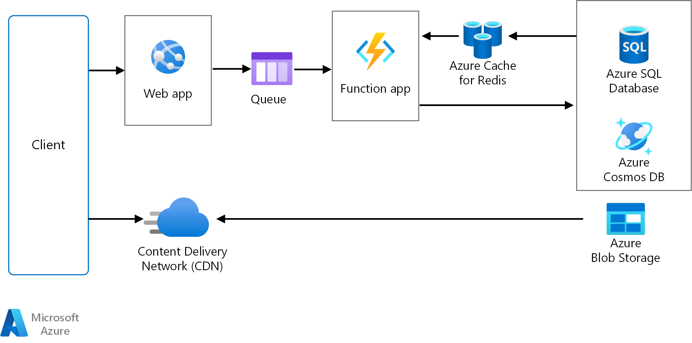
Implementation – Web-Worker Architecture

Slide 11
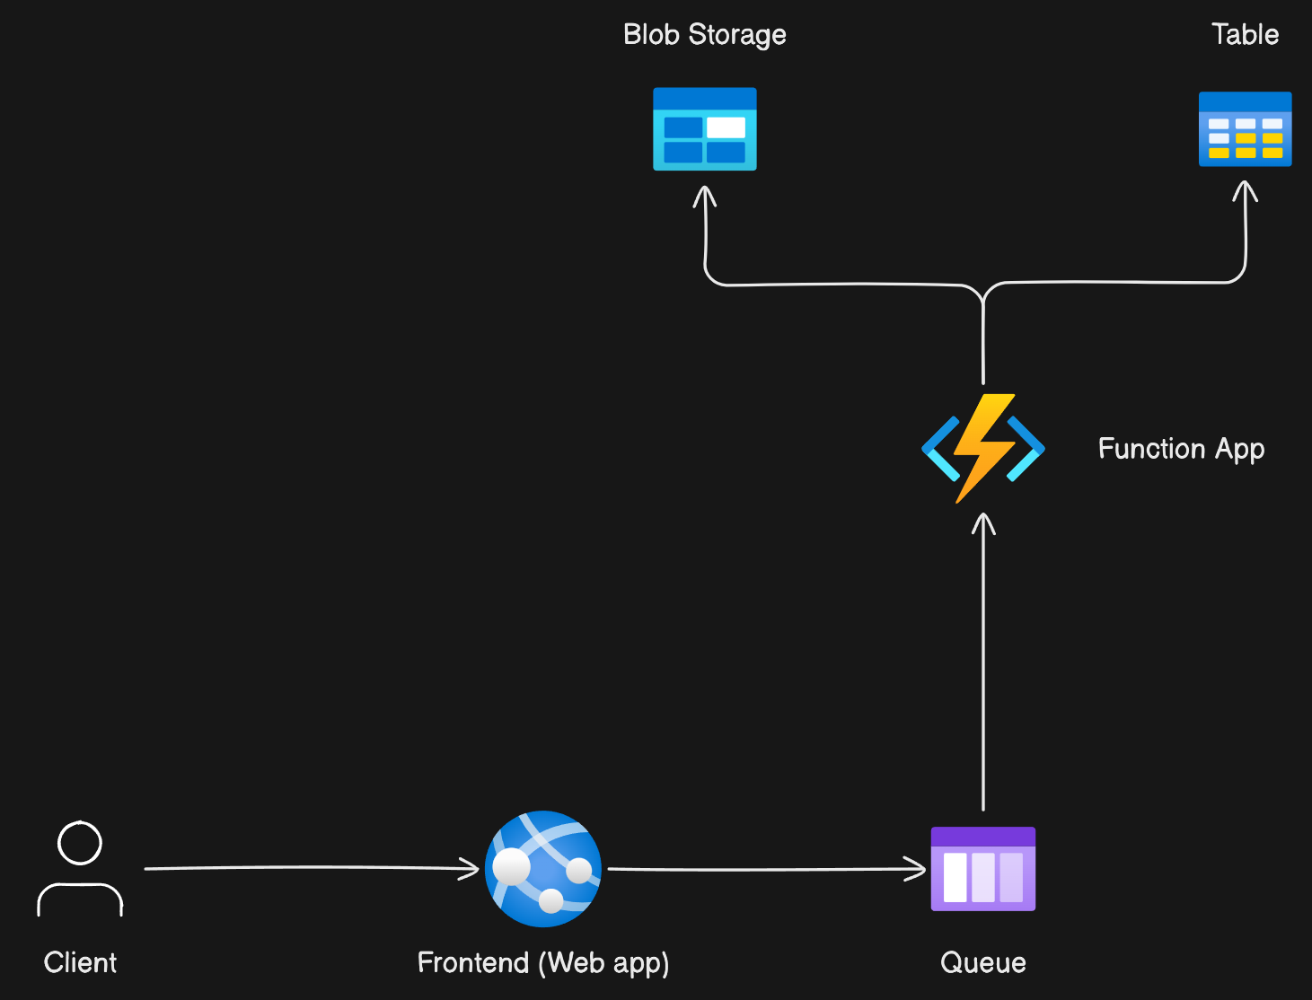
Implementation – Web-Worker Architecture

Slide 12

Live Demo
Let’s try it out!

Slide 13
Conclusion – Summary
Forge AI was implemented successfully, satisfying all MVP requirements.
We have devised our own framework for Video Captioning, using a mix of Azure Video Indexer with Image Captioning and Text Captioning.

Slide 14

Conclusion - Strengths
We have used the web-worker architecture, making our application easily extensible.
The blob storage can be used further to train ML models + Data Analysis.
The framework can easily be embedded into other applications.
Our API is easily scalable and can implement new tasks.

Slide 15




Conclusion - Weaknesses
We did not implement any fail-safe methods (ping, redundancy).
There is no user account (previous queries accessible for everyone).
Security was not taken into account.
Fetching of queries is not sequential, but all-at-one (very slow with large data).

Slide 16



Future Prospects
Implement problems mentioned in the weaknesses.
Implement an automated task recognizer instead of having users select which task to use.
Implement new AI subsets (Music, Video generation, etc).
Embed ForgeAI with NoteToMyself!

Slide 17

Thank you very much!
(please give us 1.0 UwU)

