Slide 1

Voxellancer
I believe, I can fly!
By Patrick Siegler, Sebastian Gerstenberg, Christian Dullweber and
Moritz Eyssen
Under humble guidance of Daniel Limberger

Slide 2
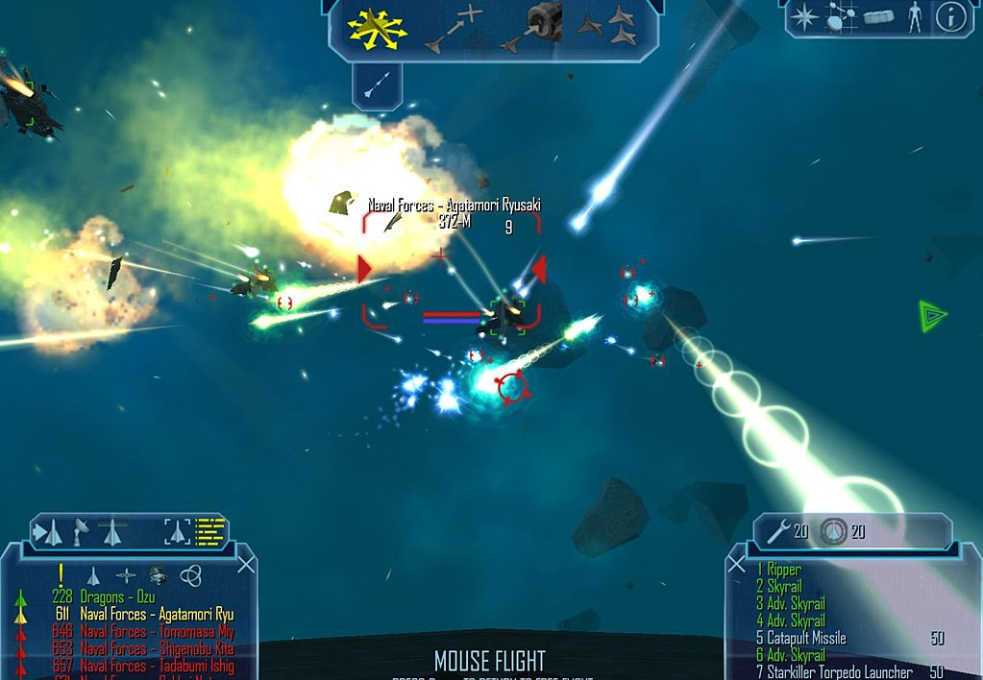
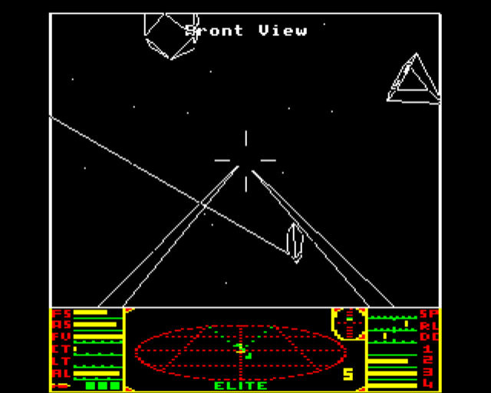
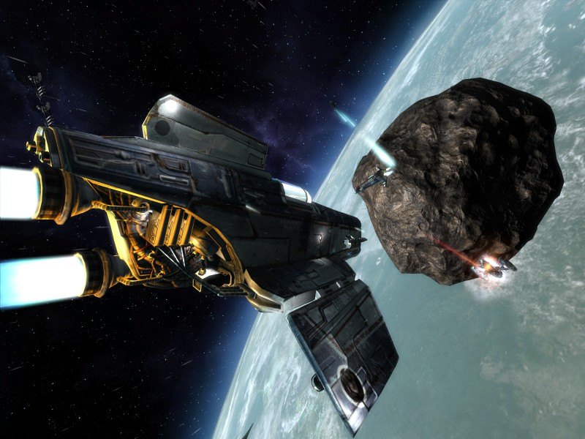
Basic Idea
Space-Shooter... Previously seen in: X, Freespace, Freelancer, Elite, Wing Commander....

Slide 3
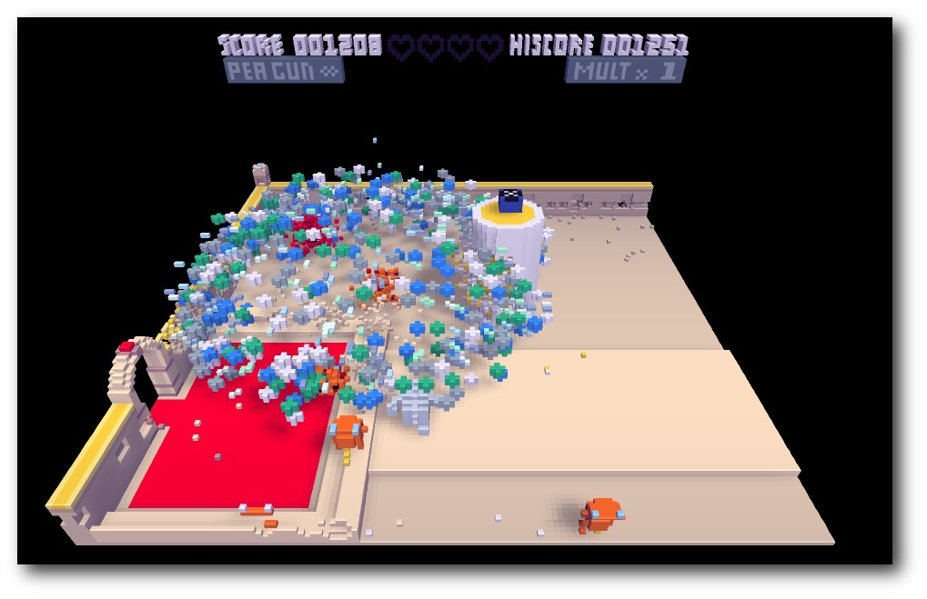
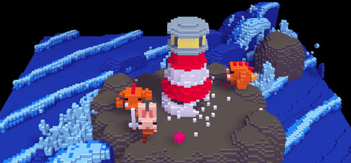
… and Voxelgraphics!
Colorful!
Suited for inferior artist
Explosions are cool!
Simplifies Physics (?)

Slide 4
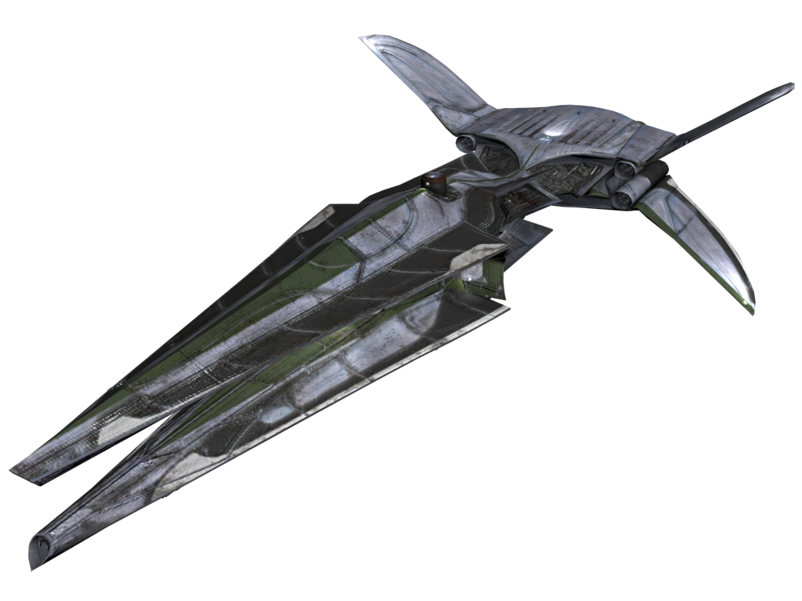


Gameplay Elements
Must have:
Should have:
Could have:
Voxelships destructible
Battles and explosions
Multiple weapons, rockets, special attacks and explosions
Rather action than realism (i.e.: explosions)
Item drops
Somewhat smart AI
Ship-Upgrades
Missions
Oculus Rift
Multiplayer
Open world
Gamepad support
Planets! Everyone
loves them!
OMG: extraordinary,
amazing, astonishing,
remarkable,
unique, genuine potato
Mission Objective: Rescue Potato,
silence Jony!

Slide 5

Misc stuff
Libs:
GLFW
GLOW
GLEW
GLM
Mainboard-beeps if no BS-free soundlib comes along
Hosted at github.com/voxelinc/voxellancer
Milestone 17.12.2013
Rendering, collisions and movement of voxel-objects
Flying a ship that can destroy inanimate objects and simple AI-ships

