Slide 1
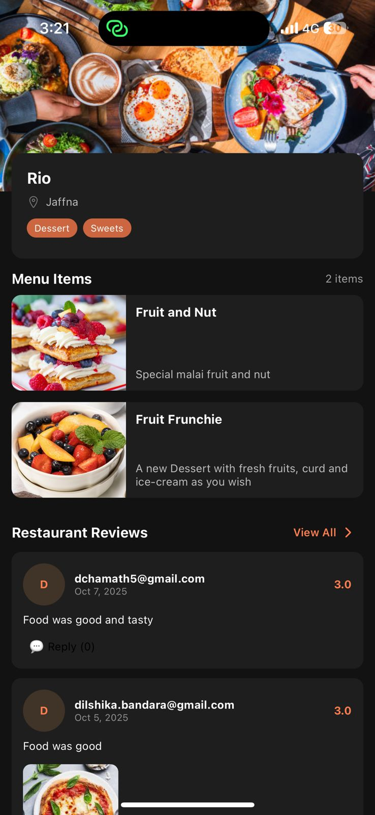
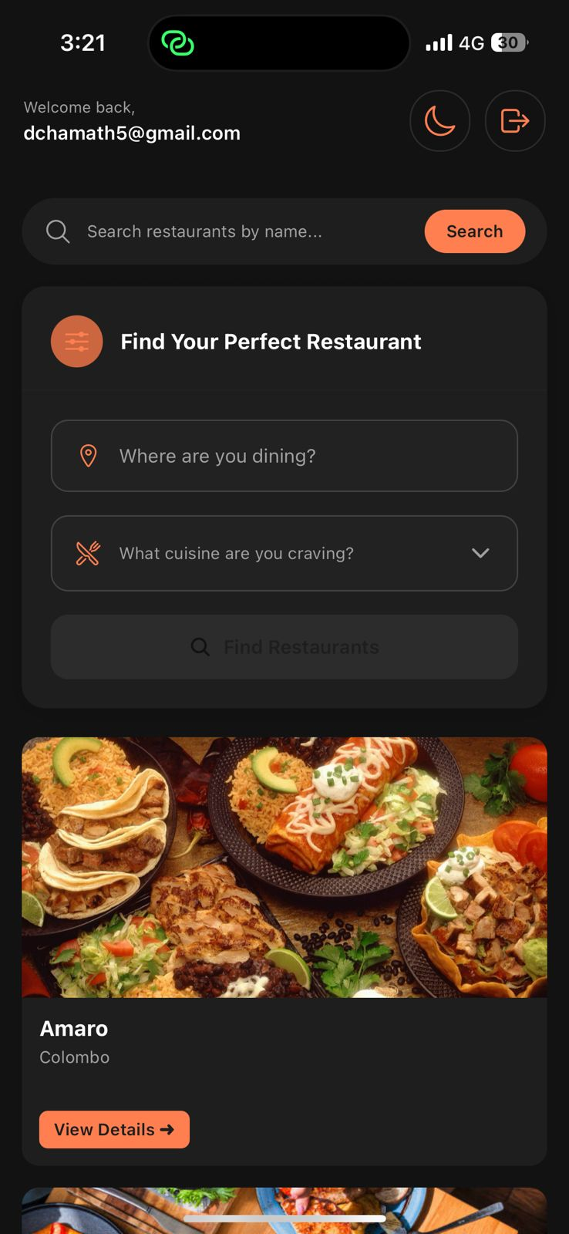
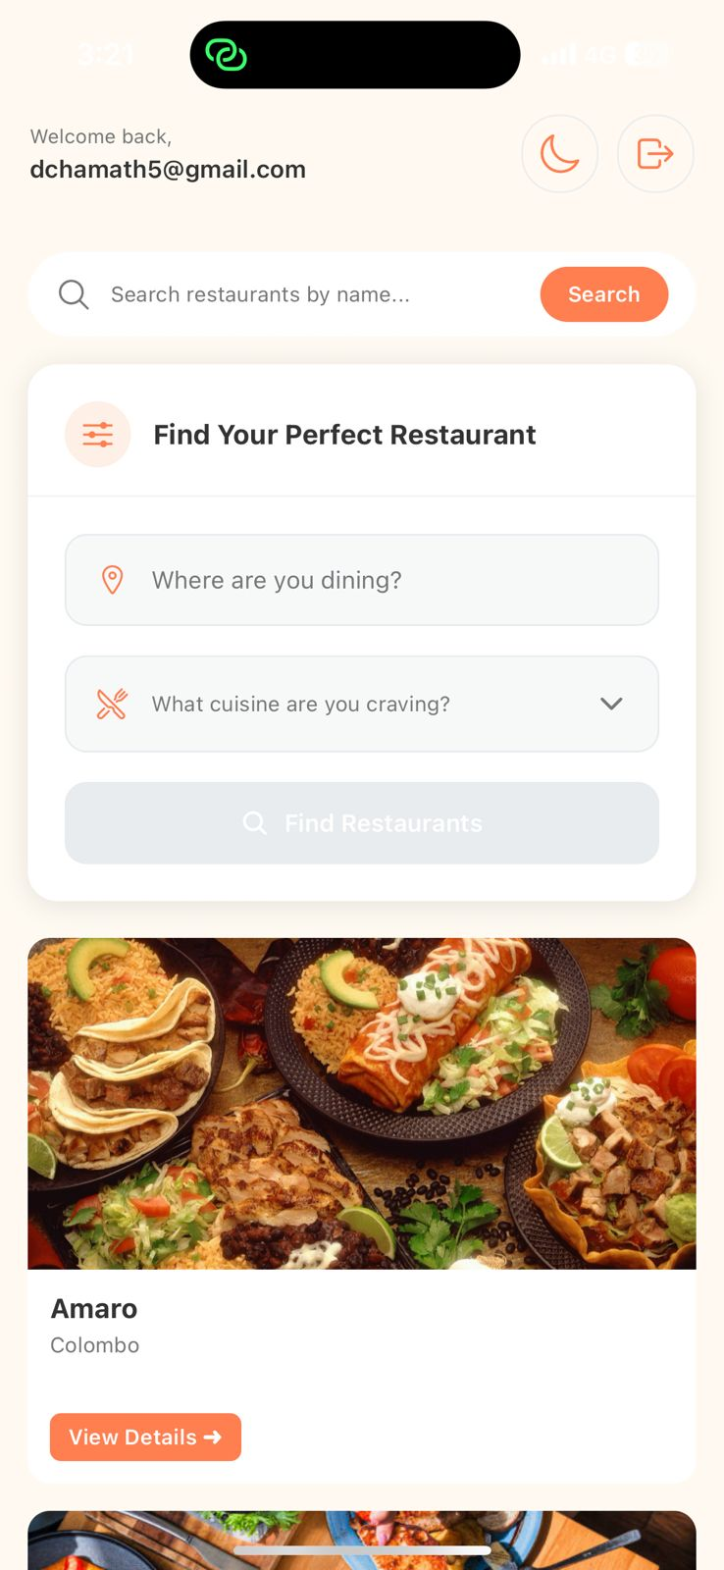
Foddie
FamilyID=Office_ArchiveTorn
Mobile Enabled Restaurant Review Platform

Slide 2

Team :
Krishantha Dinesh
Denuwan Bandara
Dilshika Bandara

Slide 3

Technologies:
React-Native, AWS, Node.js (TypeScript), PostgreSQL, S3, CloudFront, Cognito
Date: 25th Oct 2025

Slide 4

Problem Statement
Need for a mobile app based on scalable, cost-efficient restaurant review platform.
Issues with traditional setups:
- High infrastructure cost
- Poor scalability
- Difficulty managing media uploads
- Slow global content delivery

Slide 5

Objectives
Build fully serverless, auto-scaling backend
Enable fast, secure content delivery via CloudFront
Provide review using mobile device features such as camera
Maintain clean modular architecture for extensibility

Slide 6
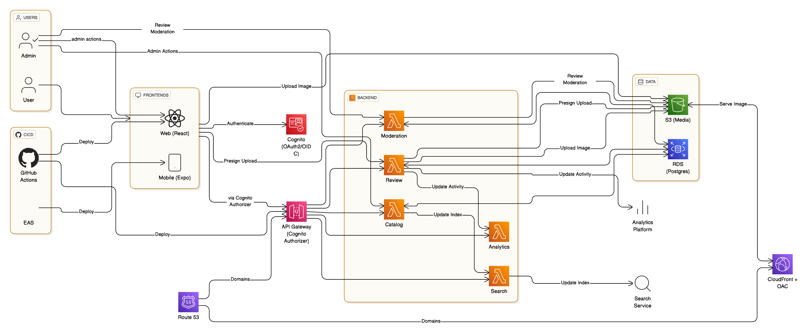

Slide 7

High-Level Architecture Overview
Frontend (Angular) → API Gateway → Lambda Functions → PostgreSQL / S3
Mobile (React Native) → API Gateway → Lambda Functions → PostgreSQL / S3
Region: us-west-2
Cost-optimized using AWS free-tier

Slide 8

Service Architecture
Developed using Serverless Framework v3 (aws-nodejs-typescript)
Common pattern:
src/handlers → Lambda entry points
src/services → Business logic
src/db → PostgreSQL pool
serverless.yml → Function configuration

Slide 9
Core Services
Catalog Service – Manage restaurants (image upload, tags)
Review Service – Reviews & ratings (pagination, validation)
BFF service (to support BFF pattern)
User information store to track activities

Slide 10

Key Architectural Decisions
Serverless-first approach for scalability
PostgreSQL on RDS for relational integrity
S3 + CloudFront + OAC for secure media
Route 53 single domain for unified API/UI
Strict TypeScript for maintainability

Slide 11
Image Upload & Download Flow
1. Client requests signed URL
2. File uploaded to private S3 bucket
3. CloudFront serves via signed/public URL
Benefits: scalability, cost-efficiency, low latency

Slide 12
Deployment Pipeline
GitHub Actions + OIDC role assumption
Deployment via serverless deploy
Environments: Dev / Staging / Prod
Parameter store for secrets

Slide 13
Security & Access Control
S3 restricted via OAC (Origin Access Control)
Fine-grained IAM roles per Lambda
oAuth2 authorization with Cognito
Principle of Least Privilege (POLP)

Slide 14
Challenges & Resolutions
pg_hba.conf error → fixed RDS config
CORS/403 → corrected OAC & bucket policy
Lambda cold start → optimized handlers & imports

Slide 15
Future Enhancements
Analytics & Recommendation Engine
Automate CloudFront invalidation
AI-based content moderation for reviews

Slide 16
Demo Walkthrough

Slide 17
Demo Walkthrough
https://foodie.codelabs.lk/

