Slide 1
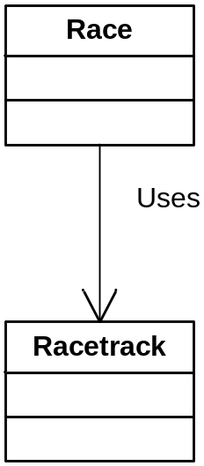
Uses
// Race.h
#include "Racetrack.h"
class Race
{
public:
Race(Racetrack &);
void go();
private:
Racetrack & rt;
// private data members and utility functions to
// conduct the race simulation
};
// Race.cpp
Race::Race(Racetrack & r)
:rt(r)
{}
void Race::go()
{
// some code that calls utility functions
// and uses rt to run the race
};
// main.cpp
#include <cstdlib>
#include "Racetrack.h"
void main()
{
system("pause");
Racetrack rt;
Race r(rt);
r.go();
}

Slide 2
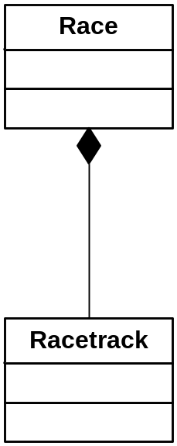
Composition (has-a)
Strict Aggregation
// Race.h
#include "Racetrack.h"
class Race
{
public:
void go();
private:
Racetrack rt;
// other private data members and utility functions to
// conduct the race simulation. these utility functions
// have access to the class-scoped rt object
};

Slide 3
Composition (has-a)
Strict Aggregation
// Race.h
class Race
{
public:
Race();
~Race();
void go();
private:
Racetrack *rt;
// private data members and utility functions to
// conduct the race simulation
};
// Race.cpp
#include "Racetrack.h"
#include "Race.h"
Race::Race()
{
rt = new Racetrack;
}
Race::~Race()
{
if (rt) delete rt;
}
void Race::go()
{
// some code that calls utility functions
// these utility functions have access to the
// class-scoped rt object
};

Slide 4
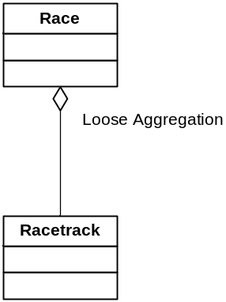
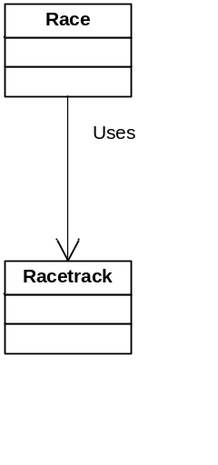
Uses? Or Loose Aggregation?
// Race.h
class Race
{
public:
void go();
private:
// private data members and utility functions to
// conduct the race simulation
};
// Race.cpp
#include "Racetrack.h"
#include "Race.h"
void Race::go()
{
Racetrack rt;
// some code that calls utility functions
// rt object is passed as a parameter to these
// utility functions because it has function scope,
// not class scope.
};

Slide 5
Uses? Or Loose Aggregation?
// Race.h
class Race
{
public:
void go();
private:
Racetrack *rt;
// other private data members and utility functions to
// conduct the race simulation
};
// Race.cpp
#include "Racetrack.h"
#include "Race.h"
void Race::go()
{
rt = new Racetrack;
// some code that calls utility functions
// pointer to rt object is not passed to utility functions
// because it has class scope.
delete rt;
};

