Slide 1
4
Control Statements:
Part 1

Slide 2
OBJECTIVES
In this chapter you’ll learn:
Basic problem-solving techniques.
To develop algorithms through the process of top-down, stepwise refinement.
To use the if and if...else selection statements to choose among alternative actions.
To use the while repetition statement to execute statements in a program repeatedly.
Counter-controlled repetition and sentinel-controlled repetition.
To use the increment, decrement and assignment operators.

Slide 3
4.1 Introduction
4.2 Algorithms
4.3 Pseudocode
4.4 Control Structures
4.5 if Selection Statement
4.6 if...else Double-Selection Statement
4.7 while Repetition Statement
4.8 Formulating Algorithms: Counter-Controlled Repetition
4.9 Formulating Algorithms: Sentinel-Controlled Repetition
4.10 Formulating Algorithms: Nested Control Statements
4.11 Assignment Operators
4.12 Increment and Decrement Operators
4.13 (Optional) Software Engineering Case Study: Identifying Class Attributes in the ATM System
4.14 Wrap-Up

Slide 4
4.1 Introduction
Before writing a program
  Have a thorough understanding of the problem
  Carefully plan your approach for solving it
While writing a program
  Know what “building blocks” are available
  Use good programming principles

Slide 5
4.2 Algorithms
Algorithms
  Specify the actions to execute
  Specify the order in which these actions execute
Program control
  Specifies the order in which actions execute in a program
  Are performed in C++ with control statements

Slide 6
4.3 Pseudocode
Pseudocode
  Artificial, informal language used to develop algorithms
    Used to “think out” a program before coding it
      Easy to convert into a C++ program
  Similar to everyday English
    Only executable statements
      No need to declare variables
  Not executed on computers

Slide 7
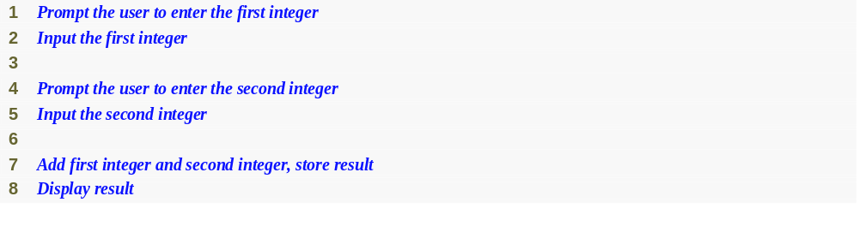
Fig. 4.1 | Pseudocode for the addition program of Fig. 2.5.

Slide 8
4.4 Control Structures
Sequential execution
  Statements executed in sequential order
Transfer of control
  Next statement executed is not the next one in sequence
Structured programming
  Eliminated goto statements

Slide 9
4.4 Control Structures (Cont.)
Only three control structures are needed
  No goto statements
  Demonstrated by Böhm and Jacopini
  Three control structures
    Sequence structure
      Programs executed sequentially by default
    Selection structures
      if, if…else, switch
    Repetition structures
      while, do…while, for

Slide 10
4.4 Control Structures (Cont.)
UML activity diagram
  Models the workflow
    Action state symbols
      Rectangles with curved sides
    Small circles
      Solid circle is the initial state
      Solid circle in a hollow circle is the final state
    Transition arrows
      Represent the flow of activity
    Comment notes
      Connected to the diagram by dotted lines

Slide 11
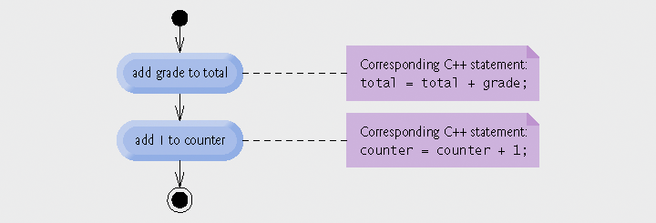
Fig. 4.2 | Sequence-structure activity diagram.

Slide 12
4.4 Control Structures (Cont.)
Single-entry/single-exit control statements
  Three types of control statements
    Sequence statement
    Selection statements
    Repetition statements
  Combined in one of two ways
    Control statement stacking
      Connects exit point of one to entry point of the next
    Control statement nesting

Slide 13
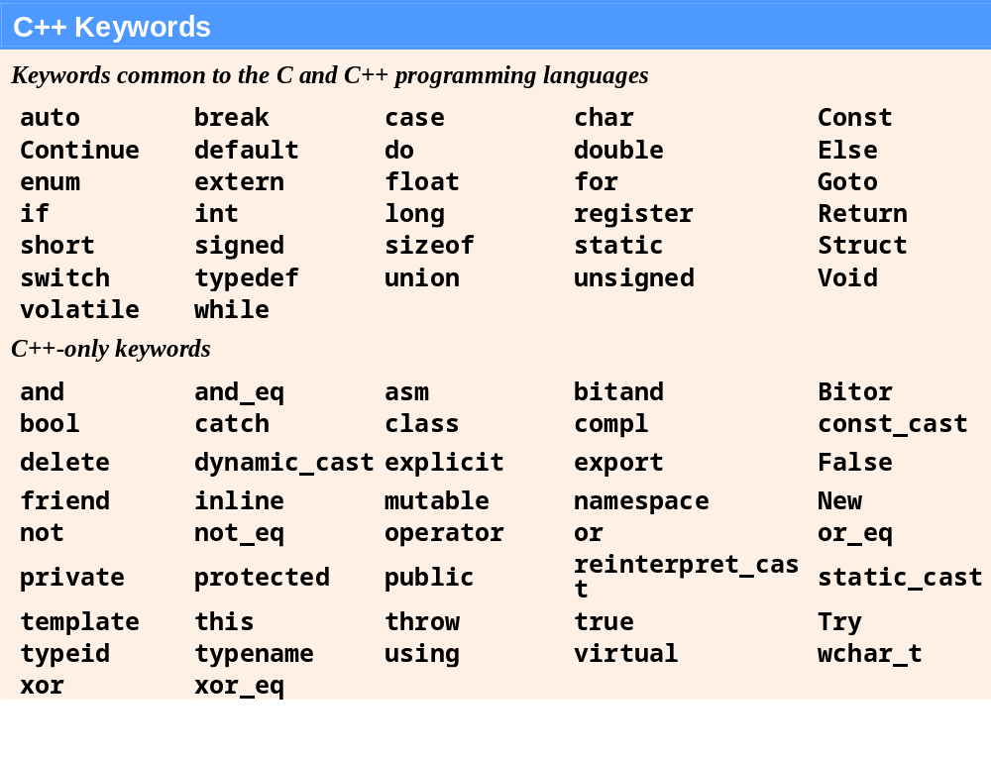
Fig. 4.3 | C++ keywords.

Slide 14
Common Programming Error 4.1
Using a keyword as an identifier is a syntax error.

Slide 15
Common Programming Error 4.2
Spelling a keyword with any uppercase letters is a syntax error. All of C++’s keywords contain only lowercase letters.

Slide 16
Software Engineering Observation 4.1
Any C++ program we’ll ever build can be constructed from only seven different types of control statements (sequence, if, if... else, switch, while, do... while and for) combined in only two ways (control-statement stacking and control-statement nesting).

Slide 17
4.5 if Selection Statement
Selection statements
  Choose among alternative courses of action
  Pseudocode example
    If student’s grade is greater than or equal to 60
      Print “Passed”
      If the condition is true
        Print statement executes, program continues to next statement
      If the condition is false
        Print statement ignored, program continues
      Indenting makes programs easier to read
        C++ ignores white-space characters

Slide 18
4.5 if Selection Statement (Cont.)
Selection statements (Cont.)
  Translation into C++
    if ( grade >= 60 )
    cout << "Passed";
  Any expression can be used as the condition
    If it evaluates to false, it is treated as false
Diamond symbol in UML modeling
  Indicates decision is to be made
  Contains guard conditions
    Test condition
    Follow correct path

Slide 19
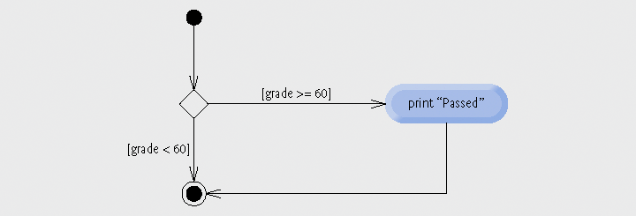
Fig. 4.4 | if single-selection statement activity diagram.

Slide 20
Portability Tip 4.1
For compatibility with earlier versions of C, which used integers for Boolean values, the bool value true also can be represented by any nonzero value (compilers typically use 1) and the bool value false also can be represented as the value zero.

Slide 21
4.6 if…else Double-Selection Statement
if
  Performs an action if the condition true
if…else
  Performs one action if the condition is true, and a different action if the condition is false
Pseudocode
  If student’s grade is greater than or equal to 60
  print “Passed”
  Else
  print “Failed”
C++ code
  if ( grade >= 60 )
  cout << "Passed";
  else
  cout << "Failed";

Slide 22
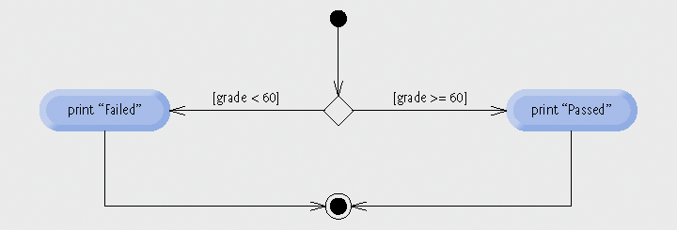
Fig. 4.5 | if...else double-selection statement activity diagram.

Slide 23
4.6 if…else Double-Selection Statement (Cont.)
Ternary conditional operator (?:)
  Three arguments (condition, value if true, value if false)
Code could be written:
  cout << ( grade >= 60 ? “Passed” : “Failed” );
Condition
Value if true
Value if false

Slide 24
Error-Prevention Tip 4.1
To avoid precedence problems (and for clarity), place conditional expressions (that appear in larger expressions) in parentheses.

Slide 25
4.6 if…else Double-Selection Statement (Cont.)
Nested if…else statements
  One inside another, test for multiple cases
  Once a condition met, other statements are skipped
  Example
    If student’s grade is greater than or equal to 90
  Print “A”
  Else
  If student’s grade is greater than or equal to 80
  Print “B”
  Else
  If student’s grade is greater than or equal to 70
  Print “C”
  Else
  If student’s grade is greater than or equal to 60
  Print “D”
  Else
    Print “F”

Slide 26
4.6 if…else Double-Selection Statement (Cont.)
Nested if…else statements (Cont.)
  Written In C++
    if ( studentGrade >= 90 )
    cout << "A";
    else
    if (studentGrade >= 80 )
    cout << "B";
    else
    if (studentGrade >= 70 )
    cout << "C";
    else
    if ( studentGrade >= 60 )
    cout << "D";
    else
    cout << "F";

Slide 27
4.6 if…else Double-Selection Statement (Cont.)
Nested if…else statements (Cont.)
  Written In C++ (indented differently)
    if ( studentGrade >= 90 )
    cout << "A";
    else if (studentGrade >= 80 )
    cout << "B";
    else if (studentGrade >= 70 )
    cout << "C";
    else if ( studentGrade >= 60 )
    cout << "D";
    else
    cout << "F";

Slide 28
Performance Tip 4.1
A nested if...else statement can perform much faster than a series of single-selection if statements because of the possibility of early exit after one of the conditions is satisfied.

Slide 29
Performance Tip 4.2
In a nested if... else statement, test the conditions that are more likely to be true at the beginning of the nested if...else statement. This will enable the nested if...else statement to run faster and exit earlier than testing infrequently occurring cases first.

Slide 30
4.6 if…else Double-Selection Statement (Cont.)
Dangling-else problem
  Compiler associates else with the immediately preceding if
  Example
    if ( x > 5 )
    if ( y > 5 )
    cout << "x and y are > 5";
    else
    cout << "x is <= 5";
  Compiler interprets as
    if ( x > 5 )
    if ( y > 5 )
    cout << "x and y are > 5";
    else
    cout << "x is <= 5";

Slide 31
4.6 if…else Double-Selection Statement (Cont.)
Dangling-else problem (Cont.)
  Rewrite with braces ({})
    if ( x > 5 )
    {
    if ( y > 5 )
    cout << "x and y are > 5";
    }
    else
    cout << "x is <= 5";
      Braces indicate that the second if statement is in the body of the first and the else is associated with the first if statement

Slide 32
4.6 if…else Double-Selection Statement (Cont.)
Compound statement
  Also called a block
    Set of statements within a pair of braces
    Used to include multiple statements in an if body
  Example
    if ( studentGrade >= 60 )
    cout << "Passed.\n";
    else
    {
    cout << "Failed.\n";
    cout << "You must take this course again.\n";
    }
  Without braces,
  cout << "You must take this course again.\n";
  always executes

Slide 33
Software Engineering Observation 4.2
A block can be placed anywhere in a program that a single statement can be placed.

Slide 34
Common Programming Error 4.3
Forgetting one or both of the braces that delimit a block can lead to syntax errors or logic errors in a program.

Slide 35
Good Programming Practice 4.5
Always putting the braces in an if...else statement (or any control statement) helps prevent their accidental omission, especially when adding statements to an if or else clause at a later time. To avoid omitting one or both of the braces, some programmers prefer to type the beginning and ending braces of blocks even before typing the individual statements within the braces.

Slide 36
4.6 if…else Double-Selection Statement (Cont.)
Empty statement
  A semicolon (;) where a statement would normally be
  Performs no action
  Also called a null statement

Slide 37
Common Programming Error 4.4
Placing a semicolon after the condition in an if statement leads to a logic error in single-selection if statements and a syntax error in double-selection if...else statements (when the if part contains an actual body statement).

Slide 38
4.7 while Repetition Statement
Repetition statement
  Action repeated while some condition remains true
  Pseudocode
    While there are more items on my shopping list
    Purchase next item and cross it off my list
  while loop repeats until condition becomes false
  Example
    int product = 3;
    while ( product <= 100 )
    product = 3 * product;

Slide 39
Common Programming Error 4.5
Not providing, in the body of a while statement, an action that eventually causes the condition in the while to become false normally results in a logic error called an infinite loop, in which the repetition statement never terminates. This can make a program appear to “hang” or “freeze” if the loop body does not contain statements that interact with the user.

Slide 40
4.7 while Repetition Statement (Cont.)
UML merge symbol
  Joins two or more flows of activity into one flow of activity
  Represented as a diamond
    Unlike the decision symbol a merge symbol has
      Multiple incoming transition arrows
      Only one outgoing transition arrows
        No guard conditions on outgoing transition arrows
  Has no counterpart in C++ code

Slide 41
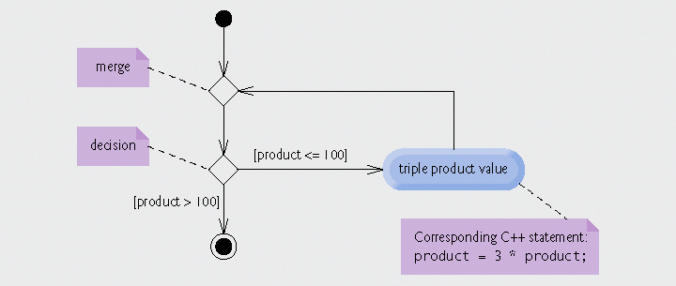
Fig. 4.6 | while repetition statement UML activity diagram.

Slide 42
4.8 Formulating Algorithms: Counter-Controlled Repetition
Problem statement
A class of ten students took a quiz. The grades (integers in the range 0 to 100) for this quiz are available to you. Calculate and display the total of
all student grades and the class average on the quiz.
Counter-controlled repetition
  Loop repeated until counter reaches certain value
  Also known as definite repetition
    Number of repetitions is known beforehand

Slide 43
4.8 Formulating Algorithms: Counter-Controlled Repetition (Cont.)
Counter-controlled repetition (Cont.)
  Counter variable
    Used to count
      In example, indicates which of the 10 grades is being entered
  Total variable
    Used to accumulate the sum of several values
    Normally initialized to zero beforehand
      Otherwise it would include the previous value stored in that memory location

Slide 44
Software Engineering Observation 4.3
Experience has shown that the most difficult part of solving a problem on a computer is developing the algorithm for the solution. Once a correct algorithm has been specified, the process of producing a working C++ program from the algorithm is normally straightforward.

Slide 45
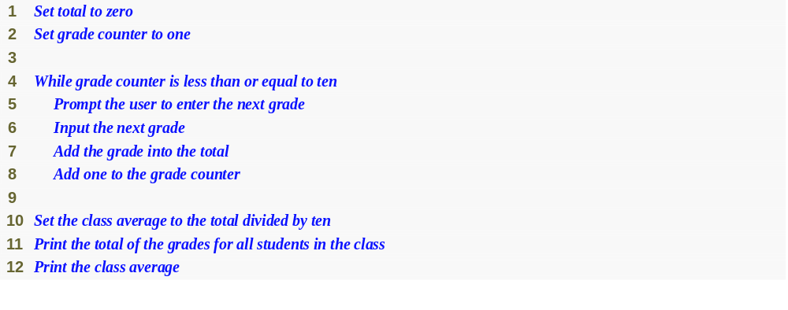
Fig. 4.7 | Pseudocode algorithm that uses counter-controlled repetition to solve the class average problem.

Slide 46
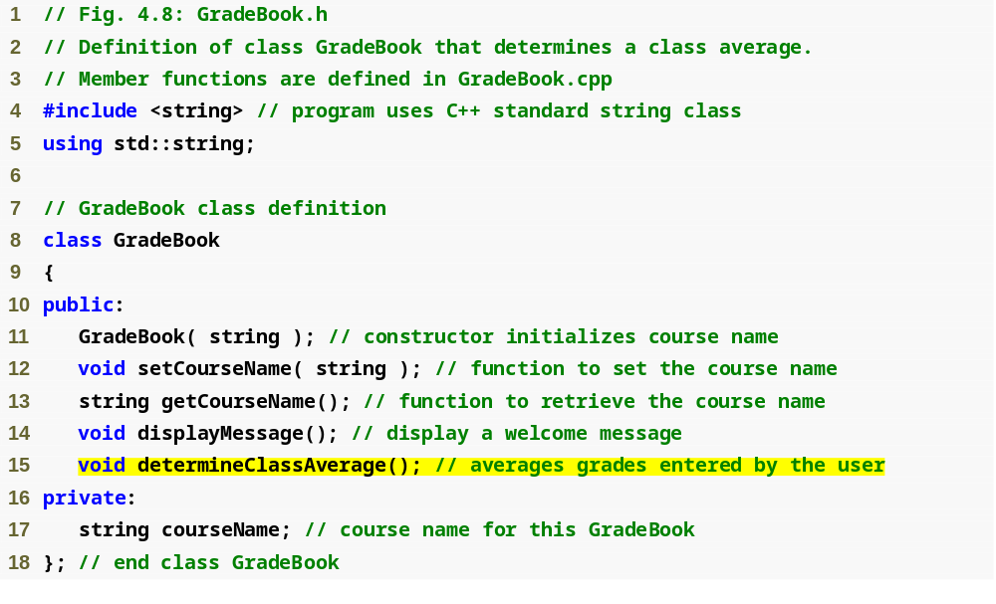
Outline
fig04_08.cpp
(1 of 1)
Function determineClassAverage implements the class average algorithm described by the pseudocode

Slide 47
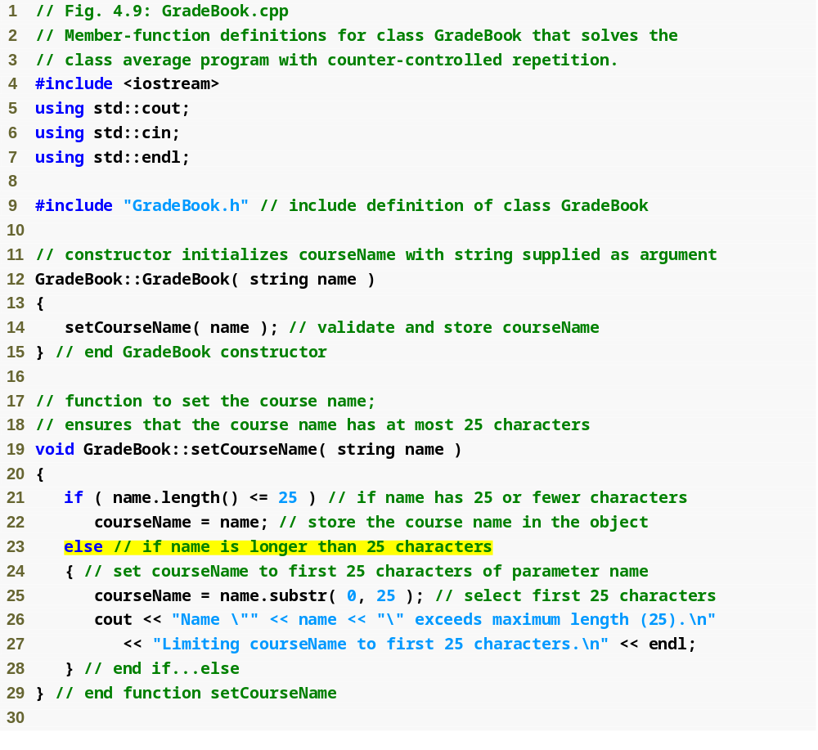
Outline
fig04_09.cpp
(1 of 3)
If course name was longer than 25 characters, select first 25 characters

Slide 48
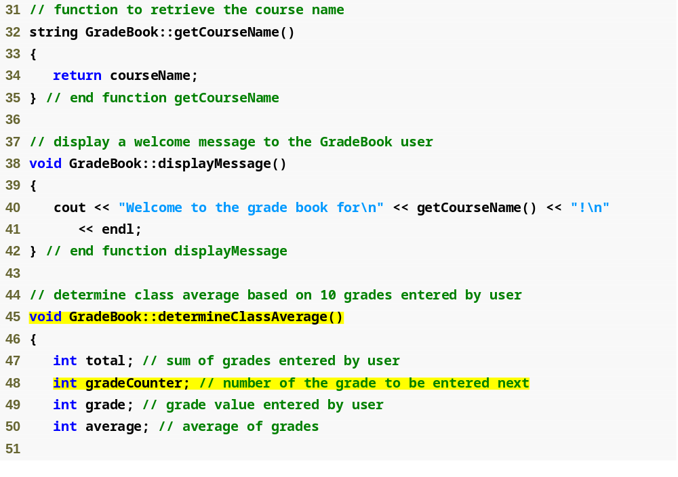
Outline
fig04_09.cpp
(2 of 3)
Function determineClassAverage implements the class average algorithm described by the pseudocode
Declare total variable total
Declare counter variable gradeCounter

Slide 49
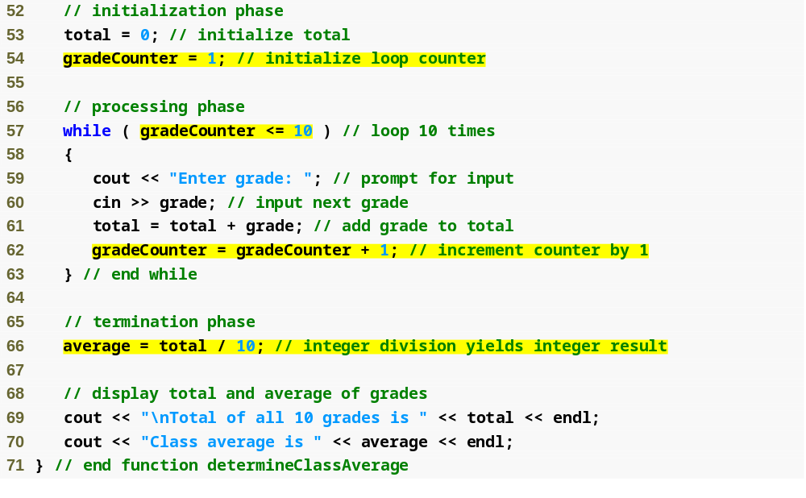
Initialize the total variable total to 0
Outline
Initialize the counter variable gradeCounter to 1
Continue looping as long as gradeCounter’s value is less than or equal to 10
fig04_09.cpp
(3 of 3)
Add the current grade to total
Increment counter by 1, which causes gradeCounter to exceed 10 eventually
Perform the averaging calculation and assign its result to the variable average

Slide 50
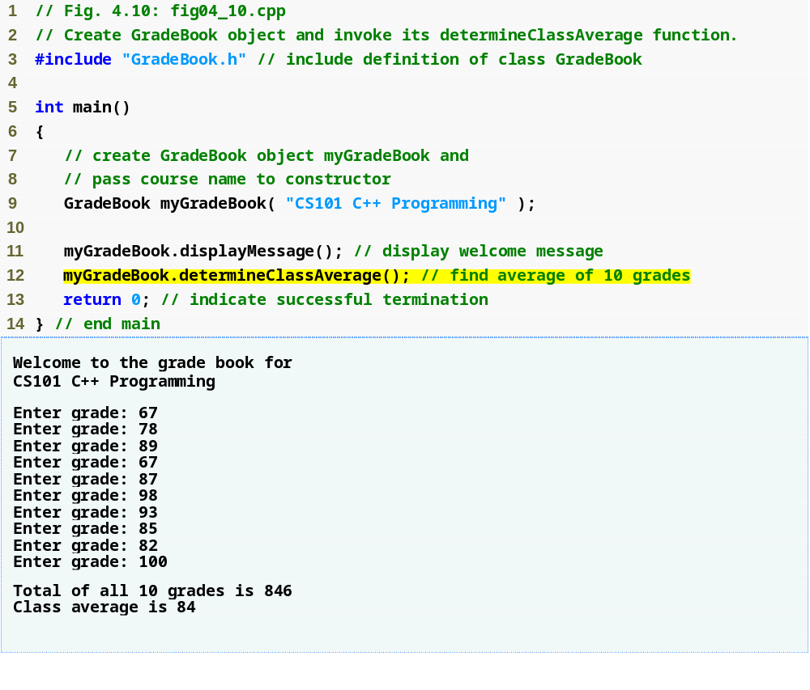
Outline
fig04_10.cpp
(1 of 1)

Slide 51
4.8 Formulating Algorithms: Counter-Controlled Repetition (Cont.)
Uninitialized variables
  Contain “garbage” (or undefined) values
Notes on integer division and truncation
  Integer division
    When dividing two integers performs truncation
      Fractional part of the resulting quotient is lost

Slide 52
Common Programming Error 4.6
Not initializing counters and totals can lead to logic errors.

Slide 53
Error-Prevention Tip 4.2
Initialize each counter and total, either in its declaration or in an assignment statement. Totals are normally initialized to 0. Counters are normally initialized to 0 or 1, depending on how they are used (we will show examples of when to use 0 and when to use 1).

Slide 54
Good Programming Practice 4.7
Declare each variable on a separate line with its own comment to make programs more readable.

Slide 55
Common Programming Error 4.7
Assuming that integer division rounds (rather than truncates) can lead to incorrect results. For example, 7 ÷ 4, which yields 1.75 in conventional arithmetic, truncates to 1 in integer arithmetic, rather than rounding to 2.

Slide 56
Common Programming Error 4.8
Using a loop’s counter-control variable in a calculation after the loop often causes a common logic error called an off-by-one-error. In a counter-controlled loop that counts up by one each time through the loop, the loop terminates when the counter’s value is one higher than its last legitimate value (i.e., 11 in the case of counting from 1 to 10).

Slide 57
4.9 Formulating Algorithms: Sentinel-Controlled Repetition
Problem statement
Develop a class average program that processes grades
for an arbitrary number of students each time it is run.
Sentinel-controlled repetition
  Also known as indefinite repetition
  Use a sentinel value
    Indicates “end of data entry”
    A sentinel value cannot also be a valid input value
    Also known as a signal, dummy or flag value

Slide 58
Common Programming Error 4.9
Choosing a sentinel value that is also a legitimate data value is a logic error.

Slide 59
4.9 Formulating Algorithms: Sentinel-Controlled Repetition (Cont.)
Top-down, stepwise refinement
  Development technique for well-structured programs
  Top step
    Single statement conveying overall function of the program
    Example
      Determine the class average for the quiz
  First refinement
    Multiple statements using only the sequence structure
    Example
      Initialize variables
      Input, sum and count the quiz grades
      Calculate and print the total of all student grades and the class average

Slide 60
Software Engineering Observation 4.4
Each refinement, as well as the top itself, is a complete specification of the algorithm; only the level of detail varies.

Slide 61
Software Engineering Observation 4.5
Many programs can be divided logically into three phases: an initialization phase that initializes the program variables; a processing phase that inputs data values and adjusts program variables (such as counters and totals) accordingly; and a termination phase that calculates and outputs the final results.

Slide 62
Common Programming Error 4.10
An attempt to divide by zero normally causes a fatal runtime error.

Slide 63
Error-Prevention Tip 4.3
When performing division by an expression whose value could be zero, explicitly test for this possibility and handle it appropriately in your program (such as by printing an error message) rather than allowing the fatal error to occur.

Slide 64
4.9 Formulating Algorithms: Sentinel-Controlled Repetition (Cont.)
Top-down, stepwise refinement (Cont.)
  Second refinement
    Commit to specific variables
    Use specific control structures
    Example in Fig. 4.11
Fatal logic error
  Could cause the program the fail
    Often called “bombing” or “crashing”
  Division by zero is normally a fatal logic error

Slide 65
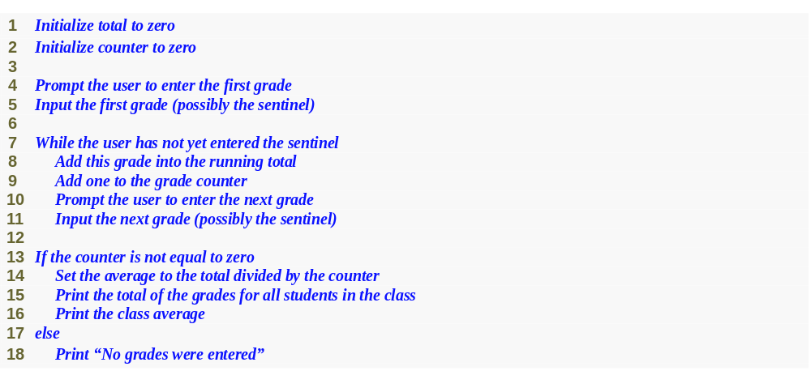
Fig. 4.11 | Class average problem pseudocode algorithm with sentinel-controlled repetition.

Slide 66
Software Engineering Observation 4.6
Terminate the top-down, stepwise refinement process when the pseudocode algorithm is specified in sufficient detail for you to be able to convert the pseudocode to C++. Normally, implementing the C++ program is then straightforward.

Slide 67
Software Engineering Observation 4.7
Many experienced programmers write programs without ever using program development tools like pseudocode. These programmers feel that their ultimate goal is to solve the problem on a computer and that writing pseudocode merely delays the production of final outputs. Although this method might work for simple and familiar problems, it can lead to serious difficulties in large, complex projects.

Slide 68
4.9 Formulating Algorithms: Sentinel-Controlled Repetition (Cont.)
Floating-point numbers
  A real number with a decimal point
  C++ provides data types float and double
    double numbers can have larger magnitude and finer detail
      Called precision
    Floating-point constant values are treated as double values by default
  Floating-point values are often only approximations

Slide 69

Outline
fig04_12.cpp
(1 of 1)

Slide 70
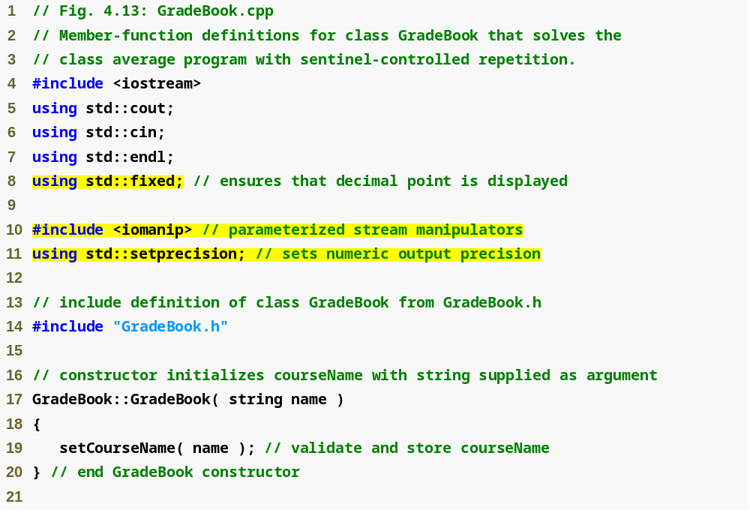
Outline
fixed forces output to print in fixed point format (not scientific notation) and forces trailing zeros and decimal point to print
fig04_13.cpp
(1 of 4)
setprecision stream manipulator (in header <iomanip>) sets numeric output precision

Slide 71
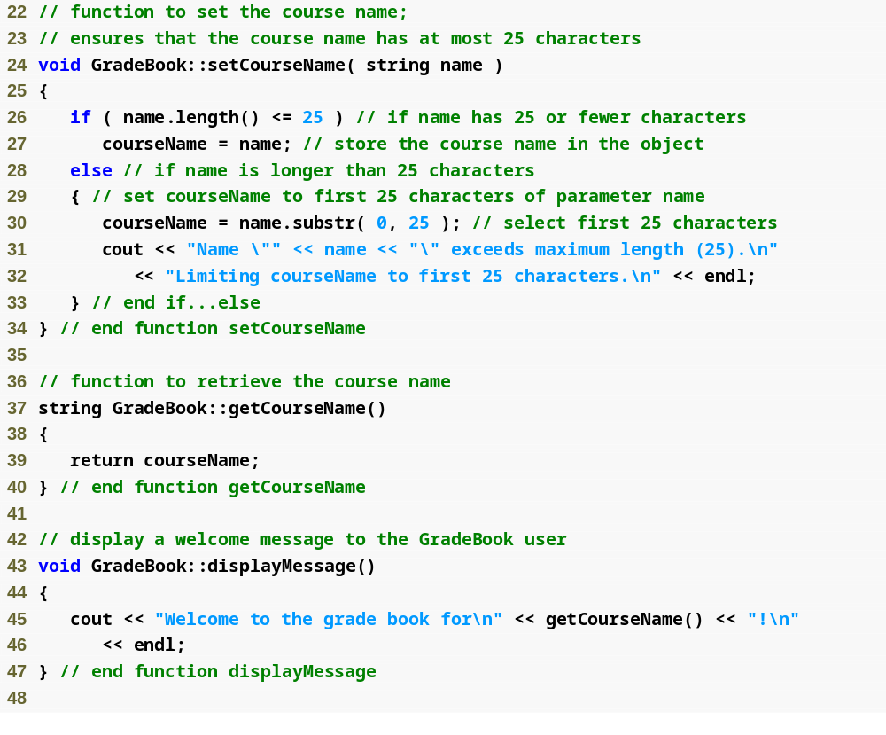
Outline
fig04_13.cpp
(2 of 4)

Slide 72
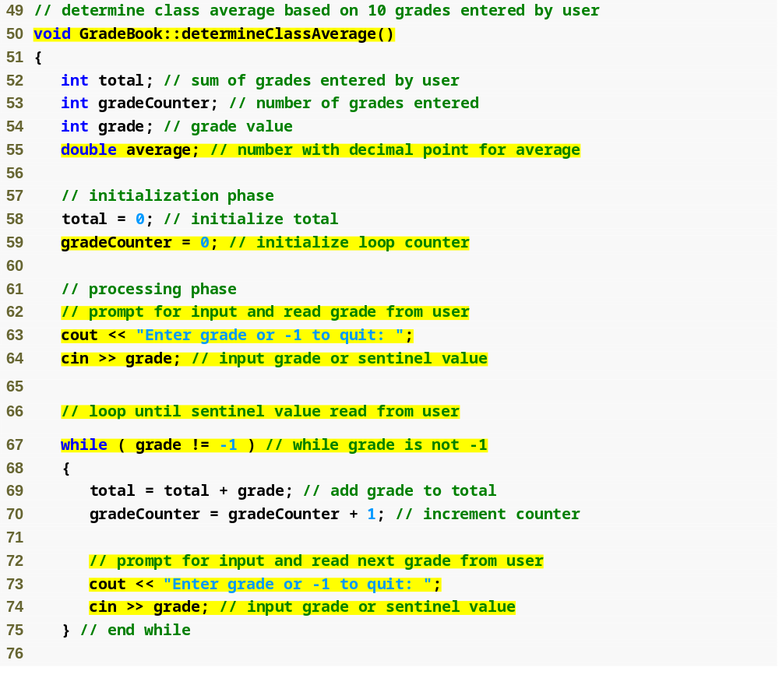
Outline
Function determineClassAverage implements the class average algorithm described by the pseudocode
fig04_13.cpp
(3 of 4)
Declare local int variables total, gradeCounter and grade, and double variable average
while loop iterates as long as grade does not equal the sentinel value -1

Slide 73
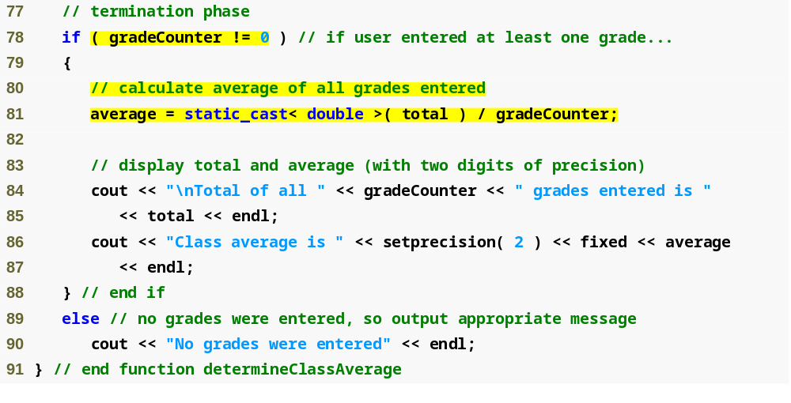
Outline
fig04_13.cpp
(4 of 4)
Calculate average grade using static_cast< double > to perform explicit conversion

Slide 74
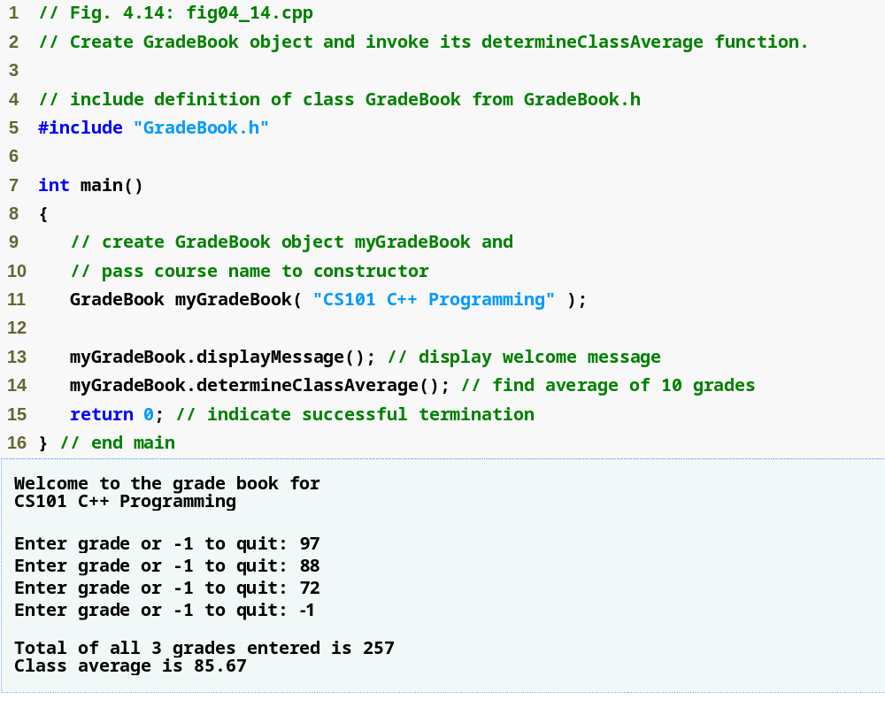
Outline
fig04_14.cpp
(1 of 1)

Slide 75
Good Programming Practice 4.8
Prompt the user for each keyboard input. The prompt should indicate the form of the input and any special input values. For example, in a sentinel-controlled loop, the prompts requesting data entry should explicitly remind the user what the sentinel value is.

Slide 76
Common Programming Error 4.11
Omitting the braces that delimit a block can lead to logic errors, such as infinite loops. To prevent this problem, some programmers enclose the body of every control statement in braces, even if the body contains only a single statement.

Slide 77
Common Programming Error 4.12
Using floating-point numbers in a manner that assumes they are represented exactly (e.g., using them in comparisons for equality) can lead to incorrect results. Floating-point numbers are represented only approximately by most computers.

Slide 78
4.9 Formulating Algorithms: Sentinel-Controlled Repetition (Cont.)
Unary cast operator
  Creates a temporary copy of its operand with a different data type
    Example
      static_cast< double > ( total )
        Creates temporary floating-point copy of total
  Explicit conversion
Promotion
  Converting a value (e.g. int) to another data type (e.g. double) to perform a calculation
  Implicit conversion

Slide 79
Common Programming Error 4.13
The cast operator can be used to convert between fundamental numeric types, such as int and double, and between related class types (as we discuss in Chapter 13, Object-Oriented Programming: Polymorphism). Casting to the wrong type may cause compilation errors or runtime errors.

Slide 80
4.9 Formulating Algorithms: Sentinel-Controlled Repetition (Cont.)
Formatting floating-point numbers
  Parameterized stream manipulator setprecision
    Specifies number of digits of precision to display to the right of the decimal point
    Default precision is six digits
  Nonparameterized stream manipulator fixed
    Indicates that floating-point values should be output in fixed-point format
      As opposed to scientific notation (3.1 × 10³)
  Stream manipulator showpoint
    Forces decimal point to display

Slide 81
4.10 Formulating Algorithms: Nested Control Statement
Problem statement
A college offers a course that prepares students for the state licensing exam for real estate brokers. Last year, ten of the students who completed this course took the exam. The college wants to know how well its students did on the exam. You have been asked to write a program to summarize the results. You have been given a list of these 10 students. Next to each name is written a 1 if the student passed the exam or a 2 if the student failed.
Your program should analyze the results of the exam as follows:
1. Input each test result (i.e., a 1 or a 2). Display the prompting message
“Enter result” each time the program requests another test result.
2. Count the number of test results of each type.
3. Display a summary of the test results indicating the number of
students who passed and the number who failed.
4. If more than eight students passed the exam, print the message “Raise
tuition.”

Slide 82
4.10 Formulating Algorithms: Nested Control Statement (Cont.)
Notice that
  Program processes 10 results
    Fixed number, use counter-controlled loop
  Each test result is 1 or 2
    If not 1, assume 2
  Two counters can be used
    One counts number that passed
    Another counts number that failed
  Must decide whether more than eight students passed

Slide 83
4.10 Formulating Algorithms: Nested Control Statement (Cont.)
Top level outline
  Analyze exam results and decide whether tuition should be raised
First refinement
  Initialize variables
  Input the 10 exam results and count passes and failures
  Print a summary of the exam results and decide whether tuition
  should be raised
Second Refinement
  Initialize variables
  to
  Initialize passes to zero
  Initialize failures to zero
  Initialize student counter to one

Slide 84
4.10 Formulating Algorithms: Nested Control Statement (Cont.)
Second Refinement (Cont.)
  Input the ten exam results and count passes and failures
  to
  While student counter is less than or equal to 10
  Prompt the user to enter the next exam result
  If the student passed
  Add one to passes
  Else
  Add one to failures
    Add one to student counter

Slide 85
4.10 Formulating Algorithms: Nested Control Statement (Cont.)
Second Refinement (Cont.)
  Print a summary of the exam results and decide whether
  tuition should be raised
  to
  Print the number of passes
  Print the number of failures
  If more than eight students passed
  Print “Raise tuition”

Slide 86
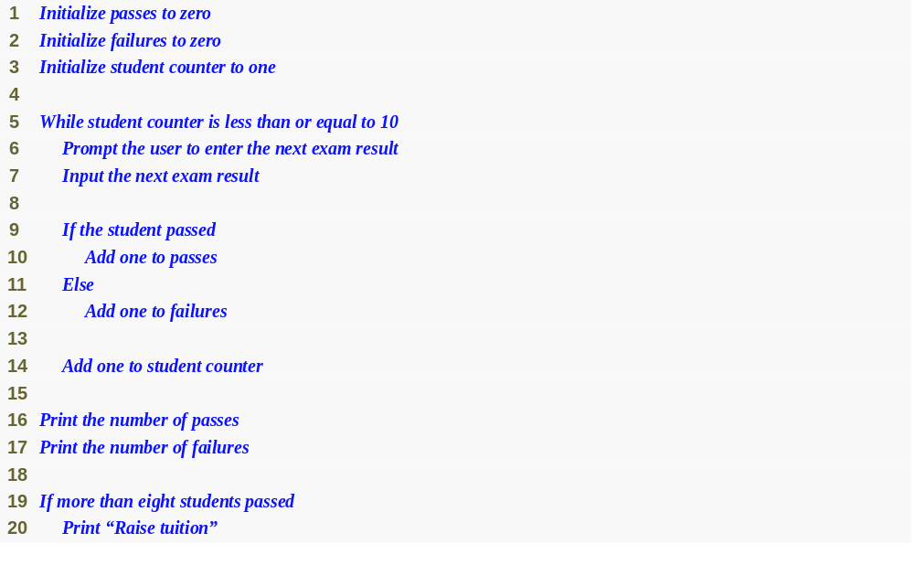
Fig. 4.15 | Pseudocode for examination-results problem.

Slide 87
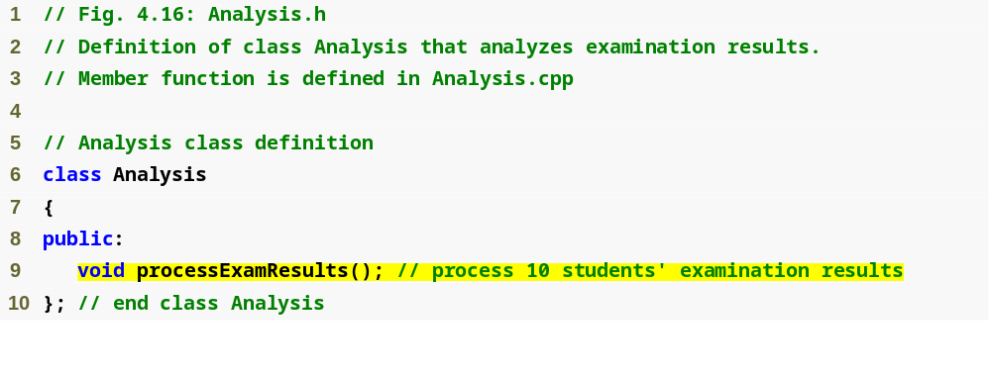
Outline
fig04_16.cpp
(1 of 1)

Slide 88
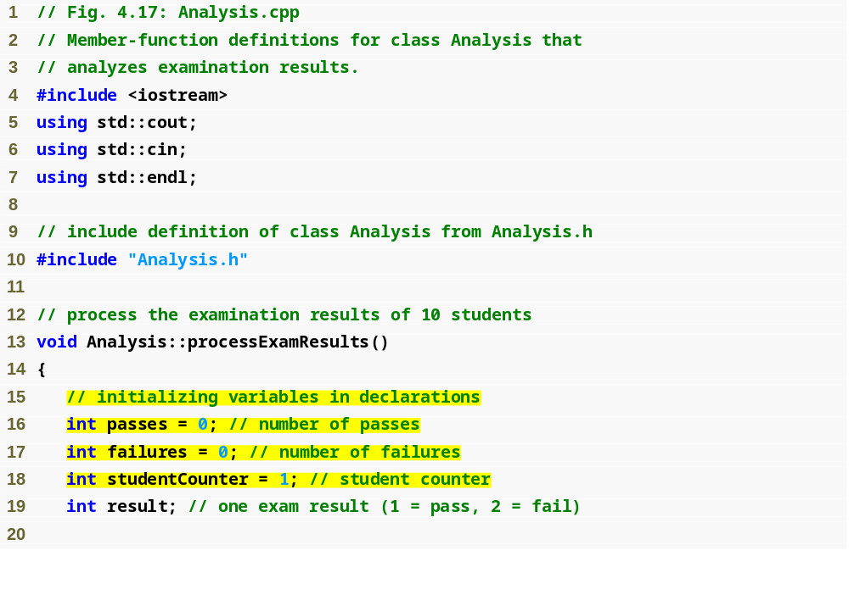
Outline
fig04_17.cpp
(1 of 2)
Declare function processExamResults’s local variables

Slide 89
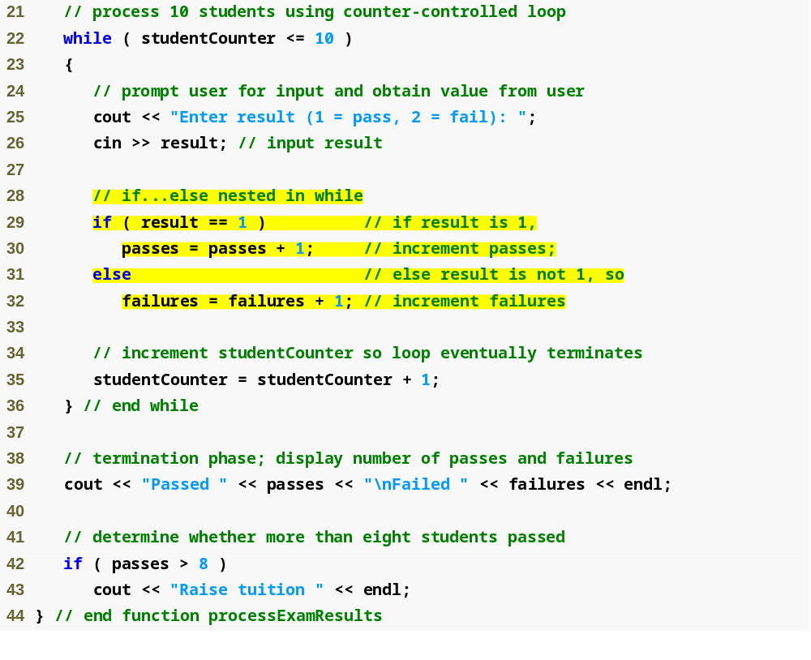
Outline
fig04_17.cpp
(2 of 2)
Determine whether this student passed or failed, and increment the appropriate variable
Determine whether more than 8 students passed

Slide 90
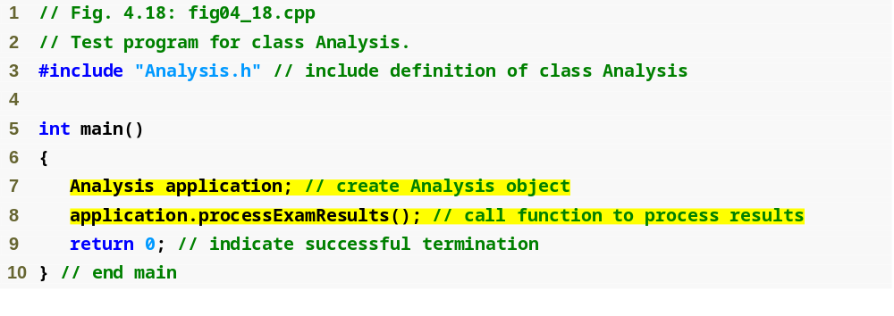
Outline
fig04_18.cpp
(1 of 2)

Slide 91
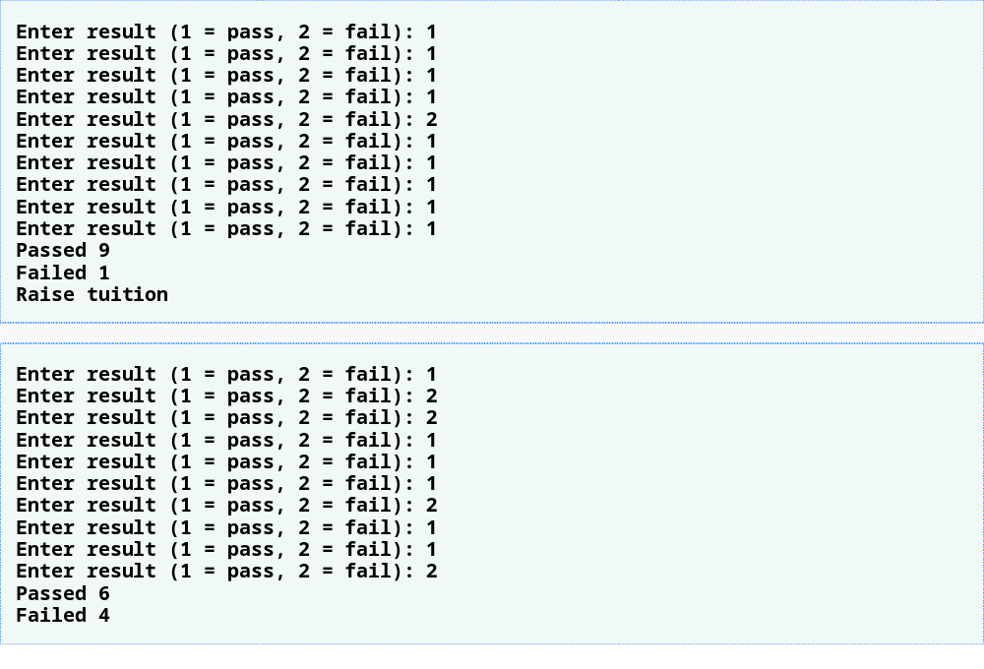
Outline
fig04_18.cpp
(2 of 2)
More than eight students passed the exam, so “Raise tuition” message is printed

Slide 92
4.11 Assignment Operators
Assignment expression abbreviations
  Addition assignment operator
    Example
      c = c + 3; abbreviates to c += 3;
Statements of the form
    variable = variable operator expression;
  can be rewritten as
    variable operator= expression;
Other assignment operators
  d -= 4 (d = d - 4)
  e *= 5 (e = e * 5)
  f /= 3 (f = f / 3)
  g %= 9 (g = g % 9)

Slide 93
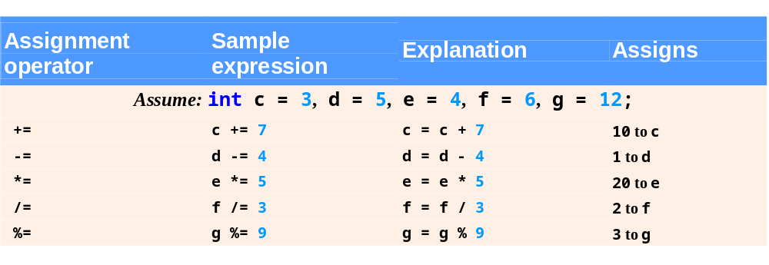
Fig. 4.19 | Arithmetic assignment operators.

Slide 94
4.12 Increment and Decrement Operators
Increment operator ++
  Increments variable by one
    Example
      c++
Decrement operator --
  Decrements variable by one
    Example
      c--

Slide 95
4.12 Increment and Decrement Operators (Cont.)
Preincrement
  When the operator is used before the variable (++c or --c)
  Variable is changed, then the expression it is in is evaluated using the new value
Postincrement
  When the operator is used after the variable (c++ or c--)
  Expression the variable is in executes using the old value, then the variable is changed

Slide 96
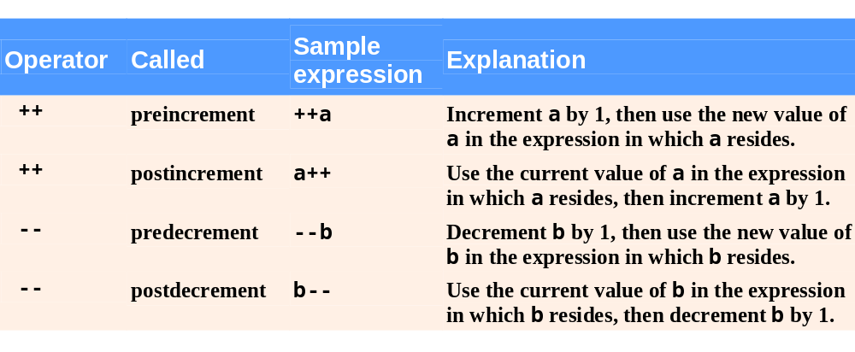
Fig. 4.20 | Increment and decrement operators.

Slide 97
Good Programming Practice 4.9
Unlike binary operators, the unary increment and decrement operators should be placed next to their operands, with no intervening spaces.

Slide 98
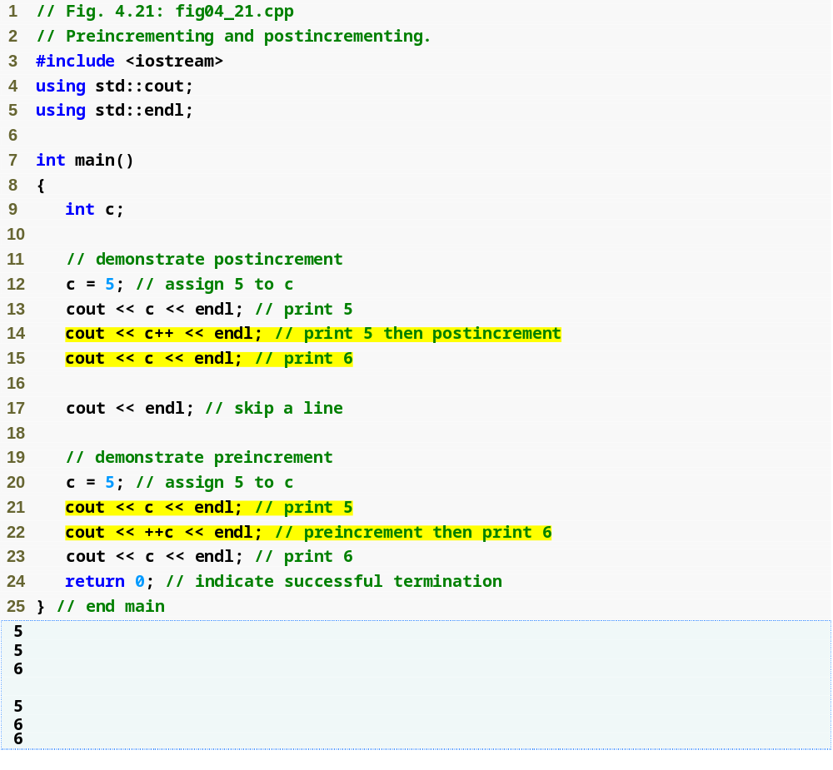
Outline
fig04_21.cpp
(1 of 1)
Postincrementing the c variable
Preincrementing the c variable

Slide 99
4.12 Increment and Decrement Operators (Cont.)
If c = 5, then
  cout << ++c;
    c is incremented to 6
    Then 6 is printed
  cout << c++;
    Prints 5 (printing occurs before the increment)
    Then c is incremented to 6

Slide 100
4.12 Increment and Decrement Operators (Cont.)
When variable is not in an expression
  Preincrementing and postincrementing have same effect
    Example
      ++c;
      cout << c;
      and
      c++;
      cout << c;
      print the same result

Slide 101
Common Programming Error 4.14
4Attempting to use the increment or decrement operator on an expression other than a modifiable variable name or reference, e.g., writing ++(x + 1), is a syntax error.

Slide 102
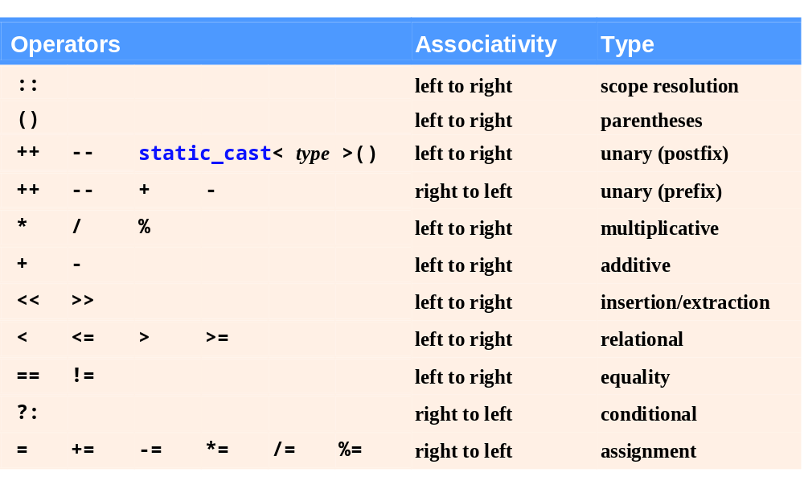
Fig. 4.22 | Operator precedence for the operators encountered so far in the text.

