Slide 1
8
Pointers and
Pointer-Based
Strings

Slide 2
OBJECTIVES
In this chapter you’ll learn:
What pointers are.
The similarities and differences between pointers and references and when to use each.
To use pointers to pass arguments to functions by reference.
To use pointer-based C-style strings.
The close relationships among pointers, arrays and C-style strings.
To use pointers to functions.
To declare and use arrays of C-style strings.

Slide 3
8.1 Introduction
8.2 Pointer Variable Declarations and Initialization
8.3 Pointer Operators
8.4 Passing Arguments to Functions by Reference with Pointers
8.5 Using const with Pointers
8.6 Selection Sort Using Pass-by-Reference
8.7 sizeof Operators
8.7 Pointer Expressions and Pointer Arithmetic
8.9 Relationship Between Pointers and Arrays
8.10 Arrays of Pointers
8.11 Case Study: Card Shuffling and Dealing Simulation
8.12 Function Pointers
8.13 Introduction to Pointer-Based String Processing
8.13.1 Fundamentals of Characters and Pointer-Based Strings
8.13.2 String Manipulation Functions of the String-Handling Library
8.14 Wrap-Up

Slide 4
8.1 Introduction
Pointers
  Powerful, but difficult to master
  Can be used to perform pass-by-reference
  Can be used to create and manipulate dynamic data structures
  Close relationship with arrays and strings
    char * pointer-based strings

Slide 5
8.2 Pointer Variable Declarations and Initialization
Pointer variables
  Contain memory addresses as values
    Normally, variable contains specific value (direct reference)
    Pointers contain address of variable that has specific value (indirect reference)
Indirection
  Referencing value through pointer

Slide 6
8.2 Pointer Variable Declarations and Initialization (Cont.)
Pointer declarations
  * indicates variable is a pointer
    Example
      int *myPtr;
        Declares pointer to int, of type int *
    Multiple pointers require multiple asterisks
      int *myPtr1, *myPtr2;
Pointer type
  Always the same size, based on size of address of platform
  Contains a value that is an address
Pointer initialization
  Initialized to 0, NULL, or an address by program. Not done automagically
    0 or NULL points to nothing (null pointer)

Slide 7
Common Programming Error 8.1
Assuming that the * used to declare a pointer distributes to all variable names in a declaration’s comma-separated list of variables can lead to errors. Each pointer must be declared with the * prefixed to the name (either with or without a space in between—the compiler ignores the space). Declaring only one variable per declaration helps avoid these types of errors and improves program readability.

Slide 8
Good Programming Practice 8.1
Although it is not a requirement, including the letters Ptr in pointer variable names makes it clear that these variables are pointers and that they must be handled appropriately. This goes back to having good naming conventions.

Slide 9
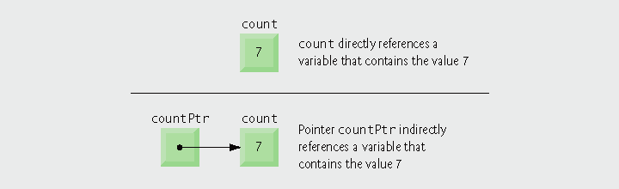
Fig. 8.1 | Directly and indirectly referencing a variable.

Slide 10
8.3 Pointer Operators
Address operator (&)
  Returns memory address of its operand
  Example
    int y = 5;
    int *yPtr;
    yPtr = &y;
    assigns the address of variable y to pointer variable yPtr
      Variable yPtr “points to” y
        yPtr indirectly references variable y’s value

Slide 11

Fig. 8.2 | Graphical representation of a pointer pointing to a variable in memory.

Slide 12
8.3 Pointer Operators (Cont.)
* operator
  Also called indirection operator or dereferencing operator
  Returns synonym for the object its operand points to
  *yPtr returns value of y (because yPtr points to y)
  Dereferenced yptr can be an lvalue
      *yptr = 9;
  Or an rvalue
    x = *yptr;
* and & are inverses of each other
  Will “cancel one another out” when applied consecutively in either order

Slide 13

Fig. 8.3 | Representation of y and yPtr in memory.

Slide 14
Common Programming Error 8.2
Dereferencing a pointer that has not been properly initialized or that has not been assigned to point to a specific location in memory could cause a fatal execution-time error, or it could accidentally modify important data and allow the program to run to completion, possibly with incorrect results.

Slide 15
Common Programming Error 8.3
An attempt to dereference a variable that is not a pointer is a compilation error.

Slide 16
Common Programming Error 8.4
Dereferencing a null pointer is normally a fatal execution-time error.

Slide 17
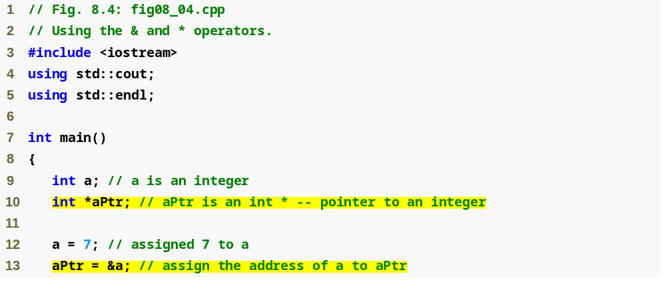
Outline
fig08_04.cpp
(1 of 2)
Variable aPtr is a point to an int
Initialize aPtr with the address of variable a

Slide 18
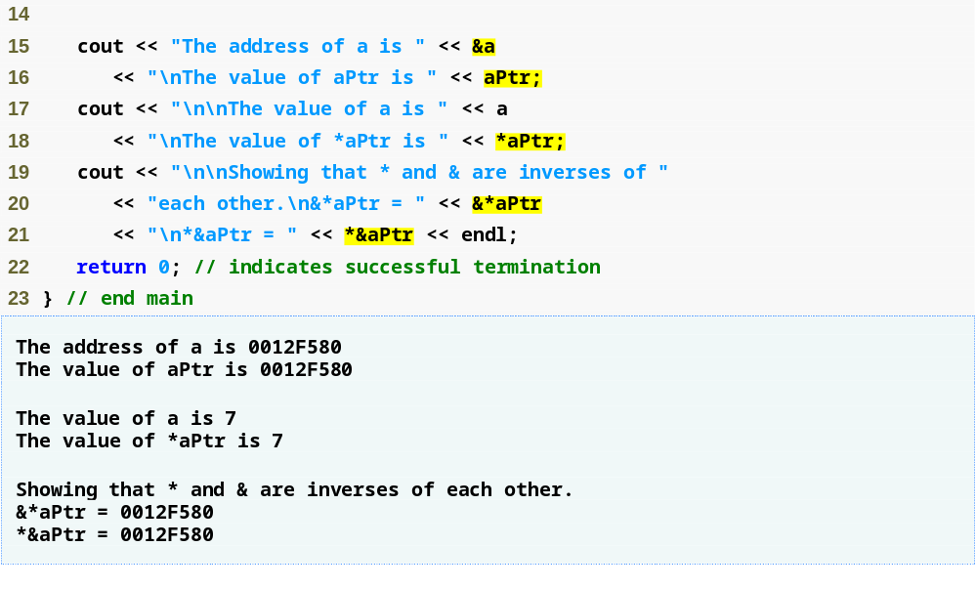
Outline
Address of a and the value of aPtr are identical
Value of a and the dereferenced aPtr are identical
fig08_04.cpp
(2 of 2)
* and & are inverses of each other
* and & are inverses; same result when both are applied to aPtr

Slide 19
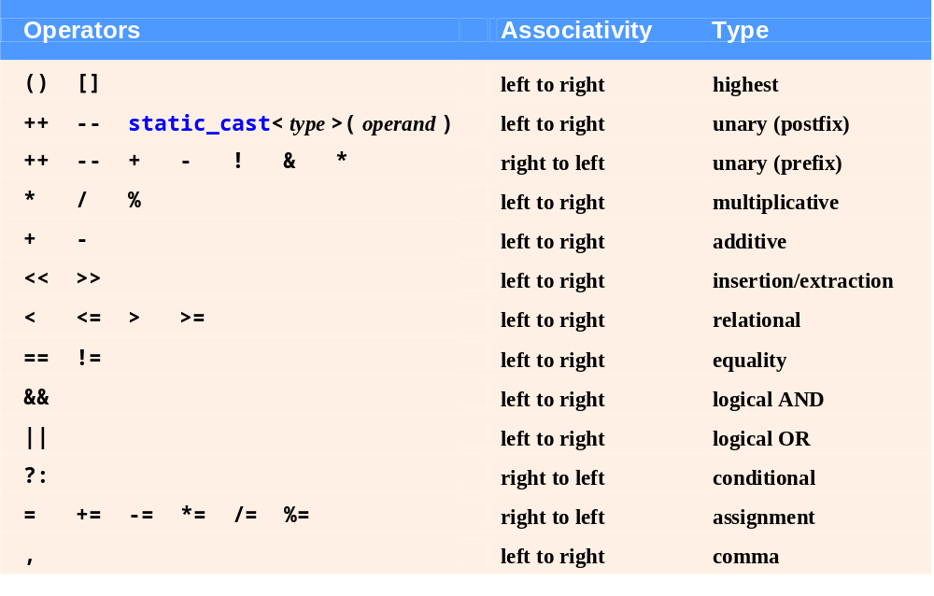
Fig. 8.5 | Operator precedence and associativity.

Slide 20
8.4 Passing Arguments to Functions by Reference with Pointers
Three ways to pass arguments to a function
  Pass-by-value
  Pass-by-reference with reference arguments
  Pass-by-reference with pointer arguments
A function can return only one value
Arguments passed to a function using reference arguments
  Function can modify original values of arguments
    More than one value “returned”
    Referred more commonly as an “output” then a return value.

Slide 21
8.4 Passing Arguments to Functions by Reference with Pointers (Cont.)
Pass-by-reference with pointer arguments
  Simulates pass-by-reference
    Use pointers and indirection operator
  Pass address of argument using & operator
  Arrays not passed with & because array name is already a pointer
  * operator used as alias/nickname for variable inside of function

Slide 22
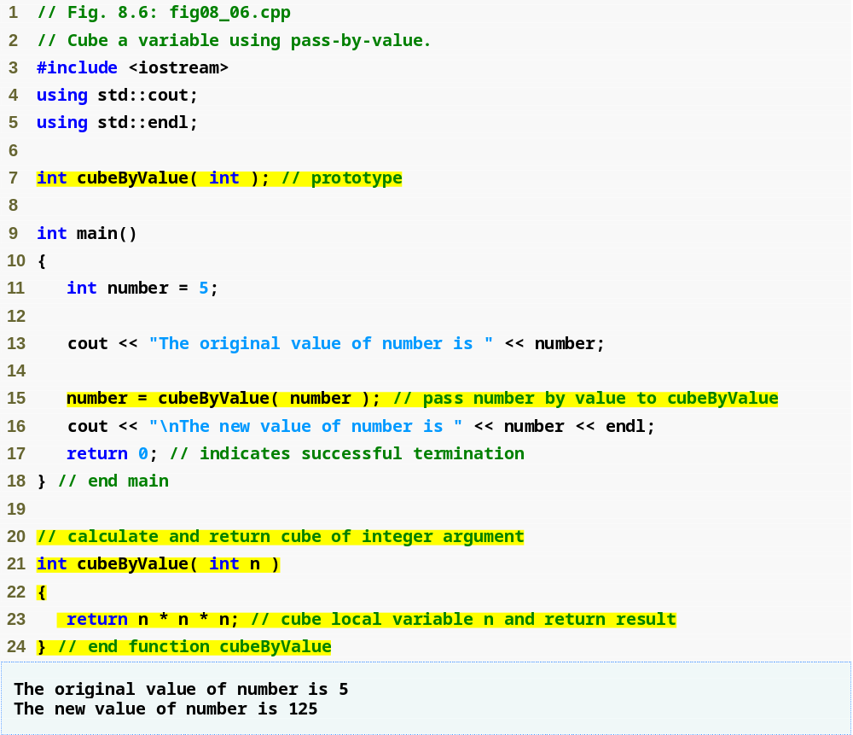
Outline
      Review Pass by Value
fig08_06.cpp
(1 of 1)
Pass number by value; result returned by cubeByValue
cubeByValue receives parameter passed-by-value
Cubes local variable n
and return the result

Slide 23
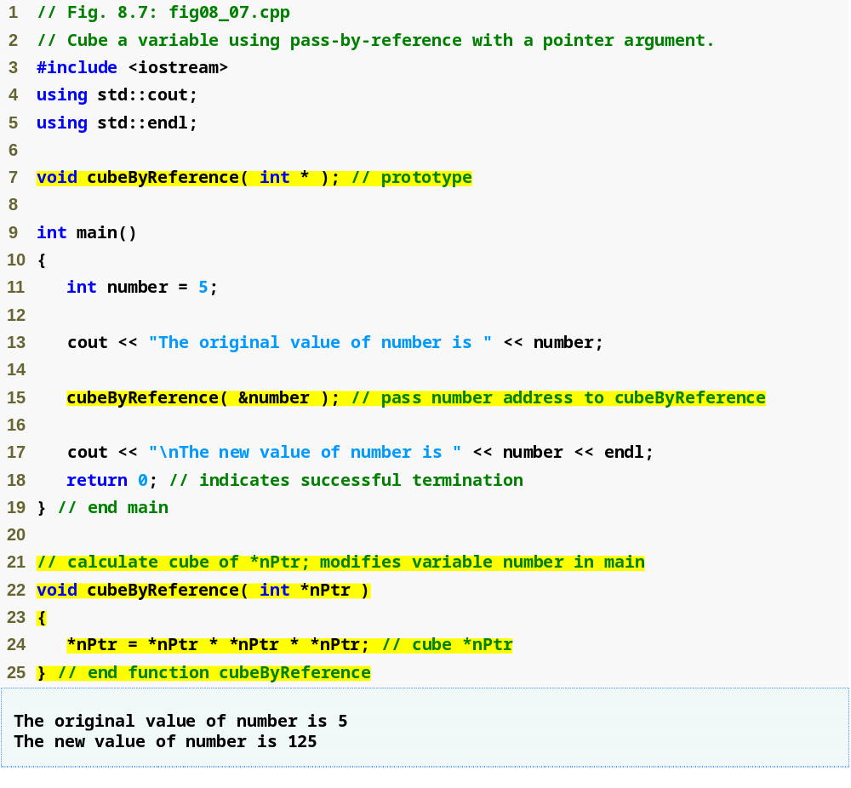
Outline
Prototype indicates parameter is a pointer to an int
fig08_07.cpp
(1 of 1)
Apply address operator & to pass address of number to cubeByReference
cubeByReference modifies variable number
Modify and access int variable using indirection operator *
cubeByReference receives address of an int variable,
i.e., a pointer to an int

Slide 24
Common Programming Error 8.5
Not dereferencing a pointer when it is necessary to do so to obtain the value to which the pointer points is an error.

Slide 25
Software Engineering Observation 8.1
Use pass-by-value to pass arguments to a function unless the caller explicitly requires that the called function directly modify the value of the argument variable in the caller. This is another example of the principle of least privilege.

Slide 26
C Structures
Used to package data that cannot be represented as a single type.
Uses the struct keyword.
A user-defined type.
Use dot notation to access structure members.

Slide 27
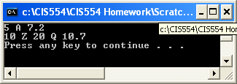
C Structures
struct myStruct
{
int a;
char b;
float c;
};
struct myNestedStruct
{
int x;
char y;
struct myStruct z;
};
void main()
{
myStruct ms;
myNestedStruct mns;
ms.a = 5;
ms.b = 'A';
ms.c = 7.2;
mns.x = 10;
mns.y = 'Z';
mns.z.a = 20;
mns.z.b = 'Q';
mns.z.c = 10.7;
cout << ms.a << " " << ms.b << " " << ms.c << endl;
cout << mns.x << " " << mns.y << " " << mns.z.a << " "
<< mns.z.b << " " << mns.z.c << endl;
system ("pause");
}

Slide 28
Referencing Object Members
Object members are typically referenced using dot notation.
  object.member
Example
#include <iostream.h>
typedef struct tagmyStruct
{
int memberA;
float memberB;
} myStruct;
int x;
float y;
myStruct ms = {1, 1.1};
void main()
{
x = ms.memberA;
y = ms.memberB;
cout << "x = " << x << endl;
cout << "y = " << y << endl;
}

Slide 29
Pointers to Object Members
If we have access to an object through a pointer, then we use a different notation.
  object->member
Example
myStruct * ms;
void main()
{
// must allocate space for structure
ms = static_cast<myStruct *>(malloc(sizeof myStruct));
ms->memberA = 1;
ms->memberB = 1.1;
x = ms->memberA;
y = ms->memberB;
cout << "x = " << x << endl;
cout << "y = " << y << endl;
// very important to release dynamic memory when finished
free(ms);
}

Slide 30
Pointers to Objects with Member Objects
typedef struct tagmyNewStruct
{
int memberA;
float memberB;
myStruct ms;
}myNewStruct;
myNewStruct * mns;
int a;
float b;
void main()
{
// must allocate space for structure
mns = static_cast<myNewStruct *>(malloc(sizeof myNewStruct));
mns->memberA = 1;
mns->memberB = 1.1;
mns->ms.memberA = 2;
mns->ms.memberB = 2.1;
x = mns->memberA;
y = mns->memberB;
a = mns->ms.memberA;
b = mns->ms.memberB;
cout << "x = " << x << endl;
cout << "y = " << y << endl;
cout << "a = " << a << endl;
cout << "b = " << b << endl;
// very important to release dynamic memory when finished
free(mns);
}

Slide 31
Pointers to Objects with Pointers to Member Objects
typedef struct tagmyStruct
{
int memberA;
float memberB;
} myStruct;
typedef struct tagmyNewStruct
{
int memberA;
float memberB;
myStruct * ms;
} myNewStruct;

Slide 32
Pointers to Objects with Pointers to Member Objects (1 of 2)
void main()
{
myNewStruct * mns;
// must allocate space for structure
mns = static_cast<myNewStruct *>(malloc(sizeof myNewStruct));
// must allocate space for structure in structure
mns->ms = static_cast<myStruct *>(malloc(sizeof myStruct));
// give object members values, using pointer notation
mns->memberA = 1;
mns->memberB = 1.1;
// note that we use pointer notation here when
mns->ms->memberA = 2;
// referencing the members of the embedded structure
mns->ms->memberB = 2.1;

Slide 33
Pointers to Objects with Pointers to Member Objects (2 of 2)
// set our variables equal to the object members, per the correct
// notation
x = mns->memberA;
y = mns->memberB;
a = mns->ms->memberA;
b = mns->ms->memberB;
// print out our variables for show.
cout << "x = " << x << endl;
cout << "y = " << y << endl;
cout << "a = " << a << endl;
cout << "b = " << b << endl;
// very important to release dynamic memory when finished.
// NOTE THAT it is VERY important to free the member in this order
free(mns->ms);
free(mns);
}

Slide 34
8.5 Using const with Pointers
const qualifier
  Indicates that value of variable should not be modified
  const used when function does not need to change the variable’s value
Principle of least privilege
  Award function enough access to accomplish task, but no more
  Example
    A function that prints the elements of an array, takes array and int indicating length
      Array contents are not changed – should be const
      Array length is not changed – should be const

Slide 35
Error-Prevention Tip 8.2
Before using a function, check its function prototype to determine the parameters that it can modify.

Slide 36
8.5 Using const with Pointers (Cont.)
Four ways to pass pointer to function
  Nonconstant pointer to nonconstant data
    Highest amount of access
    Data can be modified through the dereferenced pointer
    Pointer can be modified to point to other data
      Pointer arithmetic
        Operator ++ moves array pointer to the next element
    Its declaration does not include const qualifier

Slide 37
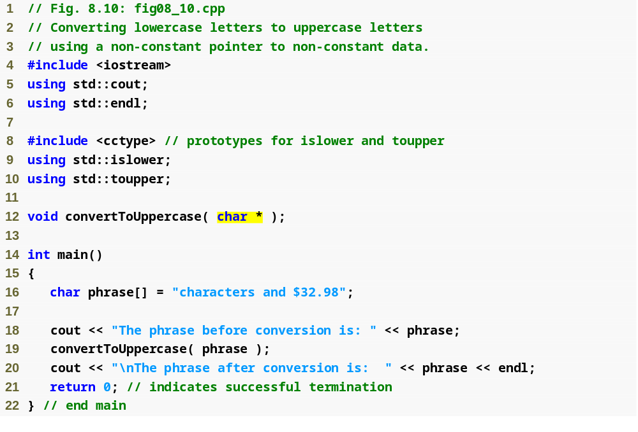
Outline
fig08_10.cpp
(1 of 2)
Parameter is a nonconstant pointer to nonconstant data
convertToUppercase modifies variable phrase

Slide 38
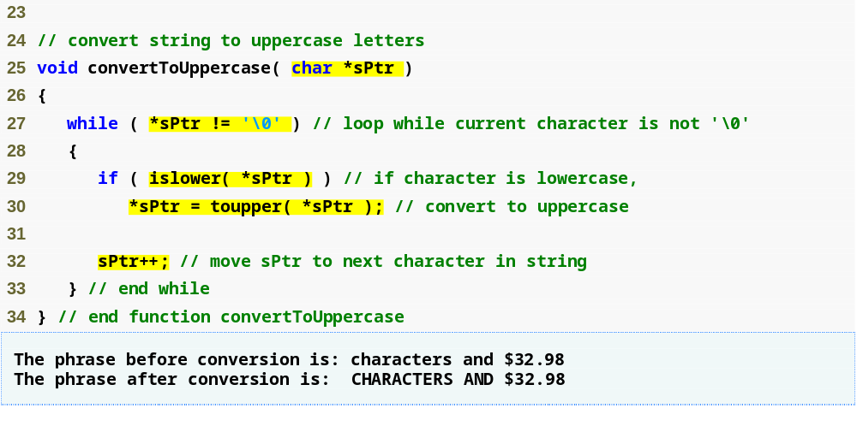
Outline
Parameter sPtr is a nonconstant pointer to nonconstant data
Function islower returns true if the character is lowercase
fig08_10.cpp
(2 of 2)
Function toupper returns corresponding uppercase character if original character is lowercase; otherwise toupper returns the original character
Modify the memory address stored in sPtr to point to the next element of the array

Slide 39
8.5 Using const with Pointers (Cont.)
Four ways to pass pointer to function (Cont.)
  Nonconstant pointer to constant data
    Pointer can be modified to point to any appropriate data item
    Data cannot be modified through this pointer
    Provides the performance of pass-by-reference and the protection of pass-by-value
    const char *sPtr
    Read from right to left as: sPtr is a pointer to a character constant.

Slide 40
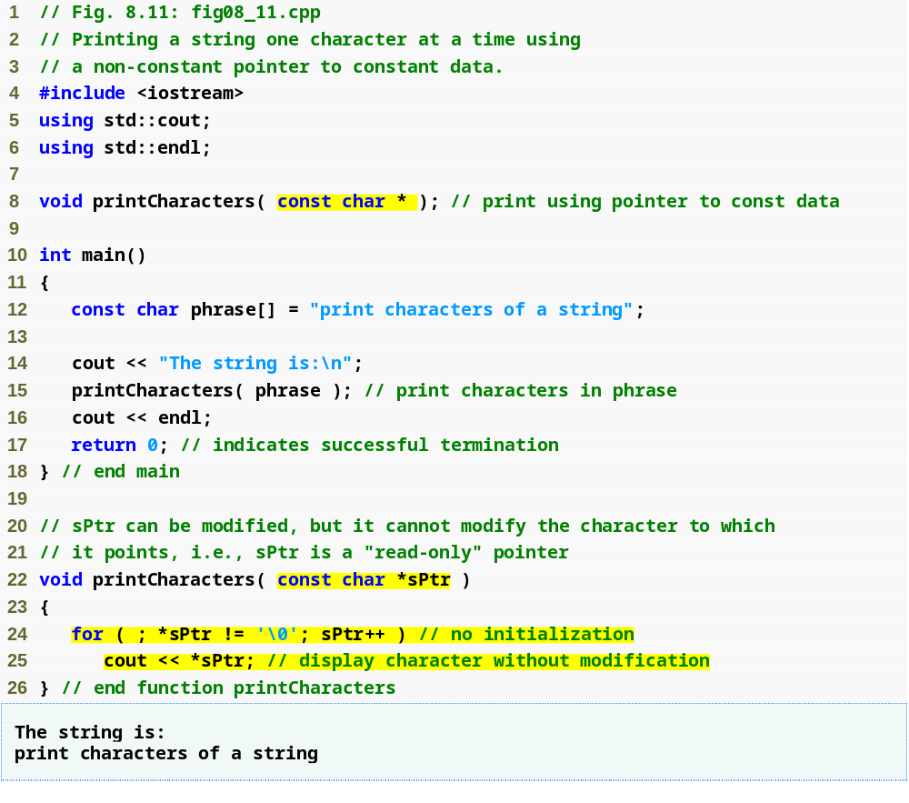
Outline
Parameter is a nonconstant pointer to constant data
fig08_11.cpp
(1 of 1)
Pass pointer phrase to function printCharacters
sPtr is a nonconstant pointer to constant data; it cannot modify the character to which it points
Increment sPtr to point to the next character

Slide 41
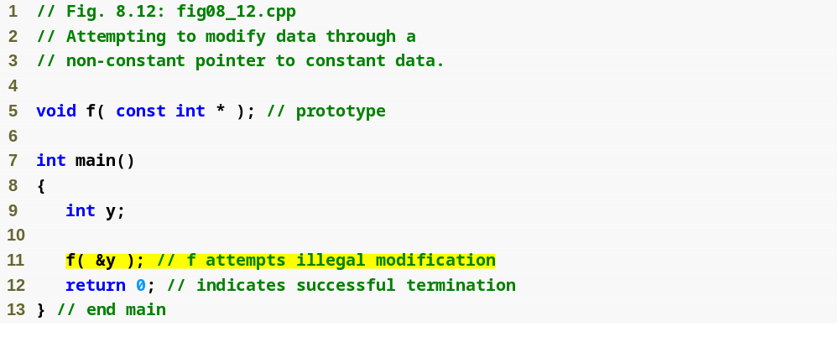
Outline
fig08_12.cpp
(1 of 2)
Parameter is a nonconstant pointer to constant data
Pass the address of int variable y to attempt an illegal modification

Slide 42
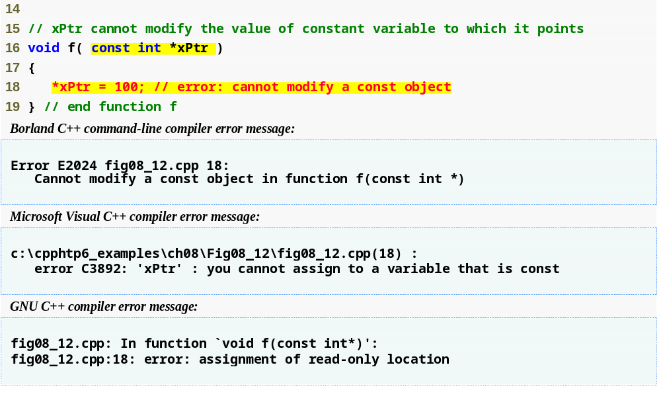
Outline
Attempt to modify a const object pointed to by xPtr
fig08_12.cpp
(2 of 2)
Error produced when attempting to compile

Slide 43
Performance Tip 8.1
If they do not need to be modified by the called function, pass large objects using pointers to constant data or references to constant data, to obtain the performance benefits of pass-by-reference.

Slide 44
Software Engineering Observation 8.3
Pass large objects using pointers to constant data, or references to constant data, to obtain the security of pass-by-value.

Slide 45
8.5 Using const with Pointers (Cont.)
Four ways to pass pointer to function (Cont.)
  Constant pointer to nonconstant data
    Always points to the same memory location
      Can only access other elements using subscript notation
    Data can be modified through the pointer
    Default for an array name
      Can be used by a function to receive an array argument
    Must be initialized when declared
    int * const ptr
    Read from right to left: ptr is a constant pointer to an integer.

Slide 46
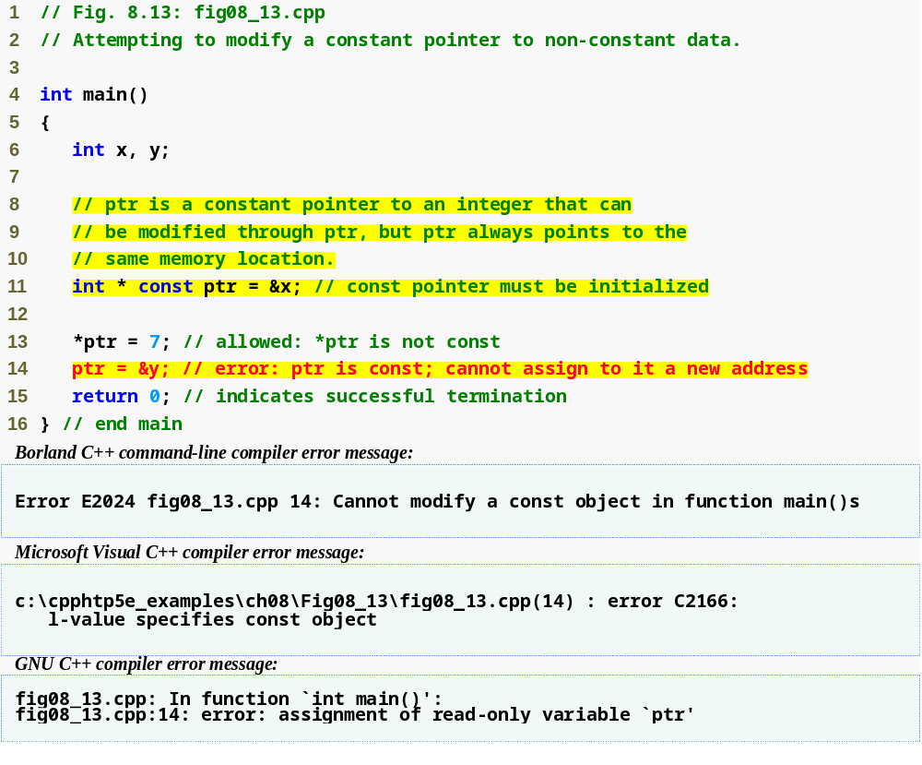
Outline
fig08_13.cpp
(1 of 1)
ptr is a constant pointer to an integer
Can modify x (pointed to by ptr) since x is not constant
Cannot modify ptr to point to a new address since ptr is constant
Line 14 generates a compiler error by attempting to assign a new address to a constant pointer

Slide 47
Common Programming Error 8.6
Not initializing a pointer that is declared const is a compilation error.

Slide 48
8.5 Using const with Pointers (Cont.)
Four ways to pass pointer to function (Cont.)
  Constant pointer to constant data
    Least amount of access
    Always points to the same memory location
    Data cannot be modified using this pointer
    Pointers declared as const must be initialized when declared.
    const int * const ptr
    Read from right to left: ptr is a constant pointer to an integer constant.

Slide 49
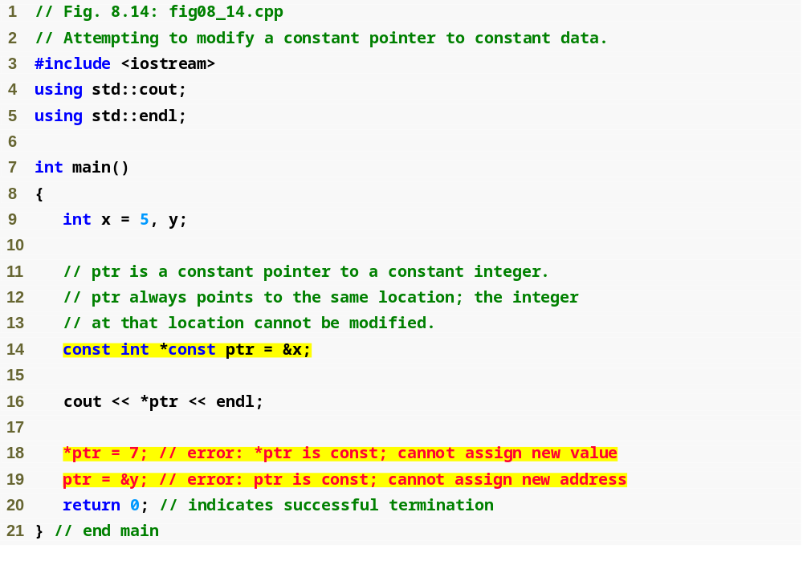
Outline
fig08_14.cpp
(1 of 2)
ptr is a constant pointer to a constant integer
Cannot modify x (pointed to by ptr) since *ptr is constant
Cannot modify ptr to point to a new address since ptr is constant

Slide 50
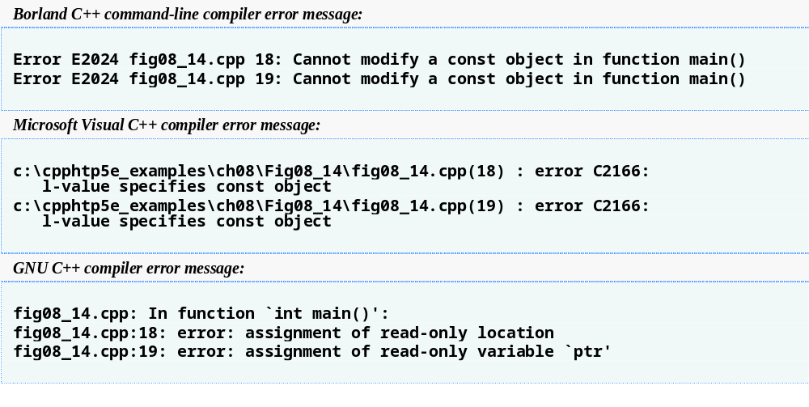
Outline
Line 18 generates a compiler error by attempting to modify a constant object
fig08_14.cpp
(2 of 2)
Line 19 generates a compiler error by attempting to assign a new address to a constant pointer

Slide 51
8.6 Selection Sort Using Pass-by-Reference
Implement selectionSort using pointers
  Selection sort algorithm
    Swap smallest element with the first element
    Swap second-smallest element with the second element
    Etc.
  Want function swap to access array elements
    Individual array elements: scalars
      Passed by value by default
    Pass by reference via pointers using address operator &

Slide 52
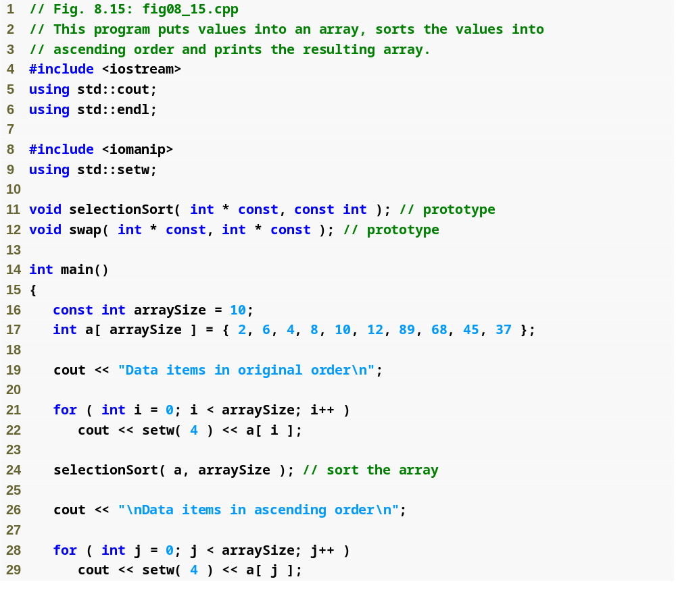
Outline
fig08_15.cpp
(1 of 3)

Slide 53
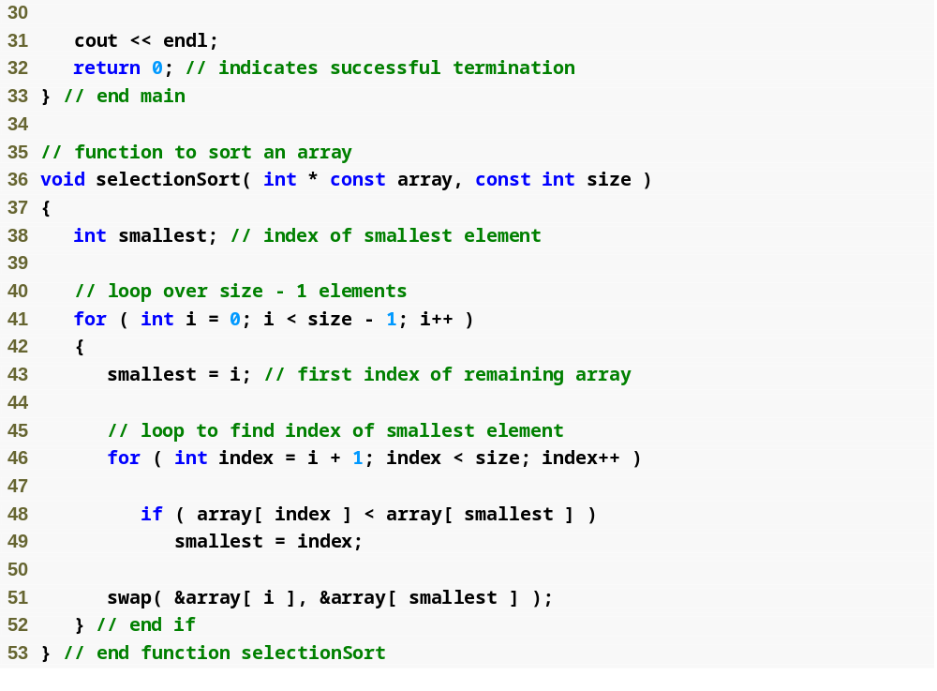
Outline
Declare array as int *array (rather than int array[]) to indicate function selectionSort receives single-subscripted array
fig08_15.cpp
(2 of 3)
Receives the size of the array as an argument; declared const to ensure that size is not modified

Slide 54
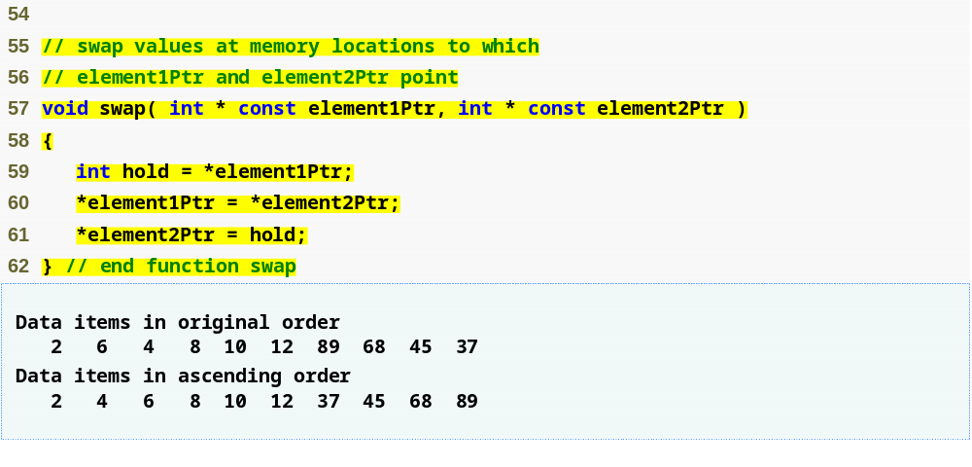
Outline
fig08_15.cpp
(3 of 3)
Arguments are passed by reference, allowing the function to swap values at the original memory locations

Slide 55
8.7 sizeof Operators
sizeof operator
  Returns size of operand in bytes
  For arrays, sizeof returns
      ( size of 1 element ) * ( number of elements )
  If sizeof( int ) returns 4 then
  int myArray[ 10 ];
  cout << sizeof( myArray );
  will print 40
  Can be used with
    Variable names
    Type names
    Constant values

Slide 56
Common Programming Error 8.7
Using the sizeof operator in a function to find the size in bytes of an array parameter results in the size in bytes of a pointer, not the size in bytes of the array.

Slide 57
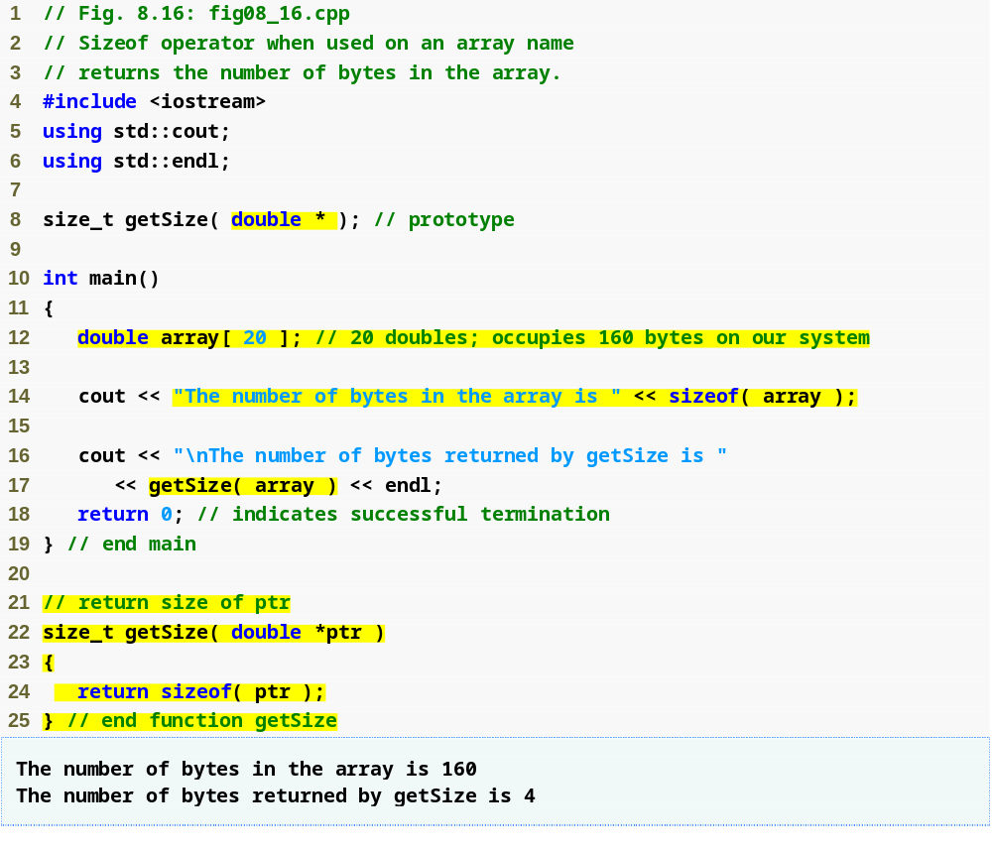
Outline
fig08_16.cpp
(1 of 1)
Operator sizeof applied to an array returns total number of bytes in the array
Function getSize returns the number of bytes used to store array address
Operator sizeof returns number of bytes of pointer

Slide 58
8.7 sizeof Operators (Cont.)
sizeof operator (Cont.)
  Is performed at compiler-time
  For double realArray[ 22 ];
    Use sizeof realArray / sizeof( double ) to calculate the number of elements in realArray
  Parentheses are only required if the operand is a type name

Slide 59
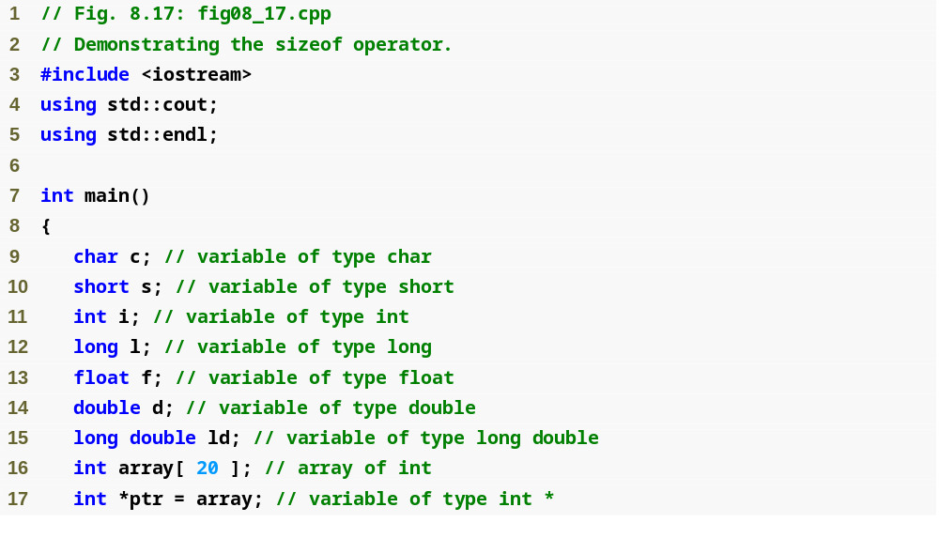
Outline
fig08_17.cpp
(1 of 2)

Slide 60
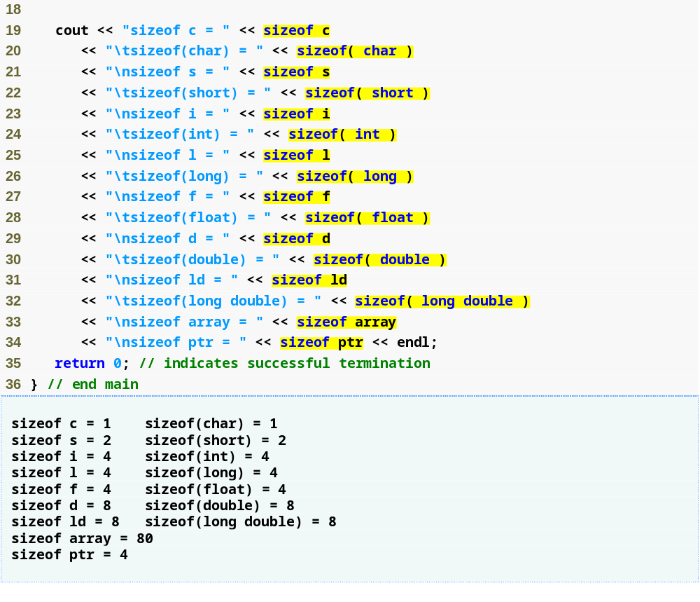
Outline
Operator sizeof can be used on a variable name
Operator sizeof can be used on a type name
fig08_17.cpp
(2 of 2)
Operator sizeof returns the total number of bytes in the array

Slide 61
Portability Tip 8.2
The number of bytes used to store a particular data type may vary between systems. When writing programs that depend on data type sizes, and that will run on several computer systems, use sizeof to determine the number of bytes used to store the data types.

Slide 62
Common Programming Error 8.8
Omitting the parentheses in a sizeof operation when the operand is a type name is a compilation error.

Slide 63
Performance Tip 8.2
Because sizeof is a compile-time unary operator, not an execution-time operator, using sizeof does not negatively impact execution performance.

Slide 64
Error-Prevention Tip 8.3
To avoid errors associated with omitting the parentheses around the operand of operator sizeof, many programmers include parentheses around every sizeof operand.

Slide 65
8.8 Pointer Expressions and Pointer Arithmetic
Pointer arithmetic
  Increment/decrement pointer (++ or --)
  Add/subtract an integer to/from a pointer (+ or +=,
  - or -=)
  Pointers may be subtracted from each other
  Pointer arithmetic is meaningless unless performed on a pointer to an array

Slide 66
8.8 Pointer Expressions and Pointer Arithmetic (Cont.)
5 element int array on a machine using 4 byte ints
  vPtr points to first element v[ 0 ], at location 3000
    vPtr = &v[ 0 ];
  vPtr += 2; sets vPtr to 3008 (3000 + 2 * 4)
    vPtr points to v[ 2 ]
Subtracting pointers
  Returns number of elements between two addresses
        vPtr2 = &v[ 2 ];
        vPtr = &v[ 0 ];
        vPtr2 - vPtr is 2

Slide 67
Portability Tip 8.3
Most computers today have two-byte or four-byte integers. Some of the newer machines use eight-byte integers. Because the results of pointer arithmetic depend on the size of the objects a pointer points to, pointer arithmetic is machine dependent.

Slide 68
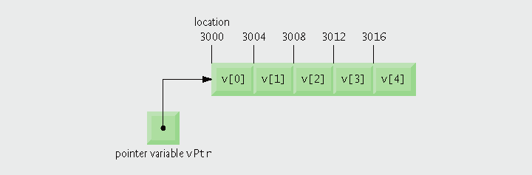
Fig. 8.18 | Array v and a pointer variable vPtr that points to v.

Slide 69
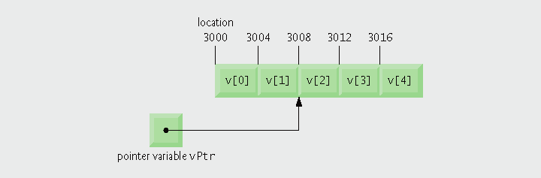
Fig. 8.19 | Pointer vPtr after pointer arithmetic.

Slide 70
8.8 Pointer Expressions and Pointer Arithmetic (Cont.)
Pointer assignment
  Pointer can be assigned to another pointer if both are of same type
    If not same type, cast operator must be used
    Exception
      Pointer to void (type void *)
        Generic pointer, represents any type
        No casting needed to convert pointer to void *
        Casting is needed to convert void * to any other type
        void pointers cannot be dereferenced

Slide 71
8.8 Pointer Expressions and Pointer Arithmetic (Cont.)
Pointer comparison
  Use equality and relational operators
  Compare addresses stored in pointers
    Comparisons are meaningless unless pointers point to members of the same array
  Example
    Could show that one pointer points to higher-index element of array than another pointer
  Commonly used to determine whether pointer is 0 (null pointer)

Slide 72
8.9 Relationship Between Pointers and Arrays
Arrays and pointers are closely related
  Array name is like constant pointer
  Pointers can do array subscripting operations

Slide 73
8.9 Relationship Between Pointers and Arrays (Cont.)
Accessing array elements with pointers
  Assume declarations:
  int b[ 5 ];
  int *bPtr;
  bPtr = b;
  Element b[ n ] can be accessed by *( bPtr + n )
    Called pointer/offset notation
  Addresses
    &b[ 3 ] is same as bPtr + 3
  Array name can be treated as pointer
    b[ 3 ] is same as *( b + 3 )
  Pointers can be subscripted (pointer/subscript notation)
    bPtr[ 3 ] is same as b[ 3 ]

Slide 74
Common Programming Error 8.14
Although array names are pointers to the beginning of the array and pointers can be modified in arithmetic expressions, array names cannot be modified in arithmetic expressions, because array names are constant pointers.

Slide 75
Good Programming Practice 8.2
For clarity, use array notation instead of pointer notation when manipulating arrays.

Slide 76
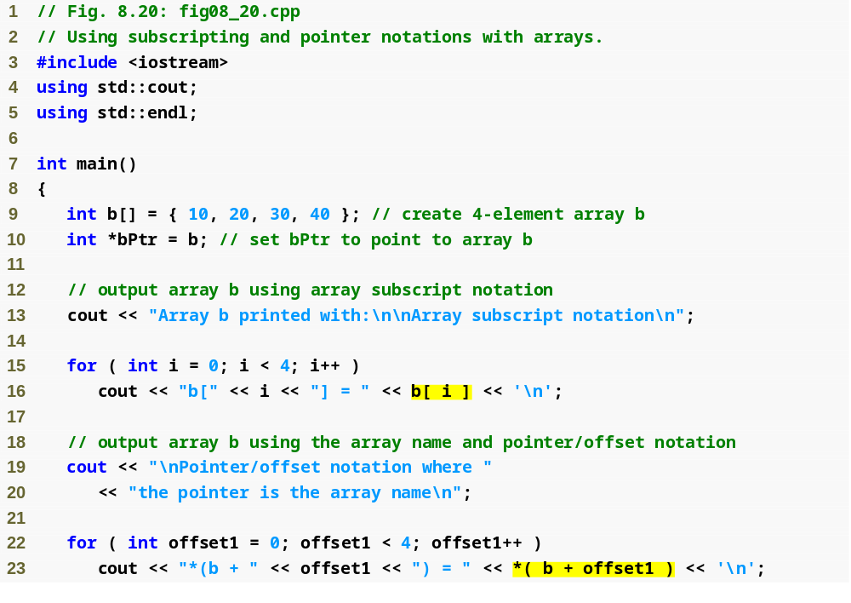
Outline
fig08_20.cpp
(1 of 3)
Using array subscript notation
Using array name and pointer/offset notation

Slide 77
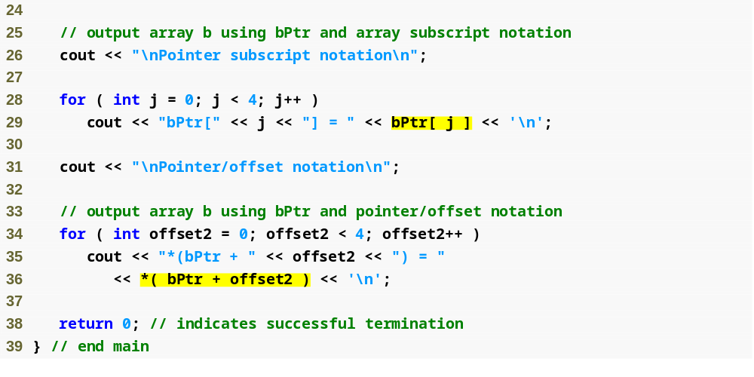
Outline
fig08_20.cpp
(2 of 3)
Using pointer subscript notation
Using pointer name and pointer/offset notation

Slide 78
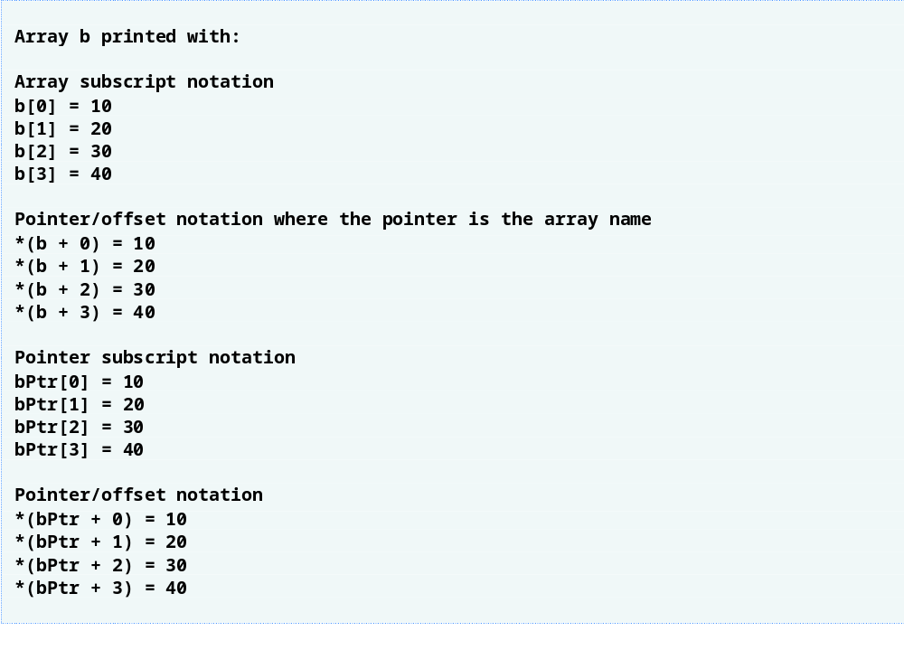
Outline
fig08_20.cpp
(3 of 3)

Slide 79
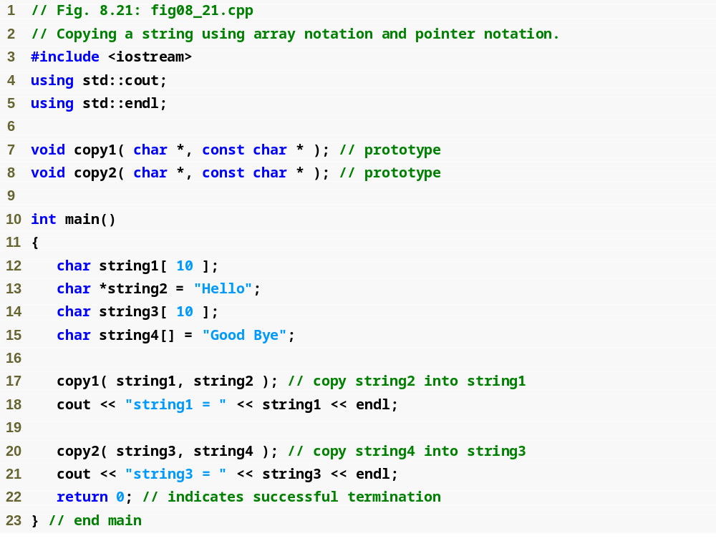
Outline
fig08_21.cpp
(1 of 2)

Slide 80
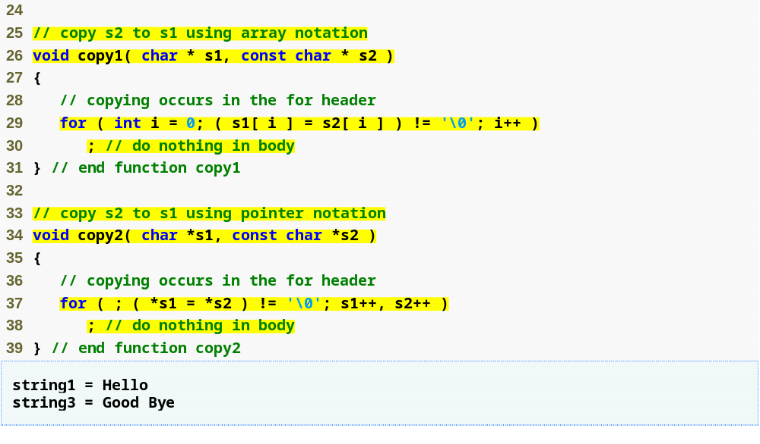
Outline
Use array subscript notation to copy string in s2 to character array s1
fig08_21.cpp
(2 of 2)
Use pointer notation to copy string in s2 to character array in s1
Increment both pointers to point to next elements in corresponding arrays

Slide 81
8.12 Function Pointers
Pointers to functions
  Contain addresses of functions
    Similar to how array name is address of first element
    Function name is starting address of code that defines function
Function pointers can be
  Passed to functions
  Returned from functions
  Stored in arrays
  Assigned to other function pointers

Slide 82
8.12 Function Pointers (Cont.)
Calling functions using pointers
  Assume function header parameter:
    bool ( *compare ) ( int, int )
  Execute function from pointer with either
    ( *compare ) ( int1, int2 )
      Dereference pointer to function
  OR
    compare( int1, int2 )
      Could be confusing
        User may think compare is name of actual function in program

Slide 83
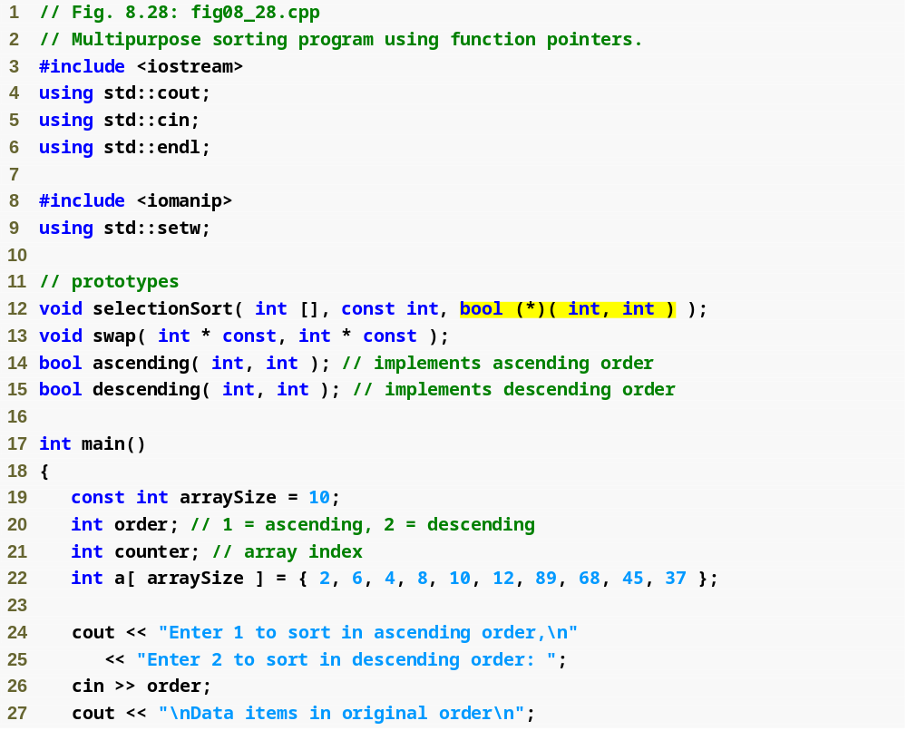
Outline
fig08_28.cpp
(1 of 4)
Parameter is pointer to function that receives two integer parameters and returns bool result

Slide 84
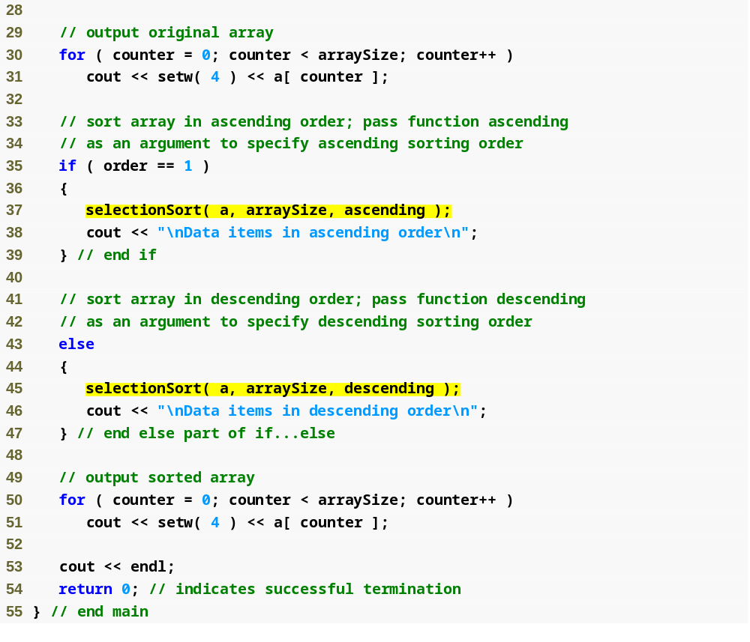
Outline
fig08_28.cpp
(2 of 4)
Pass pointers to functions ascending and descending as parameters to function selectionSort

Slide 85
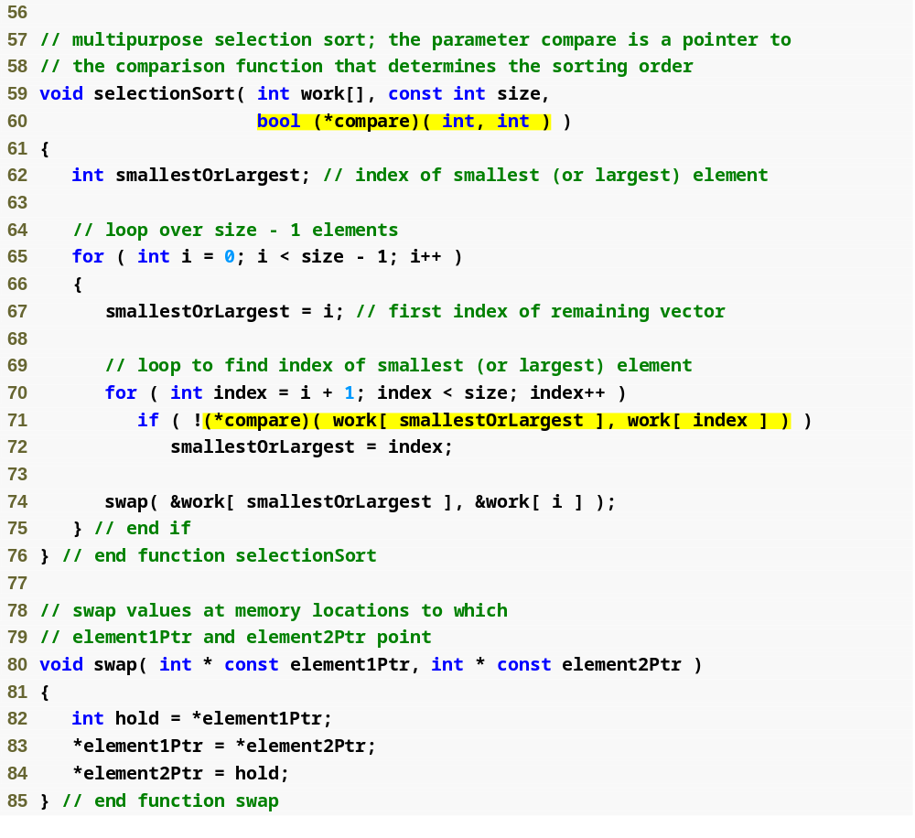
Outline
compare is a pointer to a function that receives two integer parameters and returns a bool result
fig08_28.cpp
(3 of 4)
Parentheses necessary to indicate pointer to function
Dereference pointer compare to execute the function

Slide 86
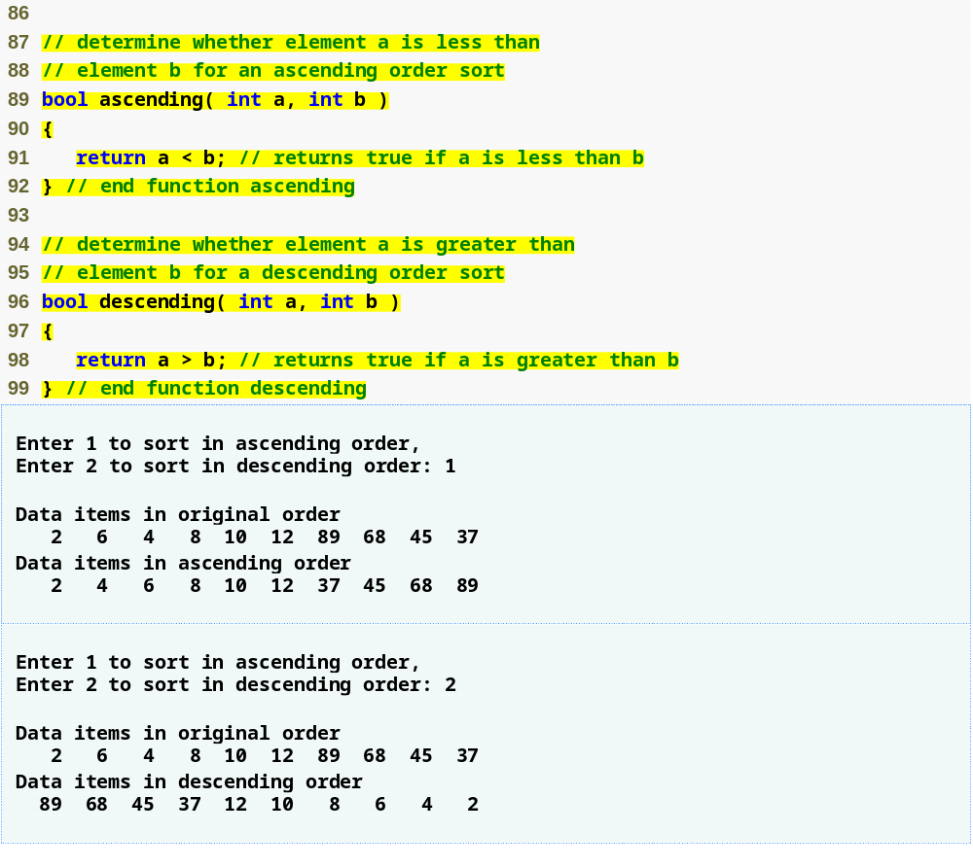
Outline
fig08_28.cpp
(4 of 4)

Slide 87
8.12 Function Pointers (Cont.)
Arrays of pointers to functions
  Menu-driven systems
    Pointers to each function stored in array of pointers to functions
      All functions must have same return type and same parameter types
    Menu choice determines subscript into array of function pointers

Slide 88
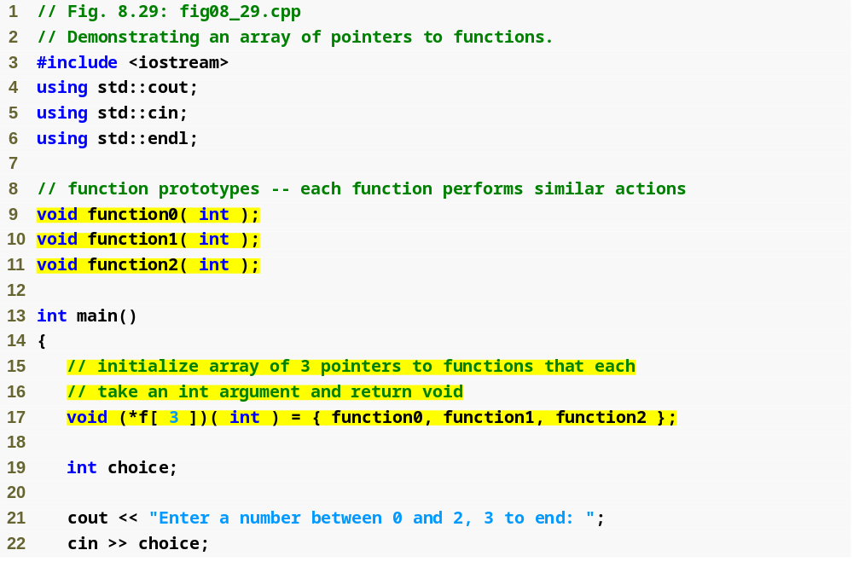
Outline
fig08_29.cpp
(1 of 3)
Array initialized with names of three functions

Slide 89
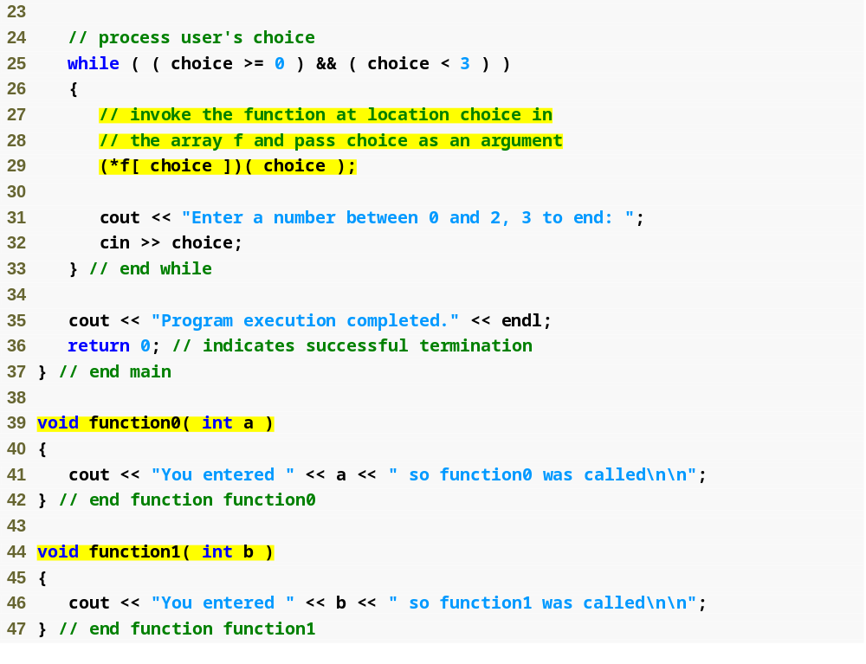
Outline
fig08_29.cpp
(2 of 3)
Call chosen function by dereferencing corresponding element in array

Slide 90
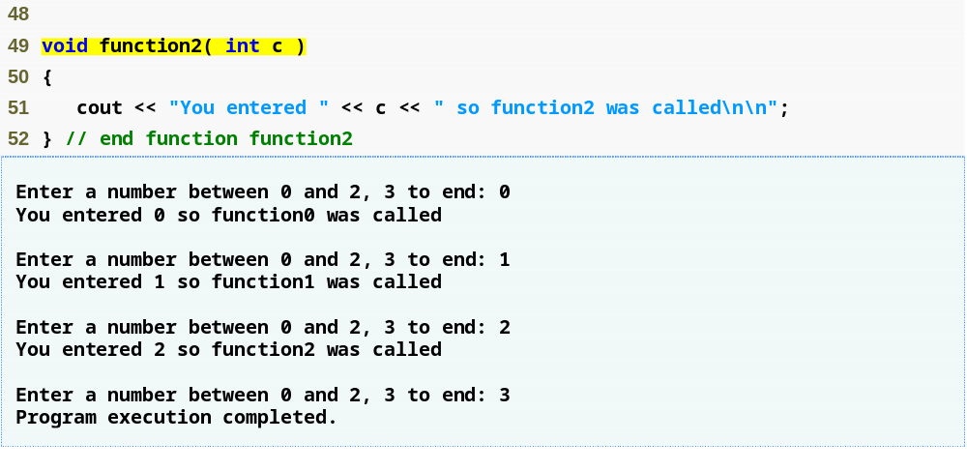
Outline
fig08_29.cpp
(3 of 3)

