Slide 1
9
Classes:
A Deeper Look,
Part 1

Slide 2
OBJECTIVES
In this chapter you’ll learn:
How to use a preprocessor wrapper to prevent multiple definition errors caused by including more than one copy of a header file in a source-code file.
To understand class scope and accessing class members via the name of an object, a reference to an object or a pointer to an object.
To define constructors with default arguments.
How destructors are used to perform "termination housekeeping" on an object before it is destroyed.
When constructors and destructors are called and the order in which they are called.
The logic errors that may occur when a public member function of a class returns a reference to private data.
To assign the data members of one object to those of another object by default memberwise assignment.

Slide 3
9.2 Time Class Case Study
Preprocessor wrappers
  Prevents code from being included more than once
    #ifndef – “if not defined”
      Skip this code if it has been included already
    #define
      Define a name so this code will not be included again
    #endif
  If the header has been included previously
    Name is defined already and the header file is not included again
  Prevents multiple-definition errors
  Example
    #ifndef TIME_H
    #define TIME_H
    … // code
    #endif

Slide 4
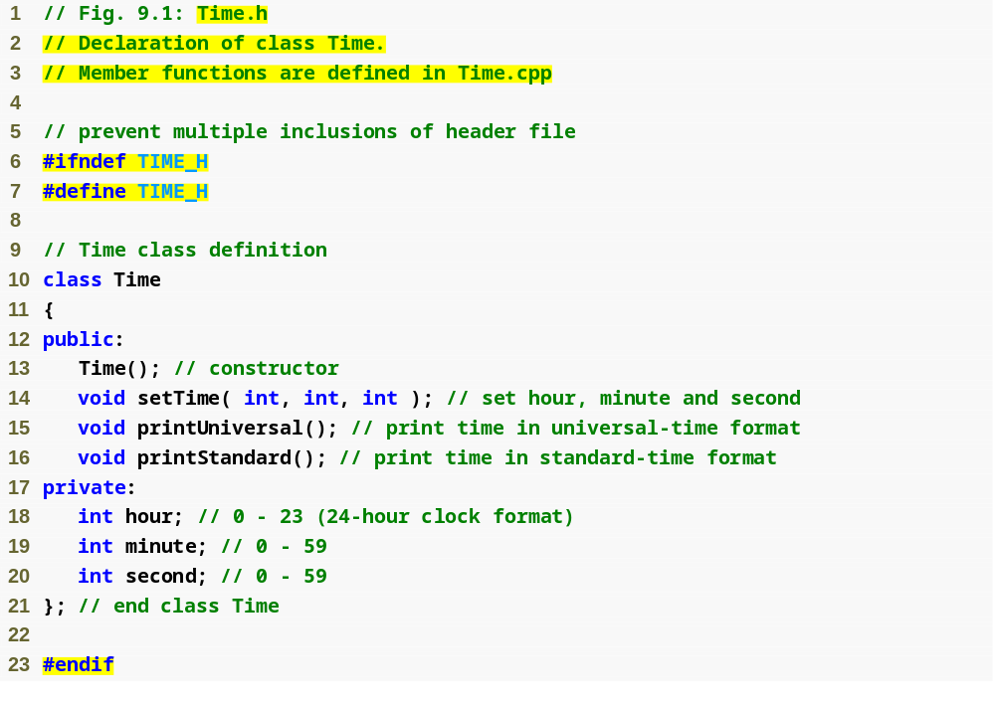
Outline
Preprocessor directive #ifndef determines whether a name is defined
Time.h
(1 of 1)
Preprocessor directive #define defines a name (e.g., TIME_H)
Preprocessor directive #endif marks the end of the code that should not be included multiple times

Slide 5
Software Engineering Observation 9.1
Each element of a class should have private visibility unless it can be proven that the element needs public visibility. This is another example of the principle of least privilege.

Slide 6
Error-Prevention Tip 9.1
Use #ifndef, #define and #endif preprocessor directives to form a preprocessor wrapper that prevents header files from being included more than once in a program.

Slide 7
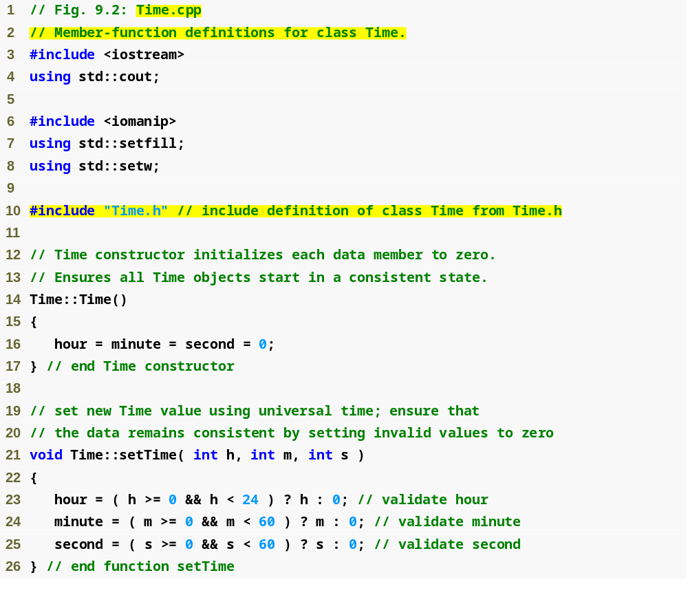
Outline
Time.cpp
(1 of 2)
Ensure that hour, minute and second values remain valid

Slide 8
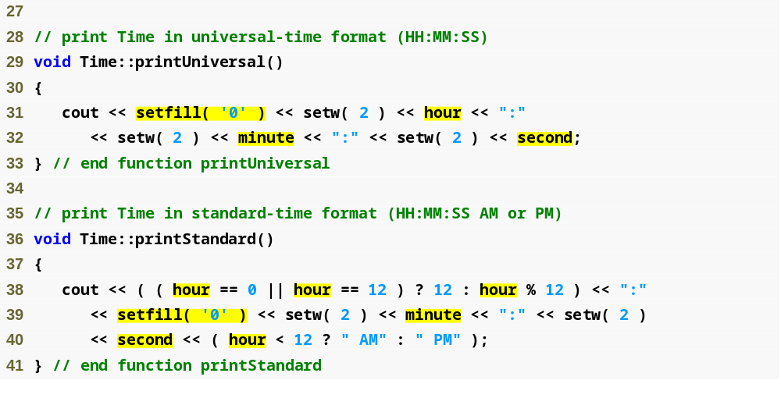
Outline
Using setfill stream manipulator to specify a fill character
Time.cpp
(2 of 2)

Slide 9
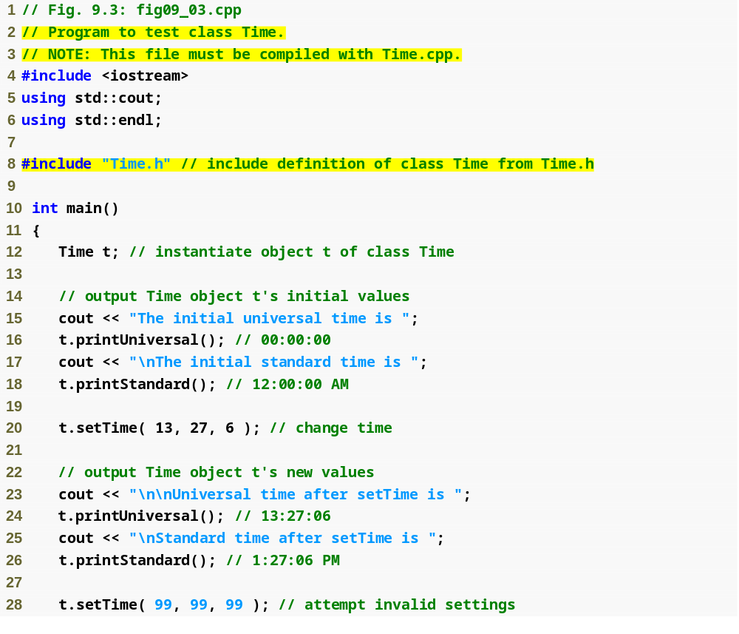
Outline
fig09_03.cpp
(1 of 2)

Slide 10
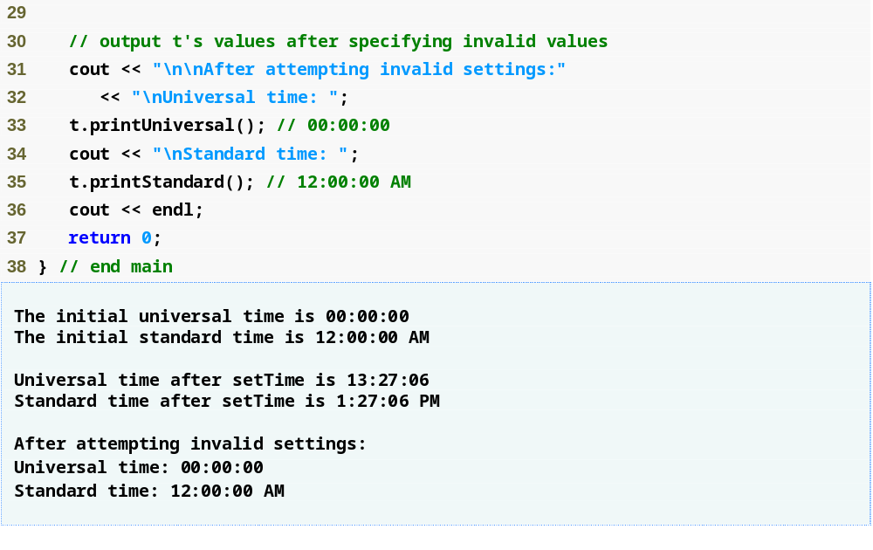
Outline
fig09_03.cpp
(2 of 2)

Slide 11
9.2 Time Class Case Study (Cont.)
Member function declared in a class definition but defined outside that class definition
  Still within the class’s scope
  Known only to other members of the class unless referred to via
    Object of the class
    Reference to an object of the class
    Pointer to an object of the class
    Binary scope resolution operator
Member function defined in the body of a class definition
  C++ compiler attempts to inline calls to the member function

Slide 12
9.2 Time Class Case Study (Cont.)
Using class Time
  Once class Time has been defined, it can be used in declarations
    Time sunset;
    Time arrayOfTimes[ 5 ];
    Time &dinnerTime = sunset;
    Time *timePtr = &dinnerTime;

Slide 13
Performance Tip 9.2
Objects contain only data, so objects are much smaller than if they also contained member functions. Applying operator sizeof to a class name or to an object of that class will report only the size of the class’s data members. The compiler creates one copy (only) of the member functions separate from all objects of the class. All objects of the class share this one copy. Each object, of course, needs its own copy of the class’s data, because the data can vary among the objects. The function code is nonmodifiable (also called reentrant code or pure procedure) and, hence, can be shared among all objects of one class.

Slide 14
9.3 Class Scope and Accessing Class Members
Class scope contains
  Data members
    Variables declared in the class definition
  Member functions
    Functions declared in the class definition
Nonmember functions are defined at file scope

Slide 15
9.3 Class Scope and Accessing Class Members (Cont.)
Within a class’s scope
  Class members are accessible by all member functions
Outside a class’s scope
  public class members are referenced through a handle
    An object name
    A reference to an object
    A pointer to an object

Slide 16
9.3 Class Scope and Accessing Class Members (Cont.)
Variables declared in a member function
  Have block scope
  Known only to that function
Hiding a class-scope variable
  In a member function, define a variable with the same name as a variable with class scope
  Such a hidden variable can be accessed by preceding the name with the class name followed by the scope resolution operator (::)

Slide 17
9.3 Class Scope and Accessing Class Members (Cont.)
Dot member selection operator (.)
  Accesses the object’s members
  Used with an object’s name or with a reference to an object
Arrow member selection operator (->)
  Accesses the object’s members
  Used with a pointer to an object

Slide 18
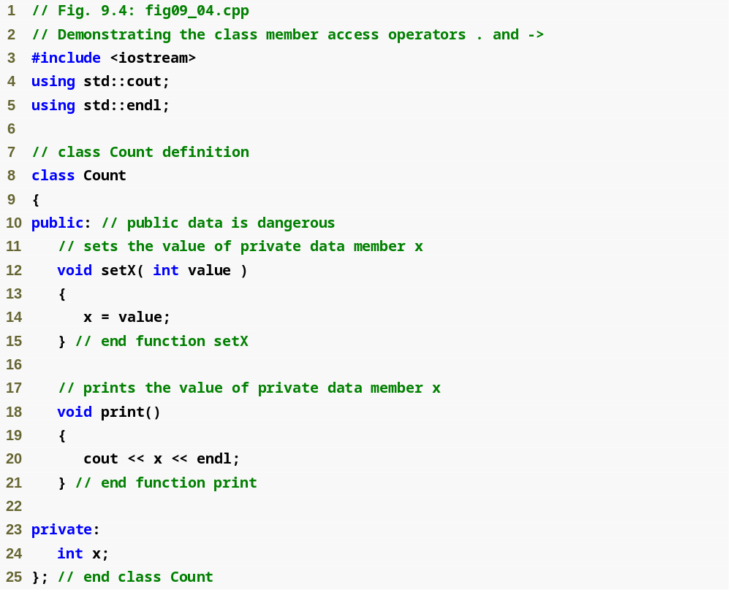
Outline
fig09_04.cpp
(1 of 2)

Slide 19
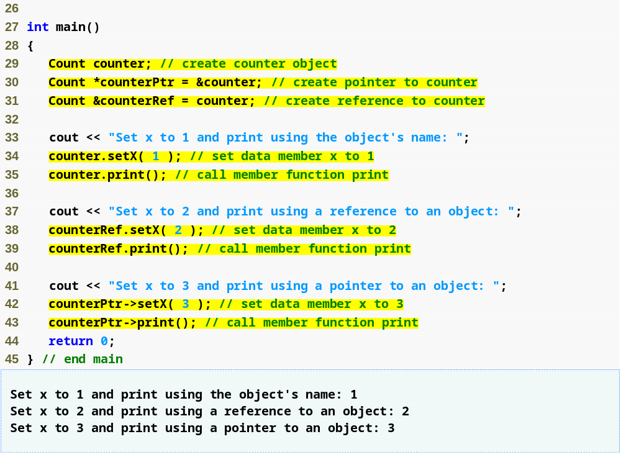
Outline
fig09_04.cpp
(2 of 2)
Using the dot member selection operator with an object
Using the dot member selection operator with a reference
Using the arrow member selection operator with a pointer

Slide 20
9.4 Separating Interface from Implementation
Separating a class definition and the class’s member-function definitions
  Makes it easier to modify programs
    Changes in the class’s implementation do not affect the client as long as the class’s interface remains unchanged
  Things are not quite this rosy
    Header files do contain some portions of the implementation and hint about others
      Inline functions need to be defined in header file
      private members are listed in the class definition in the header file

Slide 21
Software Engineering Observation 9.6
Clients of a class do not need access to the class’s source code in order to use the class. The clients do, however, need to be able to link to the class’s object code (i.e., the compiled version of the class). This encourages independent software vendors (ISVs) to provide class libraries for sale or license. The ISVs provide in their products only the header files and the object modules. No proprietary information is revealed—as would be the case if source code were provided. The C++ user community benefits by having more ISV-produced class libraries available.

Slide 22
Software Engineering Observation 9.7
Information important to the interface to a class should be included in the header file. Information that will be used only internally in the class and will not be needed by clients of the class should be included in the unpublished source file. This is yet another example of the principle of least privilege.

Slide 23
9.5 Access Functions and Utility Functions
Access functions
  Can read or display data
  Can test the truth or falsity of conditions
    Such functions are often called predicate functions
    For example, isEmpty function for a class capable of holding many objects
Utility functions (also called helper functions)
  private member functions that support the operation of the class’s public member functions
  Not part of a class’s public interface
    Not intended to be used by clients of a class

Slide 24
9.6 Time Class Case Study: Constructors with Default Arguments
Constructors can specify default arguments
  Can initialize data members to a consistent state
    Even if no values are provided in a constructor call
  Constructor that defaults all its arguments is also a default constructor
    Can be invoked with no arguments
    Maximum of one default constructor per class

Slide 25
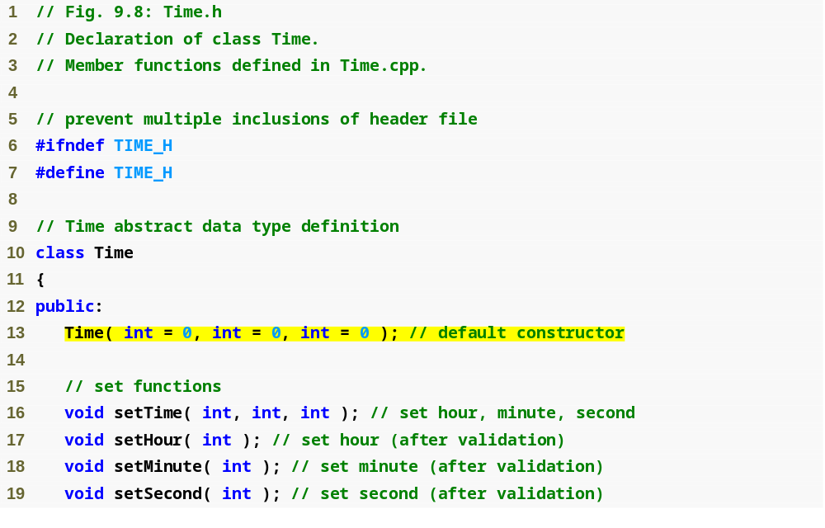
Outline
Time.h
(1 of 2)
Prototype of a constructor with default arguments

Slide 26
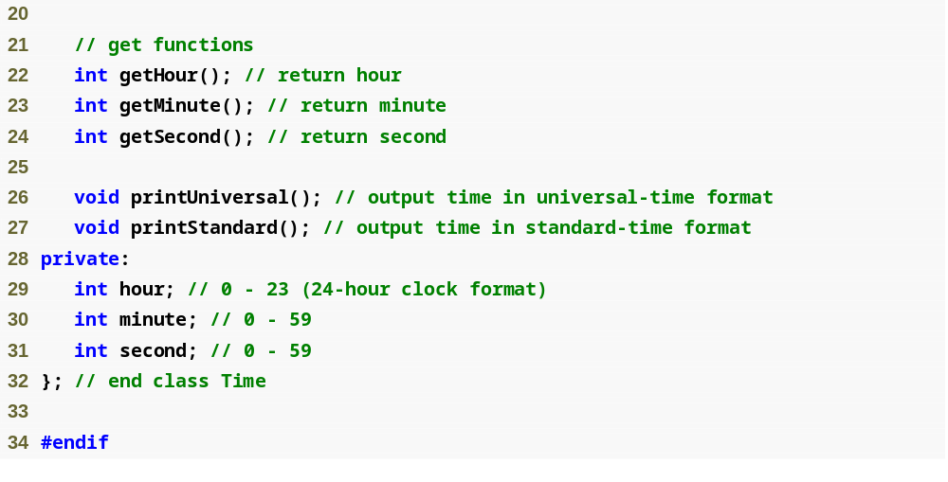
Outline
Time.h
(2 of 2)

Slide 27
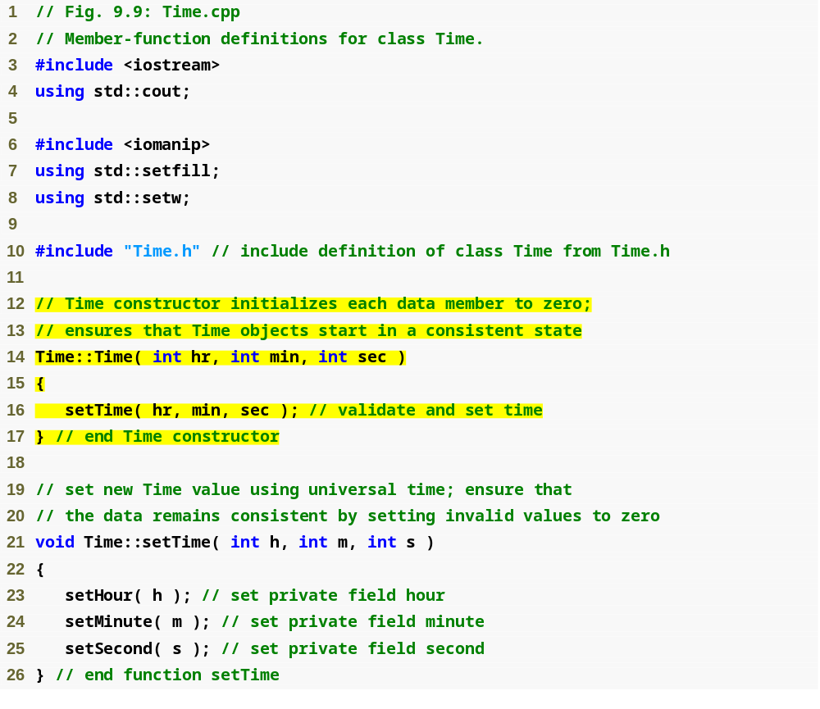
Outline
Time.cpp
(1 of 3)
Parameters could receive the default values

Slide 28
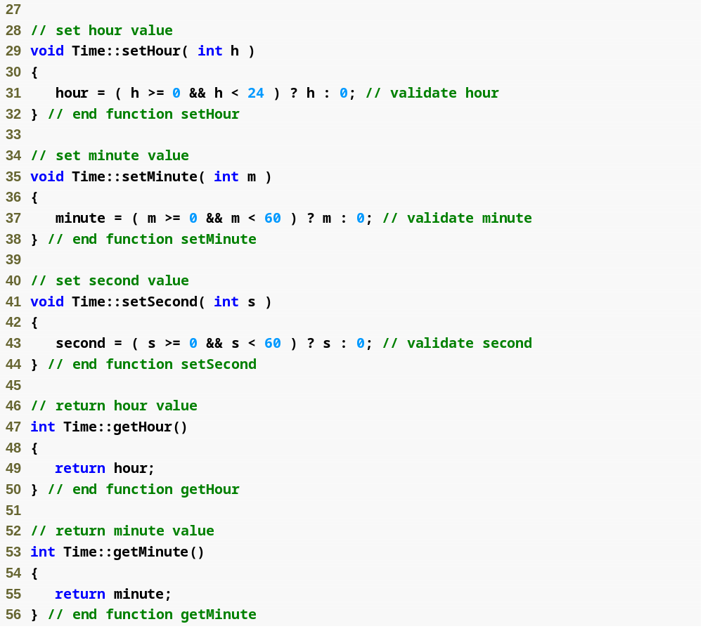
Outline
Time.cpp
(2 of 3)

Slide 29
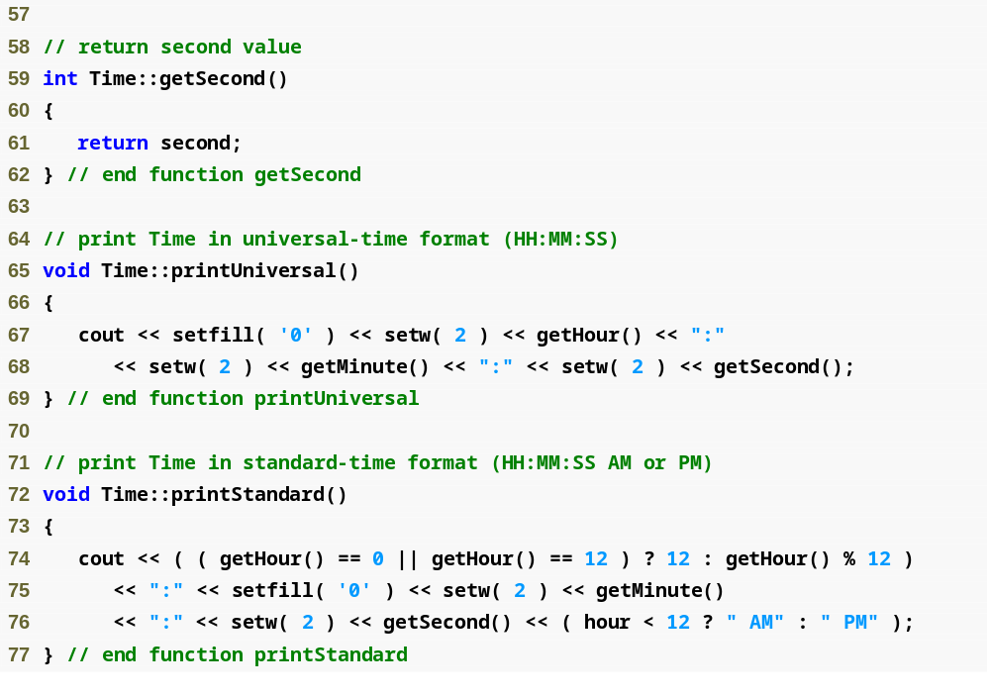
Outline
Time.cpp
(3 of 3)

Slide 30
Software Engineering Observation 9.10
Any change to the default argument values of a function requires the client code to be recompiled (to ensure that the program still functions correctly).

Slide 31
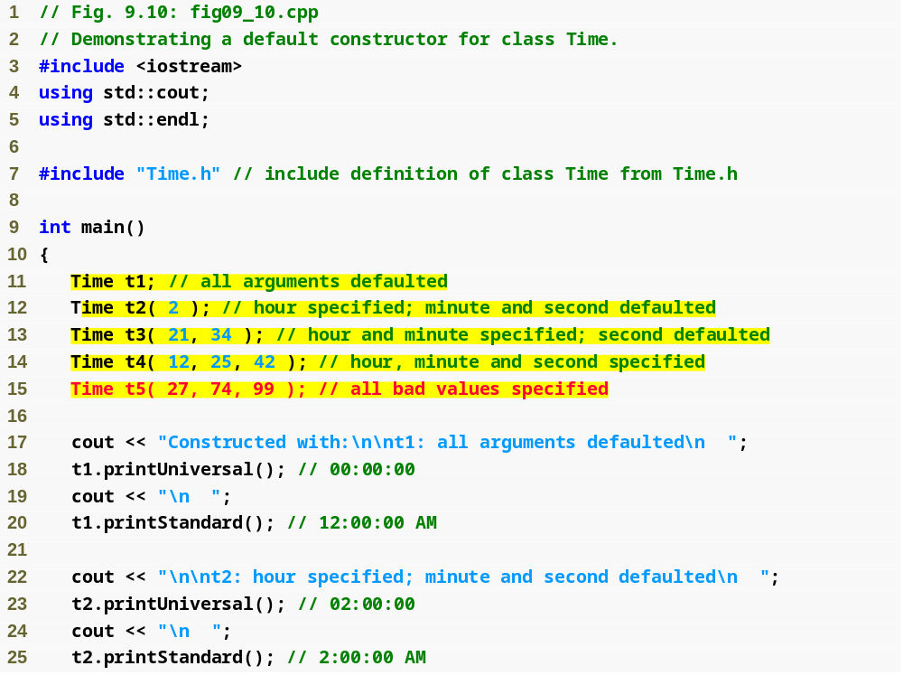
Outline
fig09_10.cpp
(1 of 3)
Initializing Time objects using 0, 1, 2 and 3 arguments

Slide 32
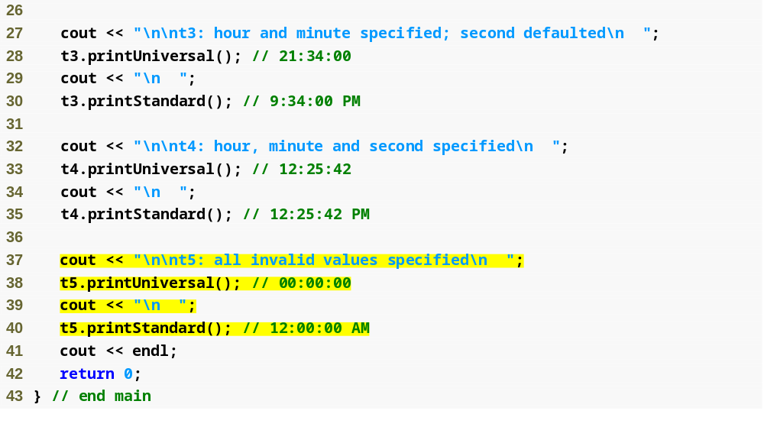
Outline
fig09_10.cpp
(2 of 3)

Slide 33
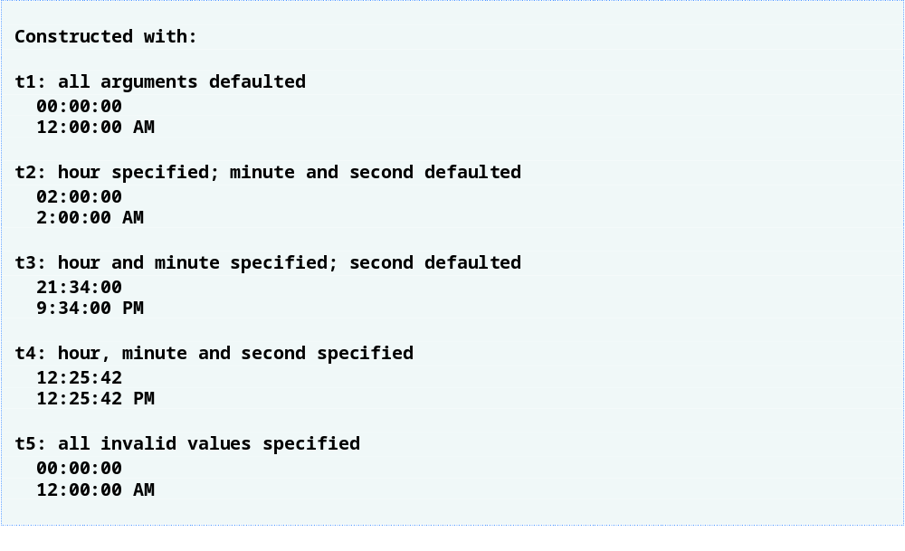
Outline
fig09_10.cpp
(3 of 3)
Invalid values passed to constructor, so object t5 contains all default data

Slide 34
Common Programming Error 9.2
A constructor can call other member functions of the class, such as set or get functions, but because the constructor is initializing the object, the data members may not yet be in a consistent state. Using data members before they have been properly initialized can cause logic errors.

Slide 35
9.7 Destructors
Destructor
  A special member function
  Name is the tilde character (~) followed by the class name, e.g., ~Time
  Called implicitly when an object is destroyed
    For example, this occurs as an automatic object is destroyed when program execution leaves the scope in which that object was instantiated
  Does not actually release the object’s memory
    It performs termination housekeeping
    Then the system reclaims the object’s memory
      So the memory may be reused to hold new objects

Slide 36
9.7 Destructors (Cont.)
Destructor (Cont.)
  Receives no parameters and returns no value
    May not specify a return type—not even void
  A class may have only one destructor
    Destructor overloading is not allowed
  If the programmer does not explicitly provide a destructor, the compiler creates an “empty” destructor

Slide 37
Common Programming Error 9.3
It is a syntax error to attempt to pass arguments to a destructor, to specify a return type for a destructor (even void cannot be specified), to return values from a destructor or to overload a destructor.

Slide 38
Software Engineering Observation 9.11
As we will see in the remainder of the book, constructors and destructors have much greater prominence in C++ and object-oriented programming than is possible to convey after only our brief introduction here.

Slide 39
9.8 When Constructors and Destructors Are Called
Constructors and destructors
  Called implicitly by the compiler
    Order of these function calls depends on the order in which execution enters and leaves the scopes where the objects are instantiated
  Generally,
    Destructor calls are made in the reverse order of the corresponding constructor calls
  However,
    Storage classes of objects can alter the order in which destructors are called

Slide 40
9.8 When Constructors and Destructors Are Called (Cont.)
For objects defined in global scope
  Constructors are called before any other function (including main) in that file begins execution
  The corresponding destructors are called when main terminates
    Function exit
      Forces a program to terminate immediately
        Does not execute the destructors of automatic objects
      Often used to terminate a program when an error is detected
    Function abort
      Performs similarly to function exit
        But forces the program to terminate immediately without allowing the destructors of any objects to be called
      Usually used to indicate an abnormal termination of the program

Slide 41
9.8 When Constructors and Destructors Are Called (Cont.)
For an automatic local object
  Constructor is called when that object is defined
  Corresponding destructor is called when execution leaves the object’s scope
For automatic objects
  Constructors and destructors are called each time execution enters and leaves the scope of the object
  Automatic object destructors are not called if the program terminates with an exit or abort function

Slide 42
9.8 When Constructors and Destructors Are Called (Cont.)
For a static local object
  Constructor is called only once
    When execution first reaches where the object is defined
  Destructor is called when main terminates or the program calls function exit
    Destructor is not called if the program terminates with a call to function abort
Global and static objects are destroyed in the reverse order of their creation

Slide 43
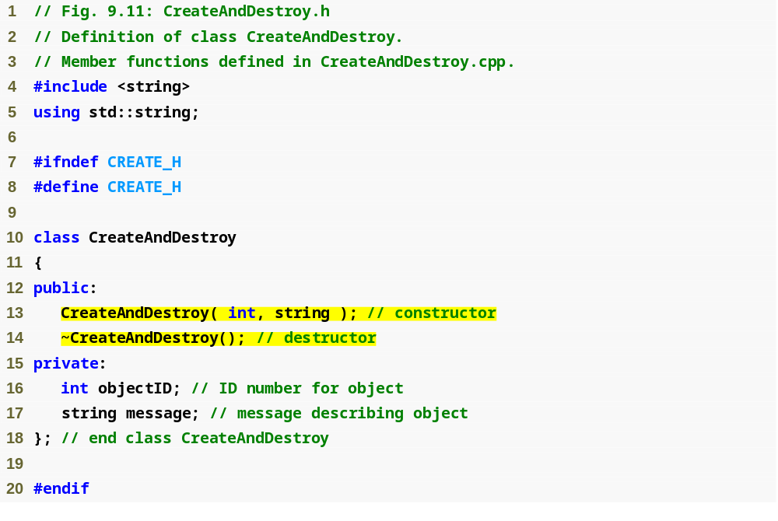
Outline
CreateAndDestroy.h
(1 of 1)
Prototype for destructor

Slide 44
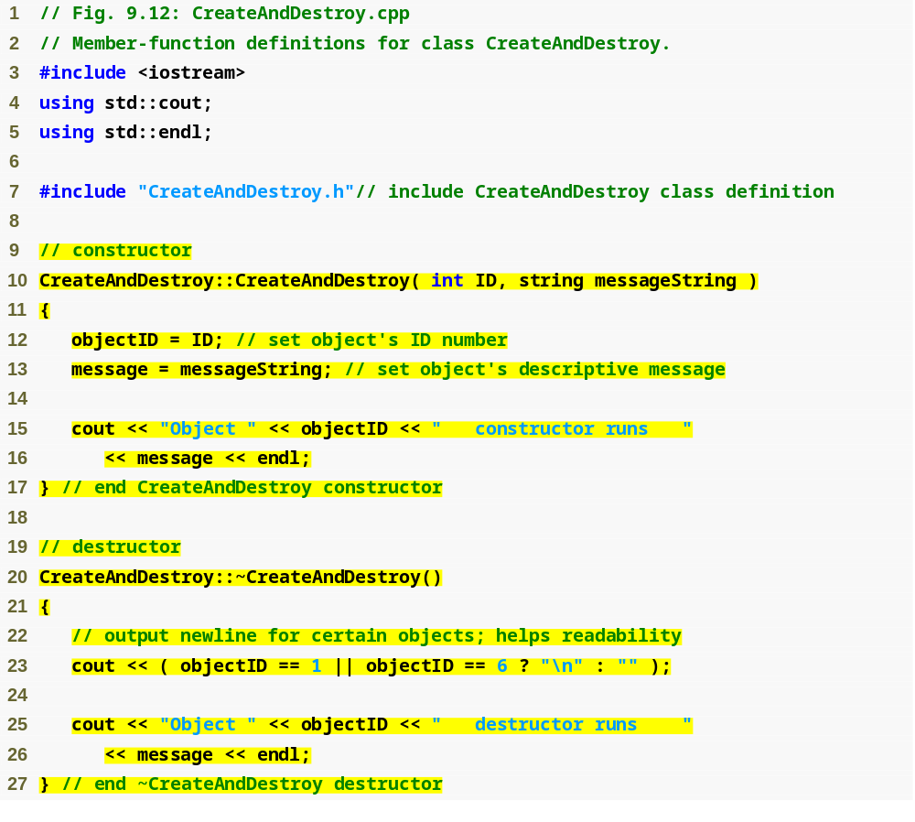
Outline
CreateAndDestroy.cpp
(1 of 1)
Defining the class’s destructor

Slide 45
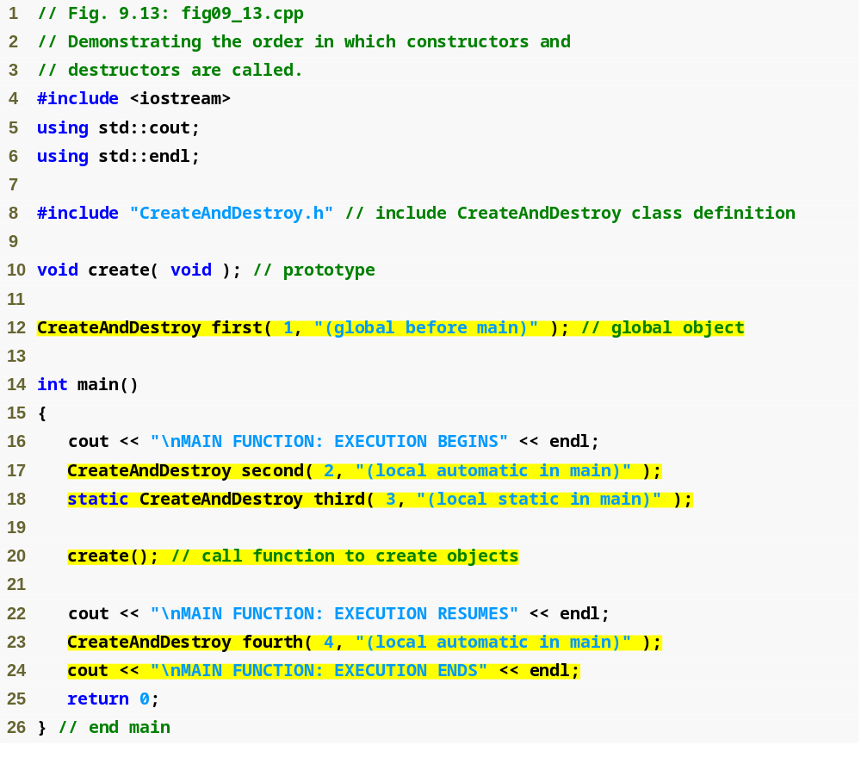
Outline
Fig09_13.cpp
(1 of 3)
Object created outside of main
Local automatic object created in main
Local static object created in main
Local automatic object created in main

Slide 46
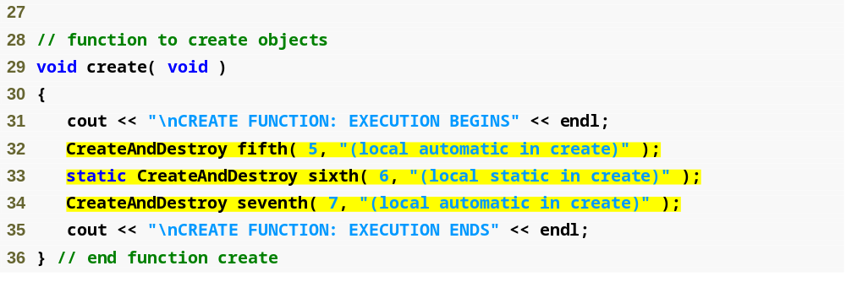
Outline
Fig09_13.cpp
(2 of 3)
Local automatic object created in create
Local static object created in create
Local automatic object created in create

Slide 47
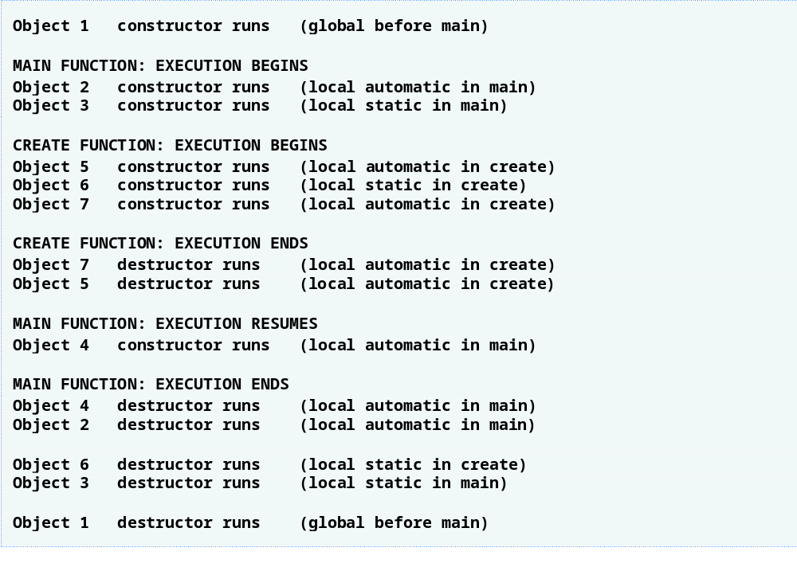
Outline
Fig09_13.cpp
(3 of 3)

Slide 48
9.9 Time Class Case Study: A Subtle Trap—Returning a Reference to a private Data Member
Returning a reference to an object
  Alias for the name of an object
    An acceptable lvalue that can receive a value
      May be used on the left side of an assignment statement
    If a function returns a const reference
      That reference cannot be used as a modifiable lvalue
  One (dangerous) way to use this capability
    A public member function of a class returns a reference to a private data member of that class
      Client code could alter private data
      Same problem would occur if a pointer to private data were returned

Slide 49
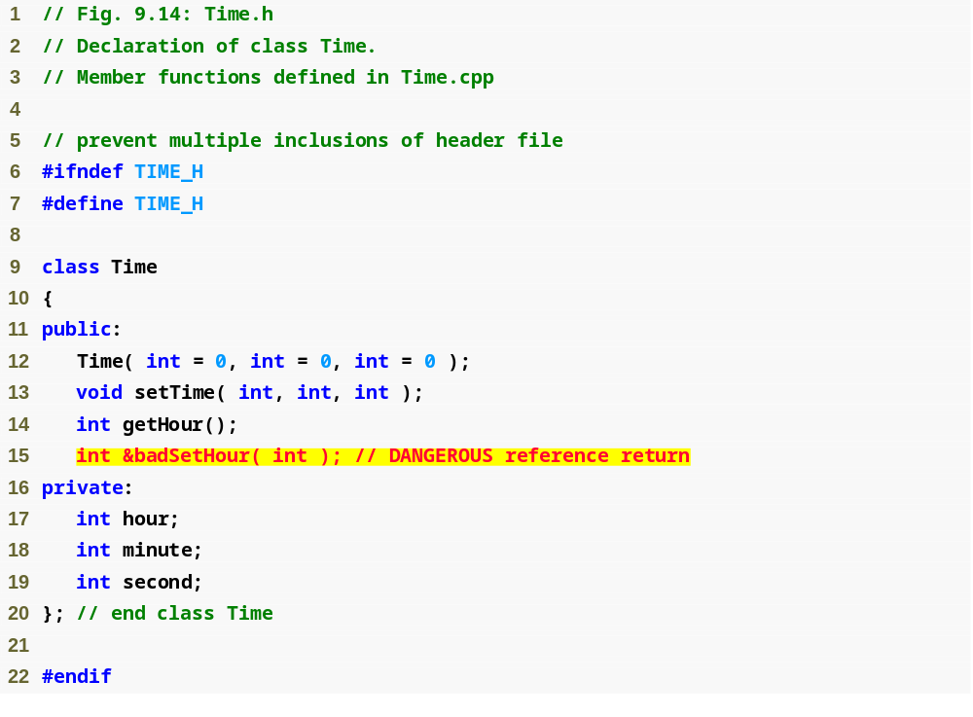
Outline
Time.h
(1 of 1)
Prototype for function that returns a reference

Slide 50
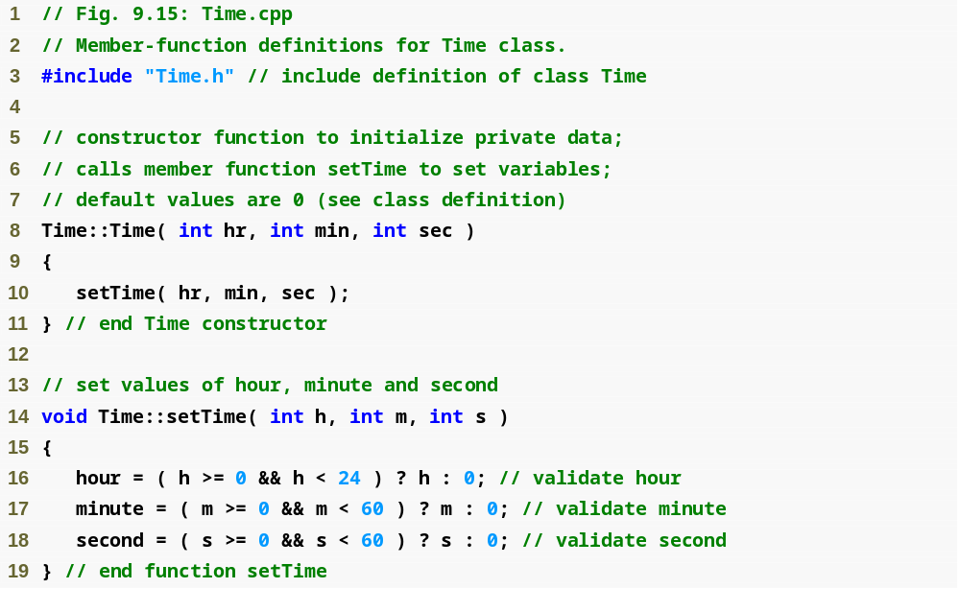
Outline
Time.cpp
(1 of 2)

Slide 51
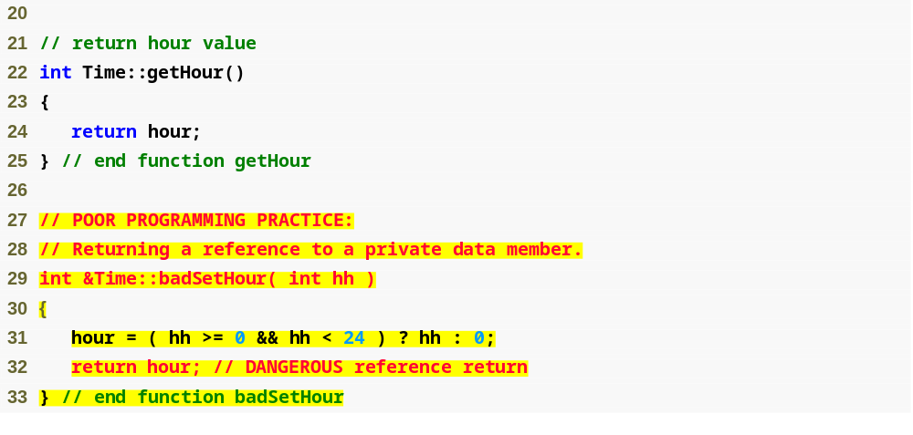
Outline
Time.cpp
(2 of 2)
Returning a reference to a private data member = DANGEROUS!

Slide 52
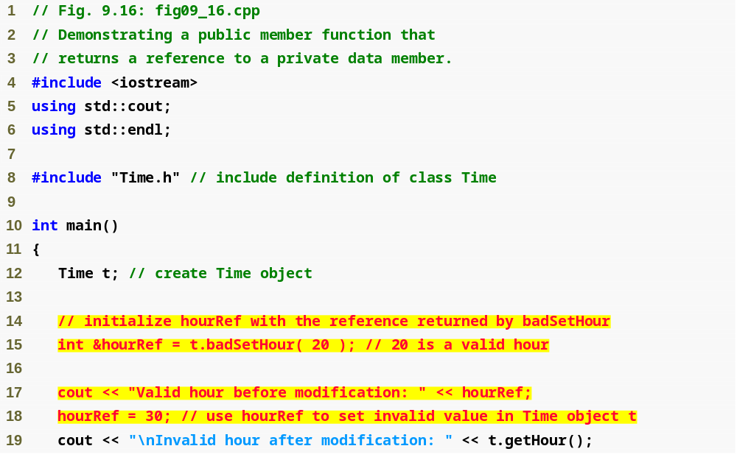
Outline
Fig09_16.cpp
(1 of 2)
Modifying a private data member through a returned reference

Slide 53
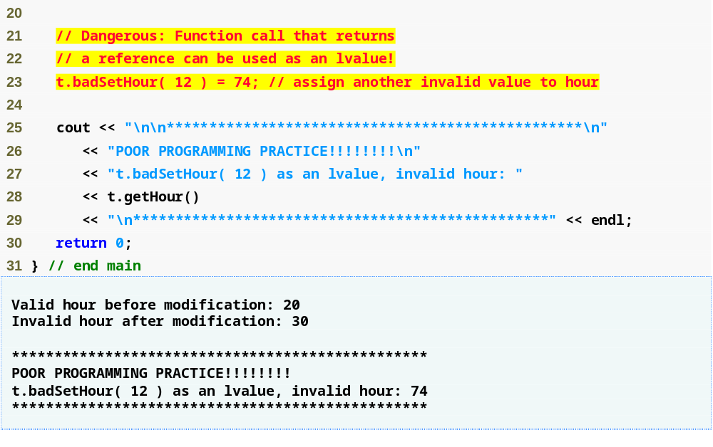
Outline
Modifying private data by using a function call as an lvalue
Fig09_16.cpp
(2 of 2)

Slide 54
Error-Prevention Tip 9.4
Returning a reference or a pointer to a private data member breaks the encapsulation of the class and makes the client code dependent on the representation of the class’s data. So, returning pointers or references to private data is a dangerous practice that should be avoided.

Slide 55
9.10 Default Memberwise Assignment
Default memberwise assignment
  Assignment operator (=)
    Can be used to assign an object to another object of the same type
      Each data member of the right object is assigned to the same data member in the left object
    Can cause serious problems when data members contain pointers to dynamically allocated memory

Slide 56
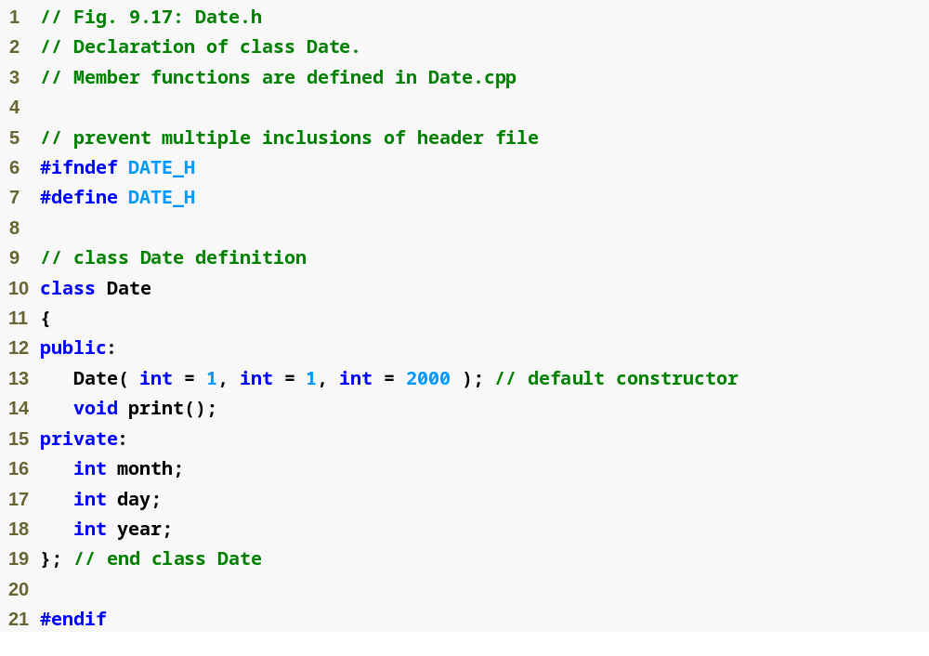
Outline
Date.h
(1 of 1)

Slide 57
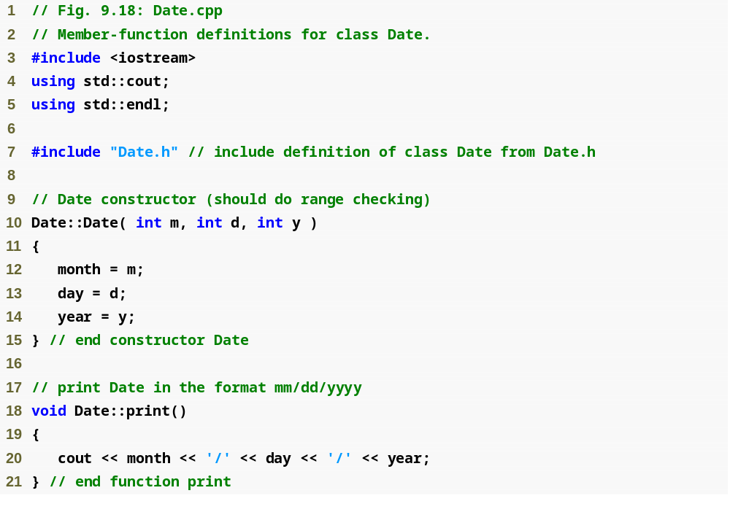
Outline
Date.cpp
(1 of 1)

Slide 58
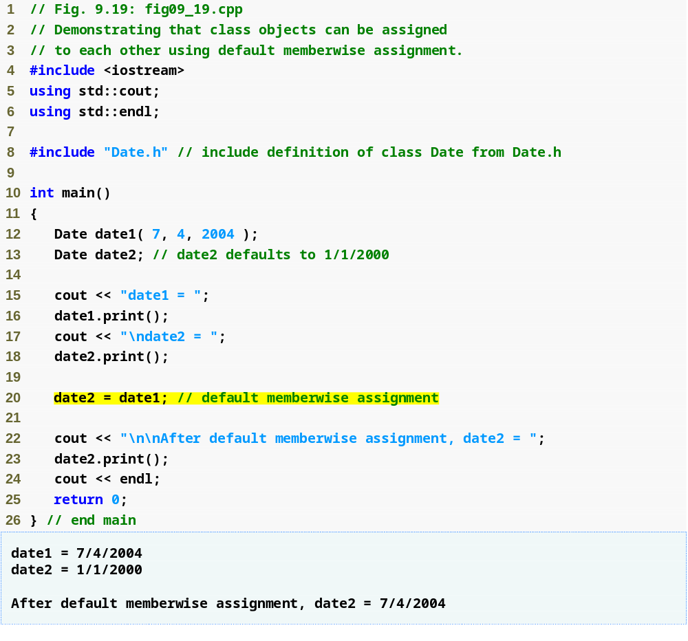
Outline
fig09_19.cpp
(1 of 1)
Memberwise assignment assigns data members of date1 to date2
date2 now stores the same date as date1

Slide 59
9.10 Default Memberwise Assignment (Cont.)
Copy constructor
  Enables pass-by-value for objects
    Used to copy original object’s values into new object to be passed to a function or returned from a function
  Constructor which initializes it's object member variables with another object of the same class.
  If you don't implement one in your class the compiler implements one for you by doing a member-wise copy (sometimes referred to as a shallow copy)
    Also can cause serious problems when data members contain pointers to dynamically allocated memory

Slide 60
When is a Copy Constructor Called
When the object of that class is passed by value as an argument to a function
  function(Obj1); //
When a function returns an object of that class by value
  Obj2 = function();
When you construct an object based on another object of the same class
  Boo Obj2(Obj1); // calling boo copy constructor
When compiler generates a temporary object
  As in 1) and 2) above
  Explicit casting
  Boo Obj2 = Obj1;// calling boo copy constructor

Slide 61
Example
class Boo
{
friend ostream & operator<<(ostream & output, Boo &b)
{
output << "I am a Boo. My name is " << b.booName << endl;
return output;
}
public:
// default constructor
Boo(string name = "casper")
{
booName = name;
cout << booName << "::Boo default constructor called" << endl;
}
// copy constructor
Boo (Boo & b)
{
booName = b.booName;
cout << "class boo copy constructor called" << endl;
}
private:
string booName;
};
Class Boo

Slide 62
Example
Test Driver
Boo getBoo();
void putBoo(Boo);
void main()
{
// call default constructor
Boo b;
cout << b << endl;
// Case 1) calling copy constructor for function return by value
cout << "***** Case 1 *****" << endl;
b = getBoo();
cout << b << endl;
// Case 2) calling copy constructor for parameter pass by value to function
cout << "***** Case 2 *****" << endl;
Boo b1("sammy");
putBoo(b1);
// Case 3) calling copy constructor for an object which is created based
// on another
cout << "***** Case 3 *****" << endl;
Boo b2(b);
cout << b2 << endl;
}
Helper Functions
Boo getBoo()
{
Boo b("freddy");
return b;
}
void putBoo(Boo b)
{
cout << b << endl;
}
CIS 554/<number>

Slide 63
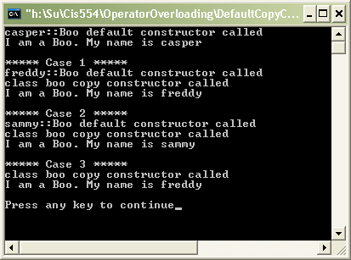
Example
// Case 1) calling copy constructor for function
// return by value
cout << "***** Case 1 *****" << endl;
b = getBoo();
cout << b << endl;
// Case 2) calling copy constructor for parameter
// pass by value to function
cout << "***** Case 2 *****" << endl;
Boo b1("sammy");
putBoo(b1);
// Case 3) calling copy constructor for an
// object which is created based on another
cout << "***** Case 3 *****" << endl;
Boo b2(b);
cout << b2 << endl;
CIS 554/<number>

Slide 64
Important Note
If you need a copy constructor, you also need a destructor and operator=
  If you need a copy constructor, it's because you need something like a deep copy, or some other management of resources. Thus it is almost certain that you will need a destructor, and will need to override the assignment operator.
CIS 554/<number>

