Slide 1
10
Classes: A Deeper Look, Part 2

Slide 2
10.1 Introduction
const objects and const member functions
  Prevent modifications of objects
  Enforce the principle of least privilege
Composition
  Classes having objects of other classes as members
Friendship
  Enables class designer to specify that certain non-member functions can access the class’s non-public members

Slide 3
10.1 Introduction (Cont.)
this pointer
Dynamic memory management
  new and delete operators
static class members
Proxy classes
  Hide implementation details of a class from clients
Pointer-base strings
  Used in C legacy code from the last two decades

Slide 4
10.2 const (Constant) Objects and const Member Functions
Principle of least privilege
  One of the most fundamental principles of good software engineering
  Applies to objects, too
const objects
  Keyword const
  Specifies that an object is not modifiable
  Attempts to modify the object will result in compilation errors

Slide 5
10.2 const (Constant) Objects and const Member Functions (Cont.)
const member functions
  Only const member function can be called for const objects
  Member functions declared const are not allowed to modify the object
  A function is specified as const both in its prototype and in its definition
  const declarations are not allowed for constructors and destructors

Slide 6
Software Engineering Observation 10.2
A const member function can be overloaded with a non-const version. The compiler chooses which overloaded member function to use based on the object on which the function is invoked. If the object is const, the compiler uses the const version. If the object is not const, the compiler uses the non-const version.

Slide 7
Common Programming Error 10.4
Attempting to declare a constructor or destructor const is a compilation error.

Slide 8
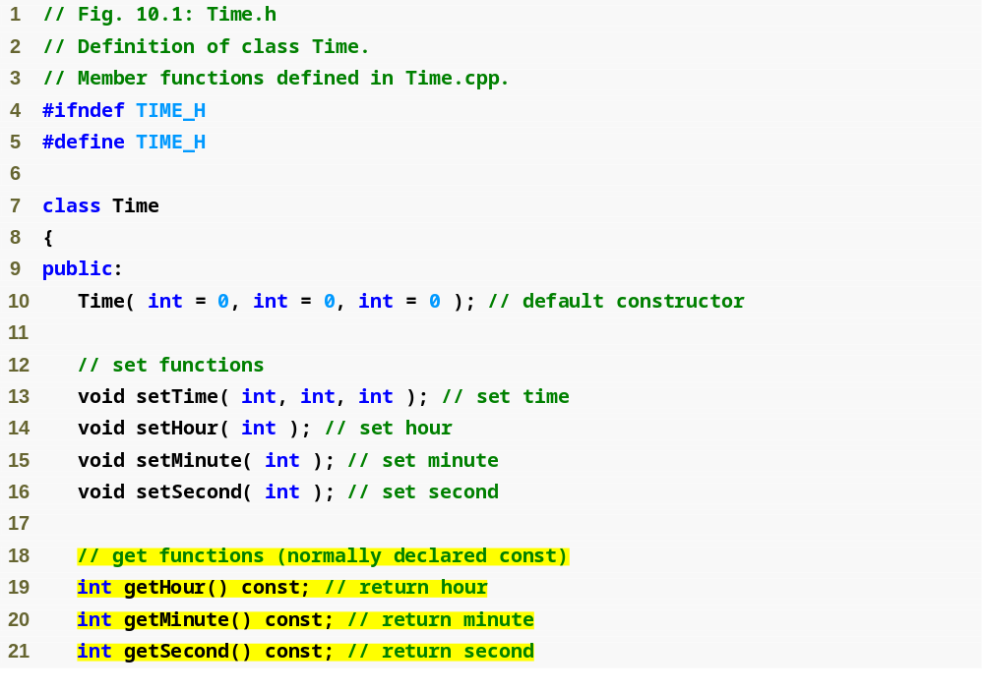
Outline
Time.h
(1 of 2)
const keyword to indicate that member function cannot modify the object

Slide 9
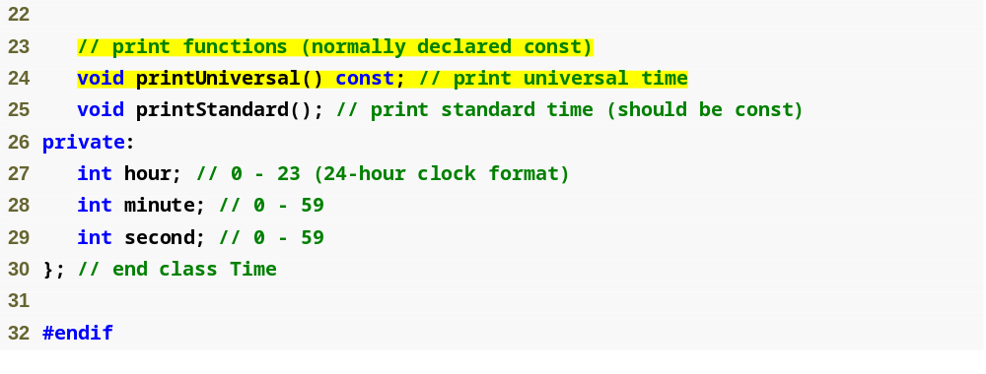
Outline
Time.h
(2 of 2)

Slide 10
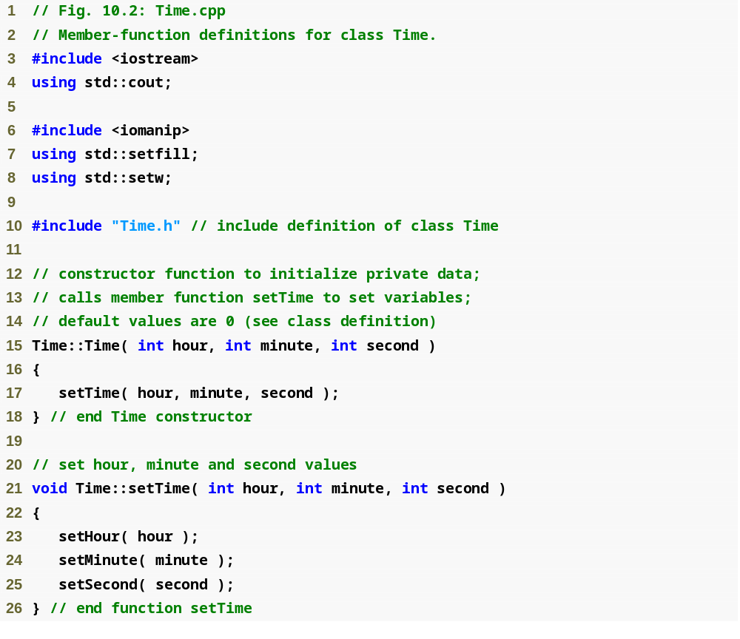
Outline
Time.cpp
(1 of 3)

Slide 11
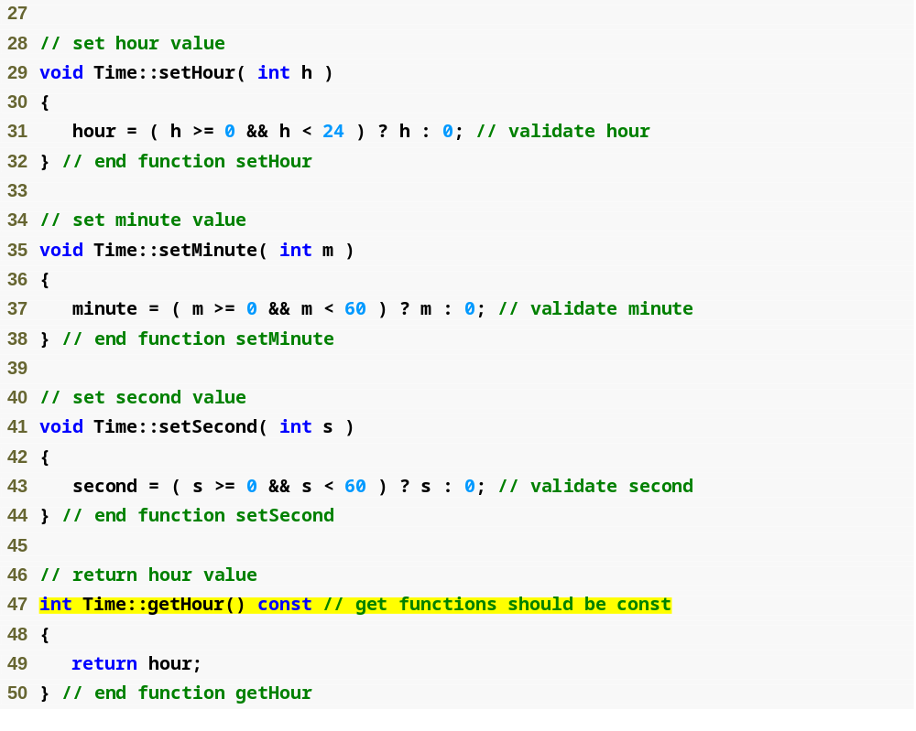
Outline
Time.cpp
(2 of 3)
const keyword in function definition, as well as in function prototype

Slide 12
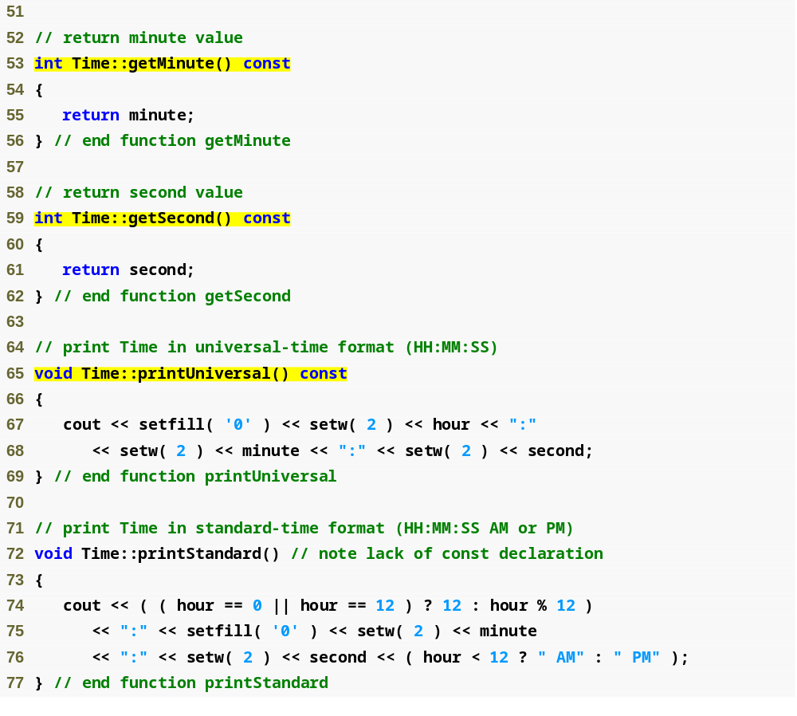
Outline
Time.cpp
(3 of 3)

Slide 13
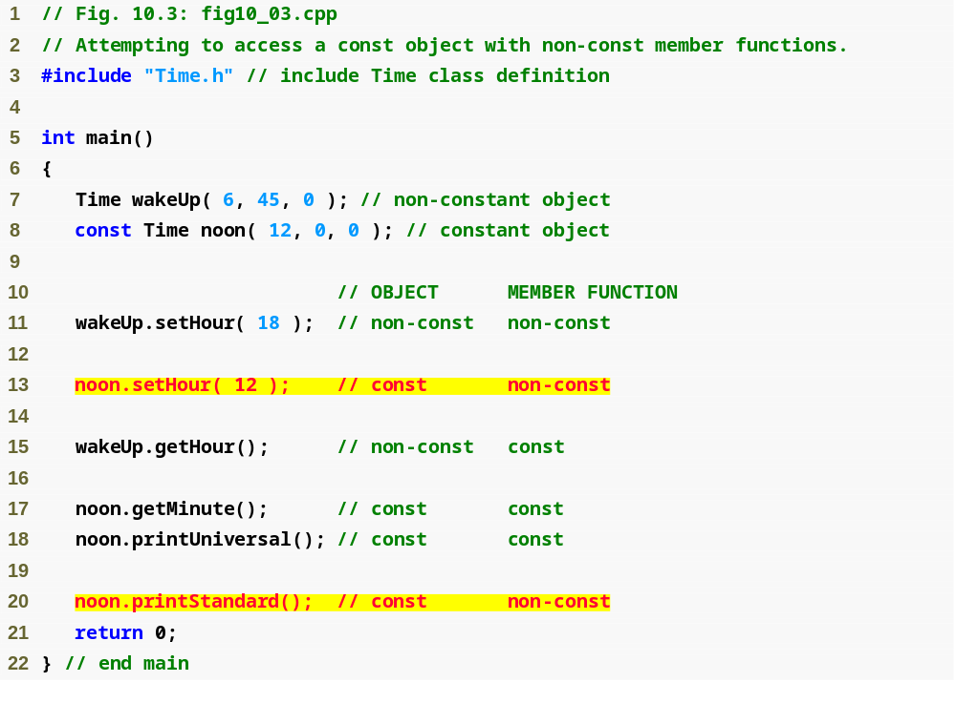
Outline
fig10_03.cpp
(1 of 2)
Cannot invoke non-const member functions on a const object

Slide 14
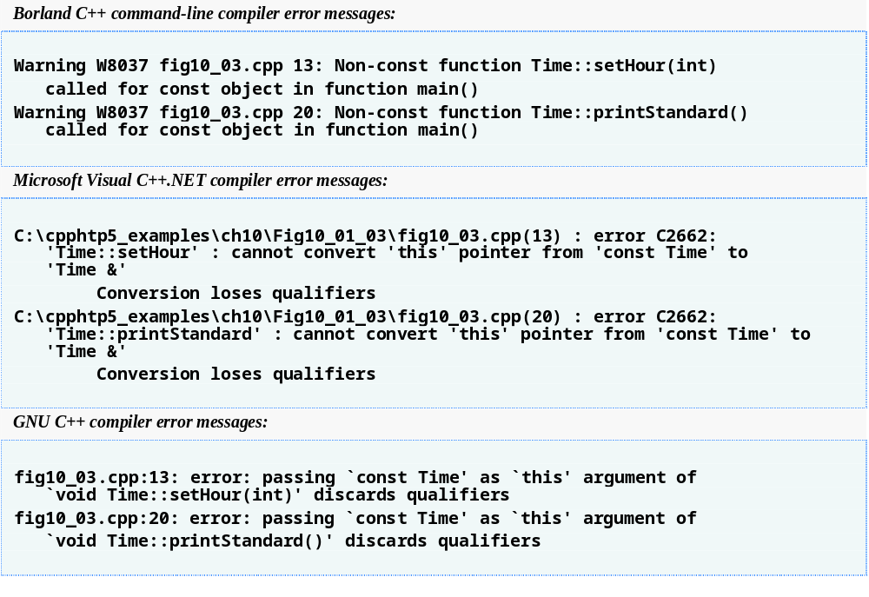
Outline
fig10_03.cpp
(2 of 2)

Slide 15
10.2 const (Constant) Objects and const Member Functions (Cont.)
Member initializer
  Required for initializing
    const data members
    Data members that are references
  Can be used for any data member
Member initializer list
  Appears between a constructor’s parameter list and the left brace that begins the constructor’s body
  Separated from the parameter list with a colon (:)
  Each member initializer consists of the data member name followed by parentheses containing the member’s initial value
  Multiple member initializers are separated by commas
  Executes before the body of the constructor executes

Slide 16
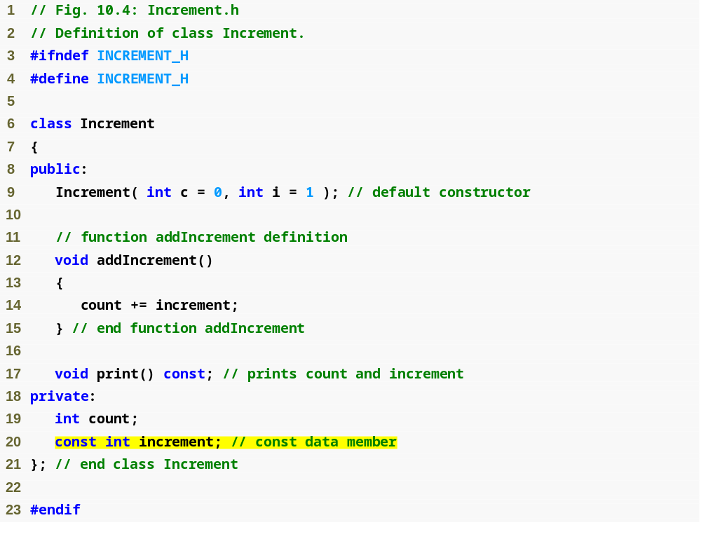
Outline
Increment.h
(1 of 1)
const data member that must be initialized using a member initializer

Slide 17
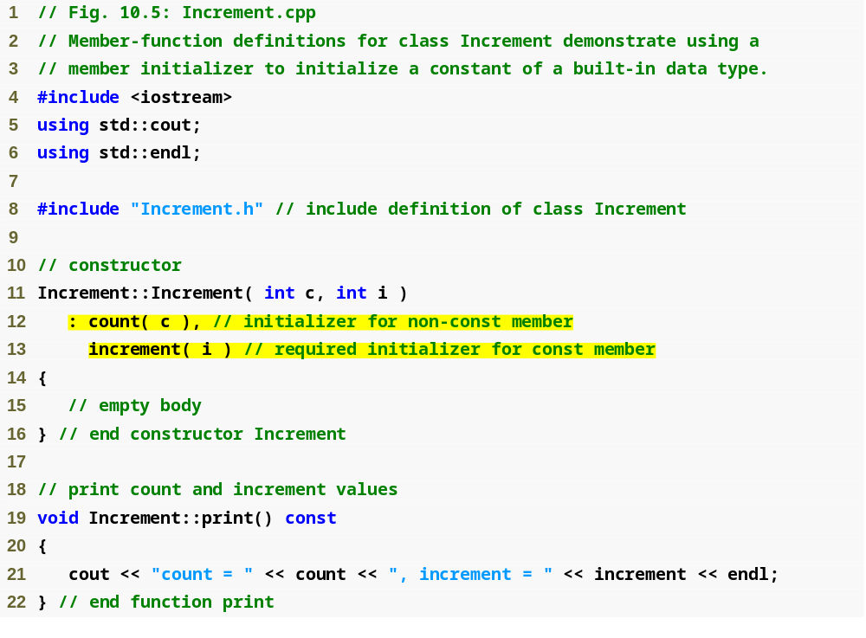
Outline
Increment.cpp
(1 of 1)
Colon (:) marks the start of a member initializer list
Member initializer for non-const member count
Required member initializer for const member increment

Slide 18
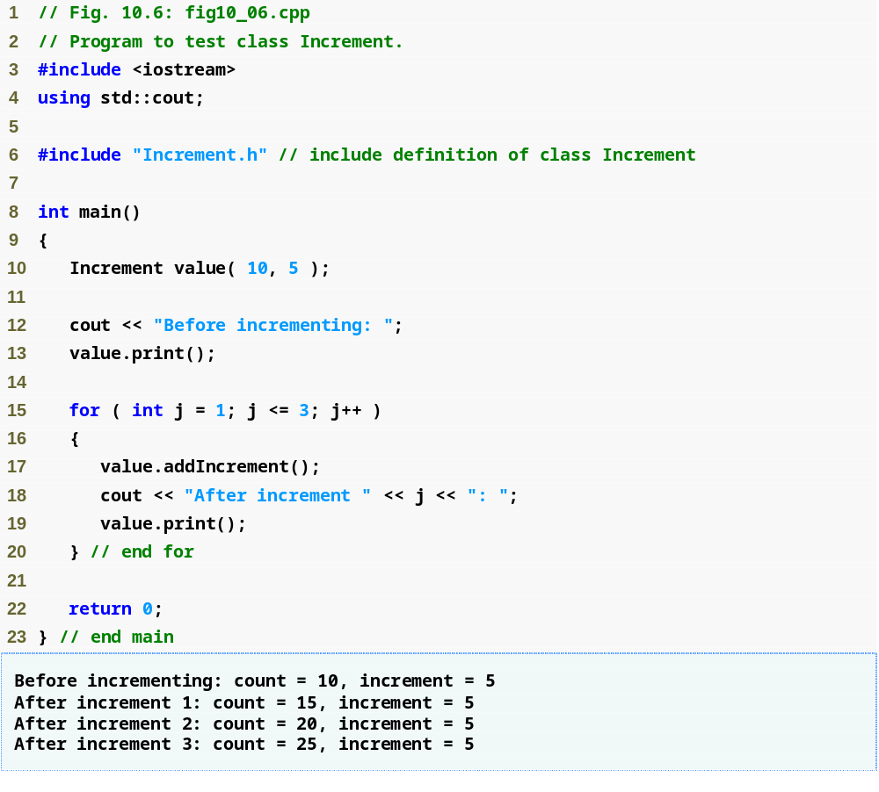
Outline
fig10_06.cpp
(1 of 1)

Slide 19
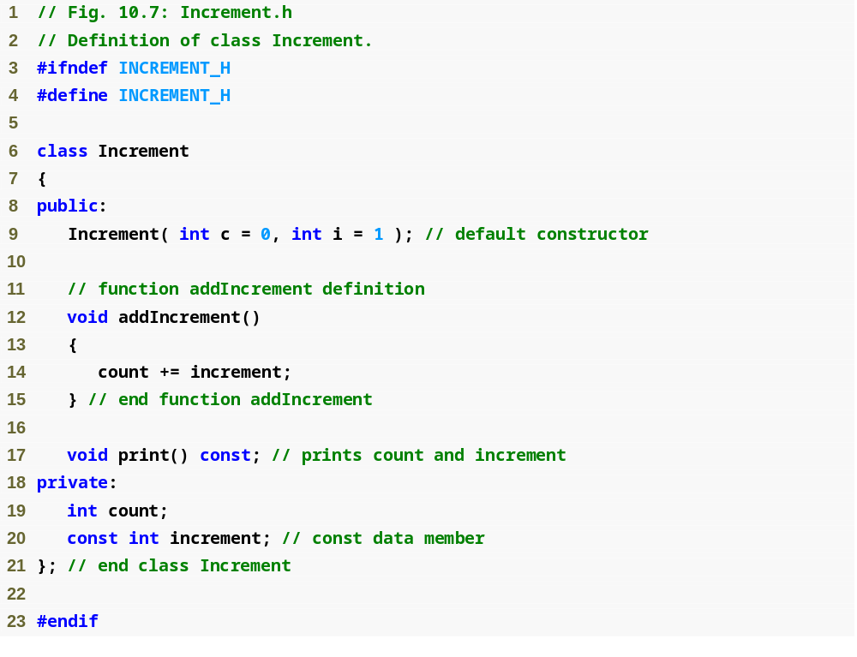
Outline
Increment.h
(1 of 1)
Member function declared const to prevent errors in situations where an Increment object is treated as a const object

Slide 20
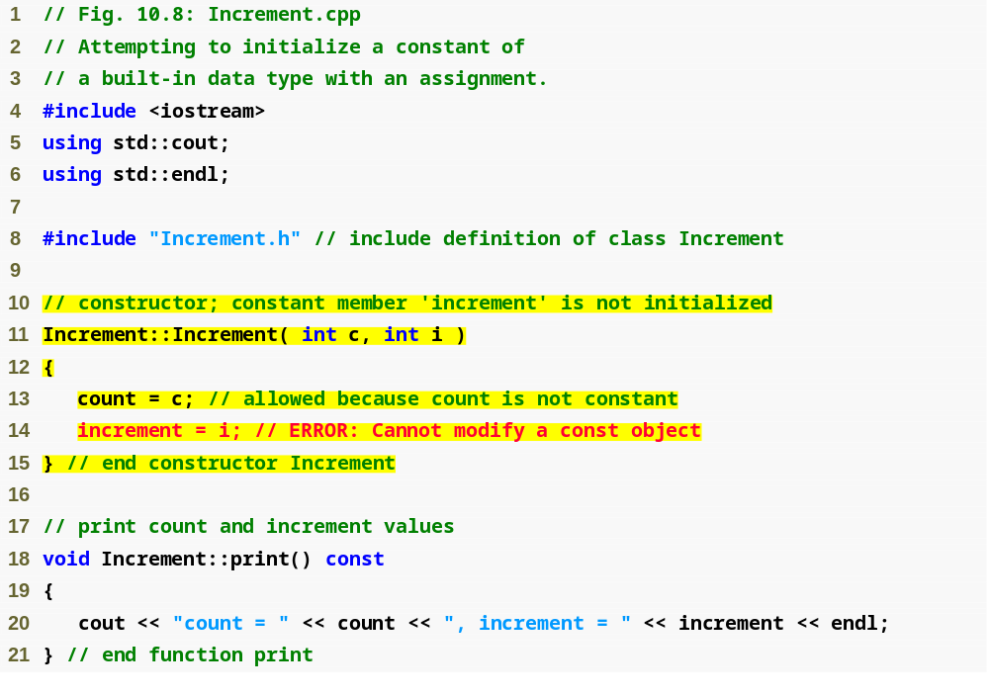
Outline
Increment.cpp
(1 of 1)
It is an error to modify a const data member; data member increment must be initialized with a member initializer

Slide 21
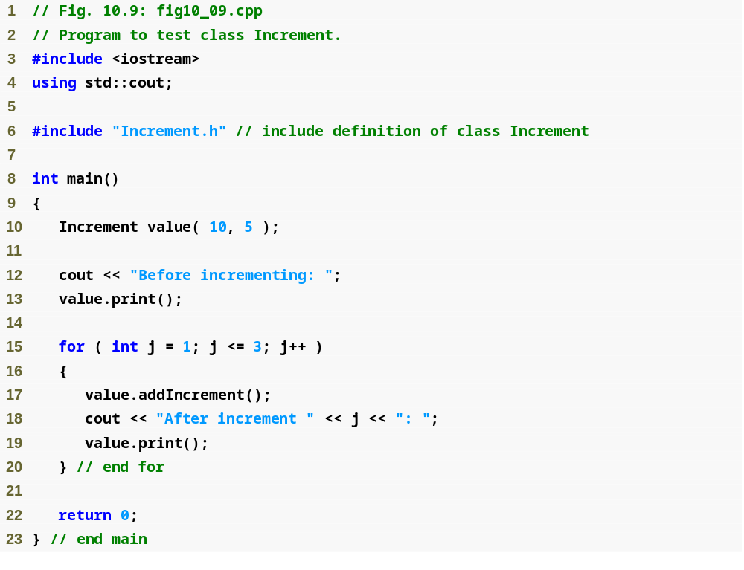
Outline
fig10_09.cpp
(1 of 2)

Slide 22
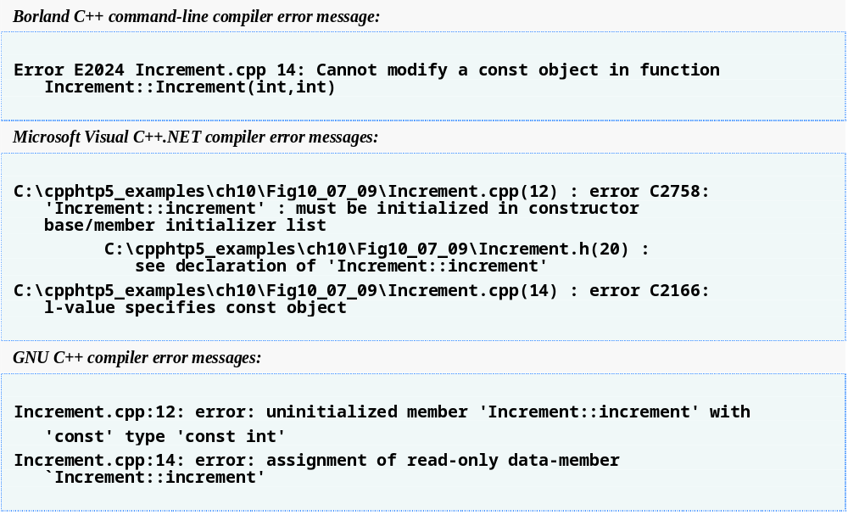
Outline
fig10_09.cpp
(2 of 2)

Slide 23
10.3 Composition: Objects as Members of Classes
Composition
  Sometimes referred to as a has-a relationship
  A class can have objects of other classes as members
  Example
    AlarmClock object with a Time object as a member

Slide 24
10.3 Composition: Objects as Members of Classes (Cont.)
Initializing member objects
  Member initializers pass arguments from the object’s constructor to member-object constructors
  Member objects are constructed in the order in which they are declared in the class definition
    Not in the order they are listed in the constructor’s member initializer list
    Before the enclosing class object (host object) is constructed
  If a member initializer is not provided
    The member object’s default constructor will be called implicitly

Slide 25
Software Engineering Observation 10.6
Member objects are constructed in the order in which they are declared in the class definition (not in the order they are listed in the constructor’s member initializer list) and before their enclosing class objects (sometimes called host objects) are constructed.

Slide 26
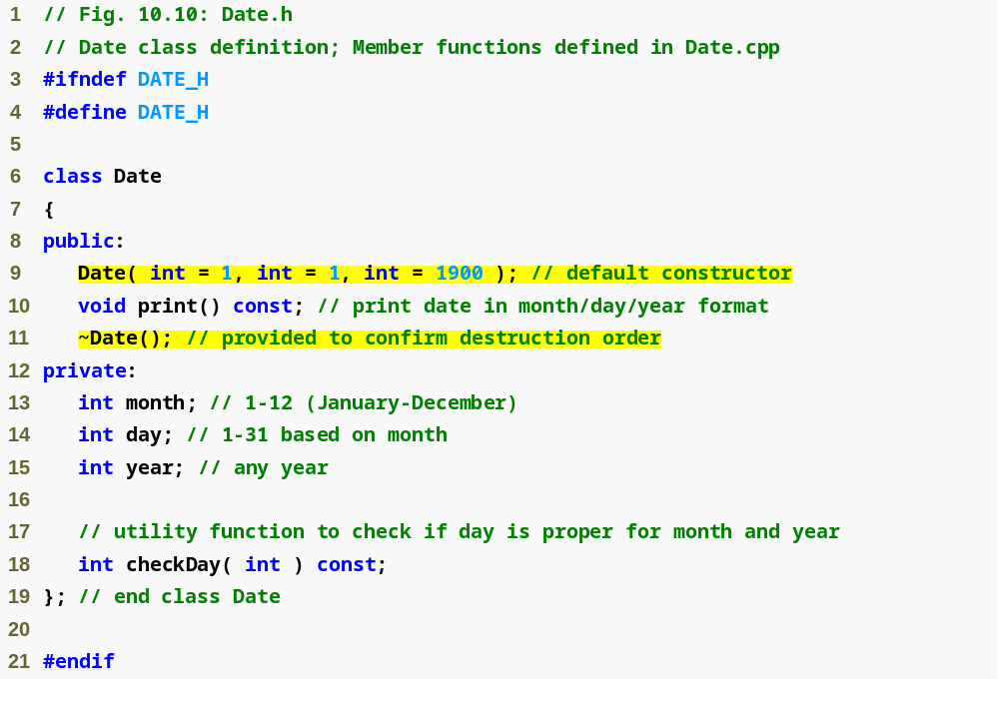
Outline
Date.h
(1 of 1)

Slide 27
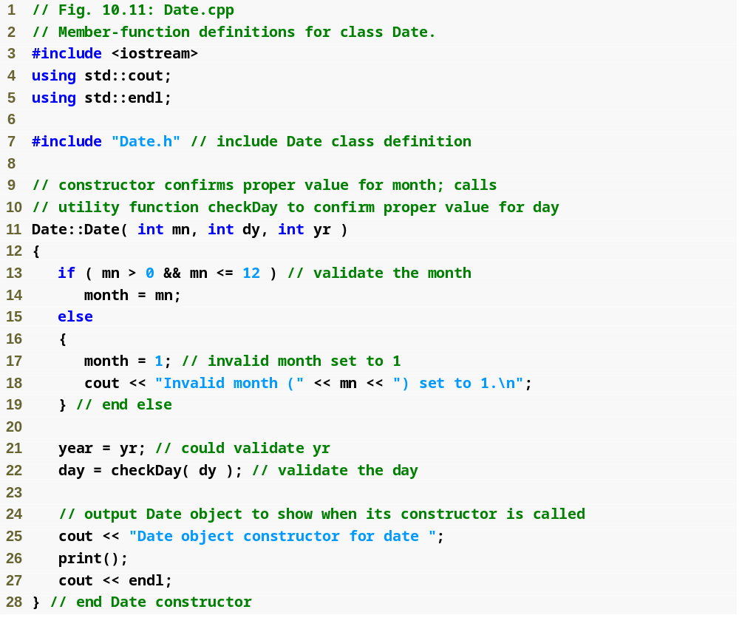
Outline
Date.cpp
(1 of 3)

Slide 28
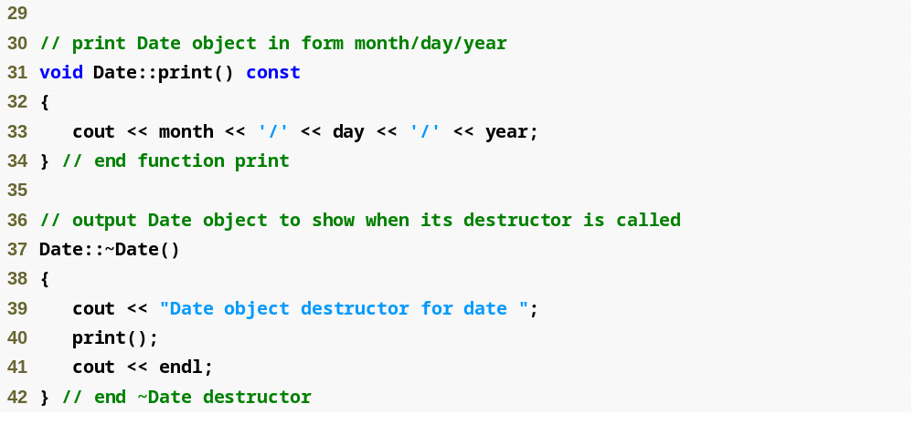
Outline
Date.cpp
(2 of 3)

Slide 29
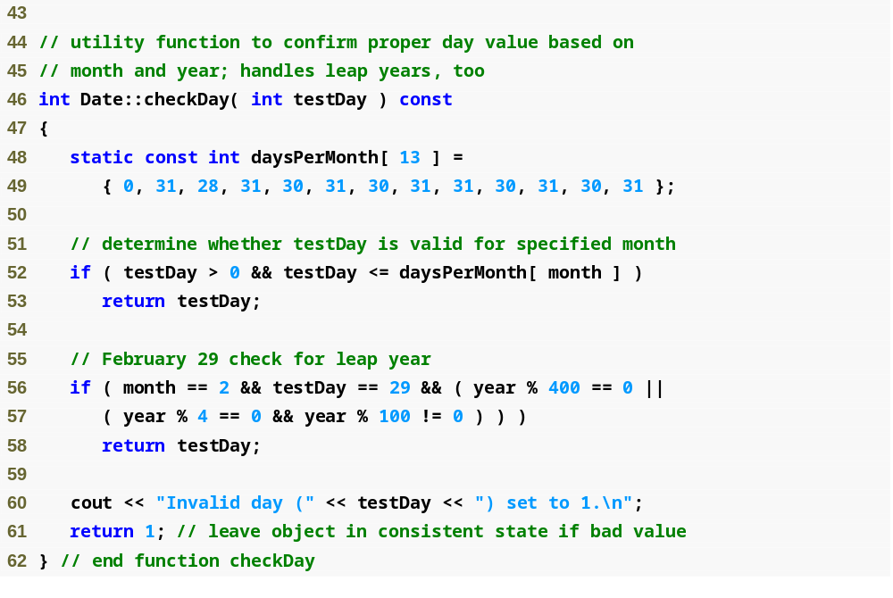
Outline
Date.cpp
(3 of 3)

Slide 30
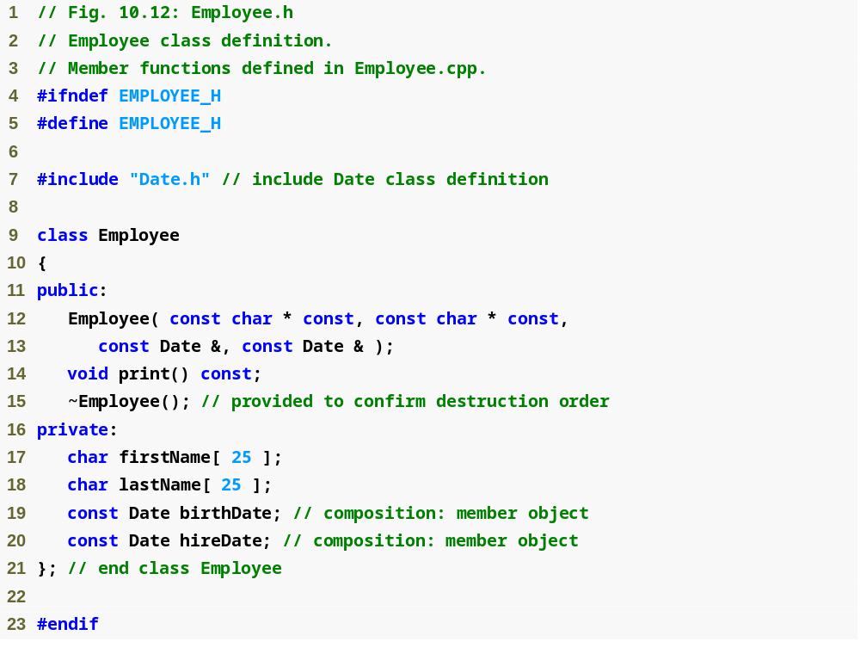
Outline
Employee.h
(1 of 1)
Parameters to be passed via member initializers to the constructor for class Date
const objects of class Date as members

Slide 31
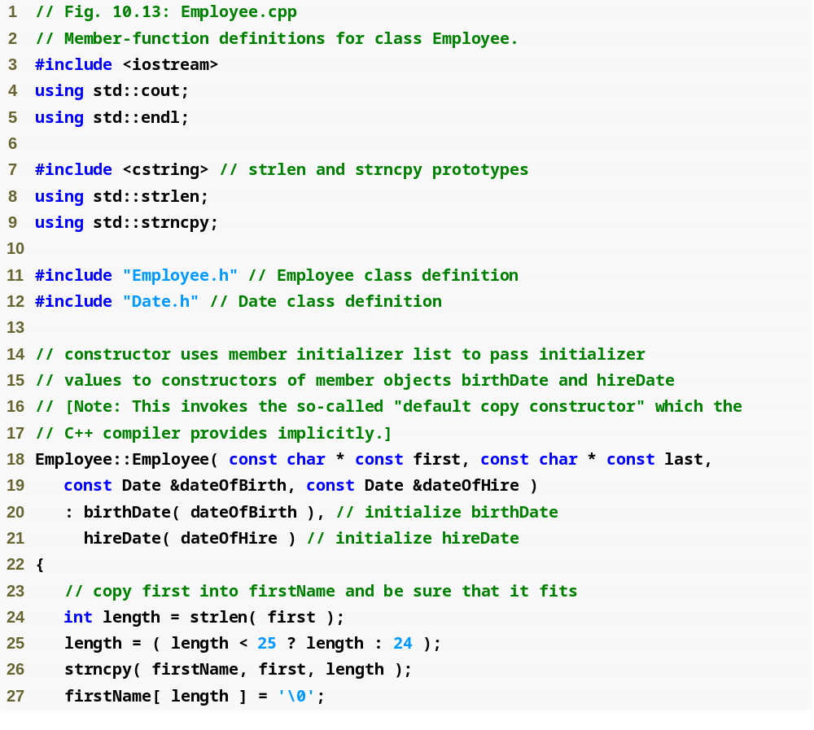
Outline
Employee.cpp
(1 of 2)
Member initializers that pass arguments to Date’s implicit default copy constructor

Slide 32
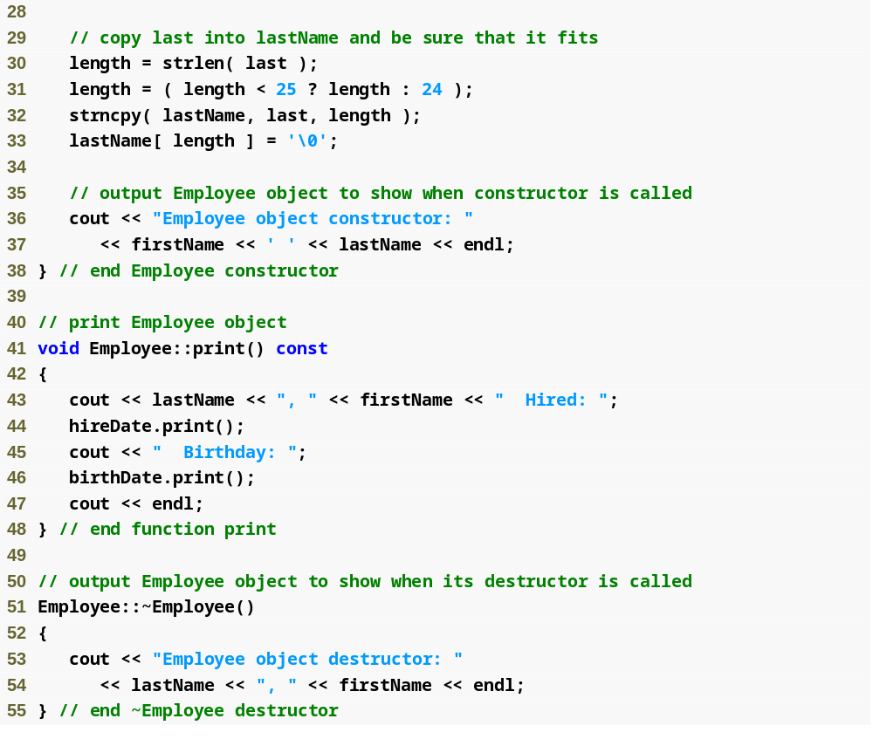
Outline
Employee.cpp
(2 of 2)

Slide 33
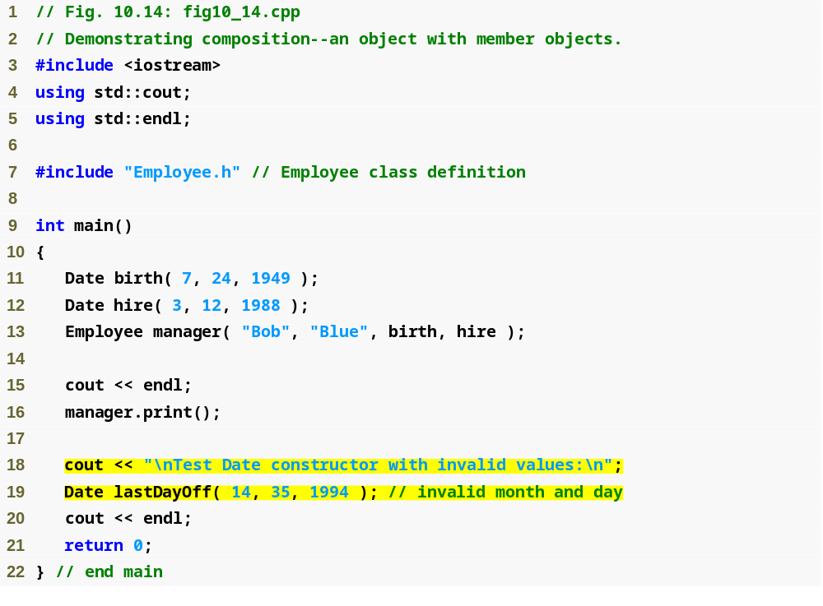
Outline
fig10_14.cpp
(1 of 2)
Passing objects to a host object constructor

Slide 34
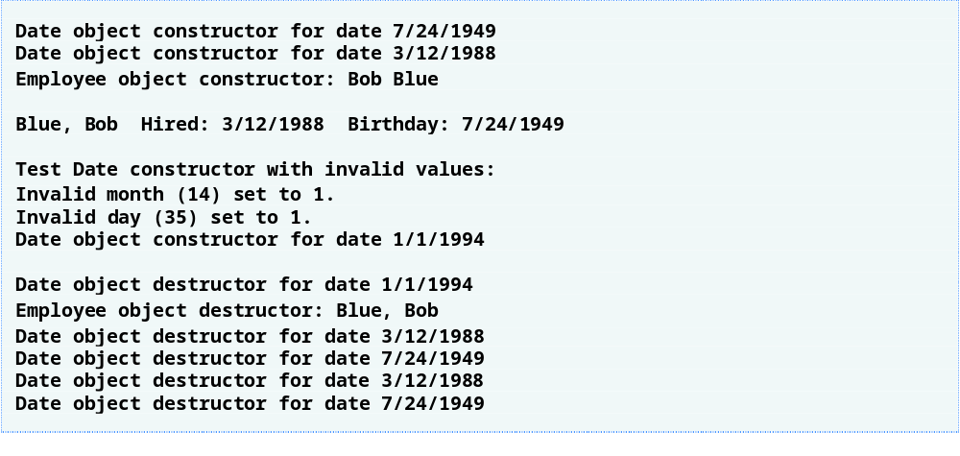
Outline
fig10_14.cpp
(2 of 2)

Slide 35
10.4 friend Functions and friend Classes
friend function of a class
  Defined outside that class’s scope
    Not a member function of that class
  Yet has the right to access the non-public (and public) members of that class
  Standalone functions or entire classes may be declared to be friends of a class
  Can enhance performance
  Often appropriate when a member function cannot be used for certain operations

Slide 36
10.4 friend Functions and friend Classes (Cont.)
To declare a function as a friend of a class:
  Provide the function prototype in the class definition preceded by keyword friend
To declare a class as a friend of a class:
  Place a declaration of the form
  friend class ClassTwo;
  in the definition of class ClassOne
    All member functions of class ClassTwo are friends of class ClassOne

Slide 37
10.4 friend Functions and friend Classes (Cont.)
Friendship is granted, not taken
  For class B to be a friend of class A, class A must explicitly declare that class B is its friend
Friendship relation is neither symmetric nor transitive
  If class A is a friend of class B, and class B is a friend of class C, you cannot infer that class B is a friend of class A, that class C is a friend of class B, or that class A is a friend of class C
It is possible to specify overloaded functions as friends of a class
  Each overloaded function intended to be a friend must be explicitly declared as a friend of the class

Slide 38
Software Engineering Observation 10.10
Some people in the OOP community feel that “friendship” corrupts information hiding and weakens the value of the object-oriented design approach. In this text, we identify several examples of the responsible use of friendship.

Slide 39
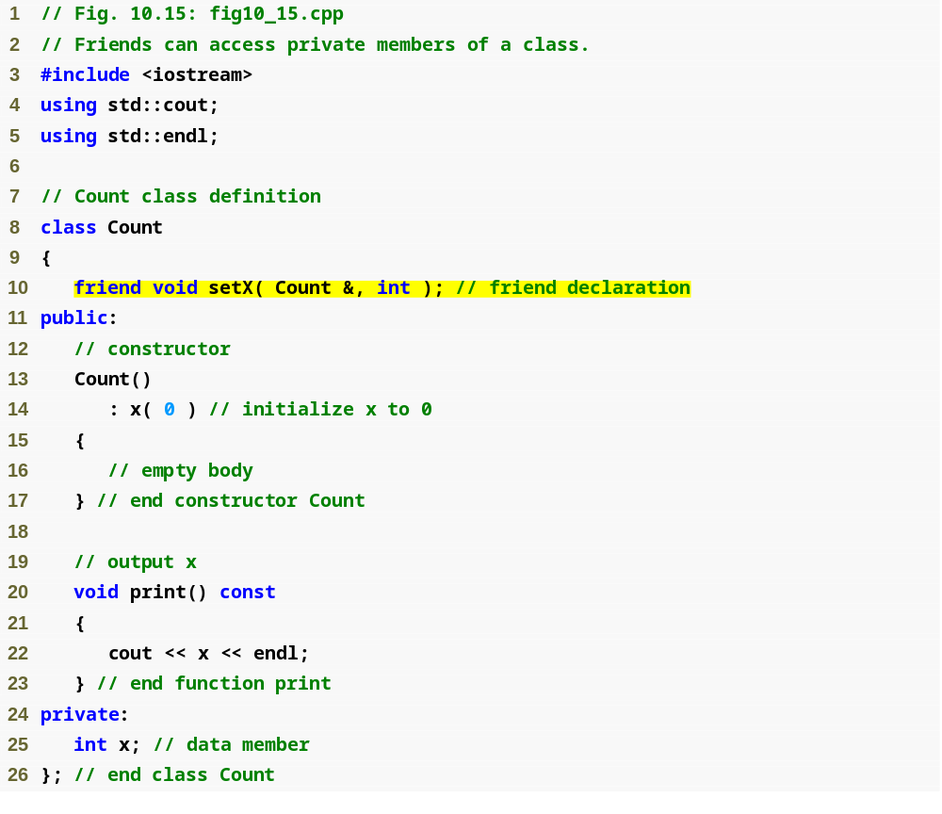
Outline
friend function declaration (can appear anywhere in the class)
fig10_15.cpp
(1 of 2)

Slide 40
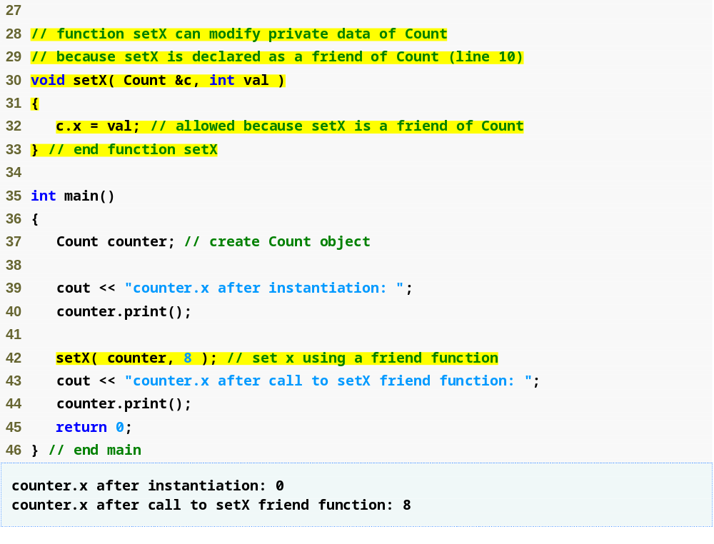
Outline
fig10_15.cpp
(2 of 2)
friend function can modify Count’s private data
Calling a friend function; note that we pass the Count object to the function

Slide 41
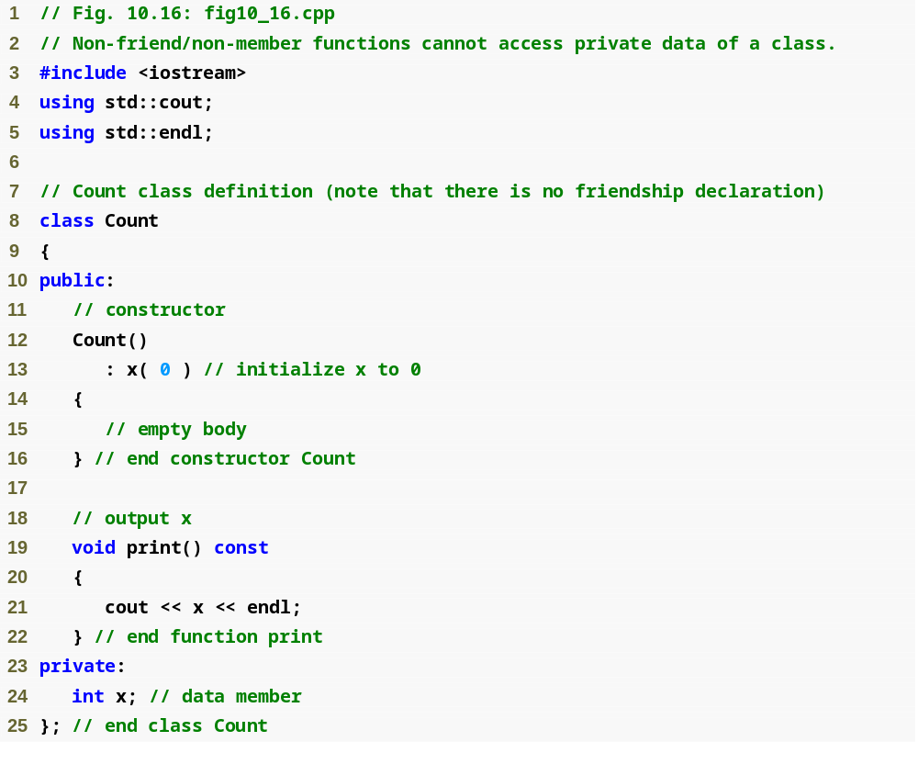
Outline
fig10_16.cpp
(1 of 3)

Slide 42
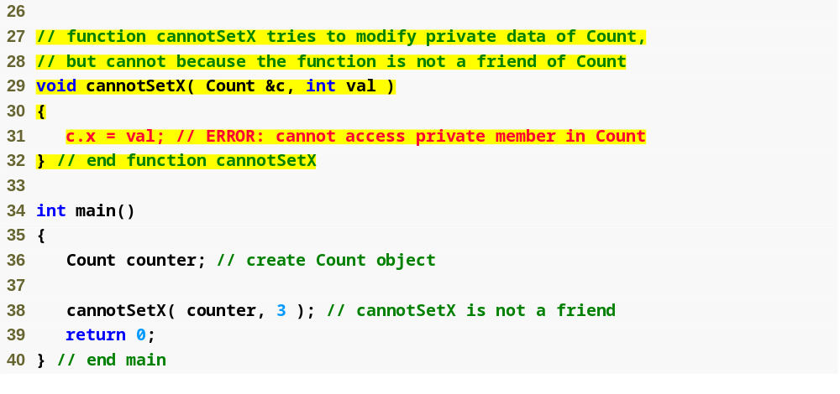
Outline
Non-friend function cannot access the class’s private data
fig10_16.cpp
(2 of 3)

Slide 43
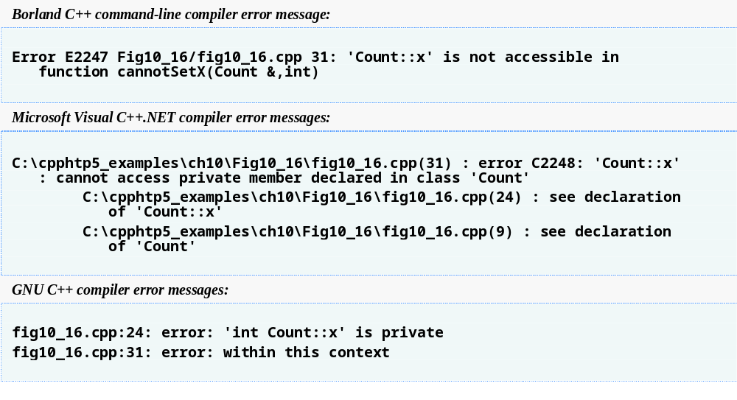
Outline
fig10_16.cpp
(3 of 3)

Slide 44
friend Class Example
Classes Part II
// ClassOne Interface
#include “classtwo.h”
class ClassOne {
public:
void setX(int val) {c.x = val;}
void setY(int val) {c.y = val;}
void setZ(int val) {c.z = val;}
void print() const
{
cout << "x= " << c.x << endl;
cout << "y= " << c.y << endl;
cout << "z= " << c.z << endl;
}
private:
ClassTwo c;
};
// ClassTwo Interface
class ClassTwo {
friend class ClassOne;
public:
// constructor
ClassTwo() :x(0), y(0), z(0)
{} // no body
void print() const
{
cout << "x= " << x << endl;
cout << "y= " << y << endl;
cout << "z= " << z << endl;
}
private:
int x,y,z; // data members
void setX(int val) {x = val;};
void setY(int val) {y = val;};
void setZ(int val) {z = val;};
};

Slide 45
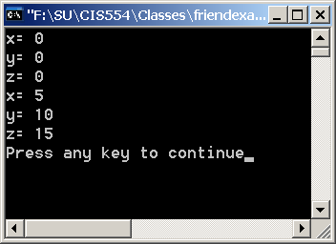
friend Class Example test driver and output
Classes Part II
#include classone.h
void main()
{
ClassOne c1;
c1.print();
c1.setX(5);
c1.setY(10);
c1.setZ(15);
c1.print();
}
CIS 554/<number>

Slide 46
10.5 Using the this Pointer
Member functions know which object’s data members to manipulate
  Every object has access to its own address through a pointer called this (a C++ keyword)
  An object’s this pointer is not part of the object itself
  The this pointer is passed (by the compiler) as an implicit argument to each of the object’s non-static member functions
Objects use the this pointer implicitly or explicitly
  Implicitly when accessing members directly
  Explicitly when using keyword this
  Type of the this pointer depends on the type of the object and whether the executing member function is declared const

Slide 47
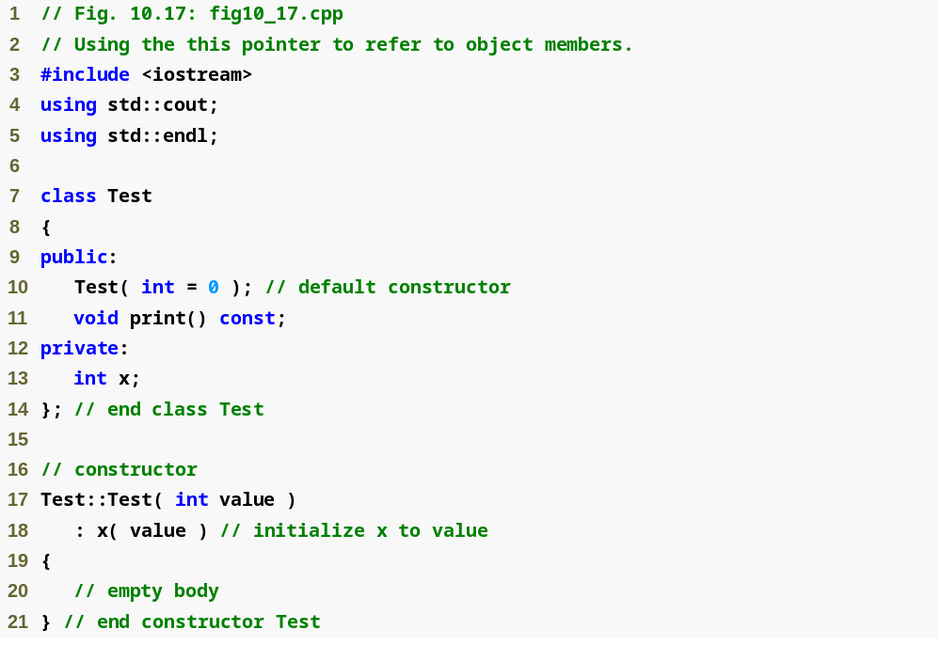
Outline
fig10_17.cpp
(1 of 2)

Slide 48
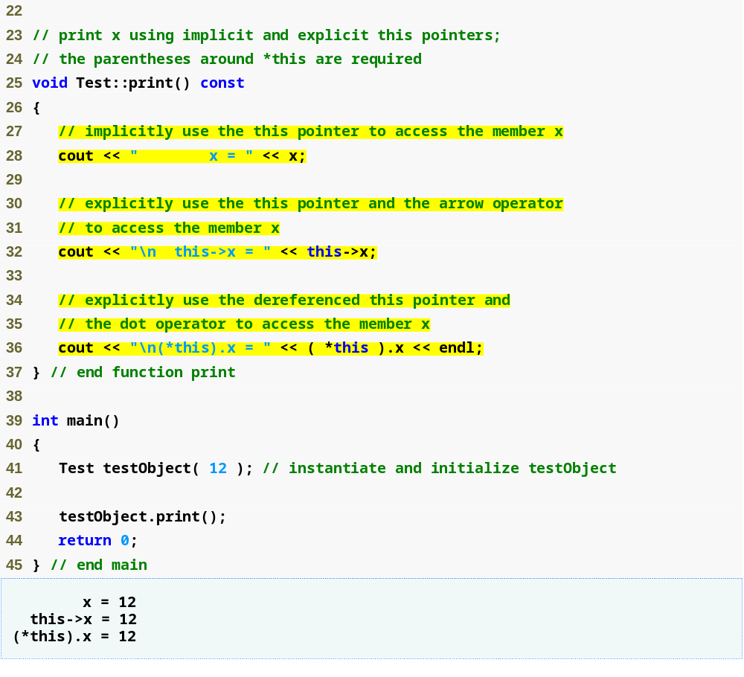
Outline
fig10_17.cpp
(2 of 2)
Implicitly using the this pointer to access member x
Explicitly using the this pointer to access member x
Using the dereferenced this pointer and the dot operator

Slide 49
10.5 Using the this Pointer (Cont.)
Cascaded member-function calls
  Multiple functions are invoked in the same statement
  Enabled by member functions returning the dereferenced this pointer
  Example
    t.setMinute( 30 ).setSecond( 22 );
      Calls t.setMinute( 30 );
      Then calls t.setSecond( 22 );

Slide 50
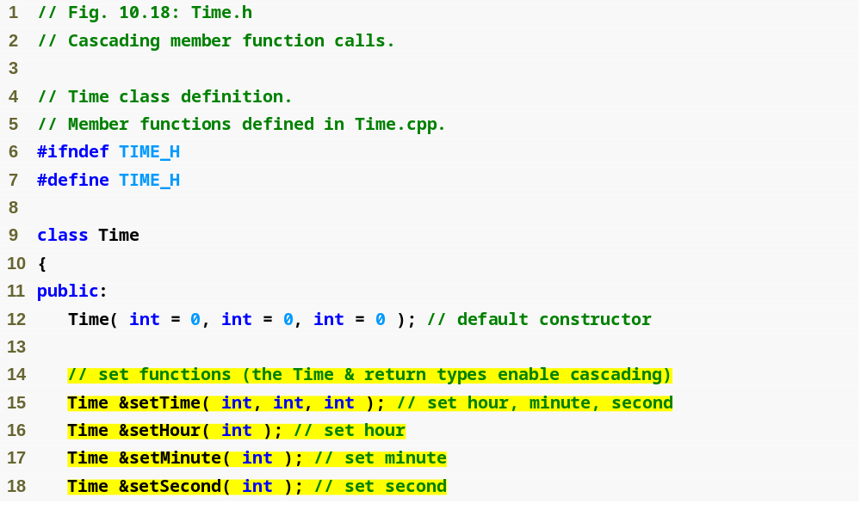
Outline
Time.h
(1 of 2)
set functions return Time & to enable cascading

Slide 51
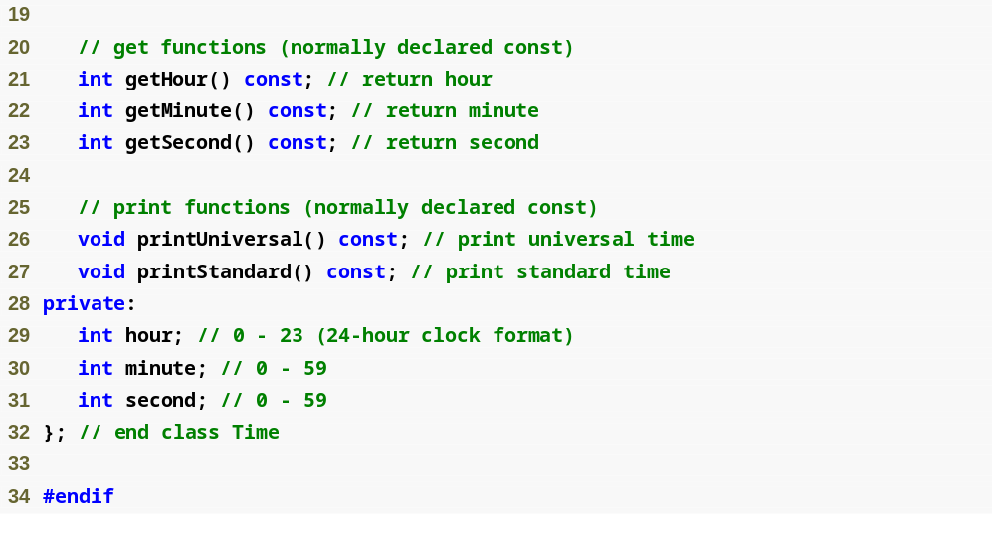
Outline
Time.h
(2 of 2)

Slide 52
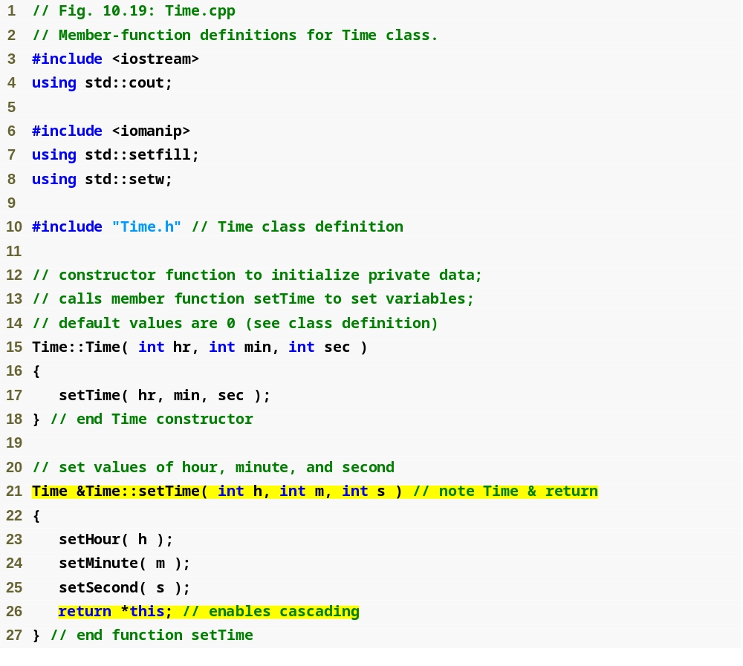
Outline
Time.cpp
(1 of 3)
Returning dereferenced this pointer enables cascading

Slide 53
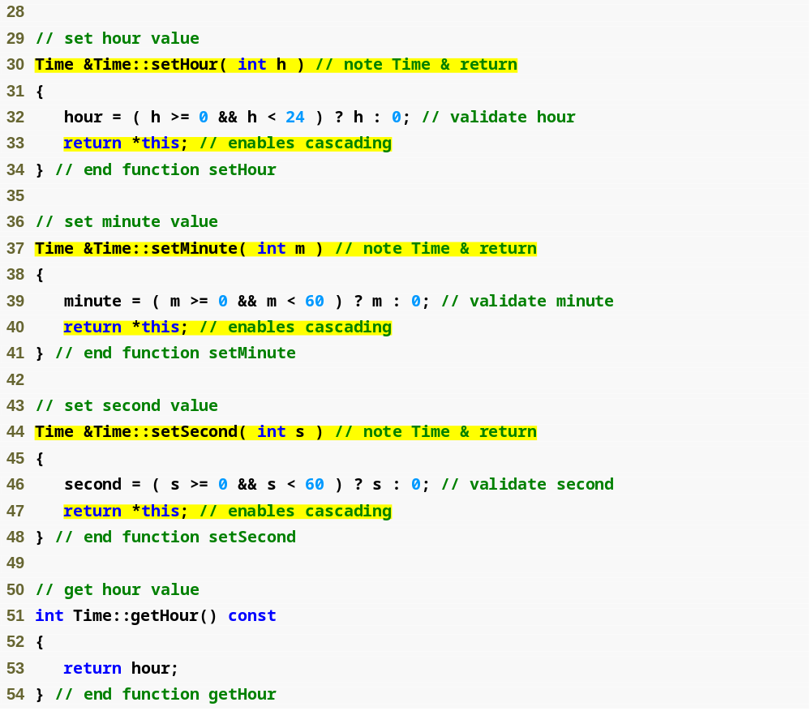
Outline
Time.cpp
(2 of 3)

Slide 54
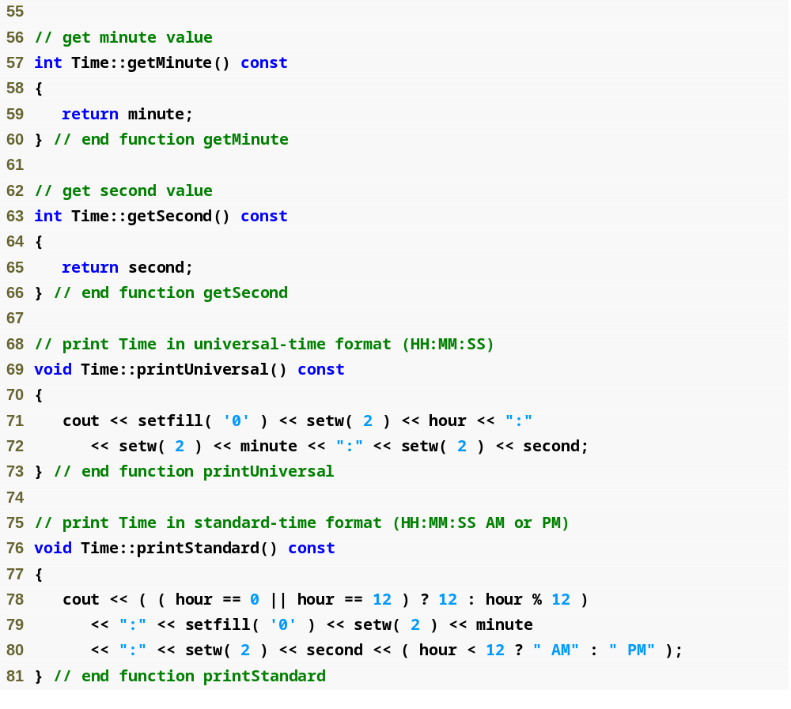
Outline
Time.cpp
(3 of 3)

Slide 55
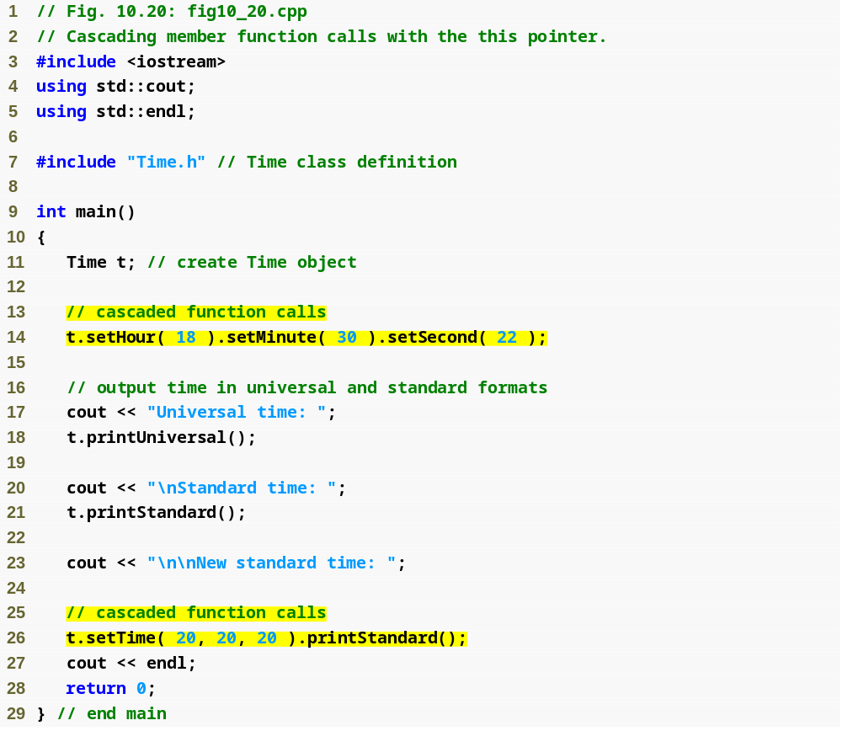
Outline
fig10_20.cpp
(1 of 2)
Cascaded function calls using the reference returned by one function call to invoke the next
Note that these calls must appear in the order shown, because printStandard does not return a reference to t

Slide 56

Outline
fig10_20.cpp
(2 of 2)

Slide 57
10.6 Dynamic Memory Management with Operators new and delete
Dynamic memory management
  Enables programmers to allocate and deallocate memory for any built-in or user-defined type
  Performed by operators new and delete
  For example, dynamically allocating memory for an array instead of using a fixed-size array

Slide 58
10.6 Dynamic Memory Management with Operators new and delete (Cont.)
Operator new
  Allocates (i.e., reserves) storage of the proper size for an object at execution time
  Calls a constructor to initialize the object
  Returns a pointer of the type specified to the right of new
  Can be used to dynamically allocate any fundamental type (such as int or double) or any class type
Free store
  Sometimes called the heap
  Region of memory assigned to each program for storing objects created at execution time

Slide 59
10.6 Dynamic Memory Management with Operators new and delete (Cont.)
Operator delete
  Destroys a dynamically allocated object
  Calls the destructor for the object
  Deallocates (i.e., releases) memory from the free store
  The memory can then be reused by the system to allocate other objects

Slide 60
10.6 Dynamic Memory Management with Operators new and delete (Cont.)
Initializing an object allocated by new
  Initializer for a newly created fundamental-type variable
    Example
      double *ptr = new double( 3.14159 );
  Specify a comma-separated list of arguments to the constructor of an object
    Example
      Time *timePtr = new Time( 12, 45, 0 );

Slide 61
Common Programming Error 10.8
Not releasing dynamically allocated memory when it is no longer needed can cause the system to run out of memory prematurely. This is sometimes called a “memory leak.”

Slide 62
10.6 Dynamic Memory Management with Operators new and delete (Cont.)
new operator can be used to allocate arrays dynamically
  Dynamically allocate a 10-element integer array:
  int *gradesArray = new int[ 10 ];
  also:
  int arraySize = 5; // non-const
  int * myArray = new int[arraySize];
  …
  delete [] myArray
  Size of a dynamically allocated array
    Specified using any integral expression that can be evaluated at execution time

Slide 63
10.6 Dynamic Memory Management with Operators new and delete (Cont.)
Delete a dynamically allocated array:
  delete [] gradesArray;
  This deallocates the array to which gradesArray points
  If the pointer points to an array of objects
    First calls the destructor for every object in the array
    Then deallocates the memory
  If the statement did not include the square brackets ([]) and gradesArray pointed to an array of objects
    Only the first object in the array would have a destructor call

Slide 64
Common Programming Error 10.9
Using delete instead of delete [] for arrays of objects can lead to runtime logic errors. To ensure that every object in the array receives a destructor call, always delete memory allocated as an array with operator delete []. Similarly, always delete memory allocated as an individual element with operator delete; otherwise, the result of the operation is undefined.

Slide 65
10.7 static Class Members
static data member
  Only one copy of a variable shared by all objects of a class
    “Class-wide” information
    A property of the class shared by all instances, not a property of a specific object of the class
  Declaration begins with keyword static

Slide 66
10.7 static Class Members (Cont.)
static data member (Cont.)
  Example
    Video game with Martians and other space creatures
      Each Martian needs to know the martianCount
      martianCount should be static class-wide data
      Every Martian can access martianCount as if it were a data member of that Martian
      Only one copy of martianCount exists
  May seem like global variables but they have class scope
  Can be declared public, private or protected

Slide 67
10.7 static Class Members (Cont.)
static data member (Cont.)
  Fundamental-type static data members
    Initialized by default to 0
    If you want a different initial value, a static data member can be initialized once (and only once)
  A const static data member of int or enum type
    Can be initialized in its declaration in the class definition
  All other static data members
    Must be defined at file scope (i.e., outside the body of the class definition)
    Can be initialized only in those definitions
  static data members of class types (i.e., static member objects) that have default constructors
    Need not be initialized because their default constructors will be called

Slide 68
10.7 static Class Members (Cont.)
static data member (Cont.)
  Exists even when no objects of the class exist
    To access a public static class member when no objects of the class exist
      Prefix the class name and the binary scope resolution operator (::) to the name of the data member
      Example
        Martian::martianCount
  Also accessible through any object of that class
    Use the object’s name, the dot operator and the name of the member
      Example
        myMartian.martianCount

Slide 69
10.7 static Class Members (Cont.)
static member function
  Is a service of the class, not of a specific object of the class
static applied to an item at file scope
  That item becomes known only in that file
  The static members of the class need to be available from any client code that accesses the file
    So we cannot declare them static in the .cpp file—we declare them static only in the .h file.

Slide 70
Software Engineering Observation 10.11
A class’s static data members and static member functions exist and can be used even if no objects of that class have been instantiated.

Slide 71
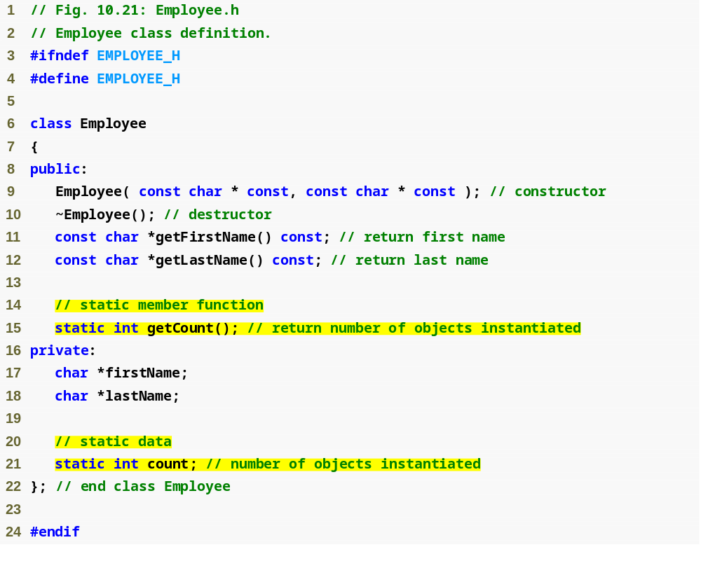
Outline
fig10_21.cpp
(1 of 1)
Function prototype for static member function
static data member keeps track of number of Employee objects that currently exist

Slide 72
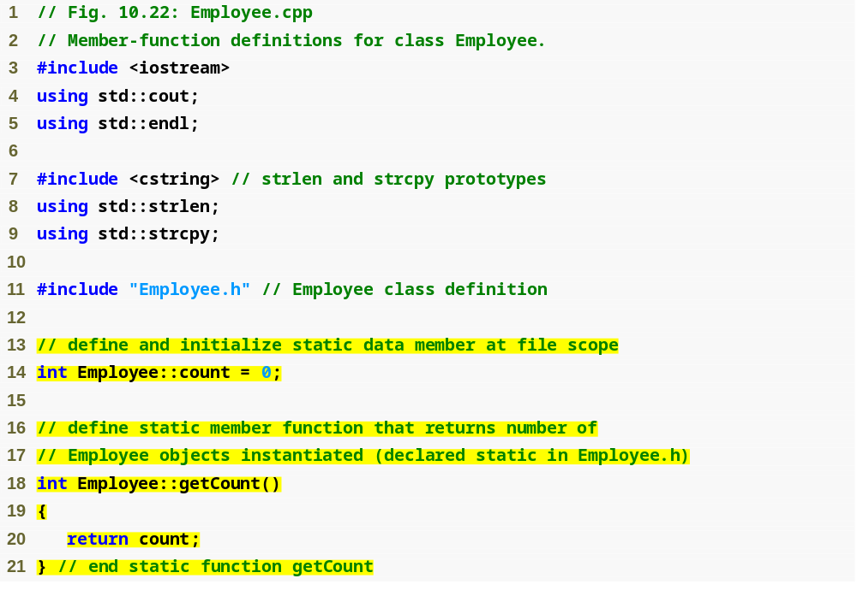
Outline
Employee.cpp
(1 of 3)
static data member is defined and initialized at file scope in the .cpp file
static member function can access only static data, because the function might be called when no objects exist

Slide 73
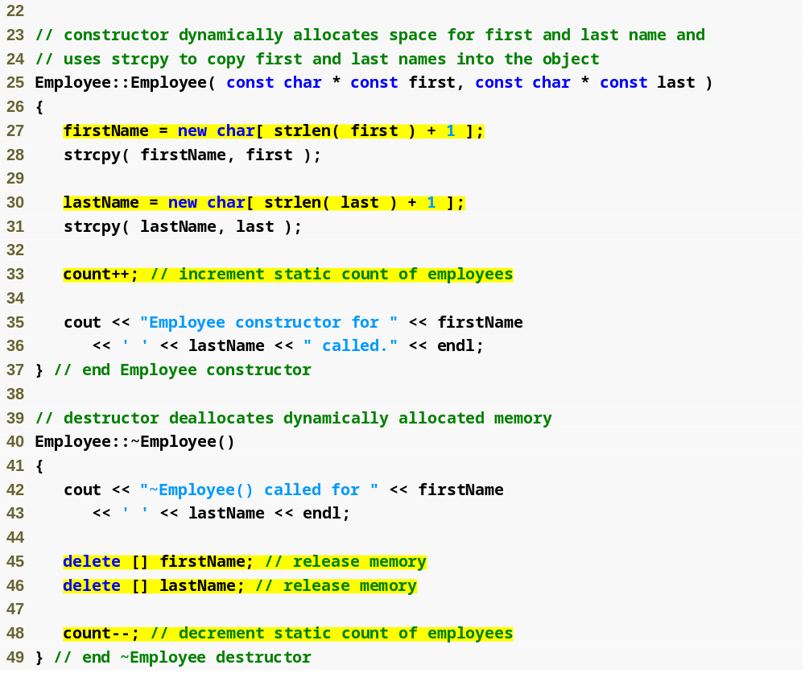
Outline
Employee.cpp
(2 of 3)
Dynamically allocating char arrays
Non-static member function (i.e., constructor) can modify the class’s static data members
Deallocating memory reserved for arrays

Slide 74
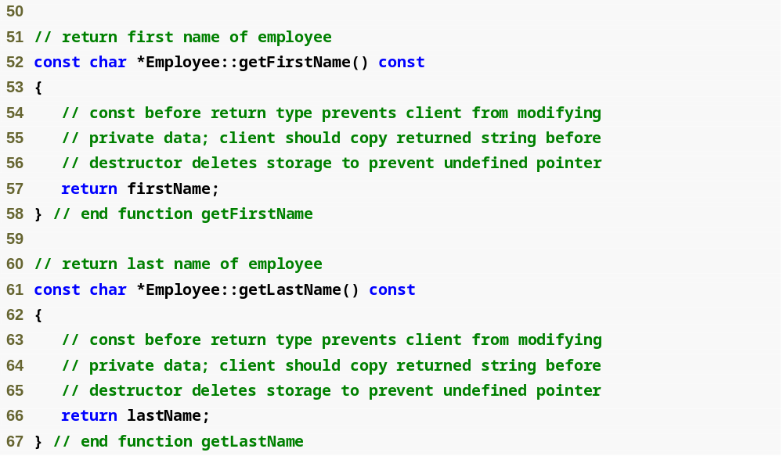
Outline
Employee.cpp
(3 of 3)

Slide 75
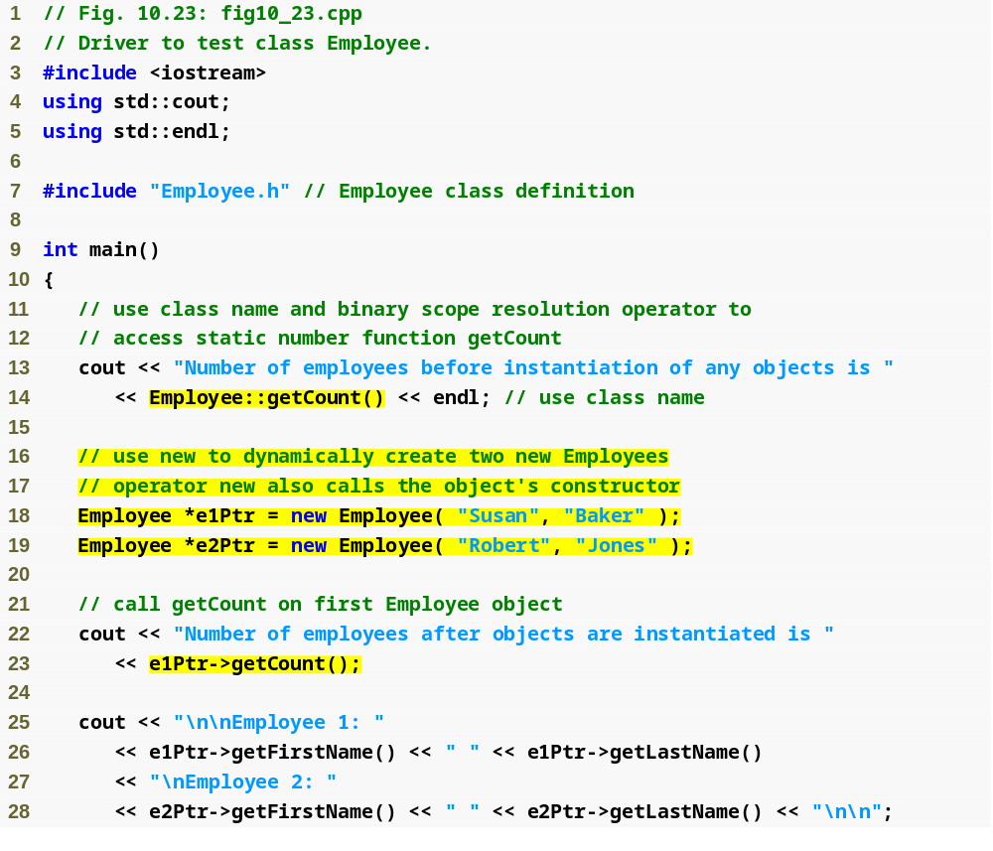
Outline
fig10_23.cpp
(1 of 2)
Calling static member function using class name and binary scope resolution operator
Dynamically creating Employees with new
Calling a static member function through a pointer to an object of the class

Slide 76
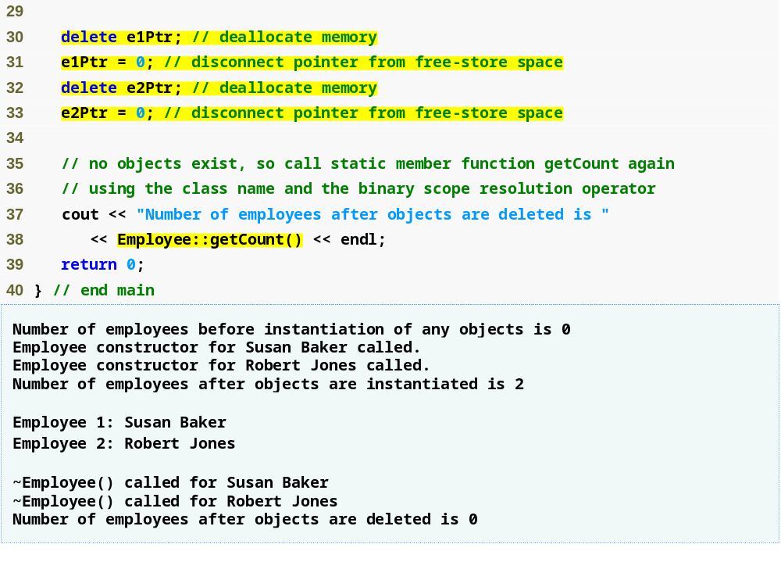
Outline
Releasing memory to which a pointer points
fig10_23.cpp
(2 of 2)
Disconnecting a pointer from any space in memory

Slide 77
10.7 static Class Members (Cont.)
static member functions
  Cannot access non-static data or member functions.
  A static member function does not have a this pointer
  static data members and static member functions exist independently of any objects of a class
  When a static member function is called, there might not be any objects of its class in memory

Slide 78
Common Programming Error 10.12
Declaring a static member function const is a compilation error. The const qualifier indicates that a function cannot modify the contents of the object in which it operates, but static member functions exist and operate independently of any objects of the class.

Slide 79
Singleton Classes
A singleton class implements the singleton design pattern.
Only one instance of an object can exist.
Noone can actually instantiate an instance of a singleton.
    It instantiates itself.
Static member function Instance() returns the one and only instance.
Static member data instance holds pointer to one and only instance

Slide 80
Singleton Class (Cont.)
class I2CDriverConfig
{
public:
bool ReadConfig(ConfigData &);
static I2CDriverConfig * Instance();
private:
I2CDriverConfig(void);
~I2CDriverConfig(void);
static I2CDriverConfig * instance;
ConfigData configData;
};

Slide 81
Singleton Class (Cont)
I2CDriverConfig * I2CDriverConfig::instance = NULL;
I2CDriverConfig::I2CDriverConfig(void) { }
I2CDriverConfig::~I2CDriverConfig(void)
{
delete instance;
}
I2CDriverConfig * I2CDriverConfig::Instance()
{
if (instance == NULL)
{
instance = new I2CDriverConfig();
}
return instance;
}

Slide 82
10.10 Proxy Classes
Header files contain some portion of a class’s implementation and hints about others
  For example, a class’s private members are listed in the class definition in a header file
  Potentially exposes proprietary information to clients of the class

Slide 83
10.10 Proxy Classes (Cont.)
Proxy class
  Hides even the private data of a class from clients
  Knows only the public interface of your class
  Enables the clients to use your class’s services without giving the client access to your class’s implementation details

Slide 84
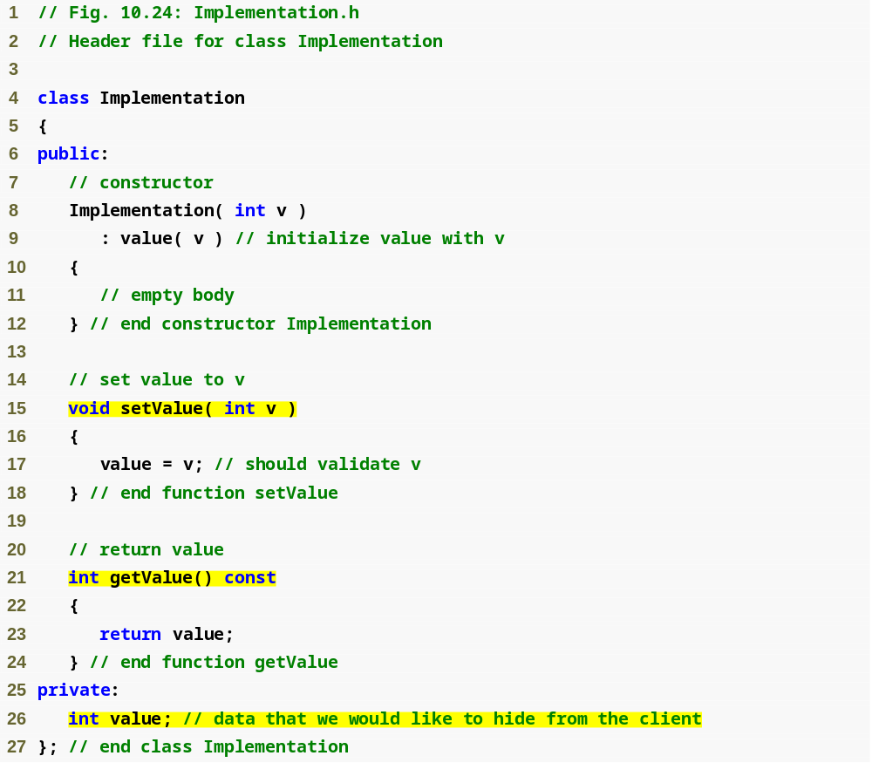
Outline
Class definition for the class that contains the proprietary implementation we would like to hide
Implementation.h
(1 of 1)
The data we would like to hide from the client

Slide 85
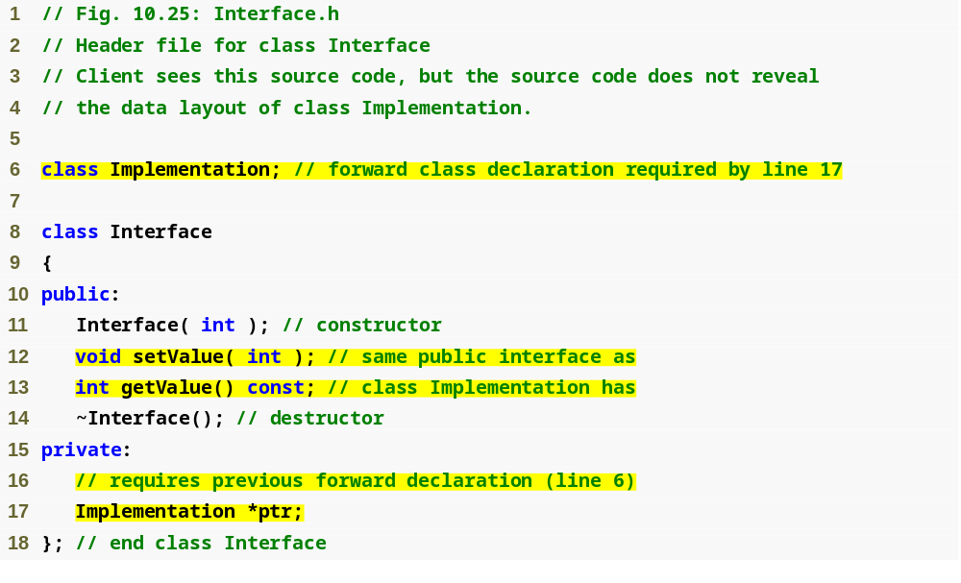
Outline
Interface.h
(1 of 1)
Declares Implementation as a data type without including the class’s complete header file
public interface between client and hidden class
Using a pointer allows us to hide implementation details of class Implementation

Slide 86
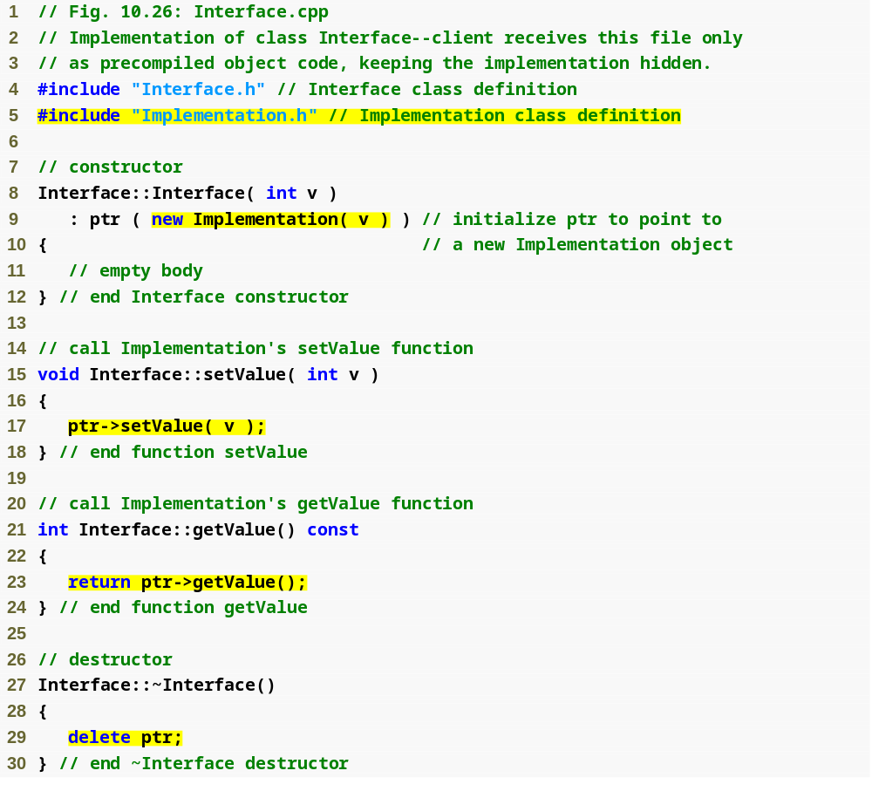
Outline
Interface.cpp
(1 of 1)
Only location where Implementation.h is included with #include
Setting the value of the hidden data via a pointer
Getting the value of the hidden data via a pointer

Slide 87
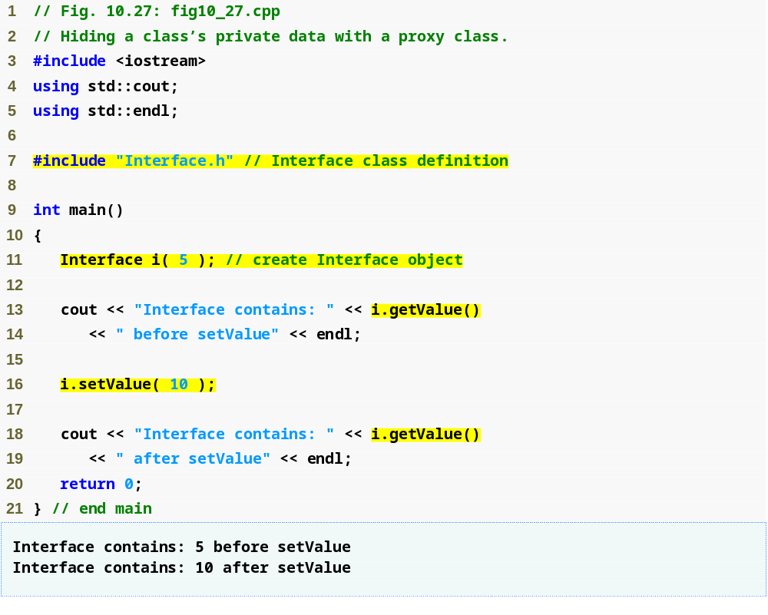
Outline
fig10_27.cpp
(1 of 1)
Only the header file for Interface is included in the client code—no mention of the existence of a separate class called Implementation

Slide 88
Software Engineering Observation 10.14
A proxy class insulates client code from implementation changes.

