Slide 1
14
Templates

Slide 2
OBJECTIVES
In this chapter you’ll learn:
To use function templates to conveniently create a group of related (overloaded) functions.
To distinguish between function templates and function-template specializations.
To use class templates to create a group of related types.
To distinguish between class templates and class-template specializations.
To overload function templates.
To understand the relationships among templates, friends, inheritance and static members.

Slide 3
14.1 Introduction
14.2 Function Templates
14.3 Overloading Function Templates
14.4 Class Templates
14.5 Nontype Parameters and Default Types for Class Templates
14.6 Notes on Templates and Inheritance
14.7 Notes on Templates and Friends
14.8 Notes on Templates and static Members
14.9 Wrap-Up

Slide 4
14.1 Introduction
Function templates and class templates
  Enable programmers to specify an entire range of related functions and related classes
    Called function-template specializations and class-template specializations, respectively
  Generic programming
  Analogy: templates are like stencils, template specializations are like separate tracings
    All tracings have the same shape, but they could have different colors

Slide 5
Software Engineering Observation 14.1
Most C++ compilers require the complete definition of a template to appear in the client source-code file that uses the template. For this reason and for reusability, templates are often defined in header files, which are then #included into the appropriate client source-code files. For class templates, this means that the member functions are also defined in the header file.

Slide 6
14.2 Function Templates
Function Templates
  Used to produce overloaded functions that perform identical operations on different types of data
    Programmer writes a single function-template definition
    Compiler generates separate object-code functions (function-template specializations) based on argument types in calls to the function template
  Similar to macros in C, but with full type checking

Slide 7
14.2 Function Templates (Cont.)
Function-template definitions
  Preceded by a template header
    Keyword template
    List of template parameters
      Enclosed in angle brackets (< and >)
      Each template parameter is preceded by keyword class or keyword typename (both are interchangeable)
      Used to specify types of arguments to, local variables in and return type of the function template
    Examples
      template< typename T >
      template< class ElementType >
      template< typename BorderType,
      typename Filltype >

Slide 8
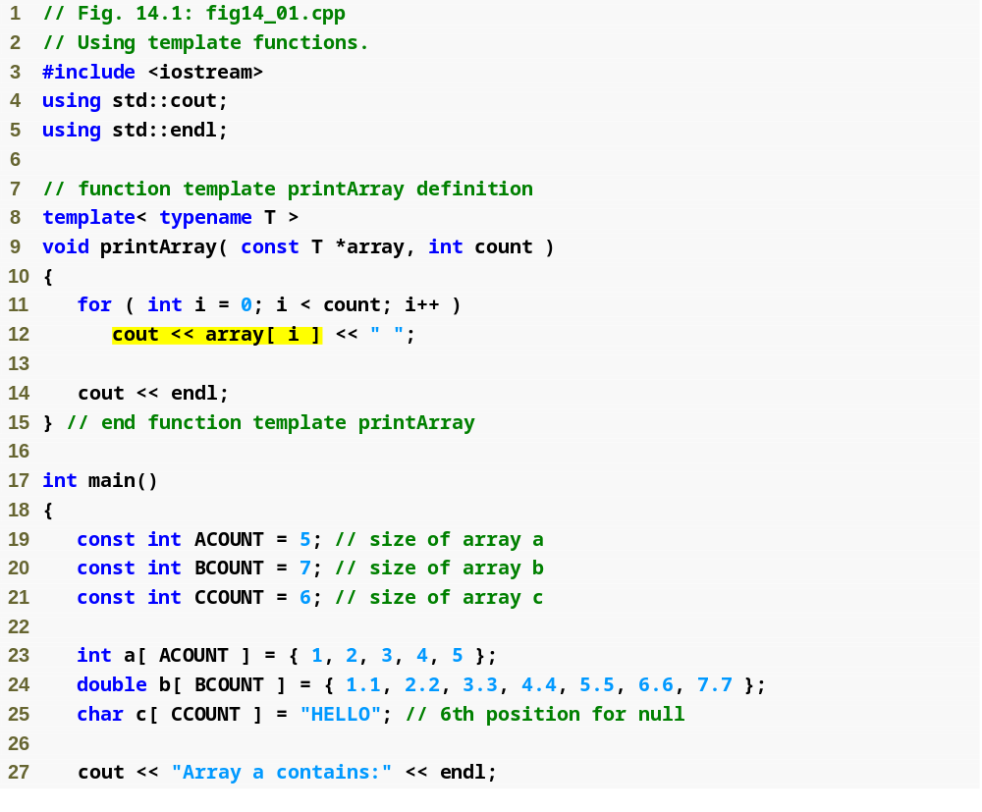
Outline
Template parameter T specified in template header
fig14_01.cpp
(1 of 2)

Slide 9
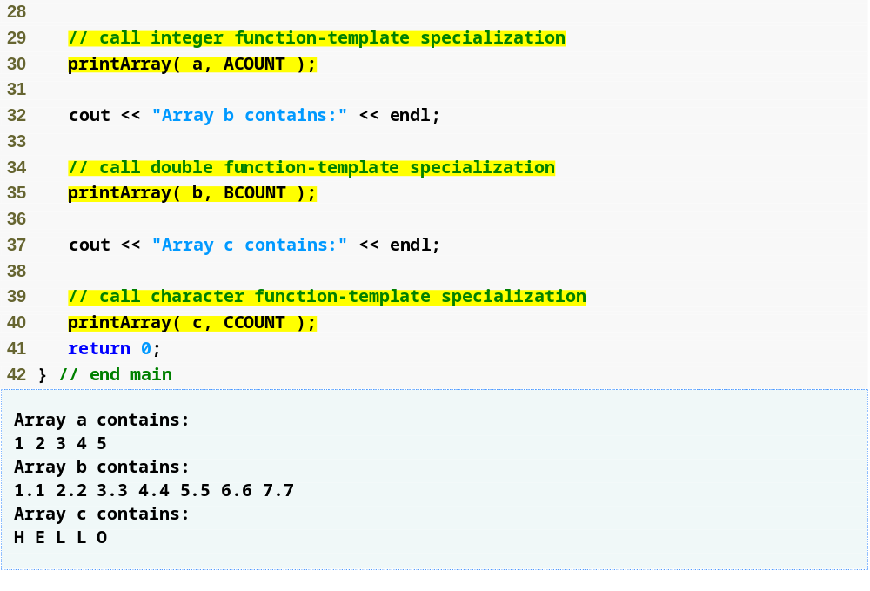
Outline
Creates a function-template specialization of printArray where int replaces T
fig14_01.cpp
(2 of 2)
Creates a function-template specialization of printArray where double replaces T
Creates a function-template specialization of printArray where char replaces T

Slide 10
Common Programming Error 14.2
If a template is invoked with a user-defined type, and if that template uses functions or operators (e.g., ==, +, <=) with objects of that class type, then those functions and operators must be overloaded for the user-defined type. Forgetting to overload such operators causes compilation errors.

Slide 11
14.3 Overloading Function Templates
A function template may be overloaded
  Other function templates that specify the same name but different parameters
  Nontemplate functions that specify the same name but different parameters
The compiler chooses the best function or specialization to match the function call
  A nontemplate function is chosen over a template specialization in case of a tie
  Otherwise, multiple matches result in a compilation error (ambiguous function call )

Slide 12
Common Programming Error 14.3
If no matching function definition can be found for a particular function call, or if there are multiple matches, the compiler generates an error.

Slide 13
Data Structure – Stack
A stack data structure allows nodes to be added to the stack and removed from the stack only at the top. For this reason, a stack is referred to as a last-in, first-out (LIFO) data structure.
push
pop
We use a stack when we need to maintain a strict order of operations in a LIFO or FILO order.
Example, the program stack.
← last item in, first item out
← first item in, last item out

Slide 14
14.4 Class Templates
Class templates (or parameterized types)
  Class-template definitions are preceded by a header
    Such as template< typename T >
  Type parameter T can be used as a data type in member functions and data members
  Multiple type parameters can be specified using a comma-separated list
    As in template< typename T1, typename T2 >

Slide 15
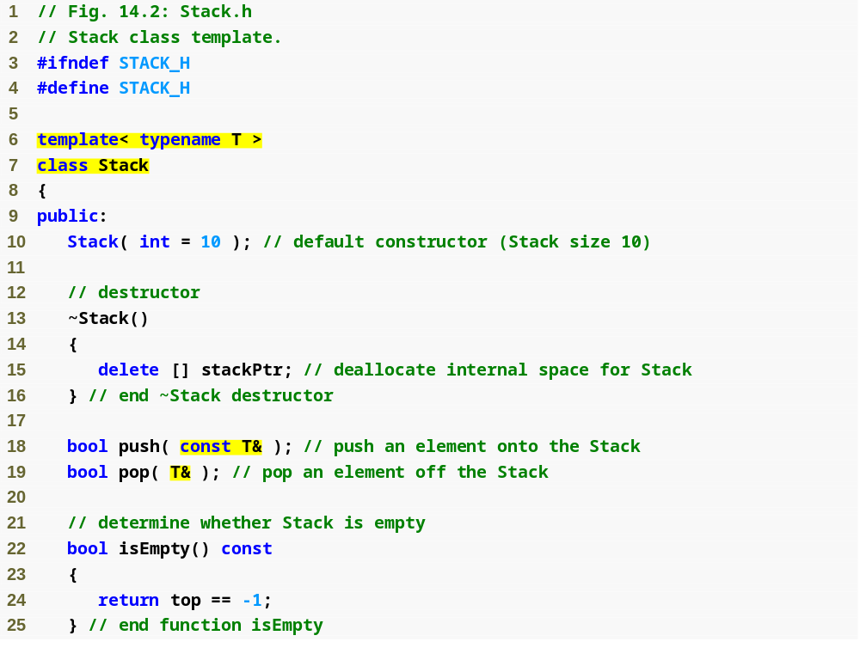
Outline
Stack.h
(1 of 3)
Create class template Stack with type parameter T
Member functions that use type parameter T in specifying function parameters

Slide 16
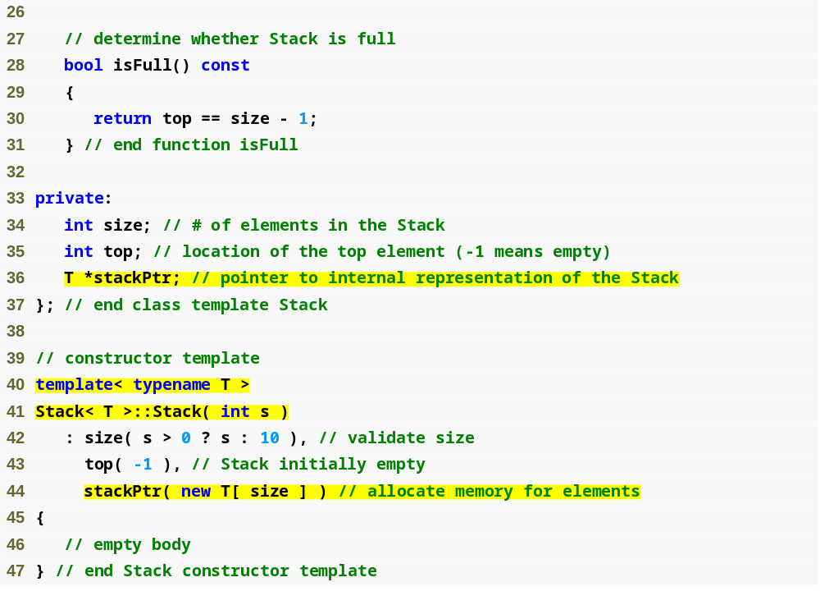
Outline
Stack.h
(2 of 3)
Data member stackPtr is a pointer to a T
Member-function template definitions that appear outside the class-template definition begin with the same template header as the class definition

Slide 17
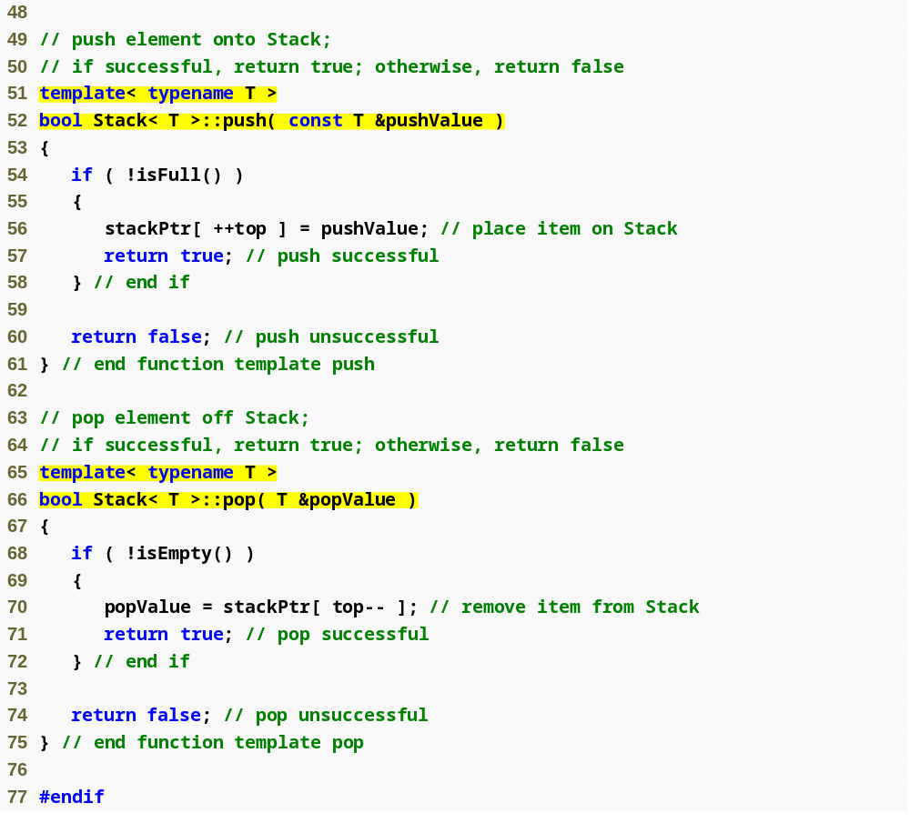
Outline
Stack.h
(3 of 3)

Slide 18
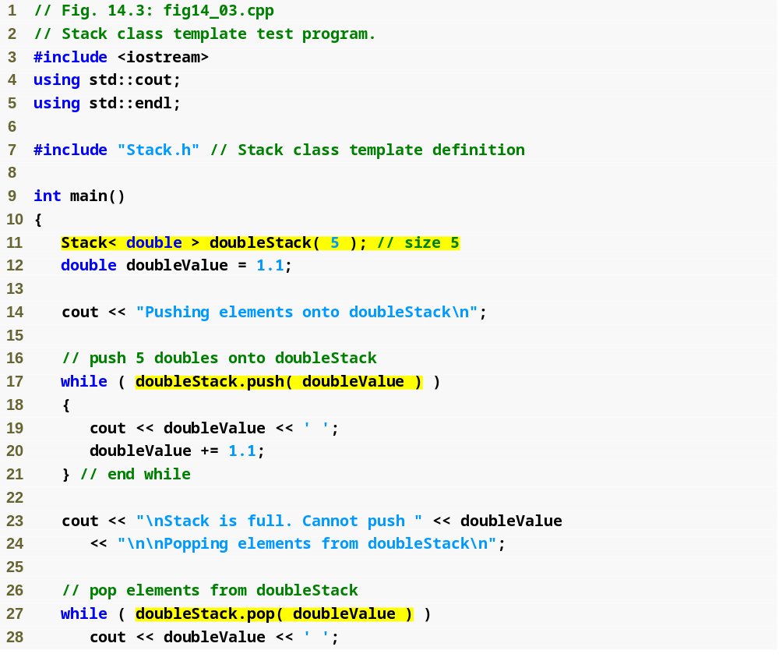
Outline
fig14_03.cpp
(1 of 3)
Create class-template specialization Stack< double > where type double is associated with type parameter T

Slide 19
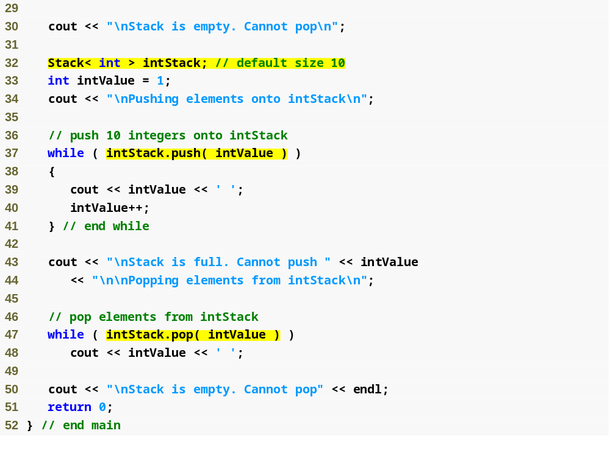
Outline
fig14_03.cpp
(2 of 3)
Create class-template specialization Stack< int > where type int is associated with type parameter T

Slide 20
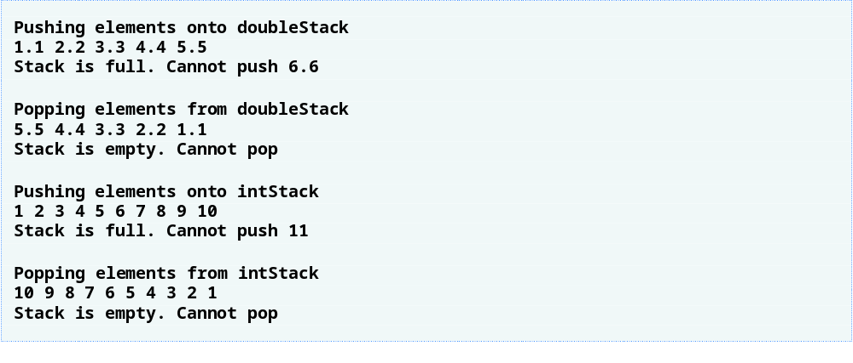
Outline
fig14_03.cpp
(3 of 3)

Slide 21
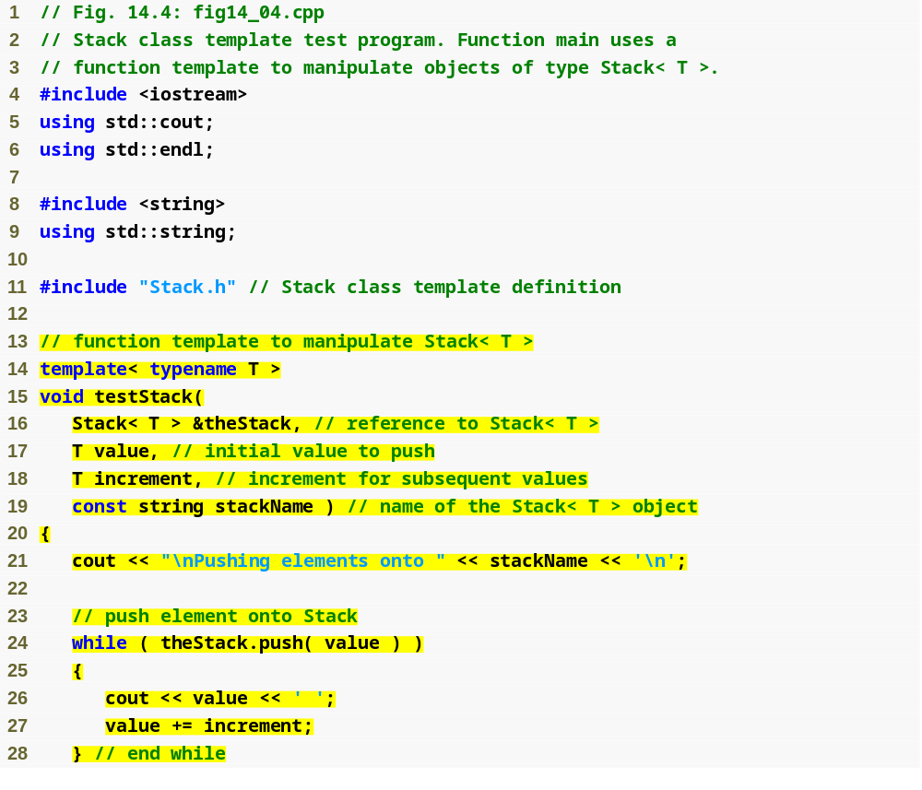
Outline
fig14_04.cpp
(1 of 3)
Use a function template to process Stack class-template specializations

Slide 22
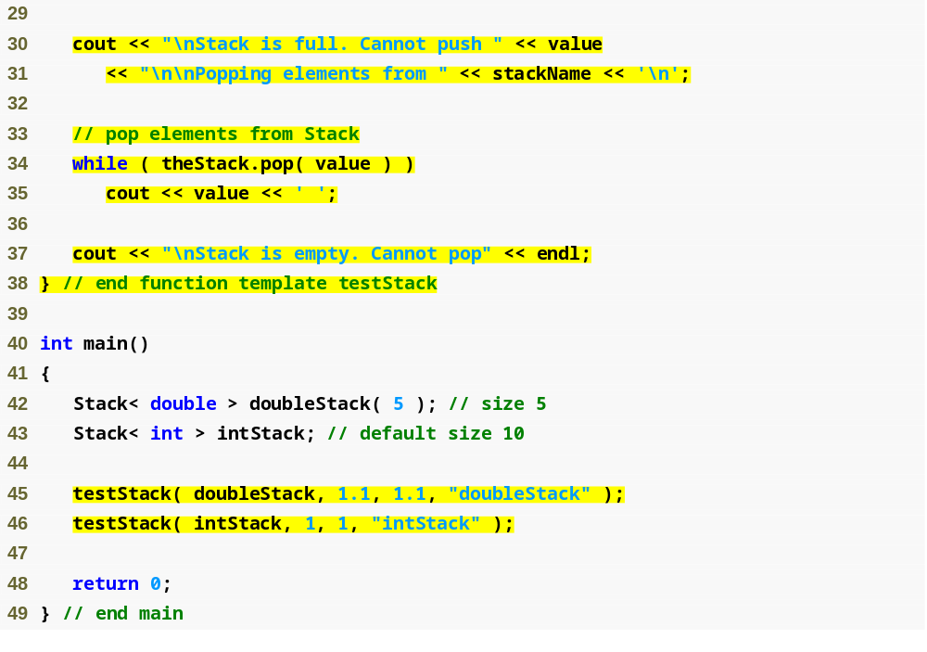
Outline
fig14_04.cpp
(2 of 3)

Slide 23

Outline
fig14_04.cpp
(3 of 3)

Slide 24
14.5 Nontype Parameters and Default Types for Class Templates
Nontype template parameters
  Can have default arguments
  Are treated as consts
  Example
    Template header:
    template< typename T, int elements = 50 >
    Declaration:
    Stack< double > salesFigures;
    Stack< double, 100 > salesFigures;
    T stackHolder[ elements ];
Type parameters can have default arguments too
  Example
    Template header:
    template< typename T = string >
    Declaration:
    Stack<> jobDescriptions;

Slide 25
Performance Tip 14.2
When appropriate, specify the size of a container class (such as an array class or a stack class) at compile time (possibly through a nontype template parameter). This eliminates the execution-time overhead of using new to create the space dynamically.

Slide 26
Software Engineering Observation 14.3
Specifying the size of a container at compile time avoids the potentially fatal execution-time error if new is unable to obtain the needed memory.

Slide 27


Linked List Overview
Singly Linked List
A Linked List is made of a series of “nodes”, each with:
  an associated data object (node)
  a “pointer” (reference) to the next node of the list
  traverse the list by following each node’s next pointer, starting at the head*, until we reach the tail*
Linked List Node
head*
tail*
data
next*
data
next*
data
next*
NULL (0)
Item Value
Item Value
Item Value

Slide 28


Adding a Node to an Empty List
AddToHead
head* = tail* = NULL (0)
Save location of current head
    node * next = head; (current head = NULL)
Create new node at head
    head = new node;
Set data value of new node
    head->data = value;
Update what the head points to for the next node in the list, which was the previous head. Set tail = head (only one node in the list)
    head->next = next;
    tail = head;
data
next*
data
next*
Item Value
head* = tail*
data
next*
NULL (0)
Item Value

Slide 29
Added a Node to an Existing List
AddToHead
Save location of current head
    node * next = head;
Create new node at head
    head = new node;
Set data value of new node
    head->data = value;
Update what the head points to for the next node in the list, which was the previous head.
    head->next = next;
data
next*
data
next*
Item Value
head*
tail*
data
next*
data
next*
NULL (0)
Item Value
Item Value

Slide 30
Deleting a Node
DeleteNode
Refer to Class NodeSLList code.

