Slide 1
Introduction
What is Inheritance?
  A form of software reusability
    new classes are created from existing classes by absorbing their attributes and operations
    overriding these with capabilities new classes require.
    enhance with new capabilities
The new class (derived class) uses the data members and member functions of the base class.
  New data members and member functions can be added into the new class which use the data members and member functions of the base class.
    More specialized group of objects
    Behaviors inherited from base class (customizable)
    Additional behaviors
Single inheritance - a class derived from one base class.
Multiple inheritance - a class derived from more than one base class.
A base class is general, while a derived class is more specific.
Overloaded Operators
CIS 554/<number>

Slide 2
Introduction
Class hierarchy
  Direct base class
    Inherited explicitly (one level up hierarchy)
  Indirect base class
    Inherited two or more levels up hierarchy
  Single inheritance
    Inherits from one base class
  Multiple inheritance
    Inherits from multiple base classes
      Base classes possibly unrelated
    Details provided later in book.
Overloaded Operators
CIS 554/<number>

Slide 3
Introduction
Three types of inheritance
  public
    Every object of derived class is also an object of base class
      Base-class objects are not objects of derived classes
      Example: All cars are vehicles, but not all vehicles are cars
    Can access non-private members of base class
      To access private base-class members
        Derived class must use inherited non-private, public member functions
  private
    Alternative to composition
  protected
    Not often used.
Overloaded Operators
CIS 554/<number>

Slide 4
Introduction
Abstraction
  Focus on commonalities among objects in system
“is-a” vs. “has-a”
  “is-a”
    Inheritance
    Derived class object can be treated as base class object
    Example: Car is a vehicle
      Vehicle properties/behaviors also apply to a car
  “has-a”
    Composition
    Object contains one or more objects of other classes as members
    Example: Car has a steering wheel
Overloaded Operators
CIS 554/<number>

Slide 5
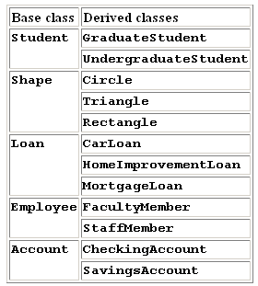
Simple Inheritance Examples
Overloaded Operators
CIS 554/<number>

Slide 6
Base and Derived Classes
An object of one class really “is an” object of another class as well.
  A rectangle “is a” quadrilateral but a quadrilateral can also be a square, parallelogram and trapezoid.
  Class Rectangle can be said to inherit from class Quadrilateral.
  Quadrilateral is the base class and Rectangle is the derived class.
Inheritance forms tree-like hierarchical structures.
A class that uses inheritance is either a base class that supplies attributes and operations to other classes, or a derived class that inherits attributes and operations.
Base-class constructors, destructors, and assignment operators are not inherited by derived classes. Derived class constructors and assignment operators, however, can call base-class constructors and assignment operators.
Overloaded Operators
CIS 554/<number>

Slide 7
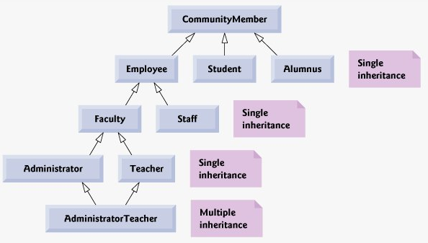
Inheritance Hierarchy
Community
Overloaded Operators
CIS 554/<number>
Notes:
- first picture is a hierarchy of a community at a collage.
- second picture is a hierarchy of different shapes

Slide 8
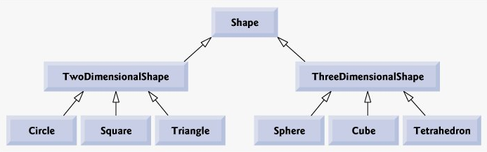
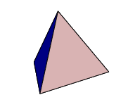
Inheritance Hierarchy
Shape
Overloaded Operators
CIS 554/<number>

Slide 9
Base and Derived Classes public inheritance
Syntax for indicating inheritance.
  class CommissionWorker : public Employee
  { ….. };
  This is public inheritance.
    The public and protected members of the base class are inherited as public and protected members of the derived class.
    Private members of the base class cannot be accessed by the derived class, but are still inherited. They are accessed through the base class public and protected member functions.
    Friend functions are not inherited.
Base class’s protected members may be accessed by members and friends of the base class and by members and friends of the derived class; but not by clients of the derived class.
Public and protected members of the base class are referenced by simply using the member names.
friend functions – not inherited
A derived class can be treated as an object of its corresponding base class.
  The reverse is not true - a base class object is not also automatically a derived-class object.
Overloaded Operators
CIS 554/<number>
Notes:
- explain that CommissionWorker is derived from Employee and has access to the public and protected member of the base class employee.

Slide 10
Simple Inheritance Example
Point
//Class Point Interface
#ifndef POINT_H
#define POINT_H
#include <iostream.h>
class Point {
friend ostream &operator<<( ostream &, const Point & );
public:
Point( int = 0, int = 0 ); // default constructor
void setX( int val) {x = val; } // set x coordinate
void setY( int val) {y = val; } // set y coordinate
int getX() const { return x; } // get x coordinate
int getY() const { return y; } // get y coordinate
private: // not accessible by derived classes
int x, y; // x and y coordinates of the Point
};
#endif
Overloaded Operators
CIS 554/<number>
Notes:
-

Slide 11
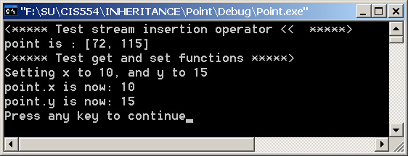
Simple Inheritance Example
Point
// Class Point Imlementation
#include <iostream>
#include "point.h"
// Constructor for class Point
Point::Point( int a, int b )
{
setX(a);
setY(b);
}
// Output Point (with overloaded stream insertion operator)
ostream &operator<<( ostream &output, const Point &p )
{
output << '[' << p.x << ", " << p.y << ']';
return output; // enables cascaded calls
}
#ifdef POINT_DRIVER
void main(void)
{
Point point(72,115);
//<***** Test stream insertion operator << *****>
cout << "point is : " << point << endl;
//<***** Test get and set functions *****>
cout << "Setting x to 10, and y to 15 " << endl;
point.setX(10);
point.setY(15);
cout << "point.x is now: " << point.getX() << endl;
cout << "point.y is now: " << point.getY() << endl;
}
Overloaded Operators
CIS 554/<number>

Slide 12
Simple Inheritance Example
Circle derived from Point
// Class Circle Interface
#ifndef CIRCLE_H
#define CIRCLE_H
#include <iostream.h>
#include <iomanip.h>
#include "point.h"
#define PI 3.14159
class Circle : public Point { // Circle inherits from Point
friend ostream &operator<<( ostream &, const Circle & );
private:
double radius;
public:
// default constructor
Circle( int x = 0, int y = 0, double r = 0.0 );
void setRadius( double ) ; // set radius
double getRadius() const {return radius; } // return radius
double getArea() const {return (PI * radius * radius); } // calculate area
double getDiameter() const {return 2 * radius; } // calculate diameter
double getCircumference() const { return PI * getDiameter(); }
// calculate circumfrence
};
#endif
Overloaded Operators
CIS 554/<number>

Slide 13
Simple Inheritance Example
Circle derived from Point - Explicit call to base constructor
// Class Circle Implementation
#include "circle.h"
// Constructor for Circle calls constructor for Point
// with a member initializer then initializes radius.
Circle::Circle( int a, int b, double r )
: Point( a, b ) // call base-class constructor
{ setRadius( r ); }
// Set radius of Circle
void Circle::setRadius( double r )
{ radius = ( r >= 0 ? r : 0 ); }
// Output a Circle
ostream &operator<<( ostream &output, const Circle &c )
{
output << "Center = " << static_cast < Point >( c ) // use point.operator<<
<< "; Radius = "
<< setiosflags( ios::fixed | ios::showpoint )
<< setprecision( 2 ) << c.radius;
return output; // enables cascaded calls
}
Overloaded Operators
CIS 554/<number>

Slide 14
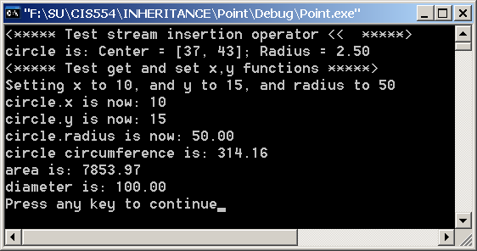
Simple Inheritance Example
Circle derived from Point
#ifdef CIRCLE_DRIVER
void main(void)
{
Circle circle(37,43,2.5);
cout << "<***** Test stream insertion operator << *****>" << endl;
cout << "circle is: " << circle << endl;
cout << "<***** Test get and set x,y functions *****>" << endl;
cout << "Setting x to 10, and y to 15, and radius to 50 " << endl;
circle.setX(10);
circle.setY(15);
circle.setRadius(50);
cout << "circle.x is now: " << circle.getX() << endl;
cout << "circle.y is now: " << circle.getY() << endl;
cout << "circle.radius is now: " << circle.getRadius() << endl;
cout << "circle circumference is: " << circle.getCircumference() << endl;
cout << "area is: " << circle.getArea() << endl;
cout << "diameter is: " << circle.getDiameter() << endl;
}
#endif
Overloaded Operators
CIS 554/<number>

Slide 15
Simple Inheritance Example
Circle derived from Point - Alternative Construction
Implicit call to base class constructor, with initialization
// Constructor for Circle calls public set functions
// in Point
Circle::Circle( int a, int b, double r )
{
setRadius( r );
setX(a); // Call available setX() function on base class
setY(b); // Call available setY() function on base class
}
Overloaded Operators
CIS 554/<number>

Slide 16

Simple Inheritance Example
Circle derived from Point - Implicit base constructor called, but no initialization
// Constructor for Circle does not call Point
// base class constructor explicitly, or initialize
// base class values.
Circle::Circle( int a, int b, double r )
{
setRadius( r );
}
Note initial point is [0,0]
Overloaded Operators
CIS 554/<number>

Slide 17
Simple Inheritance Example
Circle derived from Point - Illegal Construction
// Constructor for Circle attemps to access
// private Point data
Circle::Circle( int a, int b, double r )
{
setRadius( r );
x = a; //ILLEGAL ACCESS
y = b; //ILLEGAL ACCESS
}
--------------------Configuration: Point - Win32 Debug--------------------
Compiling...
circle.cpp
F:\SU\CIS554\Inheritance\Point\circle.cpp(10) : error C2248: 'x' : cannot access private member declared in class 'Point'
f:\su\cis554\inheritance\point\point.h(11) : see declaration of 'x'
F:\SU\CIS554\Inheritance\Point\circle.cpp(11) : error C2248: 'y' : cannot access private member declared in class 'Point'
f:\su\cis554\inheritance\point\point.h(11) : see declaration of 'y'
Error executing cl.exe.
Point.exe - 2 error(s), 0 warning(s)
Overloaded Operators
CIS 554/<number>

Slide 18
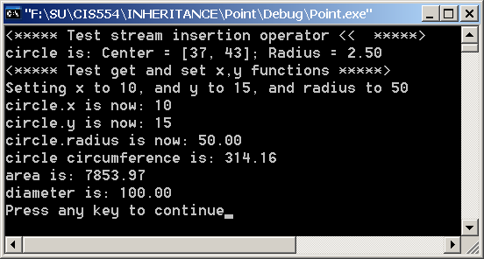
Simple Inheritance Example
Circle derived from Point - direct access to Point data
//Class Point Interface
#ifndef POINT_H
#define POINT_H
#include <iostream.h>
class Point {
friend ostream &operator<<( ostream &, const Point & );
protected: // accessible by derived classes
int x, y; // x and y coordinates of the Point
public:
Point( int = 0, int = 0 ); // default constructor
void setX( int val) {x = val; } // set x coordinate
void setY( int val) {y = val; } // set y coordinate
int getX() const { return x; } // get x coordinate
int getY() const { return y; } // get y coordinate
};
#endif
// Constructor for Circle attemps to access
// private Point data
Circle::Circle( int a, int b, double r )
{
setRadius( r );
x = a; //LEGAL ACCESS
y = b; //LEGAL ACCESS
}
Overloaded Operators
CIS 554/<number>

Slide 19
Derived Class Construction of Base Class
Summary
Explicit Construction & Initialization
  class Circle : public Point {}
  Circle::Circle(int x, int y, int R) : Point(x,y) {}
Implicit Construction, No Initialization
  Circle::Circle(int xVal, int yVal, int R) {}
Implicit Construction, Explicit Initialization (private data)
  Circle::Circle(int x, int y, int R)
  {
  setX(x); // private data of Point. Need public Point.setX()
  setY(y); // private data of Point. Need public Point.setY()
  radius = R; // private data of Circle. direct access
  }
Implicit Construction, Explicit Initialization (protected data)
  Circle::Circle(int xVal, int yVal, int R)
  {
  x = xVal; // protected data of Point. direct access
  y = yVal; // protected data of Point. direct access
  radius = R; // private data of Circle. direct access
  }
Overloaded Operators
CIS 554/<number>

Slide 20
public, protected and private Inheritance
public inheritance
  Base class public members → derived class public members
  Base class protected members → derived class protected members
  Base class private members are not accessible
protected inheritance (not is-a relationship)
  Base class public and protected members → derived class protected members
private inheritance (not is-a relationship)
  Base class public and protected members → derived class private members

Slide 21
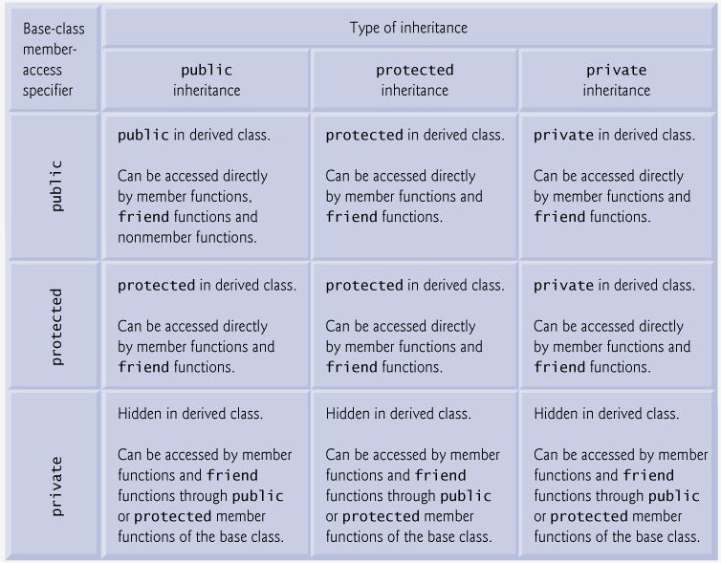
Inheritance Types
Overloaded Operators
CIS 554/<number>

Slide 22
Derived Class Constructors and Destructors
Base class constructor needs to be called to initialize the base class members of the derived class.
Base-class initializer
  member initializer syntax :initialization
  provided in the derived-class constructor to call the base-class constructor explicitly
If the base-class constructor is not explicitly called, the base-class default constructor is implicitly called.
A derived class constructor calls the constructor for its base class first to initialize the derived class’s base-class members.
Destructors are called in reverse order of constructors.
Overloaded Operators
CIS 554/<number>

Slide 23
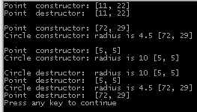
Example
Note destruction in reverse order of construction
#include <iostream.h>
#include "point2.h"
#include "circle2.h"
int main()
{
// Show constructor and destructor calls for Point
{
Point p( 11, 22 );
}
cout << endl;
Circle circle( 4.5, 72, 29 );
cout << endl;
Circle circle( 10, 5, 5 );
cout << endl;
return 0;
}
Overloaded Operators
CIS 554/<number>
Notes:
Go over example 9.7, parts 1-4 showing the definition of the Point base-class and the Circle derived class.
Then use this slide to demonstrate the order in which the constructors and destructors are called.
Note how the Circle class constructor explicitly calls the constructor on the Point class to initialize the Point base-class members of the derived Circle class.
Note in particular the creation of a Point class in a separate scope within main, and how the class goes out of scope when the scope is exited.
Note how the Circle class can directly access the protected members of the base class Point. Refer to lines 64 and 71 of Fig. 9.7

Slide 24
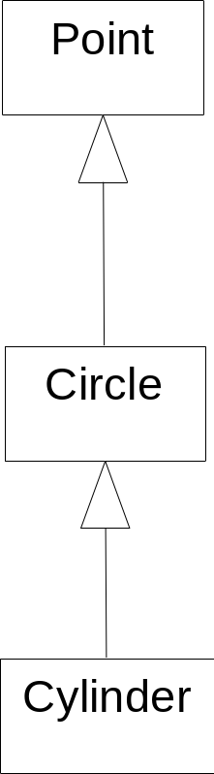
Three-Level Inheritance
Point-Circle-Cylinder Generalization
Notation for generalization (inheritance) in UML
Overloaded Operators
CIS 554/<number>

Slide 25
Three-Level Inheritance
Point-Circle-Cylinder
// Class Cylinder Interface
#ifndef CYLINDR_H
#define CYLINDR_H
#include <iostream.h>
#include "circle.h"
class Cylinder : public Circle {
friend ostream &operator<<( ostream &, const Cylinder & );
public:
// default constructor
Cylinder( int x = 0, int y = 0,
double radius = 0.0, double height = 0.0);
// set height
void setHeight( double );
// return height
double getHeight() const {return height;}
// calculate and return surface area
double getArea() const ;
// calculate and return volume
double getVolume() const {return Circle::getArea() * height;}
private:
double height; // height of the Cylinder
};
#endif
Overloaded Operators
CIS 554/<number>

Slide 26
Three-Level Inheritance
Point-Circle-Cylinder
// Class Cylinder Implementation
#include "cylinder.h"
// Cylinder constructor calls Circle constructor
Cylinder::Cylinder( int x, int y, double radius, double height )
: Circle( x, y, radius ) // call base-class constructor
{ setHeight( height ); }
// Set height of Cylinder
void Cylinder::setHeight( double h )
{ height = ( h >= 0 ? h : 0 ); }
// Calculate area of Cylinder (i.e., surface area)
double Cylinder::getArea() const
{
return 2 * Circle::getArea() +
2 * PI * getRadius() * height;
}
// Output Cylinder dimensions
ostream &operator<<( ostream &output, const Cylinder &c )
{
output << static_cast< Circle >( c )
<< "; Height = " << c.height;
return output; // enables cascaded calls
}
Overloaded Operators
CIS 554/<number>

Slide 27
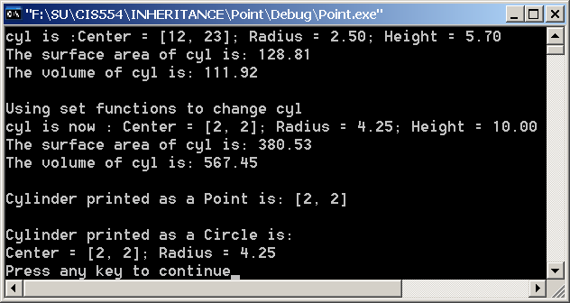
Three-Level Inheritance
Point-Circle-Cylinder
#ifdef CYLINDER_DRIVER
int main()
{
// create Cylinder object
Cylinder cyl( 12, 23, 2.5, 5.7 );
// use operator<< to print cylinder
cout << "cyl is :" << cyl << endl;
cout << "The surface area of cyl is: " << cyl.getArea() << endl << endl;
cout << "The volume of cyl is: " << cyl.getVolume() << endl << endl;
// use set functions to change the Cylinder's attributes
cout << "Using set functions to change cyl" << endl;
cyl.setHeight( 10 ); cyl.setRadius( 4.25 ); cyl.setX(2); cyl.setY(2);
cout << "cyl is now : " << cyl << endl;
cout << "The surface area of cyl is: " << cyl.getArea() << endl << endl;
cout << "The volume of cyl is: " << cyl.getVolume() << endl << endl;
// display the Cylinder as a Point
Point &pRef = cyl; // pRef "thinks" it is a Point
cout << "\nCylinder printed as a Point is: " << pRef << endl << endl;
// display the Cylinder as a Circle
Circle &circleRef = cyl; // circleRef thinks it is a Circle
cout << "Cylinder printed as a Circle is:\n" << circleRef << endl;
return 0;
}
#endif
Overloaded Operators
CIS 554/<number>

Slide 28
Constructor/Destructor Calls
Constructor Definitions
// Constructor for class Point
Point::Point( int a, int b )
{
cout << "<-----ENTERING POINT CONSTRUCTOR (" << a << "," << b << ")----->" << endl;
setX(a);
setY(b);
}
// Constructor for Circle calls constructor for Point
// with a member initializer then initializes radius.
Circle::Circle( int a, int b, double r )
:Point(a,b)
{
cout << "<-----ENTERING CIRCLE CONSTRUCTOR (" << getX() << "," << getY() << "; radius = " << r << ")----->" << endl;
setRadius( r );
}
// Cylinder constructor calls Circle constructor
// then initializes height
Cylinder::Cylinder( int x, int y, double radius, double height )
:Circle(x,y,radius)
{
cout << "<-----ENTERING CYLINDER CONSTRUCTOR (" << x << "," << y
<< "; radius = " << radius << "; height = " << height << ")----->" << endl;
setHeight( height );
}
Overloaded Operators
CIS 554/<number>

Slide 29
Constructor/Destructor Calls
Copy Constructor Definitions
// Copy constructor for class Point
Point::Point( Point &p )
{
cout << "<-----ENTERING POINT COPY CONSTRUCTOR TO COPY " << "(" << p.x << "," << p.y << ")----->" << endl;
x = p.x;
y = p.y;
}
// Copy constructor for class Circle
Circle::Circle( Circle & c)
{
cout << "<-----ENTERING CIRCLE COPY CONSTRUCTOR TO COPY (" << c.getX() << "," << c.getY() << "; radius = " << c.radius <<
")----->" << endl;
radius = c.radius;
setX(c.getX());
setY(c.getY());
}
// Copy constructor for class Cylinder
Cylinder::Cylinder(Cylinder & c)
{
cout << "<-----ENTERING CYLINDER COPY CONSTRUCTOR TO COPY (" << c.getX() << "," << c.getY()
<< "; radius = " << c.getRadius() << "; height = " << c.height << ")----->" << endl;
setX(c.getX());
setY(c.getY());
setRadius(c.getRadius());
height = c.height;
}
Overloaded Operators
CIS 554/<number>

Slide 30
Constructor/Destructor Calls
Destructor Definitions
// Destructor for Class Point
Point::~Point()
{
cout << "<-----ENTERING POINT DESTRUCTOR (" << x << "," << y << ")----->" << endl;
}
// Destructor for Class Point
Circle::~Circle()
{
cout << "<-----ENTERING CIRCLE DESTRUCTOR (" << getX() << "," << getY() << "; radius = " << radius << ")----->" << endl;
}
// Destructor for Class Point
Cylinder::~Cylinder()
{
cout << "<-----ENTERING CYLINDER DESTRUCTOR (" << getX() << "," << getY()
<< "; radius = " << getRadius() << "; height = " << height << ")----->" << endl;
}
Overloaded Operators
CIS 554/<number>

Slide 31
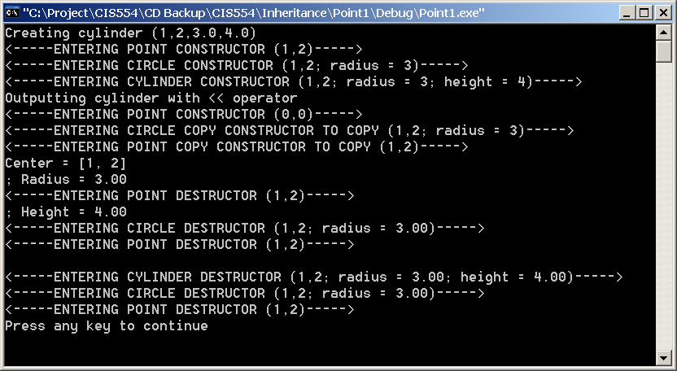
Constructor/Destructor Calls
Calling Sequence of Cylinder Test Driver
int main()
{
// create Cylinder object
cout << "Creating cylinder (1,2,3.0,4.0)" << endl;
Cylinder cyl( 1,2,3.0,4.0 );
cout << "Outputting cylinder with << operator" << endl;
cout << cyl << endl;
return 0;
}
Overloaded Operators
CIS 554/<number>

Slide 32
Constructor/Destructor Calls
Calling Sequence of Cylinder Test Driver
cout << "Creating cylinder (1,2,3.0,4.0)" << endl;
Cylinder cyl( 1,2,3.0,4.0 );
Creating cylinder (1,2,3.0,4.0)
<-----ENTERING POINT CONSTRUCTOR (1,2)----->
<-----ENTERING CIRCLE CONSTRUCTOR (1,2; radius = 3)----->
<-----ENTERING CYLINDER CONSTRUCTOR (1,2; radius = 3; height = 4)----->
Overloaded Operators
CIS 554/<number>

Slide 33
Constructor/Destructor Calls
Calling Sequence of Cylinder Test Driver
// Output Point
ostream &operator<<( ostream &output, Point &p )
{
output << '[' << p.x << ", " << p.y << ']' << endl;
return output; // enables cascaded calls
}
cout << "Outputting cylinder with << operator" << endl;
cout << cyl << endl;
Outputting cylinder with << operator
<-----ENTERING POINT CONSTRUCTOR (0,0)----->
<-----ENTERING CIRCLE COPY CONSTRUCTOR TO COPY (1,2; radius = 3) ---- >
<-----ENTERING POINT COPY CONSTRUCTOR TO COPY (1,2)----->
Center = [1, 2]
; Radius = 3.00
<-----ENTERING POINT DESTRUCTOR (1,2)----->
; Height = 4.00
<-----ENTERING CIRCLE DESTRUCTOR (1,2; radius = 3.00)----->
<-----ENTERING POINT DESTRUCTOR (1,2)----->
// Output a Circle
ostream &operator<<( ostream &output, Circle &c )
{
output << "Center = " << static_cast < Point >( c )
<< "; Radius = "
<< setiosflags( ios::fixed | ios::showpoint )
<< setprecision( 2 ) << c.radius << endl;
return output; // enables cascaded calls
}
// Output Cylinder
ostream &operator<<( ostream &output, Cylinder &c )
{
output << static_cast< Circle >( c )
<< "; Height = " << c.height << endl;
return output; // enables cascaded calls
}
Circle copy constructor called during cast operation. Results in Point constructor called as well.
Overloaded Operators
CIS 554/<number>

Slide 34
Constructor/Destructor Calls
Calling Sequence of Cylinder Test Driver
} // program exit
<-----ENTERING CYLINDER DESTRUCTOR (1,2; radius = 3.00; height = 4.00)----->
<-----ENTERING CIRCLE DESTRUCTOR (1,2; radius = 3.00)----->
<-----ENTERING POINT DESTRUCTOR (1,2)----->
Overloaded Operators
CIS 554/<number>

Slide 35
Overriding Base-Class Members in a Derived Class
Derived classes can override a base-class member functions by supplying a new version of that function with the same signature.
The derived class version is always used instead of the base class’s version.
Overloaded Operators
CIS 554/<number>
Notes:
- make it clear that this is overriding NOT overloading. The signatures must be the same for overriding.

Slide 36
Overriding Base Class Operations
Example
// Class Employee Implementation
#include "employee.h"
#include <cstdlib>
#include <string.h>
Employee::Employee(const char * fName, const char * lName)
{
// allocate memory for first and last name
firstName = (char *)malloc(strlen(fName)+1); //add 1 for NULL terminator
lastName = (char *)malloc(strlen(lName)+1); //add 1 for NULL terminator
strcpy(firstName, fName);
strcpy(lastName, lName);
}
Employee::~Employee()
{
free(firstName);
free(lastName);
}
void Employee::print() const
{
cout << "<-----Class Employee print() operation----->" << endl;
cout << "Employee Name is: " << lastName << ", " << firstName << endl;
}
// Class Employee Interface
class Employee
{
public:
Employee( const char *, const char * ); // constructor
void print() const; // output first and last name
~Employee(); // destructor
private:
char *firstName; // dynamically allocated string
char *lastName; // dynamically allocated string
};
Overloaded Operators
CIS 554/<number>

Slide 37
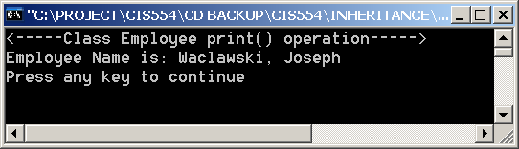
Overriding Base Class Operations
Example
#ifdef EMPLOYEE_DRIVER
void main(void)
{
Employee e("Joseph", "Waclawski");
e.print();
}
#endif
Overloaded Operators
CIS 554/<number>

Slide 38
Overriding Base Class Operations
Example
// Class HourlyWorker Interface
#include "employee.h"
class HourlyWorker : public Employee
{
public:
HourlyWorker( const char*, const char*, double, double );
double getPay() const; // calculate and return salary
void print() const; // overridden base-class print
private:
double wage; // wage per hour
double hours; // hours worked for week
};
// Class HourlyWorker Implementation
#include "hourly.h"
HourlyWorker::HourlyWorker(const char * fName, const char *lName, double w, double h)
:Employee(fName, lName)
{
wage = w;
hours = h;
}
double HourlyWorker::getPay() const
{
return wage * hours;
}
void HourlyWorker::print() const
{
cout << "<-----Class HourlyEmployee print() operation----->" << endl;
Employee::print();
cout << "This employee worked " << hours << " hours and made "
<< getPay() << " dollars last week." << endl;
}
Explicitly call base class version
Overloaded Operators
CIS 554/<number>

Slide 39
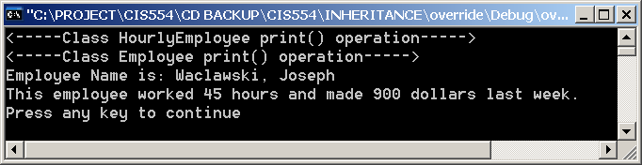
Overloading Base Class Operations
Example
#ifdef HOURLYWORKER_DRIVER
void main(void)
{
HourlyWorker w("Joseph", "Waclawski", 20, 45);
w.print();
}
#endif
Overloaded Operators
CIS 554/<number>

Slide 40
Implicit Derived-Class to
Base-Class Conversion
A derived-class object is-a base-class object, but the derived-class and base-class are still different types as far as the compiler is concerned.
Under public inheritance, derived-class objects can be treated as base-class objects.
  ClassBase = ClassDerived ; LEGAL
  Derived-class objects have members corresponding to the base-class members.
Assignment in the other direction does not make sense. Bass-class objects can NOT be treated as derived-class objects.
  ClassDerived = ClassBase ; ILLEGAL
  Base-class objects do NOT have members corresponding to the derived-class members.
  Such assignment would leave derived-class members undefined.
Although such assignment is not “naturally” allowed, it could be made legitimate by providing a properly overloaded assignment operator and/or conversion constructor.
Overloaded Operators
CIS 554/<number>
Notes:
Note that we make mention of overloaded operators in the last bullet above, however, we do not cover them until next week. This has been true throughout the examples in this chapter.

Slide 41
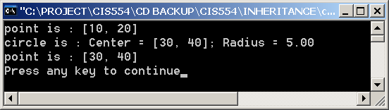
Implicit Derived-Class to
Base-Class Conversion
#ifdef CIRCLE_DRIVER
void main(void)
{
Point point(10,20);
Circle circle(30,40,5.0);
cout << "point is : " << point << endl;
cout << "circle is : " << circle << endl;
point = circle;
cout << "point is : " << point << endl;
}
#endif
Overloaded Operators
CIS 554/<number>

Slide 42
Implicit Derived-Class to
Base-Class Conversion
void main(void)
{
Point point(10,20);
Circle circle(30,40,5.0);
cout << "point is : " << point << endl;
cout << "circle is : " << circle << endl;
point = circle;
cout << "point is : " << point << endl;
circle = point;
cout << "circle is : " << circle << endl;
}
--------------------Configuration: conversion - Win32 Debug--------------------
Compiling...
circle.cpp
C:\Project\CIS554\CD Backup\CIS554\Inheritance\conversion\circle.cpp(44) :
error C2679: binary '=' : no operator defined which takes a right-hand operand of type 'class Point' (or there is no acceptable conversion)
Error executing cl.exe.
conversion.exe - 1 error(s), 0 warning(s)
Overloaded Operators
CIS 554/<number>

Slide 43
Implicit Derived-Class to
Base-Class Conversion
With public inheritance, a pointer to a derived-class object may be implicitly converted to a pointer to a base-class object
  The derived-class object is-a base-class object.
  pointPtr = circlePtr;
  Conversion is done implicitly by the compiler.
  The converse is not valid
  circlePtr = pointPtr // NOT VALID
Overloaded Operators
CIS 554/<number>

Slide 44
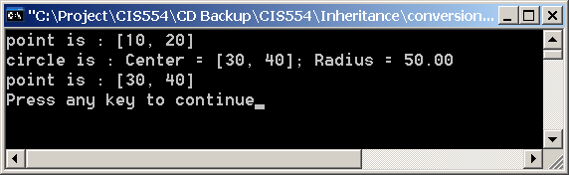
Implicit Derived-Class to
Base-Class Conversion
void main(void)
{
Point * pointPtr = new Point(10,20);
Circle * circlePtr = new Circle(30,40,50.0);
Point * basePtr;
cout << "point is : " << *pointPtr << endl;
cout << "circle is : " << *circlePtr << endl;
basePtr = circlePtr;
cout << "point is : " << *basePtr << endl;
delete pointPtr;
delete circlePtr;
}
Overloaded Operators
CIS 554/<number>

Slide 45
SW Engineering With Inheritance
Creating a derived class does not affect its base class’s source code or object code; the integrity of a base class is preserved by inheritance.
In an object-oriented system, classes are often closely related. “Factor out’ common attributes and behaviors and place these in a base class. Then use inheritance to form derived classes.
If classes produced through inheritance are larger than they need to be, memory and processing resources may be wasted. Inherit from the class “closest” to what you need.
A derived class contains the attributes and behaviors of its base class. A derived class can also contain additional attributes and behaviors. With inheritance, the base class can be compiled independently of the derived class. Only the derived class’s incremental attributes and behaviors need to be compiled to be able to combine these with the base class to form the derived class.
Modifications to a base class do not necessarily require derived classes to change as long as the public and protected interfaces to the base class remain unchanged.
Overloaded Operators
CIS 554/<number>

Slide 46
Composition Vs. Inheritance
Public inheritance forms an is-a relationship.
  A rectangle is-a quadrilateral
  A hourly person is-a employee
  A circle is-a point.
Composition is formed when a class’s data members contain other classes. This is known as a has-a relationship
  An Employee class might use a Birthdate class and a TelephoneNumber class.
  Hence, the Employee has-a Birthdate, and the employee has-a TelephoneNumber.
Overloaded Operators
CIS 554/<number>

Slide 47
is-a, has-a & uses-a Relationships
Public Inheritance - is-a relationship
  Private and protected inheritance are not is-a relationships
Composition - has-a relationship
A uses-a relationship is brought about when one class utilizes the services of another class, and instantiates an object of that class to perform a function.
Overloaded Operators
CIS 554/<number>

Slide 48
Multiple Inheritance
// Class Base1 Interface & Implementation
#ifndef BASE1_H
#define BASE1_H
#include <iostream.h>
class Base1 {
public:
Base1(int intParam) { intValue = intParam; }
int getData() const { return intValue; }
protected:
int intValue;
};
#endif
// Class Base2 Interface & Implementation
#ifndef BASE2_H
#define BASE2_H
#include <iostream.h>
class Base2 {
public:
Base2(char charParam) { charValue = charParam; }
char getData() const { return charValue; }
protected:
char charValue;
};
#endif
Overloaded Operators
CIS 554/<number>

Slide 49
Multiple Inheritance
// Class Derived Interface
#ifndef DERIVED_H
#define DERVIED_H
#include "base1.h"
#include "base2.h"
#include <iostream.h>
class Derived : public Base1, public Base2 {
friend ostream &operator<<(ostream &, const Derived &);
public:
Derived(int intParam, char charParam, double dParam);
double getReal() const;
private:
double realValue;
};
#endif
/ Class Derived Implementation
#include "derived.h"
Derived::Derived(int intVal, char charVal, double realVal)
: Base1(intVal), Base2(charVal), realValue(realVal) {}
double Derived::getReal() const { return realValue; }
ostream & operator<<( ostream & output, const Derived & derived )
{
output << "Integer: " << derived.intValue
<< "; Character: " << derived.charValue
<< "; Real: " << derived.realValue;
return output;
}
Overloaded Operators
CIS 554/<number>

Slide 50
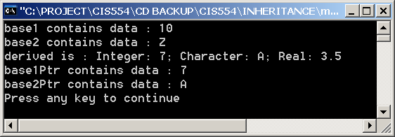
Multiple Inheritance
void main(void)
{
Base1 base1(10), *base1Ptr;
Base2 base2('Z'), *base2Ptr;
Derived derived(7, 'A', 3.5);
cout << "base1 contains data : " << base1.getData() << endl;
cout << "base2 contains data : " << base2.getData() << endl;
cout << "derived is : " << derived << endl;
base1Ptr = &derived;
cout << "base1Ptr contains data : " << base1Ptr->getData() << endl;
base2Ptr = &derived;
cout << "base2Ptr contains data : " << base2Ptr->getData() << endl;
}
Overloaded Operators
CIS 554/<number>

Slide 51
Multiple Inheritance
Class Derived is-a Base1
Class Derived is-a Base2
Mechanics of multiple inheritance in this simple example, but real-world use must be selected carefully.
Overloaded Operators
CIS 554/<number>

Slide 52
Multiple Inheritance
Ambiguous Base Class
class Derived2 : public Base
{
public:
char nameDerived2[25];
int derived2Data;
Derived2() { strcpy(nameDerived2,"Class Derived2"); }
};
class Derived3: public Derived1, public Derived2
{
public:
int sum;
};
#include <iostream.h>
#include <string.h>
class Base
{
public:
char nameBase[25];
int baseData;
Base() { strcpy(nameBase,"Class Base"); }
};
class Derived1 : public Base
{
public:
char nameDerived1[25];
int derived1Data;
Derived1() { strcpy(nameDerived1,"Class Derived1"); }
};
Class Base exists in both Derived1 and Derived2.
This results in Derived3 having multiple instances of class Base
Overloaded Operators
CIS 554/<number>

Slide 53
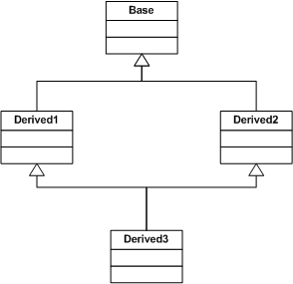
Multiple Inheritance
Ambiguous Base Class
Derived3 inherits 2 Base classes; one from Derived1 and the other from Derived2
Overloaded Operators
CIS 554/<number>

Slide 54
Multiple Inheritance
Ambiguous Base Class
Since Derived1 and Derived2 both inherit from Base, Derived3 will have 2 copies of Base.
Which copy of Base.nameBase should the compiler use? It doesn’t know
void main()
{
Derived3 d3;
cout << d3.nameBase << endl;
}
--------------------Configuration: vbase - Win32 Debug--------------------
Compiling...
vbase.cpp
C:\Project\CIS554\CD Backup\CIS554\Inheritance\vbase\vbase.cpp(42) : error C2385: 'Derived3::nameBase' is ambiguous
C:\Project\CIS554\CD Backup\CIS554\Inheritance\vbase\vbase.cpp(42) : warning C4385: could be the 'nameBase' in base 'Base' of base 'Derived1' of class 'Derived3'
C:\Project\CIS554\CD Backup\CIS554\Inheritance\vbase\vbase.cpp(42) : warning C4385: or the 'nameBase' in base 'Base' of base 'Derived2' of class 'Derived3'
Error executing cl.exe.
vbase.exe - 1 error(s), 2 warning(s)
Overloaded Operators
CIS 554/<number>

Slide 55
Virtual Base Class
Virtual derivation of a base class removes ambiguity of multiple instances of base classes in the derived class.
Base class initialization is the responsibility of the “most derived” class. I.e., the one at the bottom of the inheritance hierarchy.
Overloaded Operators
CIS 554/<number>

Slide 56
class Base {
public:
char nameBase[25];
int baseData;
Base() { strcpy(nameBase,"No Base Name"); baseData = -1; } // default constructor
Base(int x, const char * name) { strcpy(nameBase,name); baseData = x; } // initialization constructor
};
class Derived1 : virtual public Base {
public:
char nameDerived1[25];
int derived1Data;
Derived1(int bData=0, const char *bName = "Derived1 Base Class")
: Base(bData, bName) // initialize base class
// using base class initialization constructor
{
strcpy(nameDerived1,"Class Derived1");
derived1Data = bData * 10;
}
};
class Derived2 : virtual public Base {
public:
char nameDerived2[25];
int derived2Data;
Derived2(int bData=0, const char *bName = "Derived2 Base Class")
: Base(bData, bName) // initialize base class
// using base class initialization constructor
{
strcpy(nameDerived2,"Class Derived2");
derived2Data = bData * 20;
}
};
Overloaded Operators
CIS 554/<number>

Slide 57
Virtual Base Class
Derived3 does not call Base class constructor.
class Derived3: public Derived1, public Derived2 {
friend ostream& operator<<(ostream & output, Derived3 &d3)
{
output << "Class Derived3 is:" << endl;
output << d3.nameBase << ": baseData = " << d3.baseData << endl;
output << d3.nameDerived1 << ": baseData = " << d3.baseData
<< ", derived1Data = " << d3.derived1Data << endl;
output << d3.nameDerived2 << ": baseData = " << d3.baseData
<< ", derived2Data = " << d3.derived2Data << endl;
return output;
}
public:
Derived3(int bData, const char *bName)
:Derived1(bData, bName), Derived2(bData, bName) // Initialization for base classes
// Derived1 & Derived2
// Note that class Base is not intialized
{}
};
Overloaded Operators
CIS 554/<number>

Slide 58
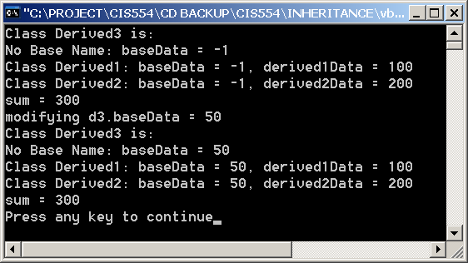
Virtual Base Class
No Explicit initialization of Base class at most derived level.
Note default constructor called for Base class. While Derived1 and Derived2 called Base class constructor, Derived3 did not.
void main()
{
Derived3 d3(10, "Base Class");
cout << d3 << endl;
cout << "modifying d3.baseData = 50" << endl;
d3.baseData = 50;
cout << d3 << endl;
}
Base class exists and can be modified.
Overloaded Operators
CIS 554/<number>

Slide 59
Virtual Base Class
Explicit initialization of Base class at most derived level.
class Derived3: public Derived1, public Derived2 {
friend ostream& operator<<(ostream & output, Derived3 &d3)
{
output << "Class Derived3 is:" << endl;
output << d3.nameBase << ": baseData = " << d3.baseData << endl;
output << d3.nameDerived1 << ": baseData = " << d3.baseData
<< ", derived1Data = " << d3.derived1Data << endl;
output << d3.nameDerived2 << ": baseData = " << d3.baseData
<< ", derived2Data = " << d3.derived2Data << endl;
output << "sum = " << d3.getSum();
return output;
}
public:
Derived3(int bData, const char *bName)
//Initialize base classes
// Derived1, Derived2 & Base
: Base(bData, bName), Derived1(bData, bName), Derived2(bData, bName)
{}
private:
int getSum() { return derived1Data + derived2Data; }
int sum;
};
Overloaded Operators
CIS 554/<number>

Slide 60
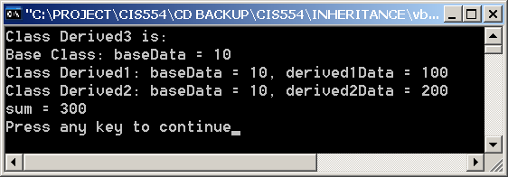
Virtual Base Class
Explicit initialization of Base class at most derived level.
Note that since the most derived class (Derived3) explicitly calls the Base class constructor, we initialize that portion of Derived3
void main()
{
Derived3 d3(10, "Base Class");
cout << d3 << endl;
}
Overloaded Operators
CIS 554/<number>

