Slide 1
MAP Container
What is a map?
  A type of associative container that contains a key value, and a mapped value.
  The key value is used for searching the map, while the mapped value contains the data of interest.
  Implemented in STL as a balanced binary tree (Red Black Tree)
  A good example of a use for a map is a telephone directory, where the key value is the name of a person, and the mapped value is information about the user, like the person’s phone number.
  Because it’s implemented as a balanced tree, a quick search can be made for a particular person to access their data.

Slide 2
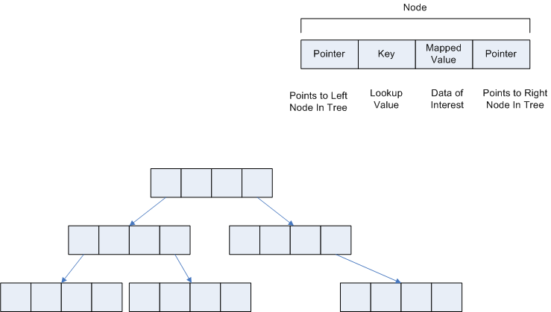
Map Structure

Slide 3
Creating a map
// type used as key in the map
enum SHAPE_TYPES {RECTANGLE, TRIANGLE, CIRCLE};
// create the map, and insert an element for
// each shape type
map<SHAPE_TYPES,vector<Shape *>> shapeMap;

Slide 4
Inserting into the map
// create vectors used for storing shapes. This is the data of interest
vector<Shape *> rectVector;
vector<Shape *> triangleVector;
vector<Shape *> circleVector;
// insert initial elements for RECTANGLEs, TRIANGLEs and CIRCLES
shapeMap.insert(pair<SHAPE_TYPES, vector<Shape *>>(RECTANGLE, rectVector));
shapeMap.insert(pair<SHAPE_TYPES, vector<Shape *>>(TRIANGLE, triangleVector));
shapeMap.insert(pair<SHAPE_TYPES, vector<Shape *>>(CIRCLE, circleVector));

Slide 5
Updating the map
// create explicit iterator for searching the map
map<SHAPE_TYPES,vector<Shape *>>::iterator mapIter;
// update map with rectangle. Note that if the RECTANGLE key is not found
// the end of the map is returned.
// also note that mapIter->second points to the mapped value (i.e.
// the vector
mapIter = shapeMap.find(RECTANGLE);
if (mapIter != shapeMap.end())
{
// the key was found, so add data
mapIter->second.push_back(data);
}

Slide 6
Getting data from the map
mapIter = shapeMap.find(CIRCLE);
// if the CIRCLE key is found
if (mapIter != shapeMap.end())
{
// if the CIRCLE vector has something in it
if ( !mapIter->second.empty() )
{
// draw the shape using polymorphism
mapIter->second.back()->Draw();
// VERY IMPORTANT - delete the memory at the pointer. we are done with the
// memory
delete mapIter->second.back();
// remove shape so we don’t display it again
mapIter->second.pop_back();
}
}

