Slide 1
Operator Fundamentals
Operators are like functions. They take parameters that the compiler acts upon, and return a value.
Unary operators take 1 parameter.
  Example ++ or --
  ++x or x++; // increments x
  --x or x--; // decrements x
Binary operators take 2 parameters.
  Example +=
  x += 5; // adds 5 to the variable x.
Ternary operators take 3 parameters.
  Only 1 such operator in C++, the ?: operator.
  cout << (grade >= 60 ? “Passed” : “Failed”);
Implicit casting is provided for built-in types.
Overloaded Operators
CIS 554/<number>

Slide 2
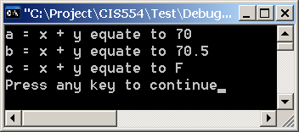
Implicit Casting
#include <iostream.h>
int main()
{
int x = 65;
float y = 5.5;
int a;
float b;
char c;
cout << "a = x + y equate to " << (a = x + y) << endl;
cout << "b = x + y equate to " << (b = x + y) << endl;
cout << "c = x + y equate to " << (c = x + y) << endl;
return 0;
}
--------------------Configuration: Test - Win32 Debug--------------------
Compiling...
Test.cpp
c:\project\cis554\test\test.cpp(13) : warning C4244: '=' : conversion from 'float' to 'int', possible loss of data
c:\project\cis554\test\test.cpp(15) : warning C4244: '=' : conversion from 'float' to 'char', possible loss of data
Linking...
Test.exe - 0 error(s), 2 warning(s)
Overloaded Operators
CIS 554/<number>

Slide 3
Introduction to Operator Overloading
Operator Overloading - user-defined C++ operators which work on your class objects.
Examples of Overloaded Operators in the C++ class library
  The “<<“ operator
    Used a stream insertion operator
    Also used as the bit-wise left-shift operator
  The “>>” operator
    Used as stream extraction operator
    Also used as the bit-wise right-shift operator
Example of Overloaded built-in operators
  “+” and “-”
    These operators know how to add and subtract in the context of integer arithmetic, floating-point arithmetic, and pointer arithmetic.
Overloaded Operators
CIS 554/<number>

Slide 4
Introduction to Operator Overloading
C++ enables the programmer to overload most operators to be sensitive to the context in which they are used
The compiler generates the appropriate code based on the manner in which the operator is used.
In the case of user-defined overloaded operators, the compiler uses your code to perform the operation.
Example. Assume a class called Time has been defined by you.
  Time a(12,0,0), b(14,0,0), x;
  int c = 5, d= 10, y;
  We know that y = c + d; assigns the value 15 to the variable y.
  But what does x = a + b do?
    The compiler does not know how to overload the “+” operator to make the x object equal to the addition of the a and b objects. You must overload the “+” operator in order for the compiler to know what to do.
Overloaded Operators
CIS 554/<number>

Slide 5
Fundamentals
Operator overloading contributes to the extensibility of C++
Use operator overloading when it makes a program clearer than accomplishing the same operations with explicit function calls.
Avoid excessive or inconsistent use of operator overloading as this can make a program cryptic and difficult to read.
Operators are overloaded by writing a function definition as you normally would, except that the function name now becomes the keyword operator, followed by the symbol for the operator being overloaded.
  Example: operator+ would be the function that overloads the operator “+”
Overloaded Operators
CIS 554/<number>

Slide 6
Fundamentals
The assignment operator “=“ and pointer operator “&” may be used with every class without explicit overloading.
The default behavior of the assignment operator is a memberwise assignment of the data members of the class.
  Memberwise assignment of data members when they are pointers is dangerous.
To use an operator on a class it must be overloaded
  Two exceptions are assignment operator “=“ and pointer operator “&”
  These two operators are implicitly overloaded by the compiler
Overloaded Operators
CIS 554/<number>

Slide 7
Fundamentals
Operator functions can be member functions or non-member functions.
Non-member functions are often made friend functions of the class for performance reasons.
Overloaded operator functions that require access to private data members of the class object being output or input must be declared as friends of the class.
Overloaded Operators
CIS 554/<number>

Slide 8
Semantics
return_type class_name::operator#(arg_list)
return_type is usually an object of the class they operate on, but can be any valid type
operator is the keyword for overloading functions
# is a placeholder for a valid operator that we are overloading
arg_list depends upon the operator we are overloading
  unary operators typically have no parameters
  binary operators typically have one parameter
  Note that C++ has only 1 ternary operator (?:) which cannot be overloaded.
Overloaded Operators
CIS 554/<number>

Slide 9
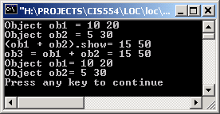
Example operator+
Member Function - Return non-Reference
// Class loc Interface
#include <iostream.h>
class loc {
int longitude, latitude;
public:
loc() {}
loc(int lg, int lt) {
longitude = lg;
latitude = lt;
}
void show() {
cout << longitude << " ";
cout << latitude << "\n";
}
loc operator+(loc op2);
};
// Class loc Implementation
#include “loc.h”
// Overload + for loc.
loc loc::operator+(loc op2)
{
loc temp;
temp.longitude = op2.longitude + longitude;
temp.latitude = op2.latitude + latitude;
return temp;
}
int main()
{
loc ob1(10, 20), ob2( 5, 30), ob3;;
cout << "Object ob1 = ";
ob1.show(); // displays 10 20
cout << "Object ob2 = ";
ob2.show(); // displays 5 30
cout << "(ob1 + ob2).show= ";
(ob1 + ob2).show();
cout << "ob3 = ob1 + ob2 = ";
ob3 = ob1+ob2;
ob3.show();
cout << "Object ob1= ";
ob1.show();
cout << "Object ob2= ";
ob2.show();
return 0;
}
Note that neither ob1 or ob2 were modified as a result of the way operator+ was defined
Overloaded Operators
CIS 554/<number>

Slide 10
Example operator+
Member Function - Return non-Reference - No default Constructor
// Class loc Interface
#include <iostream.h>
class loc {
int longitude, latitude;
public:
loc(int lg, int lt) {
longitude = lg;
latitude = lt;
}
void show() {
cout << longitude << " ";
cout << latitude << "\n";
}
loc operator+(loc op2);
};
// Class loc Implementation
#include “loc.h”
// Overload + for loc.
loc loc::operator+(loc op2)
{
loc temp;
temp.longitude = op2.longitude + longitude;
temp.latitude = op2.latitude + latitude;
return temp;
}
--------------------Configuration: Test - Win32 Debug--------------------
Compiling...
test1.cpp
loc.cpp
C:\Project\CIS554\Test\loc.cpp(25) : error C2512: 'loc' : no appropriate default constructor available
Error executing cl.exe.
Test.exe - 1 error(s), 0 warning(s)
Overloaded Operators
CIS 554/<number>

Slide 11
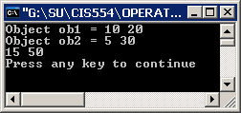
Example operator+
Member Function - Return *this (Note that left operand is modified)
// Class loc Interface
#include <iostream.h>
class loc {
int longitude, latitude;
public:
loc() {}
loc(int lg, int lt) {
longitude = lg;
latitude = lt;
}
void show() {
cout << longitude << " ";
cout << latitude << "\n";
}
loc &operator+(loc &op2);
};
// Class loc Implementation
#include “loc.h”
// Overload + for loc.
loc &loc::operator+(loc &op2)
{
longitude = op2.longitude + longitude;
latitude = op2.latitude + latitude;
return *this
}
// Class loc Test Driver
#include “loc.h”
int main()
{
loc ob1(10, 20), ob2( 5, 30);
cout << "Object ob1 = ";
ob1.show(); // displays 10 20
cout << "Object ob2 = ";
ob2.show(); // displays 5 30
ob1 + ob2;
ob1.show(); // displays 15 50
return 0;
}
Note that ob1 is modified as a result of the way the operator+ was defined.
Overloaded Operators
CIS 554/<number>

Slide 12
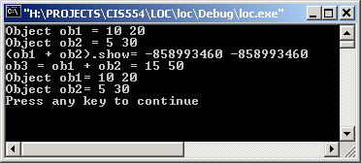
Example operator+
Member Function - Return reference to temp object.
// Class loc Implementation
#include “loc.h”
// Overload + for loc.
loc &loc::operator+(loc &op2)
{
loc temp;
temp.longitude = op2.longitude + longitude;
temp.latitude = op2.latitude + latitude;
return temp;
}
Compiling...
loc1.cpp
C:\Project\CIS554\Test\loc1.cpp(12) : warning C4172: returning address of local variable or temporary
Linking...
Test.exe - 0 error(s), 1 warning(s)
Overloaded Operators
CIS 554/<number>

Slide 13
Example operator+
Discussion
Note that operator+ has only one parameter, even though it overloads a binary operator.
If a binary operator requires 2 parameters, where did the second parameter come from?
  The left operand is passed implicitly into the function through the this pointer.
  The right operand is passed into the function as parameter op2
The fact that the left operand is passed using this also implies one important point:
  When binary operators are overloaded, it is the object on the left that generates the call to the operator function.
Note that we did not need to overload the = operator.
Overloaded Operators
CIS 554/<number>

Slide 14
Example operator+
Discussion
As mentioned, it is common for an overloaded operator function to return an object of the same class. The following would not be possible otherwise:
  ob1 = ob1 + ob2;
The following operation is also possible because we return an object of the class loc:
  (ob1+ob2).show();
The overloaded + operator does not modify either operand (if we code it right!). Rather, it returns a temporary modified object to be assigned to a new object.
  If we did not return an object of type loc from the overloaded + operation, would that make sense?
So, while we can return any type we want from an overloaded operator function, it seldom makes sense to do so.
Care must be taken when returning a reference to a temp object.
  A reference to this should be returned only when the object is being modified as part of the operator. Otherwise, an object is returned.
Overloaded Operators
CIS 554/<number>

Slide 15
Overloading Prefix and Postfix
Increment & Decrement Operators
Pre and Post increment and decrement can be overloaded.
Pre and post must have distinct signature so the compiler will be able to determine which version of ++ is intended.
  A simple trick is used, which is a convention adopted by C++.
  The pre-increment is overloaded just like any other prefix unary operator we looked at.
    loc &operator++(); // prototype
    ++ob1 is converted to a call ob1.operator++()
  For the post-increment we could use:
    loc operator++(int); // prototype
    ob1++ is converted to a call ob1.operator++(0)
The decrement (pre and post) are done the same way.
Overloaded Operators
CIS 554/<number>

Slide 16
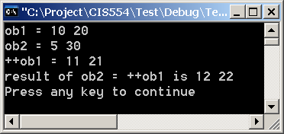
Example operator++
Member function - Return *this after modifying object.
// Class loc Interface
#include <iostream.h>
class loc {
int longitude, latitude;
public:
loc(int lg, int lt) {
longitude = lg;
latitude = lt;
}
void show() {
cout << longitude << " ";
cout << latitude << "\n";
}
loc &operator++();
};
// Class loc Implementation
#include “loc.h”
// Overload prefix ++ for loc.
loc &loc::operator++()
{
longitude++;
latitude++;
return *this;
}
// Class loc Test Driver
#include “loc.h”
int main()
{
loc ob1(10, 20), ob2( 5, 30), ob3(90, 90);
cout << "ob1 = "; ob1.show();
cout << "ob2 = "; ob2.show();
cout << "++ob1 = "; (++ob1).show(); // displays 11 21
ob2 = ++ob1;
cout << "result of ob2 = ++ob1 is "; ob2.show();
return 0;
}
By default, this will become the pre-increment operator.
Overloaded Operators
CIS 554/<number>

Slide 17
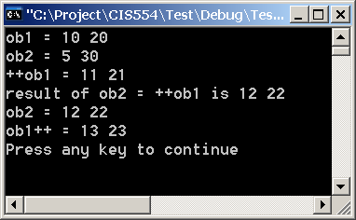
Example operator++
With no post-increment defined
int main()
{
loc ob1(10, 20), ob2( 5, 30);
cout << "ob1 = "; ob1.show();
cout << "ob2 = "; ob2.show();
cout << "++ob1 = "; (++ob1).show(); // displays 11 21
cout << "result of ob2 = ++ob1 is "; (ob2 = ++ob1).show();
cout << "ob2 = "; ob2.show();
cout << "ob1++ = "; (ob1++).show();
return 0;
}
--------------------Configuration: Test - Win32 Debug--------------------
Compiling...
test1.cpp
C:\Project\CIS554\Test\test1.cpp(14) : warning C4620: no postfix form of 'operator ++' found for type 'loc', using prefix form
c:\project\cis554\test\loc.h(4) : see declaration of 'loc'
Linking...
Test.exe - 0 error(s), 1 warning(s)
Overloaded Operators
CIS 554/<number>

Slide 18
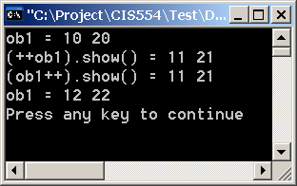
Example post-Increment
Member function
// Class loc Interface
#include <iostream.h>
class loc {
int longitude, latitude;
public:
loc(int lg, int lt) {
longitude = lg;
latitude = lt;
}
void show() {
cout << longitude << " ";
cout << latitude << "\n";
}
loc &loc::operator++(); // pre-increment
loc loc::operator++(int); // post-increment
loc &loc::operator+(loc &op2);
};
// Class loc Implementation
#include “loc.h”
// pre-increment
loc &loc::operator++()
{
longitude++;
latitude++;
return *this;
}
// post-increment
loc loc::operator++(int dummy)
{
loc temp = *this;
longitude++;
latitude++;
return temp;
}
// Overload + for loc.
loc &loc::operator+(loc &op2)
{
longitude = op2.longitude + longitude;
latitude = op2.latitude + latitude;
return *this;
}
#include “loc.h”
int main()
{
loc ob1(10, 20), ob2( 5, 30);
cout << "ob1 = "; ob1.show();
cout << "++ob1 = "; (++ob1).show();
cout << "ob1++ = "; (ob1++).show();
cout << "ob1 = "; ob1.show();
return 0;
}
The int passed in is ignored. Only used to provide a unique function footprint.
Overloaded Operators
CIS 554/<number>

Slide 19
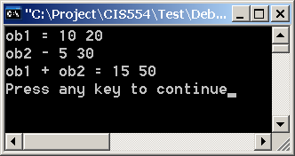
Operator +
Non-member friend function
// Class loc Interface
#include <iostream.h>
class loc {
friend loc operator+(loc&, loc&);
int longitude, latitude;
public:
loc() {} // default constructor required for
//creating temporary objects
loc(int lg, int lt) {
longitude = lg;
latitude = lt;
}
void show() {
cout << longitude << " ";
cout << latitude << "\n";
}
loc &loc::operator++(); // pre-increment
loc loc::operator++(int); // post-increment
};
#include "loc.h"
// pre-increment
loc &loc::operator++()
{
longitude++;
latitude++;
return *this;
}
// post-increment
loc loc::operator++(int dummy)
{
loc temp = *this;
longitude++;
latitude++;
return temp;
}
loc operator+(loc &op1, loc&op2)
{
loc temp;
temp.longitude = op1.longitude + op2.longitude;
temp.latitude = op1.latitude + op2.latitude;
return temp;
}
#include "loc.h"
int main()
{
loc ob1(10, 20), ob2( 5, 30);
cout << "ob1 = "; ob1.show();
cout << "ob2 - "; ob2.show();
cout << "ob1 + ob2 = "; (ob1+ob2).show();
return 0;
}
Overloaded Operators
CIS 554/<number>

Slide 20
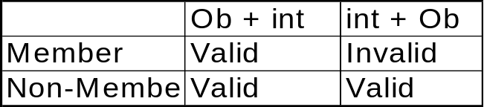
Member vs. Non-member Functions
For Binary Operators
In cases where either a member or non-member function can be used, it’s best practice to use member functions.
Non-member functions should only be used when required.
  Left operand is not of the object type
  Overloading << and >>
Overloaded Operators
CIS 554/<number>

Slide 21
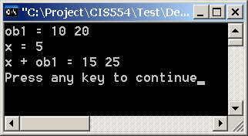
Implementing int + Ob
Left operand NOT a class loc. Non-member friend function required
// Class loc Interface
#include <iostream.h>
class loc {
friend loc operator+(int, loc&);
int longitude, latitude;
public:
// loc() {} // default constructor required for creating
// temporary objects
loc(int lg = 0, int lt = 0) {
longitude = lg;
latitude = lt;
}
void show() {
cout << longitude << " ";
cout << latitude << "\n";
}
loc &loc::operator++(); // pre-increment
loc loc::operator++(int); // post-increment
};
// Class loc Implementation
#include "loc.h"
// pre-increment
loc &loc::operator++()
{
longitude++;
latitude++;
return *this;
}
// post-increment
loc loc::operator++(int dummy)
{
loc temp = *this;
longitude++;
latitude++;
return temp;
}
loc operator+(int op1, loc& op2)
{
loc temp;
temp.longitude = op1 + op2.longitude;
temp.latitude = op1 + op2.latitude;
return temp;
}
// Test Driver
#include "loc.h"
int main()
{
int x = 5;
loc ob1(10, 20);
cout << "ob1 = "; ob1.show();
cout << "x = " << x << endl;
cout << "x + ob1 = "; (x + ob1).show();
return 0;
}
Overloaded Operators
CIS 554/<number>

Slide 22
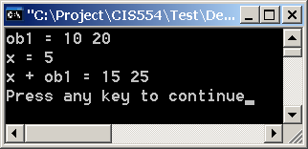
operator + non-member, non-friend function
// Class loc Interface
#include <iostream.h>
class loc {
public:
loc(int lg = 0, int lt = 0) {
longitude = lg;
latitude = lt;
}
void show() {
cout << longitude << " ";
cout << latitude << "\n";
}
int longitude, latitude;
loc &loc::operator++(); // pre-increment
loc loc::operator++(int); // post-increment
};
loc operator+(int, loc&);
// Class loc Implementation
#include "nonmem.h"
// pre-increment
loc &loc::operator++()
{
longitude++;
latitude++;
return *this;
}
// post-increment
loc loc::operator++(int dummy)
{
loc temp = *this;
longitude++;
latitude++;
return temp;
}
loc operator+(int op1, loc& op2)
{
loc temp;
temp.longitude = op1 + op2.longitude;
temp.latitude = op1 + op2.latitude;
return temp;
}
// Test Driver
int main()
{
int x = 5;
loc ob1(10, 20);
cout << "ob1 = "; ob1.show();
cout << "x = " << x << endl;
cout << "x + ob1 = "; (x + ob1).show();
return 0;
}
Must be public
Overloaded Operators
CIS 554/<number>

Slide 23
Compiler-generated Calls
Member Functions
  Unary Operators - object.operator#()
  Binary Operators - object.operator#(op1)
Non-Member Functions
  Unary Operators - operator#(lobject&)
  Binary Operators - operator#(lobject&, robject&)
Overloaded Operators
CIS 554/<number>

Slide 24
Restrictions of Overloading
Precedence cannot be altered
  As with other operators, parentheses may be used to guide precedence.
The associativity of an operator cannot be altered. (I.e., certain operators are evaluated left to right, or right to left)
It is not possible to change the “arity”. Unary operators are still unary operators (I.e. one argument), binary operators are still binary operators (I.e. two arguments), etc.
It is not possible to create new operators.
Operations on built-in types cannot be overloaded.
Overloaded Operators
CIS 554/<number>

Slide 25
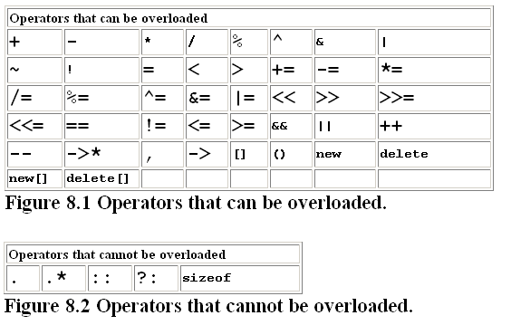
Restrictions on Overloading
Overloaded Operators
CIS 554/<number>

Slide 26
Restrictions of Overloading
Overloading an assignment operator and an addition operator allows statements like this:
  object2 = object2 + object1;
This does NOT imply that the += operator has been overloaded. I.e., this would not be legal if only the “+” and “=“ operators have been overloaded:
  object 2 += object1; <-- NOT LEGAL unless “+=“ is overloaded!
Overloaded Operators
CIS 554/<number>

Slide 27
Restrictions on Overloading
When overloading “()”, “[]”, “->” or any of the assignment operators, the operator overloading function must be declared as a class member.
When an operator is implemented as a member function, the leftmost operand must be a class object (or reference).
If the left operand must be an object of a different class or built-in type, the operator function must be implemented as a non-member function (I.e. friend).
Operator member functions of a specific class are called only when the left operand of a binary operator is specifically an object of that class, or when the single operator of a unary operator is an object of that class.
  This prevents the operator from being commutative.
    I.e. given long int number and class HugeNumber bigNumber:
    bigNumber + number is allowed, however, number + bigNumber is not, because the variable of type HugeNumber must be on the left side
Overloaded Operators
CIS 554/<number>
Notes:
As an example of operators which have a left-most argument of something other than the class type, we have the << and >> operators. The overloaded << operator must have a left operand of type ostream &, (as in cout << object) so it must be a non-member function. Same for cin.

Slide 28
Misuse of Default = Operator
// Class myName Interface
#include <iostream.h>
class myName {
char *nameString;
int age;
public:
myName(const char * n, int a);
~myName();
void show();
};
// Class myName Implementation
#include "myname.h"
#include <string.h>
myName::myName(const char * n, int a)
{
nameString = new char[132];
strcpy(nameString,n);
age = a;
}
myName::~myName()
{
delete [] nameString;
}
void myName::show()
{
cout << "My name is " << nameString << endl;
cout << "I am " << age << " years old" << endl;
}
// Test Driver
void main(void)
{
myName Jeff("Jeff",32);
myName Betty("Betty",29);
cout << " Object Jeff is: " << endl;
Jeff.show();
cout << " Object Betty is: " << endl;
Betty.show();
Jeff = Betty;
cout << endl << endl
<< "After Jeff = Betty "
<< endl << endl;
cout << " Object Jeff is: " << endl;
Jeff.show();
cout << " Object Betty is: " << endl;
Betty.show();
}
How does default operator handle this?
Overloaded Operators
CIS 554/<number>

Slide 29
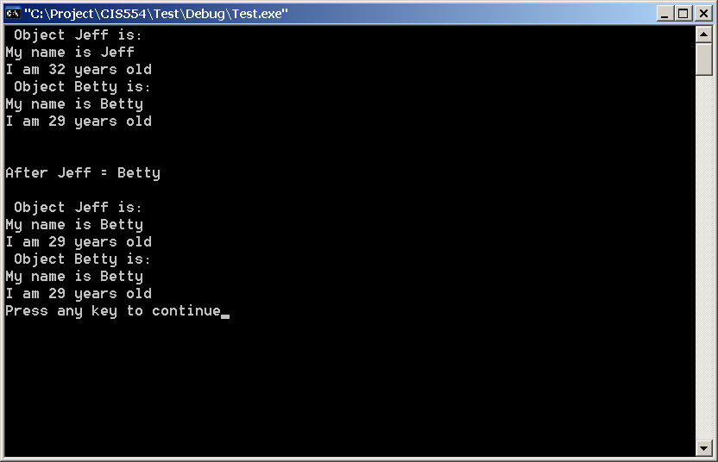
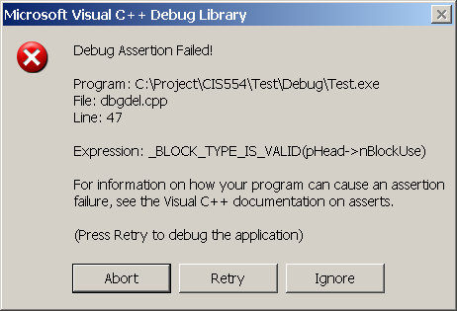
Default = Operator
Disastrous Results
Overloaded Operators
CIS 554/<number>

Slide 30
Properly Overloaded = Operator
// Class myName Interface
#include <iostream.h>
class myName {
char *nameString;
int age;
public:
myName(const char * n, int a);
myName(myName &mn);
~myName();
void show();
void operator=(myName &);
};
// Class myName Implementation
#include "myname.h"
#include <string.h>
myName::myName(const char * n, int a)
{
nameString = new char[132];
strcpy(nameString,n);
age = a;
}
myName::~myName()
{
delete [] nameString;
}
void myName::show()
{
cout << "My name is " << nameString << endl;
cout << "I am " << age << " years old" << endl;
}
void myName::operator = (myName & c)
{
age = c.age;
strcpy(nameString, c.nameString);
}
// Test Driver
void main(void)
{
myName Jeff("Jeff",32);
myName Betty("Betty",29);
cout << " Object Jeff is: " << endl;
Jeff.show();
cout << " Object Betty is: " << endl;
Betty.show();
Jeff = Betty;
cout << endl << endl
<< "After Jeff = Betty "
<< endl << endl;
cout << " Object Jeff is: " << endl;
Jeff.show();
cout << " Object Betty is: " << endl;
Betty.show();
}
Overloaded Operators
CIS 554/<number>

Slide 31
Copy Constructor
void myName::myName(myName & c)
{
age = c.age;
myName = new char[132];
strcpy(nameString, c.nameString);
}
Overloaded Operators
CIS 554/<number>

Slide 32
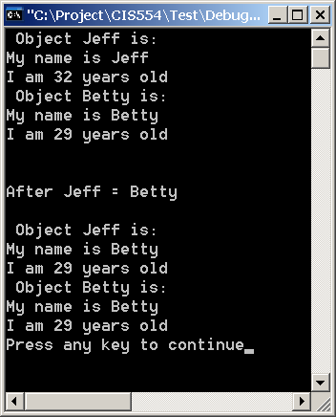
Properly Overloaded = Operator
Pleasing Results
Overloaded Operators
CIS 554/<number>

Slide 33
Overloaded == and != Operators
// Class myName Interface
#include <iostream.h>
class myName {
char *nameString;
int age;
public:
myName(const char * n, int a);
~myName();
void show();
void operator=(myName &);
bool operator==(myName &);
bool operator!=(myName &);
};
// Class myName Implementation
#include "myname.h"
#include <string.h>
….
bool myName::operator == (myName & c)
{
if ( (strcmp(nameString,c.nameString) == 0)
&& age == c.age )
return true;
else
return false;
}
bool myName::operator != (myName & c)
{
return !(*this == c)
}
Overloaded Operators
CIS 554/<number>

Slide 34
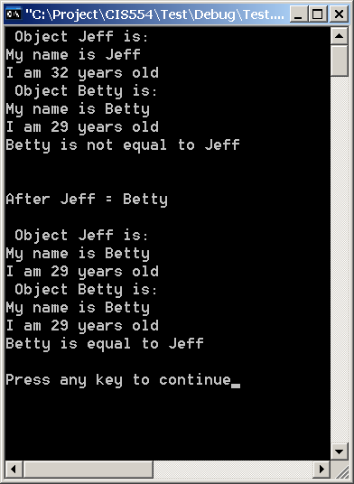
Overloaded == and != Operators
// Test Driver
void main(void)
{
myName Jeff("Jeff",32);
myName Betty("Betty",29);
cout << " Object Jeff is: " << endl;
Jeff.show();
cout << " Object Betty is: " << endl;
Betty.show();
if ( Betty == Jeff ) cout << "Betty is equal to Jeff" << endl;
if ( Betty != Jeff ) cout << "Betty is not equal to Jeff" << endl;
Jeff = Betty;
cout << endl << endl << "After Jeff = Betty " << endl << endl;
cout << " Object Jeff is: " << endl;
Jeff.show();
cout << " Object Betty is: " << endl;
Betty.show();
if ( Betty == Jeff ) cout << "Betty is equal to Jeff" << endl;
if ( Betty != Jeff ) cout << "Betty is not equal to Jeff" << endl;
cout << endl;
}
Overloaded Operators
CIS 554/<number>

Slide 35
Overloading Stream-insertion and Stream-extraction Operators.
#include <iostream.h>
#include <iomanip.h>
class PhoneNumber {
friend ostream &operator<<( ostream&, const PhoneNumber & );
friend istream &operator>>( istream&, PhoneNumber & );
private:
char areaCode[ 4 ]; // 3-digit area code and null
char exchange[ 4 ]; // 3-digit exchange and null
char line[ 5 ]; // 4-digit line and null
};
Overloaded Operators
CIS 554/<number>
Notes:
Note that two important lines here are the declarations of the overloaded << and >> operator functions.
Indicate that the reason they are non-member functions is that the overloaded functions for these two operators must have ostream & or istream & as the left most argument.
Indicate that the reason they are friend functions is that they will require access to private data of the class PhoneNumber

Slide 36
Overloading Stream-insertion Operator
// Overloaded stream-insertion operator (cannot be
// a member function if we would like to invoke it with
// cout << somePhoneNumber;).
ostream &operator<<( ostream &output, const PhoneNumber &num )
{
output << "(" << num.areaCode << ") "
<< num.exchange << "-" << num.line;
return output; // enables cout << a << b << c;
}
Overloaded Operators
CIS 554/<number>
Notes:
Note the parameters to the function
The first parameter is a reference to the cout routine
The second is a reference to an object of type PhoneNumber. The specific object referenced is the one that is used in the “cout” statement.
Example - cout << foo. A reference to the object foo would be passed in implicitly.

Slide 37
Overloading Stream-extraction Operator
istream &operator>>( istream &input, PhoneNumber &num )
{
// the expected input format is “(123) 456-7890:\n”
cout << "Enter phone number in the form (123) 456-7890:\n";
input.ignore(); // skip (
input >> setw( 4 ) >> num.areaCode; // input area code
input.ignore( 2 ); // skip ) and space
input >> setw( 4 ) >> num.exchange; // input exchange
input.ignore(); // skip dash (-)
input >> setw( 5 ) >> num.line; // input line
return input; // enables cin >> a >> b >> c;
}
Overloaded Operators
CIS 554/<number>
Notes:
Note the parameters to the function
The first parameter is a reference to the cin routine
The second is a reference to an object of type PhoneNumber. The specific object referenced is the one that is used in the “cout” statement.
Example - cin << foo. A reference to the object foo would be passed in implicitly.

Slide 38

Test Driver
int main()
{
PhoneNumber phone; // create object phone
// cin >> phone invokes operator>> function by
// issuing the call operator>>( cin, phone ).
cin >> phone;
// cout << phone invokes operator<< function by
// issuing the call operator<<( cout, phone ).
cout << "The phone number entered was: " << phone << endl;
return 0;
}
Overloaded Operators
CIS 554/<number>
Notes:
Note that cin >> phone is compiled to operator>>( cin, phone).
input becomes an alias for cin, and reference num becomes an alias for phone.
cout << phone is compiled to operator<<( cout, phone )
output becomes and alias for cout, and reference num becomes an alias for phone.

Slide 39
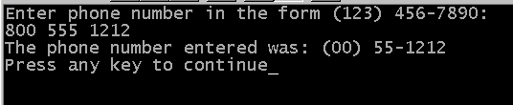
Incorrect User Input
Note how incorrect input is misinterpreted.
Overloaded Operators
CIS 554/<number>
Notes:
Note that since specific input was required, the overloaded stream extraction function incorrectly interpreted the phone number, resulting in the above.
This demonstrates how important error detection and correction is with user-input. This version of the overloaded >> operator did not perform any detection and correction. It assumed that the data input from the keyboard was correct.

Slide 40
Overloaded () Operator
int & myIntArray::operator()(int row)
{
dummy=0;
if ((row <= numRows) && (row > 0))
return arrayImpl[row];
else return dummy; // need to return reference to
// something if we overstep
// the array
}
myIntArray x(5);
int y;
y = x(5); // works because x.operator(5) returns a reference to an
// integer value from arrayImpl (I.e. arrayImpl[5])
// to which y can be set equal.
x(5) = y; // also works because x.operator(5) returns a reference to
// arrayImpl[5], which allows us direct access to modify it.
Overloaded Operators
CIS 554/<number>

Slide 41
Converting Between Types
Compiler can handle conversions between built-in types.
Programmers can force conversions among built-in types by casting.
Programmer must specify how to do conversions between user-defined types.
  Performed with conversion constructors. These turn objects of other types into objects of a particular class.
The cast operator can be used to convert an object of one class into an object of another class.
  Must be a non-static member function
  Cannot be a friend function.
Overloaded cast operator does not specify a return type.
  The return type is the type to which the object is being converted.
Overloaded Operators
CIS 554/<number>
Notes:
Explain how the cast will work. The compile will generate the call to the object overloaded cast operator, Where the cast is found in the code.

Slide 42
Converting Between Types
Conversion Operators (aka Casting Operator)
Overloaded cast or conversion operator functions can be defined for converting objects of user-defined types into built-in types, or into objects of other user-defined types.
    A::operator int() const; // convert object of type A to int
    A::operator otherClass() const; // convert object of type A to type otherClass
The compiler will call the overload cast operators automatically to create temporary objects.
  In the example below, the compiler will use the char* cast operator to implicitly convert a String to a char *. Thus, the << operator does not need to be overloaded, because cout can use it’s built-in ability to display char * types via cout.
    given: String::operator const char*(){}
    String s;
    cout << s; // cout uses char * implicit conversion of String
    // type to pointer to char
Overloaded Operators
CIS 554/<number>

Slide 43
Converting Between Types
Conversion Constructor
Conversion constructors can be defined for converting objects of built-in or user-defined types, into objects of our ADT’s.
Conversion constructors are single-argument constructors
    A::A(const int &); // convert int into object of type A
    A::A(const B &); // convert object of type B into object of type A
    given: String::String(const char *){}
    // explicitly invoking the conversion constructor
    String s1( "happy birthday " );
    // implicitly invoking the conversion constructor
    // the compiler needs to create a temp copy of the
    // to you string in order to allow the += operator to
    // be invoked
    s1 += "to you "; // test conversion constructor
Overloaded Operators
CIS 554/<number>
Notes:
- The examples
- first one converts an user defined typeA into an integer.
- second one converts an object of user-defined type A into an object of user-defined type otherClass.
- the third the compile calls the overloaded cast operator to convert the object into a char* and uses the resulting char* in the expression.

Slide 44
Converting Between Types
#define STRING1_H
#include <iostream>
using std::ostream;
using std::istream;
class String {
public:
String( const char * = "" ); // conversion/default ctor
String( const String & ); // copy constructor
~String(); // destructor
operator char * ();
const String &operator+=(const String &);
private:
int length; // string length
char *sPtr; // pointer to start of string
void setString( const char * ); // utility function
}; // end class String
#endif
#include "myString.h" // String class definition
// char * conversion constructor
// converts char * to String
String::String( const char *s )
: length( ( s != 0 ) ? strlen( s ) : 0 )
{
cout << "Conversion constructor: " << s << '\n';
setString( s ); // call utility function
} // end String conversion constructor
// char * casting operator
String::operator char *()
{
cout << "Casting operator: " << '\n';
return (sPtr);
} // end char * casting operator
Overloaded Operators
CIS 554/<number>

Slide 45
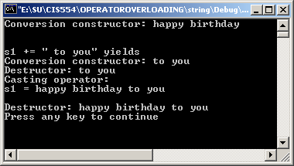
Converting Between Types
With implicit conversion constructor
Note: Since we don’t explicitly have operator+=(char *), the compiler uses the next best thing, implicit conversion via the conversion constructor, which is provided by the String class.
#include "myString.h"
int main()
{
// test explicit conversion constructor
String s1( "happy birthday " );
// test implicit conversion constructor
cout << "\n\ns1 += \" to you\" yields\n";
s1 += "to you "; // test conversion constructor
// test casting operator
cout << "s1 = " << static_cast<char *>(s1) << "\n\n";
} // end main
Overloaded Operators
CIS 554/<number>

Slide 46
Add String::operator+=(const char *)
// operator+=(const char *)
const String &String::operator+=( const char * right)
{
cout << "Entering String::operator+=(char *)" << endl;
size_t newLength = length + strlen(right); // new length
char *tempPtr = new char[ newLength + 1 ]; // create memory
strcpy( tempPtr, sPtr ); // copy sPtr
strcpy( tempPtr + length, right); // copy right.sPtr
delete [] sPtr; // reclaim old space
sPtr = tempPtr; // assign new array to sPtr
length = newLength; // assign new length to length
return *this; // enables cascaded calls
} // end function operator+=
Overloaded Operators
CIS 554/<number>

Slide 47
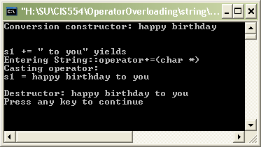
Converting Between Types
With overloaded += operator
Note: Since we have String::operator+=(char *), the compiler uses it. No implicit conversion required.
#include "myString.h"
int main()
{
// test explicit conversion constructor
String s1( "happy birthday " );
// test operator+=
cout << "\n\ns1 += \" to you\" yields\n";
s1 += "to you "; // test operator+=
// test casting operator
cout << "s1 = " << static_cast<char *>(s1) << "\n\n";
} // end main
Overloaded Operators
CIS 554/<number>

Slide 48
Copy Constructors
What are they?
Constructor which initializes it's object member variables with another object of the same class.
If you don't implement one in your class the compiler implements one for you by doing a member-wise copy (sometimes referred to as a shallow copy)
Overloaded Operators
CIS 554/<number>

Slide 49
Copy Constructors
When are they called?
When a function returns an object of that class by value
When the object of that class is passed by value as an argument to a function
When you construct an object based on another object of the same class
When compiler generates a temporary object.
  As in 1) and 2) above
  Explicit casting
Overloaded Operators
CIS 554/<number>

Slide 50
Example
class Boo
{
friend ostream & operator<<(ostream & output, Boo &b)
{
output << "I am a Boo. My name is " << b.booName << endl;
return output;
}
public:
// default constructor
Boo(string name = "casper")
{
booName = name;
cout << booName << "::Boo default constructor called" << endl;
}
// copy constructor
Boo (Boo & b)
{
booName = b.booName;
cout << "class boo copy constructor called" << endl;
}
private:
string booName;
};
Class Boo
Overloaded Operators
CIS 554/<number>

Slide 51
Example
Test Driver
Helper Functions
Boo getBoo();
void putBoo(Boo);
void main()
{
// call default constructor
Boo b;
cout << b << endl;
// Case 1) calling copy constructor for function return by value
cout << "***** Case 1 *****" << endl;
b = getBoo();
cout << b << endl;
// Case 2) calling copy constructor for parameter pass by value to function
cout << "***** Case 2 *****" << endl;
Boo b1("sammy");
putBoo(b1);
// Case 3) calling copy constructor for an object which is created based
// on another
cout << "***** Case 3 *****" << endl;
Boo b2(b);
cout << b2 << endl;
}
Boo getBoo()
{
Boo b("freddy");
return b;
}
void putBoo(Boo b)
{
cout << b << endl;
}
Overloaded Operators
CIS 554/<number>

Slide 52
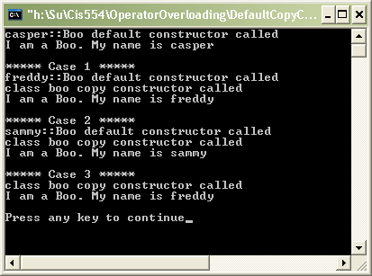
Example
// Case 1) calling copy constructor for function
// return by value
cout << "***** Case 1 *****" << endl;
b = getBoo();
cout << b << endl;
// Case 2) calling copy constructor for parameter
// pass by value to function
cout << "***** Case 2 *****" << endl;
Boo b1("sammy");
putBoo(b1);
// Case 3) calling copy constructor for an
// object which is created based on another
cout << "***** Case 3 *****" << endl;
Boo b2(b);
cout << b2 << endl;
Overloaded Operators
CIS 554/<number>

Slide 53
Important Note
If you need a copy constructor, you also need a destructor and operator=
  If you need a copy constructor, it's because you need something like a deep copy, or some other management of resources. Thus it is almost certain that you will need a destructor, and will need to override the assignment operator.
Overloaded Operators
CIS 554/<number>

