Slide 1

International Organizations

Slide 2
Supranational Political Bodies
Associations of three or more states created for mutual benefit and to achieve shared objectives.
Supranational organizations – come into being when countries give up a portion of their sovereignty (willingly) in order to gain the advantages of having a closer relationship with their neighboring countries, politically, economically or culturally.

Slide 3
Goals of International Organizations
Political & Military
  United Nations
  North Atlantic Treaty Organization (NATO)
  Warsaw Pact
  Organization of American States (OAS)
  African Union (AU)

Slide 4
Goals of International Organizations
Economic
  European Union (EU)
  Council for Mutual Economic Assistance (COMECON) – communist countries
  North American Free Trade Agreement (NAFTA)

Slide 5
Political & Military Organizations

Slide 6
United Nations
1945 – original 49 members
2007 – 192 members

Slide 7
United Nations
The United Nations System is based on five active principal organizations:
UN General Assembly
UN Security Council
UN Economic and Social Council
UN Secretariat
International Court of Justice

Slide 8
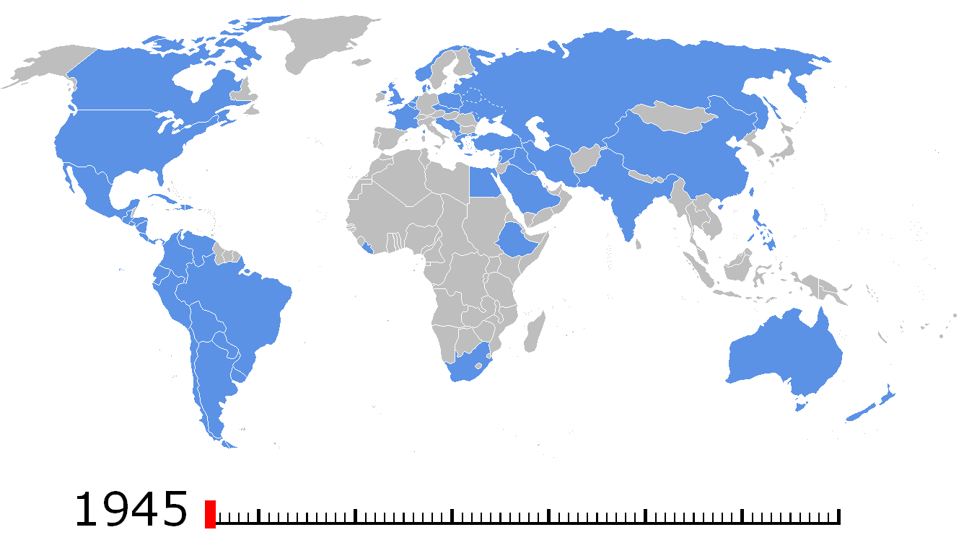
http://en.wikipedia.org/wiki/United_Nations

Slide 9
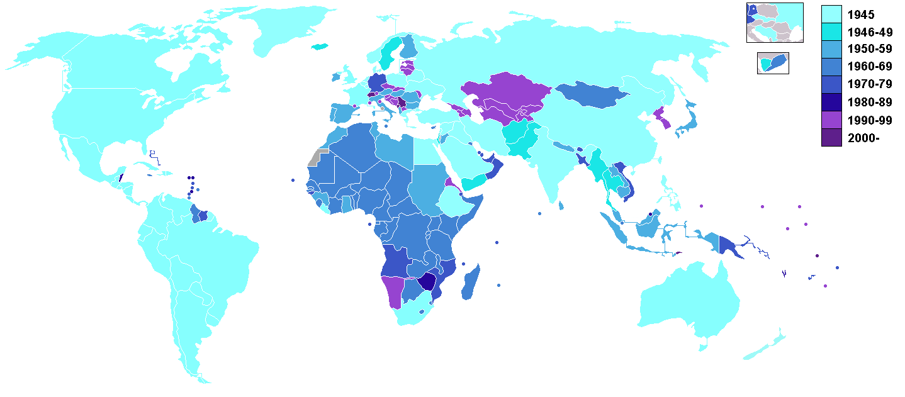
Non-member States
Taiwan (China)
Vatican City
Western Sahara (territory of Morocco)
Palestinian Territories
Tibet (China)

Slide 10
Sample United Nations Organizations
UNDP - United Nations Development Programme
UNIFEM - United Nations Development Fund for Women
UNV - United Nations Volunteers
UNEP - United Nations Environment Programme
UNFPA - United Nations Fund for Population Activities
UNHCR - Office of the United Nations High Commissioner for Refugees
UN-HABITAT - United Nations Human Settlements Programme (UN-HABITAT)
UNICEF - United Nations Children's Fund

Slide 11
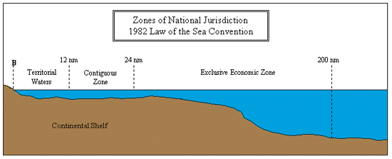
Maritime boundaries
United Nations Convention on the Law of the Sea (UNCLOS):
Four zones:
  Territorial sea – 12 nautical miles
  Contiguous zone
  Exclusive Economic zone (EEZ)-200 n.m.
  High Seas or Global Commons

Slide 12
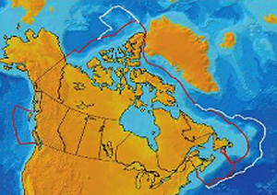
Map of Canada outlining the 200 mile exclusive economic zone (red line) and the possible limit of the extended continental shelf (white line).

Slide 13
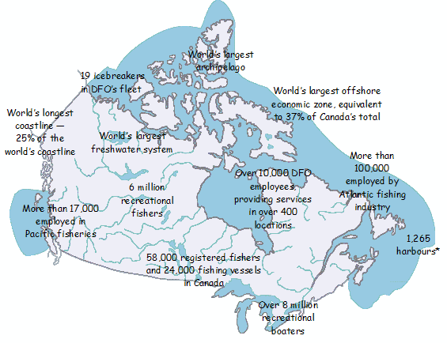

Slide 14
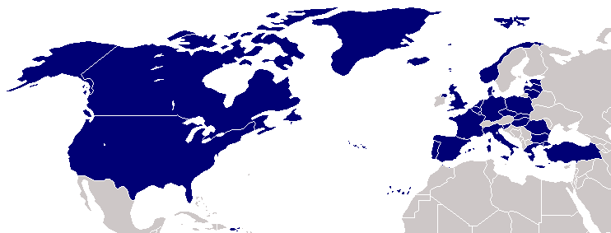
NATO
After WWII – 16 member nations
Since fall of communism – some former Warsaw pact countries have joined

Slide 15
Economic Organizations

Slide 16
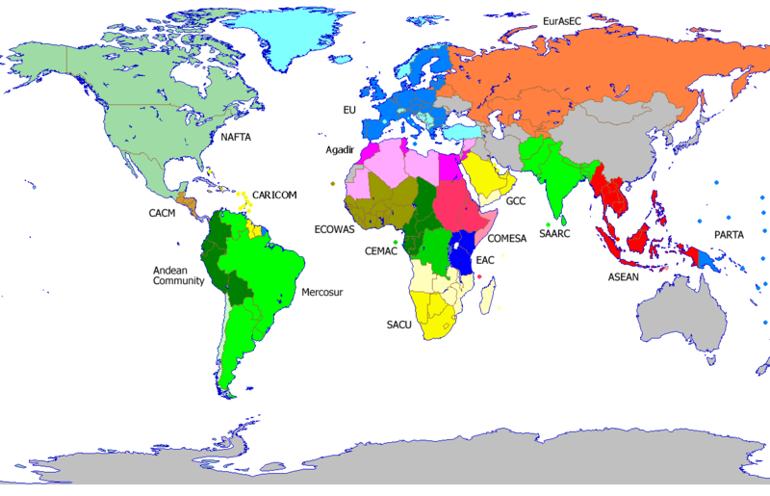
Trading Blocs

Slide 17
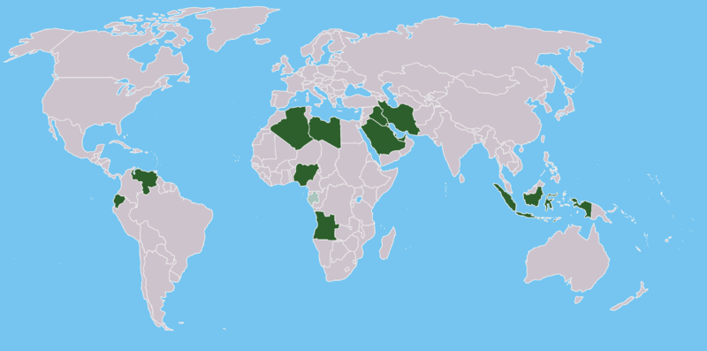
OPEC
The Organization of the Petroleum Exporting Countries (OPEC) is a large group of countries[1][2] made up of Algeria, Angola, Indonesia, Iran, Iraq, Kuwait, Libya, Nigeria, Qatar, Saudi Arabia, the United Arab Emirates, Venezuela, and Ecuador (which rejoined OPEC in November 2007)

Slide 18

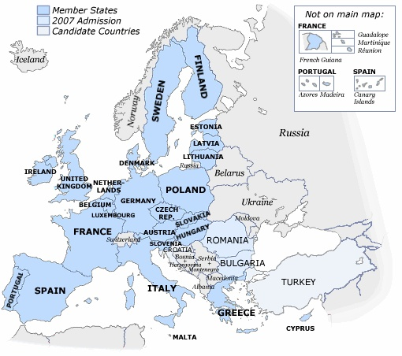
European
Union
Began as
European
Economic
Community
(EEC), 1957.
Stronger in 1994
10 new members
joined, 2004
Turkey and Romania want to join but have faced resistance.

Slide 19
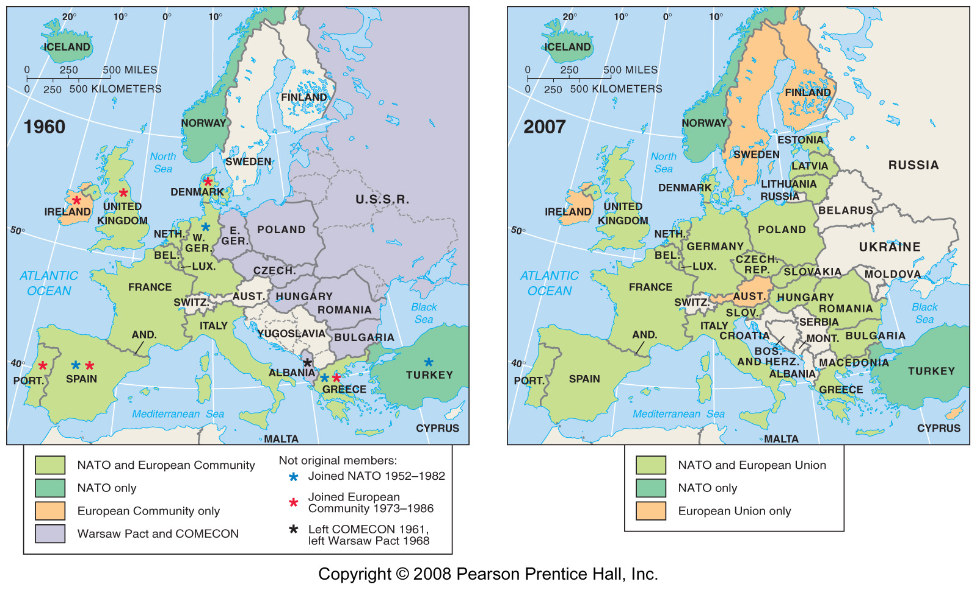

Slide 20
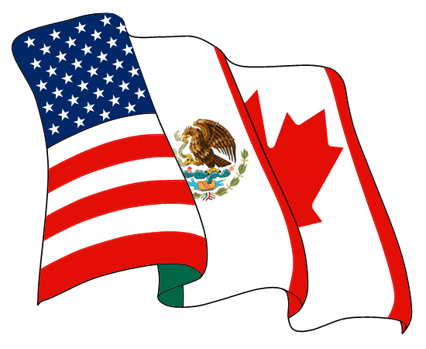
NAFTA
1993
Designed to converge wealth between Canada, US, & Mexico
Increase in wealth for elite, decline in income for Mex. farmers, and job loss for US workers
Increase in maquiladoras

Slide 21
Group Research
1. When did this organization become official?
2. Were there any predecessors to this organization?
3. How many states are members to this organization?
4. List 5 major member states.
5. What is the purpose of this organization?
6. How is this organization structured?
7. How do you join this organization?
8. What are the benefits of this organization?
9 What are the downfalls of this organization?
10. Why would a state want to join this organization?
EU
NAFTA
ASEAN
WTO
ADPA
NATO
AU
OAS
OPEC
UNPO
(African Diamond Producers Association )
(Unrepresented Nations & Peoples Organization

