Slide 1

Exploratory Data Analysis (EDA) of AMCAT Dataset
And Hypothesis Testing: Investigating Salary Claims

Slide 2
About me
Myself Neeraj , Currently Pursuing BTech. In CSE From ITM (sls) Baroda University, Vadodara , Gujarat.
Data Science was my field of interest from the beginning, working on this since 2 years.
I’m also Development Team Lead of Aerosat Launch Program’s Ground Station Software, where we build small scale payloads and launch them.
The advancement in the field Machine Learning like GPT’s and LLM’s caught my interest.
I want to build my career in this field and contribute to the fullest with a growing mindset
Contact links :-
Linkedin.com
Github
X

Slide 3
Agenda
Objective
Summary of Data
Data Pre-processing
Exploratory Data Analysis
Research Questions
Conclusion

Slide 4
1. Objective
• To perform Exploratory Data Analysis on AMEO Dataset.
• To get better understanding each feature by interpreting in different forms using statistical tools.
• To understand the relationship of each feature with ‘Salary’ and observe different trends, patterns.
Some specific goals to consider
Identify factors affecting salary
Salary trends and potential pay gaps
Experience and salary growth
Salary and specialization
2. Summary of Data
The dataset was released by Aspiring Minds from the Aspiring Mind
Employment Outcome 2015 (AMEO). The study is primarily limited only to
students with engineering disciplines. The dataset contains the employment
outcomes of engineering graduates as dependent variables (Salary, Job Titles,
and Job Locations) along with the standardized scores from three different
areas – cognitive skills, technical skills and personality skills. The dataset also
contains demographic features. The dataset contains around 40 independent variables and 4000 data
points. The independent variables are both continuous and categorical in
nature. The dataset contains a unique identifier for each candidate.

Slide 5
3. Data Pre-processing
Typecasted the data into the right format
Date features were converted into pandas date time format
The DOL for the employees who are working in the company is considered
as present date
Numerical continuous features the outliers are removed for better data analysis.
Categorical features with no need or high cardinality were removed
Spelling correction done for ’10thboard’ using fuzzywuzzy for better data
understanding.
df.column
Index(['ID', 'Salary', 'DOJ', 'DOL', 'Designation', 'JobCity', 'Gender', 'DOB',
'10percentage', '10board', '12graduation', '12percentage', '12board',
'CollegeTier', 'Degree', 'Specialization', 'collegeGPA', 'CollegeState',
'GraduationYear', 'English', 'Logical', 'Quant', 'Domain',
'ComputerProgramming', 'ElectronicsAndSemicon', 'ComputerScience',
'MechanicalEngg', 'ElectricalEngg', 'TelecomEngg', 'CivilEngg',
'conscientiousness', 'agreeableness', 'extraversion', 'nueroticism',
'openess_to_experience', 'Experience', 'Age', 'AverageScore',
'Acadperf'],
dtype='object')

Slide 6
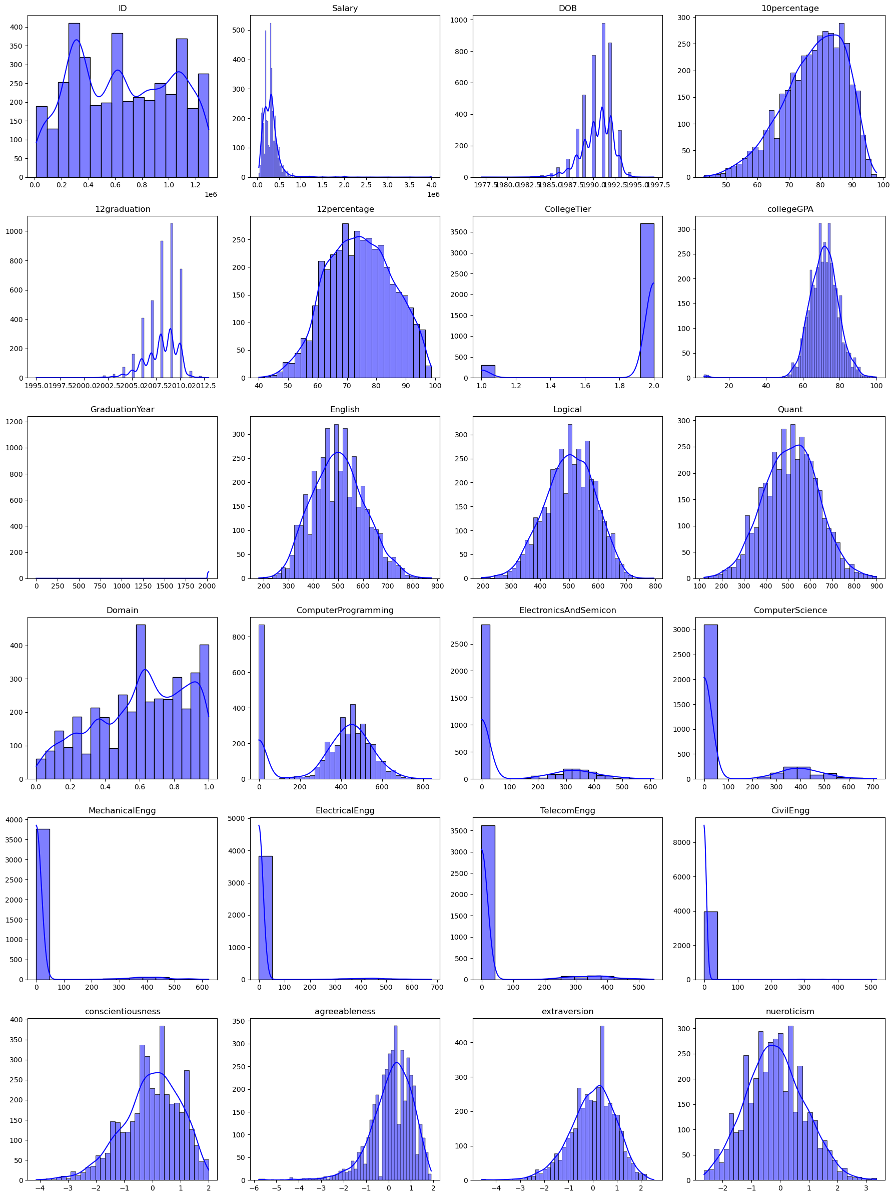
4. Exploratory Data Analysis
4.1. Univariate Analysis
The distribution of salary shows indicates positive skewness and moderately high Kurtosis.
The median salary of an employee is 3,00,000 INR and the lowest wage is 35000 INR.
10th ,12th Percentage and collegeGPA: 1. All the three features follow similar distributions. 2. More than half of the students got at least 70% and above. 3. The distribution represents a normal distribution.

Slide 7
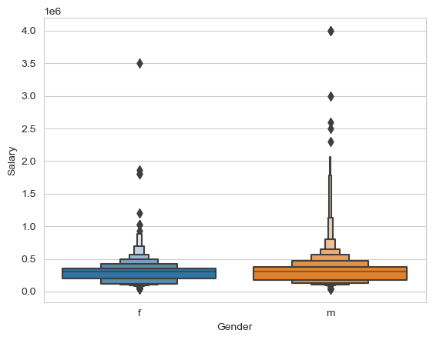
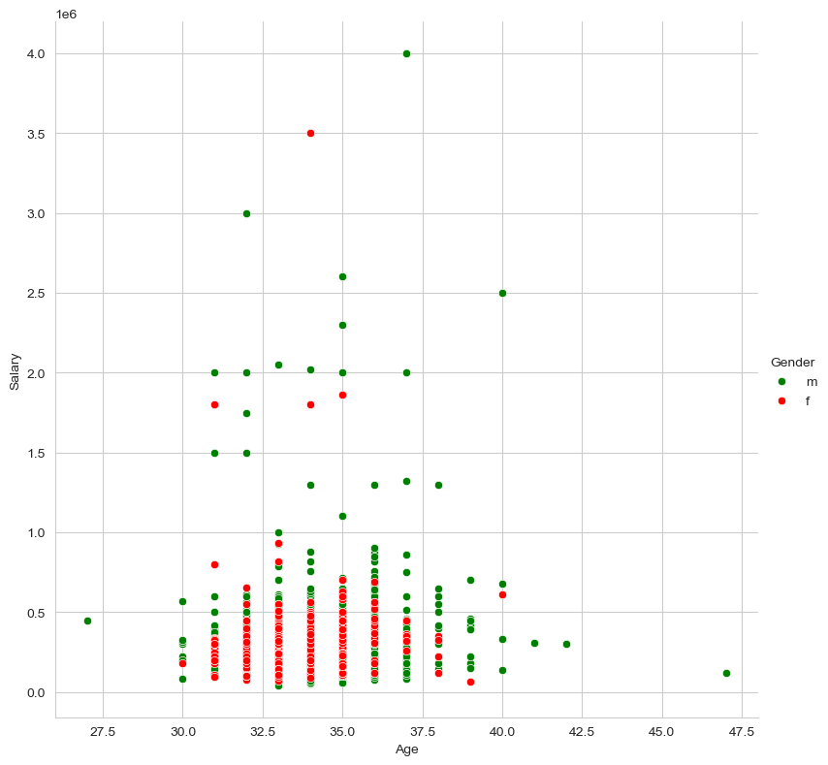
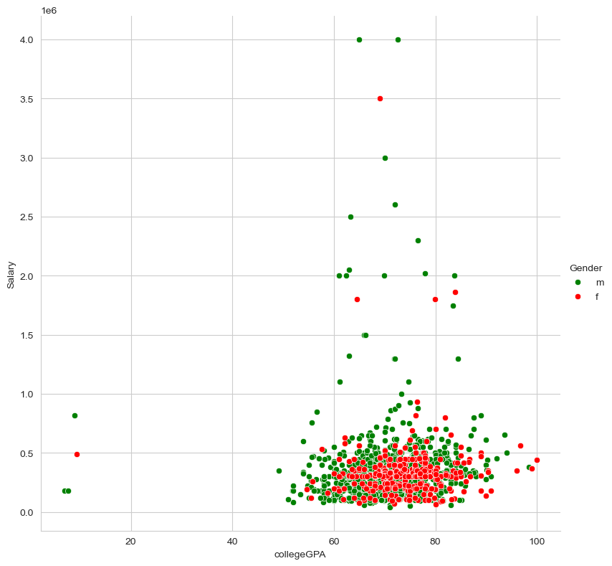
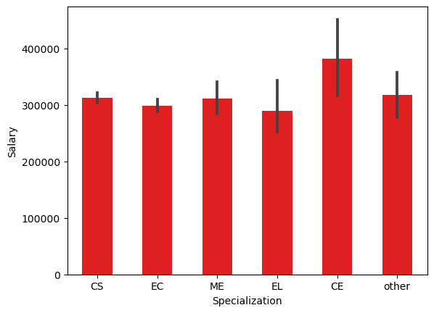
4.2. Bivariate Analysis
The scatter plot show how the salary changes with the employees at each age group.
Initially the employee salary is on the lower side assuming the person starts as a Fresher.
As the person age increases we can clearly observe the increase in salary showing relationship with age.
Decrease in median salary was observed after the age of 36.
The correlation between Age and Salary 0.17.

Slide 8
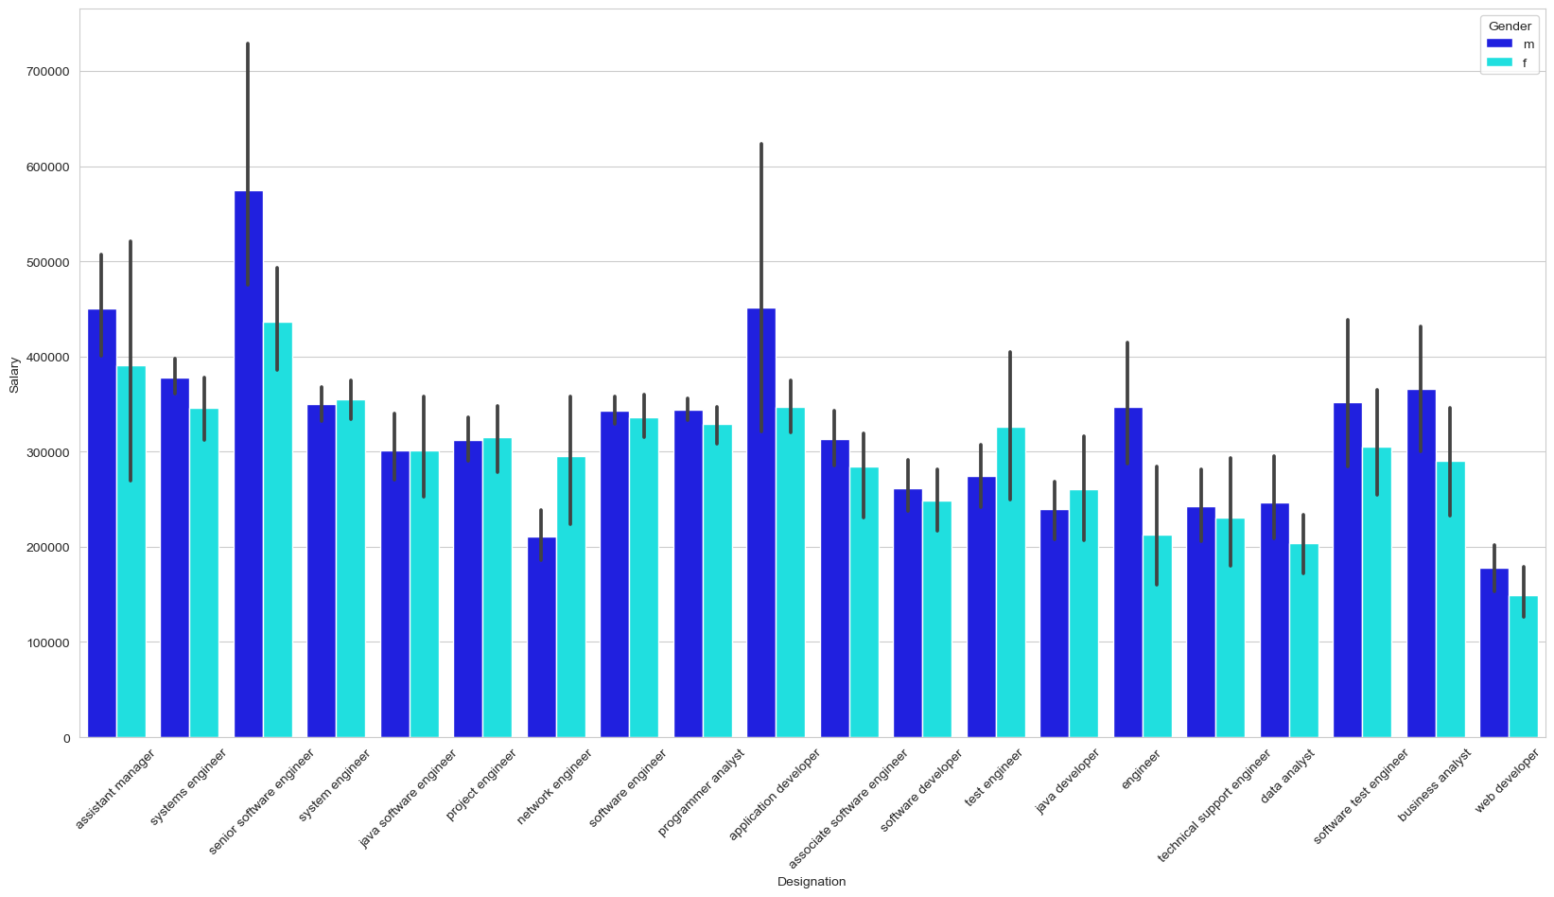
Salary vs Designation

Slide 9
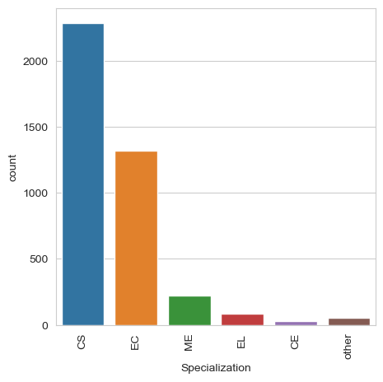
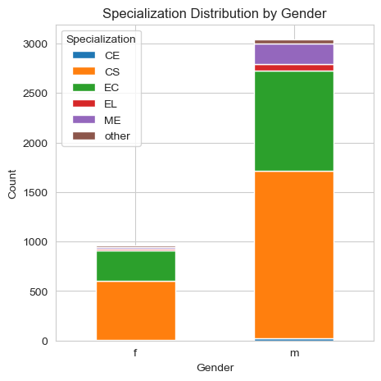
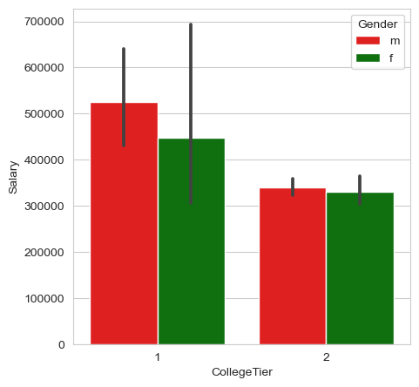
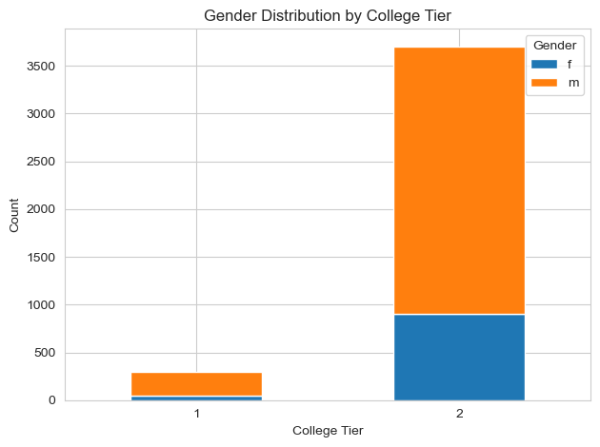
1. The Box plot shows the relationship between Salary and CollegeTier
2. We can observe that the Salaries given in Tier-1 cities have higher Median salary and higher inter quantile range compared to Tier-2.

Slide 10
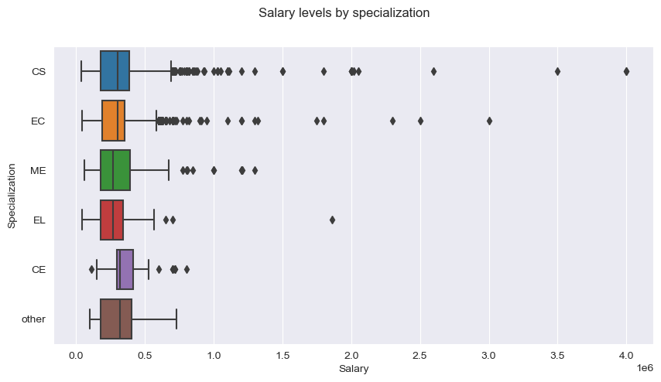

Slide 11
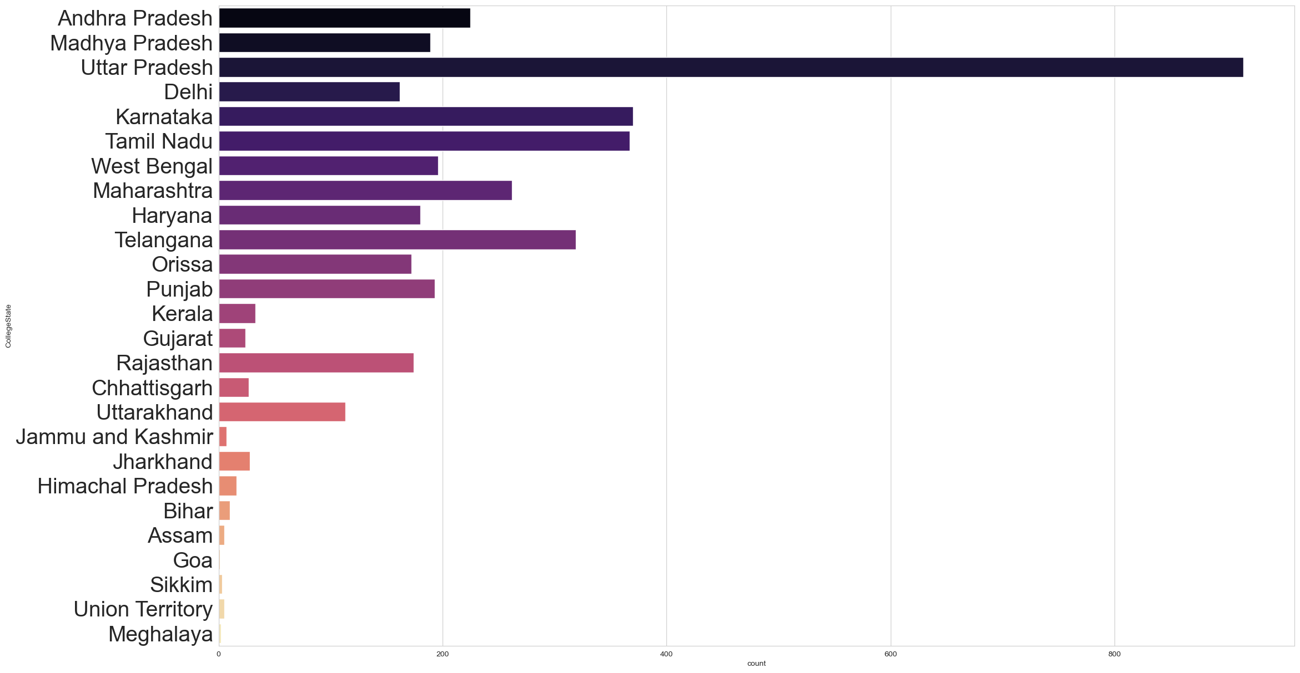

Slide 12
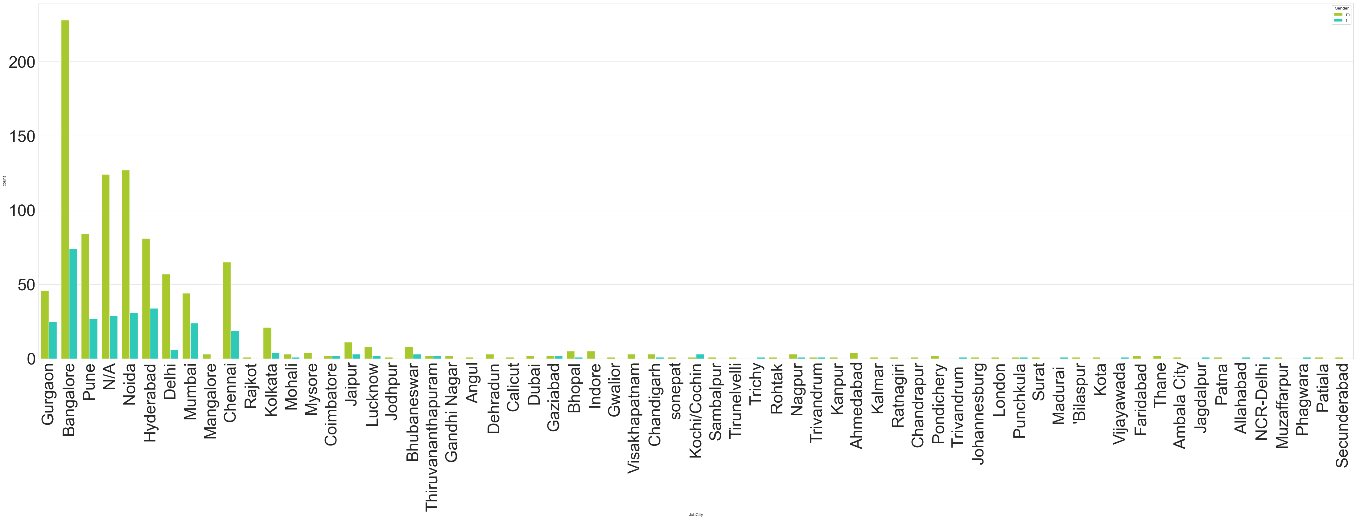
Most amcat aspirants work in bengalore,Noida,Hyderabad and pune.
It is because most of them are from IT domain so majority of them work in these cities

Slide 13
Gained Insights from the EDA
Most of Amcat Aspirants are male working in IT domain with an experience of around 5years with degree in B tech and specialization in Computer Science/Information Technology from tier-2 college in uttarpradesh with an average salary around 300k.
- High paying jobs taken up by amcat aspirants are mostly from 'IT' Domain.
- Software Engineer and Software Developer are the most aimed profession for amcat aspirants.and chemical engineers have more high-balanced salary.

Slide 14
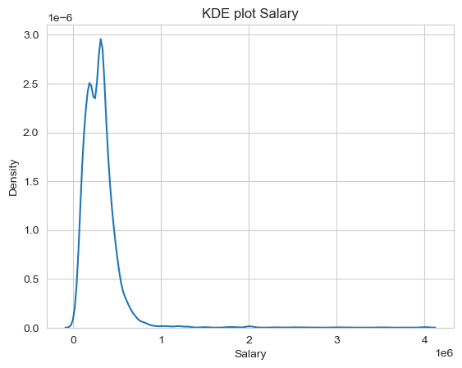
5. Research Questions
1. Times of India article dated Jan 18, 2019 states that “After doing your Computer Science Engineering if you take up jobs as a Programming Analyst, Software Engineer, Hardware Engineer and Associate Engineer you can earn up to 2.5-3 lakhs as a fresh graduate.” Test this claim with the data given to you.
Solution :
a) The Data has been filtered with Specialization as computer science & engineering
and Designation as Programming Analyst, Software Engineer, Hardware Engineer
and Associate Engineer. The resulting KDE plot is shown above.
b) Hypothesis testing was conducted and after checking distributions of different
Job profiles with the given salary range.
(c) We have sufficient evidence to reject the Null Hypothesis for Programming Analyst and Software Engineer.

Slide 15
2. Is there a relationship between gender and specialization?
There are more men than woman in all the Specialization categories.
Most of the Amcat Aspirants are from CS&EC specialization.
So,The above made claims are True, the preference of Specialisation depends upon the Gender
3. Is there any relationship between CollegeTier and Salary?
- From the above bar graph,we can see that students from tier1 colleges have higher salary.
- We can see more men are from tier1 colleges than women and overall most of the students are from tier2 colleges.
This might be a reason for women
being paid less than men in high
paying jobs because as most of
women are from tier-2 colleges

Slide 16
6. Conclusions
After completing a thorough analysis on the AMEO dataset we have uncovered valuable insights, trends, patterns and areas of interest that are influencing ‘Salary’ such as ‘Age’, ‘Personality’, ‘CollegeTier’ etc.
These insights help the companies to take right decisions with respect to employee recruitment, employee maintenance and also students to choose right Specialization and Designation in the future.

Slide 17

THANK YOU

