Slide 1
QA & WTM
Presents:
IMS Starter

Slide 2
Introduction
The purpose of this document is to outline the individual project * specification that I was working on during the training.
This project will involve concepts from all core training modules.
*my special thanks are coming to Paul pstyp, Matt “Duckee”, Rowan the “Plain”, James ,Eli and Earl.

Slide 3
Idea behind
To create and build a functional application – using supporting tools, methodologies, and technologies – which encapsulates all fundamental modules covered during training.
The application required is an inventory management system that an end user can interact with
via a Command-Line Interface (CLI).
Specifically, to create an application using the JAVA language which interacts with a managed database.

Slide 4
Fulfilling Project Needs
The requirements of the MSI Started are as follows:
Back-End programming language used – JAVA, Eclipse – IDE.
Code fully integrated into a Source Code Management via Github. using the feature-branch model: main, and 3 features.
Version Control System – Git including any dependencies it needs.
Integrated build tool – Maven.
Unit testing – Junit.
Jira used as a project management (Kanban) board.
A risk assessment which outlines the issues and risks – pdf format.
A relational database used to persist data for the project – MYSQL Server 5.7+
TeamViewer, OpenOffice, QubesOS 4.1, Windows 10, MYSQL Workbench 8.0, Discord

Slide 5
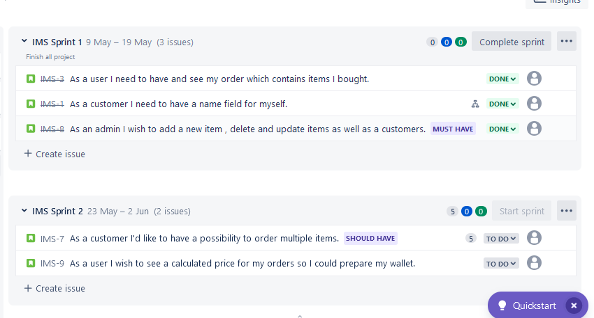
JIRA
Indicate the customers needs.
Apply, plan and set Sprint.

Slide 6
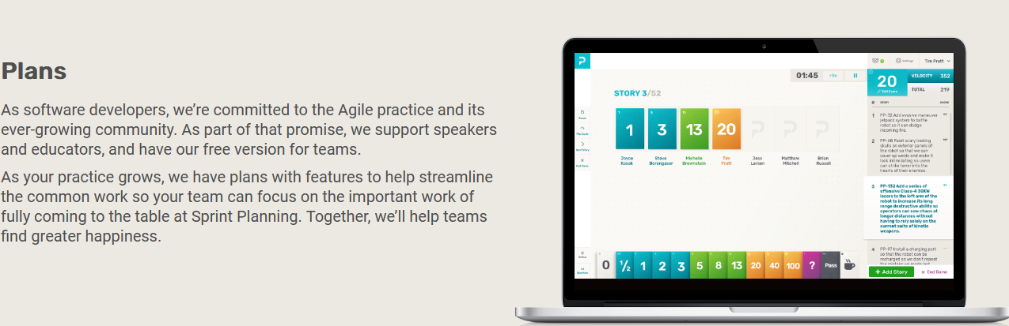
Plan&Play
Summarize the features and customer needs of the product being introduced
Play and Plan using a method such as reverse
Fibonacci poker game (https://play.planningpoker.com/plans)

Slide 7
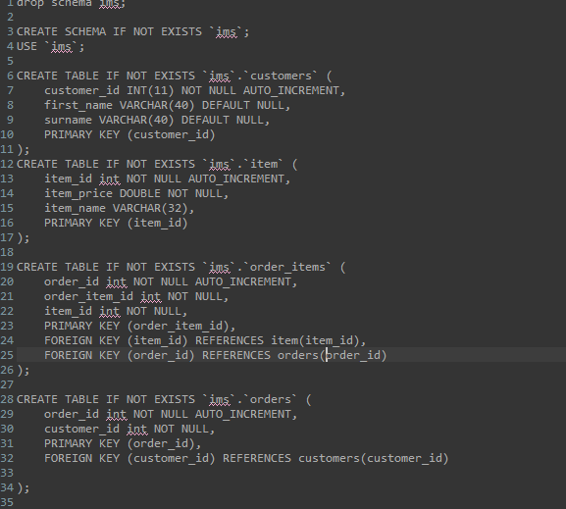
DB briefly explained

Slide 8
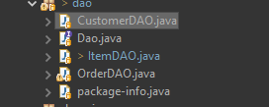
JAVA connectors to DB
DAO files

Slide 9
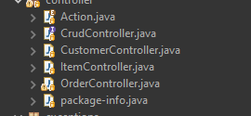
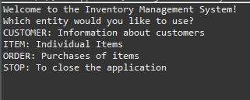
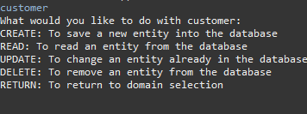
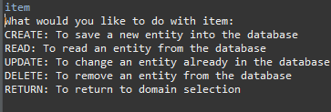
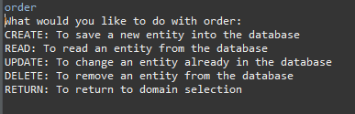
Menu - JAVA
So, my friends now there is going to
be another part of java presentation

Slide 10
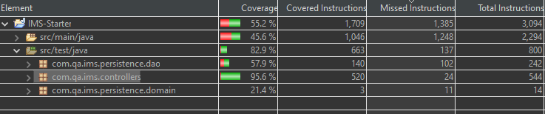
Maven and Junit testing

Slide 11
Next Steps of Action
As an Agile principle of Robust coding instead of extended documentation, this project has finished without OSCOW, readme files etc.
Feel free to add more comments/issues etc

