Slide 1
Debt Management Service

Slide 2
Outline:
Problem Statement
Challenges
Technologies
Diagrams and Explanations
Future goals
Demo
Q & A

Slide 3
Problem Statement:
Design and implement a service (microservice)
Be able to receive a rest service to receive user account records and be able to output to reporting system.
Be able to process via File from FTP
Be able to output record and upload to SFTP server.

Slide 4
Challenges:
Structure of records
Time
Developing resource

Slide 5
Technologies:
SpringBoot
Rest
Spring-Scheduling
hsqlDB
Jaxb
Orika
Jsch
Commont-net
GoF
Karate Automation test
etc...

Slide 6
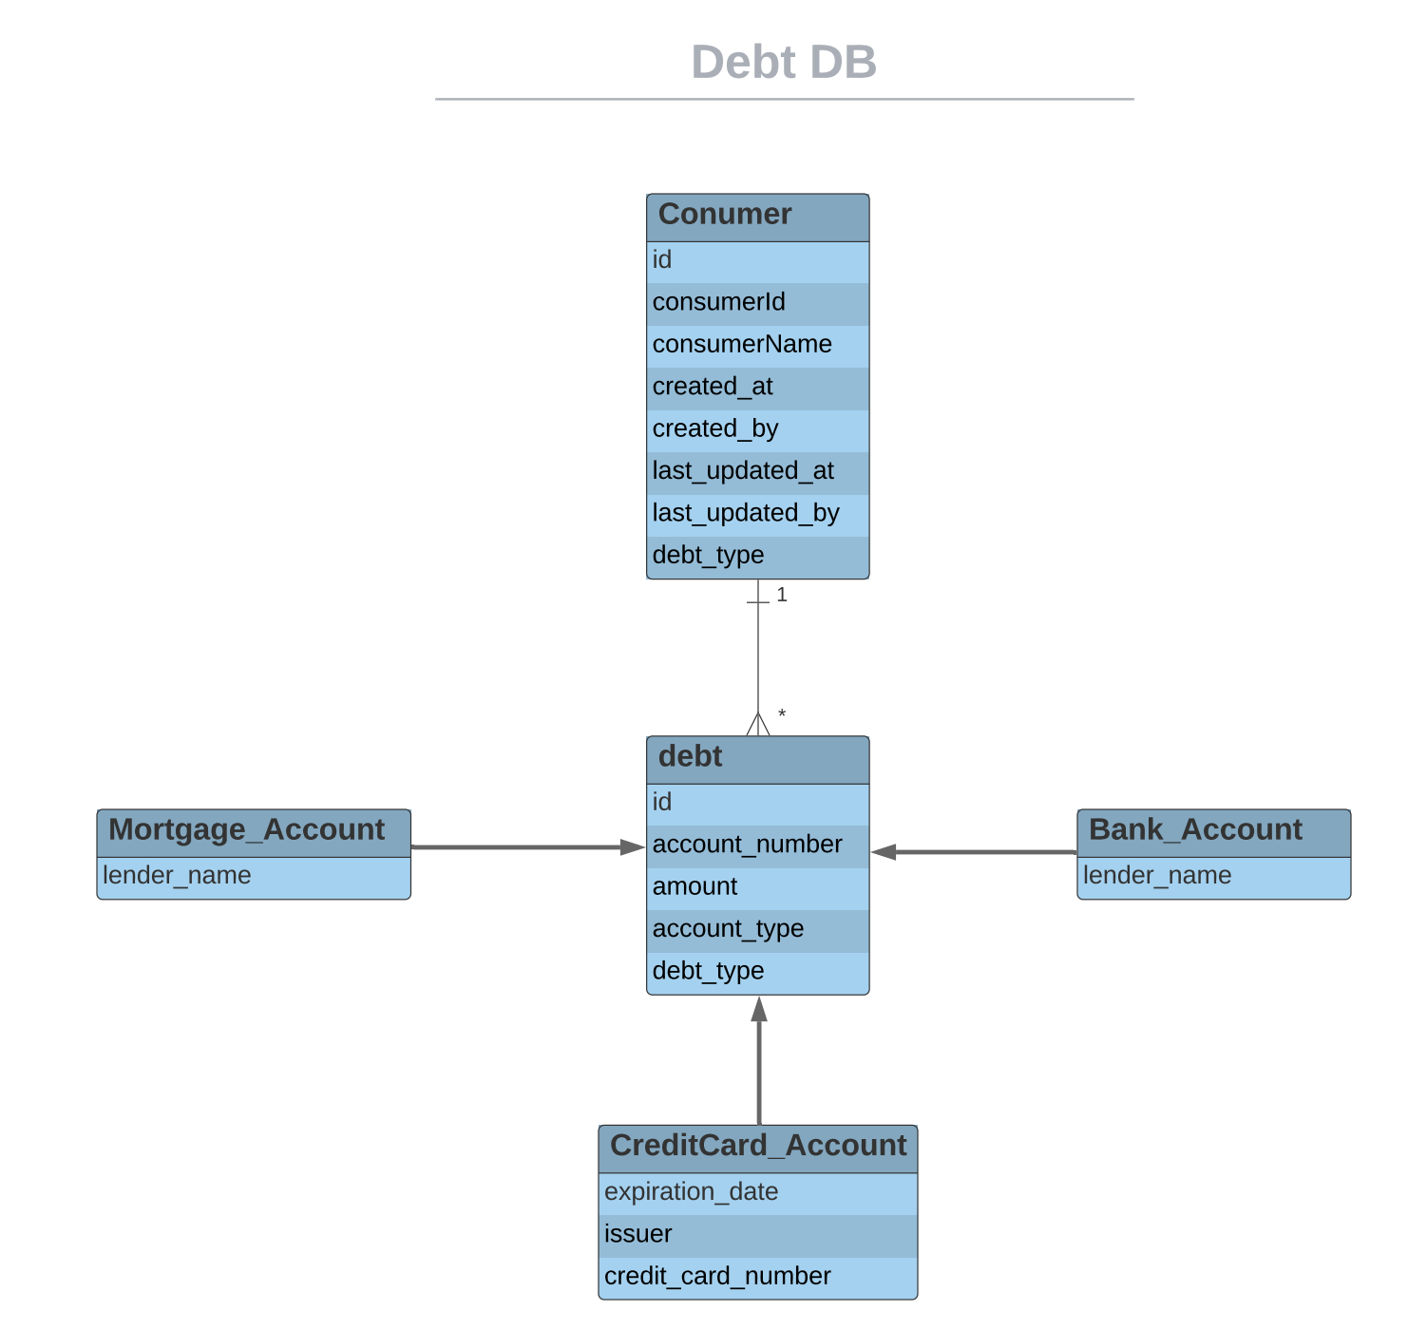
Diagrams

Slide 7
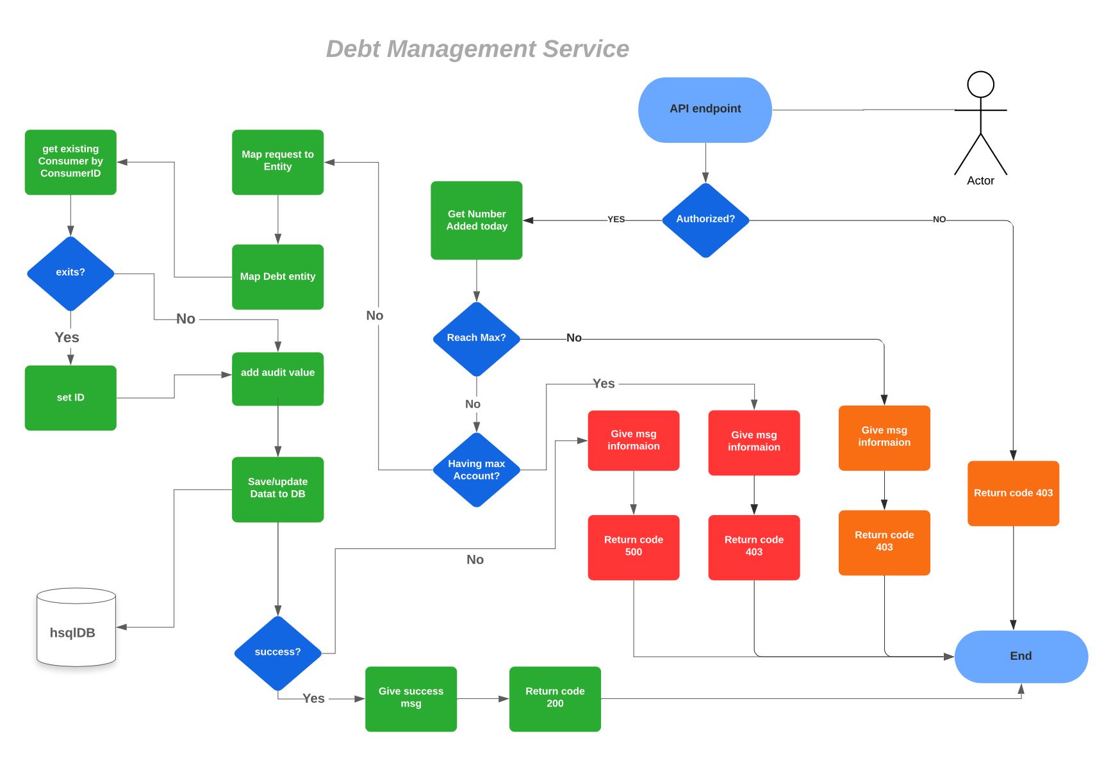
1
9
2

Slide 8
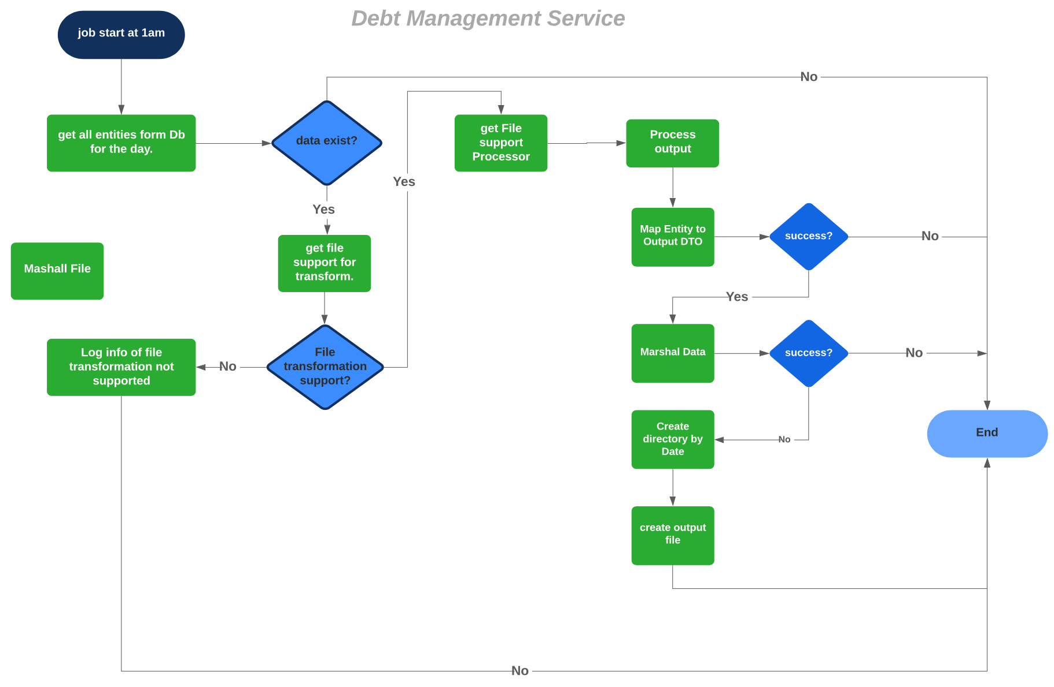
4
5
3
6
6

Slide 9
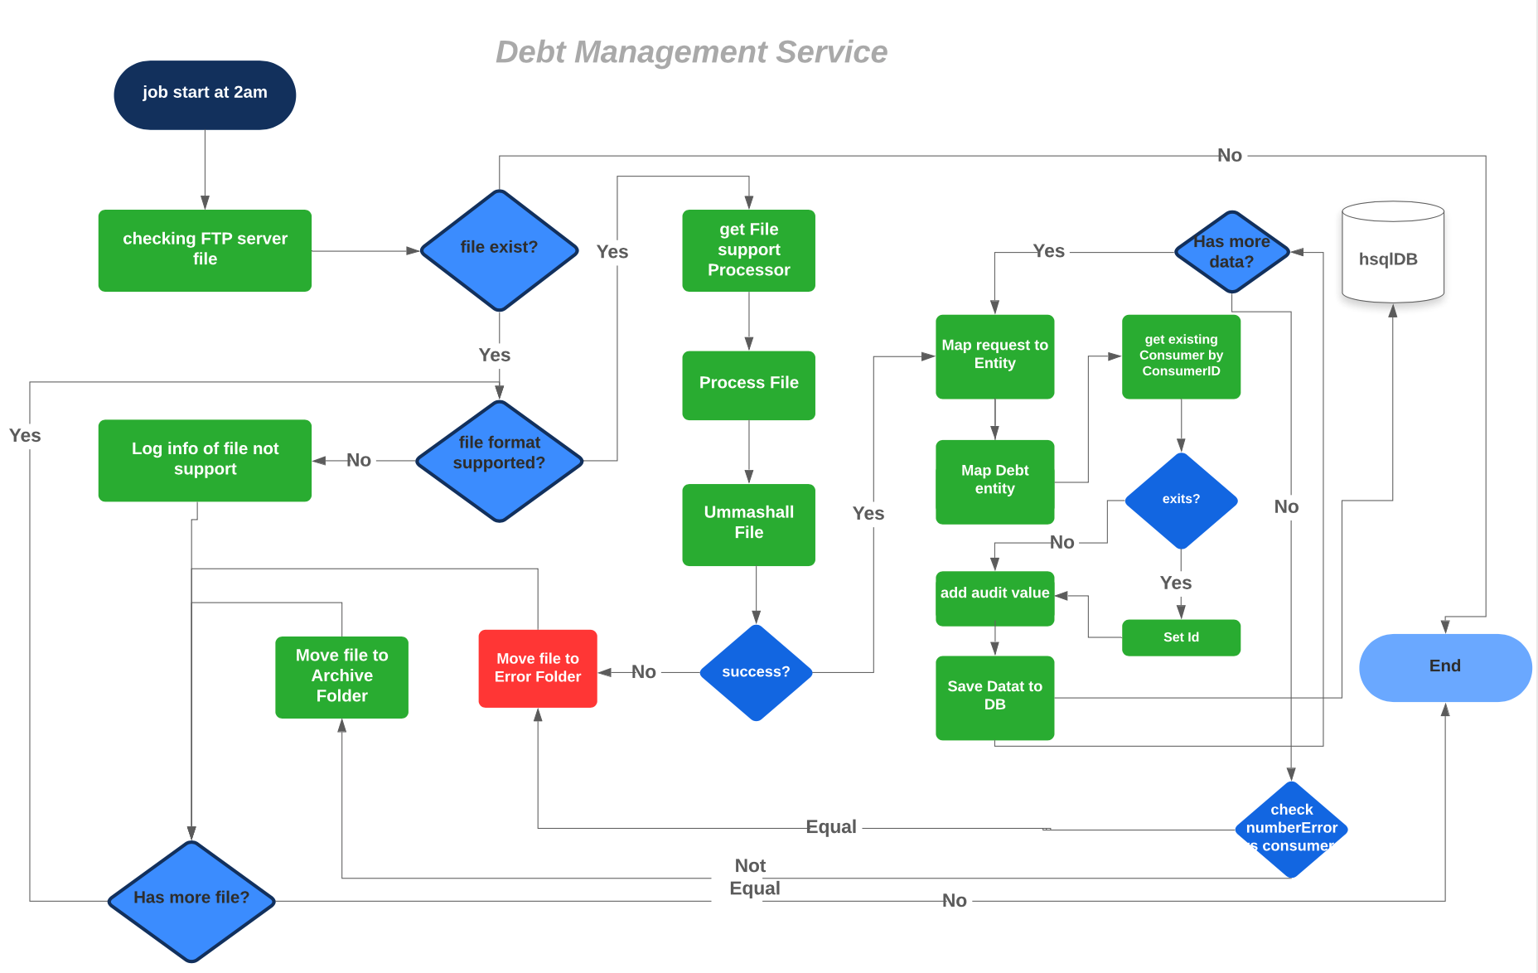
7
8
1
9
6

Slide 10
Explanations
Debt DB: As the debt can be BankAccount, CreditCardAccount, MortgageAccount and others(in the future); So, I am in “debt” I am using discriminatorColumn to distinguist those types.
To avoid another join I decided to put all the fields of Description tags from input into “debt” as fields of Description will be dynamic according to Debt Type.

Slide 11
Explanations (cont)
(1) : For mapping I am using ”Orika” for data Mapping from Entity to DTO and vice versa.
(2) : Since, I don’t have any Database server installed, I am using hsqlDB which is a memory DB
(3) , (4) & (8) : I am Strategy Processor, where checking the supported file that is configurable in the properties. In the future, if another file is needed we can always update supported file and created new processor to process the output which is flexible enough.
(5) : Similar to (1) using “Orika” for data mapping from DTO back to Entity.

Slide 12
Explanations (cont)
(6) : marshalling and unmashalling according to file support. For now it’s XMl so I am using JAXB for transformation. We can use Gson for example for JSON file in the future. After creating file I am using “JSCH” for uploading to SFTP server.
(7) : Reading files from FTP using “common-net” library.
(9) : For mapping debt entity to DTO and vice versa, Builder patter to build the DebtType (BankAccount, CreditCardAccount, MortgageAccount) according to according to the DebtType of the data. So, in case there another debt type coming soon we can always easy build that object.

Slide 13
Future goals:
Add more unit tests to cover all the code at least 85% in order to pass the maven build using JACOCO
Find another better way to to check the type of debt from input (RequestBody as well as input files.)
Update DB using DB server

Slide 14
Demo

Slide 15
Question and Answer & Thanks for your time

