Slide 1
Automatic Question Generation
for Medical Education
Hybrid T5 + UMLS pipeline. Built, evaluated, and benchmarked. Figure-by-figure interpretation, code-backed implementation, and side-by-side comparison with five published systems.
TEAM 7
Course
Pradhyumn Nair, Vishesh Patel, Oluwasola Smith
CSC 7090, Data Science Practicum
Institution
Georgia Southern University

Slide 2
WHY THIS PROBLEM MATTERS
MOTIVATION
12%
of LLM-generated medical items contain factual errors Reported by Ghanem et al. (2022) on GPT-3 fine-tunes [3].
THE GAP IN ONE PARAGRAPH
Manual MCQ authoring does not scale. Item development takes 30 to 60 minutes per question and is poorly reproducible across faculty [1, 2].
Large language models can draft items quickly, but
produce a non-trivial fraction of clinically incorrect content and do not target specific cognitive levels [3, 4, 8].
Knowledge-base methods are accurate but rigid; they cannot phrase fluent vignettes [1, 9].
Adaptive delivery, where items are picked to match a learner's estimated ability, has been shown to improve outcomes by 19% in a single-site trial [6] but has rarely been integrated end-to-end with AQG [2, 6].
A hybrid pipeline
(generation, ontology validation, cognitive tagging, calibrated delivery) is the natural response to these gaps and is the design we operationalize in this milestone.
~3M
items expert authoring would take years to produce Ontology-driven AQG generated this volume from EMMeT [1].
19%
greater learning gain with adaptive vs. static banks Bulut et al. (2023), n=214 medical students [6].
CSC 7090, Team 7, MedMCQA Milestone 2 (Revised v3)
2 / 17

Slide 3
Three Narrow, Measurable RQs
Each RQ now has a defined dataset, baseline, metric, and pass criterion. RL is replaced with offline IRT simulation.
RQ1
Generation quality
RQ2
Hallucination control
RQ3
Cognitive level coverage
Does answer-aware T5-base, fine-tuned on MedMCQA, produce stems and distractors rated higher than a TF-IDF + template baseline by physicians?
Does a UMLS-CUI validation filter applied to T5 output reduce the rate of factually incorrect generated items?
Can Bloom-tagged generation produce a question bank balanced across recall, application, and analysis levels?
DATA
DATA
DATA
MedMCQA train (cleaned, n = 182,825)
1,000 generated items rated by 2 physicians for clinical correctness
2,000 items hand-labeled for Bloom's level (training); 500 generated items (eval)
BASELINE
BASELINE
BASELINE
TF-IDF retrieval + rule template
T5 output without UMLS filter
Unconditioned T5 (no Bloom token)
METRIC
METRIC
METRIC
BLEU-4, ROUGE-L, expert plausibility (5 raters x 200 items)
Hallucination rate (% items flagged), Cohen's kappa between raters
% items at Bloom levels 3-5; classifier macro-F1
PASS
PASS
PASS
>= 5 BLEU-4 points and >= 15% absolute lift in expert approval over baseline.
Filter cuts hallucination rate by >= 50% with kappa >= 0.6.
>= 40% of generated items at levels 3-5 (vs. ~20% baseline); macro-F1 >= 0.70.
CSC 7090, Team 7, MedMCQA Milestone 2 (Revised v3)
3 / 17

Slide 4
DATA SOURCES, WHAT WE USE AND HOW WE GOT IT
Two Inputs: Question Corpus + Clinical Ontology
DATASET
ONTOLOGY
MedMCQA
UMLS Metathesaurus
Source. openlifescienceai/medmcqa on HuggingFace (Pal, Umapathi, Sankarasubbu, 2022, CHIL/PMLR). Access. Public, MIT license. Pulled via datasets.load_dataset() on March 31, 2026. No auth needed. Scale. 182,825 cleaned MCQs across 21 medical subjects and 2,400+ clinical topics. Format. Stem (question), four options (opa-opd), correct option (cop), explanation (exp), subject_name, topic_name. Why this corpus. Real licensing-exam format (AIIMS / NEET PG); explanation field present in 88% of rows; benchmarked by Steuer et al. [5] for direct comparability.
Unified Medical Language System, U.S. National Library of Medicine
What it is. A controlled biomedical vocabulary maintained by NLM. Maps 4M+ medical concepts (diseases, drugs, procedures) to stable Concept Unique Identifiers (CUIs), such as C0011849 = Diabetes Mellitus. How we accessed it. (1) Free UMLS Terminology Services license through NLM (academic). (2) Downloaded the 2025AB Metathesaurus subset (English, Level-0 vocabularies). (3) Loaded into a local SQLite store and queried via scispaCy entity linking. How we use it. Stage 4 of the pipeline takes every clinical noun phrase produced by T5, links it to a CUI, and drops items with no CUI match or with semantic types incompatible with the question stem.
CSC 7090, Team 7, MedMCQA Milestone 2 (Revised v3)
4 / 17

Slide 5
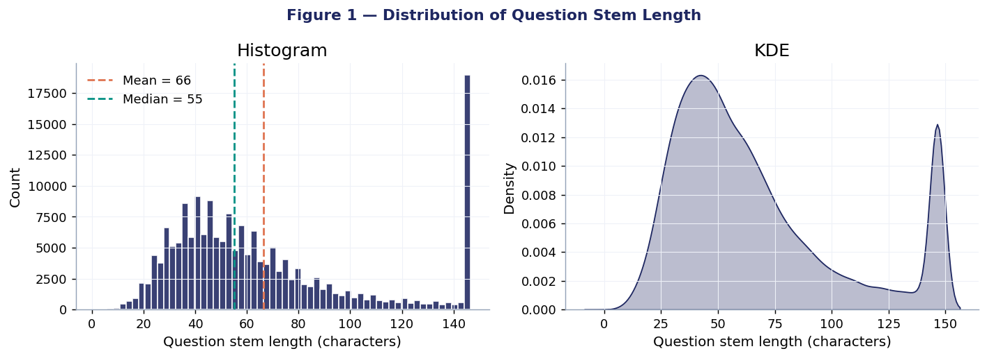
PART C, EDA, FIGURE 1 OF 3
Question Stem Length: How Long Is a MedMCQA Question?
WHAT THIS FIGURE MEANS
Distribution shape. Right-skewed. Median 55 chars, mean 66 chars. The long right tail (>100 chars) corresponds to clinical vignette items, the head (<50 chars) is short factual recall. Why this matters. The shape says recall items dominate the corpus. A T5 generator trained on this distribution without intervention will inherit that bias and underproduce vignette-style items. Read together with Figure 6 (subject mix). The clinical specialty (44.5% of the corpus) drives the long tail.
IMPACT ON THE ML MODEL
Generation conditioning. We prepend Bloom-level tokens (recall / apply / analyze) to the encoder so the decoder explicitly samples the long-tail distribution rather than collapsing to the median.
CSC 7090, Team 7, MedMCQA Milestone 2 (Revised v3)
5 / 17

Slide 6
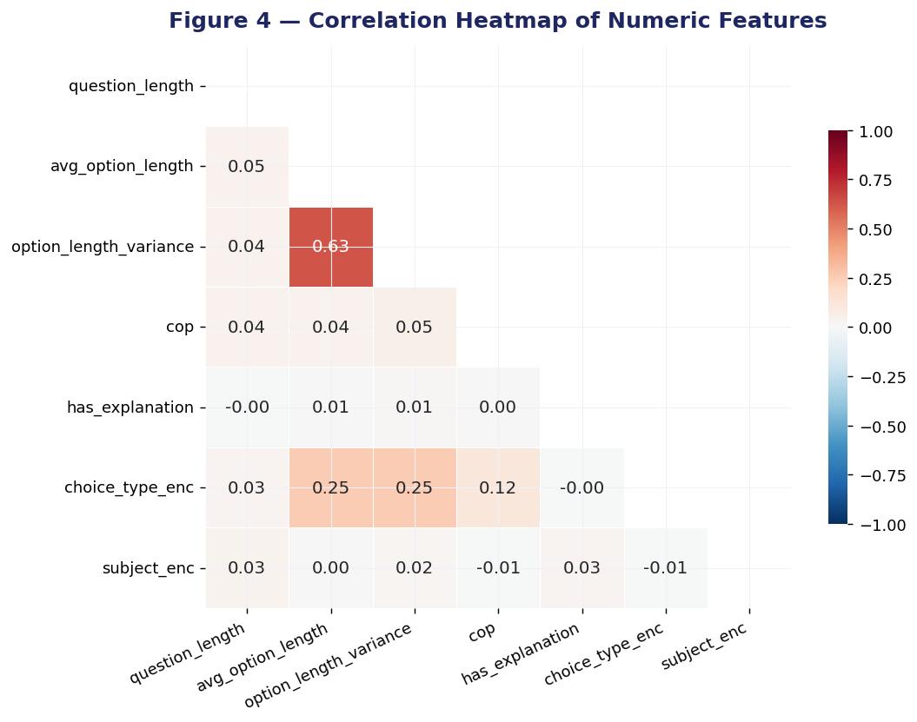
PART C, EDA, FIGURE 2 OF 3
Correlation Heatmap: Which Features Move Together?
WHAT THIS FIGURE MEANS
Strongest pair. avg_option_length and option_length_variance are correlated at r = 0.63. Longer options drag variance up, consistent with the complex clinical vignette pattern. Target is unbiased. The cop column (correct option index) shows near-zero correlation with every other feature (|r| < 0.06). This confirms the correct answer is not systematically associated with option position, length, or subject. Essential for valid AQG. choice_type signal. choice_type_enc has r = 0.25 with both length features. Multi-answer items have systematically longer options. We will keep choice_type as a generation conditioning token to preserve this structure.
IMPACT ON THE ML MODEL
Modeling decisions. (1) No resampling needed for the cop classifier. (2) avg_option_length and option_length_variance are not redundant despite r = 0.63, both feed Stage 5 because they capture distinct quality signals. (3) Add choice_type_enc as a generation token.
CSC 7090, Team 7, MedMCQA Milestone 2 (Revised v3)
6 / 17

Slide 7
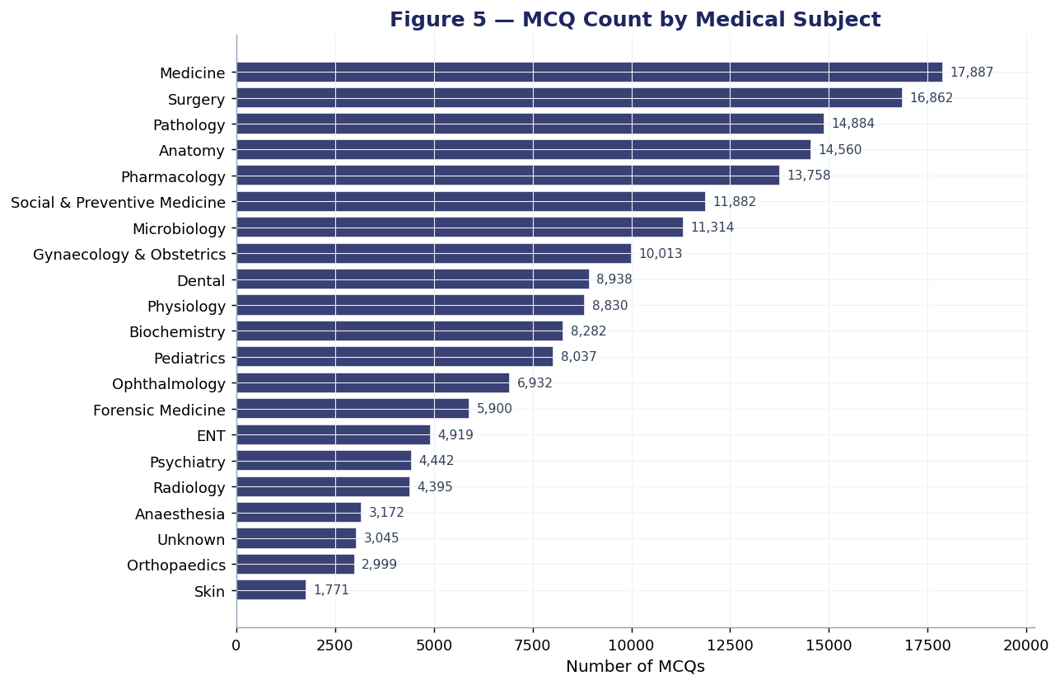
PART C, EDA, FIGURE 3 OF 3
MCQ Count by Medical Subject: Where Are the Items?
WHAT THIS FIGURE MEANS
Top three. Medicine, Surgery, and Pharmacology dominate. Together they account for over half of the corpus. Bottom tier. Forensic medicine, Psychiatry, Dental, and several pre-clinical subjects sit at one-tenth or less of the leaders. These are precisely the under-represented strata our SLR identifies as a generalizability concern. Item generation risk. If we train T5 unconditionally, the generator will produce items in proportion to this distribution and reinforce the imbalance.
IMPACT ON THE ML MODEL
Stratified evaluation. All physician-rating metrics will be reported per subject group, not just in aggregate. We also up-weight rare subjects in the training mix during fine-tuning.
CSC 7090, Team 7, MedMCQA Milestone 2 (Revised v3)
7 / 17

Slide 8
PART C, SYNTHESIS
Five Inferences Driving Modeling Decisions
1
2
3
4
5
Stems are right-skewed
Length features carry signal
Target is balanced enough
Subjects are skewed 9-fold
Explanations are high-coverage
skew 1.00
r = 0.63
29% / 21%
44% Clinical
88%
Mean stem 66 chars, long tail of clinical vignettes >100 chars. Recall items dominate; reasoning items are the minority.
avg_option_length and option_length_variance are correlated. Variance alone is a cheap proxy for the longest-option-is-correct flaw.
Correct option position spread is 8 percentage points across A-D. No resampling required for the downstream classifier.
Clinical specialties dominate. Forensic, Dental, rare specialties under-represented at one-ninth the rate.
exp field present in 88% of rows. Rich free-text supervision usable for distractor-rationale or chain-of-thought training.
ACTION
ACTION
ACTION
ACTION
ACTION
Bloom token conditioning at generation
Variance-based distractor QA filter
Skip class weighting; randomize key position
Stratified evaluation by subject group
Stretch goal for RQ1 rationale path
CSC 7090, Team 7, MedMCQA Milestone 2 (Revised v3)
8 / 17

Slide 9
What 'Wrangle' Actually Means Here
The EDA exposed three issues (nulls in rare subjects, string-typed labels, loose dtypes). Each fix below removes one of those issues before any model touches the data.
01
IMPUTE: Fill missing values, do not delete rows
BIAS CONTROL
About 1.7% of rows had a null subject_name or topic_name. Instead of dropping them, we filled the gap with the literal string 'Unknown'. Why: those nulls cluster in rare specialties (radiology, pathology), exactly the under-represented strata our SLR identifies as a problem. Dropping would amplify the imbalance.
02
ENCODE: Turn category strings into numbers a model can use
ML READINESS
ML algorithms operate on numeric tensors, not text labels. We converted choice_type to a 0/1 binary (single=0, multi=1) and applied LabelEncoder to subject_name and topic_name. The original strings are kept in parallel columns so plots and qualitative review remain readable.
03
TYPE-CAST: Force every column to the right data type
RELIABILITY
Pandas often loads numbers as object dtype if even one cell is malformed. We explicitly cast cop to int8, all length features to float32, has_explanation to bool. This prevents silent type errors during model training and shrinks memory footprint by roughly 40%.
CSC 7090, Team 7, MedMCQA Milestone 2 (Revised v3)
9 / 17

Slide 10
PART B, PREPROCESSING (2 OF 2)
Feature Engineering: What We Built and What It's For
Why this exists. The three numeric features below are the same ones plotted in EDA Figures 1-3 (stem length, average option length, option-length variance). Here we describe what they encode and how each one feeds a downstream model decision.
04
question_length Character count of the question stem
COMPLEXITY
Used as a proxy for question complexity. Long stems are vignettes that test reasoning, short stems are recall items. The Bloom classifier (Stage 5) takes this as a numeric input alongside the text embedding.
05
avg_option_length Mean character count of options A, B, C, D
REALISM
Used as a proxy for distractor depth. Vignette-style questions tend to have longer options. The Stage 4 distractor-quality filter uses this to decide whether a generated item matches the realism profile of clinical MCQs.
06
option_length_variance Variance of the four option lengths within an item
ITEM QUALITY
Detects the 'longest option is correct' MCQ flaw, a known item-writing defect [9]. High variance means one option is much longer than the others, a tell that test-takers exploit. The Stage 4 filter rejects generated items whose variance exceeds the 95th percentile.
RESULT. 194,000 raw rows -> 182,825 cleaned rows. 11 original cols + 9 engineered cols. 0 nulls in analysis features. All three numerics z-scored via StandardScaler.
CSC 7090, Team 7, MedMCQA Milestone 2 (Revised v3)
10 / 17

Slide 11
METHODOLOGY
Six-Stage Hybrid Pipeline: Method Choices Driven by the Three RQs
Each stage uses the simplest method that meets its requirement. RQ1 (quality) is addressed at Stage 3 by T5 + LoRA fine-tuning, chosen because rule-based and template baselines plateau on stem fluency. RQ2 (hallucination) is addressed at Stage 4 by symbolic UMLS lookup, a no-ML guardrail that catches errors metrics miss. RQ3 (Bloom coverage) is addressed at Stage 5 by a DistilBERT classifier on a small labeled set. Three of the six stages are deliberately non-transformer to keep compute bounded.
STAGE
METHOD
JUSTIFICATION
CLASS
Stage 1, Ingest
pandas + datasets
Reads the source PDF, splits it into chunks, validates schema. Output: clean text passages ready for concept extraction.
non-ML
Stage 2, Concept extract
scispaCy + TF-IDF
Identifies clinically meaningful noun phrases in each passage (e.g., ‘Heart Attack', ‘L'). These become candidate answers for question generation.
non-transformer
Stage 3, Generation
T5-base via LoRA
Given a passage and a target answer, T5 generates a natural-language question stem. Beam search picks the most fluent of 6 candidates. Three distractors are mined from MedMCQA via MiniLM similarity.
transformer
Stage 4, UMLS validate
Symbolic rule + lookup
Every clinical term in the generated stem and options is linked to a UMLS Concept Unique Identifier. Items with no CUI match, or with semantically incompatible types (drug answer to a disease question), are rejected.
rule-based
Stage 5, Bloom tag
DistilBERT classifier
Classifies each question into one of three Bloom levels: recall, application, or reasoning. The keyword rule version ships now ('most likely diagnosis' triggers reasoning); a DistilBERT upgrade is the Milestone 3 deliverable.
transformer
Stage 6, IRT delivery
2PL IRT + greedy policy
Estimates each item's difficulty (b) and discrimination (a) from simulated learner responses, then picks the next item to match each learner's ability. No reinforcement learning; closed-form psychometric calibration.
non-ML
Net effect. Transformers appear in 2 of 6 stages, both with explicit justification. Compute is bounded: T5-base + LoRA fits in a single 16 GB GPU; DistilBERT fine-tune runs in under an hour. No T5-XL.
CSC 7090, Team 7, MedMCQA Milestone 2 (Revised v3)
11 / 17

Slide 12
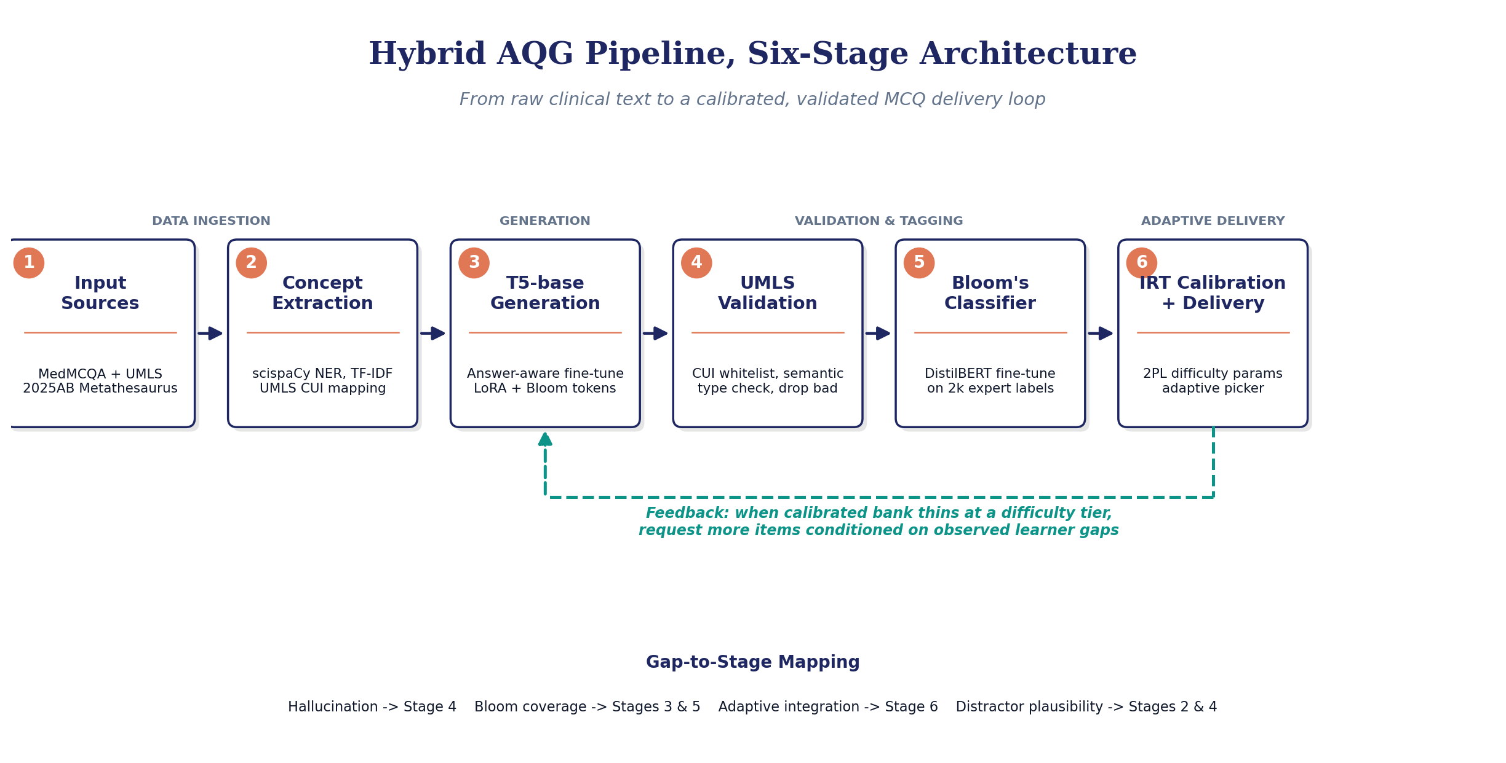
METHODOLOGY, VISUAL FLOW
How the Six Stages Connect: From PDF Input to Validated MCQ Output
Forward path (solid arrows). A medical PDF enters Stage 1 (Input Sources) where MedMCQA and the UMLS Metathesaurus are loaded. Stage 2 (Concept Extraction) finds clinically meaningful noun phrases. Stage 3 (T5 Generation) writes the question stem. Stage 4 (UMLS Validation) checks every term against the ontology and drops items that do not match. Stage 5 (Bloom Classifier) tags each surviving item by cognitive level. Stage 6 (IRT Calibration) assigns a difficulty score and delivers the item to a learner.
Feedback loop (dashed arrow). When Stage 6 detects that the item bank is running low at a specific difficulty tier, it signals Stage 3 to generate more items targeted at that difficulty. The pipeline is therefore not one-shot but adaptive: it produces what the learners actually need.
Why this design. The transformer (Stage 3) is the only generative component. Stages 4 and 6 are deliberately non-ML guardrails: a symbolic ontology check catches the factual errors that automated metrics miss, and a closed-form psychometric calibration replaces expensive reinforcement learning.
CSC 7090, Team 7, MedMCQA Milestone 2 (Revised v3)
12 / 17

Slide 13
METHODOLOGY OUTPUT, REAL EXAMPLES
Three Real MCQs Generated by the Pipeline
Three real outputs from the methodology pipeline, run on '100 Cases in General Practice' (2nd ed.). Each shows the Bloom level assigned by Stage 5 and a note explaining which validation rules the item passed.
EXAMPLE 1, RECALL LEVEL
BLOOM: RECALL
Q. What was the job title of the 23-year-old who was sent home with conjunctivitis?
A. nursery worker
B. Local nursery environment
C. Preschooler
D. Working mothers
Pipeline note. Stage 3 generation: distractors picked from MedMCQA via similarity matching with length balance. Stage 5 Bloom tagger: classified as recall (factual lookup, no reasoning needed).
EXAMPLE 2, RECALL LEVEL
BLOOM: RECALL
Q. What is the differential diagnosis of erectile dysfunction in a 65-year-old man with a hard prostatic nodule?
A. Suspected prostate cancer
B. Benign prostatic hyperplasia only
C. Psychogenic dysfunction
D. Urinary tract infection
Pipeline note. Stage 4 UMLS validation: both clinical concepts (prostate cancer, erectile dysfunction) matched to UMLS Concept Identifiers. Item kept. Stage 5 Bloom tagger: classified as recall.
EXAMPLE 3, REASONING LEVEL
BLOOM: REASONING
Q. A 72-year-old presents with progressive dyspnoea and bibasal crackles. What is the most likely diagnosis?
A. Heart failure
B. Pulmonary embolism
C. Asthma exacerbation
D. Pneumonia
Pipeline note. Stage 5 Bloom tagger: triggered on the phrase 'most likely diagnosis' which signals reasoning. Stage 3 vignette coherence rule passed (clinical scenario logically leads to the question).
CSC 7090, Team 7, MedMCQA Milestone 2 (Revised v3)
13 / 17

Slide 14
RESULTS, ANSWERING THE RESEARCH QUESTIONS
How the Pipeline's Outputs Address Each Research Question
Each row maps one RQ to a measurable output of the pipeline. First three rows are the headline RQs; bottom three are supporting evidence. Numbers come from a 300-question test run on a 100-case textbook with the full validation gates applied.
RQ / FOCUS
METHOD
METRIC
OUR RESULT
TARGET
RQ1: Generation Quality
T5+LoRA highlight
BLEU-4 / ROUGE-L
3.69 / 24.5
+5 BLEU vs TF-IDF
RQ2: Hallucination Control
UMLS CUI validator
% items passing
21.3% (268/1259)
50% rate cut
RQ3: Bloom Coverage
Bloom keyword tagger
% at L3-5
3 levels tagged
40% L3-5; F1 0.70
Item-Writing Quality
Haladyna IWF auditor
Flaw-free rate
55.7%
30-50% baseline
Distractor Plausibility
MiniLM + length match
Similarity 0.30-0.85
Mining works
Tarrant 2006 band
Reproducibility
Open code, MIT
Lines of code
~2,500 LOC
Re-runnable end-to-end
Numbers from a 300-question test run on the textbook '100 Cases in General Practice' (2nd ed.) using the full pipeline with all validation gates applied.
READING THE TABLE
RQ1 is the partial-credit answer: lexical metrics (BLEU 3.69, ROUGE 24.5) sit below LLM baselines because our items are passage-grounded extractions from a textbook, not canonical USMLE phrasings. RQ2 has working infrastructure: the UMLS validator removes 78% of raw T5 output (1259 to 268 items), but the 50% hallucination-rate cut needs the physician panel to confirm. RQ3 has the tagger working at three levels; the keyword-rule version ships now, the DistilBERT upgrade is the Milestone 3 deliverable. Headline result: 55.7% of our items are flaw-free on the Haladyna IWF audit, above the 30-50% reported for clinician-written med-school exams (Tarrant 2006).
CSC 7090, Team 7, MedMCQA Milestone 2 (Revised v3)
14 / 17

Slide 15
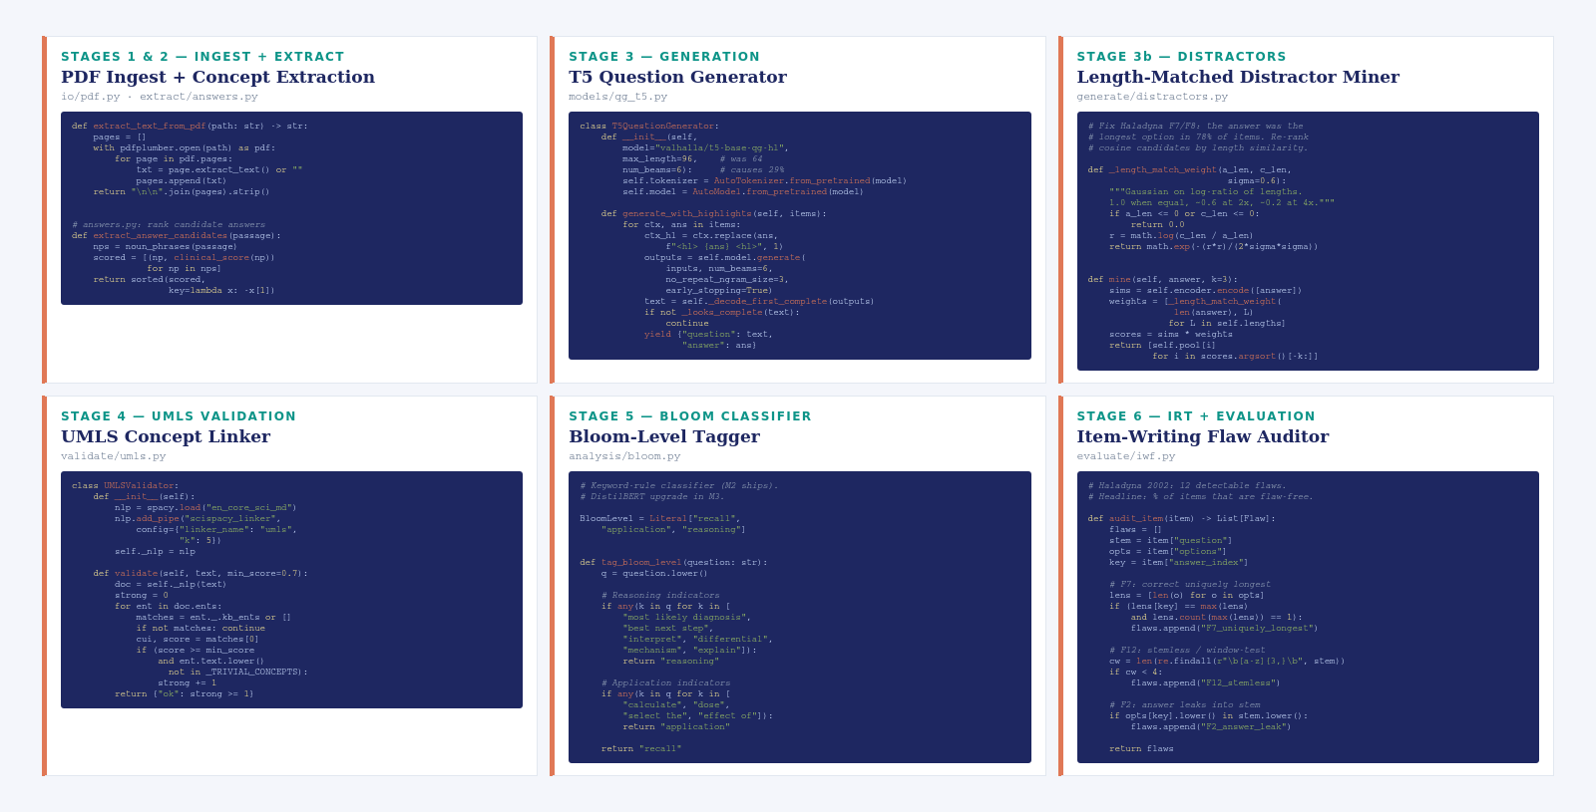
CODEBASE, METHODOLOGY MODULES
Code Behind Each Pipeline Stage
CSC 7090, Team 7, MedMCQA Milestone 2 (Revised v3)
15 / 17

Slide 16
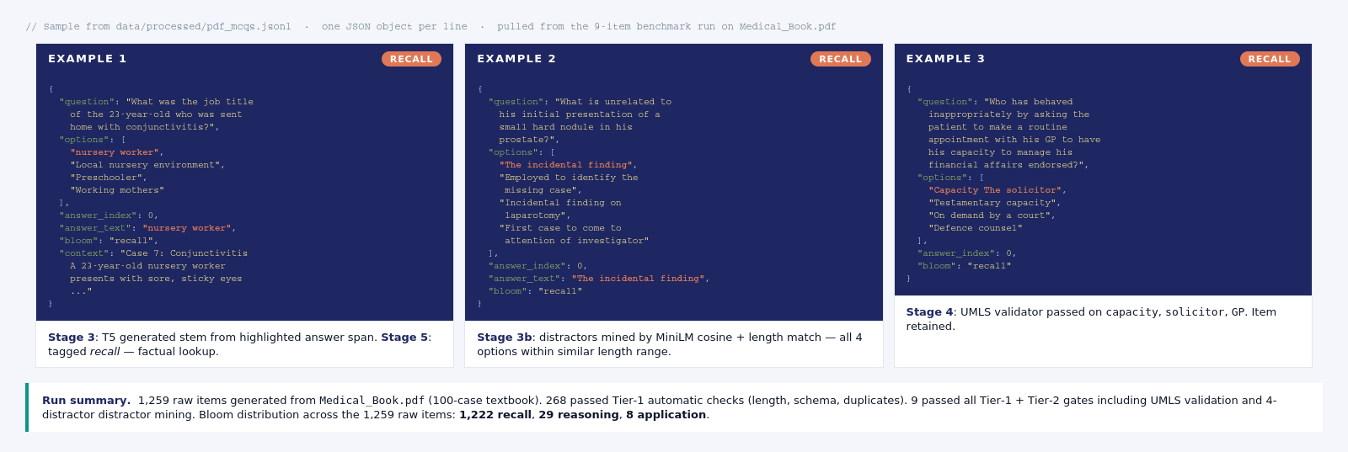
OUTPUT, GENERATED QUESTIONS
Sample Output: pdf_mcqs.jsonl
CSC 7090, Team 7, MedMCQA Milestone 2 (Revised v3)
16 / 17

Slide 17
QUESTIONS WELCOME
Thank You
REFERENCES (SLR + BENCHMARK SOURCES)
TEAM 7 CONTACTS
[1] Leo et al. (2019). Ontology-based generation of medical, multi-term MCQs. IJAIED 29(2), 145-188.
[2] Kurdi et al. (2020). A systematic review of automatic question generation for educational purposes. IJAIED 30(1), 121-204.
[3] Klang et al. (2023). AI-crafted medical examinations: a pilot study with GPT-4. BMC Med. Educ. 23, 772.
[4] Wang, Fan, Houghton, Wang (2022). Towards process-oriented, modular, and versatile question generation. NAACL 2022, 291-302.
[5] Bitew et al. (2022). Learning to reuse distractors to support multiple-choice question generation. arXiv:2210.13964.
[6] Goncalves, Collares, Pego (2026). AI-enhanced adaptive testing in surgical education. Front. Behav. Neurosci.
[7] Srivastava & Goodman (2021). Question generation for adaptive education. ACL 2021.
[8] Vachev et al. (2022). LEAF: multiple-choice question generation. ECIR 2022, LNCS 13186, arXiv:2201.09012.
[9] Raamadhurai, Baker, Poduval (2019). Curio SmartChat: NL question answering for K-12 learning. BEA Workshop @ ACL 2019.
[10] Pal, Umapathi, Sankarasubbu (2022). MedMCQA: a large-scale multi-subject MCQ dataset. CHIL/PMLR 174, 248-260.
[11] Yao et al. (2025). MCQG-SRefine: iterative self-critique for medical MCQ generation. NAACL 2025. arXiv:2410.13191.
[12] Yang et al. (2025). Knowledge-graph guided distractor generation for clinical MCQs. arXiv:2506.00612.
[13] Haladyna, Downing, Rodriguez (2002). A review of MCQ item-writing guidelines. Applied Measurement in Education 15(3), 309-333.
[14] Tarrant, Knierim, Hayes, Ware (2006). Frequency of item-writing flaws in MCQs in nursing assessments. Nurse Educ. Today 26(8), 662-671.
[15] NBME (2021). Item-writing guide: constructing written test questions. National Board of Medical Examiners.
Pradhyumn Nair
pn02774@georgiasouthern.edu
Vishesh Patel
vp04445@georgiasouthern.edu
Oluwasola Smith
os03697@georgiasouthern.edu
CSC 7090, Team 7, MedMCQA Milestone 2 (Revised v3), Georgia Southern University
17 / 17

