Slide 1
BERNOULLI’S PRINCIPLE
Chapter Quiz 2 (V/H)
Use Bernoulli’s equation to predict the relative speed, height, and pressure at two locations of a pipe system.
Start Quiz
LEVEL SELECT

Slide 2
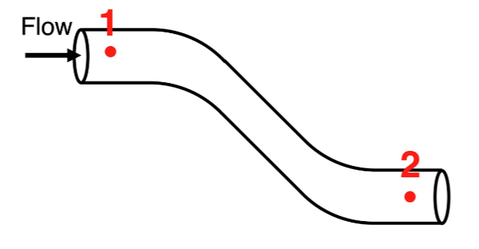
A fluid is undergoing steady-state, laminar flow through a pipe from
location 1 and to location 2.
Compare the values of velocity, height, and pressure for the two locations
Reasoning Help
Velocity
Height
Pressure
V1>V2
H1>H2
P1>P2
Wrong Answer
V1<V2
H1<H2
P1<P2
V1=V2
H1=H2
P1=P2
Right Answer
LEVEL SELECT
Insufficient Info
Insufficient Info
Insufficient Info

Slide 3
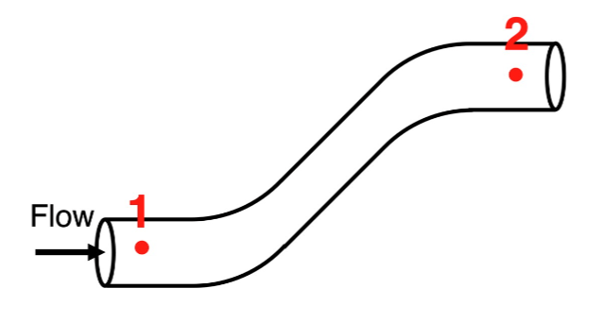
A fluid is undergoing steady-state, laminar flow through a pipe from
location 1 and to location 2.
Compare the values of velocity, height, and pressure for the two locations
Reasoning Help
Velocity
Height
Pressure
V1>V2
H1>H2
P1>P2
Wrong Answer
V1<V2
H1<H2
P1<P2
V1=V2
H1=H2
P1=P2
Right Answer
LEVEL SELECT
Insufficient Info
Insufficient Info
Insufficient Info

Slide 4
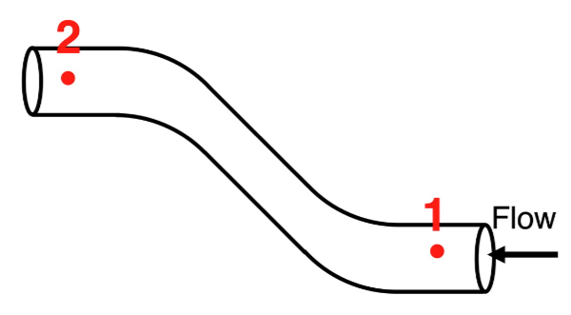
A fluid is undergoing steady-state, laminar flow through a pipe from
location 1 and to location 2.
Compare the values of velocity, height, and pressure for the two locations
Reasoning Help
Velocity
Height
Pressure
V1>V2
H1>H2
P1>P2
Wrong Answer
V1<V2
H1<H2
P1<P2
V1=V2
H1=H2
P1=P2
Right Answer
LEVEL SELECT
Insufficient Info
Insufficient Info
Insufficient Info

Slide 5
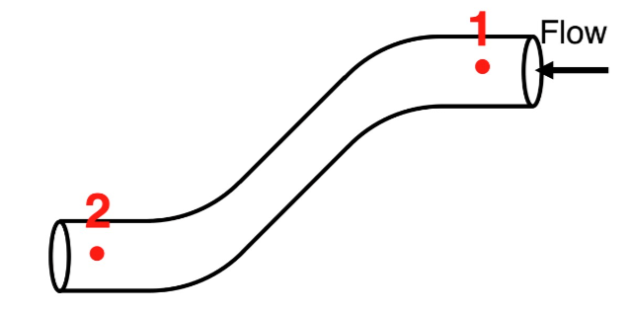
A fluid is undergoing steady-state, laminar flow through a pipe from
location 1 and to location 2.
Compare the values of velocity, height, and pressure for the two locations
Reasoning Help
Velocity
Height
Pressure
V1>V2
H1>H2
P1>P2
Wrong Answer
V1<V2
H1<H2
P1<P2
V1=V2
H1=H2
P1=P2
Right Answer
LEVEL SELECT
Insufficient Info
Insufficient Info
Insufficient Info

Slide 6
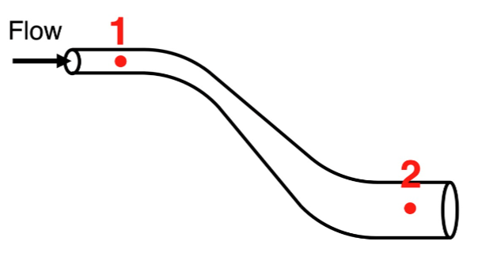
A fluid is undergoing steady-state, laminar flow through a pipe from
location 1 and to location 2.
Compare the values of velocity, height, and pressure for the two locations
Reasoning Help
Velocity
Height
Pressure
V1>V2
H1>H2
P1>P2
Wrong Answer
V1<V2
H1<H2
P1<P2
V1=V2
H1=H2
P1=P2
Right Answer
LEVEL SELECT
Insufficient Info
Insufficient Info
Insufficient Info

Slide 7
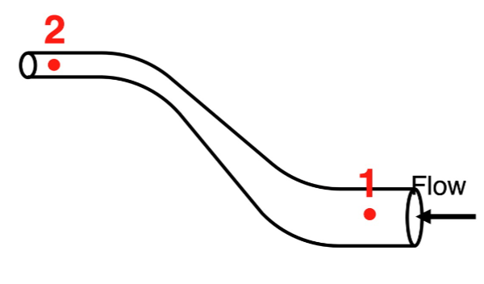
A fluid is undergoing steady-state, laminar flow through a pipe from
location 1 and to location 2.
Compare the values of velocity, height, and pressure for the two locations
Reasoning Help
Velocity
Height
Pressure
V1>V2
H1>H2
P1>P2
Wrong Answer
V1<V2
H1<H2
P1<P2
V1=V2
H1=H2
P1=P2
Right Answer
LEVEL SELECT
Insufficient Info
Insufficient Info
Insufficient Info

Slide 8
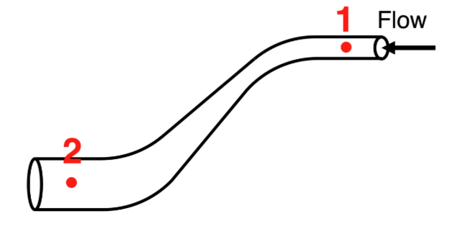
A fluid is undergoing steady-state, laminar flow through a pipe from
location 1 and to location 2.
Compare the values of velocity, height, and pressure for the two locations
Reasoning Help
Velocity
Height
Pressure
V1>V2
H1>H2
P1>P2
Wrong Answer
V1<V2
H1<H2
P1<P2
V1=V2
H1=H2
P1=P2
Right Answer
LEVEL SELECT
Insufficient Info
Insufficient Info
Insufficient Info

Slide 9
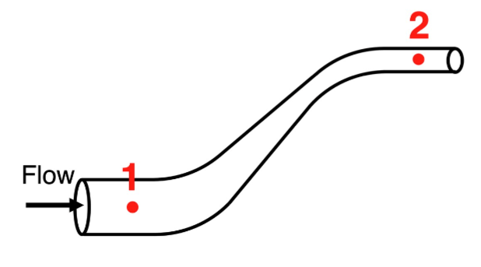
A fluid is undergoing steady-state, laminar flow through a pipe from
location 1 and to location 2.
Compare the values of velocity, height, and pressure for the two locations
Reasoning Help
Velocity
Height
Pressure
V1>V2
H1>H2
P1>P2
Wrong Answer
V1<V2
H1<H2
P1<P2
V1=V2
H1=H2
P1=P2
Right Answer
LEVEL SELECT
Insufficient Info
Insufficient Info
Insufficient Info

Slide 10
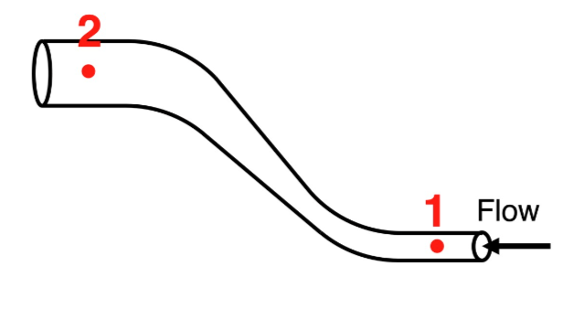
A fluid is undergoing steady-state, laminar flow through a pipe from
location 1 and to location 2.
Compare the values of velocity, height, and pressure for the two locations
Reasoning Help
(TRAP QUESTION)
Velocity
Height
Pressure
V1>V2
H1>H2
P1>P2
Wrong Answer
V1<V2
H1<H2
P1<P2
V1=V2
H1=H2
P1=P2
Right Answer
LEVEL SELECT
Insufficient Info
Insufficient Info
Insufficient Info

Slide 11
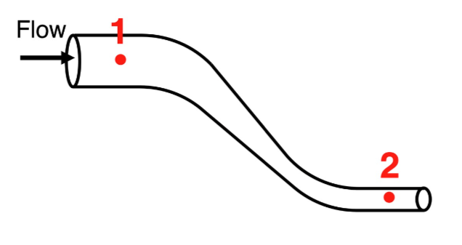
A fluid is undergoing steady-state, laminar flow through a pipe from
location 1 and to location 2.
Compare the values of velocity, height, and pressure for the two locations
Reasoning Help
(TRAP QUESTION)
Velocity
Height
Pressure
V1>V2
H1>H2
P1>P2
Wrong Answer
V1<V2
H1<H2
P1<P2
V1=V2
H1=H2
P1=P2
Right Answer
LEVEL SELECT
Insufficient Info
Insufficient Info
Insufficient Info

Slide 12
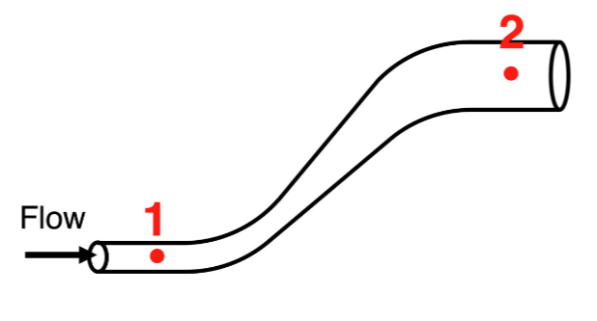
A fluid is undergoing steady-state, laminar flow through a pipe from
location 1 and to location 2.
Compare the values of velocity, height, and pressure for the two locations
Reasoning Help
(TRAP QUESTION)
Velocity
Height
Pressure
V1>V2
H1>H2
P1>P2
Wrong Answer
V1<V2
H1<H2
P1<P2
V1=V2
H1=H2
P1=P2
Right Answer
LEVEL SELECT
Insufficient Info
Insufficient Info
Insufficient Info

Slide 13
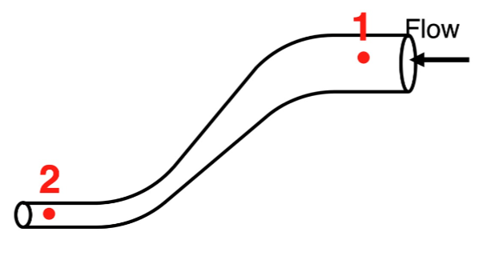
A fluid is undergoing steady-state, laminar flow through a pipe from
location 1 and to location 2.
Compare the values of velocity, height, and pressure for the two locations
Reasoning Help
(TRAP QUESTION)
Velocity
Height
Pressure
V1>V2
H1>H2
P1>P2
Wrong Answer
V1<V2
H1<H2
P1<P2
V1=V2
H1=H2
P1=P2
Right Answer
LEVEL SELECT
Insufficient Info
Insufficient Info
Insufficient Info

Slide 14
Back to
Question
HELP!
Bernoulli Equation Reminder
Using energy conservation principles, it can be shown that for a fluid undergoing steady-state flow:
P + ρ*g*h + ρ*v²/2 = a constant
where p = pressure, ρ = density, h = height, and v = velocity.

Slide 15
Back to
Question
HELP!
The Correct Reasoning
Remember the Continuity principle
Compare the heights
Use Bernoulli’s equation to compare the pressures

Slide 16
Back to
Question
HELP!
The Correct Reasoning
3) Use Bernoulli’s equation to compare the pressures:
The equation P₁ + ρ*v₁²/2 + ρ*g*h₁ = P₂ + ρ*v₂²/2 + ρ*g*h₂ has a load of symbols in it that can be rather distracting.
Let's re-write it or at least re-color it as:
P₁ + ρ*v₁²/2 + ρ*g*h₁ = P₂ + ρ*v₂²/2 + ρ*g*h₂
​so that you can see the three important variables for the two locations. Now convince yourself that the sum of the three terms on the left side of the equation must equal the sum of the three terms on the right side of the equation. You know how the terms v₁ and h₁ compare to v₂ and h₂. Let's suppose that you have concluded that both v₁ and h₁ are bigger than v₂ and h₂. This would mean that the left side of the equation has two terms that are bigger than the same-quantity terms of the right side. In order to maintain the equal sign of the equation, the P₁ term must then be smaller than the P₂ term. Put another way, if term 2 and term 3 on the left side of the equation are large, then term 1 must be small in order for the sum of the three terms on the left side to equal the sum of the three terms on the right side. That is, the pressure term on the right (P₂) must be large to make up for the smallness of the v₂ and h₂ terms on the right side.
Similar reasoning can be used if you have decided that both v₂ and h₂ are bigger than v₁ and h₁. In such a case, the P₂ term must be smaller than the P₁ term. That is, the pressure term on the left (P₁) must be large to make up for the smallness of the v₁ and h₁ terms. This is the only way that the sum of the three terms on the left side of the equation can equal the sum of the three terms on the right side of the equation.
And finally, you can imagine the difficulty of making a conclusion if the velocity term on one side of the equation is largest and the height term on the opposite side of the equation is largest. In such situations, actual numbers would be required in order to determine the sums of
ρ*v₁²/2 + ρ*g*h₁ and ρ*v₂²/2 + ρ*g*h₂. Only after such numerical information is known can a conclusion be made about the relative size of P₁ and P₂. In the absence of such numerical information, one cannot make a conclusion under such conditions.

Slide 17




BERNOULLI’S PRINCIPLE – Chapter 1
Lecture
INTRO
Level 1
Velocity-Pressure
Level 3
V/H - P
Level 4
g/ρ - P
Level5
All variables
Level 2
Height-Pressure
Quiz 1
Equation
Quiz 2
V/H
Lecture
APPLYING
Quiz 4
Final
Quiz 3
g/ρ

Slide 18
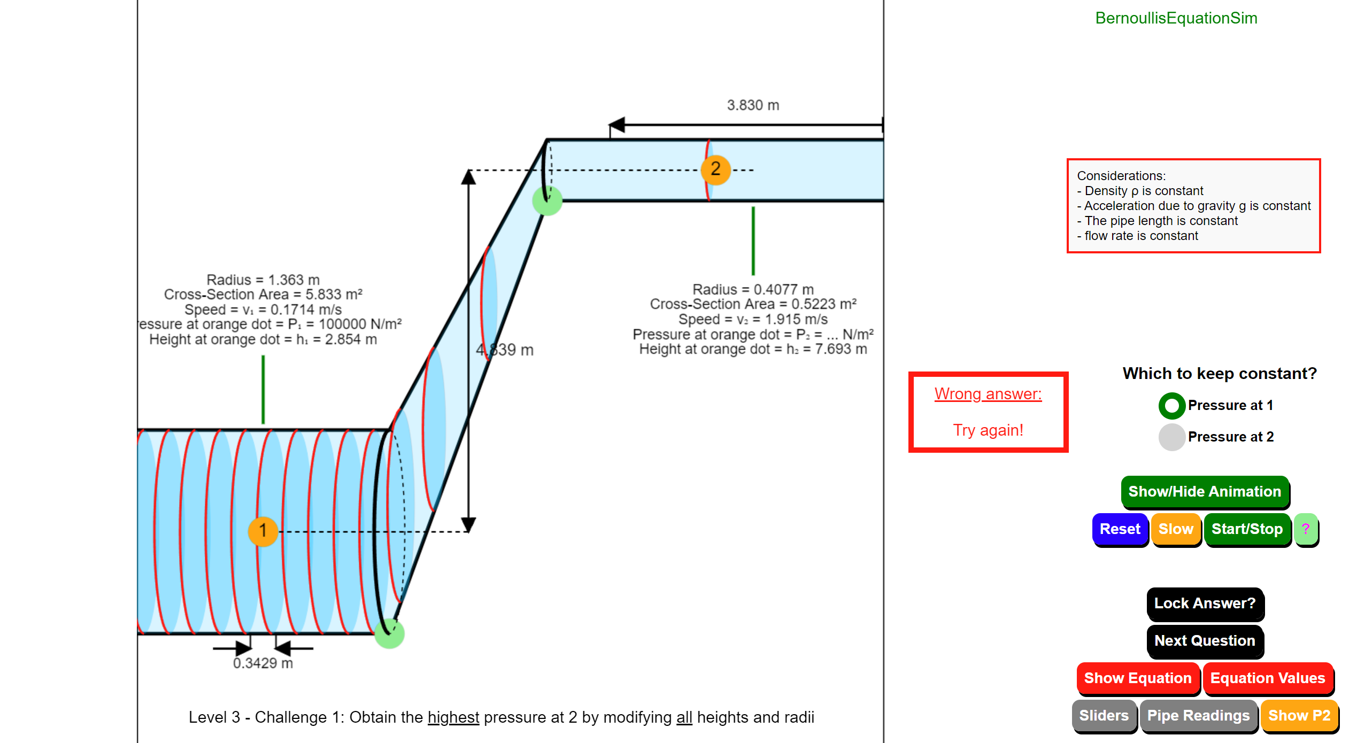
Level 3 Simulator: velocity + height
LEVEL SELECT

