Slide 1




Girija Digital Portfolio
Name : R. Vishnupriya Register no : 2422j0966 Department :Bachelor of computer applications College : Sasurie college of Arts & Science,Vijayamangalam/ Bharathiyar University

Slide 2



Project Tittle
“Vishnupriya Digital Portfolio – A Web-based Interactive Profile using HTML, CSS & JavaScript”

Slide 3
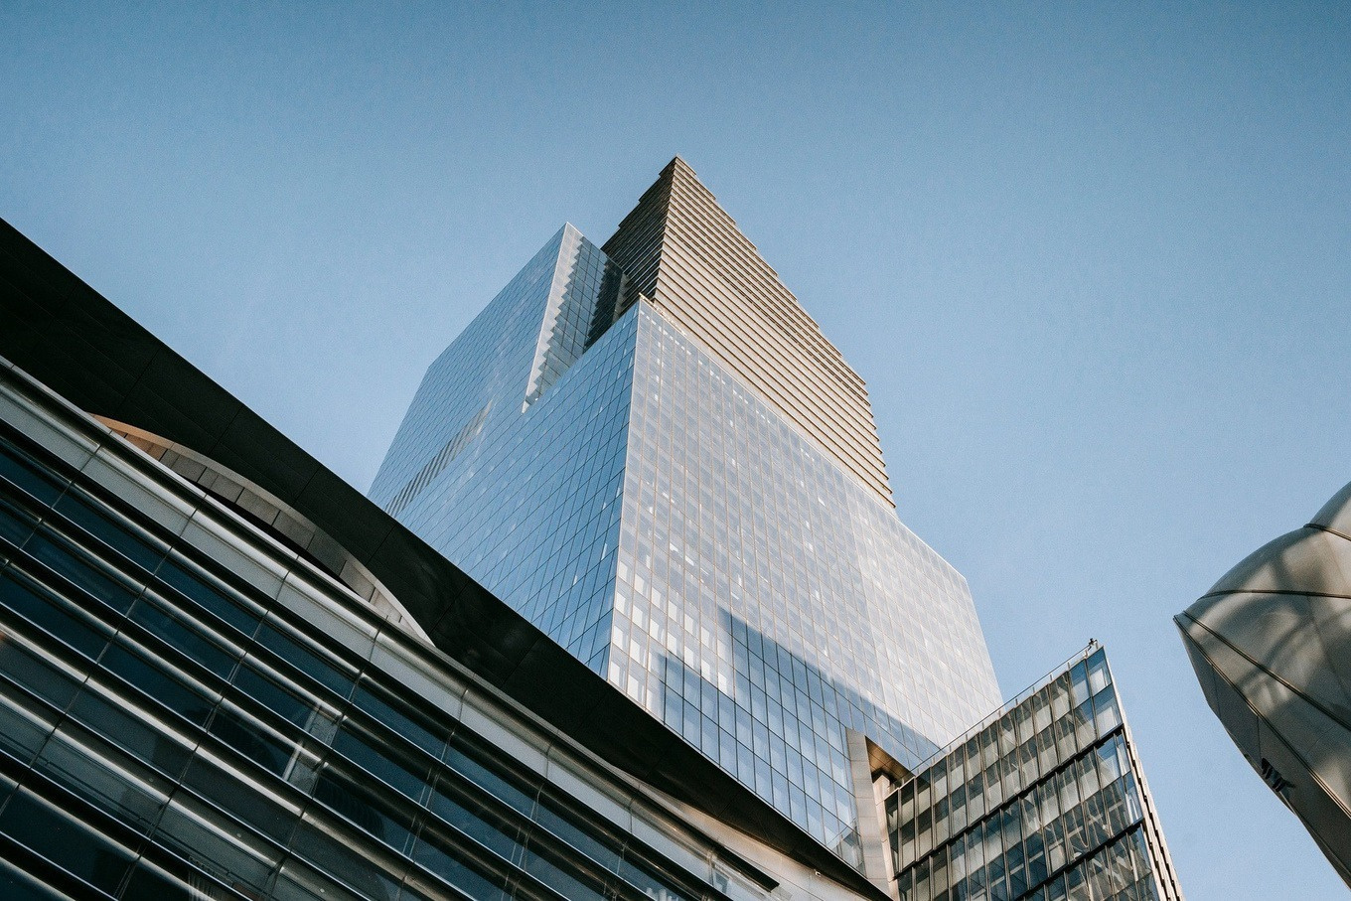
AGENDA
1) Problem statement 2) Project overview 3) End users 4) Tools and technology 5) Portfolio design and layout 6) Features and functionality 7) Results and screen shot 8) Conclusion

Slide 4
PROBLEM STATEMENT
Resumes are static and lack interactivity.
Students often struggle to highlight skills & projects dynamically.
Recruiters prefer a modern, digital portfolio that is mobile-friendly, i
nteractive, and easy to access online.
---

Slide 5
Project Overview
My project is a personal digital portfolio website built using HTML, CSS, and JavaScript. It acts as a one-stop professional identity, showcasing: ✅ Academic details ✅ Projects & certifications ✅ Skills & technical strengths ✅ Contact information & resume download

Slide 6
End User
👨‍🎓 Students – to showcase work
👩‍🏫 Faculty/Reviewers – for project evaluation 👨‍💼 Recruiters/HR – for hiring assessments
👩‍💻
Developers & Peers – for collaboration & inspiration

Slide 7
Tools & Technologies
💻 Frontend: HTML5, CSS3, JavaScript (Vanilla JS)
🎨
Styling & Effects: CSS Grid, Flexbox, Animations, Media Queries
⚡
Enhancements: JavaScript DOM manipulation, Form validation
📂 Version Control: GitHub
🎨 Design Mockups: Canva / Figma

Slide 8
Portfolio Design & Layout
Landing Page: Professional intro with animated text
About Section: Education, career goals, personal profile
Skills Section: Progress bars & icons for HTML, CSS, JS
Projects Section: Cards with hover effects & GitHub links
Contact Section: Interactive form with validation

Slide 9
Features & Functionality
✨
Fullyresponsive design (works on mobile & desktop)
✨
Smooth CSS animations & hover effects JavaScript-powered interactive navigation
✨
✨
Resume download option in PDF format LiveGitHub integration for project showcase
✨

Slide 10

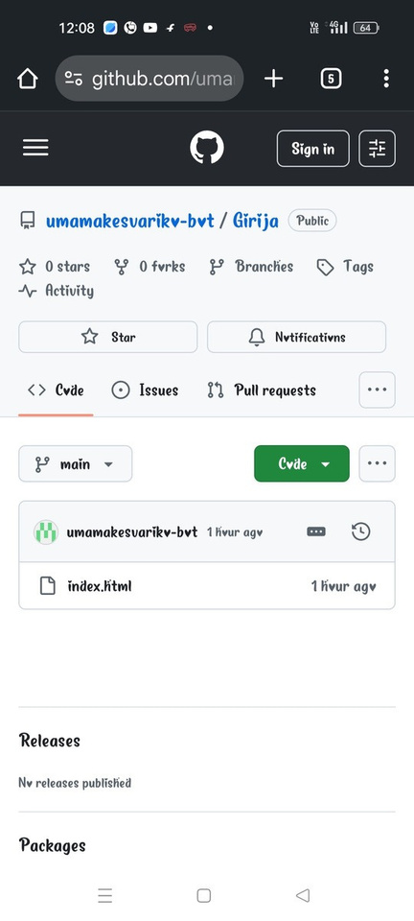
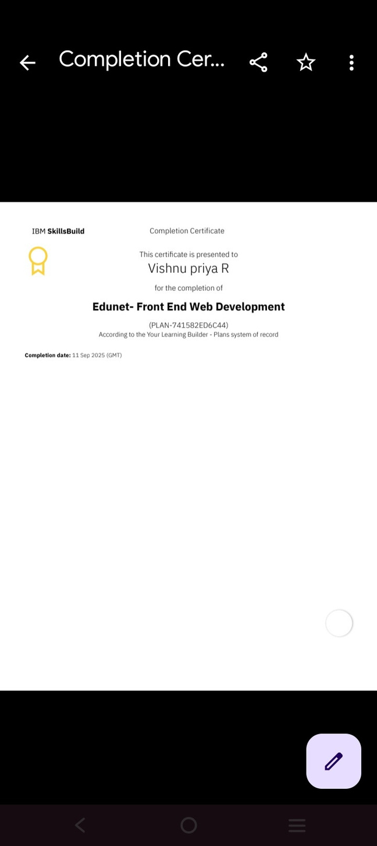
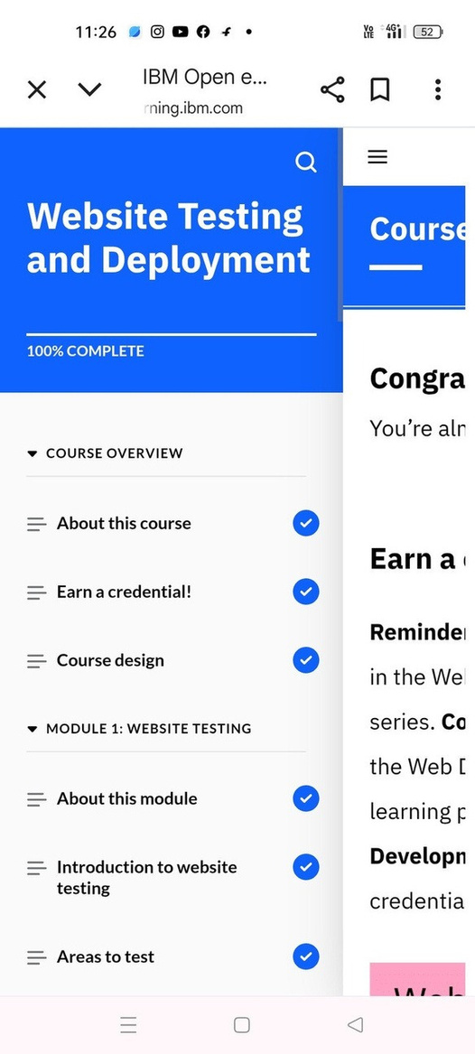
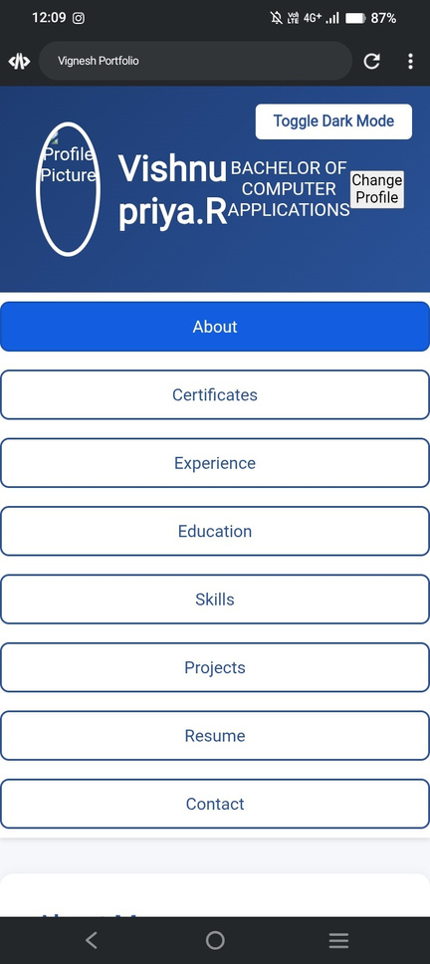
Results & Screenshots

Slide 11
Conclusion
The Girijadigitalportfoliois amodern web solution for self-presentation. It demonstrates my practical knowledge of HTML, CSS, and JavaScript while helping me showcase my academic journey, skills, and projects in an interactive and professional format

Slide 12



Thank you
Contact with me...
91 9080853220
vp5979036@gmail.com

