Slide 1

CrowdStrike Outage 2024
The Largest IT Outage in History - 8.5 Million Devices Crashed
PRASHANTI AND JASMEEN STUDENT OF COMPUTER PROGRAMMING IN FALL 2026

Slide 2

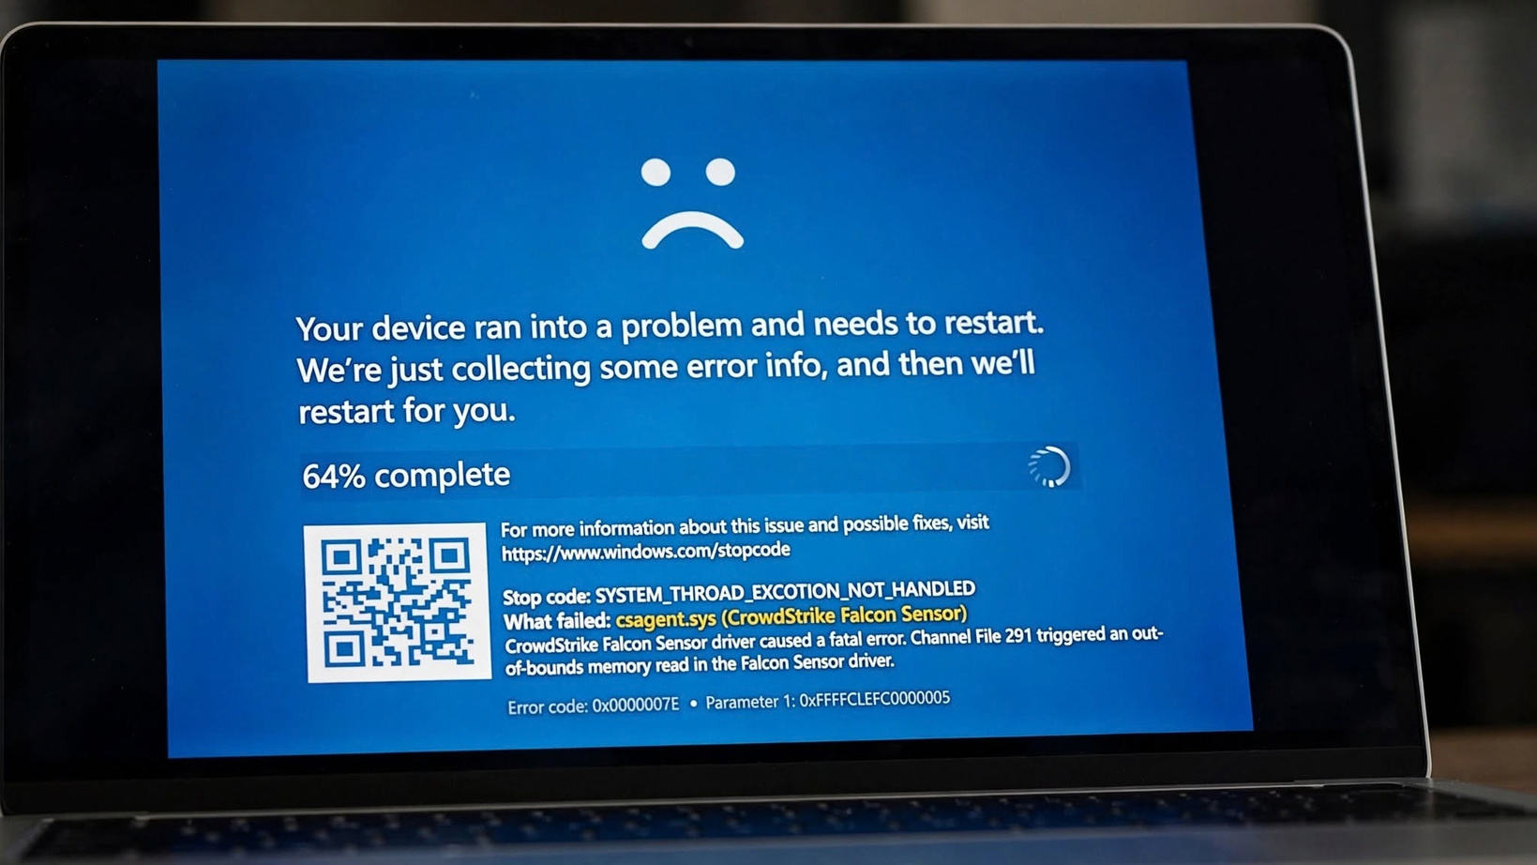
What Happened? July 19, 2024
04:09 UTC - Global Outage
• CrowdStrike is a cybersecurity company - Falcon sensor protects Windows
• Faulty update: Channel File C-00000291*.sys with logic error
• Pushed via CDN to millions of PCs in minutes
• Only 78 minutes live, but caused global crash
• Affected: Windows 10/11 with Falcon 7.11+ that were online
• Safe: Mac, Linux, offline PCs
• Result: Blue Screen of Death (BSOD) boot loop

Slide 3

Timeline of Outage
From Deployment to Fix
• 00:09 UTC - New template deployment started
• 04:09 UTC - BAD Channel File 291 pushed via CDN - Millions affected instantly
• 05:27 UTC - CrowdStrike reverted bad file, pushed GOOD file C-00000291*.sys
• 05:36 UTC - Issue identified in EU & US, workaround published
• 06:00+ UTC - IT teams worldwide start manual fixes - Safe Mode + Delete file
• July 20-29 - 97% to 99% sensors fixed, but airlines/hospitals took days
• Key lesson: Fast deployment without staged rollout caused disaster

Slide 4
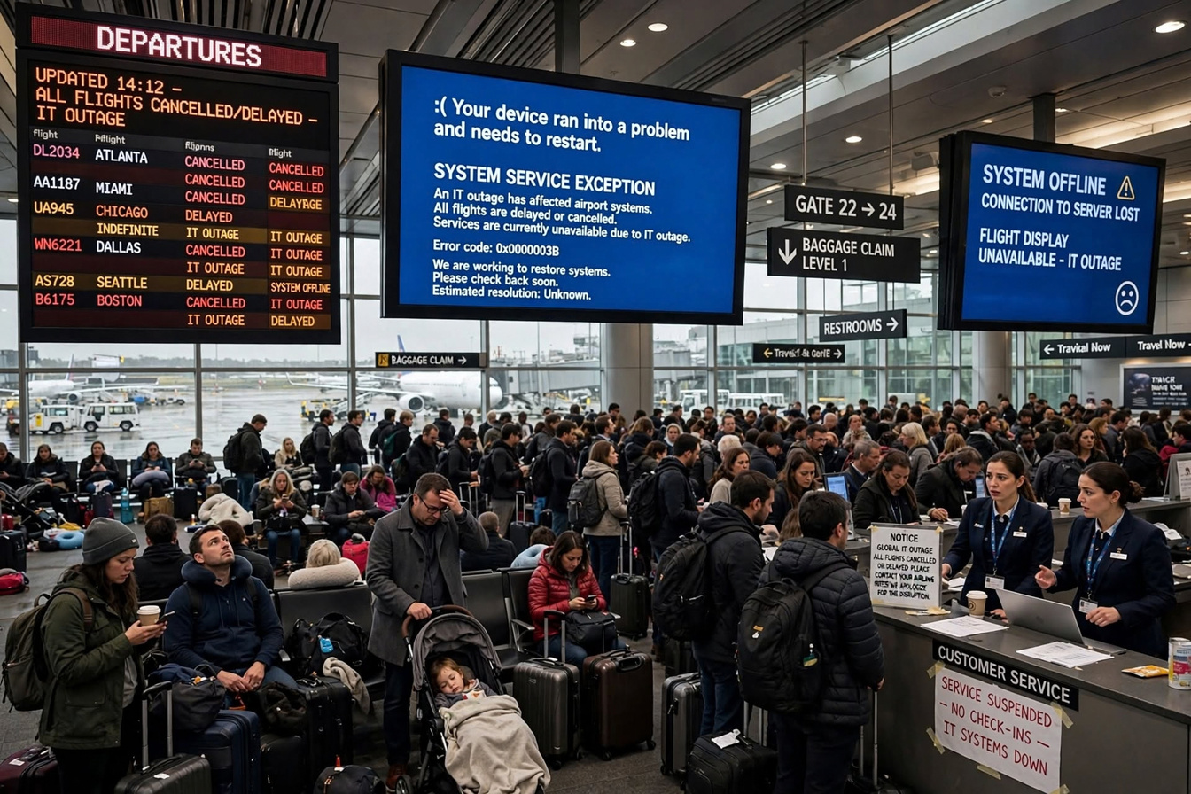
Global Impact - Real Airport Chaos
Media: airport.jpg from our repo
• 8.5 Million Windows devices crashed
• Airlines: Delta, United, American, WestJet - Pearson Toronto affected
• Flights: 5000+ cancelled, departure boards showed CANCELLED
• Hospitals: Surgeries delayed, ER systems down
• Banks: Payments, ATMs down
• Emergency: 911 services disrupted in US
• Retail, Logistics, Media all hit
• Loss: Estimated $5.4 Billion USD
• Biggest IT outage in history!

Slide 5
Root Cause - Channel File 291
C-00000291*.sys - Logic Error
• Falcon sensor uses Channel Files to check named pipes (malware technique)
• Channel File 291 delivers template for that check
• Faulty file had 21 fields, code expected 20 parameters
• Caused Out-of-bounds memory read -> Crash in csagent.sys driver
• Stop code: SYSTEM_THREAD_EXCEPTION_NOT_HANDLED
• What failed: csagent.sys (CrowdStrike Falcon Sensor)
• Location: C:\Windows\System32\drivers\CrowdStrike\C-00000291*.sys
• Only Windows affected - Driver level bug

Slide 6
Blue Screen of Death - BSOD
Media: bsod.png from our repo
• Screen: Your device ran into a problem and needs to restart
• Sad face :(
• 64% complete collecting error info
• Stop code: SYSTEM_THREAD_EXCEPTION_NOT_HANDLED
• What failed: csagent.sys (CrowdStrike Falcon Sensor)
• Channel File 291 triggered out-of-bounds read
• QR code links to windows.com/stopcode
• PC stuck in boot loop - Could not boot normally
• Required Safe Mode to delete bad file

Slide 7

Fix Steps - Manual Recovery
IT teams fixed 8.5M PCs one by one
• STEP 1: Boot into Safe Mode or Windows Recovery Environment (WinRE)
• STEP 2: Navigate to C:\Windows\System32\drivers\CrowdStrike\
• STEP 3: Find file C-00000291*.sys (bad channel file)
• STEP 4: Delete the file - Right-click -> Delete
• STEP 5: Reboot normally - PC should boot!
• If BitLocker enabled - Need recovery key
• Cloud PCs - Azure, AWS had to do same
• CrowdStrike pushed GOOD file at 05:27 UTC but manual delete needed for crashed PCs
• Took 2-5 days for large orgs to fix all PCs

Slide 8

Prevention & Lessons Learned
How CrowdStrike Changed Process
• Enhanced Testing: Added content validator, template type checks, stress tests
• Staged Deployment: No more global push at once - Rollout in phases
• Faster Rollback: Ability to revert in minutes not hours
• Customer Control: Customers can choose when/which updates - N-1 support
• Better Monitoring: Real-time sensor health monitoring
• External Review: Third-party code review for channel files
• Lesson: Single config file can paralyze world - Importance of testing!
• Industry Lesson: Don't deploy Friday, have offline recovery plan, backup comms

Slide 9
Our GitHub Project Structure
vp6wgjc29d-hub/crowdstrike-outage-2024-project
• docs/notes.md - Detailed timeline & research
• script/script.md - Video presentation script (Jasmeen + Prashanthi lines clear)
• slides/jasmeen-slides.md - Slides 6-10 content
• slides/prashanthi-slides.md - Slides 1-5 content
• media/bsod.png - Real BSOD error (161KB)
• media/airport.jpg - Real airport chaos (356KB)
• presentation.pptx - This deck (10 slides)
• README.md - Project overview + contributions
• 10+ commits, 2 contributors, all tracked!

Slide 10

Conclusion & Contributions
Thank You! Questions?
• CrowdStrike outage July 19 2024 = Largest IT outage in history
• Cause: Logic error in Channel File C-00000291*.sys - 21 fields vs 20 expected
• 78 min deployment -> 8.5M Windows PCs BSOD -> $5.4B loss
• Fix: Safe Mode -> Delete C-00000291*.sys -> Reboot
• Prevention: Staged rollout, content validator, customer control
• Prashanthi: Media (real images), GitHub repo, Slides 1-5, README, Matrix fixes
• Jasmeen: Research, Script content, Slides 6-10, Root cause analysis
• GitHub: 10+ commits visible, 2 contributors, all files tracked
• Next: Record 5-min video + YouTube link in README
• Q&A - Thank you!

