Slide 1
Endocrine lectures – Adrenal
Sathya Subbiah, MD

Slide 2
Objectives
Learn relevant anatomy and embryology of adrenal glands
Understand pathophysiology of adrenal insufficiency and treatment
Define polyglandular autoimmune syndromes
Understand steroid synthesis pathways and pathology of congenital adrenal hyperplasia (CAH) 1
Describe the varying clinical features of CAH and how they relate to hormonal abnormalities.2
Understand hormonal causes of hypertension – Primary hyperaldosteronism and pheochromocytoma
Describe the genetic features, cellular origins, and presentation and treatment of pheochromocytoma.3
4

Slide 3
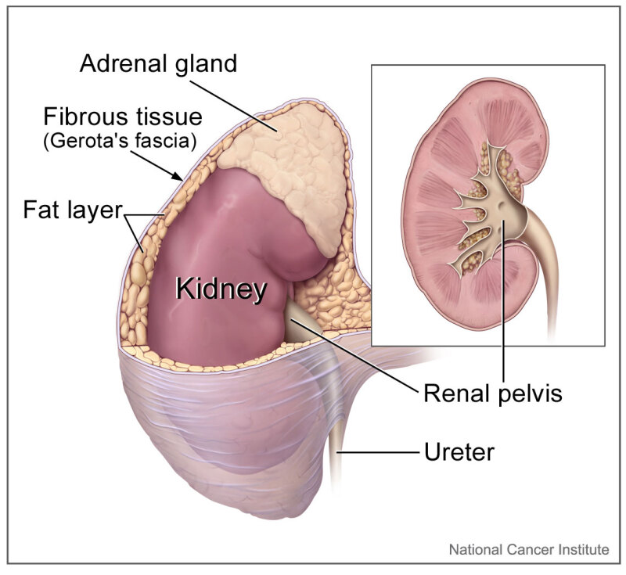
The adrenal gland comprises 2 distinct tissues: the outer cortex and the inner medulla. It weighs about 5 gm.​

Slide 4
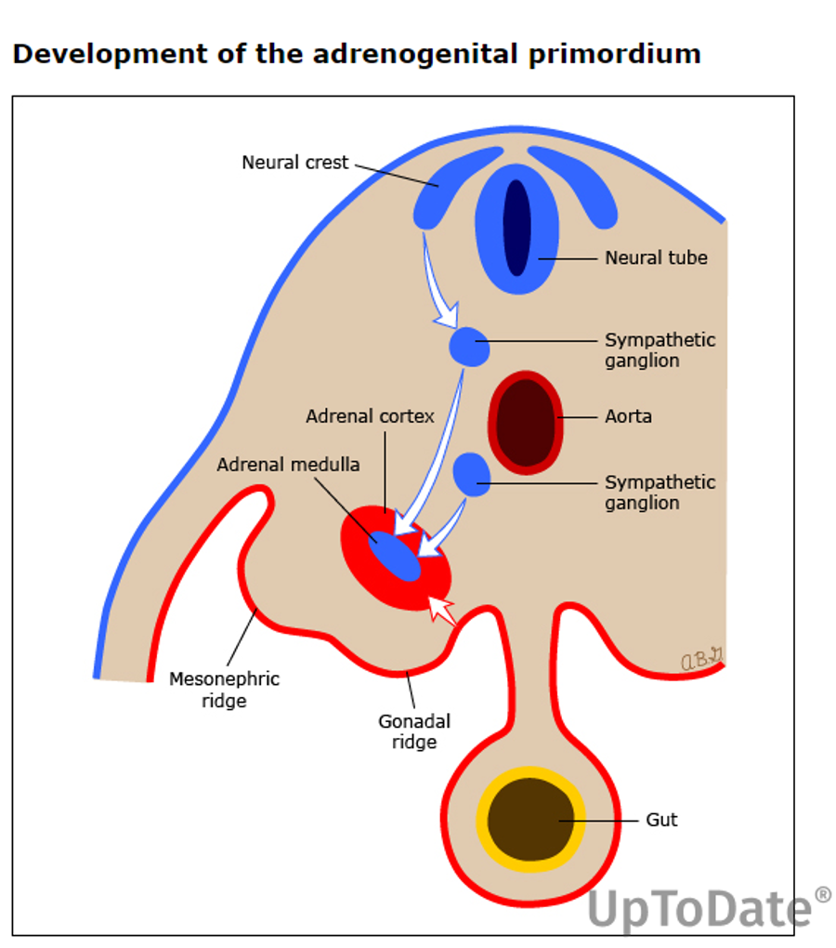
Embryology
In the 5th week of development, an isolated cluster of cells emerges within the urogenital ridge, identified as the adrenal-gonadal primordial germ cells.
The Adrenal cortex and medulla have different embryologic origins.
By week 8 -
The adrenal cortex is derived from mesoderm.
The adrenal medulla derives from neural crest (ectoderm).
So it produces the neurotransmitters norepinephrine and epinephrine
The gland is not mature at birth,
and evolves over the first 4 years of life into its adult form

Slide 5
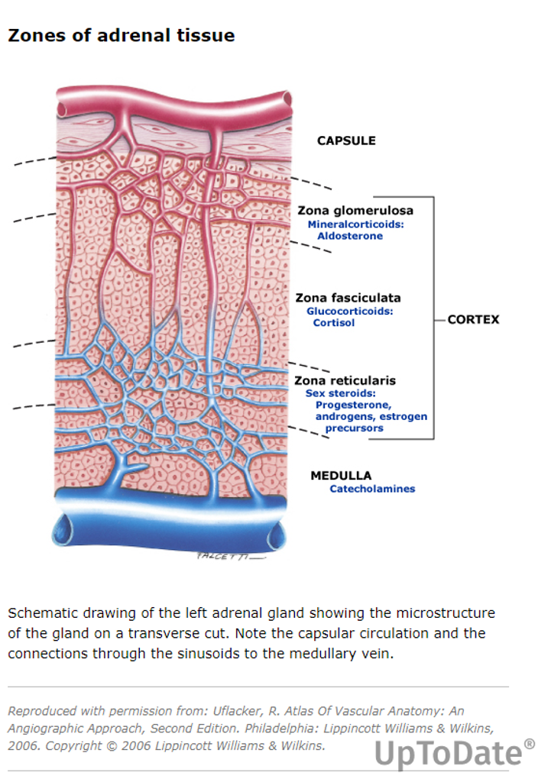
The names of these zones can also be recalled by remembering "GFR" for glomerulosa, fasciculata, and reticularis.

Slide 6
Adrenal cortex
The adrenal cortex is much larger than the smaller medulla, accounting only for approximately 15% of the gland. It is composed of 3 distinct zones:
Zona Glomerulosa -- Aldosterone synthesis under ACTH, regulated by Renin
The zona glomerulosa (outer layer) synthesizes mineralocorticoids, the most important of which is aldosterone. This hormone plays an important role in electrolyte balance and blood pressure regulation.
Zona Fasciculata --under ACTH control
The zona fasciculata (middle layer) produces glucocorticoids, the predominant hormone being cortisol. This hormone regulates blood sugar via gluconeogenesis, modulates the immune system, and regulates the metabolism of fat, protein, and carbohydrates. Cortisol secretion is regulated by the adrenocorticotropic hormone, which is released from the pituitary gland.
Zona Reticularis—under ACTH control
The zona reticularis (inner zone) produces androgens and plays a role in the development of secondary sexual characteristics. The primary androgen produced in the zona reticularis is dehydroepiandrosterone (DHEA), which is the most abundant hormone in the body. It serves as a precursor for synthesizing many other hormones the adrenal gland produces, such as progesterone, estrogen, cortisol, and testosterone.

Slide 7
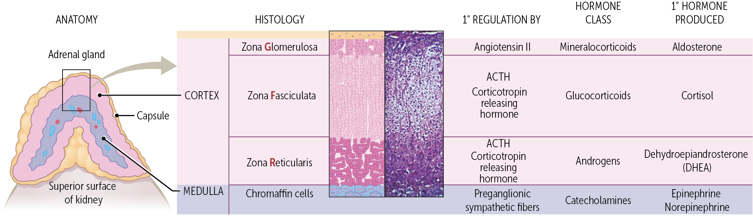

Slide 8
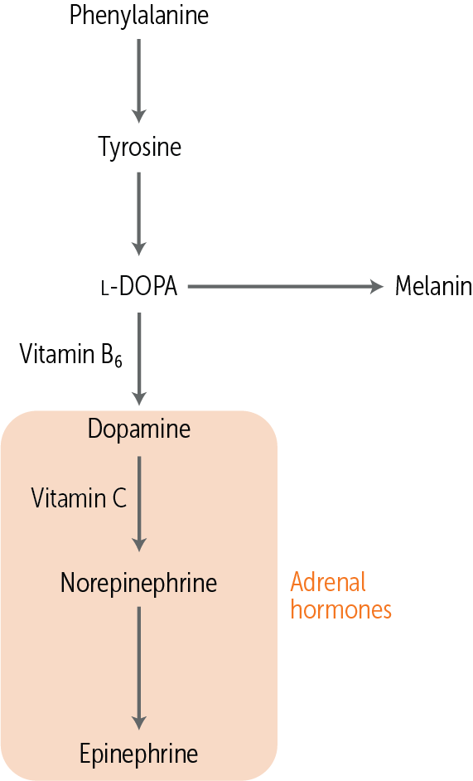
Adrenal medulla
The adrenal medulla synthesizes catecholamines.
Once norepinephrine has been created, it is then methylated via phenylethanolamine N-methyltransferase (PNMT), which is only present in the adrenal medulla to epinephrine. In the adrenal gland, norepinephrine and dopamine act mainly as precursor molecules to adrenaline, but in neurons and the central nervous system, they have their own unique roles as important neurotransmitters.
Protein-rich foods, including meats, poultry, fish, dairy products, and certain nuts and seeds.
Adrenal medulla

Slide 9
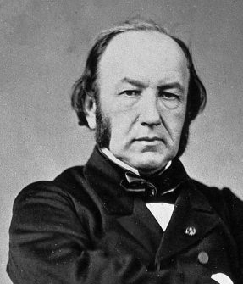


Slide 10
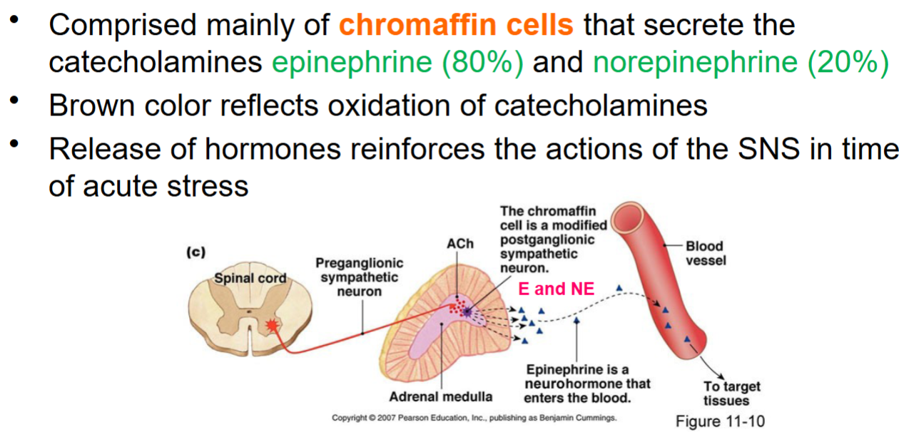
Adrenal medulla

Slide 11
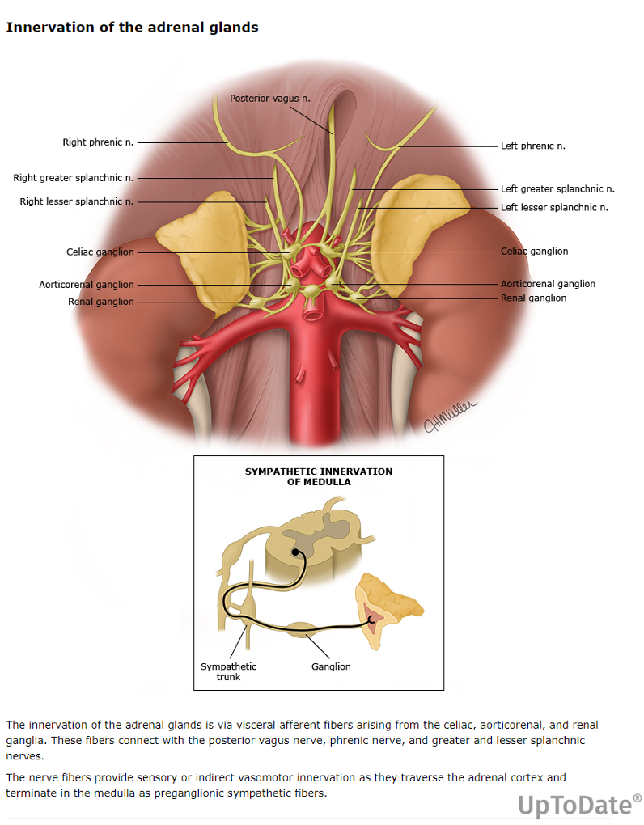
spinal cord's lateral horn from the T5–T8 spinal cord segments.
Spinal cord's lateral horn from the T5–T8 spinal cord segments.
2. Some fibers of the greater splanchnic nerve circumvent the celiac ganglion and directly enter the adrenal gland to synapse at the chromaffin cells' membranes. This is why the adrenal medulla acts as a neuroendocrine junction between the 2 physiological segments. The chromaffin cells release their neurohormones directly into the bloodstream to produce a widespread sympathetic response

Slide 12
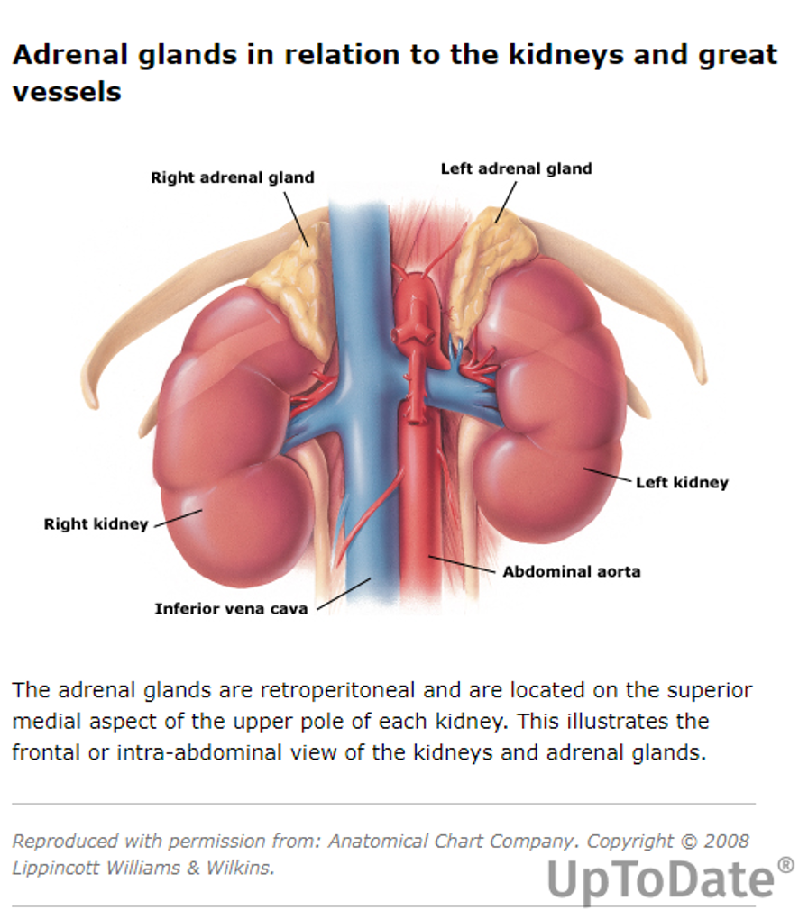
The venous drainage from the adrenal glands is dependent on the side of the gland. The left adrenal gland is anatomically further away from the inferior vena cava; therefore, the left adrenal vein drains into the left renal vein. The right adrenal vein is much closer to the inferior vena cava and drains directly into this large vessel.

Slide 13
Adrenal ( Adrenocortical) insufficiency- Addison's disease
32 year man presents with weight loss of 15 pds, skin darkening in spite of staying out of sun, poor appetite, dizziness and fatigue. Non smoker.
Labs- Glucose – normal , Na normal , K mild high 5.5, Renal function normal.
8 am cortisol 4 mcg/dl ( low) and ACTH is 500( high)
TSH 6 mild high , with low FT4 and + Thyroperoxidase ab

Slide 14
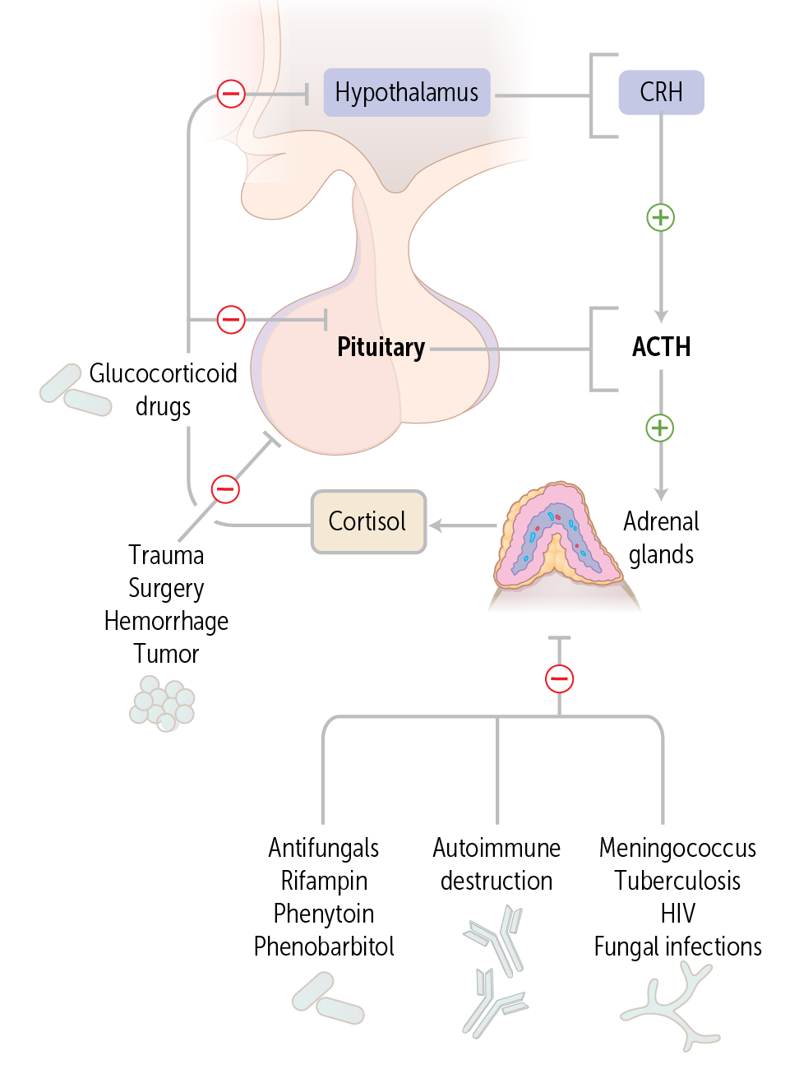
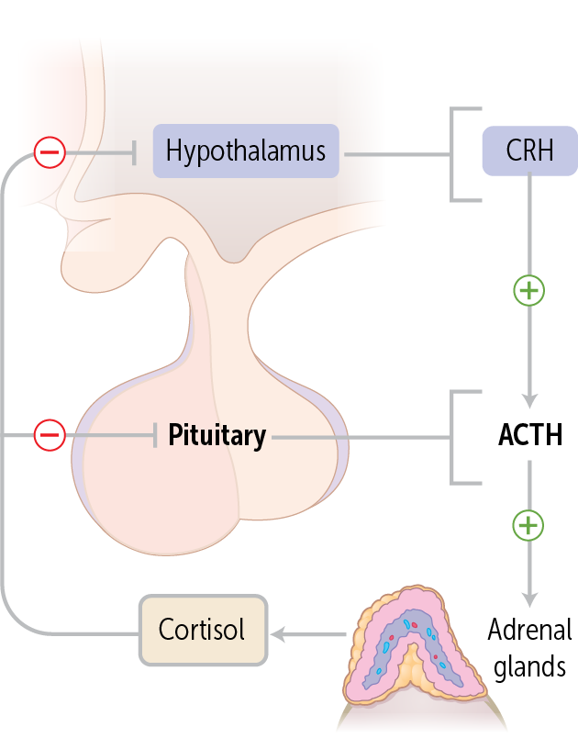
Causes

Slide 15
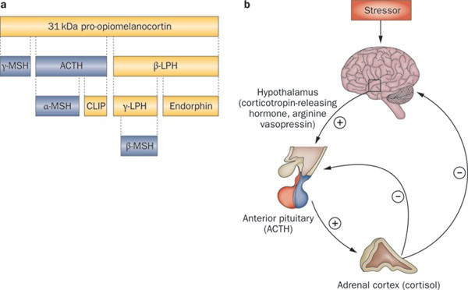
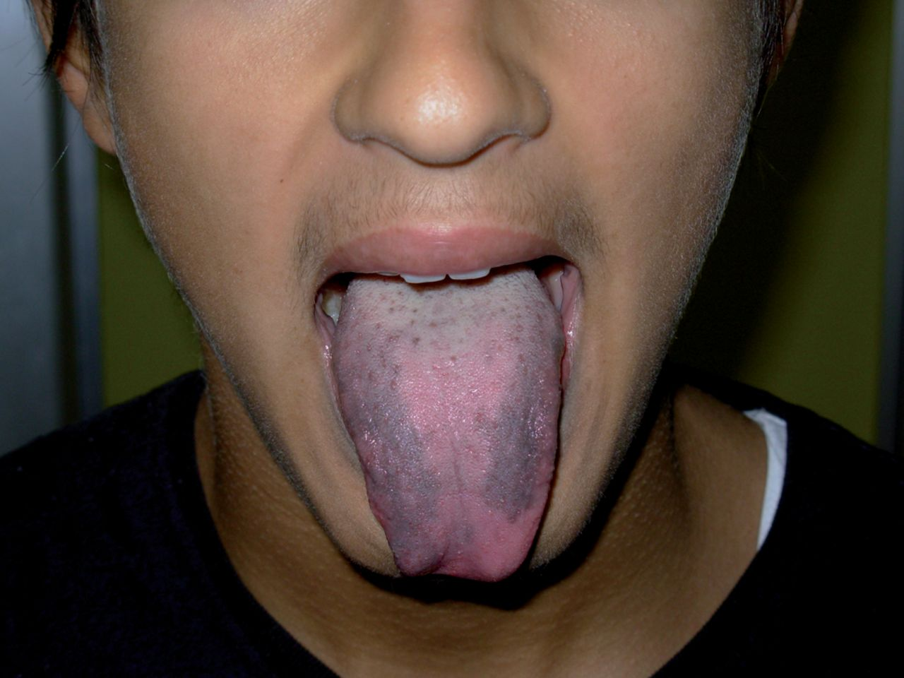
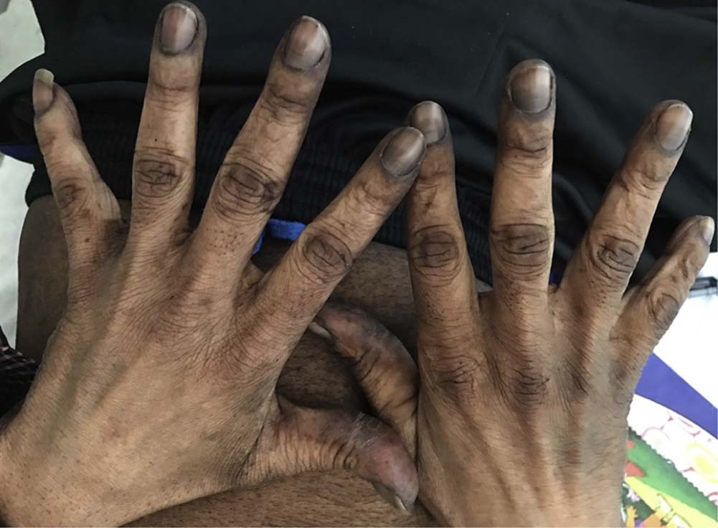
Primary adrenal insufficency - Hyperpigmentation of skin (elbows and palmarcreases) and tongue – pigmented fungiform papillae

Slide 16
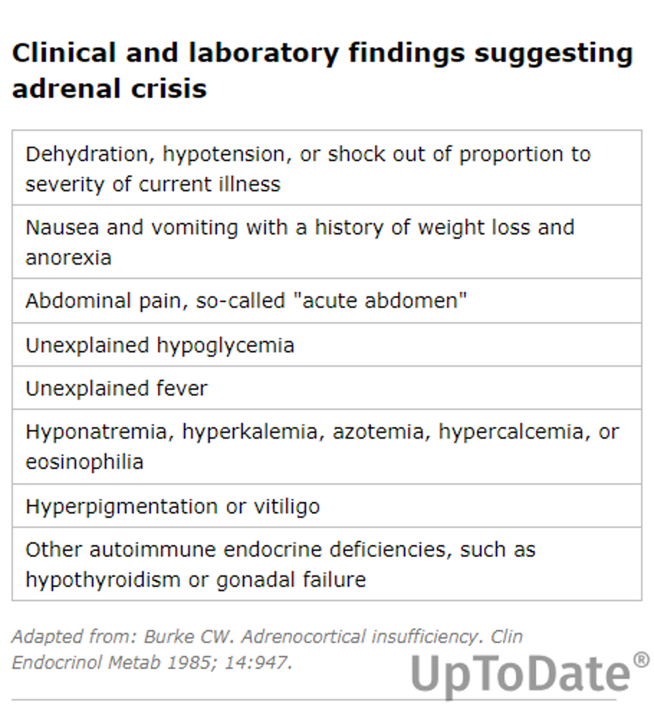

Slide 17
Causes of Primary Adrenal Insufficiency (Addison’s Disease)
1. Autoimmune Adrenocortical Insufficiency – positive 21 hydroxylase antibodies
Most common cause;
Adrenal glands are small and atrophic
Frequently accompanied by other immune disorders as described above (APS-2)
Adrenal Hemorrhage – observed in patients that have been taking anti-coagulant therapy or are predisposed to thrombosis
Infections – Tuberculosis is a common cause in countries outside the US; systemic fungal infection (and treatment with antifungal agents that inhibit adrenal cytochrome P450 steroidogenic enzymes); HIV/AIDS,
Metastatic adrenal disease – adrenal glands are common sites of metastasis for lung, GI, breast, and renal neoplasia; non-Hodgkin and Hodgkin lymphoma
Congenital Adrenal Hyperplasia (CAH) – autosomal recessive genetic defect in one of the adrenal enzymes involved in synthesizing adrenal steroid hormones from cholesterol

Slide 18
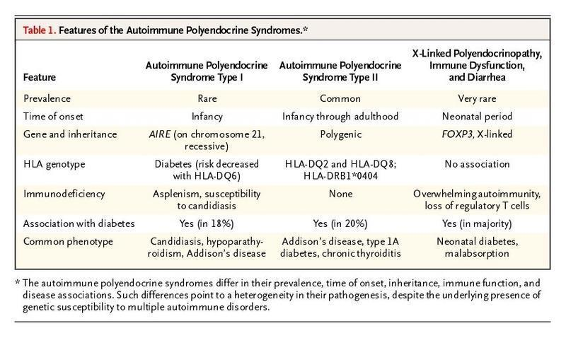
Autoimmune polyglandular syndrome (APS), Type II (also known as Polyglandular Autoimmune Syndrome, or PGAS) – heterogeneous group of diseases of the immune system which may lead to inflammatory damage of various endocrine glands
About 1 in 7 people have Type II APS; In addition to type 1 diabetes, they develop thyroid disease, malfunctioning adrenal glands and sometimes other immune disorders.
Type II APS is characterized by AI (100% frequency), hypothyroidism/hyperthyroidism (69%), and type 1 (52%) diabetes. Usually occurs in adults; peak incidence is age 30, and occurs more often in women
Monitor for premature menopause

Slide 19
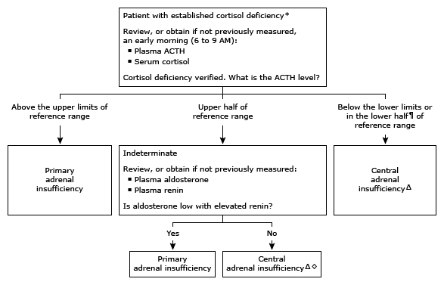
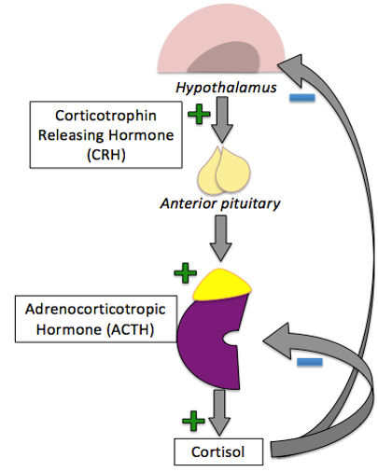

Slide 20
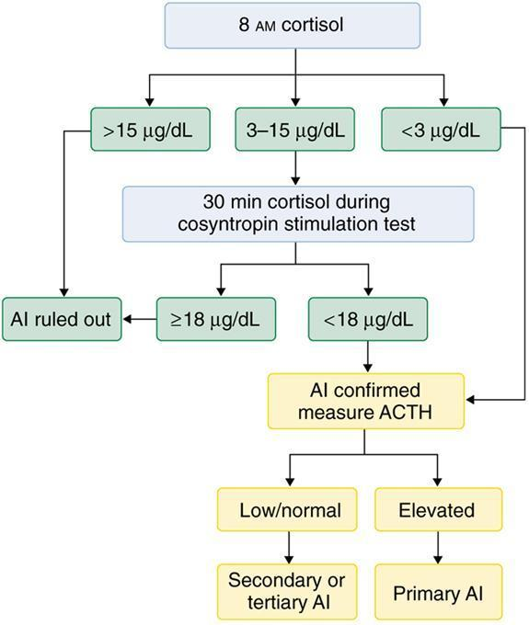
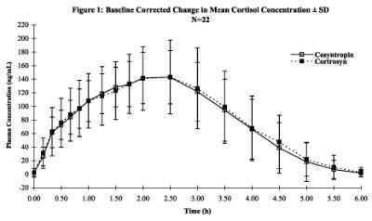
What is a cosyntropin stimulation test? Evaluate adrenal corticosteroid insuff
Rationale: Cosyntropin, (ACTH 1-24), consists of the first 24 amino acids of the N-terminal portion of the intact native ACTH molecule (ACTH 1-36).

Slide 21
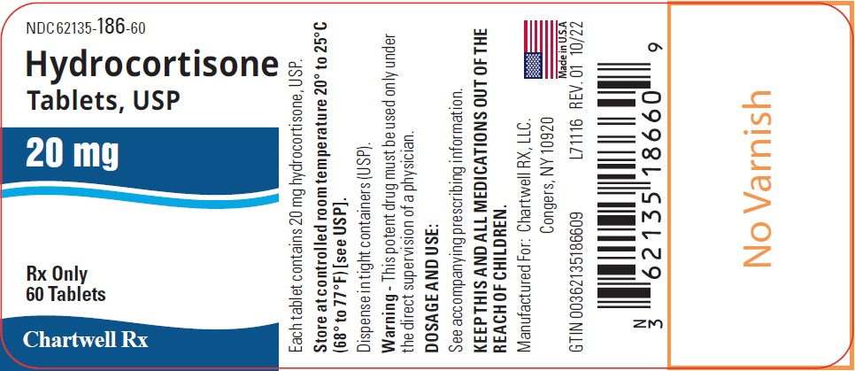
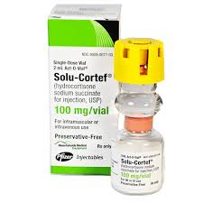
Treatment
PRIMARY ADRENAL INSUFF:
Corticosteroids – Hydrocortisone 10-15 mg am and 5-10 mg late afternoon, Prednisone 5 mg daily , dexamethasone
AND
Mineralocorticoid – Fludrocortisone 0.1 to 0.2 mg daily as entire cortex is destroyed
Sick day advice- doubling of steroids when ill or during emergency
Caution: starting Thyroid hormone therapy prior to replacement of glucocorticoids can precipitate acute adrenal insufficiency and crisis.

Slide 22
Addison's crisis
Acute adrenal crisis is precipitated by
Missed steroid doses/ abrupt steroid withdrawal
Infections/ MI/ surgery etc
Symptoms: Hypotension, Tachycardia, vomiting/ abdominal pain/electrolyte changes( low Na/ High K, low glucose)
Treatment: Immediate..
- IV Fluids- Normal saline till BP is normal
-IV high dose steroids

Slide 23
Secondary Adrenal insufficiency
Commonest cause -
Abrupt withdrawal of exogenous steroids (injections, pills etc)
Pituitary adenoma/ lesions or post surgical/ post radiation
Hypophysitis – inflammation, cancer immunotherapy, post partum etc
Labs – ACTH and cortisol are both low
SECONDARY ADRENAL INSUFF: Only corticosteroid replacement is needed

Slide 24
Do not abruptly stop long term steroids
Withdrawal of Glucocorticoids. The abrupt withdrawal from prolonged use of glucocorticoid drugs like prednisone is the most common cause of AI overall.
Glucocorticoid drugs act like endogenous cortisol to suppress the HPA axis (lower CRH and ACTH secretion). Over time, the low ACTH levels lead to adrenal atrophy and insufficiency (secondary AI), so the gland cannot make cortisol. As long as patients take the glucocorticoid drug, they will appear normal or have signs of hypercortisolism (Cushing syndrome) like moon facies and mood swings. But, if the drug is abruptly stopped, the suppressed ACTH secretion and insufficient adrenal gland cannot produce enough cortisol to maintain body functions, and signs of hypocortisolism can occur, including nausea, vomiting, hypotension, and hypoglycemia.
Steroids are anti-inflammatory.
Creams
Injections
Pills

Slide 25
Cushing syndrome
42 yr woman with DM2 , HTN, complains that she is unable to lose weight in spite of dieting. She has a h/o irregular menses, and is seeing a therapist for depression. She also had an ankle fracture few years ago.
Exam – 150/100, Skin – facial acne, purple striae in abdomen, central abdominal obesity with some fat padding of neck.
Labs- Na/renal function normal , Mild low potassium, A1c 10,
11 pm salivary cortisol high
1 pm low dose dexamethasone suppression test – 2.5 and 4 mcg/dl ( high)
24 h Urine Free Cortisol – 100 mcg/dl ( high)
Bone density is low

Slide 26
What is the difference between Cushing Syndrome and Cushing Disease?
Cushing syndrome is a constellation of symptoms and physical features due to chronic glucocorticoid excess -from any source - pituitary, adrenal, ectopic or exogenous.
Cushing disease – term is used when cortisol excess is due to excess ACTH secretion from a pituitary source.

Slide 27
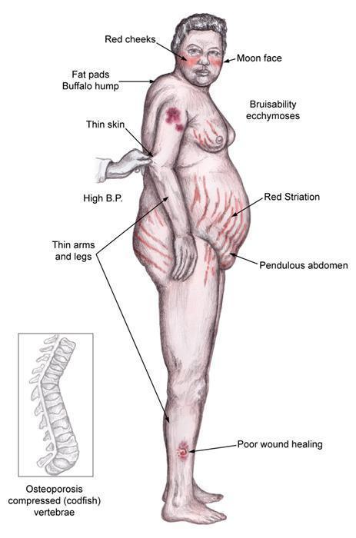
Clinical features of Cushing Syndrome? THE MECHANISMS BEHIND THE CLINICAL FEATURES
Central obesity/ Buffalo hump (90% prevalence)--redistribution of fat
skin changes-
  Atrophy of epidermis and connective tissue leads to skin thinning, easy bruising , purple striae > 1 cm due to bleeding dermal vessels,
  reduced fibroblast activity
  Acne due to excess Cortisol or hyperandrogenism.
  High cortisol reduces immunity - recurrent infections
  High risk of blood clots, MI
Hypertension (85%) esp diastolic due to increased Na/ H20 retention
Proximal muscle weakness (65%) due to loss of muscle mass and body protein
Glucose intolerance or diabetes mellitus (75%) due to insulin resistance
Menstrual irregularities, decreased libido or impotence (70-85%) due to high androgens and cortisol.
Depression or psychosis (85%)
Low bone mass (85%) and Osteoporosis due to excess calcium loss in urine, increased osteoclast / reduced osteoblast action, poor calcium absorption etc
Hirsutism – excess hair growth (75%) due to hypersecretion of adrenal androgens
Reduced linear growth in kids

Slide 28
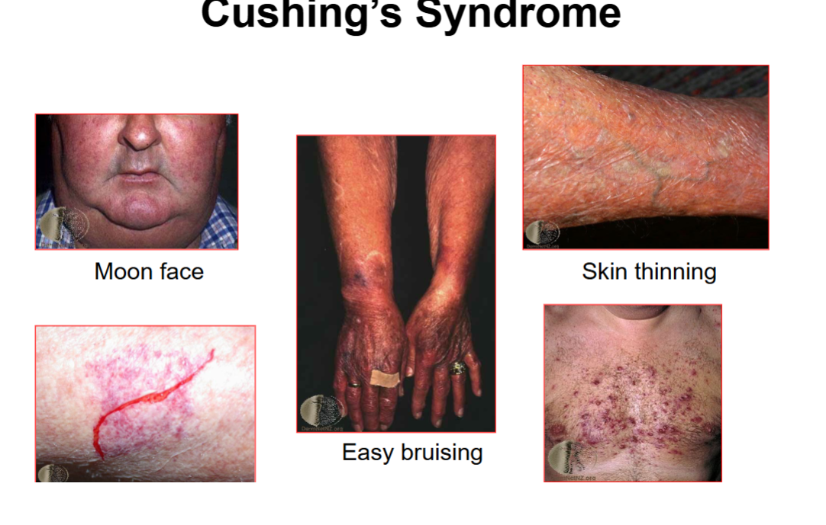

Slide 29
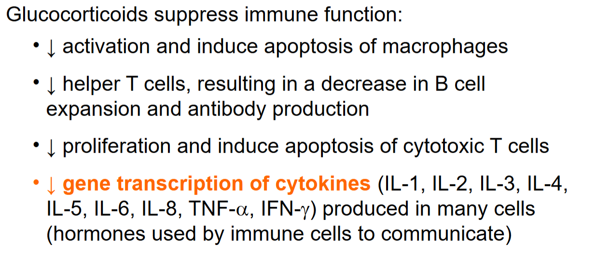

Slide 30
Causes of Cushing syndrome
ACTH-dependent = Pituitary adenoma (Cushing disease 80%) or nonpituitary neoplasm (ectopic ACTH- small cell cancer lung etc)
ACTH-independent = Iatrogenic (glucocorticoid use), Adrenal neoplasm (adenoma, carcinoma), or nodular adrenal hyperplasia
Pseudo- Cushing- Clinically similar to Cushing syndrome , but tests are nonconclusive. It seen in people with chronic alcoholism, depression etc.

Slide 31
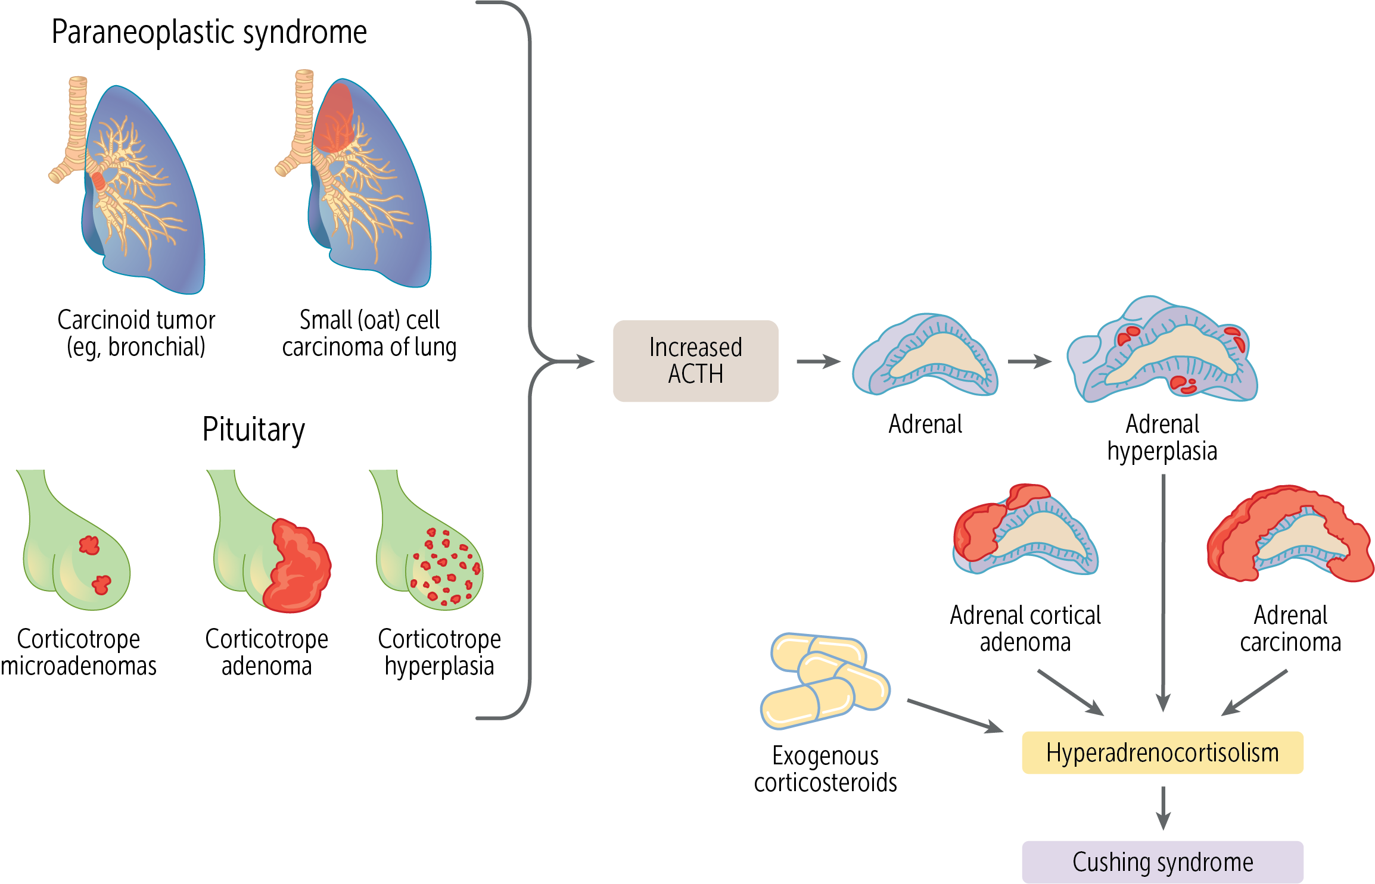

Slide 32
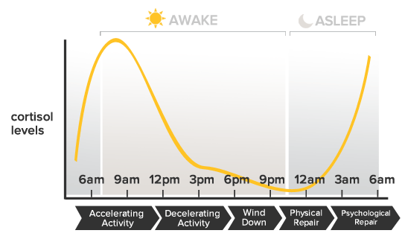
Testing - 3
There are 3 tests that are used for diagnosis. If one test is abnormal, it is recommended to confirm with another test and also to repeat the test
1. Low dose 1 mg dexamethasone suppression test Rationale is that Dexamethasone should suppress plasma cortisol in healthy subjects to less than 1.8 ug/dL following an overnight 1 mg test. Dexamethasone provides negative feedback to the HPA axis, thus blocking production of natural corticoids as the binding of dexamethasone to glucocorticoid receptors in hypothalamus –this inhibits corticotropin-releasing hormone, which blocks ACTH secretion.
2. 24-hr urinary cortisol – A 24 hour urine free cortisol level reflects the cortisol secretion throughout an entire day. .
3. Late night salivary cortisol test – This is one of the most sensitive diagnostic tests for Cushing’s syndrome. Elevated cortisol between 11:00 p.m. and midnight appears to be the earliest detectable abnormality in many patients

Slide 33
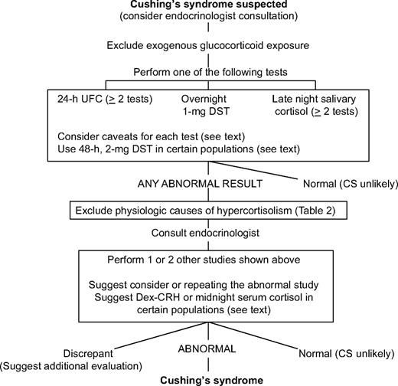
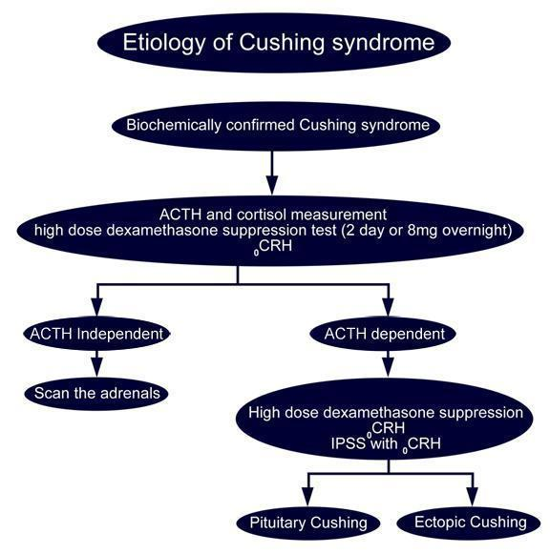
Step 1
Step 2
ACTH-Independent (Adrenals) = ACTH level <5 pg/mL
ACTH-Dependent (ACTH Tumors) = ACTH level > 10 pg/mL . ACTH secreting tumors are not responsive to negative feedback.
Surgical therapy offered first line.

Slide 34
Treatment
Exogenous (iatrogenic) disease is treated by lowering the glucocorticoid dose or removing the drug, if possible. The drug should be tapered off, not stopped abruptly, to avoid acute adrenal insufficiency.
Pituitary adenomas can be surgically resected.
Adrenal adenomas and bilateral adrenal hyperplasia are treated with adrenalectomy, sometimes along with drugs that inhibit the synthesis of cortisol; such medicines include metyrapone, ketoconazole, and mitotane.
Ectopic cancers are located and treated surgically or with chemotherapy, depending on the cancer. Cortisol-reducing drugs can be used in cancer for unresectable metastatic disease.

Slide 35
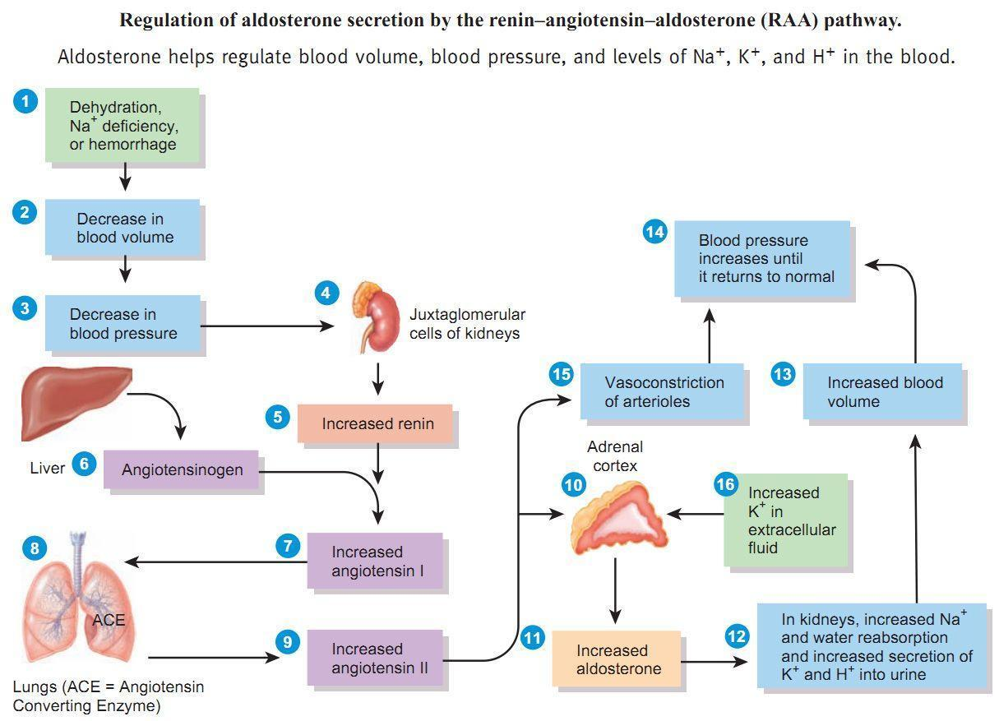
Aldosterone excess-
Primary hyperaldosteronism
Aldosterone producing adenoma
or bilateral hyperplasia
Labs- High aldosterone and Low renin
Difficult to control HTN , hypokalemia
Treatment -
Medical :Spironolactone, eplerenone
( aldosterone receptor antagonist)
Improve myocardial remodeling
Surgical removal after localization
Aldosterone is secreted from the zona glomerulosa under the primary control of angiotensin II, potassium, and corticotropin (ACTH).
The secretion of aldosterone is restricted to the zona glomerulosa because of zonal-specific expression of aldosterone synthase (CYP11B2)
Aldosterone causes the renal tubules to increase the reabsorption of sodium and water into the blood, while at the same time causing the excretion of potassium (to maintain electrolyte balance). This increases the volume of extracellular fluid in the body, which also increases blood pressure.

Slide 36
Adrenal cancer - rare
Usually present with symptoms of excess adrenal androgen precursors- virilization, voice changes, weight loss etc
CT/ PET scan etc
If adrenal biopsy needed – Rule out pheochromocytoma first (make sure catecholamines are negative)
Treatment- Chemotherapy, radiation

Slide 37
Adrenal medulla - Pheochromocytoma
A pheochromocytoma is a rare neuroendocrine tumor of adrenal medulla.
The tachycardia is caused by β₁-adrenergic stimulation.
α₁-Adrenergic–mediated vasoconstriction can cause patients to appear pale (pallor).
The sweating/ flushing - is in response to the increased thermogenesis and vasoconstriction.
Symptoms – Paroxysmal HTN, Tachycardia, sweating, tachycardia, flushing
90% Intra adrenal, 10 % bilateral, 10% metastatic , 10 % extra –adrenal
Labs
24 hour urine catecholamines and metabolites – normetanephrine and metanephrines are increased
Plasma free metanephrines – sensitive test – usually used for screening

Slide 38
Genetics
About 30% to 40% of pheochromocytomas arise from an inherited gene mutation, and another 20% come from a somatic mutation that occurs after birth. Most of these mutations are random, but some happen as part of an inherited syndrome.
The most common distinct inherited syndromes are the multiple endocrine neoplasia 2 (MEN2) syndrome with RET gene mutations, neurofibromatosis type 1 with NF1 mutations, and the Von Hippel-Lindau disease with VHL mutations. Because of these, genetic testing is an important part of the evaluation of people with pheochromocytoma.

Slide 39
Cellular Origins
These epithelial tumors arise from neuroendocrine cells, which are hormone-secreting cells with glandular and neural features. During normal fetal development, neural crest cells migrate to the adrenal medulla and sympathetic chain ganglia near the vertebral column. The adrenal chromaffin cells are derived from a neural crest and normally secrete catecholamines to support BP. Pheochromocytomas arise from these chromaffin cells.
Histology
This neoplasm is composed largely of polygonal/spindle cells arranged in nests within a rich vascular network The nuclei of the cells are oval to round and frequently contain prominent nucleoli. The cytoplasm is red-purple.

Slide 40
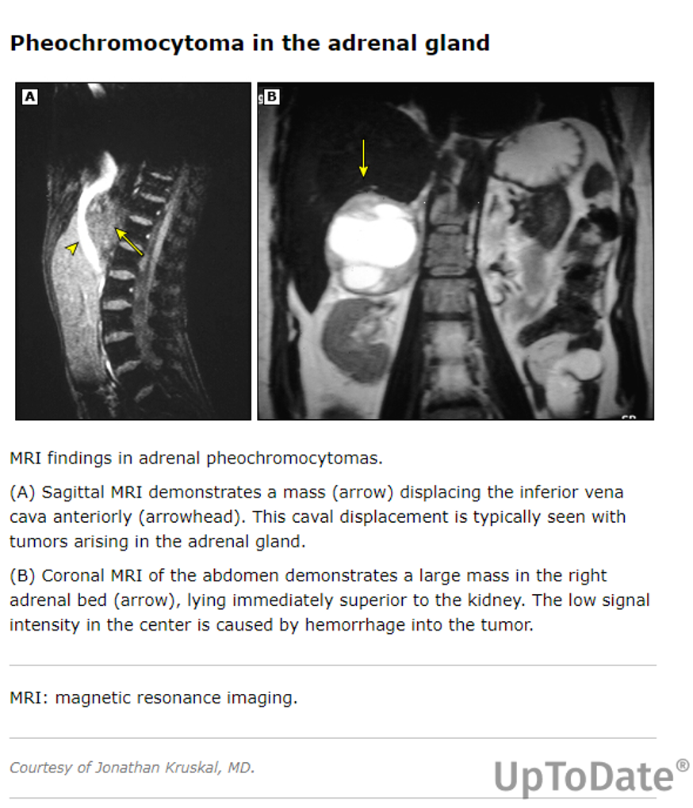
An alpha-adrenergic blocker like phenoxy benzamine , Doxazocin ( selective) followed by beta blocker or calcium channel blockers is given for at least seven days preoperatively to normalize blood pressure and expand the contracted intravascular space.
A minimally invasive approach to the adrenal gland is the procedure of choice

Slide 41
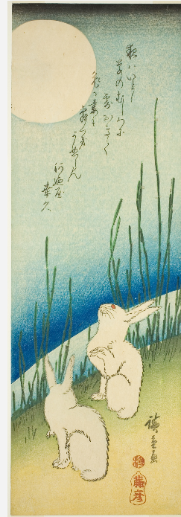
Questions—so far
Rabbits under full moon
Date:
c. 1830s
Artist:
Utagawa Hiroshige 歌川 広重

Slide 42
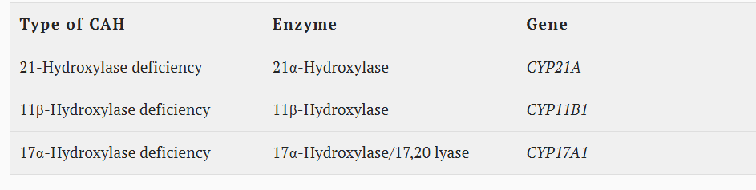
Congenital Adrenal Hyperplasia (CAH) is a group of autosomal recessive genetic disorders that affect the adrenal glands, leading to deficiencies in the production of cortisol

Slide 43
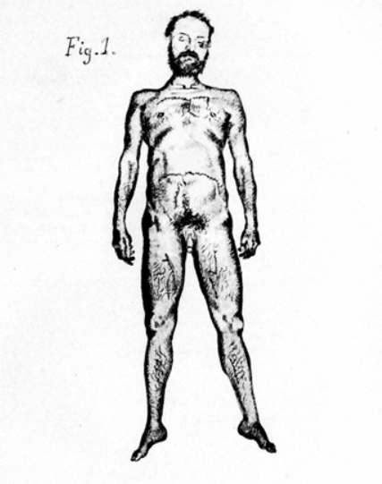
CAH
Publication of Luigi De Crecchio’s classic, Sopra un Caso di Apparenze Virili in una Donna (A Case Report of Masculine Appearance in a Woman) in Il Morgagni. The paper is generally regarded as the first detailed report of congenital adrenal hyperplasia (CAH), describing the autopsy and life of Giuseppe Marzo, who lived as a man but had internal female anatomy and enlarged adrenals, and died in an apparent Addisonian crisis at the age of 44 years.
ENDOCRINOLOGY VOL 156, Issue 4 , April 2015

Slide 44
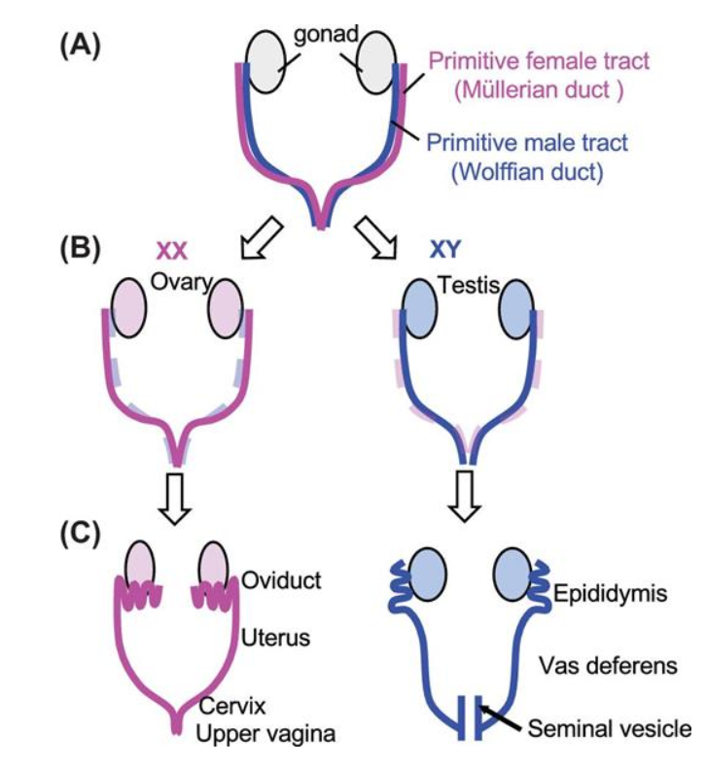
Y chromosome
Fetal testes- Testosterone
Anti Mullerian Factor – regression of Mullerian duct
Biology of Reproduction, Volume 101, Issue 3, September 2019

Slide 45
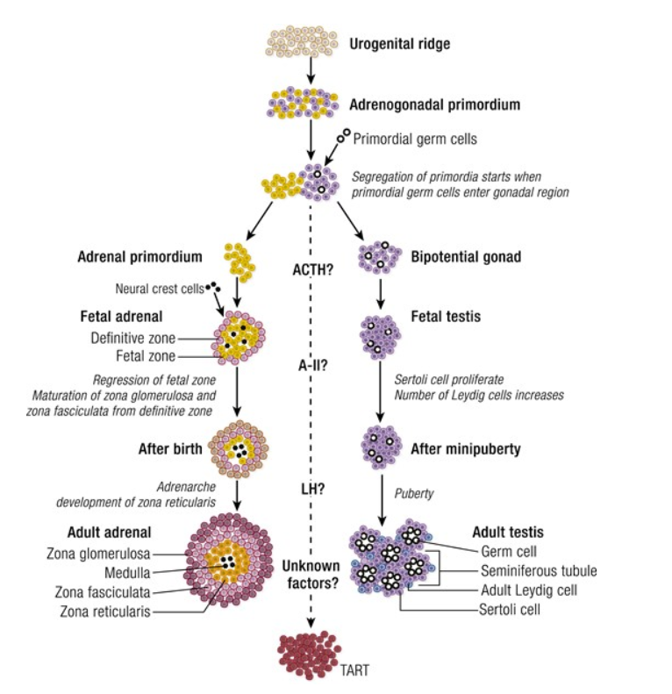
In tandem...
Endocrine reviews Aug 2019 Vol40, issue 4

Slide 46
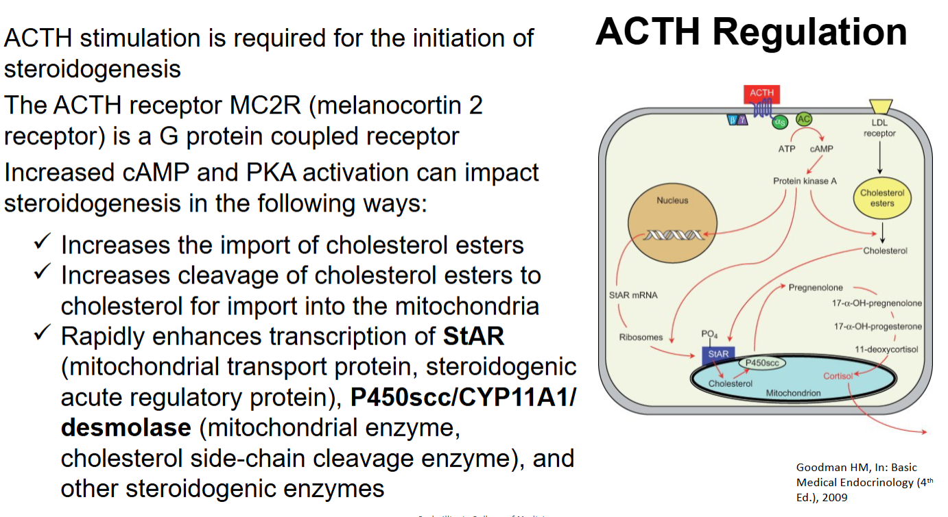

Slide 47
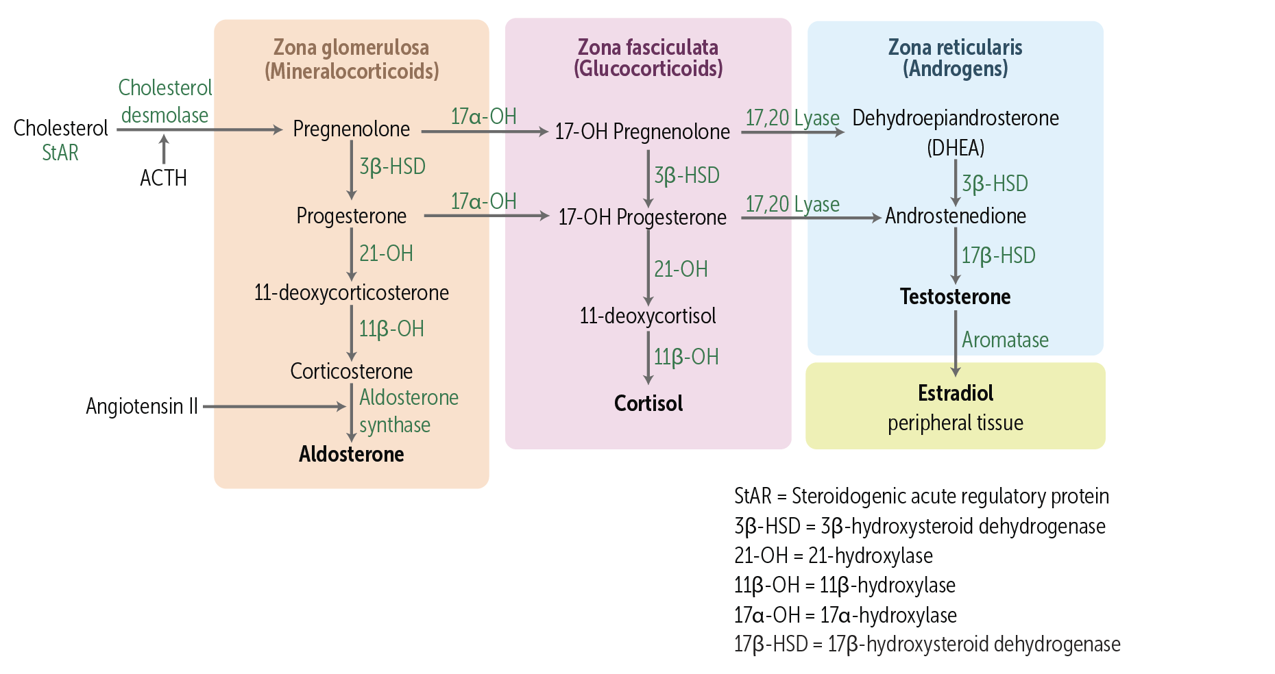
CAH
ACTH stimulation is needed for adrenal steroidogenesis.
---Some of the intermediate precursors like 11-deoxycortisol and androstenedione are active hormones as well. They normally circulate at much lower levels. But in CAH, because of enzymatic blocks, the levels of these precursors can go up in the blood, causing hormonal effects.

Slide 48
21 hydroxylase deficiency
Genetic Basis:
The CYP21A2 gene is located on the short arm of chromosome 6. The most common mechanisms leading to defects in this gene are large deletions and gene conversion, which are exchanges of genetic material between CYP21A2 and its pseudogene, CYP21A1P.
Inheritance Pattern:
Because it's autosomal recessive, parents who are heterozygous (one normal and one mutated CYP21A2 copy) can be carriers and may not exhibit symptoms themselves. When two carriers have a child, there's a 25% chance of the child inheriting two mutated copies and being affected, a 50% chance of inheriting one normal and one mutated copy and being a carrier, and a 25% chance of inheriting two normal copies and being unaffected.
Clinical Significance:
The amount of functional 21-hydroxylase enzyme determines the severity of the disorder. In salt-wasting CAH, the deficiency of aldosterone leads to sodium loss and dehydration, while in simple virilizing CAH, cortisol deficiency leads to androgen excess.
Diagnosis:
Very high 17-OHP levels in the blood are a key diagnostic tool, with high levels indicating a potential diagnosis of 21-hydroxylase deficiency. However, comprehensive CYP21A2 genotyping remains the gold standard for confirmation.

Slide 49
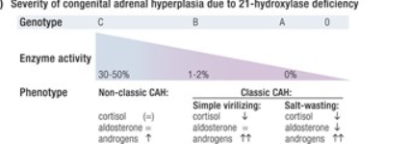
Endocrine reviews Aug 2019, Vol 40 issue 4

Slide 50
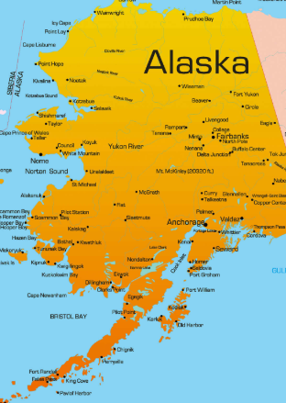
21 hydroxylase deficiency
Newborn screening programs that test for 17-hydroxyprogesterone levels, which are elevated in CAH
Incidence of 21 hydroxylase def - Commonest
Classic (salt wasting) 1 in 15,000
Non classic/ Simple virilizing 1 in 1000
The "salt-wasting" form of the disorder (most severe) is most often associated with large deletions or mutations that result in no enzyme activity. Seventy-five percent of patients with classic 21OHD have this form.
●Twenty-five percent of patients with classic 21OHD have the "simple-virilizing" form (less severe) with low but detectable enzyme activity (1 to 2 percent) that supports some aldosterone production. This form most commonly results from point mutations leading to nonconservative amino acid substitutions such as Ile172Asp. A mutation in intron 2 that variably impairs splicing (g.A/C656G) manifests with a range of classic 21OHD phenotypes.
●Individuals with the nonclassic form (least severe) retain 5 to 20 percent of normal enzymatic activity
Nonclassic 21OHD may present as early pubarche or sexual precocity in school-age children, hirsutism and menstrual irregularity in young women, or there may be no symptoms.

Slide 51
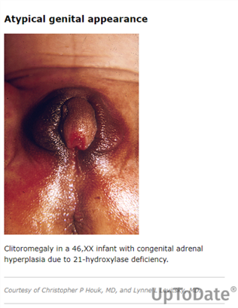
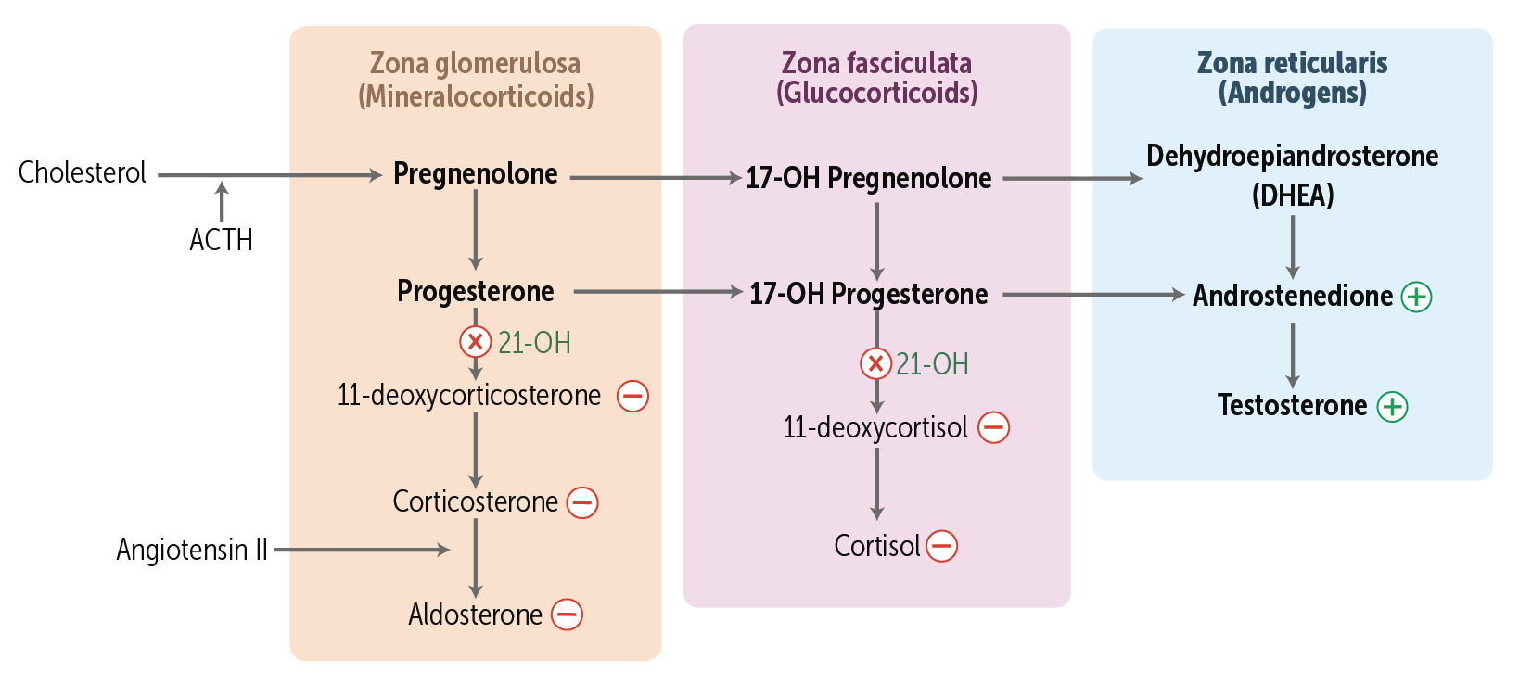
21 hydroxylase def

Slide 52
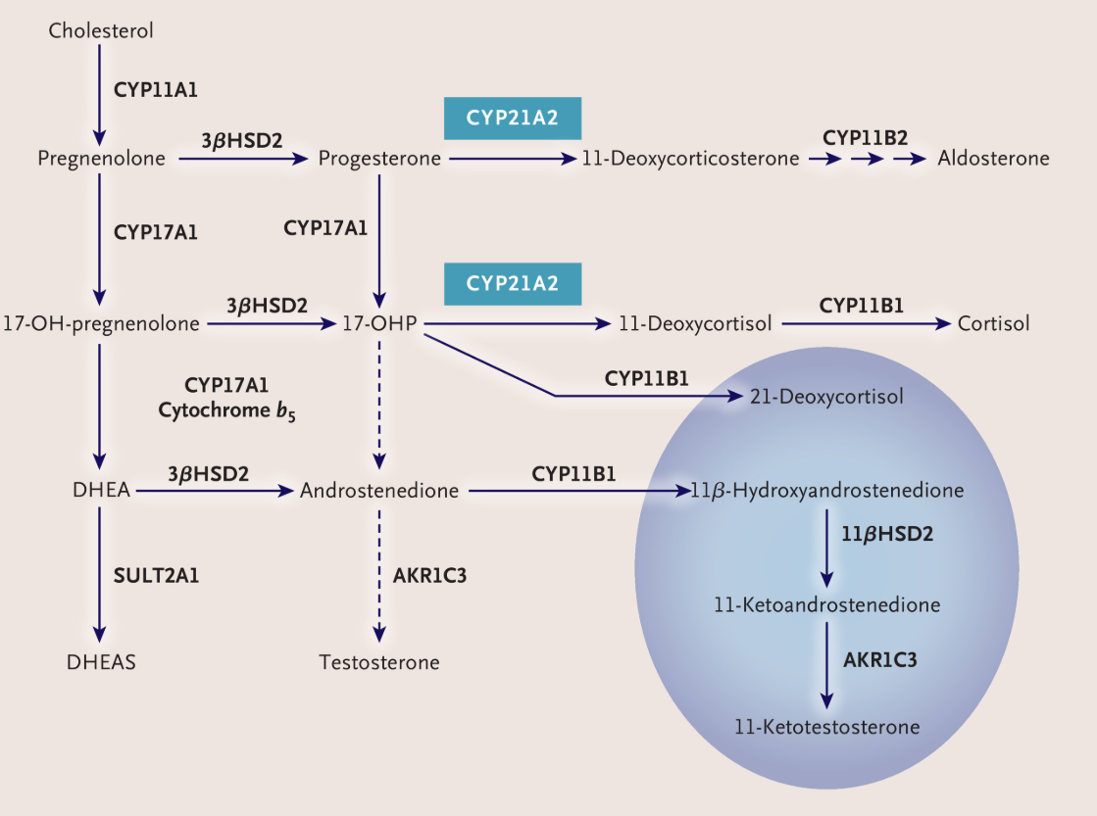
September 23, 2020
N Engl J Med 2020;383:1248-1261

Slide 53
Clinical presentation
46,XX infants with classic 21OHD are typically born with atypical genitalia characterized by clitoral enlargement , labial fusion, and formation of a urogenital sinus
Males – 46,XY infants with classic CAH have normal-appearing genitalia at birth but may have subtle findings such as hyperpigmentation of the scrotum or an enlarged phallus.
Males with the salt-wasting form who are not identified by neonatal screening may present with failure to thrive, dehydration, hyponatremia, hypoglycemia and hyperkalemia typically at 7 to 14 days of life (Adrenal crisis)
Adults in both – present with early puberty, short stature, fertility issues. Adult male can have testicular adrenal rest tumors

Slide 54
CAH treatment
Glucocorticoid therapy – In adults with classic 21OHD, glucocorticoid therapy is required to treat cortisol deficiency, optimize reproductive function and, in females, minimize hyperandrogenic symptoms. Hydrocortisone therapy often achieves these goals and imparts lower risk of long-term complications than longer-acting glucocorticoids.
•Mineralocorticoid therapy – Fludrocortisone therapy is needed to treat mineralocorticoid deficiency
As with any form of adrenal insufficiency, patients with classic 21OHD should be provided with sick-day rules for stress dosing, medical alert identification, and injectable hydrocortisone sodium succinate (or other injectable glucocorticoid) for emergencies . At each visit, we verify that patients always wear or carry a medical alert identifier and have an unexpired emergency glucocorticoid injection kit.
●Glucocorticoid dose adjustment during acute stress – An increase in glucocorticoid dose is critical during acute physiologic stress including illness or surgery.

Slide 55
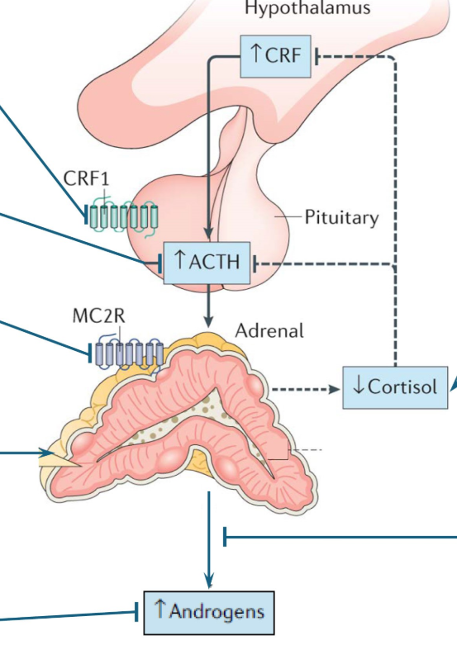
Crinicerfont – To suppress CRF and then ACTH.
Given with steroids

Slide 56
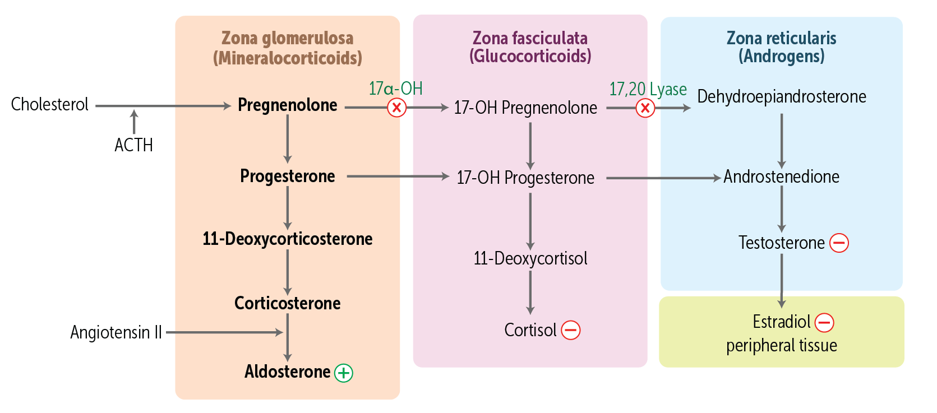
Other CAH
The hallmarks of 17OHD, include hypertension and hypokalemia due to the accumulation of cortisol precursors with mineralocorticoid activity upstream of the block, plus sexual infantilism due to inability to synthesize androgens and estrogens.
Clinical presentation — The classic presentation of severe 17OHD in phenotypic females (who can have 46,XX or 46,XY karyotype) includes :
●Hypertension- early adulthood, severe.
●Primary amenorrhea
●Absence of secondary sexual characteristics
( XY Males – out 1/3 vaginal pouch, XX female –rudeimentary uterus, cervix and upper part vagina)
CYP17A1 gene codes for both 17 a hydroxylase and 17,20 lyase

Slide 57
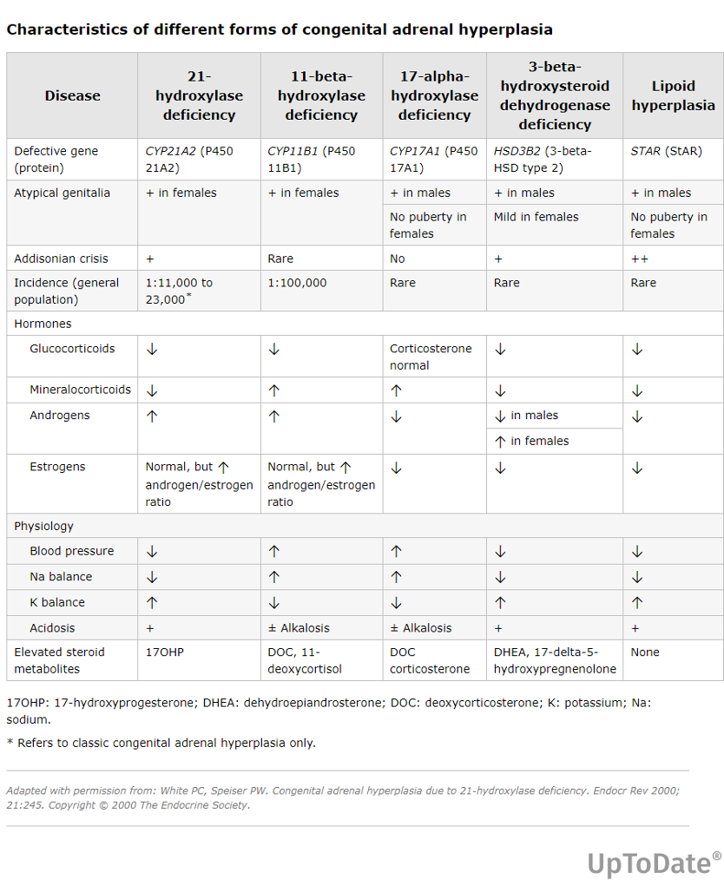

Slide 58
17-hydroxylase deficiency | ↑ DOC, corticosterone ↓ 17OH-steroids, cortisol ↓ aldosterone ↓ androgens and estrogens | Atypical genitalia or infantilism Autosomal recessive | CYP17A1
11-beta-hydroxylase deficiency | ↑ DOC, 11-deoxycortisol ↓ corticosterone, cortisol ↓ aldosterone ↑ androgens | HTN Androgen excess Autosomal recessive | CYP11B1

Slide 59
CAH
ACTH stimulation is needed for adrenal steroidogenesis.
---Some of the intermediate precursors like 11-deoxycortisol and androstenedione are active hormones as well. They normally circulate at much lower levels. But in CAH, because of enzymatic blocks, the levels of these precursors can go up in the blood, causing hormonal effects.

Slide 60
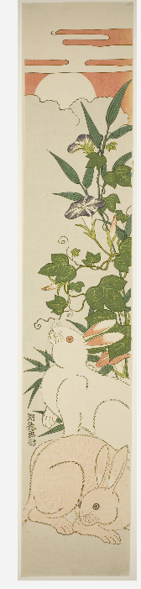
Thank you
References
Scholar rx, uptodate, earlier lectures
Morning-Glories, Rabbits, and Moon
Date:
c. 1920
Artist:
After Isoda Koryusai
Japanese, 1735-1790

