Slide 1
Diabetes Mellitus
Sathya Subbiah, MD

Slide 2
Objectives
Explain the histology and function of the islets of Langerhans.2
Explain insulin and glucagon synthesis and sites of production.3
Explain the physiologic actions of insulin and glucagon.4
Explain the regulation of insulin and glucagon release.
Identify insulin target tissues and relevant physiological effects of insulin secretion
Understand the etiology and risk factors for type 1 and type 2 diabetes
Describe the pathophysiology and symptoms of type 1 and type 2 diabetes
Describe the mechanistic basis for changes in vital signs and electrolytes in patients with DKA
Discuss the acute management of DKA and potential complications associated with treatment
Define normoglycemia and outline the diagnostic criteria for diabetes
Describe hyperosmolar hyperglycemic state (HHS)
Discuss the long-term management and treatment of type 1 and type 2 diabetes and it's complications

Slide 3
Pancreas
- Exocrine 80%
- Endocrine - Dysfunction causes disturbance in nutrient homeostasis
- The pancreas has tiny glands called islets of Langerhans, which
secrete hormones.
- Alpha cells- Glucagon
- Beta cells- Insulin and its precursors
- Delta cell- somatostatin
- Epsilon cell- ghrelin ( predominantly Ghrelin is produced from stomach)
- PP cells- pancreatic polypeptide

Slide 4
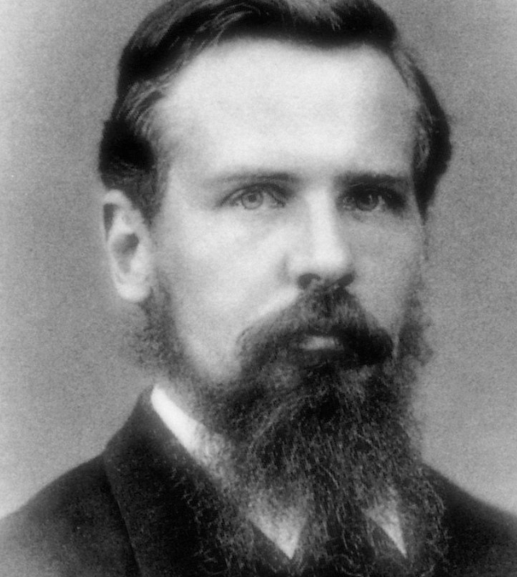
He identified nine different cell types: one in particular greatly fascinated him. It was a “small, irregularly polygonal structure. Its cytoplasm is brilliant and free of any granules. Its nucleus distinct, round and moderate size…these cells lie together generally in considerable numbers, diffusely scattered” throughout the pancreas.--Royal Canadian Institute for Science

Slide 5
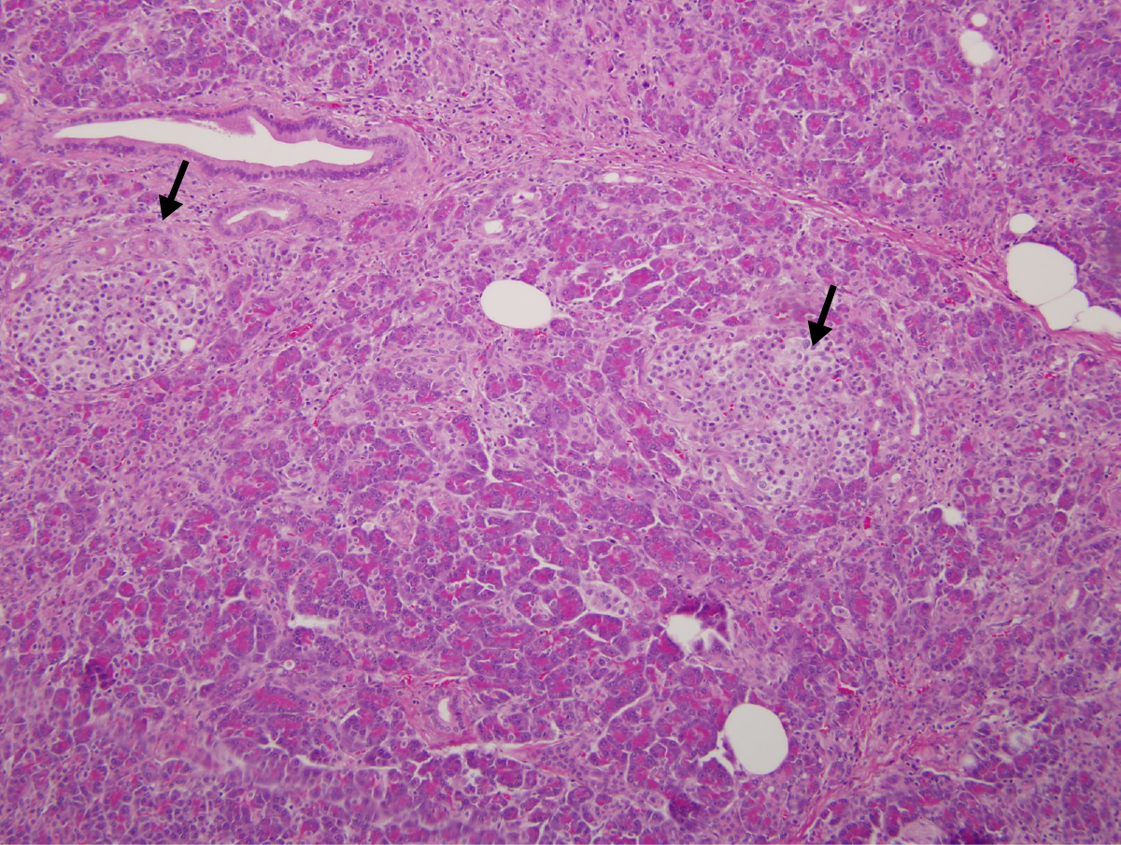
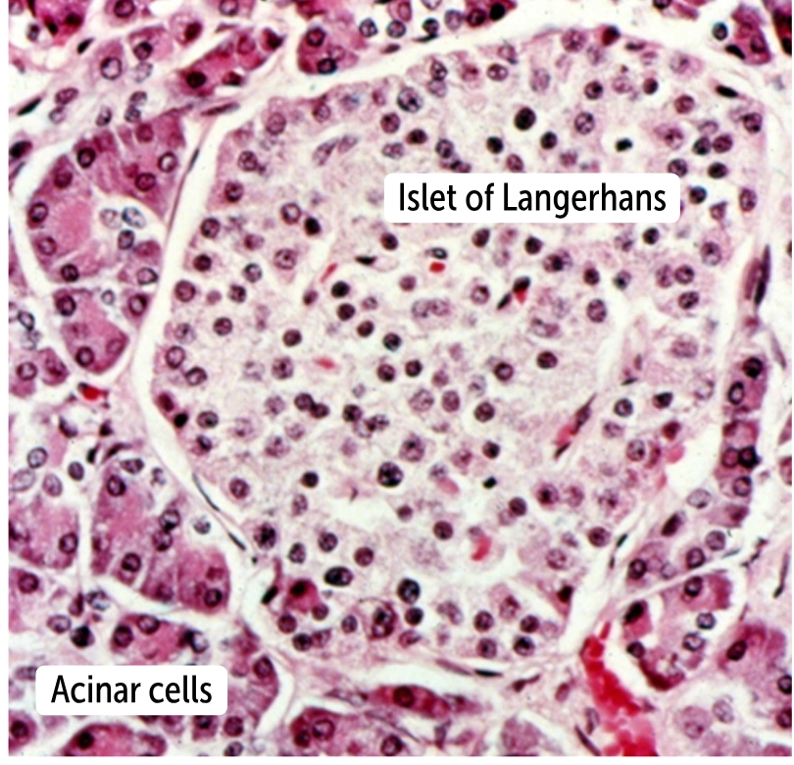

Slide 6
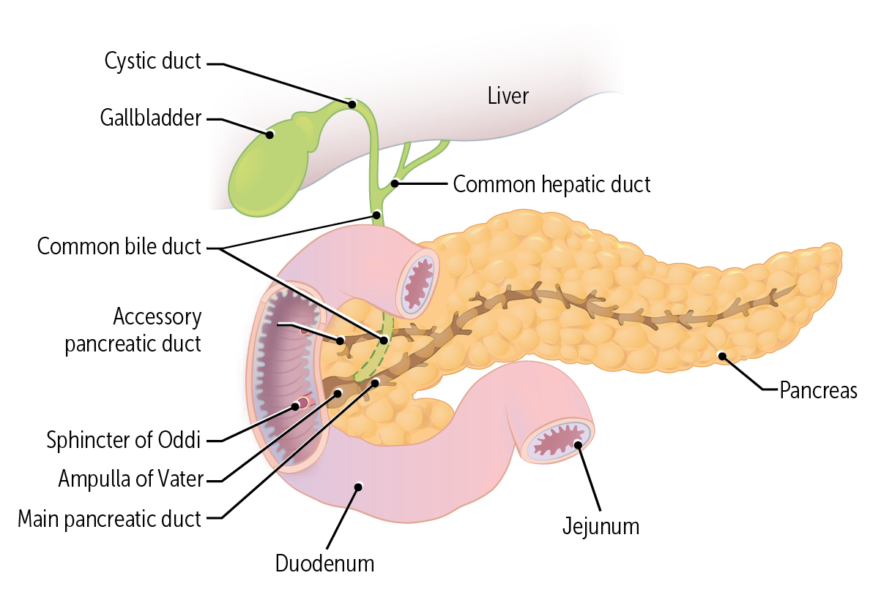
Insulin release is stimulated by parasympathetic stimulation.
Glucagon release is stimulated by sympathetic activation.

Slide 7
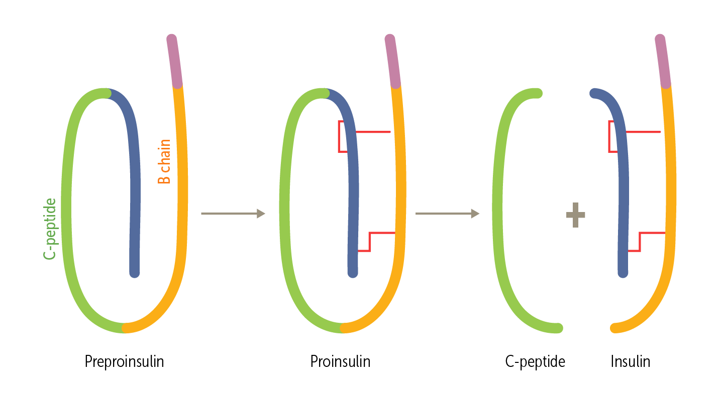
Insulin is a peptide hormone
Preproinsulin is cleaved to form proinsulin, which is broken into insulin + C peptide in equimolar amounts
Secretion :Human pancreas makes about 30 units/day.
Basal=10 units, constantly made in tiny amount. ​
Why? Insulin is an anabolic hormone- necessary for life. ​
​
Prandial- rest is produced after meal ingestion. Glucose is the most potent stimulator. ​
​

Slide 8
Insulin – Anabolic hormone
The normal fasting glucose level is 60 to 100 mg/dL. Maintaining this normal level is important
After a glucose load, the level of blood glucose increases. The excess glucose signals the endocrine pancreas to secrete insulin, which promotes glucose storage in the liver and muscles. This stored glycogen is the primary short-term storage form of glucose.
When the liver is saturated with glycogen, any additional glucose taken up by hepatocytes is instead converted to fatty acids, which enter the blood as lipoproteins. These can provide free fatty acids for adipocytes. The adipocytes are stimulated by insulin to take up glucose and convert it to glycerol. In the adipocyte, this glycerol combines with the free fatty acid to make triglycerides, stored in the adipocyte for future energy use. So insulin leads to storage: liver glycogen and adipocyte triglycerides.

Slide 9
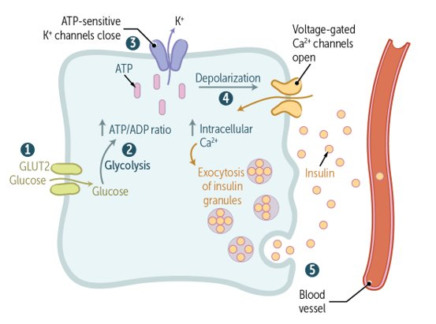
Insulin secretion
Glut 2 for glucose sensing at pancreas.
Glut 4 for glucose uptake in fat and muscle.

Slide 10
Hormone Transport and Receptor Binding
After synthesis in the islet cells as water-soluble peptide hormones, both insulin and glucagon travel unbound in the circulation to their target cells. Three primary actions occur next:
Insulin stimulates glucose uptake into cells.
Glucose Uptake. Insulin is a storage hormone that facilitates the conversion of glucose to glycogen, fat, and other storable substances. To do this, insulin binds to target cells by using the insulin receptor, a receptor tyrosine kinase

Slide 11
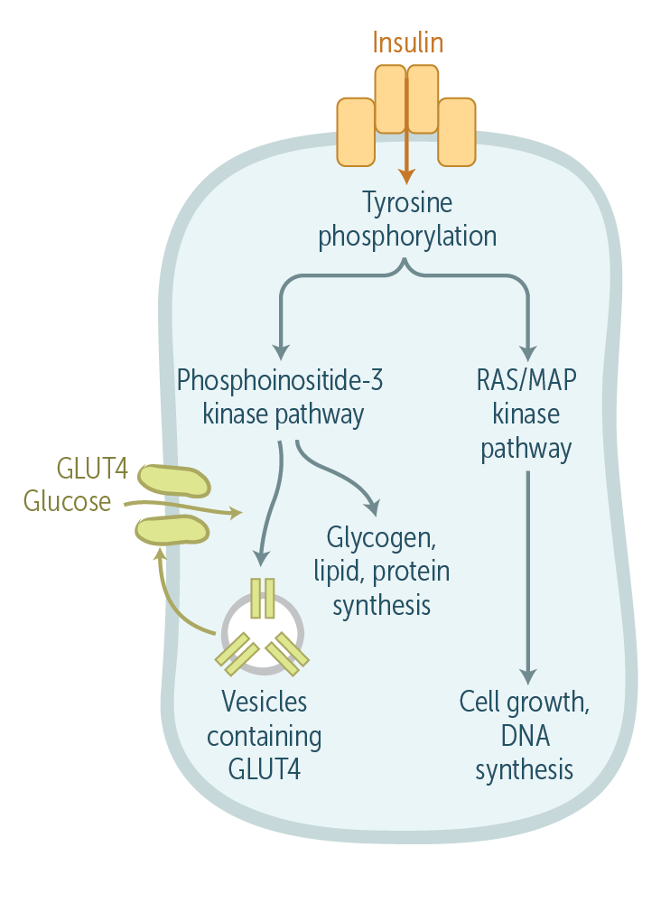
Glucose uptake
Autophosphorylation of tyrosine residues starts the signaling pathway, which ends with glucose transporter type 4 (GLUT4) moving to the cell membrane. This allows glucose to enter the cell by using facilitated diffusion down its concentration gradient. (Intracellular glucose levels are very low, since glucose is quickly metabolized). This pathway stimulates the formation of glycogen, lipids, and proteins in multiple cell types. Separately, another insulin-dependent pathway, the mitogen-activated protein (MAP) kinase pathway, promotes cell growth and DNA synthesis.

Slide 12
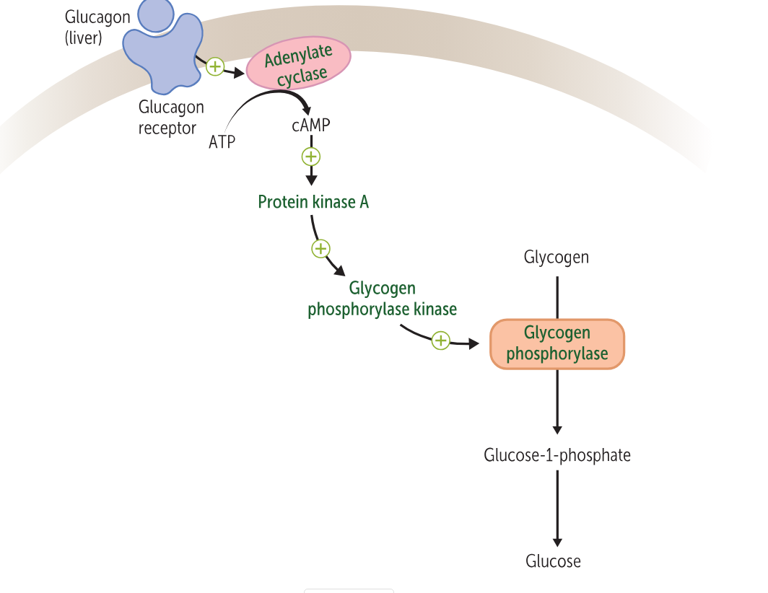
Glucagon is catabolic
Glucagon stimulates glycogenolysis.
Glucagon stimulates gluconeogenesis – production of glucose from non carbohydrates.
Glycogenolysis. Opposing the function of insulin, glucagon performs glycogenolysis—the breakdown of stored glycogen to provide glucose (and energy). This mainly occurs in the liver, where glucagon receptors are dense.

Slide 13
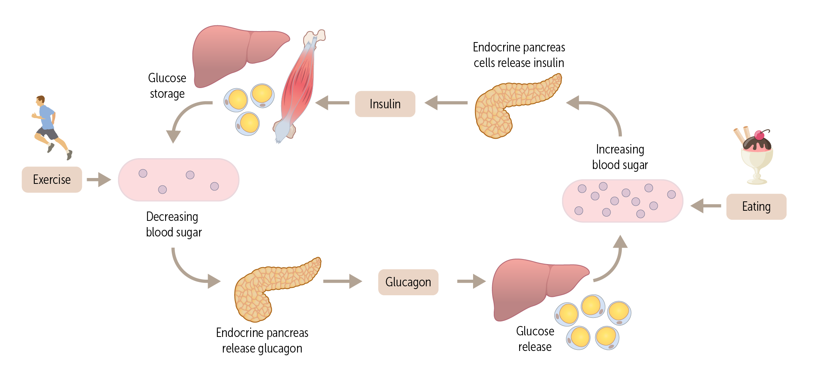
How do insulin and glucagon act together?

Slide 14
Diabetes Mellitus
Diabetes mellitus is a group of metabolic disorders of carbohydrate(fuel) metabolism in which glucose is both underutilized as an energy source and overproduced due to inappropriate gluconeogenesis and glycogenolysis, resulting in hyperglycemia
Dx in non pregnant adults
A1C ≥6.5%
OR
FPG ≥126 mg/dL . Fasting is defined as no caloric intake for at least 8 h.*
OR
2-h PG ≥200 mg/dL during OGTT. The test should be performed as described by the WHO, using a glucose load containing the equivalent of 75 g anhydrous glucose dissolved in water.*
OR
In an individual with classic symptoms of hyperglycemia or hyperglycemic crisis, a random plasma glucose ≥200 mg/dL (≥11.1 mmol/L). Random is any time of the day without regard to time since previous meal.

Slide 15
Total: 38.4 million people have diabetes (11.6% of the U.S. population)
Diagnosed: 29.7 million people, including 29.4 million adults
Undiagnosed: 8.7 million people (22.8% of adults with diabetes are undiagnosed)

Slide 16
Pre DM
A1C 5.7–6.4%
OR
FPG 100 mg/dL to 125 mg/dL (IFG)
OR
2-h PG during 75-g OGTT 140 mg/dL to 199 mg/dL (IGT)
Prediabetes is associated with heightened cardiovascular risk; therefore, screening for and treatment of modifiable risk factors—lipids, smoking cessation for cardiovascular disease are suggested.

Slide 17
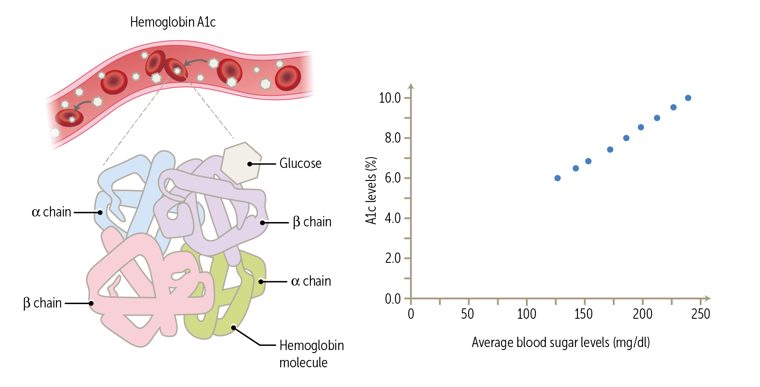
GLYCATION of Hb
Glycation of protein and lipids--- Advanced Glycation Endproducts.
AGE
Increase viscosity
Increase free radical damage to endothelium and vascular smooth muscle

Slide 18
Glycohemoglobin A1c
A1C reflects glucose bound to hemoglobin over the life span of the erythrocyte (∼120 days) and is thus a “weighted” average that is more heavily affected by recent blood glucose exposure.
A1C is an indirect measure of glucose exposure, and factors that affect hemoglobin concentrations or erythrocyte turnover can affect A1C (e.g., thalassemia or folate deficiency) . anemia, people treated with erythropoietin, or hemodialysis or HIV treatment
A1C (%) | mg/dL* | mmol/L
5 | 97 (76–120) | 5.4 (4.2–6.7)
6 | 126 (100–152) | 7.0 (5.5–8.5)
7 | 154 (123–185) | 8.6 (6.8–10.3)
8 | 183 (147–217) | 10.2 (8.1–12.1)
9 | 212 (170–249) | 11.8 (9.4–13.9)
10 | 240 (193–282) | 13.4 (10.7–15.7)
11 | 269 (217–314) | 14.9 (12.0–17.5)
12 | 298 (240–347) | 16.5 (13.3–19.3)
A1C | <7.0% (<53 mmol/mol)*†
Preprandial capillary plasma glucose | 80–130 mg/dL* (4.4–7.2 mmol/L)
Peak postprandial capillary plasma glucose‡ | <180 mg/dL* (<10.0 mmol/L)

Slide 19
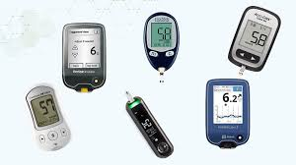

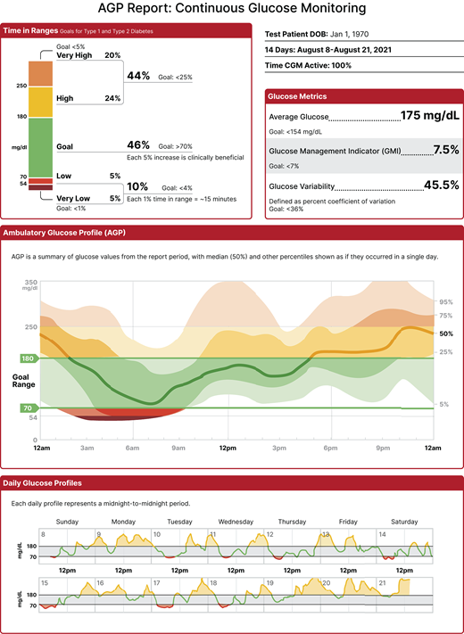
Monitoring
Using fingerstick blood glucose -
Using continuous glucose monitoring ( sensor)
CGM measures interstitial glucose which correlates well with plasma glucose
mean CGM glucose, correlates with A1C
TIME IN RANGE 70% ( SUGARS between 70-180) -- correlates with a1c of 7 approx
Time below range (<70 and <54 mg/dL and time above range (>180 mg/d])
are useful parameters

Slide 20
The Diabetes Control and Complications Trial (DCCT) , a prospective randomized controlled trial of intensive (mean A1C ∼7% [∼53 mmol/mol]) versus standard (mean A1C ∼9% [∼75 mmol/mol]) glycemic management in people with type 1 diabetes, showed definitively that better glycemic status is associated with 50–76% reductions in rates of development and progression of microvascular complications (retinopathy, neuropathy, and diabetic kidney disease)

Slide 21
Classification
1. Type 1 diabetes (due to autoimmune β-cell destruction, usually leading to absolute insulin deficiency, including latent autoimmune diabetes in adults)
2. Type 2 diabetes (due to a nonautoimmune progressive loss of adequate β-cell insulin secretion, frequently on the background of insulin resistance)
3. Specific types of diabetes due to other causes, e.g., monogenic diabetes syndromes, diseases of the exocrine pancreas, and drug- or chemical-induced diabetes
4. Gestational diabetes mellitus (diabetes diagnosed in the second or third trimester of pregnancy that was not clearly overt diabetes prior to gestation or other types of diabetes occurring throughout pregnancy, such as type 1 diabetes).
AABBCC approach: Age (e.g., for individuals <35 years old, consider type 1 diabetes); Autoimmunity (e.g., personal or family history of autoimmune disease or polyglandular autoimmune syndromes); Body habitus (e.g., BMI <25 kg/m); Background (e.g., family history of type 1 diabetes); Control (preferred term is “goal,” i.e., the inability to achieve glycemic goals on noninsulin therapies); and Comorbidities (e.g., treatment with immune checkpoint inhibitors for cancer can cause acute autoimmune type 1 diabetes)
Loss of pancreas tissue- pancreatitis, surgery etc – use insulin for therapy

Slide 22
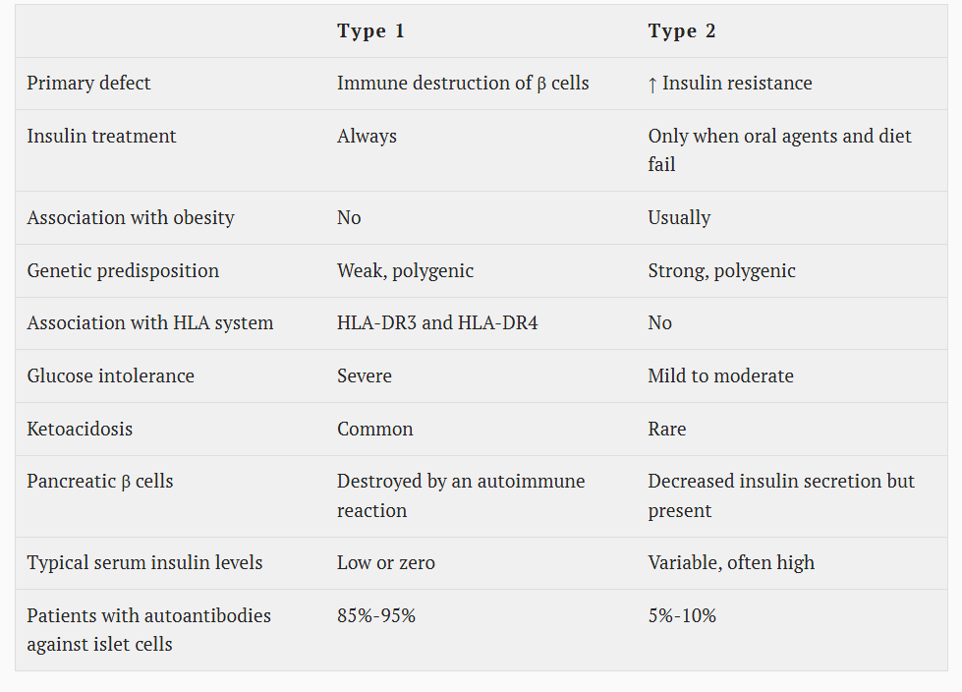

Slide 23
Autoimmunity in type 1
Type 1 diabetes is immune- related in 95% of diabetes and is caused by autoimmune destruction of the pancreatic β-cells. Highest incidence in Scandinavians / Northern European descent.
Autoimmune markers include islet cell autoantibodies and autoantibodies to glutamic acid decarboxylase (GAD) (such as GAD65- seen in 75%), insulin, the tyrosine phosphatases islet antigen 2 (IA-2) and IA-2b, and zinc transporter 8 (ZnT8).
Cromosome 6 short arm- The disease has strong HLA associations, with linkage to the DQB1 and DRB1 haplotypes, and genetic screening has been used in some research studies to identify high-risk populations. Specific alleles in these genes can be either predisposing (e.g., DRB1*0301-DQB1*0201 [DR3-DQ2] and DRB1*0401-DQB1*0302 [DR4-DQ8])
Type 1 diabetes can be associated with polyglandular autoimmune syndromes-Hashimoto thyroiditis, Graves disease, celiac disease, Addison disease, vitiligo, autoimmune hepatitis, myasthenia gravis, and pernicious anemia

Slide 24
Genetics
Family members of type 1 diabetes have an increased lifetime risk of developing type 1
Offspring of mother - risk of 3%
Offspring a father - risk of 6%
Monozygotic twin studies show environmental factors Play a role - 50% genetic / 50% Environmental factors.

Slide 25
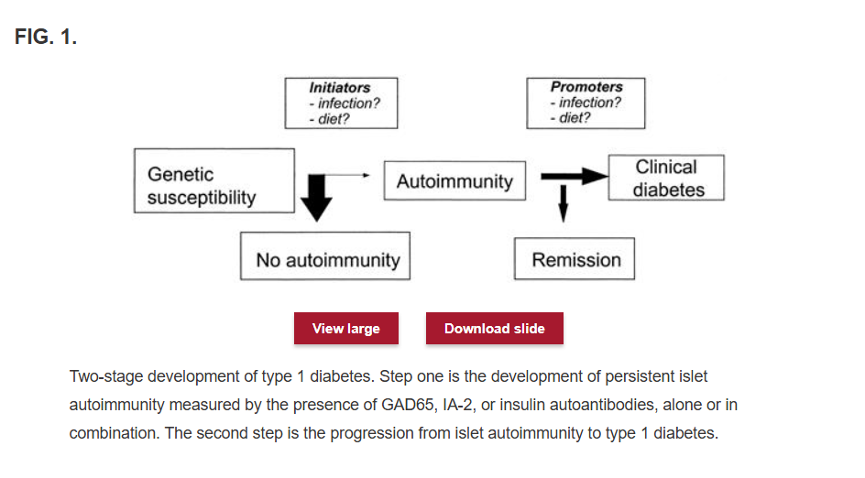
Diabetes 2005 Vol 54

Slide 26
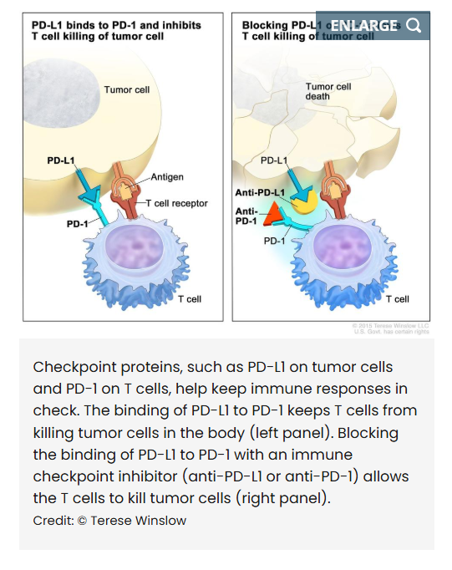
CIADM
Introduction of immunotherapy, specifically checkpoint inhibitors, most commonly occurs with agents that block the programmed cell death protein 1/programmed cell death ligand 1 pathway for cancer treatment has led to unexpected adverse events, including immune system activation precipitating autoimmune disease.
Incidence 1%
Fulminant onset of type 1 diabetes can occur, with DKA and low or undetectable levels of C-peptide as a marker of endogenous β-cell function

Slide 27
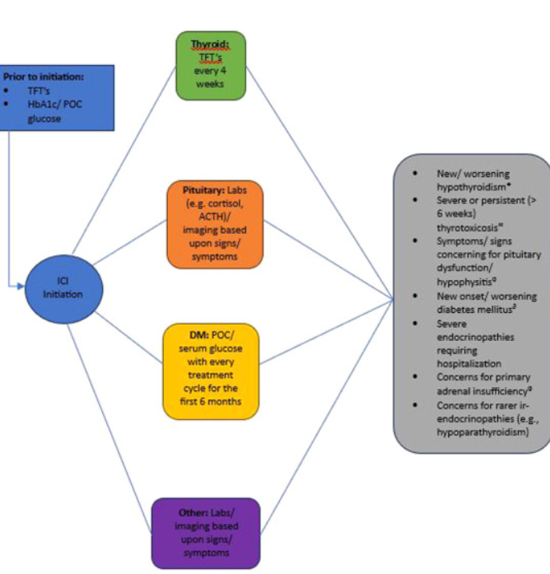
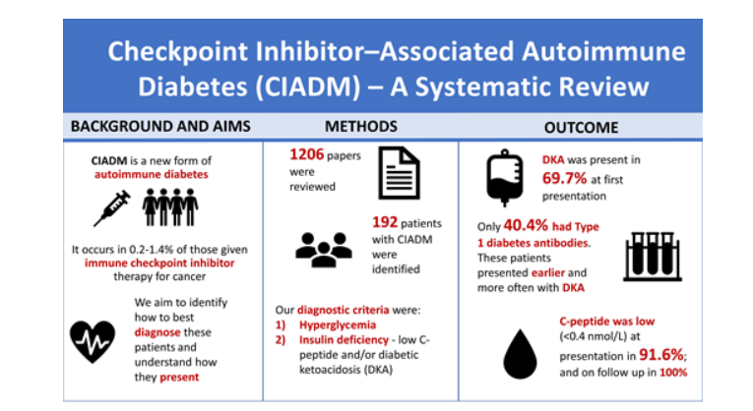
Diabetes care Vol 46: Issue 6
Endocrine practice, Vol 30:issue 6

Slide 28

Hamen y León, Juan van der
Madrid, 1596 - Madrid, 1631
See author's file
Still Life with Sweetmeats and Glass Vessels

Slide 29
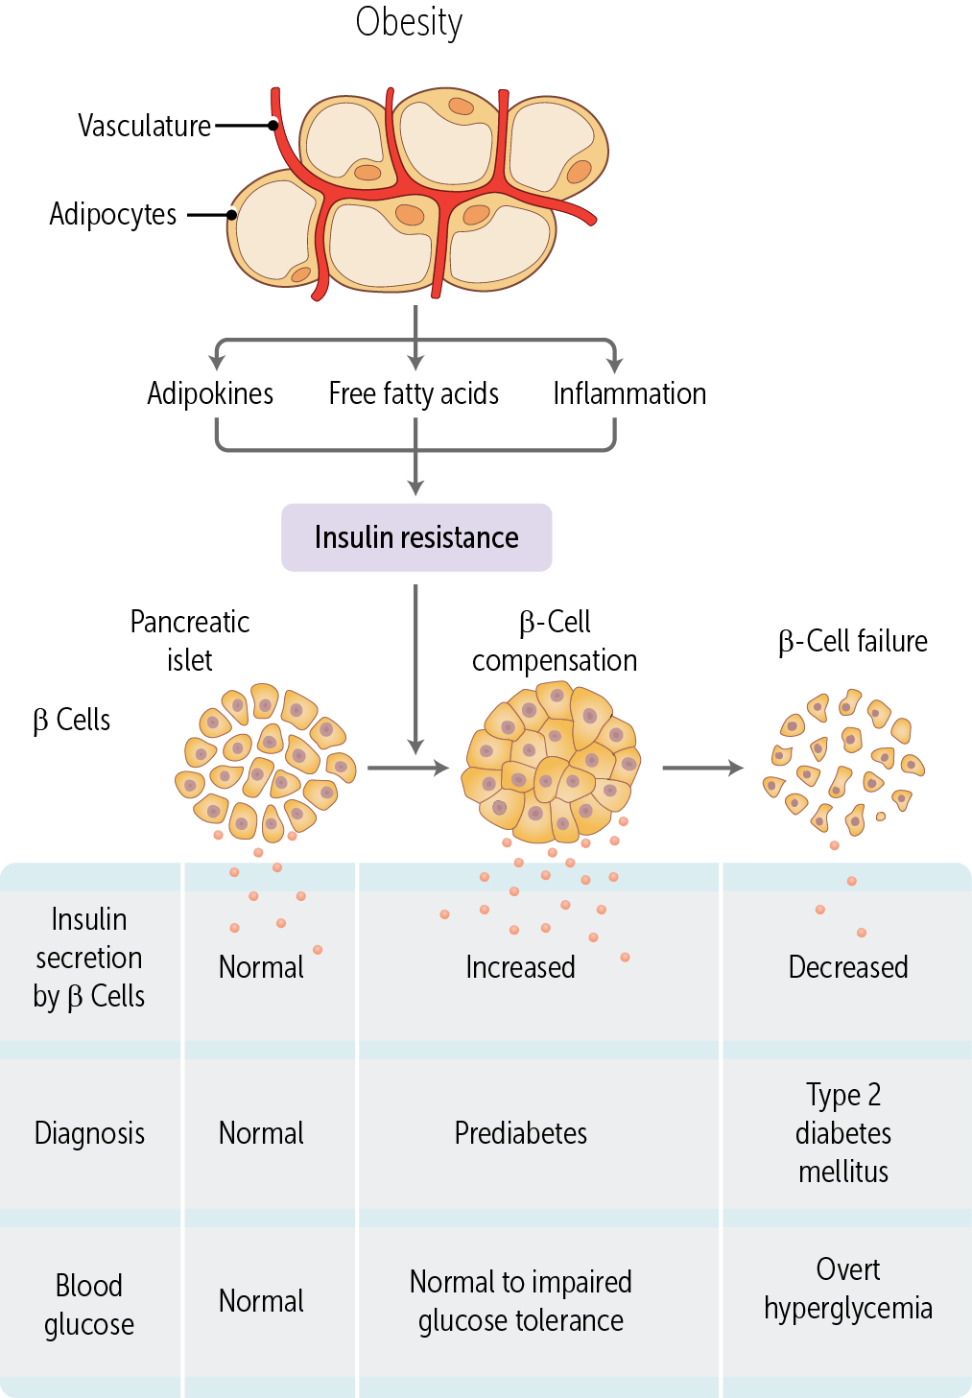
Type 2 diabetes accounts for 90–95% of all diabetes. This form encompasses individuals who generally have relative (rather than absolute) insulin deficiency and have insulin resistance (i.e., decreased biological responses to insulin like glucose uptake into skeletal muscle).
60-80% of individuals with type 2 diabetes are obese (BMI >30)
Abdominal/visceral fat accumulation is tightly correlated with insulin resistance
Insulin resistance initially leads to a hyperinsulinemia state to compensate.
Lack of the ability for the pancreas to compensate (beta cell exhaustion)
leads to diagnosis of type 2 diabetes.

Slide 30
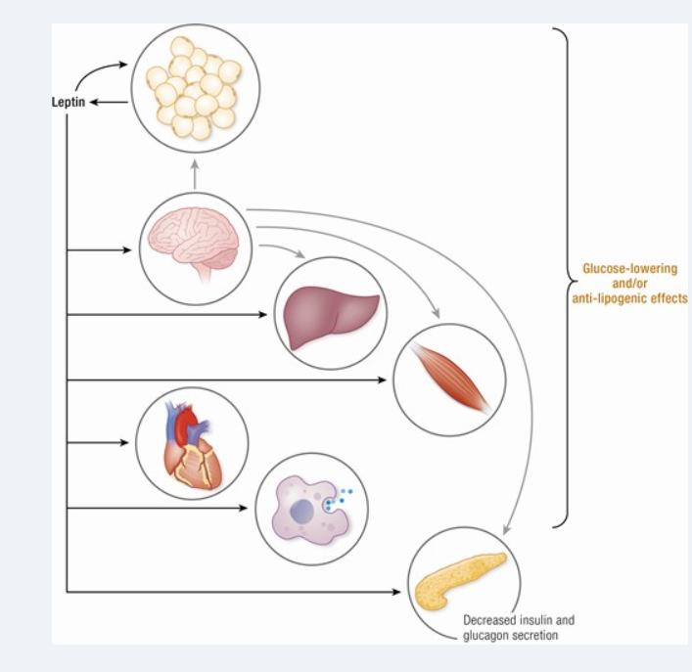
Leptin- Peripheral and central actions
Endocrine reviews Vol 42: Issue 1

Slide 31
Ghrelin and leptin are two hormones that play opposing roles in regulating appetite and energy balance.
Ghrelin:
Function: Ghrelin is primarily known for stimulating appetite and increasing food intake.
Levels: Ghrelin levels tend to rise before a meal and decrease after eating.
Leptin:
Function: Leptin acts as a satiety signal, signaling the body that it has enough energy stored. It suppresses appetite and reduces food intake.
.
Brain
Satiety
Leptin from fat
Hunger
Ghrelin from stomach/ duodenum
Leptin levels are directly proportional to the amount of body fat.
Leptin Resistance: In some individuals, particularly those with obesity, the body can become resistant to leptin's effects, leading to continued hunger even with high leptin levels.
Ghrelin stimulates appetite, while leptin suppresses it. ​

Slide 32
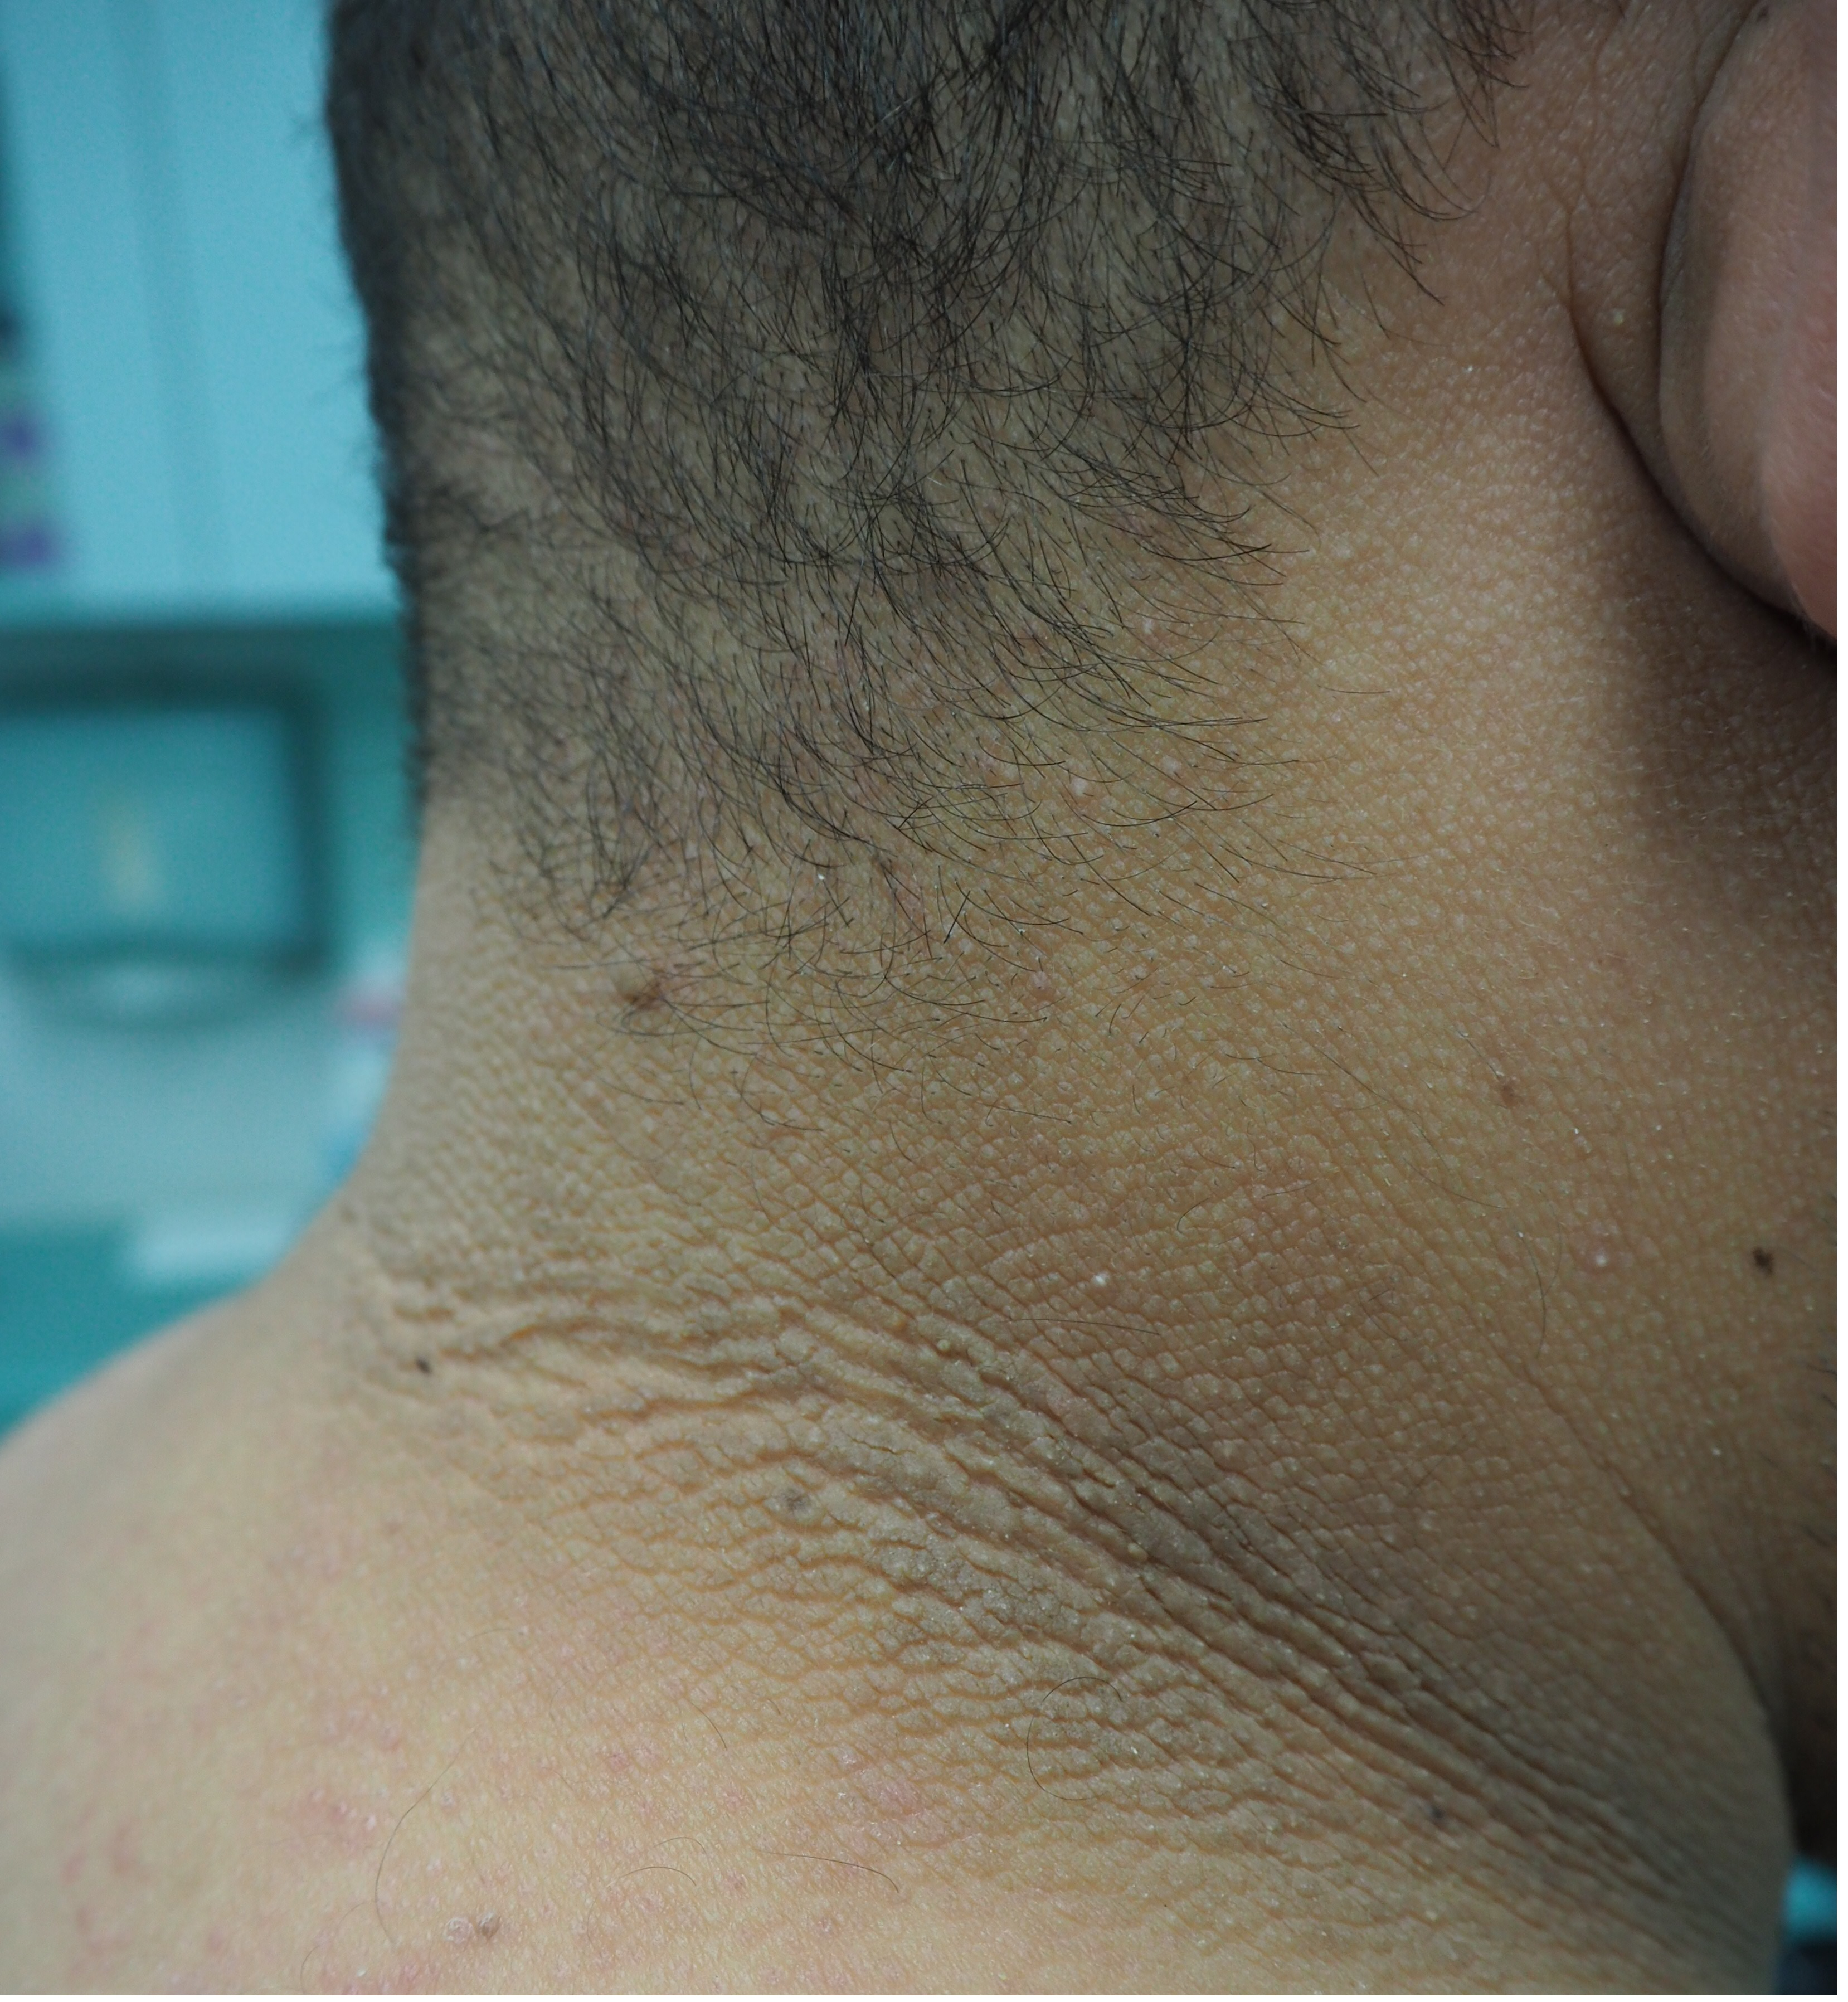
Metabolic syndrome
Metabolic syndrome is a cluster of medical conditions that increases the risk of heart disease, stroke, and type 2 diabetes.
It's diagnosed when a person has at least three of the following:
Conditions associated with Metabolic Syndrome:
High Blood Pressure: A reading of 130/85 mmHg or higher.
High Blood Sugar: Fasting glucose level of 100 mg/dL or higher.
Excess Abdominal Fat: Waist circumference of 40 inches or more for men and 35 inches or more for women.--Visceral fat linked to vascular disease
High Triglycerides: Fasting triglycerides level of 150 mg/dL or higher.
Low HDL (Good) Cholesterol: HDL cholesterol level less than 40 mg/dL in men or 50 mg/dL in women.
Acanthosis nigricans as an indicator for insulin resistance or diabetes
Characterized by velvety, papillomatous, hyperkeratotic, darkly pigmented skin lesions found in body folds such as the neck, axilla, and groin
High circulating insulin levels of insulin bind to the insulin like growth factor receptors in melanin containing skin cells which leads to skin hyperplasia with papillomatosis and hyperpigmentation.

Slide 33
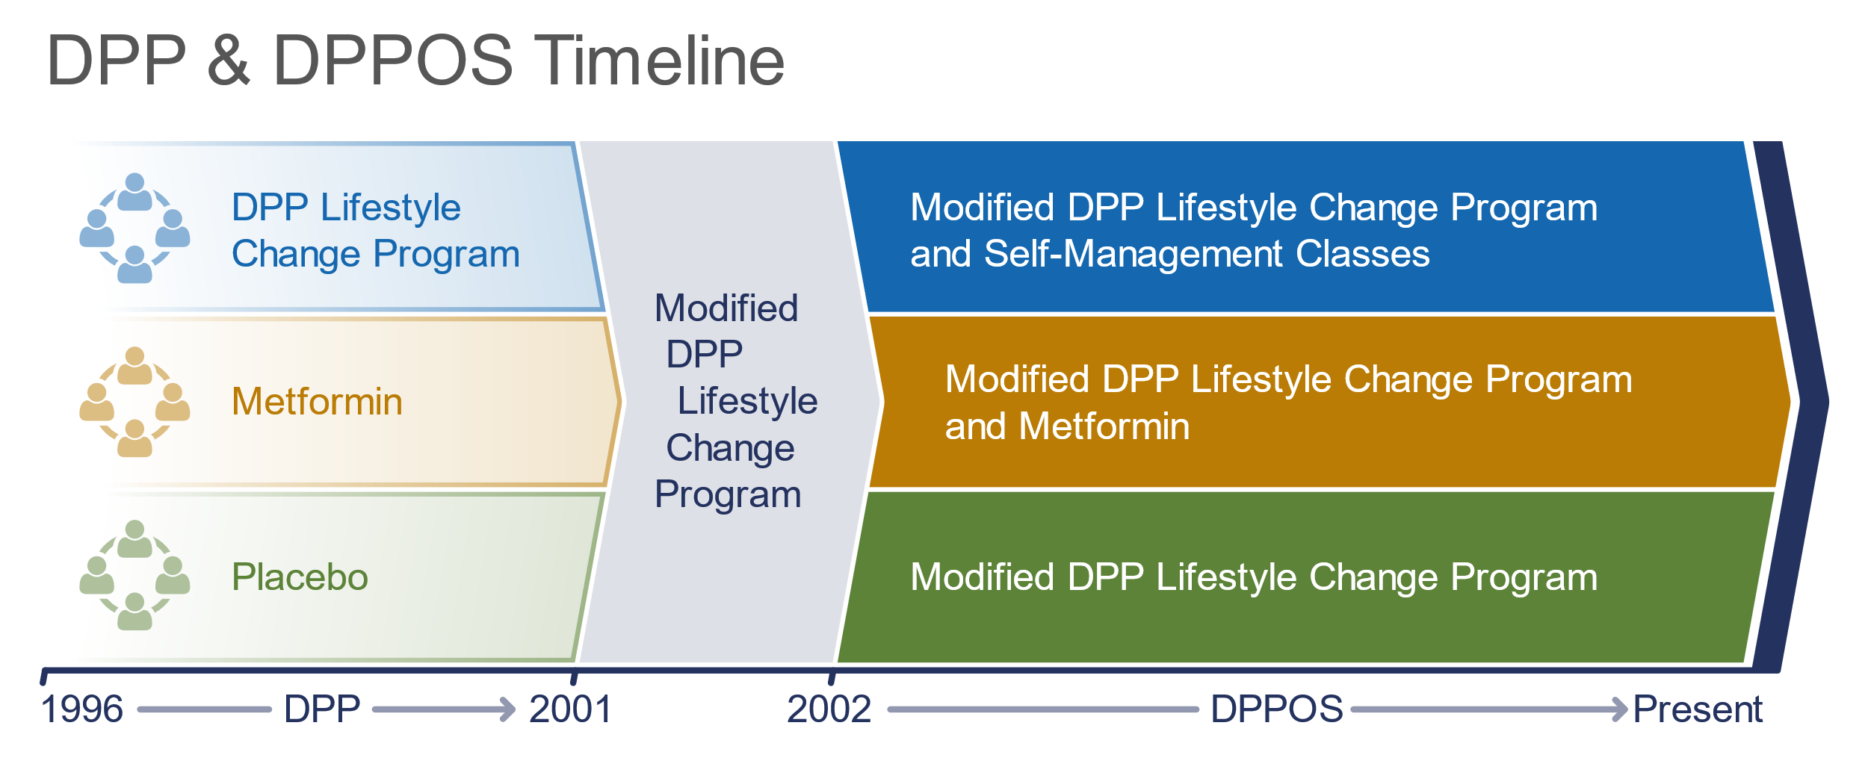
Prevention of Type 2 DM- Diabetes prevention trial
In the DPP, weight loss was an important factor in reducing the risk of progression, with every kilogram of weight loss conferring a 16% reduction in risk of progression over 3.2 years
In the DPP, metformin was as effective as lifestyle modification in participants with BMI ≥35 kg/m² and in younger participants aged 25–44 years . In individuals with a history of GDM in the DPP, metformin and intensive lifestyle modification led to an equivalent 50% reduction in diabetes risk . Both interventions remained highly effective during a 10-year follow-up period
Decreased vitamin B12 levels due to impaired absorption are a known consequence of long-term treatment with metformin . Periodic assessment of vitamin B12 level in those taking metformin chronically should be considered
Newer Therapies- GLP 1 agonists –
Semaglutide , Liraglutide etc

Slide 34
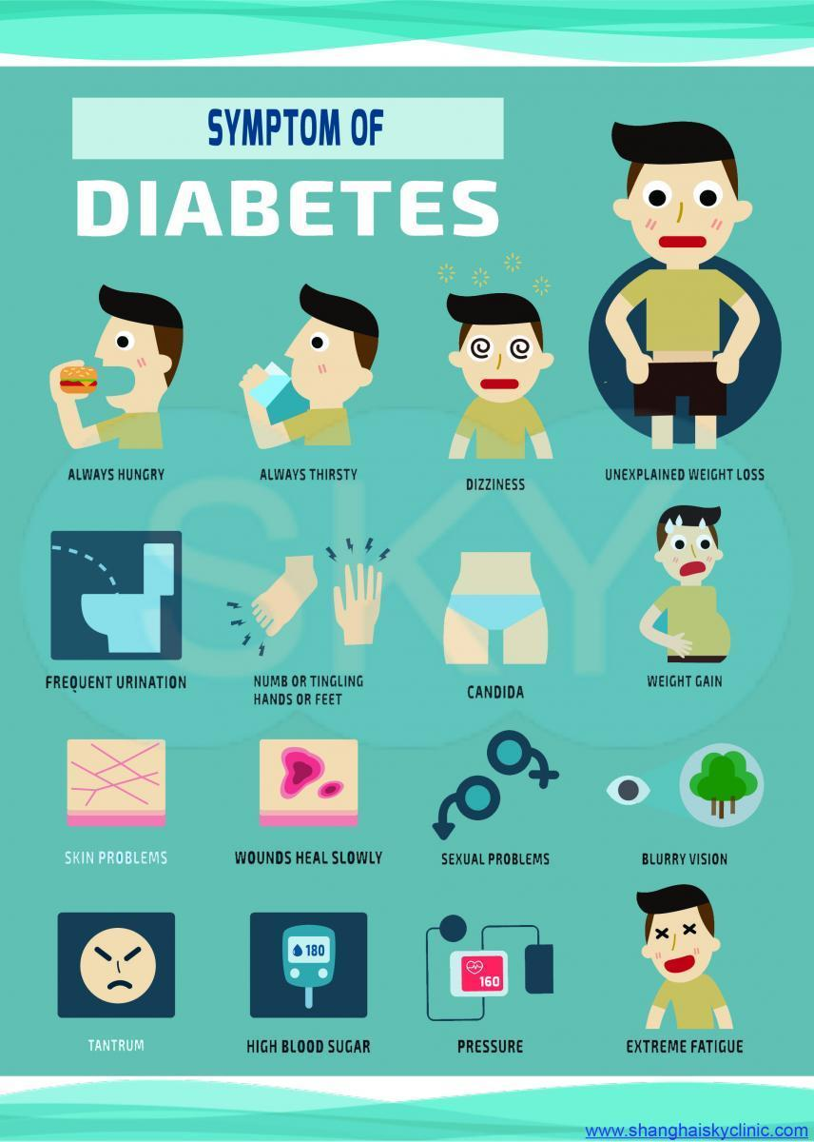
Symptoms
What are common symptoms for diabetes?
Polyuria – due to osmotic diuresis (glucose in blood attracts water; excess glucose is removed from blood by the kidneys and excreted via the urine, along with water and electrolytes) = hyperosmolar state (loss of water and high glucose/sodium)
Polydipsia – excessive thirst due to hyperosmolar state/ water loss
Polyphagia – increased hunger; due to lack of insulin and ability for glucose to enter cells. Body cannot convert glucose into usable source of energy.
Weight loss – despite normal or increased appetite; due to depletion of water, glycogen( glucose stores); skeletal muscle catabolism and conversion of amino acids to glucose via gluconeogenesis in the liver
Dizziness and weakness – due to dehydration, low BP, whole body potassium loss
High ketones contribute to nausea and vomiting (cause unknown), leading to decreased food and fluid intake, exacerbating hyperosmolar state. Ketones also result in sweet, fruity breath odor and increased respiratory compensation (Kussmaul respiration)
Hyperkalemia-induced cardiac arrhythmias...???
Blurry vision – due to exposure of lenses and retinas to hyperosmolar fluids,

Slide 35
Treatment

Slide 36
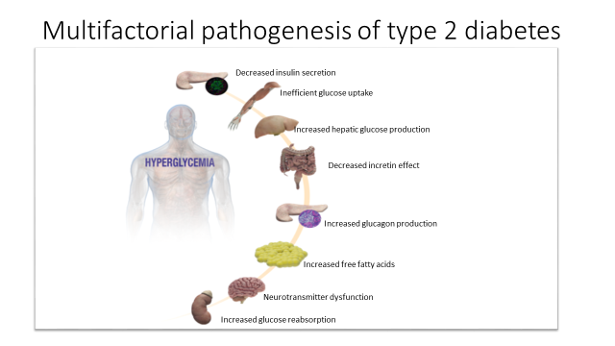
References:
DeFronzo RA. Banting Lecture. From the triumvirate to the ominous octet: a new paradigm for the treatment of type 2 diabetes mellitus.
Diabetes. 2009;58:773-795.
Drucker DJ. Enhancing incretin action for the treatment of type 2 diabetes. Diabetes Care. 2003;26:2929-2940

Slide 37
Properties of anti-hyperglycemic agents
Oral Class | Mechanism | Advantages | Disadvantages
Biguanides | Activates AMP-kinase (?other) ↓ Hepatic glucose production | Extensive experience No hypoglycemia Weight neutral ? ↓ CVD | Gastrointestinal Lactic acidosis (rare) B-12 deficiency Contraindications
Sulfonylureas | Closes K_{ATP} channels ↑ Insulin secretion | Extensive experience ↓ Microvascular risk | Hypoglycemia ↑ Weight Low durability Caution in renal insufficiency
Meglitinides | Closes K_{ATP} channels ↑ Insulin secretion | ↓ Postprandial glucose Dosing flexibility | Hypoglycemia ↑ Weight Dosing frequency
TZDs | PPAR-γ activator ↑ Insulin sensitivity | No hypoglycemia Durability ↓ TGs (pio) ↑ HDL-C ? ↓ CVD events (pio) | ↑ Weight Edema/heart failure Bone fractures ↑ LDL-C (rosi)
Diabetes Care 2015;38:140-149;
Diabetologia 2015;58:429-442
Notes:
Here are some of the older oral drug classes used in T2DM. The table describes the mechanism of action of each class, its advantages, disadvantages and cost. Less commonly used classes are denoted in grey font.

Slide 38
Oral Class | Mechanism | Advantages | Disadvantages
α-Glucosidase inhibitors | Inhibits α-glucosidase Slows carbohydrate digestion / absorption | No hypoglycemia Nonsystemic ↓ Postprandial glucose ? ↓ CVD events | Gastrointestinal Dosing frequency Modest ↓ A1c
DPP-4 inhibitors | Inhibits DPP-4/ the enzyme that degrades Incretins Increases incretin (GLP-1, GIP) levels | No hypoglycemia Well tolerated | Angioedema / urticaria ? Pancreatitis ? ↑ Heart failure Cost
Bile acid sequestrants | Bind bile acids ? ↓ Hepatic glucose production | No hypoglycemia ↓ LDL-C | Gastrointestinal Modest ↓ A1c Dosing frequency Cost
Dopamine-2 agonists | Activates DA receptor Alters hypothalamic control of metabolism ↑ insulin sensitivity | No hypoglyemia ? ↓ CVD events | Modest ↓ A1c Dizziness, fatigue Nausea Rhinitis Cost
SGLT2 inhibitors | Inhibits SGLT2 in proximal nephron Increases glucosuria | ↓ Weight No hypoglycemia ↓ BP Effective at all stages | GU infections Volume depletion ↑ LDL-C Cost
Diabetes Care 2015;38:140-149;
Diabetologia 2015;58:429-442
Notes:
Additional oral agent classes used in T2DM are included on this slide. The table describes the mechanism of action of each class, its advantages, disadvantages and cost. Less commonly used classes are denoted in grey font.

Slide 39
Injectable Class | Mechanism | Advantages | Disadvantages
Amylin mimetics | Activates amylin receptor ↓ glucagon ↓ gastric emptying ↑ satiety | ↓ Weight ↓ Postprandial glucose | Gastrointestinal Modest ↓ A1c Hypoglycemia Dosing frequency Training requirements Cost
GLP-1, GIP receptor agonists | Activates GLP-1 R ↑ Insulin, ↓ glucagon ↓ gastric emptying ↑ satiety | ↓ Weight No hypoglycemia ↓ Postprandial glucose ↓ Some CV risk factors | Gastrointestinal ? Pancreatitis Medullary ca (rodents) Training requirements Cost
Insulin – daily injections/ pump | Activates insulin receptor Myriad | Universally effective Unlimited efficacy ↓ Microvascular risk | Hypoglycemia Weight gain Patient reluctance Training requirements Cost – for analogues
Diabetes Care 2015;38:140-149;
Diabetologia 2015;58:429-442
Notes:
Here now are the injectable drugs used in T2DM. The table describes the mechanism of action of each class, its advantages, disadvantages and cost. Less commonly used classes are denoted in grey font.

Slide 40
DM Chronic Complications

Slide 41
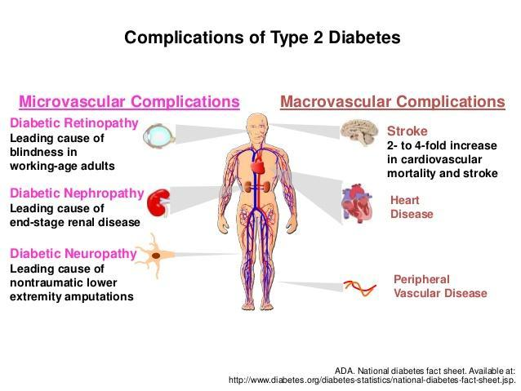

Slide 42
Microvascular complications of diabetes mellitus—due to ischemia of vessels supplying endorgans
1. Ophthalmology complications
- Diabetic retinopathy-Type 1 diabetes for more than 5 years and all patients with type 2 diabetes should be referred to an ophthalmologist.
After 15 years 50% show some sign of retinopathy.
Non- proliferative / background retinopathy–The capillaries leak proteins,
lipids and red cells into the retina and when it occurs in the macula it is
called macular edema and compromises visual acuity.
Proliferative retinopathy - this involves a growth of new capillaries and fibrous tissue due to small vessel occlusion causing retinal hypoxia. This stimulates new vessel growth.
Cataracts -Glycosylation of lens proteins and excess of sorbitol from increased glucose accumulation leads to osmotic changes in the lens resulting in fibrosis and sclerosis ( cataract) formation.
Glaucoma – Increased intra ocular pressure, due to new vessel growth at angle of eye( drainage block) + increased fluid leak

Slide 43
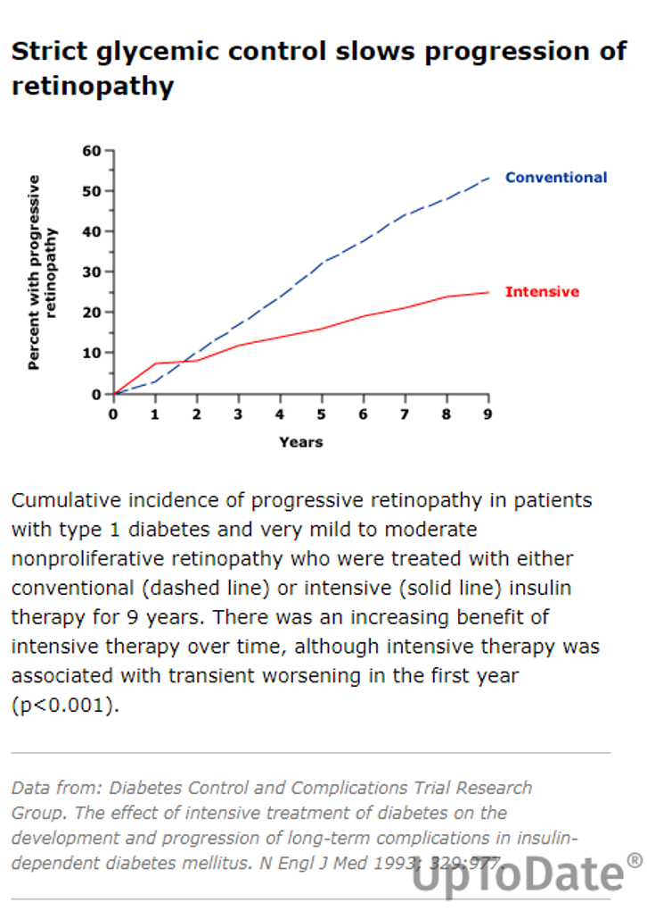
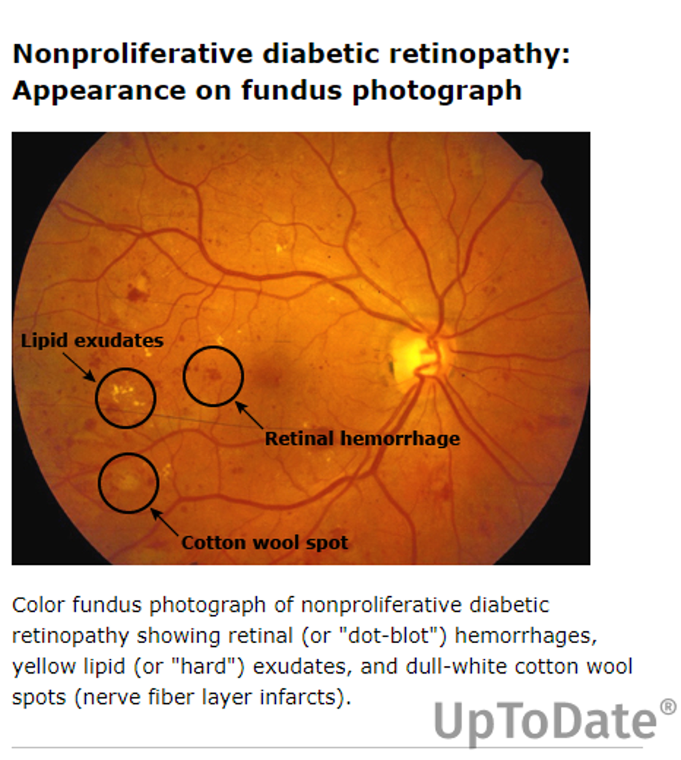

Slide 44
Adults with type 1 diabetes should have an initial dilated and comprehensive eye examination by an ophthalmologist or optometrist within 5 years after the onset of diabetes.
People with type 2 diabetes should have an initial dilated and comprehensive eye examination by an ophthalmologist or optometrist at the time of the diabetes diagnosis.
To reduce the risk of vision loss
Panretinal laser photocoagulation therapy
Intravitreous injections of anti–vascular endothelial growth factor (anti-VEGF) --esp for macular edema
Macular focal/grid photocoagulation and intravitreal injections of corticosteroid

Slide 45
Renal complications
- Diabetic nephropathy-Thickened capillary basement membranes of renal glomeruli results in glomerulosclerosis and renal insufficiency. This results in proteinuria.
- Necrotizing papillitis - this occurs primarily in diabetic patients.
Presents with fever, pain and sloughing of the renal papillae.
- Contrast induced diabetic renal failure- increase in serum
creatinine after exposure to IV contrast. This happens within a
week. Adequate hydration before a procedure is important

Slide 46
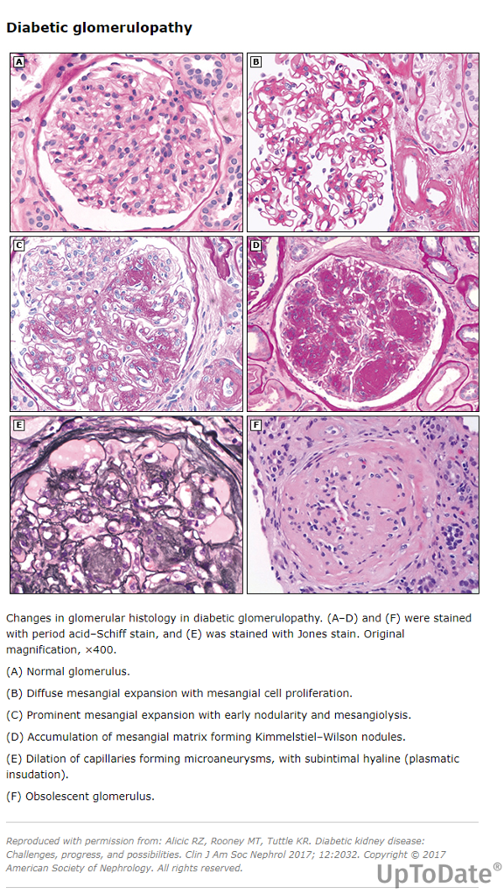
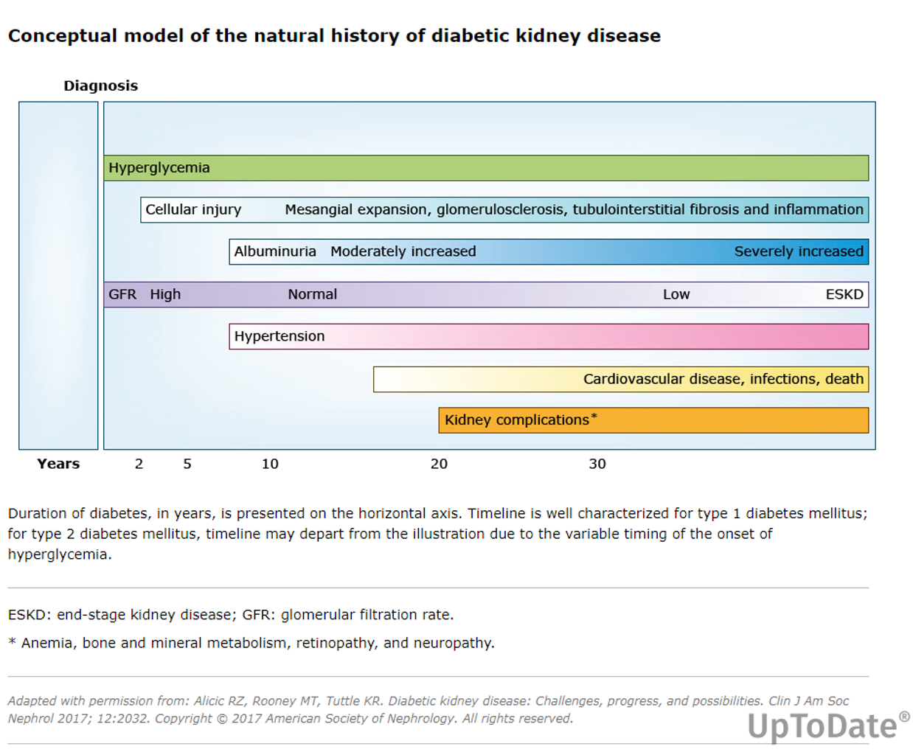
Albumin Cr Ratio (mg/g) | <30 normal | 30 to 299- Mild increase | ≥300- Severe

Slide 47
Neurology complications
Peripheral
Cranial
Autonomic

Slide 48
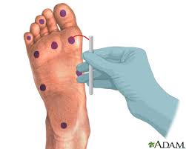
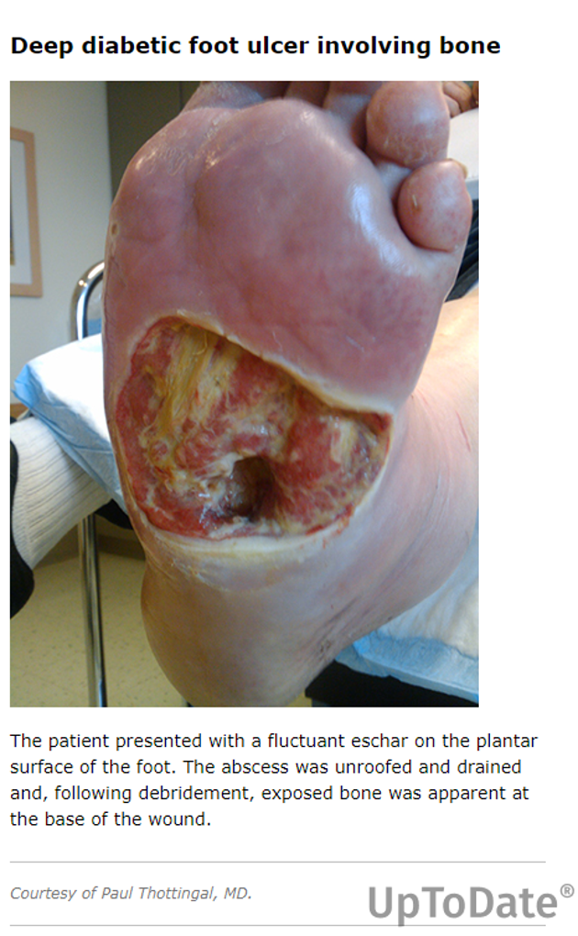
Diabetic Peripheral Neuropathy
The most common early symptoms are induced by the involvement of small fibers and include pain and dysesthesia (unpleasant sensations of burning and tingling).
The involvement of large fibers may cause balance issues, numbness, and loss of protective sensation (LOPS). LOPS indicates the presence of distal sensory polyneuropathy and is a risk factor for diabetic foot ulceration.
The following clinical tests may be used to assess small- and large-fiber function and protective sensation:
1. Small-fiber function: pinprick and temperature sensation.
2. Large-fiber function: lower-extremity reflexes, vibration perception. 128 MHz, and
3. Protective sensation: 10-g monofilament.
The denervation of small muscles of the food results in clawed toes and displacement of fat pads
altering the biomechanics of the foot. This leads to calluses from repetitive injury and ulceration in high pressure
areas such as the metatarsal head. Finally this leads to bone loss and fractures and deformity called the
Charcot foot.
Gabapentin is a medication that inhibits the release of excitatory neurotransmitters

Slide 49
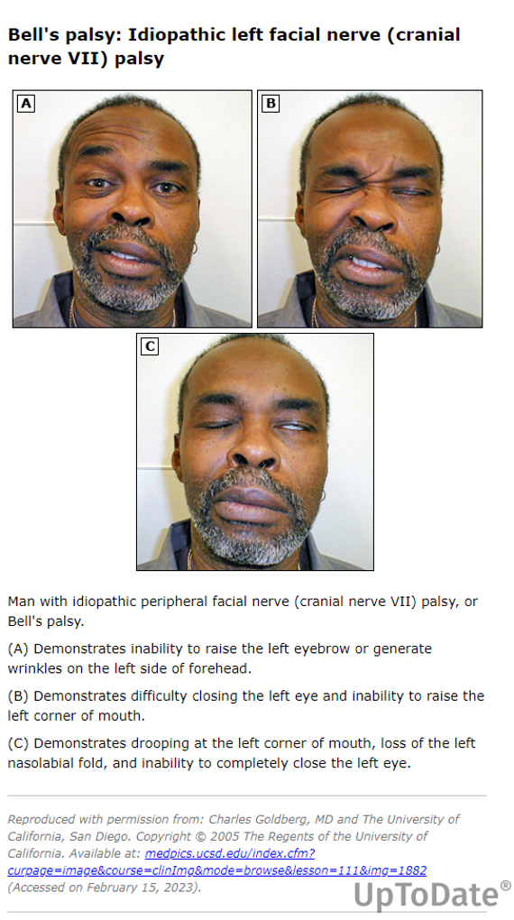
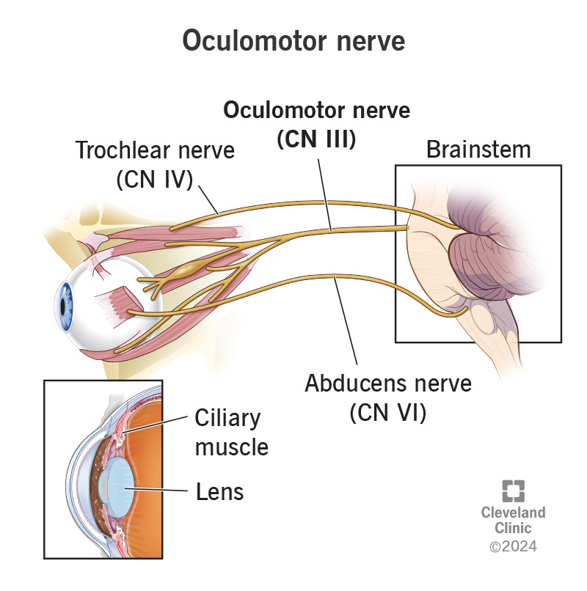
Cranial mononeuropathy: This can cause double vision, eye pain, or paralysis on one side of the face.
Focal neuropathies: These can cause pain in the thighs, lower back, or pelvis, or even mimic heart attack or appendicitis symptoms.
Entrapment neuropathies: These can cause numbness or weakness in the hands or feet.
Commonly affected nerves:
The oculomotor nerve (controls eye movement) is frequently affected in cranial mononeuropathy—Diplopia Other nerves that can be affected include the median nerve (causing finger weakness and numbness), and the peroneal nerve (causing foot drop).

Slide 50
Diabetic Autonomic Neuropathy
Individuals who have had type 1 diabetes for ≥5 years and all individuals with type 2 diabetes should be assessed annually for autonomic neuropathy
Major clinical manifestations of diabetic autonomic neuropathy include
resting tachycardia,
orthostatic hypotension,
gastroparesis, constipation, diarrhea, fecal incontinence,
erectile dysfunction,
neurogenic bladder, and
sudomotor dysfunction with either increased or decreased sweating.

Slide 51
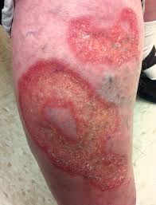
Skin
Necrobiosis lipoidica diabeticorum-Oval plaques with the reddish
border and a glistening yellow surface due to thinning of dermis. Seen on
the anterior surfaces of legs. This happens due to degeneration of collagen
and granulomatous inflammation. More commonly associated with type 1
diabetes.
-- Bone and Joint complications
--Dupytrne’s contractures -Fibrosis results in contracture of the Palmar
fascia producing flexion contractures of the fingers.
Carpal tunnel syndrome - when median nerve is compressed probably
due to glycosylation of collagen. Frozen shoulder due to adhesive capsulitis
in long standing diabetes.
Infections Picture source- wikipedia

Slide 52

Medical emergencies
DKA- Diabetic KetoAcidosis
HHS- Hyperosmolar Hyperglycemic State
Pathogenesis of DKA and HHS.
In HHS, compared with DKA, there is less severe insulin deficiency and, therefore, sufficient insulin to prevent ketogenesis but not enough to prevent hyperglycemia, due to increased hepatic glucose production and decreased glucose utilization by peripheral tissues. Hyperglycemia leads to an osmotic diuresis, leading to volume depletion

Slide 53
Precipitating factors
25-30% of Type 1 DM present with DKA
Poor metabolic control or missed insulin doses – makes up the majority of cases; frequent among adolescents. Pump malfunction.
Infections - increased need for insulin.
Illness – stress hormones can increase hepatic glucose output and insulin resistance. Also, vomiting and dehydration can interrupt food intake, and patients sometimes omit insulin to avoid hypoglycemia. Occult MI
Medications – corticosteroids, atypical antipsychotics, and others
Pregnancy
Drugs and alcohol

Slide 54
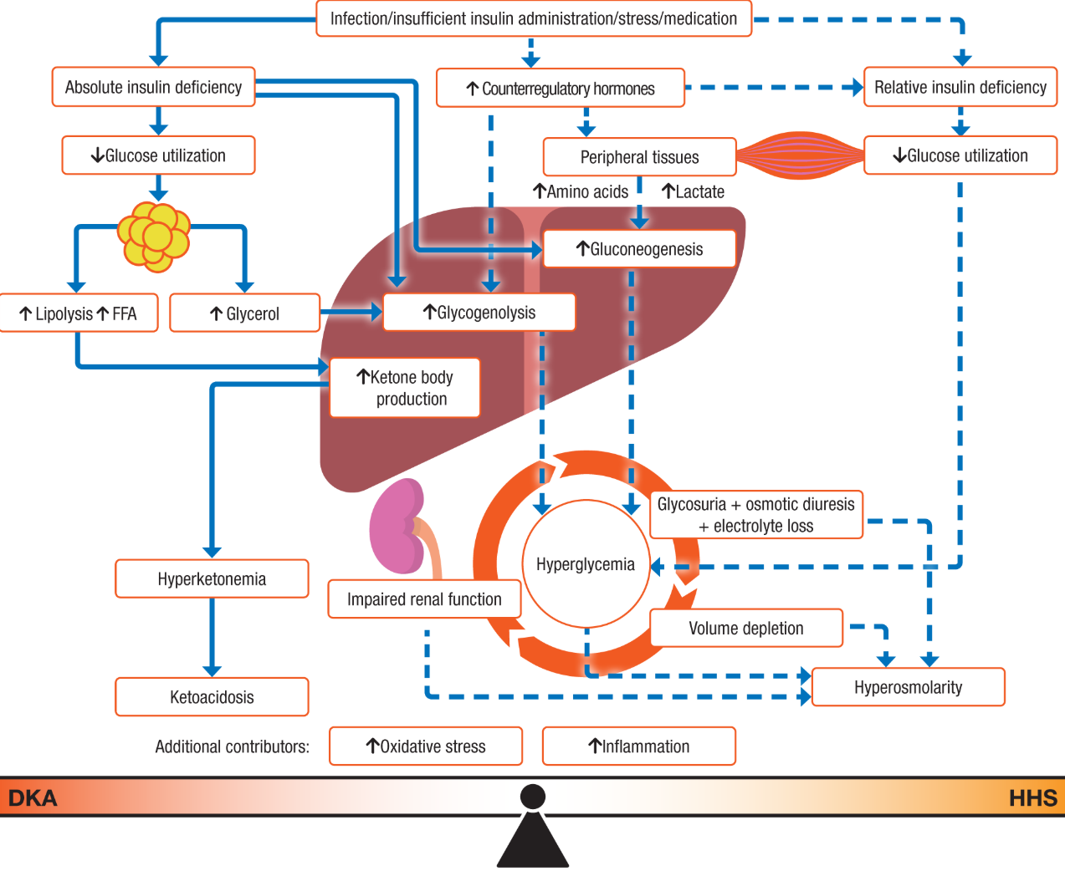

Slide 55
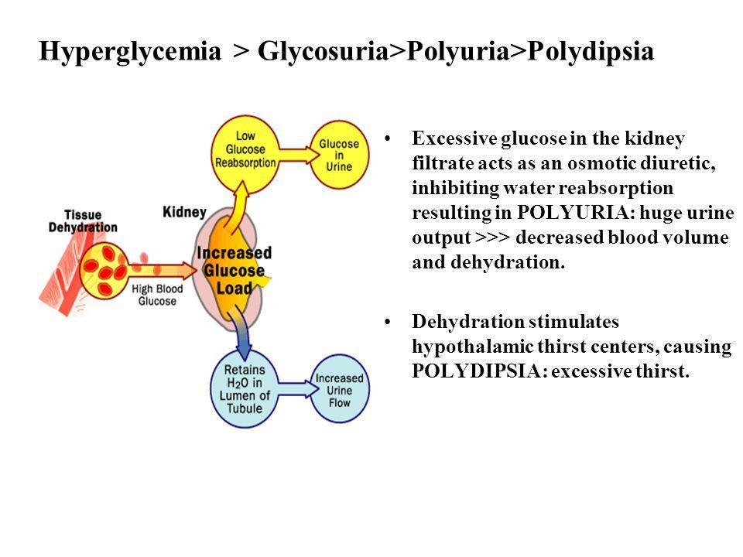
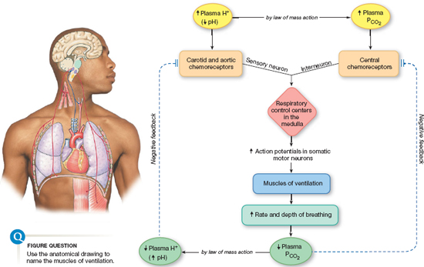
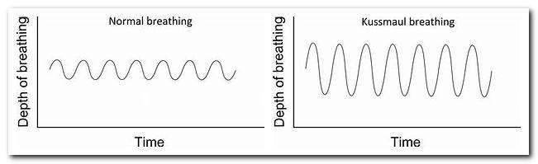
Kussmaul’s breathing = hyperventilation characterized by constantly deep sighing respirations in a rapid manner. Generally noted in the last stages of severe acidosis/diabetic acidosis. Patients suffering from Kussmaul’s breathing become “air-hungry” and are seen desperately gasping for more air.

Slide 56
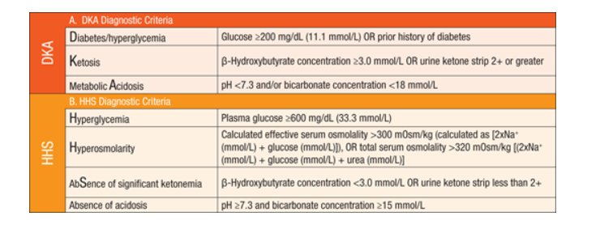
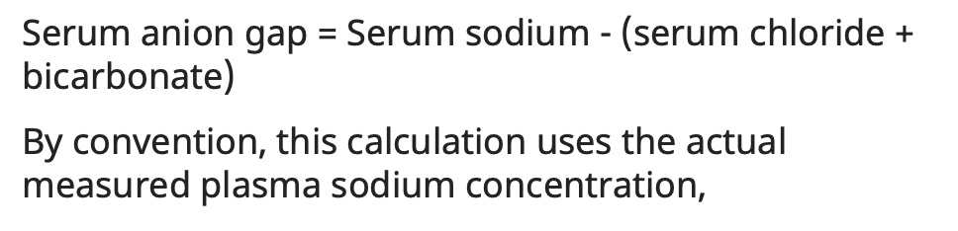
Diagnostic criteria

Slide 57
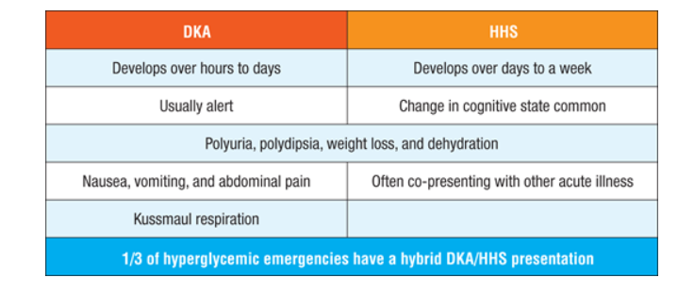
Clinical presentation

Slide 58
Diabetic ketoacidosis
18 year girl presents with vomiting, epigastric pain. Vitals – HR 120, BP 100/60, Afebrile
Upon further history -polyuria and weight loss over 3 weeks. CT – negative for appendicitis or other acute conditions.
Labs
Glu 510, PH 7.2, HCO3 9, Na 130, K 5.5 , cr 1.8
Anion gap- HIGH 28
A1c 12%
Beta hydroxy butyrate 5.8 mmol/L – high
UA- +++ glucose, ++ ketones, pregnancy test negative, no infection

Slide 59
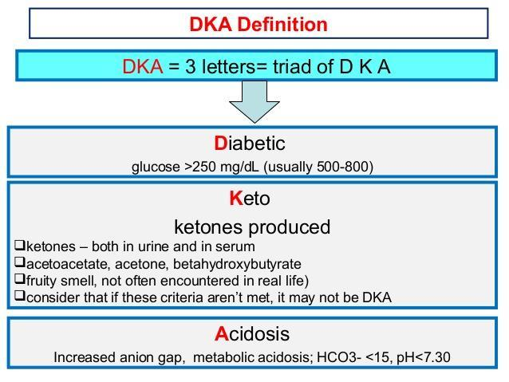
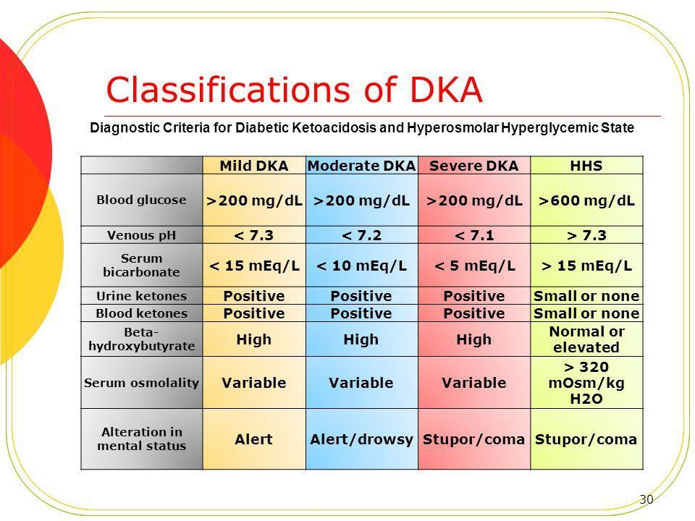

Slide 60
HHS
70 yr woman with h/o type 2 DM, presents with cough ,confusion , lethargy, polyuria and dehydration over 4 days . She was given steroids for cough recently. Vitals show low BP 80/60, low grade fever and HR 120s
Labs-
Glucose 900, PH 7.3, Na corrected to glucose- 150, potassium normal,
Serum osmolality high, Mild renal failure,
urine glucose ++, ketones trace to negative , beta hydroxy butyrate negative, A1c 12%,
CXR- = Right lobe pneumonia
•
•
•Effective Posm = [2 x Na (mEq/L)] + [glucose (mg/dL) ÷ 18]
•Effective Posm = [2 x Na (mmol/L)] + glucose (mmol/L)
•The Na concentration in these equations is the actual measured plasma Na concentration and not the corrected Na concentration.

Slide 61
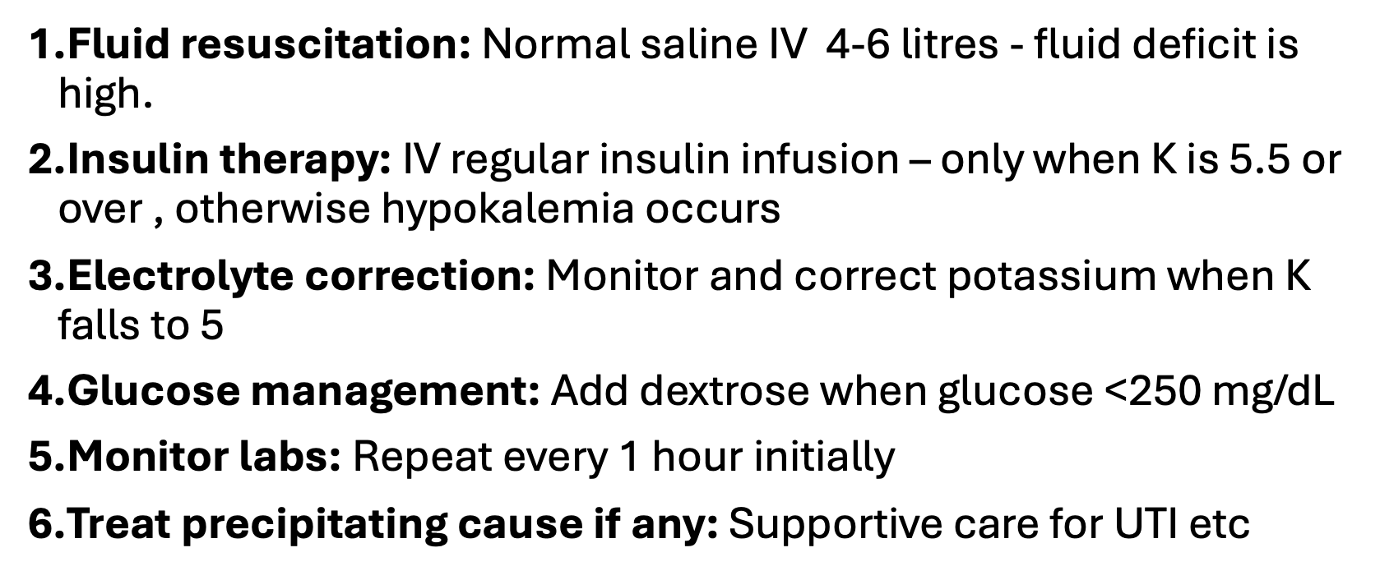
MANAGEMENT

Slide 62
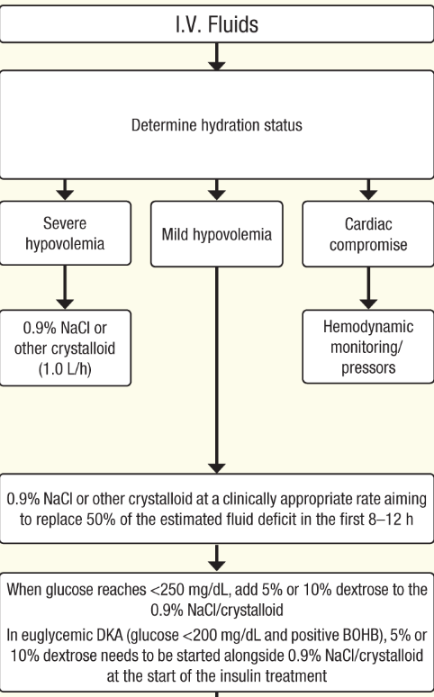

Slide 63
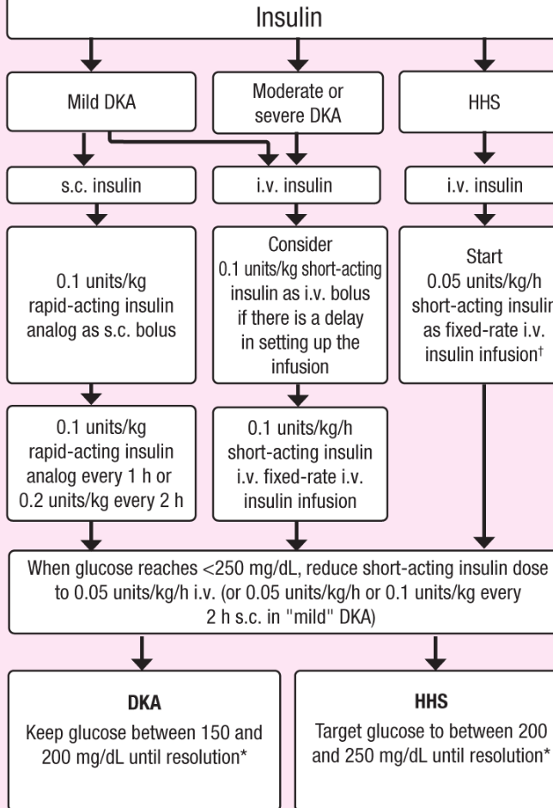
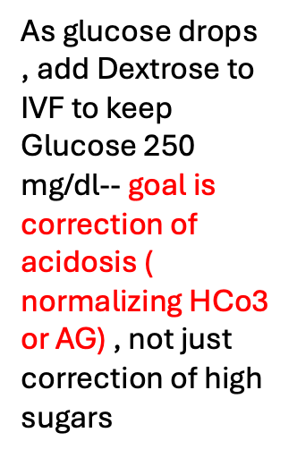

Slide 64
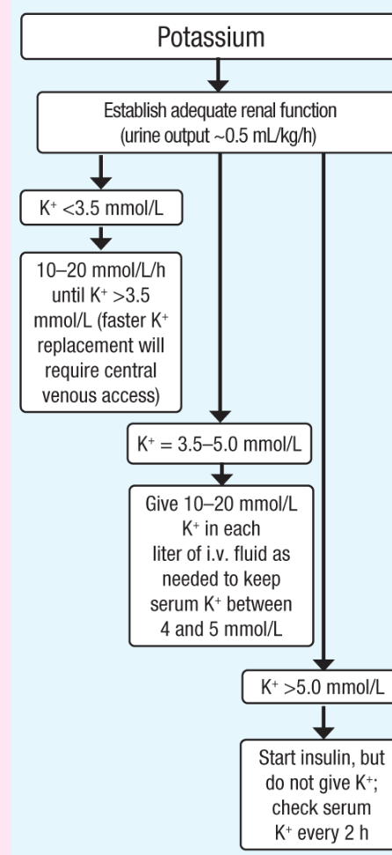
During DKA, much of it shifts out into the blood, causing hyperkalemia. This happens for three main reasons:
Insulin normally stimulates the Na⁺/K⁺-ATPase to pump potassium from the blood into cells, so a lack of insulin means this pump is inactive, raising the potassium level in the blood.
Hyperglycemia increases the serum osmolarity, pulling water out of all cells, and the potassium follows along (osmotic shift).
To buffer the decreased serum pH, the membrane H⁺/K⁺ exchanger brings extracellular H⁺ into the cell and pumps K⁺ out.
So, the total level of potassium is low in the patient’s body, but the initial level in the serum is high.

Slide 65
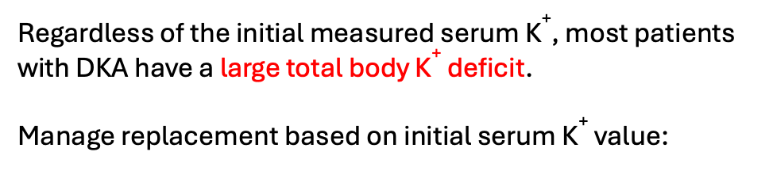
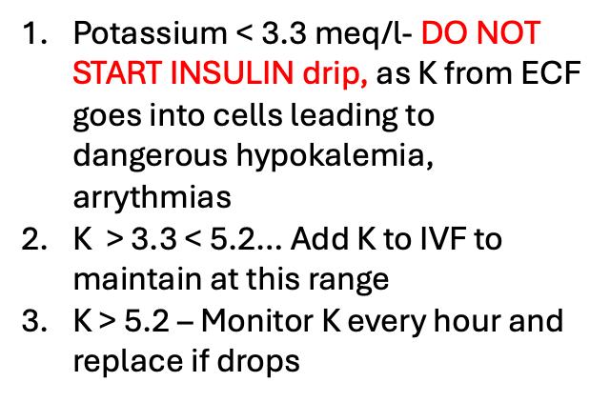
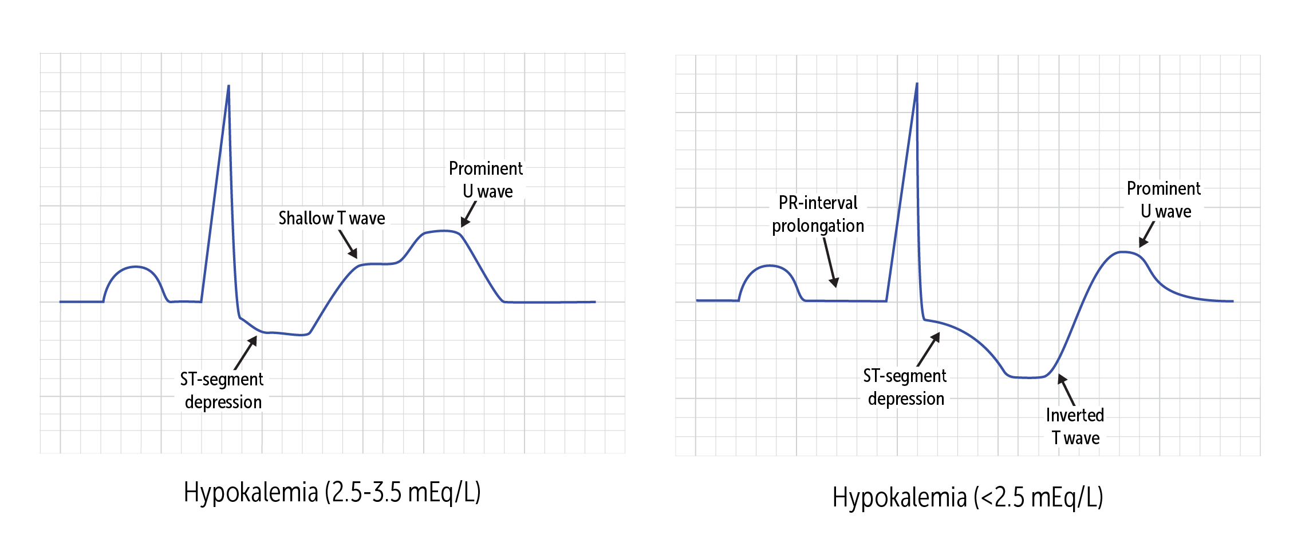

POTASSIUM

Slide 66
Type 1 Diabetic patient wants to start empagliflozin ( SGLT-2 inhibitor) as she had read good things about its cardiovascular benefits and her mother who is a 59-year-old Type 2 DM is taking it. You discourage its use in this patient due to risk of what complication?
a) Lactic acidosis
b) Ketoacidosis
c) Hypoglycemia

Slide 67
Euglycemic DKA
DKA with sugars under 250 – Acidosis+, PH is < 7.3 , dehydration
When –
Pregnancy – is a state of relative insulin deficiency despite normal or low blood glucose levels due to increased fetal consumption of glucose, and increase in stress hormones causing increased fat breakdown and ketone production, ultimately leading to EDKA.
SGLT2 inhibitors- Cause glycosuria and natriuresis causing dehydrationà increase stress hormones, lipolysis and ketogenesisà DKA with normal glucose

Slide 68

Thank you
References
Scholar rx, Uptodate, limited online sources, earlier lectures
ADA journals
JCEM
Endocrine review
Rest from Work (after Millet), 1890 by Vincent Van Gogh

