Slide 1
Endocrine lectures- Pituitary
Sathya Subbiah, MD

Slide 2
Objectives
Understand the anatomy, cell types of pituitary and hormones secreted
Identify the visual pathways and vision disturbance caused by pituitary tumor
Understand the Hypothalamic-Pituitary axis and it's disturbances
Identify basic radiology findings of pituitary tumors
Understand the various causes/ patterns of over and underactive pituitary lesions , including Diabetes insipidus and pituitary apoplexies

Slide 3
34 yr man c/o blurred vision , headache for past 4 months.
Labs- normal electrolytes, renal function
Eye visit – shows partial defects in visual fields
MRI pituitary – 12 mm pituitary macroadenoma pressing on optic chiasm

Slide 4
Master gland
The pituitary gland, controls many of the hormones that circulate in our bodies
The pituitary gland is roughly the size of a pea and projects out anteroinferiorly from the hypothalamus.
The pituitary is located just inferior to the optic chiasm (where the optic nerves cross) and sits in the sellar space within the sella turcica (Turkish saddle), a saddle-shaped depression in the sphenoid bone of the skull.
The pituitary consists of two distinct lobes that project from the hypothalamus by a thin stalk called the infundibulum

Slide 5
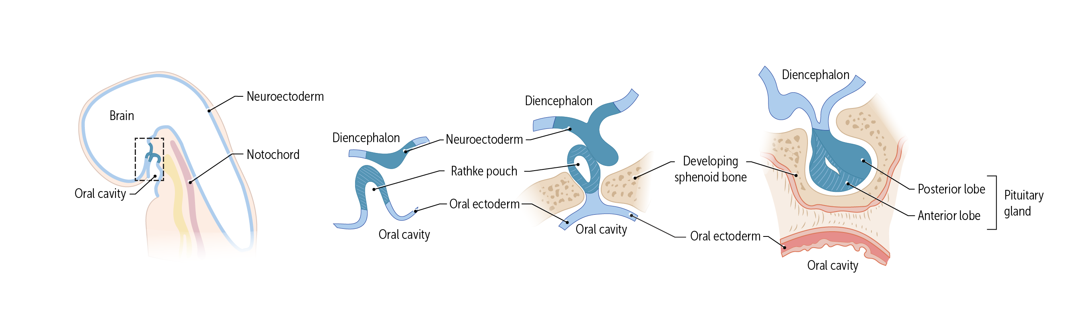
The anterior pituitary gland, also known as the adenohypophysis, is formed from the Rathke pouch, a finger of ectoderm that buds off from the roof of the developing mouth. In contrast, the posterior pituitary gland, also known as the neurohypophysis, is made of nerve axons that extend from the hypothalamus. At the same time the Rathke pouch is developing, another pouch of neuroectoderm extends from the developing brain to become the posterior pituitary.
The two adjoining tissues form the mature pituitary gland. However, their histology is different.

Slide 6
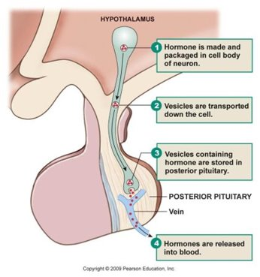
The two lobes are the anterior pituitary (adenohypophysis) and the posterior pituitary (neurohypophysis).
The anterior pituitary is a true gland, with cells that synthesize and release hormones. It is richly perfused with capillaries.
The posterior pituitary is a neural extension of the brain. It is connected to the hypothalamus through the infundibulum, which contains the hypothalamo-hypophyseal portal tract
The tract carry oxytocin and antidiuretic hormone (ADH, vasopressin) from the nerve cell bodies in the hypothalamus, where they are made, to the nerve endings in the posterior pituitary, where they are stored

Slide 7
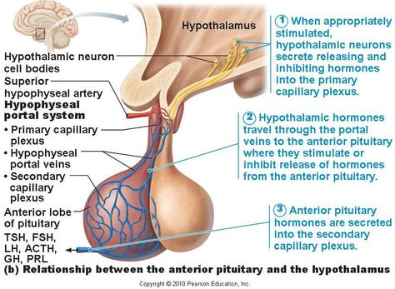
Hypothalamic Hormones Regulating the
Secretion of Anterior Pituitary Hormones
Hypothalamic neurones synthesize and secrete
peptides (releasing hormones):
Corticotrophin Releasing Hormone (CRH)
Thyrotrophin Releasing Hormone (TRH)
Growth Hormone Releasing Hormone (GHRH)
Gonadotrophin Releasing Hormone (GnRH)
Somatostatin (also GH-Inhibiting Hormone)
Dopamine (also Prolactin-Inhibiting Hormone)

Slide 8
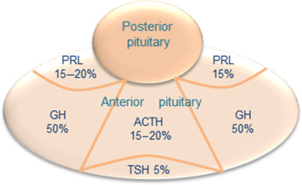
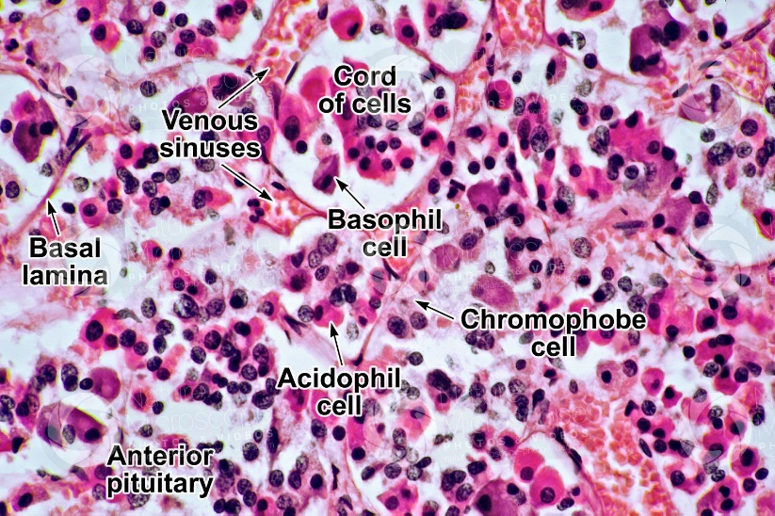
Five Cell Types of the Anterior Pituitary Gland
Corticotrophs (20%): produce corticotrophin, also called adrenocorticotropic hormone (ACTH)
Thyrotrophs (5%): produce thyrotropin, also called thyroid stimulating hormone (TSH)
Somatotrophs (45%): produce growth hormone (GH)
Gonadotrophs (5%): produce the gonadotropins, luteinizing hormone (LH) and follicle-stimulating hormone (FSH)
Lactotrophs (25%): produce prolactin (PL)
Adapted from Scheithauer BW, et al., 2001
Chromophils (Acidophils [GH/Prolactin] + Basophils) and Chromophobes (Undifferentiated)
https://www.nature-microscope-photo-video.com

Slide 9
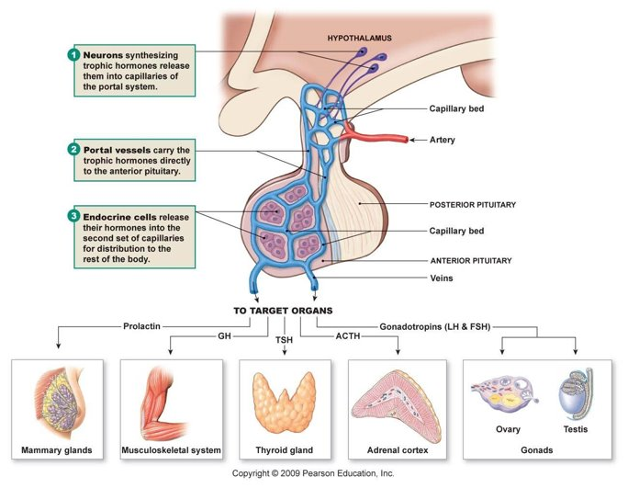
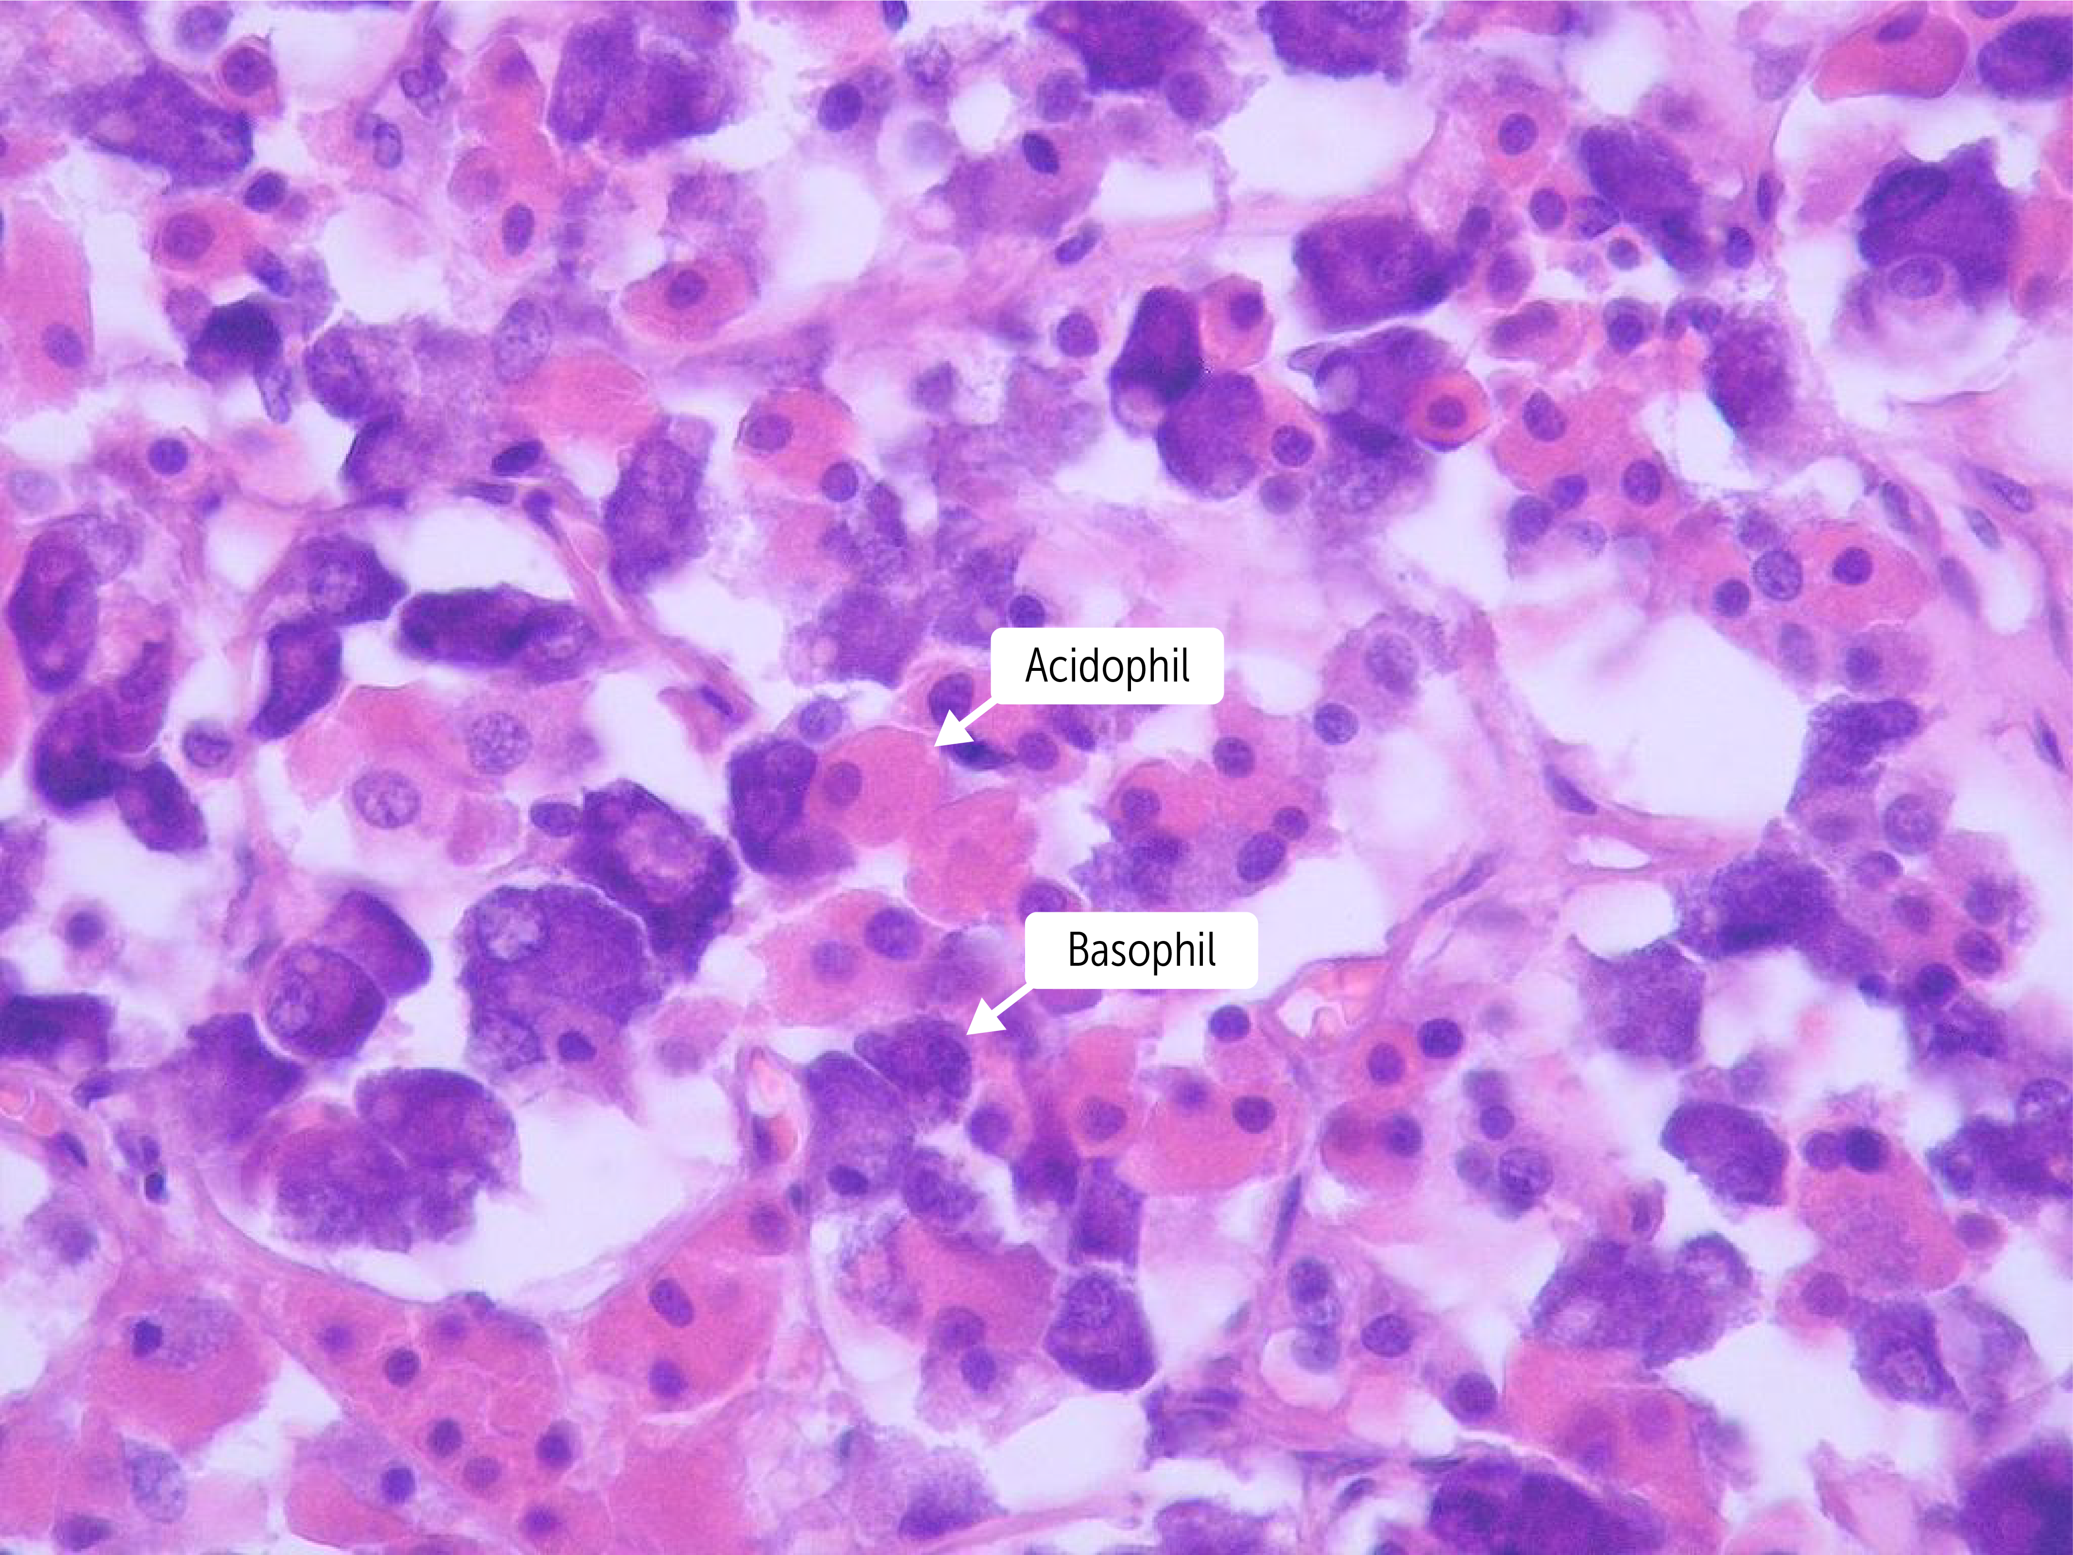
Acidophils – GH and Prolactin
Basophils –B -FLAT

Slide 10
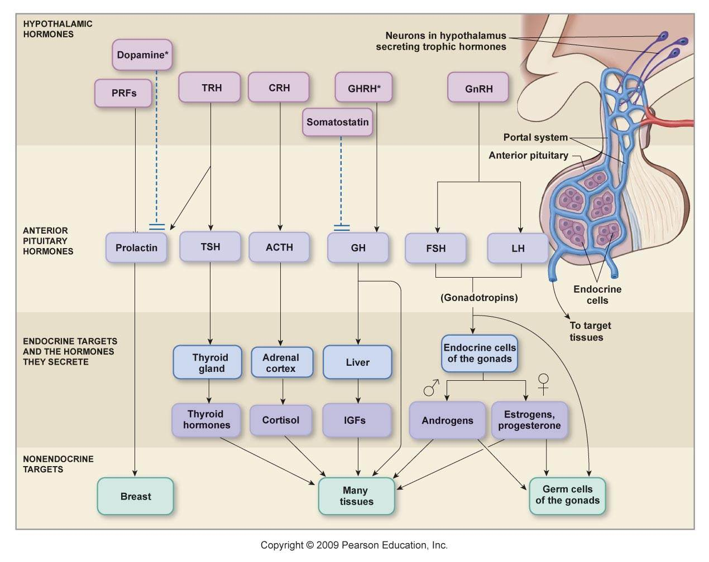
Stress
Releasing &
Release-Inhibiting Hormones
Tropic Hormones

Slide 11
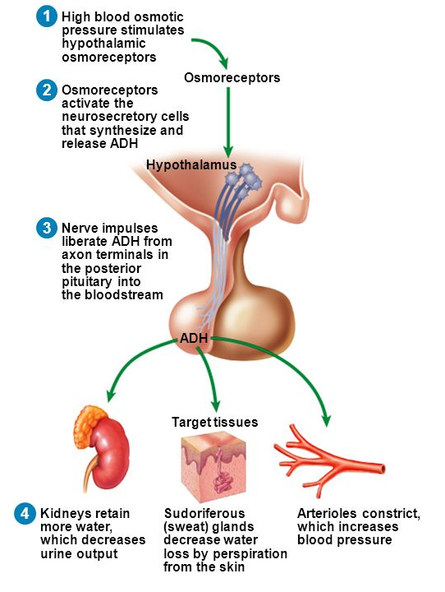
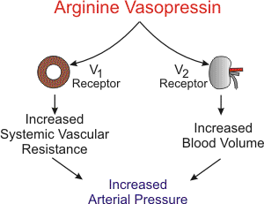
Posterior Pituitary – ADH/VP
1. Loss of plasma volume = ↑ Osmolarity (# particles
dissolved in fluid)
Detected by osmoreceptors in hypothalamus
Results in increased thirst sensation & ↑ ADH/VP release
2. Loss of plasma volume = = ↓ BP
Detected by cardiopulmonary baroreceptors
Results in ↑ ADH/VP release
ADH Mechanism:
Kidney - binds to V2 receptors, ↑ water channels (aquaporin 2) in renal collecting ducts, ↑ water reabsorption (solute free), ↓ urine output
Blood vessels – binds to V1 receptors on vascular SM cells to cause vasoconstriction via IP₃ pathway
https://slideplayer.com/slide/8275831/

Slide 12
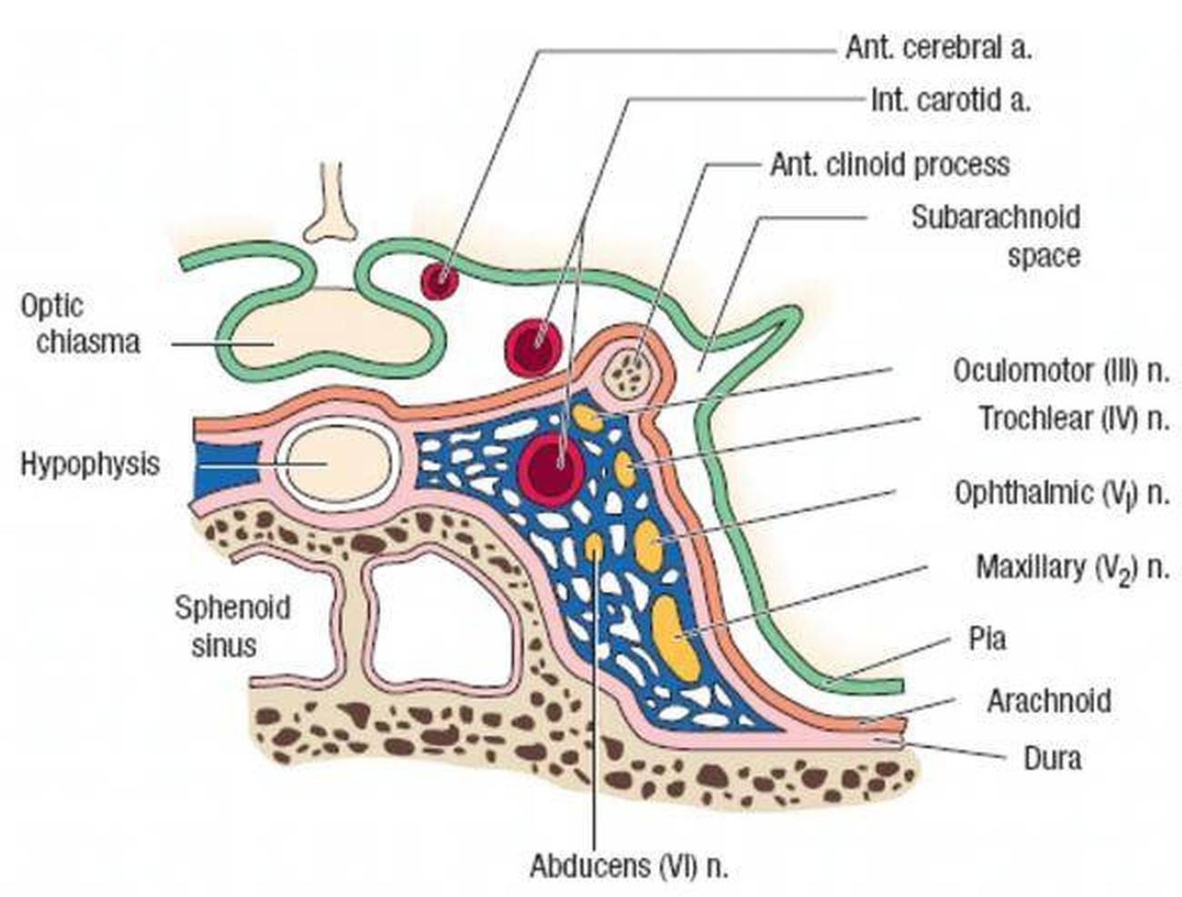
Anatomy of the cavernous sinus

Slide 13
Visual Field testing
CN2 = Optic Nerve – this nerve carries visual impulses from the eye to the optical cortex of the brain by means of the optic tracts.
CN3, CN4, CN6 = Oculomotor, Trochlear and Abducens Nerves – responsible for extraocular movement.
Testing
Acuity with Snellen Chart – in office
Visual Field Testing with Humphrey Visual Field Analyser (specific areas of the retina receive input from precise areas of the visual field) – ophthalmologist

Slide 14
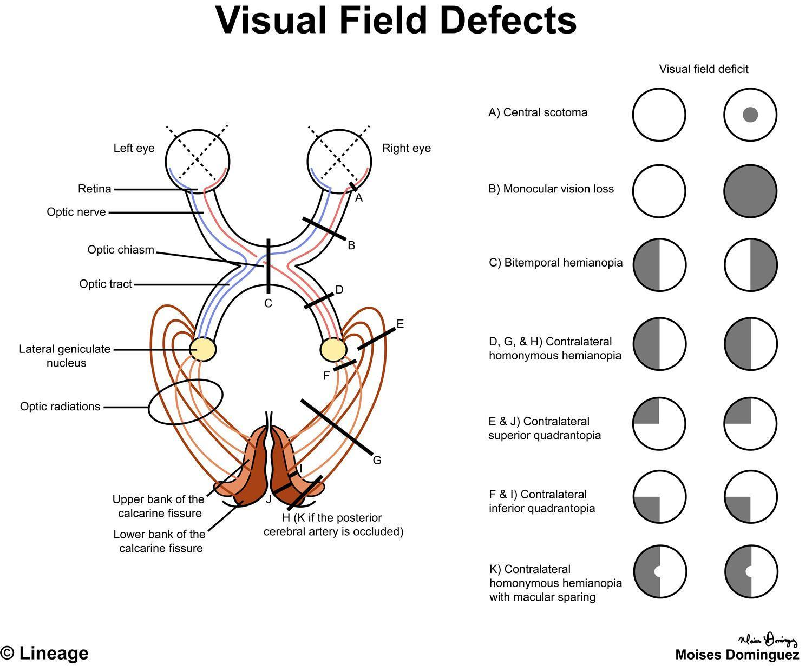

Slide 15
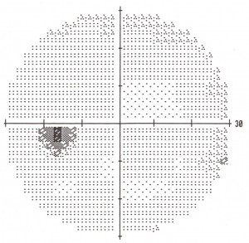
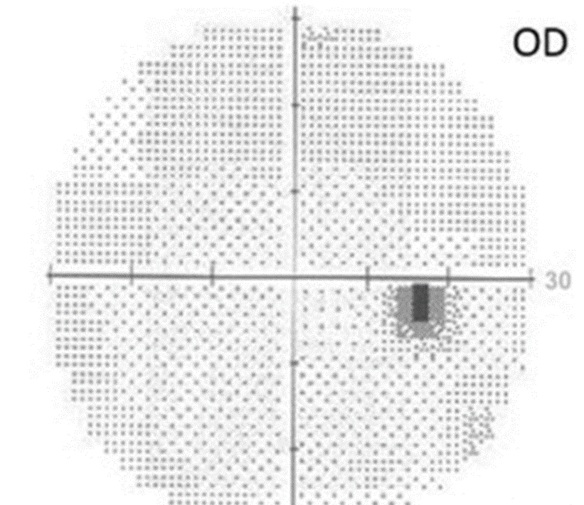
Normal Humphrey visual field

Slide 16
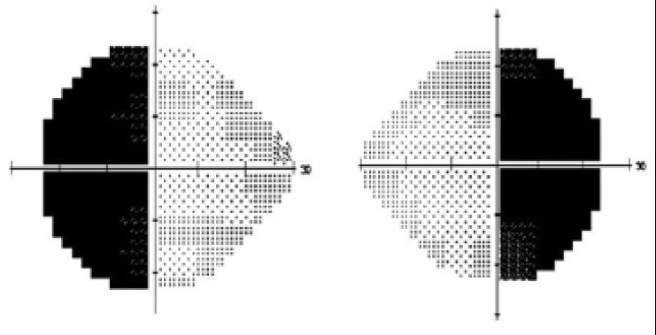
Bitemporal visual field defect

Slide 17
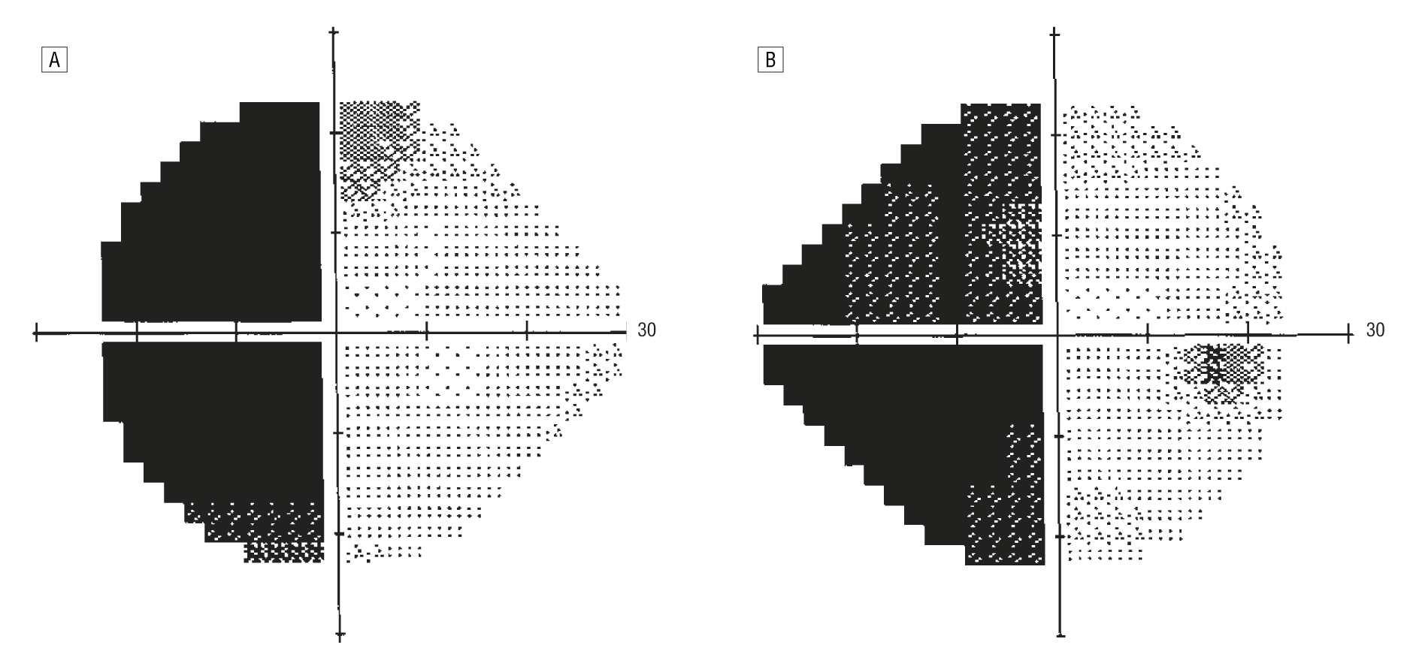
Homonymous hemianopsia

Slide 18
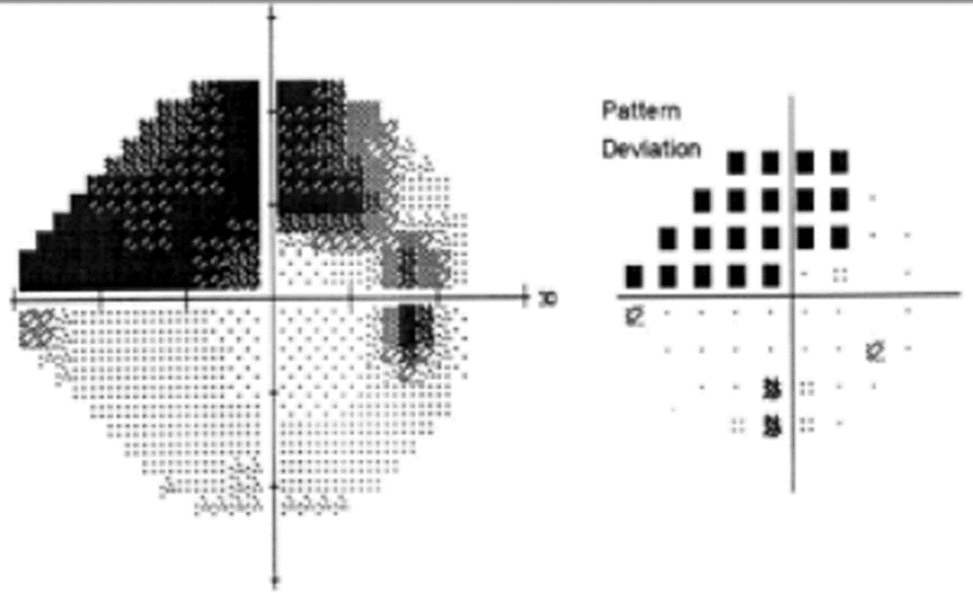
Optic nerve related visual field defect

Slide 19
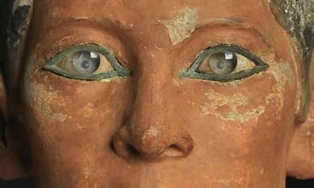

Slide 20
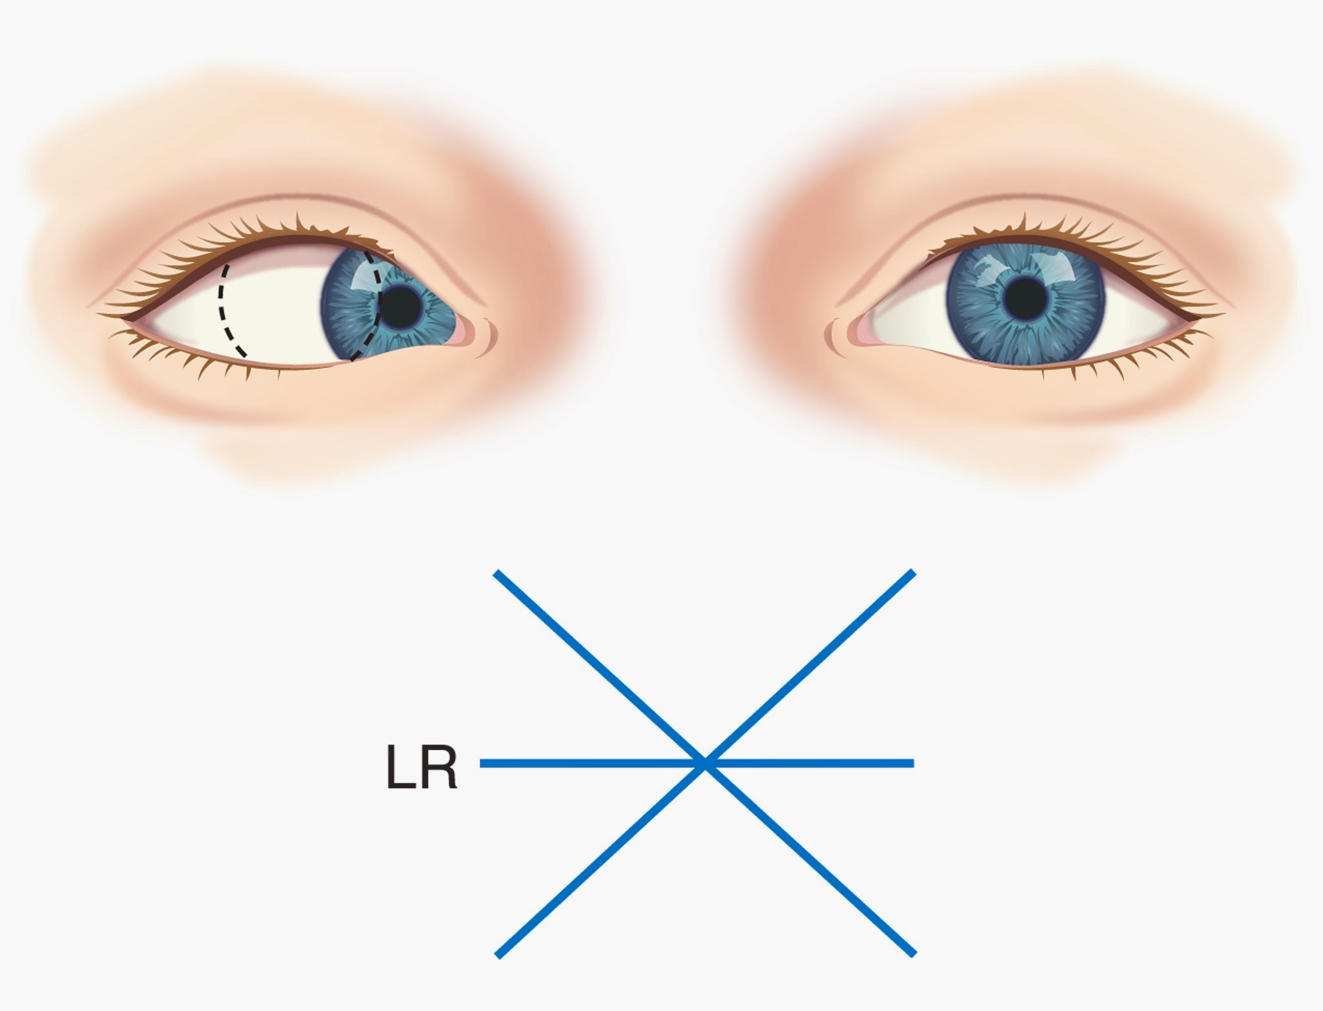
LR6
The abducens nerve innervates the lateral rectus (LR) muscle, which abducts the eye to move it outward. In the case of a CN VI lesion, the affected eye will not be able to abduct beyond the midline. So for example, with a palsy of the left CN VI, the left eye does not move laterally when the right eye is brought medially to gaze left.

Slide 21
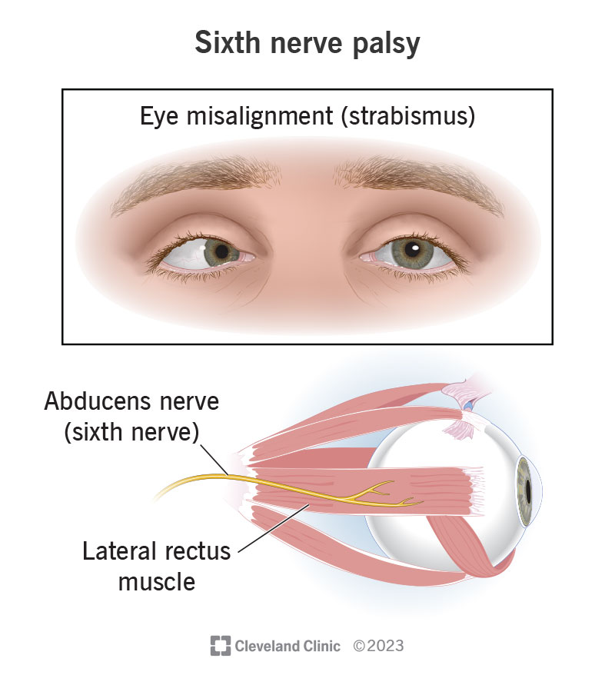
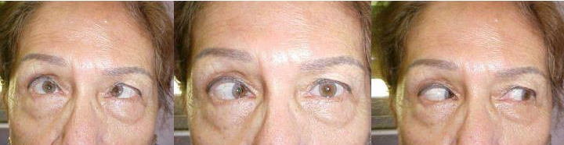
6th cranial nerve palsy, right eye

Slide 22
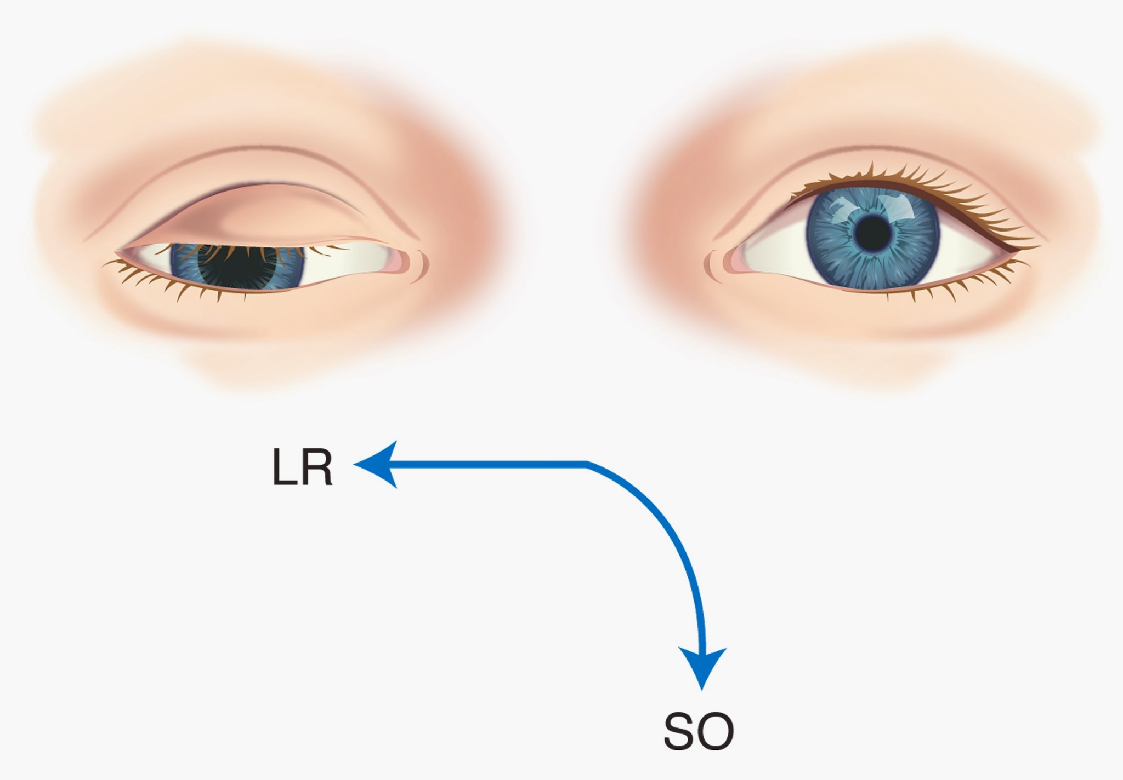
3rd cranial N
CN III supplies all of the extraocular muscles with the exception of the lateral rectus (LR) and the superior oblique (SO). A CN III palsy therefore results in unopposed action of these two muscles. The result is that the eye is pulled down (loss of inferior oblique) and out (loss of medial rectus) . There would also be ptosis, or drooping, of the upper eyelid, due to loss of the levator palpebrae superioris as well as the mydriasis

Slide 23
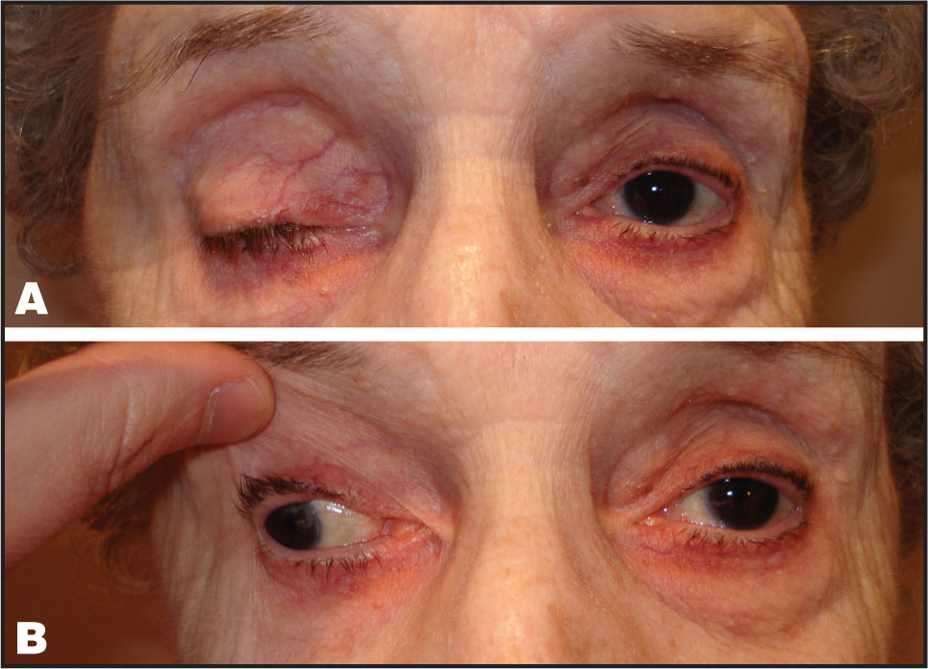
3rd cranial nerve palsy, right eye

Slide 24
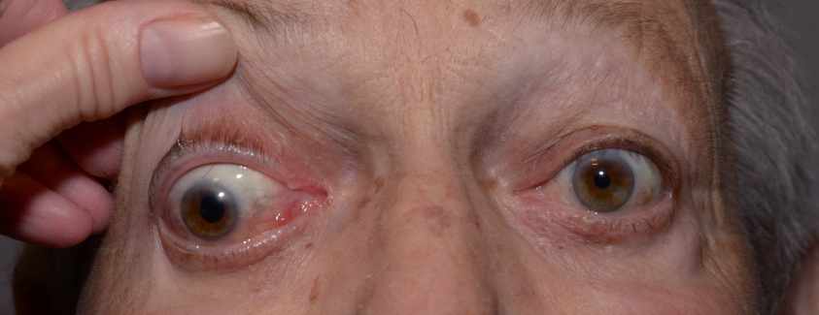
3rd cranial nerve palsy, right eye pupil involvement

Slide 25
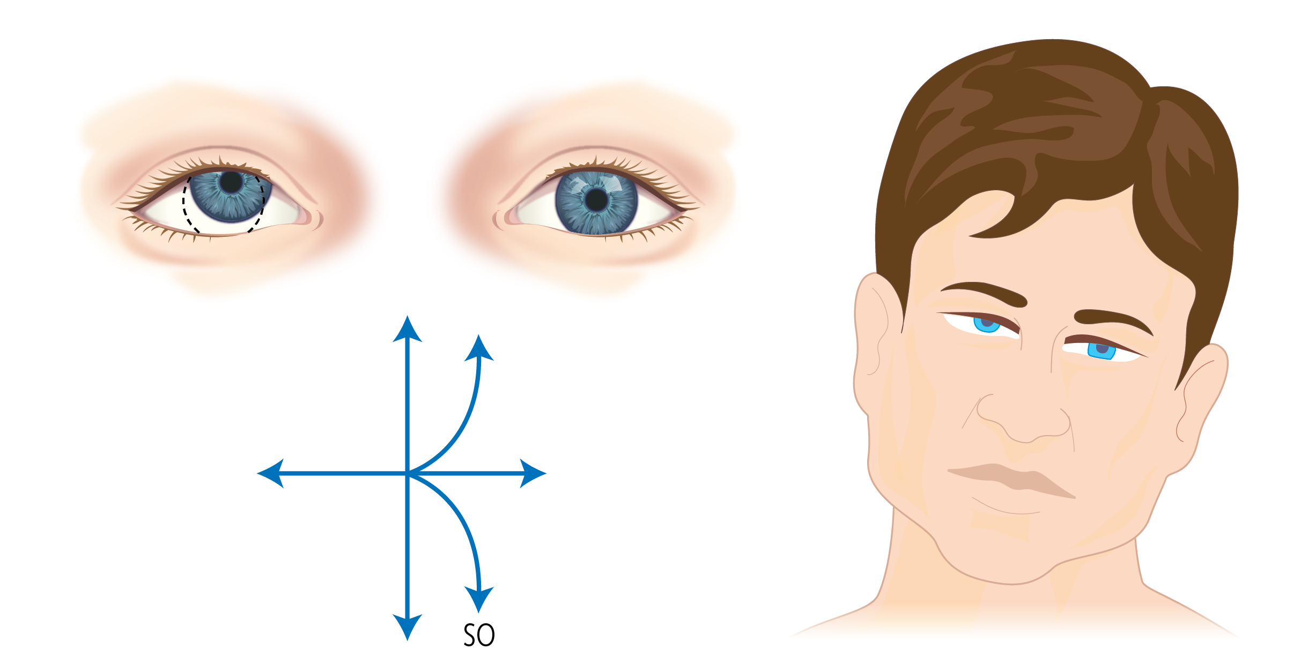
SO4
The trochlear nerve innervates the superior oblique (SO) muscle, which moves the eye downward, especially when the eye is adducted, ie, looking to the nose. When CN IV is damaged, the eye moves upward (elevation) and outward (extorsion) because of the unopposed action of the inferior oblique muscles. This causes the patient to experience vertical diplopia when looking down and in, such as walking downstairs or reading a book. For example, if the right trochlear nerve is damaged, then the right eye will be resting in an upward and outward gaze

Slide 26
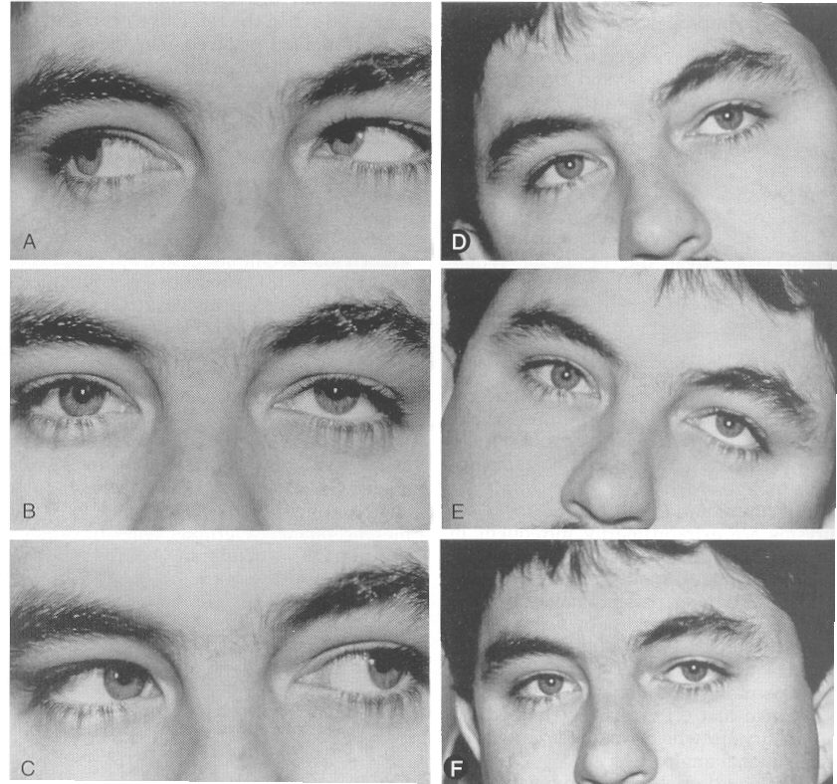
4th cranial nerve palsy, left eye

Slide 27
Sellar lesions
Pituitary adenoma
Craniopharyngioma
Meningioma
Germ cell tumors
Aneurysm
Cysts (Rathke’s cleft, dermoid, epidermoid, arachnoid)
Inflammation (histiocytic hypophysitis, sarcoid)
Infection (TB, syphilis, parasites)

Slide 28
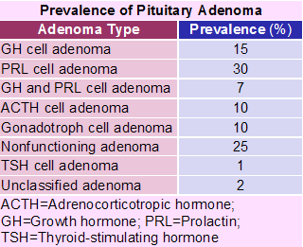
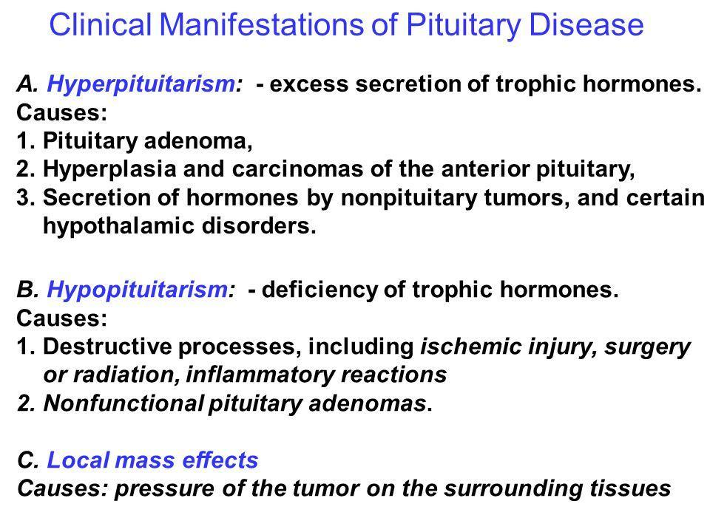
Pituitary adenoma
Microadenoma - < 10 mm
Macroadenoma- > 10 mm. These cause pressure effects- Visual field defects, Hypopituitarism due to pressure on normal hormone producing cells, Pressure on cranial nerves in cavernous sinus- Ptosis, extra ocular movement defects

Slide 29
Evaluation of a suspected sellar lesion
Pituitary function tests
  Prolactin, ACTH, AM cortisol, TSH, Free T4, LH, FSH, estradiol, testosterone, IGF-1
  ACTH and dexamethasone suppression tests
MRI of pituitary region without and with contrast
CT of brain with coronal cuts when suspecting a bleed

Slide 30
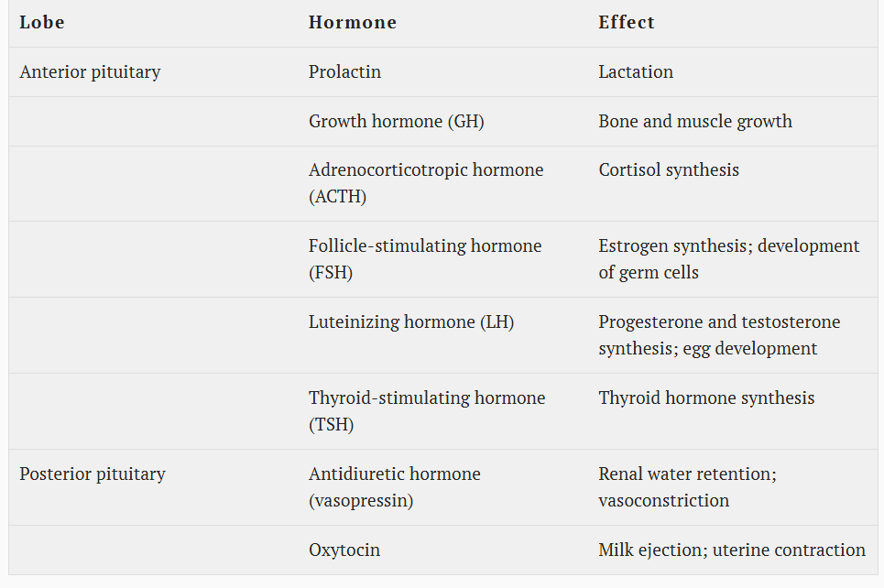
Treatment – Replace hormones- Cortisol
Hypopituitarism / Pan hypo
Lactation failure
GH def-Short stature in kids
Secondary adrenal insufficiency—fatigue, low BP, dizziness
Secondary / hypogonadotrophic hypogonadism – Infertility
Secondary hypothyroidism
Posterior pituitary
ADH deficiency – high volume of dilute urine

Slide 31
The most critical hormone to replace is cortisol, because its deficiency can cause hypotension and death. In such patients, the priority is stabilization of the circulatory system. Treatment in this setting requires the administration of intravenous (IV) saline, dextrose if the patient is hypoglycemic, and IV hydrocortisone.

Slide 32
Treatment of pituitary adenoma
Based on size
-Microadenoma , less than 1 cm -can be monitored
-Macroadenoma- Surgery usually.
Based on secretion
-Prolactin secreting – usually medical therapy is first line

Slide 33
Indications for surgery
Visual Impairment:
Surgery is a primary treatment for adenomas that are pressing on the optic chiasm or optic nerves, causing visual field defects or other visual abnormalities.
Pituitary Apoplexy:
If the pituitary gland experiences a sudden hemorrhage (pituitary apoplexy), surgery may be needed to relieve pressure on the brain and potentially improve vision.
Secreting Adenomas:-- except for prolactinoma
Surgery is often the first-line treatment for secreting adenomas, such as those causing acromegaly or Cushing's disease, when other treatments like medication have not been effective.
Large or Invasive Tumors:
Tumor Growth:
Persistent Symptoms:-If headaches, facial pain, or other symptoms persist despite other treatments, surgery may be an option.
Failure of Other Treatments: -If medical treatments (like medication or radiation) are not successful in controlling the adenoma or its symptoms, surgery may be considered

Slide 34
Treatment
Medical stabilization:
This includes administering Pre/ post operative high dose corticosteroids, monitoring fluid and electrolyte balance and pituitary hormonal defects post op
Surgical decompression: surgical removal of the tumor or decompression needed to improve vision
Prognosis:
Early detection and treatment are crucial for a positive outcome.
Visual symptoms may improve with medications or surgery, with full recovery occurring in about 40% of cases.
About 80% of individuals require long-term hormone replacement therapy.

Slide 35
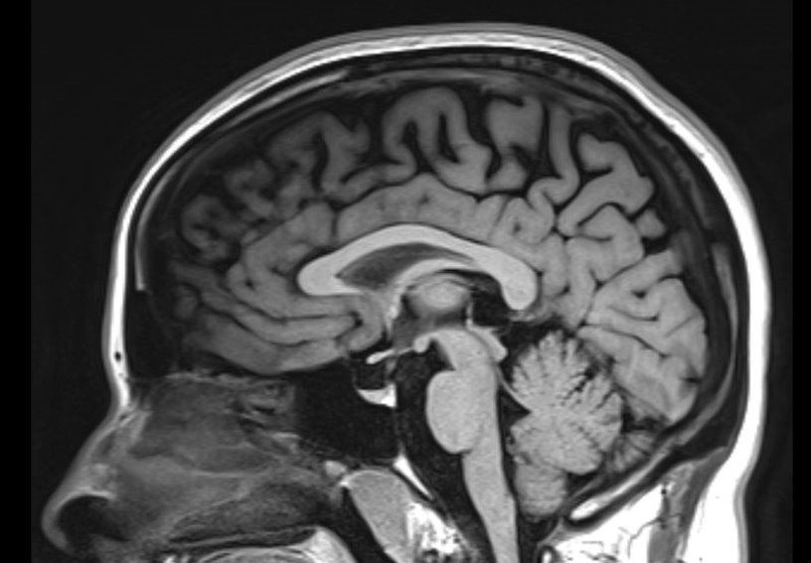
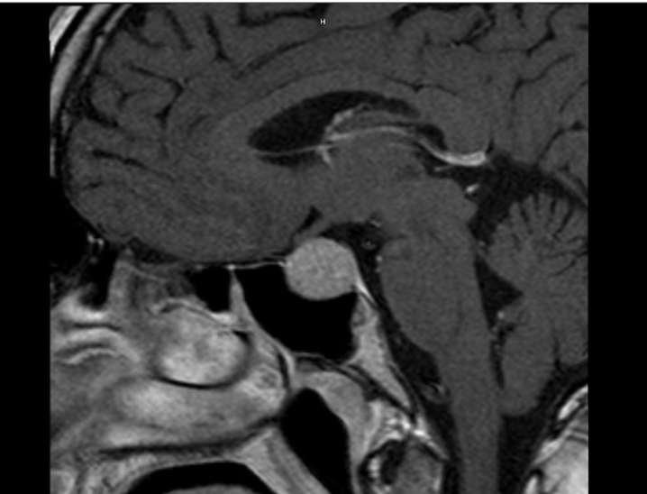
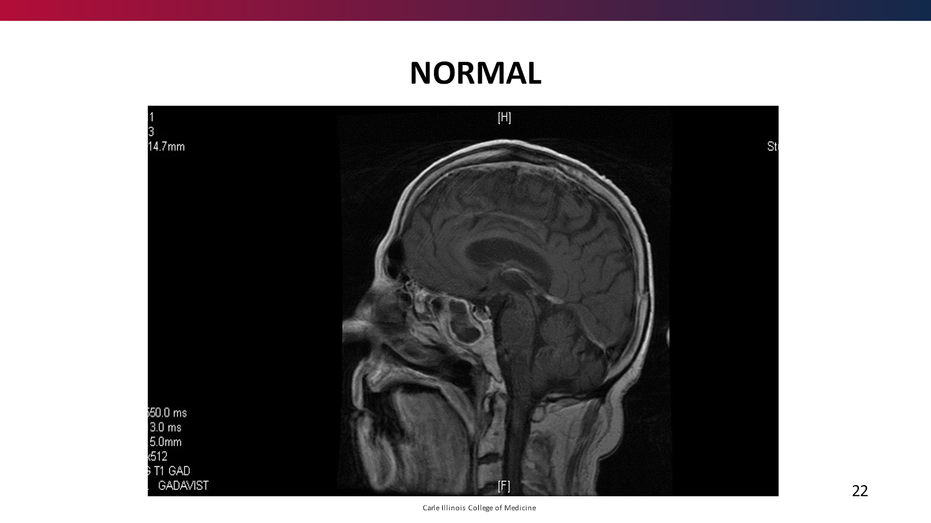
Both images show sagittal views of a pituitary dedicated MRI
I image – normal pituitary gland
II image - shows a non-enhancing 2.5 cm pituitary macroadenoma

Slide 36
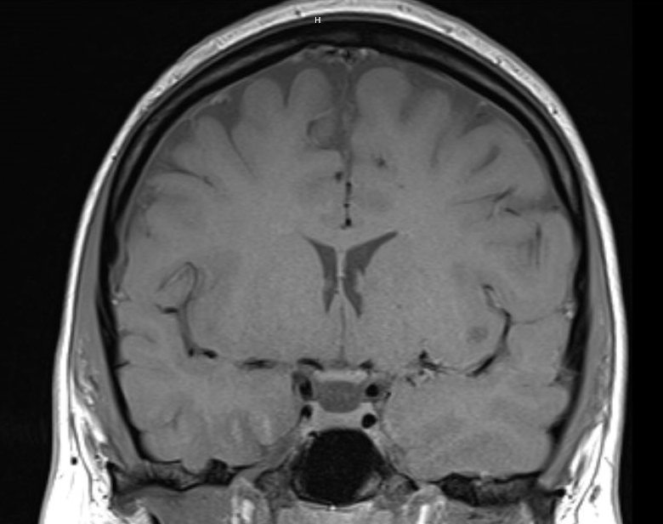
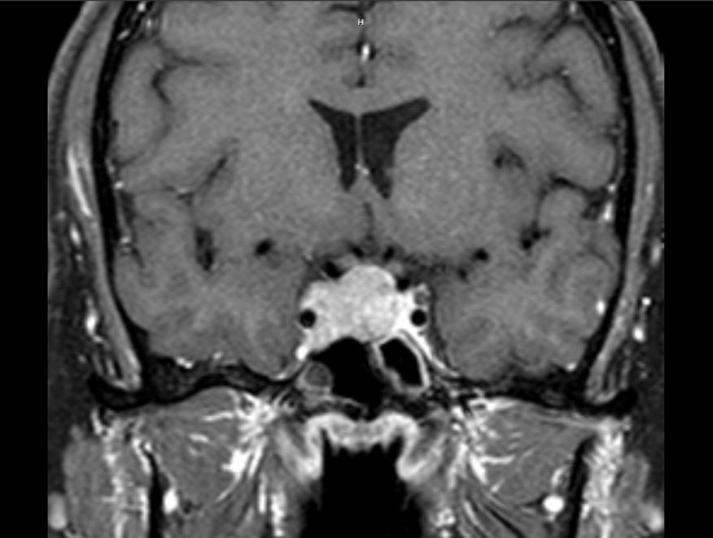
Sella and optic chiasm, cavernous sinus

Slide 37
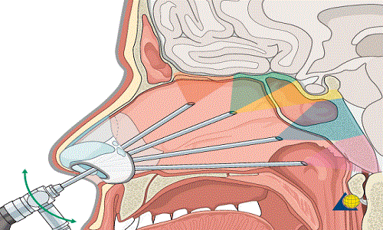
Trans-sphenoidal hypophysectomy - procedure most commonly used to remove a pituitary gland tumor. Trans-sphenoidal means through the sphenoid sinus – the air sinus cavity at the back of the nose.
The pituitary gland is within the sella turcica or the hypophyseal fossa. This structure is present near the center at the base of the cranium. The anatomical boundaries of the gland have clinical and surgical significance. Sella turcica is a concave indentation in the sphenoid bone. The reflections of the dura bound the fossa laterally and superiorly.The diaphragma sellae is a dural fold with a central aperture, and it covers the sella turcica as a roof incompletely. The adenohypophysis is separated from the optic chiasm by the diaphragma. It is continuous with the dura. The pituitary stalk and the blood vessels travel via the central aperture.he lateral walls of the pituitary fossa are made up of dura mater, and it contains the cavernous sinus. The cavernous sinus consists of the internal carotid artery, sympathetic fibers, cranial nerves III, IV, V, and VI.

Slide 38

Questions...
Nestor M Fernandez

Slide 39
Diabetes insipidus/ AVP deficiency
55 year patient underwent a transsphenoidal pituitary tumor resection 4 days ago. He complains of dry mouth , thirst, nausea and urinary incontinence and having to urinate all the time.
Strict input/ output was started and his Input is 2.3 L and output is 5 L /24 hr
Labs
BMP- sodium 148 ( normal under 145) , creatinine 1.5, K 4.4, Glucose normal
ACTH, cortisol, TSH, Thyroxine normal
Serum Osm – 396- high, Urine Osm – 400 low ,urine sodium-low

Slide 40
Diabetes insipidus/ AVP- deficiency
Usually post pituitary tumor resection, other causes include trauma, autoimmune. Postoperative diabetes insipidus (DI) is a common complication following pituitary surgery, with an incidence ranging from 10% to 30%. DI results from the pituitary gland's inability to release enough antidiuretic hormone (ADH)
Large volume(4-8L/day) of Dilute urine ( Low Osmolality)
This results in dehydration and Hypernatremia ( high sodium) → altered sensorium/ vomiting etc.
In Hyperosmolar Diabetic state – Large volume of solute high urine ( Glucose and sodium etc)– OSMOTIC DIURESIS
Usually hyponatremia to normal Na seen

Slide 41
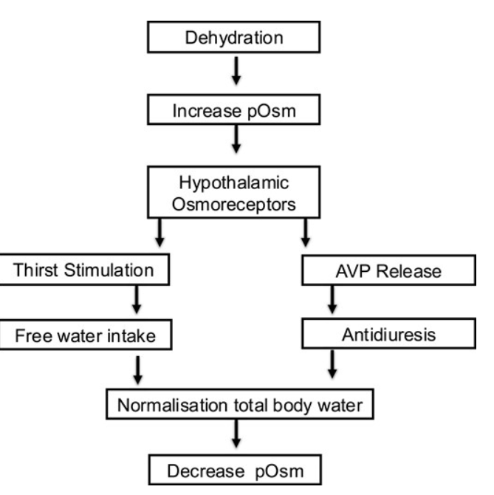
Water homeostasis
The Journal of Clinical Endocrinology & Metabolism, Volume 107, Issue 8, August 2022,

Slide 42
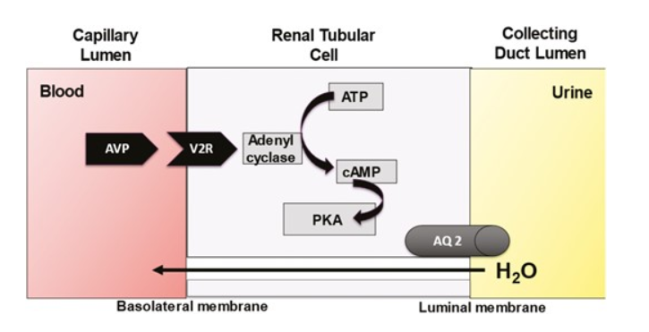
Renal response

Slide 43
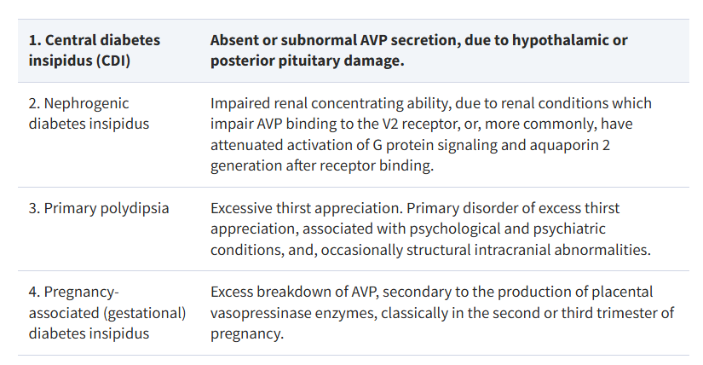
The Journal of Clinical Endocrinology & Metabolism, Volume 107, Issue 10, October 2022,
Lithium use, CKD

Slide 44
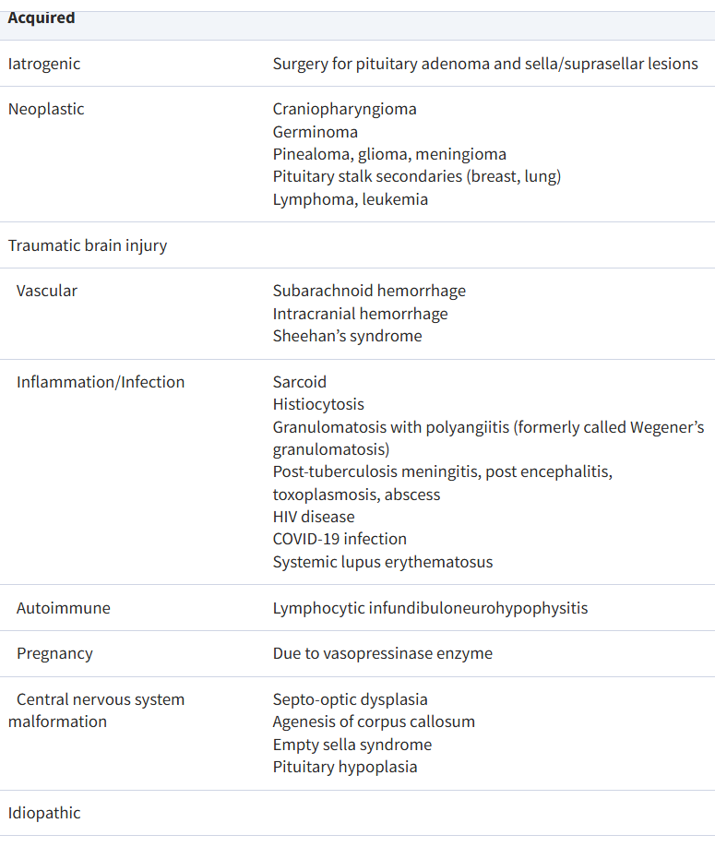

Slide 45
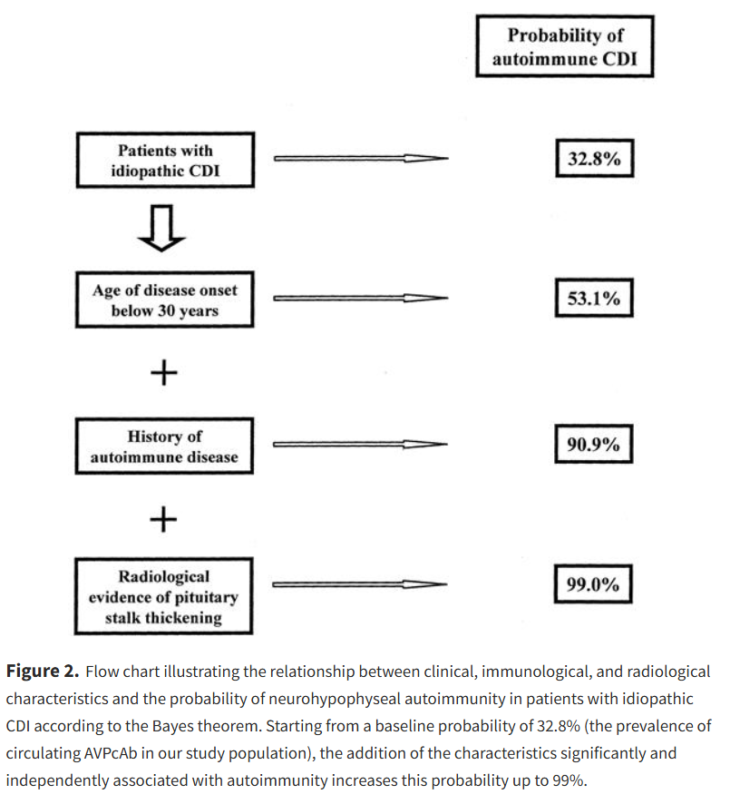
The Journal of Clinical Endocrinology & Metabolism, Volume 88, Issue 4, 1 April 2003,

Slide 46
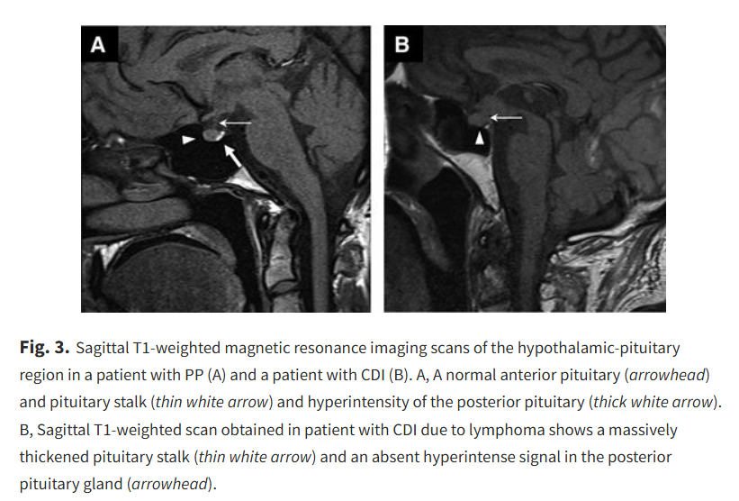
The Journal of Clinical Endocrinology & Metabolism, Volume 97, Issue 10, 1 October 2012,

Slide 47
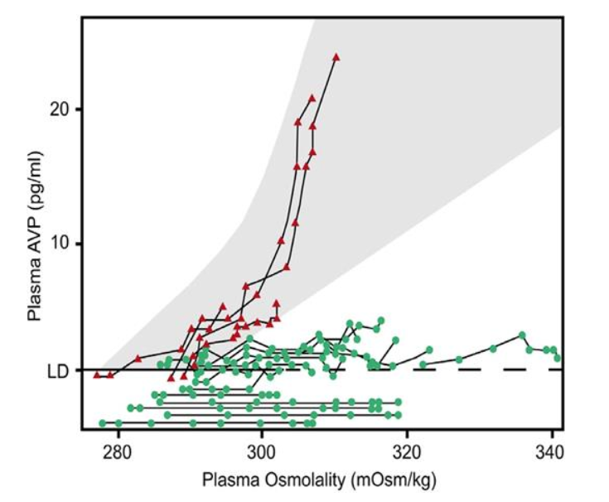
Testing – Water deprivation Test
The physiological basis for the WDT is that dehydration causes an elevation in plasma sodium concentration, which stimulates AVP release. AVP is carried from the circulation to the kidneys, where it binds to V2 receptors, causing elevation in urine osmolality. If the stimulus to AVP secretion is sufficient (plasma osmolality >295 mOsm/kg), urine osmolality should rise to over 700 mOsm/kg.
P.Osmolality (mOsm/kg) =
2[Na+] + [Glucose]/18 + [BUN]/2.8

Slide 48
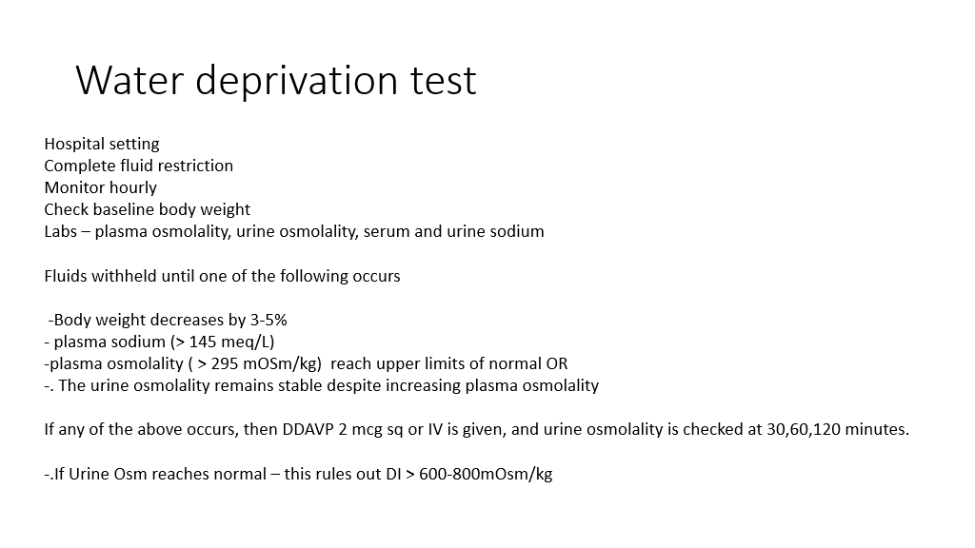
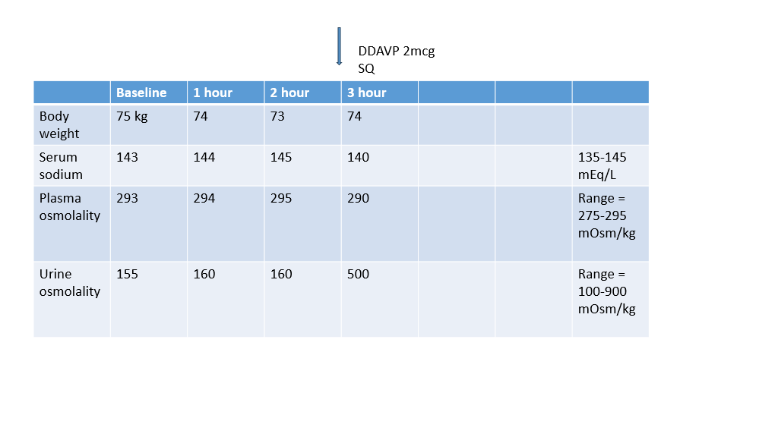

Slide 49
Water deprivation test
Condition | Urine Osmolality After Dehydration | After Desmopressin
Normal | Increases | No significant change
Central DI | No/low increase | Marked increase
Nephrogenic DI | No/low increase | Little or no change
Primary Polydipsia | Gradual increase (may reach normal) | Minimal change
Deamino-D arginine vasopressin abbreviated DDAVP, a derivative of ADH – selectively acts on V2 receptors

Slide 50
Table 1 Diagnosis of diabetes insipidus using water deprivation
Test | Central DI | Nephrogenic DI
Water-deprived plasma osmolality | ↑ | ↑
Water-deprived urine osmolality | ↓ | ↓
Urine osmolality after DDAVP | ↑ | No change
Urine volume after DDAVP | ↓ | No change

Slide 51
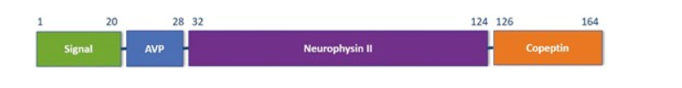
Serum AVP and Co peptin
Copeptin is secreted in equimolar amounts with AVP from posterior pituitary in response to osmo and baroreceptor stimuli

Slide 52
Treatment of central DI
Fluid intake as dictated by thirst
AVP is a nonapeptide hormone, with a short plasma half-life of 5 to 10 minutes. The main physiological action to induce postreceptor synthesis of aquaporin 2 water channels and the insertion of preformed aquaporin 2 water channels into the apical cell membrane is therefore very transient
AVP is therefore unsuitable for therapeutic use in the management of CDI, but the synthetic analog desmopressin (dDAVP [deamino D-arginine vasopressin, desmopressin]) has been modified to prolong half-life from 5 minutes to 6 to 8 hours and to eradicate the vasopressor activity. This allows dDAVP to be administered twice or 3 times daily.
dDAVP is available in a parenteral ( hospital setting), oral ( o.1 to 0.2 mg tab- start at bedtime)
and nasal spray.

Slide 53
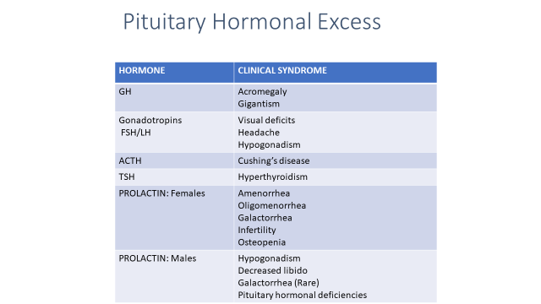

Excess pituitary hormones

Slide 54
Acromegaly ( GH excess in adult)
Soft tissue/ bone growth
Thick eyebrows, nasolabial fold, prognathism, gaps between teeth, change in ring / shoe size, oily skin
Increased risk oof
HTN
DM
Sleep apnea
Cancer- colon ca
MI
DJD- arthritis
Dental issues

Slide 55
Prolactinomas
The majority of patients with hyperprolactinemia do not have prolactinomas. Can be induced by medications/drugs that block dopamine (anti-psychotics) or suprasellar lesions that compress the hypothalamus (decrease in dopamine reaching the lactotrophs).
TSH/ TRH. Dopamine
+ _
Prolactin

Slide 56
Category | Cause | Notes
Physiological | Pregnancy | Natural increase during and after pregnancy
 | Breastfeeding (lactation) | Stimulates prolactin secretion
 | Sleep | Prolactin levels rise during sleep
 | Exercise | Intense exercise can elevate prolactin temporarily
Pharmacological | Antipsychotics (e.g., risperidone, haloperidol) | Dopamine antagonists block prolactin inhibition
 | Antidepressants (e.g., SSRIs, tricyclics)
 | Anti-emetics (e.g., metoclopramide, domperidone) | Dopamine antagonism increases prolactin
 | Estrogens (e.g., oral contraceptives) | Estrogens stimulate prolactin secretion
 | Methyldopa, verapamil

Slide 57
Pathological | Prolactinoma (pituitary adenoma) | Most common pathological cause
 | Hypothyroidism (primary) | TRH increases prolactin secretion
 | Chronic renal failure | Reduced prolactin clearance
 | Chest wall lesions or surgery | Stimulate nerve pathways increasing prolactin
 | Cirrhosis | Liver disease can reduce hormone clearance

Slide 58
Treatment
Hormone Excess | Medications
Prolactin | Dopamine agonists (e.g., cabergoline, bromocriptine) These drugs shrink the tumor and return prolactin levels to normal in ~80% of patients even in macroadenomas. If not effective, then surgery is considered.
Growth Hormone | Surgery , Somatostatin analogs (e.g., octreotide, lanreotide), growth hormone receptor antagonists (e.g., pegvisomant)
ACTH (Cushing's Disease) | Surgery, Adrenal enzyme inhibitors (e.g., metyrapone, ketoconazole), glucocorticoid receptor antagonist (e.g., mifepristone)

Slide 59
Pituitary apoplexy/ infarction
Medical and surgical emergency – ACUTE condition where the pituitary gland experiences a hemorrhage or infarction (tissue death). This usually occurs within a pre-existing pituitary tumor, often an adenoma. This requires prompt diagnosis and treatment to improve outcomes.
Causes:
Bleeding into and ischemia of the pituitary
Risk factors:
These include MACROADENOMA , prior radiation, pregnancy (Sheehan syndrome), trauma, surgery, and anticoagulation therapy.

Slide 60
Symptoms:
Sudden and severe headache.
Visual disturbances (visual loss, double vision).
Nausea, vomiting.
Altered mental status.
Signs of meningeal irritation (stiff neck).
Hormone insufficiency.
Ophthalmoplegia (paralysis of eye muscles).
Diagnosis:
Imaging: CT scans and MRI are used to confirm the presence of hemorrhage or infarction in the pituitary gland.
Blood tests: Evaluate hormone levels and electrolytes
Immediate treatment with steroids ( don't wait on labs etc) and emergent surgical decompression

Slide 61
Sheehan syndrome
Sheehan syndrome, also known as postpartum pituitary necrosis, is a condition where the pituitary gland is damaged, often due to significant blood loss during or after childbirth. This damage leads to a decreased production of pituitary hormones, resulting in various symptoms.
Causes:
Postpartum hemorrhage/ hypovolemic shock:
Severe blood loss during or after childbirth is the primary cause, leading to ischemia (reduced blood supply) and necrosis (tissue death) of the pituitary gland.
Symptoms:
Sheehan syndrome can manifest with a range of symptoms due to the deficiency of pituitary hormones, including:
Inability to breastfeed (agalactorrhea): Prolactin, a hormone necessary for milk production, is often affected. -- First symptom
Amenorrhea (absence of menstruation): Gonadotropin hormones, which regulate menstruation, are also deficient.
Hypothyroidism: Thyroid-stimulating hormone deficiency can lead to hypothyroidism symptoms like fatigue, cold intolerance, and weight gain.
Adrenal insufficiency: ACTH deficiency can lead to low cortisol levels, causing fatigue, weakness, and other symptoms.
Hypogonadism: Gonadotropin deficiency can affect sex drive and reproductive function.

Slide 62
Hypophysitis
Hypophysitis-- pituitary gland inflammation, is a rare condition that can lead to hypopituitarism (decreased hormone production) and pituitary enlargement.
Causes and Types:
Primary Hypophysitis: -due to autoimmune conditions- ex: lymphocytic hypophysitis, IgG-4. Other types include granulomatous, xanthomatous, and plasmacytic hypophysitis.
Secondary Hypophysitis: This is caused by other systemic diseases or conditions affecting the pituitary gland, such as infections or tumors.
Immune Checkpoint Inhibitor-Related Hypophysitis
Headaches are a common initial symptom.
Visual disturbances due to compression of optic nerves or cranial nerves can occur.
Hormonal deficiencies can lead to symptoms like adrenal insufficiency, hypothyroidism, hypogonadism, and growth hormone deficiency.
Diabetes insipidus

Slide 63
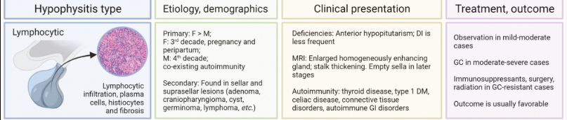
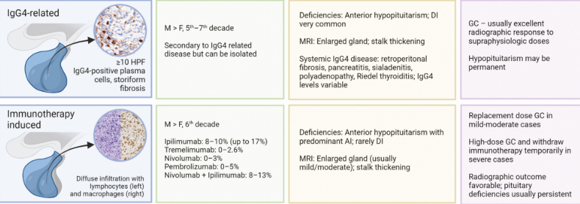
The Journal of Clinical Endocrinology & Metabolism, Volume 107, Issue 1, January 2022,

Slide 64
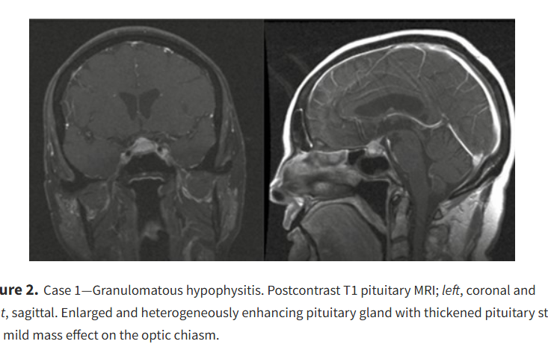

Slide 65
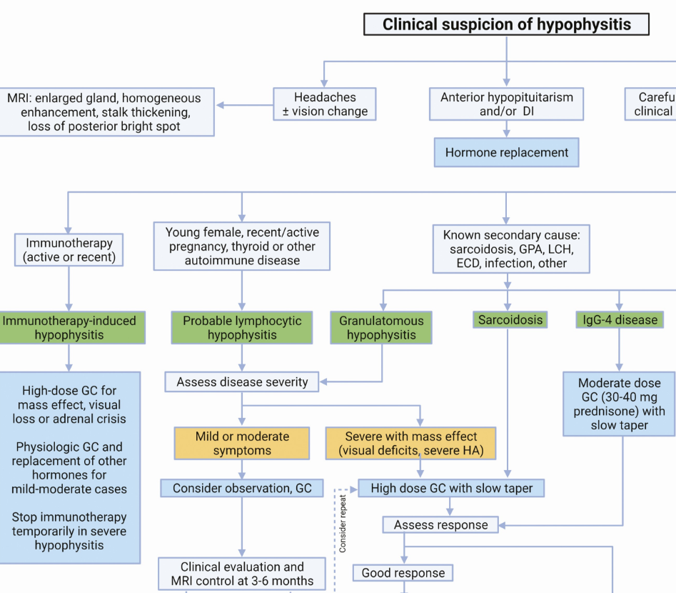
Treatment-​ Steroids given as a therapy as well as to replace deficient cortisol hormone

Slide 66
Empty sella
After pituitary surgery, hypophysitis or idiopathic.
Very little pituitary tissue is left
If idiopathic- no hormonal defects usually
If non- idiopathic, may have hormonal deficiencies

Slide 67


Hyponatremia SIADH
Syndrome of Inappropriate ADH secretion ( when euvolemic) – unregulated ADH secretion resulting in water retention------>Hyponatremia.
Causes- medications- diuretics, opioids, NSAID, alcohol, malignancies ( ectopic ADH secretion)
Labs- Low serum sodium and , normal thyroid and adrenal function
Chronic – asymptomatic– Treatment is water restriction, rarely vasopressin receptor antagonists like tolvaptan, salt tablets
Remember ADH and AVP are synonyms
Too much ADH- hyponatremia
Too liitle ADH- hypernatremia

Slide 68

SIADH- Diagnostic criteria

Slide 69


Slide 70

SIADH treatment
Acute worsening, seizures- treat aggressively with 3% hypertonic saline – to bring up Na by 4-6 meq/L in First hour and then slow down.
Chronic, mild symptoms like dizziness/ confusion, Na > 125 – go slow, goal correction to 4-6 meq over 12-24 hours to prevent osmotic demyelination syndrome

Slide 71

Thank you
References
Lange- Endocrine
Articles- JCEM, JAMA
Uptodate, Scholar rx , earlier lectures and
limited online sources

