Slide 1
Pharmacotherapy of
Type 2 Diabetes
Sathya Subbiah, MD
Carle-Illinois College of Medicine

Slide 2
Learning Objectives
Describe the indications, mechanisms of action, distinctive and adverse effects of medications used to treat type 2 diabetes
Identify appropriate initial and add-on therapy for a patient with type 2 diabetes
Identify clinically-important interactions involving anti-hyperglycemic medications
Discuss general issues to consider when choosing a specific medication

Slide 3
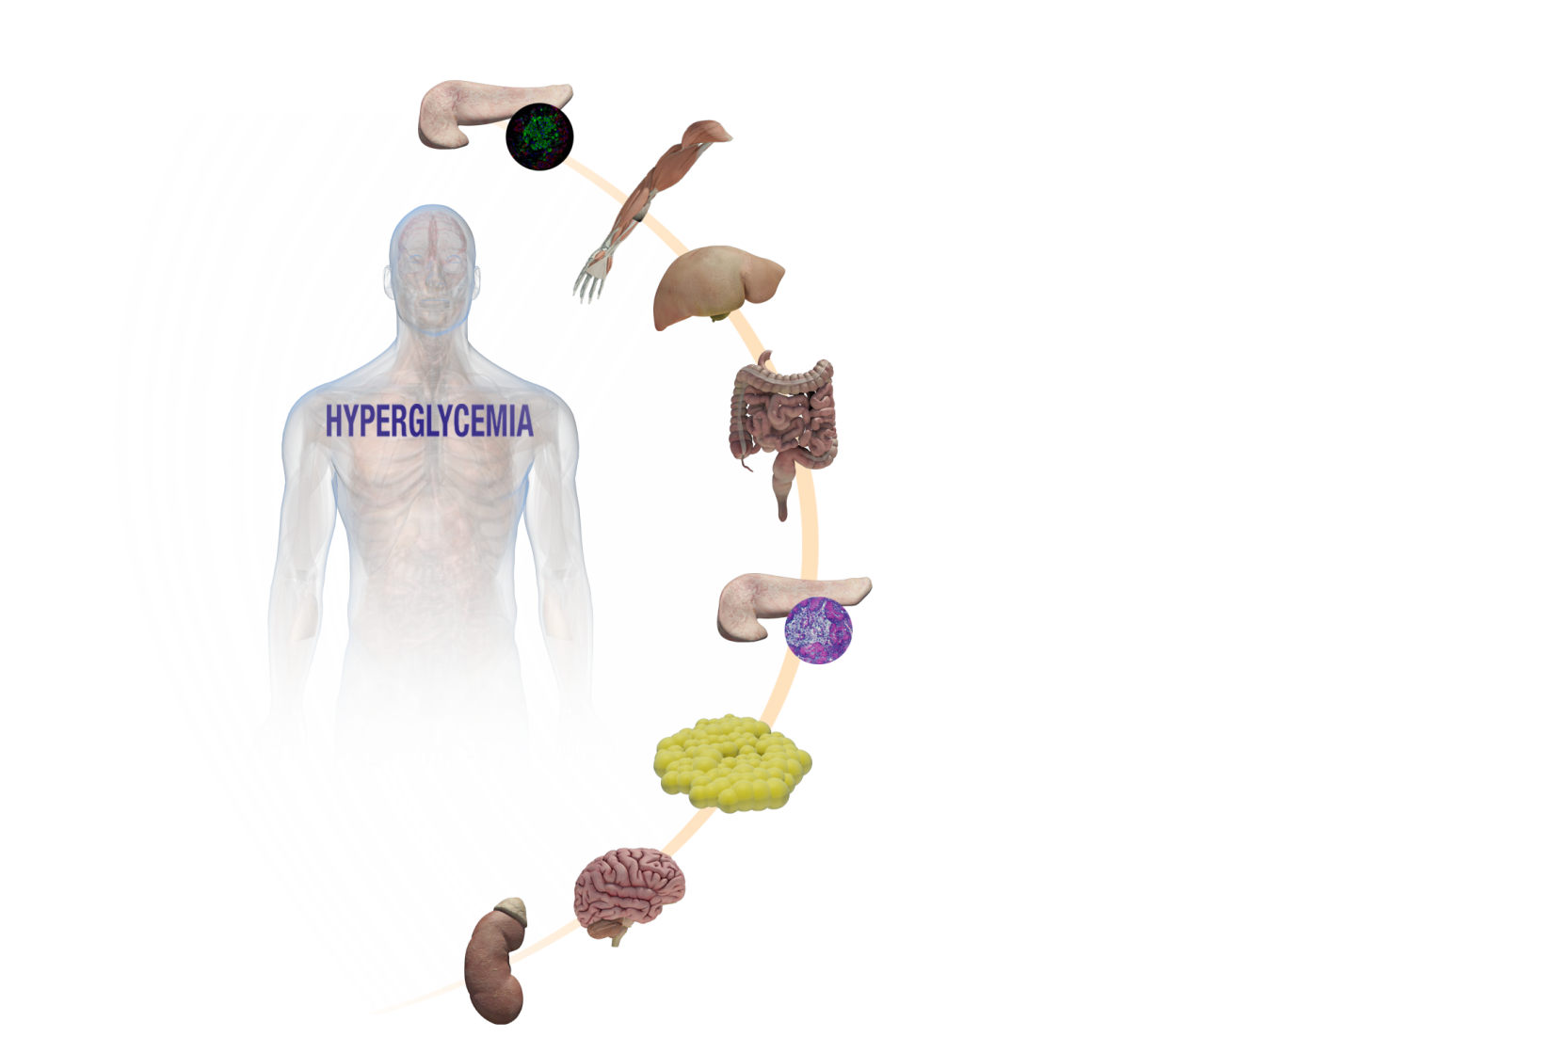

Type 2 DM Medications:
Sites of Action of Therapeutic agents
Islet cells
Skeletal muscle – Metformin, Glitazones, Insulins
Liver – Metformin, GLP 1 RA, Glitazones, Insulins
Gut - GLP-1 RA, DPP IV-i, Glitazones
Islet cells – GLP-1 RA, DPP IV-i, Sulfonylureas
Adipose tissue- Metformin, Glitazones, DPP IV-i, Insulins
GLP-1 RA, DPP IV-i
SGLT2-i
Notes:
6

Slide 4
Goal A1c and corresponding average glucose
A1C (%) | mg/dL* | mmol/L
5 | 97 (76–120) | 5.4 (4.2–6.7)
6 | 126 (100–152) | 7.0 (5.5–8.5)
7 | 154 (123–185) | 8.6 (6.8–10.3)
8 | 183 (147–217) | 10.2 (8.1–12.1)
9 | 212 (170–249) | 11.8 (9.4–13.9)
10 | 240 (193–282) | 13.4 (10.7–15.7)
11 | 269 (217–314) | 14.9 (12.0–17.5)
12 | 298 (240–347) | 16.5 (13.3–19.3)

Slide 5
Metformin (1,1-dimethylbiguanide) originates from Galega officinalis, also known as the French lilac.
1997, the results of the UK Prospective Diabetes Study (UKPDS) -more than 5000 patients with T2D were assigned to glucose-lowering treatment groups including dietary intervention, metformin, sulfonylurea, or insulin. The results clearly highlighted the beneficial outcomes of metformin, with patients randomized to this treatment group having reduced diabetes-related death and fewer hypoglycemic attacks than other pharmaceutical interventions . Metformin was subsequently recommended as a first-line therapy for the treatment of T2D.
Hepatic glucose production (HGP) reflects the net contributions of hepatic gluconeogenesis, glycogenolysis, glycogen synthesis, and glycolysis. That approximately 85% to 90% of endogenous glucose production following an overnight fast is attributed to HGP highlights the importance of HGP to whole-body glucose metabolism and glycemic control . Furthermore, in the overnight fasted state, about 50% of HGP can be attributed to hepatic gluconeogenesis and, in patients with poorly controlled T2D, an increased rate of hepatic gluconeogenesis is the primary driver of fasting hyperglycemia
In patients with poorly controlled T2D, increased gluconeogenesis is the major factor contributing to increased rates of liver glucose production and fasting hyperglycemia.
The primary mechanism of action is inhibition of liver glucose production
Increased glucose uptake by skeletal muscle
Increased intestinal glucose uptake, changes in gut microbiome

Slide 6
Proposed mechanisms of action
It has been suggested that metformin antagonizes hepatic glucagon signaling by decreasing cyclic AMP accumulation, thus preventing transcription of gluconeogenic genes.
Mitochondrial complex I inhibition leads to suppression of gluconeogenesis, including altered hepatic energy charge and AMPK activation leading to downregulation of gluconeogenic gene expression.

Slide 7
Metformin Associated Lactic Acidosis
Extremely rare (incidence 0.03 to 0.06/ 1000 patient-yrs)
  High mortality rates - 30 to 50%
Risk factors
  Poor renal function (reduced metformin clearance)
                Impaired hepatic metabolism (reduced lactate clearance)
                Increased production (sepsis, CHF, reduced tissue perfusion, or anoxia)

Slide 8
Current contraindications for metformin use include advanced chronic kidney disease , liver disease, heart failure, age >65, pulmonary disease, use of intravenous contrast agents within 48 hours, or any condition with relative tissue hypoxia
The presence of metformin-associated hyperlactatemia in critical care patients has been associated with a mortality >30%
Metformin inhibits mitochondrial cellular respiration, which increases anaerobic metabolism and lactate levels . The pathophysiology of lactic acidosis from metformin is likely due to inhibition of gluconeogenesis by blocking pyruvate carboxylase, the first step of gluconeogenesis, which converts pyruvate to oxaloacetate. Blocking this enzyme leads to accumulation of lactic acid. Biguanides also decrease hepatic metabolism of lactate and have a negative ionotropic effect on the heart, both of which elevate lactate levels .
Metformin dose, along with the duration of exposure from accumulation in patients with decreased renal clearance, can cause lactic acidosis

Slide 9
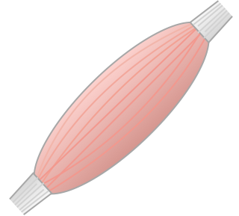
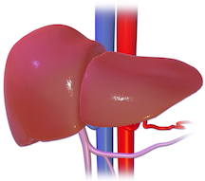
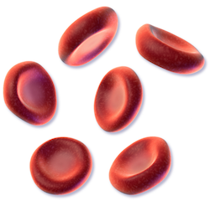
Lactic acidosis
glucose
Metformin
lactate
Hypoxic state
Notes:
Image credits:
Liver:
Author: BurceBlaus
Accessed December 9, 2015: https://commons.wikimedia.org/wiki/File:Liver_(organ).png
License: Creative Commons Attribution-Share Alike 4.0 International
Erythrocytes:
Blausen.com staff. "Blausen gallery 2014". Wikiversity Journal of Medicine. DOI:10.15347/wjm/2014.010. ISSN 20018762
License: Creative Commons Attribution 3.0 Unported

Slide 10
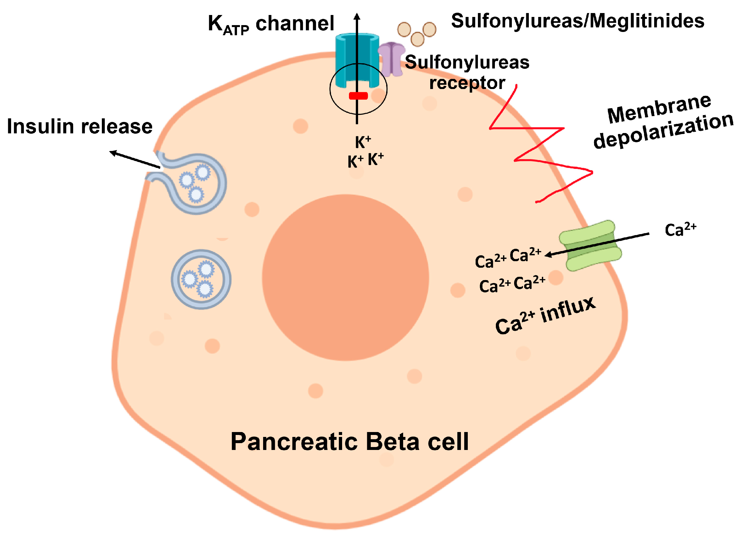
Sulfonylureas- Glipizide, Glimepiride,Glyburide
Stimulate insulin secretion from pancreatic beta cells
Their primary mechanism of action is to bind to and close ATP-sensitive potassium (KATP) channels in the beta cell plasma membrane, They stop the flow of potassium, which depolarizes the cell membrane and opens calcium channels. The increased calcium flow causes actomyosin filaments to contract, which leads to insulin exocytosis.

Slide 11
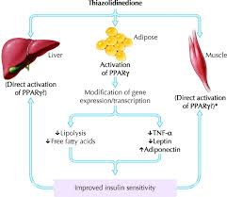
Thiazolidinediones- Pioglitazone
Thiazolidinediones, such as pioglitazone, bind to peroxisome proliferator-activated receptors (PPARs). They alter the transcription of genes influencing carbohydrate and lipid metabolism. Pioglitazone improves glycemic control in people with Type 2 diabetes by improving insulin sensitivity through its action at PPAR gamma 1 and PPAR gamma 2, and affects lipid metabolism through action at PPAR alpha. The results of these interactions include increases in glucose transporters 1 and 4, lowered free fatty acids, reduced (TNF alpha) and remodeling of adipose tissue. Together, these can increase glucose uptake and utilization in the peripheral organs and decrease gluconeogenesis in the liver, thereby reducing insulin resistance.

Slide 12
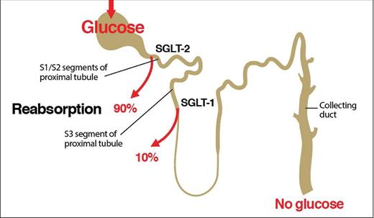
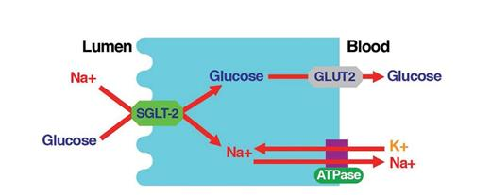
SGLT-2 inhibitors- glucose excretion can be induced by blocking the activity of the renal sodium-glucose cotransporter 2 (SGLT-2). This causes reabsorption of glucose at proximal renal tubule. This causes glucosuria and corrects hyperglycemia without stimulating release of insulin.
Empagliflozin, Dapagliflozin, Canagliflozin,

Slide 13
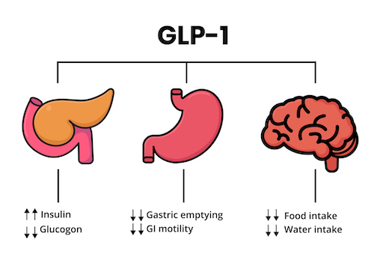
Incretins are hormones secreted from the intestine upon ingestion of glucose to stimulate insulin secretion from pancreatic β cells.
GLP1-
Intestinal L cells in distal ileum and colon produces a peptide from proglucagon molecule called Glucagon like peptides, GLP 1.They are stimulated by a meal and inactivated by protease, Dipeptidyl peptidase 4 ( DPP-4)
Pancreas- stimulates insulin secretion, inhibits glucagon secretion
Stomach -Inhibits Gastric emptying
Brain-Inhibits appetite
GIP--Produced by K cells in duodenum and jejunum, in response to glucose.
Pancreas -Stimulates Insulin, glucagon and somatostatin secretion.
Stomach-Inhibits gastric emptying.
Fat-Stimulates adipogenesis
GLP –1 agonist

Slide 14
GLP 1 agonist- Dulaglutide, Semaglutide, Liraglutide
GLP1+ GIP agonist - Tirzepatide
GLP-1 RAs stimulate the body’s own insulin secretion
Glucagon-like peptide-1 (GLP-1) is a physiological hormone that has multiple actions on glucose, mediated by the GLP-1 receptors. GLP-1 receptor agonists selectively binds to and activate the GLP-1 receptor.
Enhanced appropriate pancreatic β-cell (insulin and amylin) secretion
Pancreatic α-cell (glucagon) suppression
Decreased liver glucose production
Increased satiety through central nervous system
Slowed gastric emptying time
Increased insulin uptake in peripheral tissue via weight loss

Slide 15
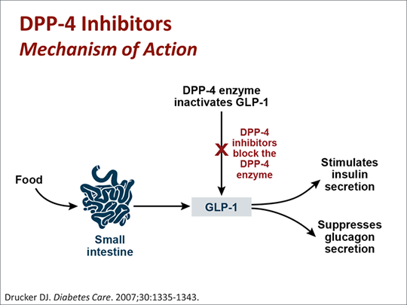
DPP 4 inhibitor-Sitagliptin,Linagliptin
Inhibit the enzyme Dipeptidyl peptidase 4 , which cleaves the GLP 1 agonist –thereby the prolonging the action and life of GLP1 agonist

Slide 16
Insulin
Insulin acts by directly binding to its receptors on the plasma membranes of the cells. These receptors are present on all the cells, but their density depends on the type of cells, with the maximum density being on the hepatic cells and adipocytes.
The insulin receptor is a glycoprotein consisting of two subunits, the alpha and the beta subunits. The extracellular alpha subunits have insulin binding sites. The beta subunits, which are transmembranous, have tyrosine kinase activity. When insulin binds to the alpha subunits, it activates the tyrosine kinase activity in the beta subunit, which causes the translocation of glucose transporters GLUT4 from the cytoplasm to the cell's surface.These glucose transporters allow the influx of glucose from the blood into the cell, thus reducing the blood glucose levels.
Insulin causes the following effects in the cells:
Hepatic cells: Promotes glycogenesis, inhibits gluconeogenesis
Adipocytes: Promotes lipogenesis, inhibits lipolysis
Muscle cells: Promotes glycogenesis and protein synthesis. Inhibits protein catabolism
Pancreatic beta cells: Inhibits glucagon release
Brain cells: Involved in appetite regulation

Slide 17
Insulin
Depending on the duration of action, insulin categorizes as short-acting, intermediate-acting, and long-acting.
Rapid-acting insulins (lispro, Glulisine, aspart) start their action in 5 to 15 minutes and peak in 30 minutes. The duration of action is 3 to 5 hours. They are generally used before meals and always used along with short-acting or long-acting insulins to control sugar levels throughout the day.
Short-acting (regular insulin) starts the action in 30 to 40 minutes and peaks in 90 to 120 minutes. The duration of action is 6 to 8 hours. Patients take these agents before meals, and food is necessary within 30 minutes after its administration to avoid hypoglycemia.
Intermediate-acting insulins (NPH) start the action in 1 to 4 hours and peak in 4 to 8 hours. Dosing is usually twice a day and helps maintain the blood sugar levels throughout the day.
Long-acting insulins, such as Detemir, glargine, Degludec, start action in 1 to 2 hours. They provide a plateau effect over 12 to 24 hours. Dosing is usually during the night time after meals. Their long duration of action helps in reducing the frequency of dosing throughout the day.

Slide 18
Properties of anti-hyperglycemic agents
Oral Class | Mechanism | Advantages | Disadvantages
Biguanides | Activates AMP-kinase (?other) ↓ Hepatic glucose production | Extensive experience No hypoglycemia Weight neutral ? ↓ CVD | Gastrointestinal Lactic acidosis (rare) B-12 deficiency Contraindications
Sulfonylureas | Closes K_{ATP} channels ↑ Insulin secretion | Extensive experience ↓ Microvascular risk | Hypoglycemia ↑ Weight Low durability Caution in renal insufficiency
Meglitinides | Closes K_{ATP} channels ↑ Insulin secretion | ↓ Postprandial glucose Dosing flexibility | Hypoglycemia ↑ Weight Dosing frequency
TZDs | PPAR-γ activator ↑ Insulin sensitivity | No hypoglycemia Durability ↓ TGs (pio) ↑ HDL-C ? ↓ CVD events (pio) | ↑ Weight Edema/heart failure Bone fractures ↑ LDL-C (rosi)
Diabetes Care 2015;38:140-149;
Diabetologia 2015;58:429-442
Notes:
Here are some of the older oral drug classes used in T2DM. The table describes the mechanism of action of each class, its advantages, disadvantages and cost. Less commonly used classes are denoted in grey font.

Slide 19
Oral Class | Mechanism | Advantages | Disadvantages
α-Glucosidase inhibitors | Inhibits α-glucosidase Slows carbohydrate digestion / absorption | No hypoglycemia Nonsystemic ↓ Postprandial glucose ? ↓ CVD events | Gastrointestinal Dosing frequency Modest ↓ A1c
DPP-4 inhibitors | Inhibits DPP-4 Increases incretin (GLP-1, GIP) levels | No hypoglycemia Well tolerated | Angioedema / urticaria ? Pancreatitis ? ↑ Heart failure Cost
Bile acid sequestrants | Bind bile acids ? ↓ Hepatic glucose production | No hypoglycemia ↓ LDL-C | Gastrointestinal Modest ↓ A1c Dosing frequency Cost
Dopamine-2 agonists | Activates DA receptor Alters hypothalamic control of metabolism ↑ insulin sensitivity | No hypoglyemia ? ↓ CVD events | Modest ↓ A1c Dizziness, fatigue Nausea Rhinitis Cost
SGLT2 inhibitors | Inhibits SGLT2 in proximal nephron Increases glucosuria | ↓ Weight No hypoglycemia ↓ BP Effective at all stages | GU infections Volume depletion ↑ LDL-C Cost
Diabetes Care 2015;38:140-149;
Diabetologia 2015;58:429-442
Notes:
Additional oral agent classes used in T2DM are included on this slide. The table describes the mechanism of action of each class, its advantages, disadvantages and cost. Less commonly used classes are denoted in grey font.

Slide 20
Injectable Class | Mechanism | Advantages | Disadvantages
Amylin mimetics | Activates amylin receptor ↓ glucagon ↓ gastric emptying ↑ satiety | ↓ Weight ↓ Postprandial glucose | Gastrointestinal Modest ↓ A1c Hypoglycemia Dosing frequency Training requirements Cost
GLP-1 receptor agonists | Activates GLP-1 R ↑ Insulin, ↓ glucagon ↓ gastric emptying ↑ satiety | ↓ Weight No hypoglycemia ↓ Postprandial glucose ↓ Some CV risk factors | Gastrointestinal ? Pancreatitis Medullary ca (rodents) Training requirements Cost
Insulin | Activates insulin receptor Myriad | Universally effective Unlimited efficacy ↓ Microvascular risk | Hypoglycemia Weight gain Patient reluctance Training requirements Cost – for analogues
Diabetes Care 2015;38:140-149;
Diabetologia 2015;58:429-442
Notes:
Here now are the injectable drugs used in T2DM. The table describes the mechanism of action of each class, its advantages, disadvantages and cost. Less commonly used classes are denoted in grey font.

Slide 21
Highlighting medications currently in common use
American Diabetes Association 2024

Slide 22
Drug | Efficacy | Hypoglycemia | weight | Cardiovascular | cost | Clinical considerations
Metformin | High | none | Mild | Neutral | Low | Diarrhea B12 def Avoid when ill( lactic acidosis)
SGLT2 inhibitors | High to medium | none | Mild to moderate | Yes Renal protection | Medium | Genital yeast infection Fournier gangrene Stop when ill Euglycemic DKA
GLP-1 agonist | High | none | Very High | Yes | High | Risk of medullary thyroid cancer in rats' Cholecystitis/pancreatitis GI side effect Stop before any surgery x 1 week
DUAL GLP1 ,GIP agonist | High | none | Very High | Yes | High | As above

Slide 23
Drug | Efficacy | Hypoglycemia | weight | Cardiovascular benefit | cost | Clinical considerations
DPP4 inhibitor | Moderate | none | Neutral | Neutral | Medium | Pancreatitis Rare- bullous pemphigoid
Sulfonylurea | High | High | Gain | Neutral | Low | Careful in chronic kidney disease
Thiazolidenediones | High | none | Gain | Increase risk of heart failure | Medium | Benefit in Fatty liver
Insulin | High | High | Gain | Neutral | Medium

Slide 24
Efficacy: Decrease in HbA1c
Insulin ≈1.5-3.5%
Most drugs ≈ 1-1.5%

Slide 25
Achievement of A1c goal
Very high efficiency
  Insulin
  Insulin with GLP1 receptor agonist
  High dose GLP1 receptor agonist
  Intermediate efficiency
  -GLP-R agonist medium doses
  -SGLT2 inhibitors
  Low to intermediate efficiency
  -Metformin --usually first choice or as part of combination therapy
  -DPP4 inhibitors

Slide 26
Preferred medications in cardiorenal risk reduction in Type 2 diabetes
- in addition to healthy lifestyle changes and statins
Vascular disease (coronary disease, peripheral vascular, stroke)-SGLT2 inhibitors or GLP 1 R-agonist therapy
Heart failure- SGLT2 inhibitor
Preventing CKD progression- SGLT2 inhibitor ( if GFR permissible)

Slide 27
Hypoglycemia
higher risk | lower risk
insulin | metformin
sulfonylureas | thiazolidinediones
glinides | incretin mimetics/ GLp1 R agonist
pramlintide (with insulin) | α-glucosidase inhibitors
 | SGLT2 inhibitors

Slide 28
Glucagon for severe hypoglycemia treatment
Product | Form(s) |  |  | Dosage(s)
Glucagon | Injection powder with diluent for reconstitution |  |  | 1 mg
Glucagon | Nasal powder |  |  | 3 mg
Glucagon | Prefilled pen, prefilled syringe |  |  | 0.5 mg, 1 mg

