Slide 1
Pap Smear Education

Slide 2
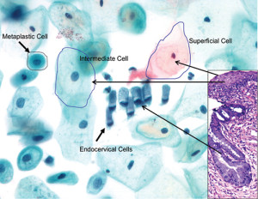
To screen for cervical cancer
What is the purpose of a pap smear?
What is the purpose of a pap smear?

Slide 3
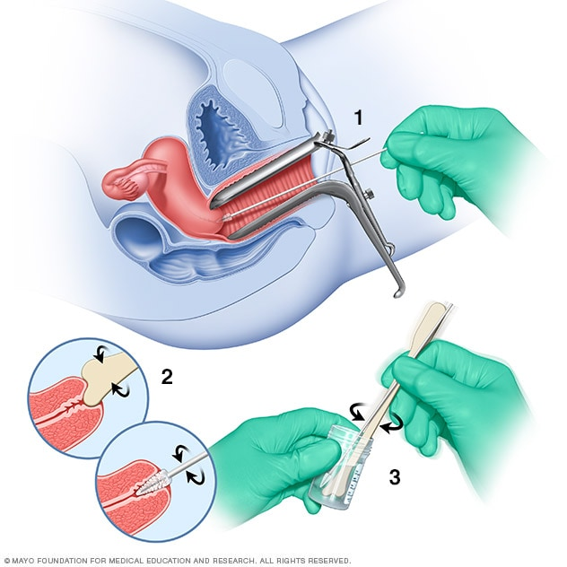
It is a screening test
Is a pap smear a screening, diagnostic, or therapeutic test?

Slide 4
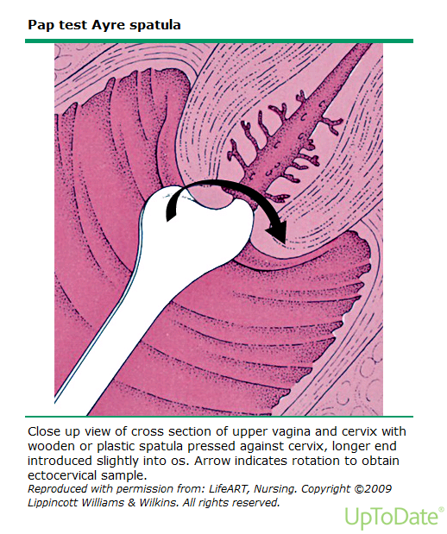

Slide 5
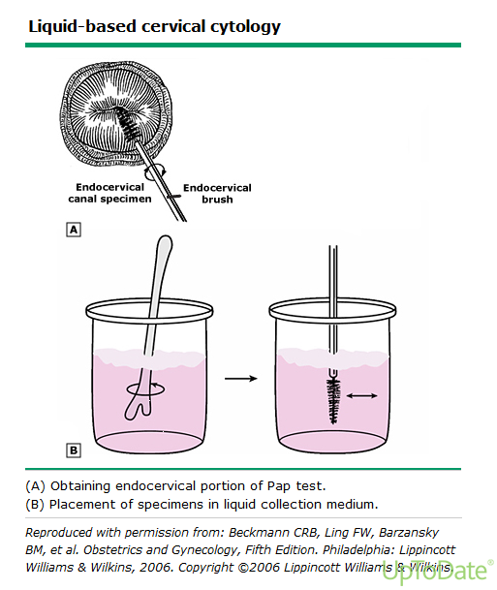

Slide 6
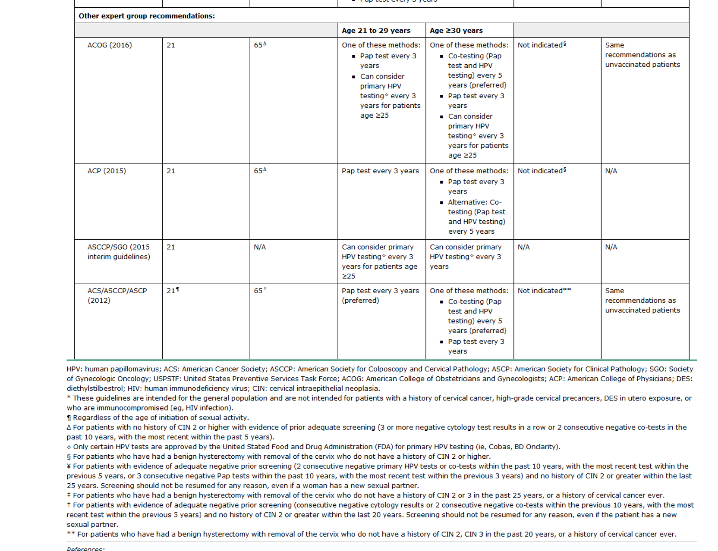
Cervical Cancer screening recommendations

Slide 7
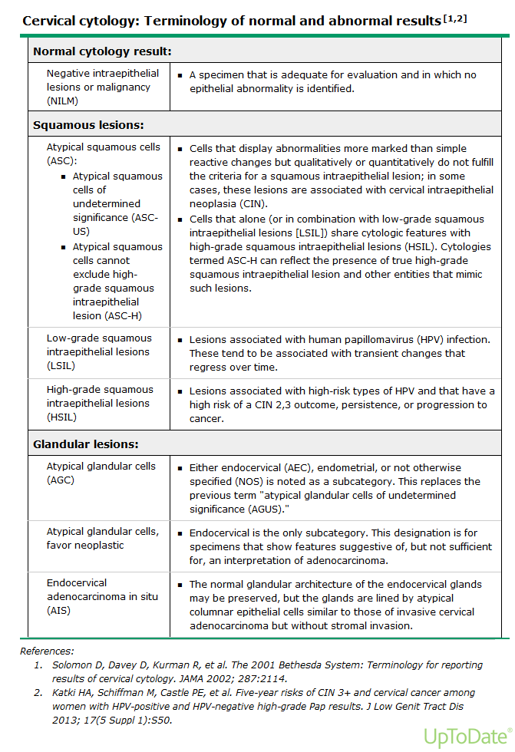

Slide 8
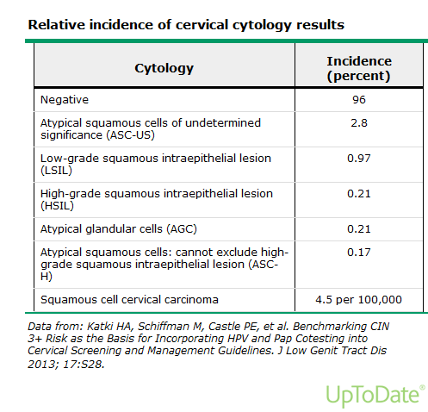

Slide 9
