Slide 1
Adnexal
Masses

Slide 2
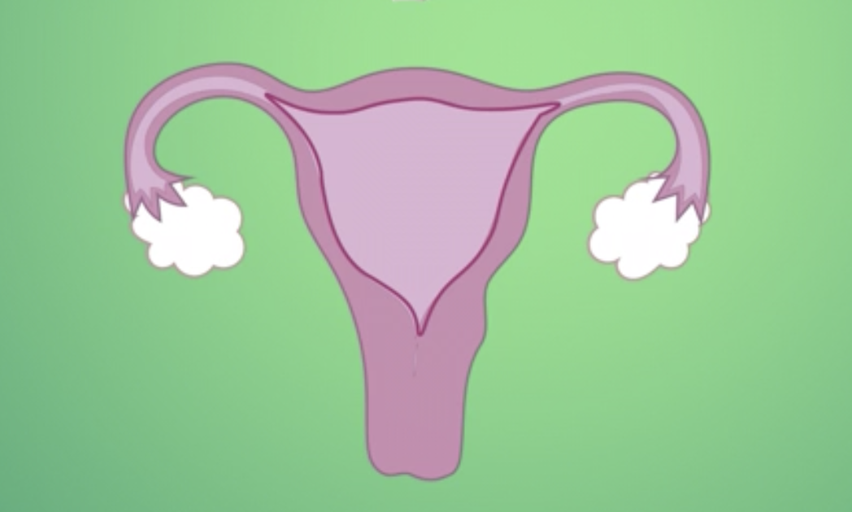
Adnexal Masses

Slide 3
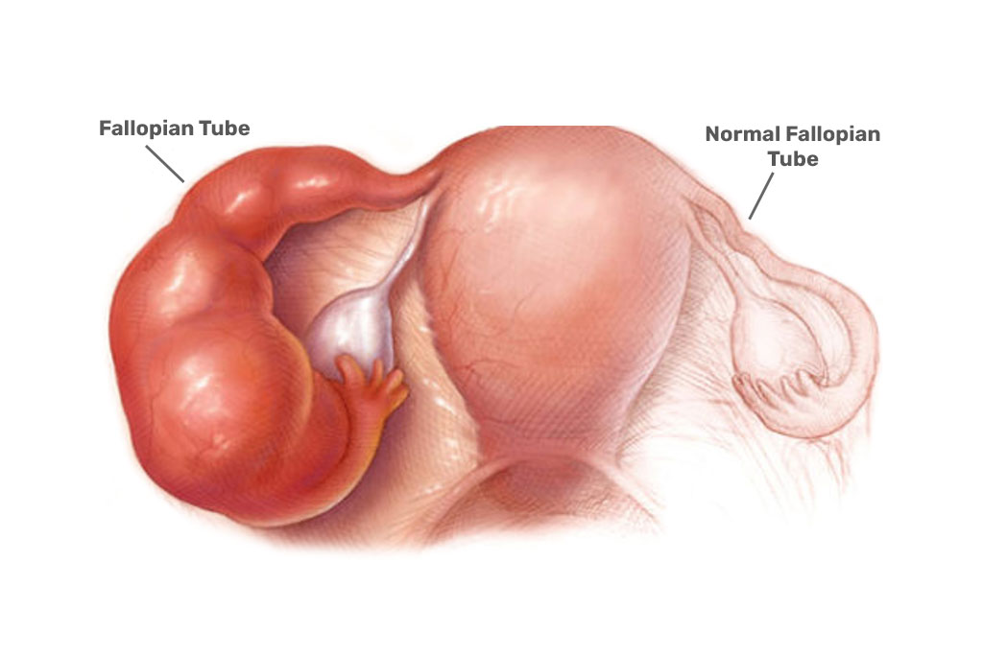
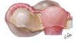
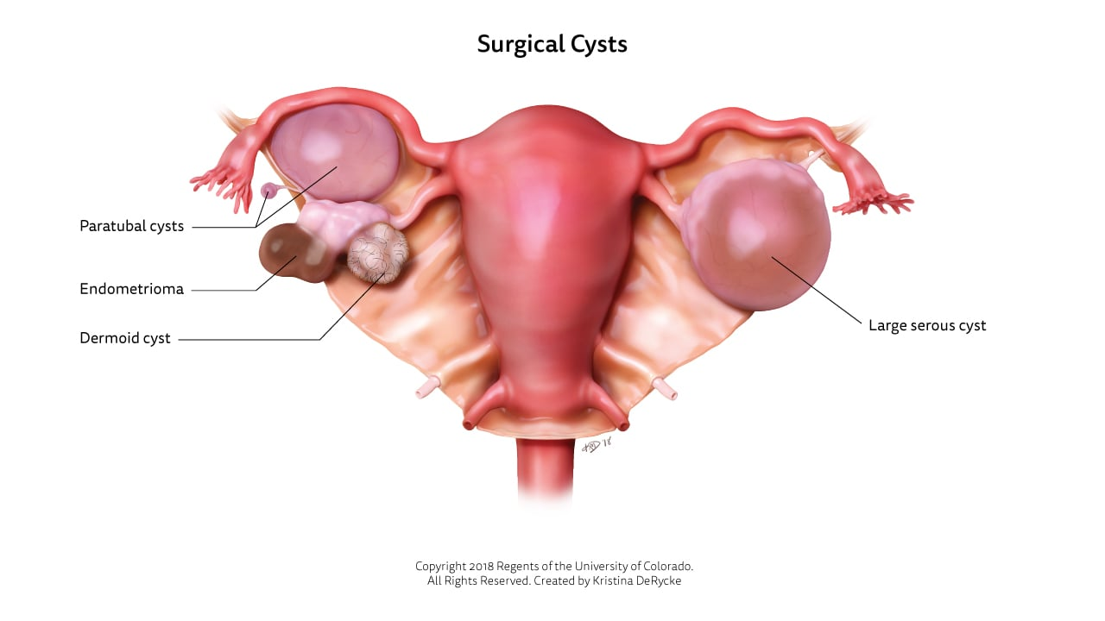
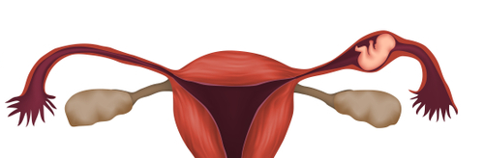
Non-Ovarian Adnexal Masses
Hydrosalpinx
Tubo-ovarian abscess
Ectopic pregnancy
Paratubal cyst
GI-related masses

Slide 4
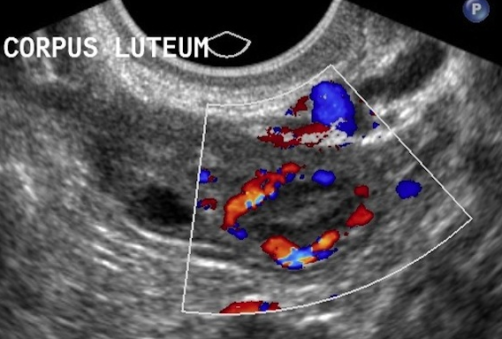
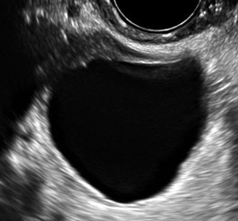
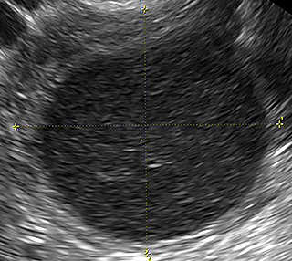
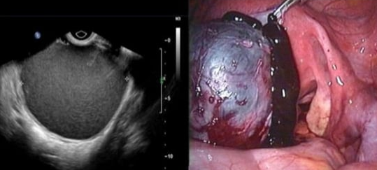
Common Ovarian Adnexal Masses
Simple Cyst
Corpus Luteum
Hemorrhagic cyst
Endometrioma

Slide 5
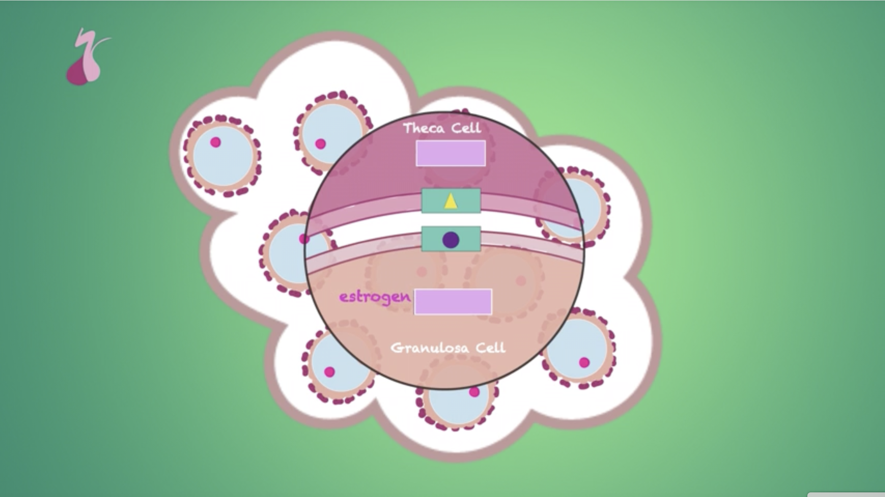

Types of Ovarian Cells
Germ cell
Epithelium
Sex-cord and
stroma

Slide 6
Types of Ovarian Tumors
Germ cell
Epithelial cell
Sex-cord-
stromal

Slide 7
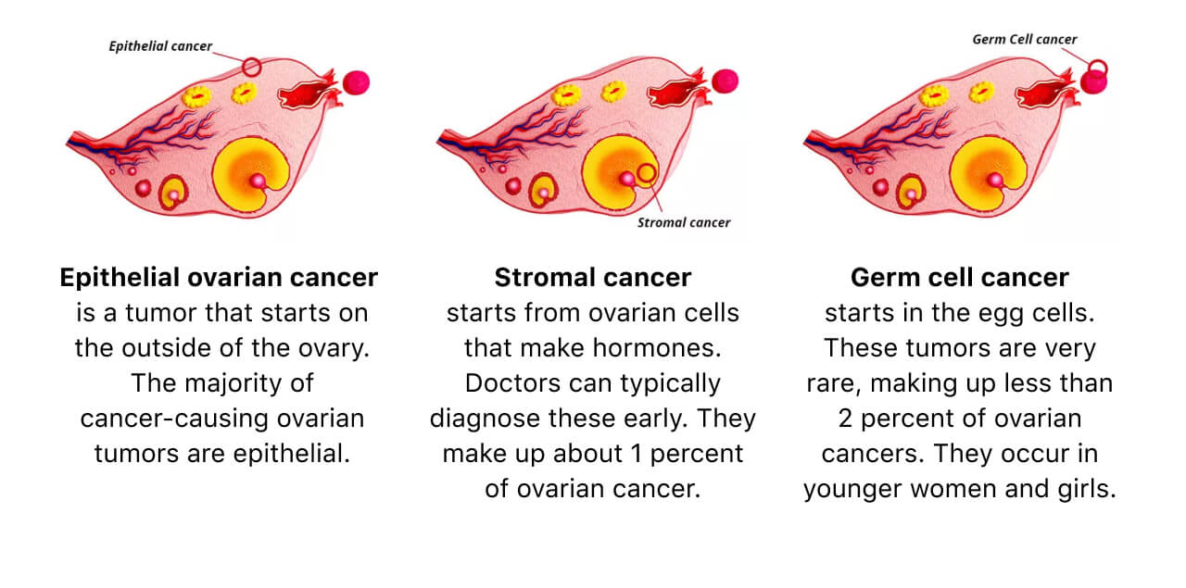

Slide 8
Types of Ovarian Tumors
Germ cell
Epithelial cell
Sex-cord-
stromal

Slide 9
Benign Epithelial Ovarian Tumors
Serous cystadenoma
Most common ovarian neoplasm
Mucinous cystadenoma
Brenner (usually benign)
Coffee bean nuclei

Slide 10
Malignant Epithelial Ovarian Tumors
Serous cystadenocarcinoma
Most common malignant ovarian neoplasm
Psammoma bodies
Thought to be derived from fallopian tube
Mucinous cystadenocarcinoma
May be metastatic from Gi tumor
Risk factors: smoking
Endometrioid
Risk factors: endometriosis and Lynch syndrome
Thought to be derived from endometrium
Clear Cell

Slide 11
Malignant Epithelial Ovarian Tumors
Most common in postmenopausal women
Comprise >90% of ovarian cancers
Leading cause of gynecologic cancer related death
CA-125 is biomarker used for evaluation
Risk factors:
  Advanced age
  Early menarche and late menopause
  Family history
  Nulliparity
  BRCA mutations
Protective factors:
  Hormonal contraception use
  Bilateral salpingectomy or tubal ligation
  Breastfeeding
  Multiparity

Slide 12
BRCA
BRCA1: 39%–59% of women will develop ovarian cancer
BRCA2: 11%–20% of women will develop ovarian cancer
General population: 1.1% of women will develop ovarian cancer
Risk Reduction:
  Oral contraceptives (lowers risk by ~50%)
  Risk reducing bilateral salpingo-oophorectomy after age 35-40

Slide 13
Types of Ovarian Tumors
Germ cell
Epithelial cell
Sex-cord-
stromal

Slide 14
Germ Cell Tumors
Dysgerminoma
  Malignant
  Tumor markers: hCG and LDH
Mature teratoma (dermoid)
  Benign
  All 3 germ layers (eg. Teeth, hair, sebaceous material)
Immature teratoma
  Malignant
  Contains neuroectoderm
Yolk sac (endodermal sinus) tumor
  Malignant
  Schiller-Duval bodies
  Tumor marker: AFP
Choriocarcinoma
  Malignant
  Tumor marker: hCG

Slide 15
Types of Ovarian Tumors
Germ cell
Epithelial cell
Sex-cord-
stromal

Slide 16
Sex-cord-stromal Tumors
Thecoma
Benign
Produces estrogen
Granulosa cell tumor
Malignant
Produces estrogen
Call-Exner bodies
Sertoli-Leydig tumor
Benign or malignant
Produces androgens
Fibroma
Benign
Associated with Meig syndrome (ovarian fibroma + ascites + pleural effusion)
Usually adolescents
Juvenile and Adult types

Slide 17
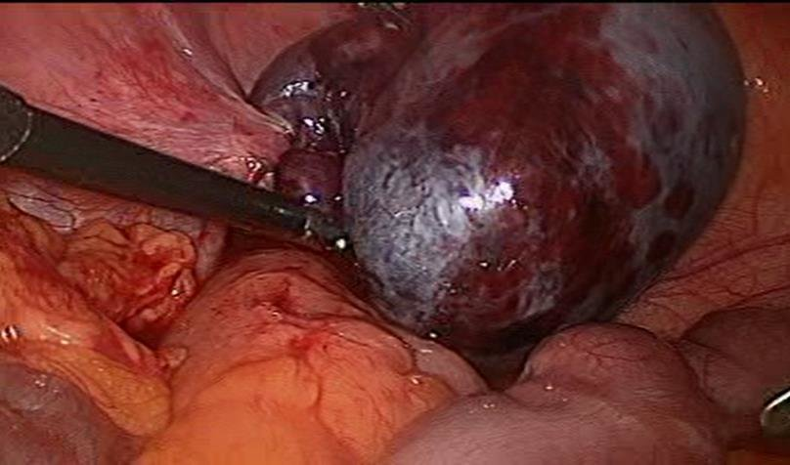
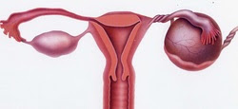
Ovarian Torsion
Twisting of ovary along suspensory ligament (infundibulopelvic ligament) and utero-ovarian ligament results in occlusion of blood vessels to ovary
Considered gynecologic emergency in order to preserve ovarian function

