Slide 1
Male Reproductive Physiology, Pathology, and Pharmacology
Vikas Desai, MD, FGPS | Clinical Assistant Professor
Carle Illinois College of Medicine | 8/27/2026, 3:00–5:00 pm

Slide 2
How This Session Works
Audience response questions every 15–20 minutes
Reference slides at the end are/will be posted to Canvas and ARE examinable and flagged as we go

Slide 3
Three Cases — Hold Your Answers
Case A. 17-year-old male. Sudden severe left scrotal pain 3 hours ago during lacrosse. Nausea. One prior episode that resolved on its own.
Case B. 34-year-old male. 18 months of infertility. “Working out hard.” Taking a supplement from a men’s clinic. Semen analysis: azoospermia.
Case C. 68-year-old male. Nocturia ×3, weak stream, PSA 6.2. Mentions at the end of the visit that erections have declined over 2 years.
We will resolve all three at the end of the presentation

Slide 4
Session Objectives
Identify normal male reproductive histology: tubule, Sertoli, Leydig, epididymis, prostate, seminal vesicle
Relate gross and zonal anatomy to the pathology that arises there
Sequence spermatogenesis and apply the 3-month timeline clinically
Diagram the HPG axis; distinguish testosterone, DHT, and inhibin; describe adult and aging changes
Explain erection, emission, ejaculation and localize the lesion when each fails
Differentiate primary from secondary hypogonadism and read the infertility panel
Work up the 19 named male reproductive pathologies
Predict effects and adverse effects of alpha-blockers, 5-ARIs, PDE-5 inhibitors, SSRIs, androgens, and anti-androgens from their mechanism
Notes:
Full wording is on the Canvas session sheet.

Slide 5
Part 1: Anatomy and Histology

Slide 6
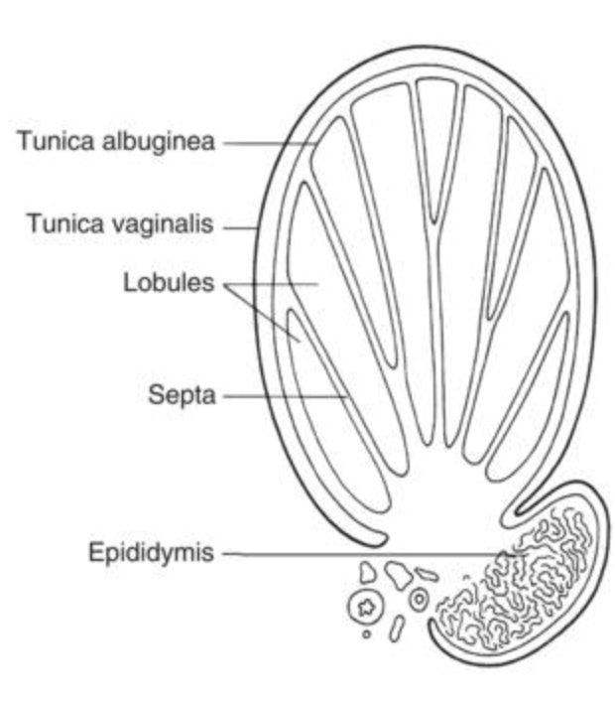
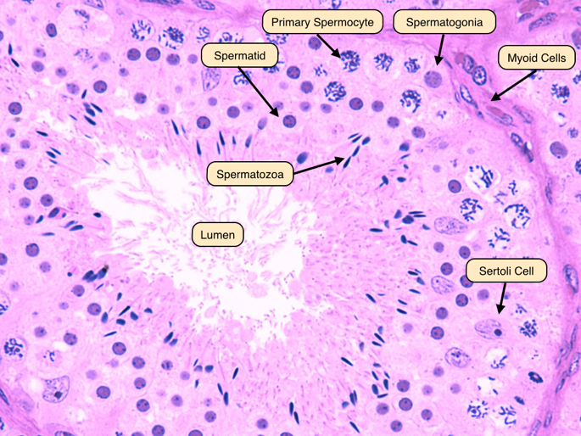
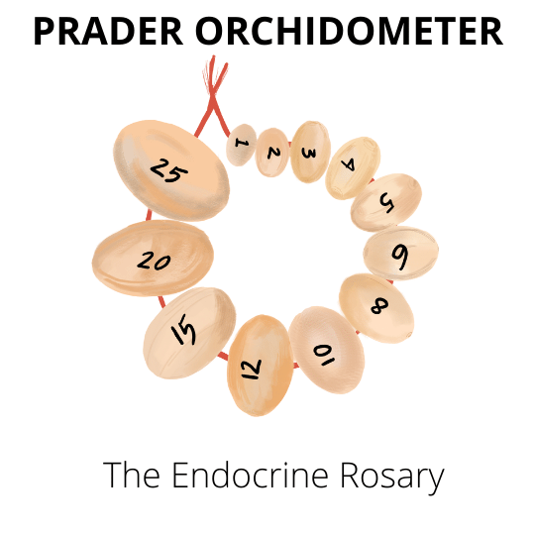
Testis Architecture
Tunica albuginea → septa → lobules → seminiferous tubules
Sertoli cells line the tubule; tight junctions form the blood-testis barrier (immune privilege)
Leydig cells in the interstitium, outside the barrier, beside capillaries
≈90% of testicular volume is tubule: small testes = impaired spermatogenesis
Normal volume 15–25 mL by orchidometer: a bedside fertility measurement
Notes:
Build the two-compartment concept: inside the barrier (germ cells, Sertoli) vs outside (Leydig, vessels).
The tunica albuginea is the capsule; it sends in septa; the septa carve out ~250 lobules; each lobule packs 1–4 seminiferous tubules where Sertoli cells shepherd germ cells through spermatogenesis, while Leydig cells in the interstitium between tubules make testosterone. [1][3][6]

Slide 7
The Duct Pathway: SEVEn UP
Seminiferous tubules → Epididymis → Vas deferens → Ejaculatory duct → Urethra → Penis
  Tubule → rete testis → efferent ductules → epididymis (head, body, tail)
Vas joins the seminal vesicle duct → ejaculatory duct → prostatic urethra
Sperm are stored in the cauda (tail) epididymis
Notes:
Say the mnemonic aloud. Retained quiz item.
The seminiferous tubules empty into the rete testis, which channels sperm through ~12 efferent ductules that reabsorb >90% of testicular fluid; the ductules merge into the single epididymal duct, where sperm mature (caput → corpus) and are then stored quiescent in the cauda until ejaculation — all while the sperm themselves remain passive passengers.

Slide 8
What Is Semen? Composition by Source
Source | Share | Key constituents
Seminal vesicles | 65–75% | Fructose, alkaline buffer, semenogelin (coagulum)
Prostate | 20–30% | PSA, zinc, citrate, acid phosphatase
Testis / epididymis | ≈5% | Spermatozoa
Bulbourethral glands | Trace | Pre-ejaculate lubrication
PSA’s day job: a serine protease that liquefies the seminal coagulum: a fertility protein we co-opted as a tumor marker
Low-volume, acidic, fructose-negative ejaculate → ejaculatory duct obstruction or absent vas
Notes:
The fructose point returns in the azoospermia workup.

Slide 9
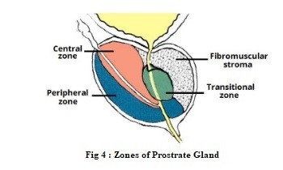
Prostate Zonal Anatomy — The Most Portable Fact Today
Peripheral zone: ≈70% of gland, posterior, palpable on DRE
→ 70–80% of prostate cancer
Transition zone: periurethral → the exclusive site of BPH
Central zone: around ejaculatory ducts, rarely diseased
Anterior fibromuscular stroma: non-glandular
So: a huge prostate ≠ cancer; a normal DRE ≠ no cancer; TURP neither treats nor prevents cancer

Slide 10
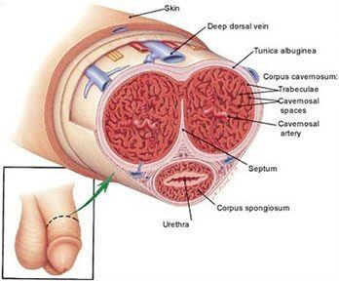
Penile Anatomy
Paired corpora cavernosa (erectile) + corpus spongiosum (surrounds urethra, stays compliant, forms glans)
Tunica albuginea — bilayered, inelastic.
Remember it: it returns in Peyronie disease, penile fracture, and the veno-occlusive mechanism
Arterial: internal pudendal → cavernosal → helicine arterioles → sinusoids
Venous: sinusoids → subtunical venous plexus → deep dorsal vein
Buck’s fascia contained hematoma to the shaft
Colles fascia extension → perineal “butterfly” →concern for urethral injury
Fascial planes
Scarpa's (abdomen) → dartos (penis/scrotum) → Colles’ (perineum) form one uninterrupted space, which is why extravasated blood or urine spreads across all three regions once Buck's fascia is breached
Notes:
Flag the tunica three-appearances arc explicitly.
Helicine arteries are the terminal, coiled branches of the deep (cavernosal) artery that open directly into the sinusoidal (lacunar) spaces of the corpus cavernosum — they are the final arterial gateway controlling penile erection. The name "helicine" reflects their tortuous, corkscrew-like course in the flaccid state, which straightens and dilates during erection
The extent of bruising localizes the plane of injury. Confined to the shaft = Buck's fascia intact (isolated tunical/corporal injury). Butterfly perineal + scrotal + suprapubic spread = Buck's fascia breached, which should raise concern for anterior (bulbar) urethral injury and prompt retrograde urethrography before catheterization

Slide 11
Scrotal Layers, Paired With Their Pathology
Tunica vaginalis (from processus vaginalis) → hydrocele; patent processus → communicating hydrocele + indirect hernia
Cremaster (internal oblique) → cremasteric reflex: stroke medial thigh
Femoral branch carries afferents up
Genital branch caries motor efferent back to cremaster → elevation of ipsilateral testis
Reflex arc mediated by the genitofemoral nerve (L1–L2)
Dartos + skin → thermoregulation; the plane of Fournier gangrene
Reflex is absent in torsion: the single most useful acute-scrotum exam finding
  Presence of reflex does not exclude torsion
Notes:
Tunica vaginalis / processus vaginalis → hydrocele & hernia. The tunica vaginalis is the peritoneal remnant left after the processus vaginalis (which the descending testis drags into the scrotum) normally obliterates; fluid trapped in a closed remnant is a simple (non-communicating) hydrocele, whereas a persistently patent processus allows peritoneal fluid down to give a communicating hydrocele and, if wide enough for bowel, an indirect inguinal hernia.
Cremaster (from internal oblique) → cremasteric reflex. Stroking the medial thigh sends afferents up the femoral branch of the genitofemoral nerve, and the genital branch carries the motor efferent back to the cremaster, elevating the ipsilateral testis — a reflex arc mediated by the genitofemoral nerve (L1–L2).
Dartos + skin → thermoregulation and the Fournier plane. The dartos is the scrotal smooth-muscle layer that contracts in cold to wrinkle the skin and reduce heat-losing surface area for testicular thermoregulation, and — as part of the continuous dartos–Colles'–Scarpa's superficial fascial space — it is the anatomical plane along which Fournier gangrene spreads.
Absent reflex in torsion — the key acute-scrotum sign. In testicular torsion the cremasteric reflex is characteristically lost; it is the single most sensitive exam finding (absent in up to 100% of torsion cases, odds ratio ~47.6), though a present reflex does not fully exclude torsion.

Slide 12
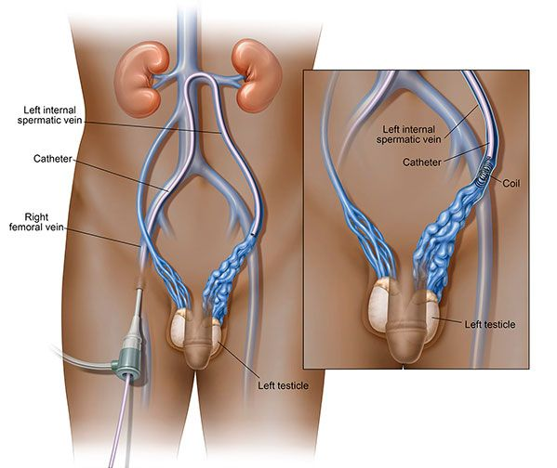
Venous and Lymphatic Drainage — Two Asymmetries That Matter
Testicular arteries arise from the aorta
Right gonadal vein → IVC; left gonadal vein → left renal vein at 90° over a longer column → left-sided varicocele
Testis lymphatics → retroperitoneal para-aortic nodes: never inguinal
Penis and scrotal skin → inguinal nodes
Hence:
Testis cancer surgery is inguinal, never trans-scrotal
Penile cancer prognosis lives in the groin
Notes:
Testis = retroperitoneum by birth → drains para-aortic → operate through the groin, never the scrotum.
Penis/scrotal skin = surface structure → drains to the groin → the groin nodes are where the prognosis is decided.

Slide 13
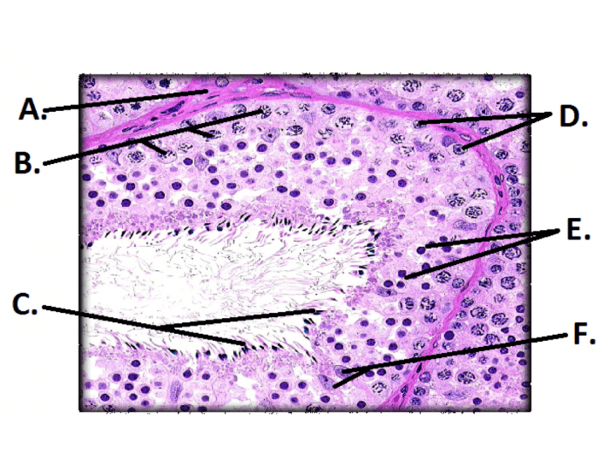
Histology 1 of 2: Seminiferous Tubule
Spermatogonia (D) at the basement membrane
Primary (B) → secondary spermatocytes → spermatids toward the lumen (E)
Spermatozoa in the lumen (C)
Sertoli cells (F) span basement membrane to lumen
Leydig cells in the interstitium between tubules
Notes:
A-Basement membrane
True secondary spermatocytes are rarely caught on a section because meiosis II is so fast, so many "E" cells in any real slide are early spermatids

Slide 14
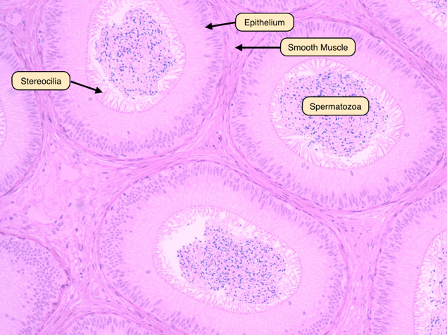
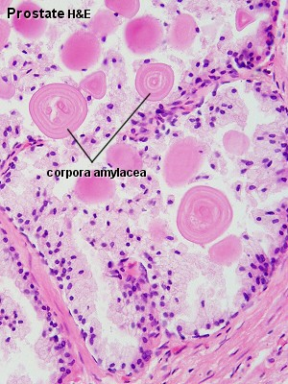
Histology 2 of 2: Epididymis and Prostate
Epididymis: pseudostratified columnar epithelium with stereocilia; lumen packed with sperm
Prostate: tuboalveolar acini with papillary infoldings; corpora amylacea (calcified secretions) in older men
Seminal vesicle mimics prostate but has no corpora amylacea
Basal cell layer loss is a histologic criterion of prostate cancer
Notes:
Corpora amylacea is the discriminator — a retained quiz item hinges on it.

Slide 15
Part 2: Spermatogenesis

Slide 16
The Three-Month Clock
Spermatogenesis: 64–74 days
Epididymal transit and maturation: 10–14 days
Total ≈ 3 months — today’s semen analysis reports events from 3 months ago
A febrile illness, hot tub, or new drug 2 months ago shows up today
Every intervention: varicocelectomy, stopping testosterone, weight loss — needs ≥3 months before the repeat semen analysis means anything
Notes:
This clock governs the entire infertility segment.

Slide 17
Stages of Spermatogenesis
Spermatogonia: type A dark (reserve) · A pale (renewing) · B (committed)
Meiosis I: primary spermatocyte → two secondary spermatocytes
Meiosis II: → spermatids (haploid)
Spermiogenesis (remodeling, no division): Golgi → acrosome; protamines replace histones; flagellum + mitochondrial midpiece; cytoplasm shed as residual body (Sertoli phagocytoses it)
Spermiation: released into the lumen — immotile and infertile
Motility is gained in the epididymis; capacitation and the acrosome reaction occur in the female tract — classic distractor
Notes:
Spermatogonia (mitotic pool, on the basement membrane). Type A-dark = reserve stem cells (rarely divide, the emergency backup), type A-pale = renewing/active stem cells (routine self-renewal + differentiation), and type B = committed cells that divide into primary spermatocytes and enter meiosis.
Meiosis I. One diploid primary spermatocyte → two haploid secondary spermatocytes; the long pachytene prophase (~3 weeks) is why primary spermatocytes are the most conspicuous germ cell on biopsy. [1][4]
Meiosis II. Each secondary spermatocyte divides quickly (<10 h, so rarely seen) into spermatids — haploid (1N).
Spermiogenesis (remodeling, NO cell division). Round spermatid → spermatozoon: the Golgi forms the acrosomal cap; protamines replace histones for extreme nuclear condensation and transcriptional silencing; a flagellum and mitochondrial midpiece are built; and excess cytoplasm is shed as a residual body that Sertoli cells phagocytose.
Spermiation. The spermatozoon is released into the tubular lumen but is still immotile and infertile at this point.
The classic distractors — the "where" questions. Motility is acquired later, during transit/storage in the epididymis; capacitation and the acrosome reaction occur in the female reproductive tract (capacitation begins in the uterus, hyperactivation/acrosome reaction in the oviduct/ampulla), NOT in the testis
the testis builds the sperm (through spermiogenesis), the epididymis makes it move, and the female tract makes it fertile (capacitation + acrosome reaction).

Slide 18
The Sertoli Cell — Most Testable Cell of the Day
Forms the blood-testis barrier → immune privilege for antigenically novel post-meiotic cells
  Explains antisperm antibodies after vasectomy or trauma, and the severity of mumps orchitis
Responds to FSH
Secretes androgen-binding protein, inhibin B (FSH feedback + spermatogenesis marker), AMH (fetal)
Number fixed after puberty → sets the ceiling on sperm output
Contrast: Leydig = LH → testosterone, androstenedione, DHEA (DHT is made peripherally, not by Leydig cells)
Notes:
Blood-testis barrier → immune privilege. Adjacent Sertoli cells form tight junctions that create the blood-testis barrier, sequestering antigenically "novel" post-meiotic germ cells (which arise after puberty, long after central immune tolerance is set) from the immune system.
Explains antisperm antibodies and mumps orchitis severity. Because those germ-cell antigens are hidden, any breach — vasectomy, trauma, torsion, or infection — exposes them and triggers antisperm antibodies; the same principle underlies the immune-mediated inflammatory damage of mumps orchitis.
Responds to FSH. Sertoli cells carry the FSH receptor, making them the primary target of FSH within the tubule.
Secretory products. FSH stimulation drives androgen-binding protein (concentrates intratubular testosterone), inhibin B (negative FSH feedback and a clinical marker of spermatogenesis), and AMH (fetal — drives Müllerian regression; falls at puberty).
Fixed number after puberty → sets the sperm-output ceiling. Each Sertoli cell supports a finite number of germ cells, so the post-pubertal Sertoli population caps maximum sperm production.
Contrast — Leydig cells (interstitium, LH-driven). LH → Leydig cells → testosterone, plus weaker androgens androstenedione and DHEA; note DHT is generated peripherally by 5α-reductase, not synthesized by Leydig cells
Sertoli = FSH → barrier, ABP, inhibin B, AMH, and the sperm-output ceiling; Leydig = LH → testosterone (DHT made peripherally)

Slide 19
Thermoregulation: Why the Testis Lives Outside
Operates 2–4 °C below core temperature
Pampiniform plexus countercurrent exchange cools arterial inflow
Cremaster and dartos adjust position and surface area
One mechanism, four diseases: cryptorchidism, varicocele, obesity, occupational heat all impair spermatogenesis through the same thermal pathway
Notes:
Operates 2–4 °C below core temperature because spermatogenesis (and DNA/enzyme integrity in meiosis) is heat-sensitive and fails at core body temperature.
Pampiniform plexus countercurrent exchange — the venous plexus wraps the testicular artery so cool venous return draws heat out of warm arterial inflow before it reaches the testis.
Cremaster and dartos adjust testicular position (closer/farther from the body) and scrotal surface area to fine-tune heat loss.
One mechanism, four diseases — cryptorchidism, varicocele, obesity, and occupational heat exposure all raise testicular temperature and impair spermatogenesis through this same thermal pathway.

Slide 20
Poll 1: The Febrile Illness
A 29-year-old man had a high fever 6 weeks ago. His semen analysis today is abnormal.
Which germ-cell stage was most likely affected at the time of the fever?
  A. Spermatozoa in the epididymis
  B. Cells in late spermiogenesis
  C. Meiotic spermatocytes / early stages
  D. Only mature stored sperm
Notes:
Answer: C — work backward through the ≈74-day timeline. Reveal after polling; reinforce that capacitation happens in the female tract.
Mature stored sperm in the epididymis (A, D) and cells in late spermiogenesis (B) would already have been ejaculated or cleared within the first 2–3 weeks after the fever, so they would not account for an abnormality persisting at 6 weeks

Slide 21
Part 3: Hormonal Regulation

Slide 22
The Hypothalamic–Pituitary–Gonadal Axis
GnRH is pulsatile — and pulsatility is obligatory
  Continuous GnRH exposure downregulates the receptor and shuts the axis off (hold that thought until leuprolide)
LH → Leydig → testosterone (rate-limiting step: StAR cholesterol transport)
FSH → Sertoli → androgen-binding protein + inhibin B
Feedback: testosterone and estradiol centrally; inhibin B selectively suppresses FSH
Notes:
Plant the leuprolide flag now, collect it in pharmacology. Spoken endocrine handoff.
GnRH is pulsatile, and pulsatility is obligatory — hypothalamic GnRH must be secreted in discrete pulses (~every 60–120 min) to sustain gonadotropin output.
Continuous GnRH exposure shuts the axis off — sustained (non-pulsatile) stimulation downregulates and desensitizes the pituitary GnRH receptor, collapsing LH/FSH release (the basis of leuprolide and other GnRH agonists causing chemical castration).
LH → Leydig → testosterone — LH drives Leydig-cell steroidogenesis, whose rate-limiting step is StAR-mediated cholesterol transport into the mitochondrion.
FSH → Sertoli → ABP + inhibin B — FSH stimulates Sertoli cells to secrete androgen-binding protein (concentrates intratubular testosterone) and inhibin B.
Feedback — testosterone and estradiol exert central negative feedback (hypothalamus + pituitary), while inhibin B selectively suppresses FSH at the pituitary

Slide 23
Intratesticular Testosterone — The Concept Behind Case B
Intratesticular testosterone ≈ 50–100× serum concentration — spermatogenesis requires the gradient
Exogenous testosterone: serum T up → LH suppressed → intratesticular T collapses → spermatogenesis stops
Testosterone is a male contraceptive
Never start testosterone in a man who wants near-term fertility
Every azoospermic young man gets asked directly about testosterone, “men’s clinic” injections, and anabolic steroids

Slide 24
Testosterone Transport: Why “Normal Total T” Can Mislead
≈44–65% bound to SHBG (tight, unavailable) · ≈33–50% to albumin (loose) · 2–3% free
Bioavailable = free + albumin-bound
SHBG falls: obesity, insulin resistance, T2DM, hypothyroidism
SHBG rises: aging, hyperthyroidism, cirrhosis, estrogens, anticonvulsants
The obese 45-year-old with a “normal” total T can still be biochemically hypogonadal
→ order free or bioavailable T only when SHBG is distorted
Notes:
Free testosterone measured by most labs is unreliable because the common direct analog immunoassay is inaccurate — it systematically misestimates free T and is not recommended; either calculated free T (from total T, SHBG, albumin) or equilibrium dialysis should be used instead.
The problem — the widely available direct analog radioimmunoassay for free T does not correlate well with the reference equilibrium-dialysis method, giving falsely low and unreliable values, especially when SHBG is abnormal.
Preferred alternatives — equilibrium dialysis (gold standard) or calculated free T using total T, SHBG, and albumin give far more accurate bioavailable/free estimates in the obese or SHBG-distorted patient.

Slide 25
One Hormone, Three Signals
Testosterone → (5-alpha-reductase) → DHT
  Type 2: prostate, seminal vesicles, genital skin
  Type 1: skin, liver
  DHT binds the androgen receptor with higher affinity, dissociates slowly, cannot be aromatized
Testosterone → (aromatase, mostly adipose) → estradiol
  Estradiol in men drives bone density, epiphyseal closure, libido, and central feedback
Obesity → more aromatization → low-T, high-E2, low-LH pattern
Notes:
Testosterone → DHT via 5-alpha-reductase — peripheral conversion amplifies androgen signaling in target tissues.
Type 2 5-alpha-reductase — dominant in prostate, seminal vesicles, and genital skin (the isoenzyme blocked by finasteride/dutasteride for BPH).
Type 1 5-alpha-reductase — predominant in skin (sebaceous glands) and liver.
DHT is the more potent androgen — binds the androgen receptor with higher affinity, dissociates slowly, and cannot be aromatized, making it a pure, amplified androgen signal.
Testosterone → estradiol via aromatase (mostly adipose tissue) — a substantial fraction of male estradiol derives from peripheral aromatization of testosterone.
Estradiol in men — drives bone mineral density, epiphyseal plate closure, libido, and central negative feedback on the HPG axis.
Obesity → increased aromatization — expanded adipose mass converts more testosterone to estradiol, producing the classic low-testosterone, high-estradiol, low/inappropriately-normal-LH pattern of obesity-related hypogonadism.

Slide 26
Testosterone vs DHT: Division of Labor
Testosterone | DHT
Wolffian ducts: epididymis, vas, seminal vesicles | External genitalia: penis, scrotum, urethra
Spermatogenesis | Prostate growth — and BPH
Muscle mass, bone, erythropoiesis | Male-pattern balding, sebaceous activity
Libido, voice deepening, growth spurt
5-alpha-reductase deficiency proves the split: normal internal ducts, undervirilized at birth, virilize at puberty — and no BPH, no balding. Nature ran the finasteride trial first.
Notes:
Testosterone and DHT are the same androgen signal split into two jobs: testosterone builds the internal machinery (Wolffian ducts, sperm, muscle, bone, libido), while its more potent metabolite DHT builds the external and cosmetic male features (genitalia, prostate, hairline).
That's why blocking the conversion with a 5-alpha-reductase inhibitor shrinks the prostate and slows balding without stopping spermatogenesis — men born without the enzyme never develop BPH or male-pattern baldness.

Slide 27
The Aging Arc
After age 30–40, total testosterone falls ≈ 1% per year
SHBG rises with age → free T falls faster than total T
Gradual age-related decline is not the same entity as classical hypogonadism
The distinction drives appropriate prescribing
Notes:
Bridge from physiology to the TRT segment.

Slide 28
Primary vs Secondary Hypogonadism: The LH Fork
 | Primary (testicular) | Secondary (central)
Testosterone | Low | Low
LH / FSH | High | Low or inappropriately normal
Causes | Klinefelter 47,XXY · mumps orchitis · chemo/RT · torsion · cryptorchidism | Kallmann (+anosmia) · pituitary adenoma · hyperprolactinemia · opioids · glucocorticoids · exogenous androgens · obesity · hemochromatosis
Fertility outlook | Poor; microTESE may still retrieve | Often fully treatable with gonadotropins
The LH is the entire diagnostic fork. Get it before you write for testosterone.
Notes:
Testosterone is low in both, so the gonadotropins tell you where the lesion is — if the pituitary is shouting (high LH/FSH) the testis is broken and can't answer; if it's silent despite low testosterone (low or "normal" LH/FSH) the brain is broken, and that's the treatable one.

Slide 29
Part 4: Erection, Emission, Ejaculation

Slide 30
Neural Control: Point and Shoot
Function | Pathway | Roots
Point — erection | Parasympathetic · pelvic splanchnic / cavernous nerves | S2–S4
Emission | Sympathetic · hypogastric nerves | T10–L2
Shoot — ejaculation | Somatic · pudendal → bulbospongiosus + ischiocavernosus | S2–S4
Three erection types: reflexogenic (sacral arc, survives suprasacral cord injury) · psychogenic (T11–L2) · nocturnal (REM, testosterone-dependent)
Notes:
Preserved morning erections argue for a psychogenic contribution — developed on slide 31.

Slide 31
Localizing the Lesion by Erection Type
Reflexogenic erections preserved, psychogenic lost → suprasacral spinal cord lesion
Nocturnal and morning erections preserved → the machinery works → strong argument for a psychogenic contribution
Nocturnal erections lost + gradual decline → organic (vascular, neural, hormonal)
Nocturnal erections are testosterone-dependent — one reason hypogonadal men lose them
Notes:
Sleep/morning erections test the intact neurovascular-hormonal machinery, so their preservation with lost psychogenic erections localizes to a suprasacral cord lesion (intact S2–S4 reflex arc, blocked cerebral input), whereas their gradual loss signals organic (vascular/neural/hormonal) disease—and because nocturnal erections are the most testosterone-dependent, hypogonadal men lose them first

Slide 32
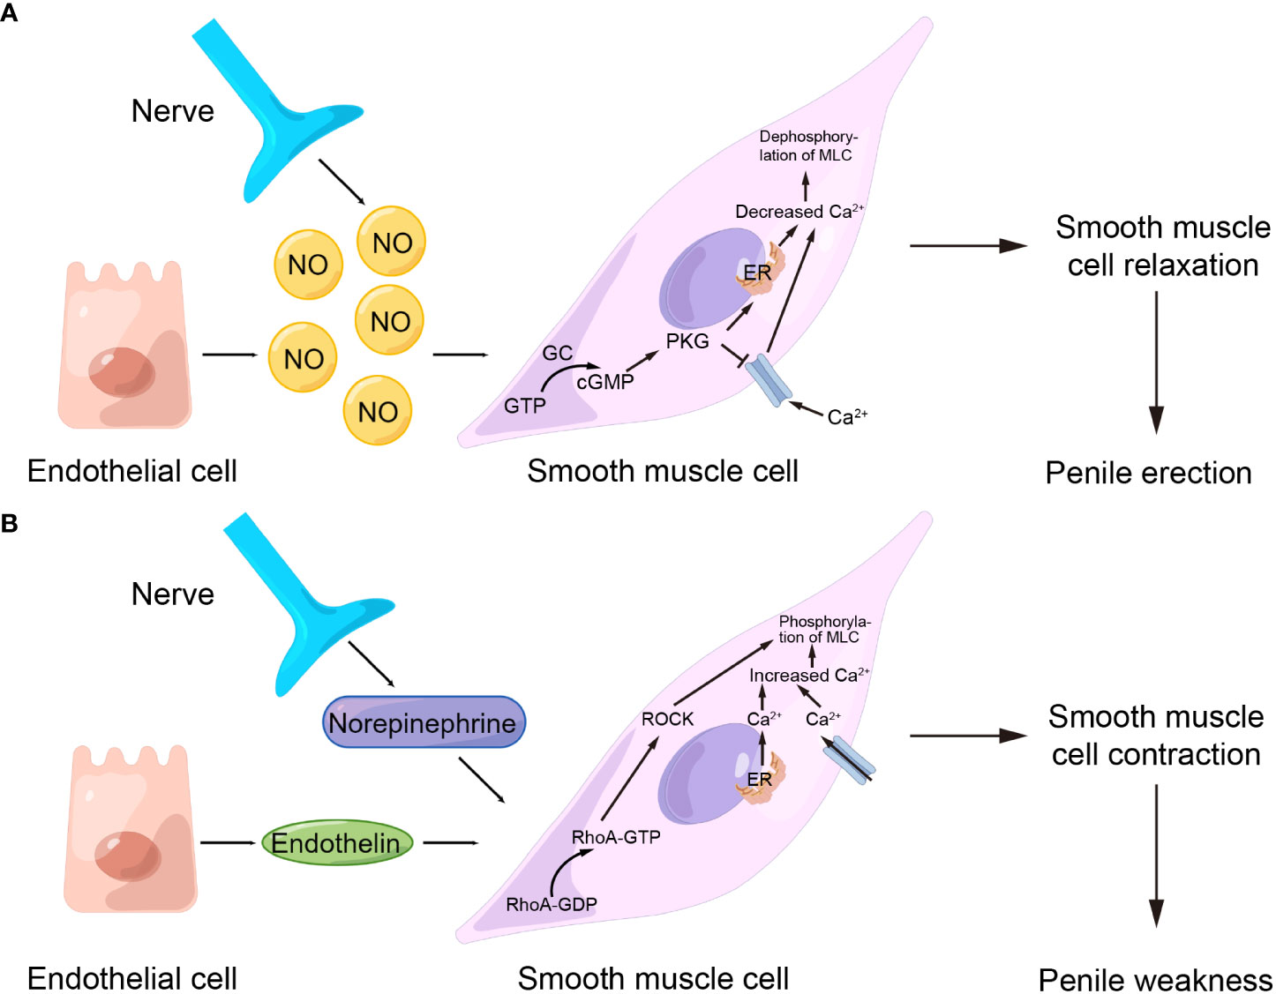
The NO–cGMP Cascade (Build)
Stimulation → NANC nerves (nNOS) + endothelium (eNOS) release NO
NO → soluble guanylate cyclase → GTP → cGMP → protein kinase G → Ca²⁺ falls
Cavernosal smooth muscle relaxes → helicine arterioles dilate → sinusoids fill
Sinusoids expand against the tunica albuginea → subtunical venules compressed
= veno-occlusive mechanism → rigidity
Notes:
Highest reading-order risk in the deck — verify animation order matches reading order before submission.

Slide 33
Detumescence — and Why Some Men Fail PDE-5 Inhibitors
PDE-5 hydrolyzes cGMP to 5′-GMP. (Say it slowly — the entire drug class follows from this line.)
Sympathetic norepinephrine at alpha-1 + RhoA/Rho-kinase restores tone
A scarred tunica (Peyronie) or fibrotic cavernosal muscle (diabetes, aging, post-priapism) cannot compress the venules → venous leak
Venous leak fails PDE-5 inhibitors at any dose — the drug amplifies a signal the anatomy can no longer contain
Notes:
Second appearance of the tunica albuginea.

Slide 34
Emission and the Bladder Neck
Sympathetic T10–L2 → coordinated contraction of vas, seminal vesicles, prostate
→ while the bladder neck closes simultaneously under alpha-1 tone
Alpha-1a-selective blockers (tamsulosin, silodosin) impair both → retrograde or absent ejaculation
Orgasm preserved, fluid absent — the #1 uncounseled reason men quietly stop tamsulosin
Notes:
Sympathetic T10–L2 fibers drive emission—coordinated contraction of the vas, seminal vesicles, and prostate—while simultaneously closing the bladder neck via alpha-1 tone to direct semen forward
So alpha-1a-selective blockers (tamsulosin, silodosin) abolish both, producing retrograde or absent ejaculation.

Slide 35
Ejaculation ≠ Orgasm
Ejaculation: rhythmic pudendal-driven contraction of bulbospongiosus + ischiocavernosus
Central serotonergic tone sets the ejaculatory threshold (5-HT2C inhibitory, 5-HT1A facilitatory) — hold for SSRIs
Orgasm is a cortical event, dissociable from ejaculation:
  After radical prostatectomy: orgasm without emission
  On alpha-blockers: orgasm with retrograde flow
Patients conflate the three — physicians must not

Slide 36
Priapism: Two Diseases, One Word
 | Ischemic (low-flow) | Non-ischemic (high-flow)
Mechanism | Failed detumescence → compartment syndrome | Arterial–lacunar fistula
Exam | Painful, rigid | Painless, partial
Causes | Sickle cell · intracavernosal injection · trazodone · antipsychotics · cocaine | Perineal / straddle trauma
Cavernosal gas | Hypoxic, hypercarbic, acidotic | Arterial
Action | Emergency: aspirate, irrigate, phenylephrine, shunt — fibrosis by 24–48 h | Not emergent — observe or embolize

Slide 37
Part 5: Penis and Foreskin

Slide 38
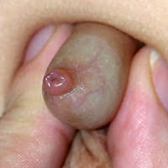
Phimosis and Paraphimosis
Physiologic phimosis is normal in young boys
(separation by ≈3–5 years of age) — do not forcibly retract
Pathologic: lichen sclerosus (BXO), recurrent balanitis, diabetes → topical steroid ± circumcision
Paraphimosis = the emergency: trapped retracted foreskin → venous congestion → edema → arterial compromise
Frequently iatrogenic — replace the foreskin after every catheter and every exam. The most preventable urologic emergency
Manual reduction; occasionally dorsal slit

Slide 39
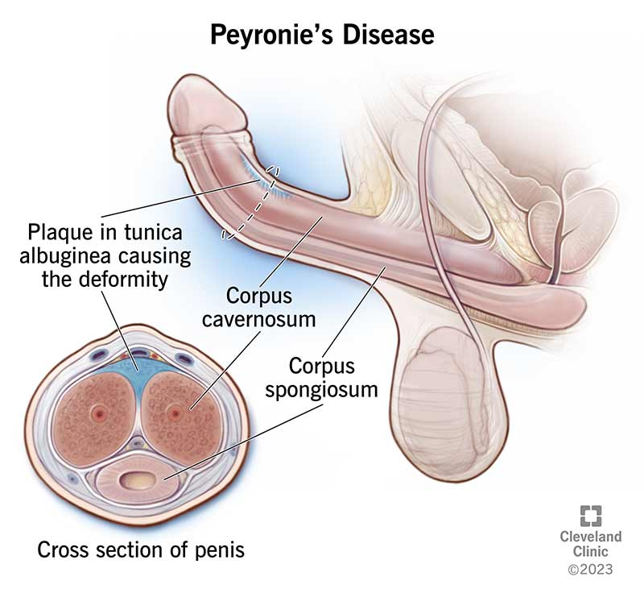
Peyronie Disease 1 of 2: Mechanism
Fibrotic plaque of the tunica albuginea (appearance #2 of 3)
Repetitive microtrauma → subtunical bleeding → aberrant TGF-β wound healing, disordered collagen
Two phases: acute/active (pain, evolving curvature, 6–18 mo) → chronic/stable
Associations: Dupuytren contracture, plantar fibromatosis, diabetes, post-prostatectomy
Presents: plaque, curvature, shortening, pain, ± ED (often venous leak)
Notes:
Distinguish from congenital curvature (no plaque, dates from puberty) and fracture (acute).

Slide 40
Peyronie Disease 2 of 2: Treatment — Stable Phase Only
Intralesional collagenase clostridium histolyticum + modeling — the only FDA-approved injectable
Intralesional verapamil or interferon — alternatives
Plication — good erections, adequate length, moderate curvature
Plaque incision/excision + graft — severe curvature (higher ED risk)
Penile prosthesis when refractory ED coexists
Nothing gets injected (board answer) or operated during the active phase
Notes:
Treatment ladder maps to curvature severity and erectile function.

Slide 41
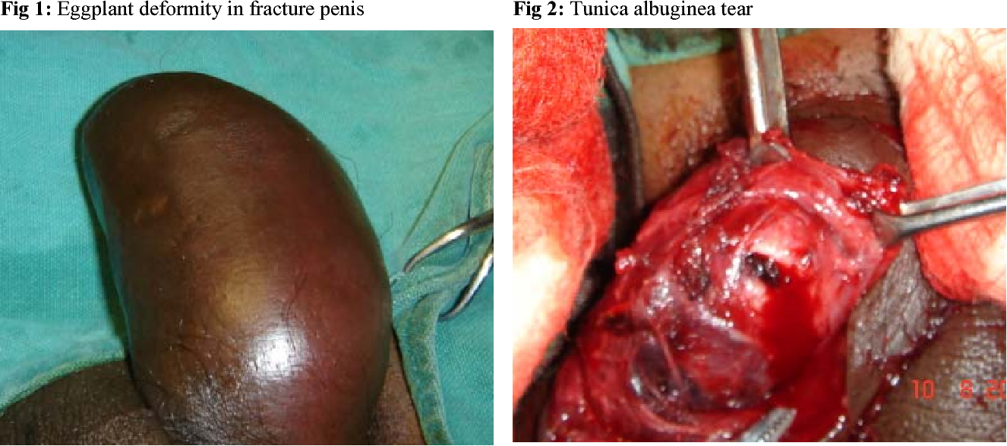
Penile Fracture
Rupture of the tunica albuginea of the corpus cavernosum during erection
Tunica thins from ≈2 mm to 0.25–0.5 mm when erect — why fracture is an erect-state injury
Pop → immediate detumescence → pain → eggplant deformity (Buck fascia contains the hematoma)
Urethral injury in 10–20%: blood at meatus, hematuria, cannot void → retrograde urethrogram
Emergency: prompt exploration and repair — delay → ED and curvature

Slide 42
Poll 2: The Audible Snap
A 30-year-old hears a snap during intercourse → immediate detumescence, pain, swelling, ecchymosis, deviation.
Rupture of which structure?
  A. Corpus spongiosum
  B. Tunica albuginea of the corpus cavernosum
  C. Suspensory ligament
  D. Bulbourethral gland
Notes:
Answer B. On reveal, re-ask: what mandates a urethrogram?

Slide 43
Break — Back in 5 minutes

Slide 44
Part 6: Scrotum and Testis

Slide 45
Case A Revisited: The Acute Scrotum
17-year-old · sudden severe left scrotal pain during lacrosse · 3 hours · nausea · prior self-resolving episode
Differential: torsion · epididymitis/orchitis · torsed appendix testis · testicular rupture · incarcerated hernia · Fournier gangrene
The prior self-resolving episode suggests intermittent torsion
What one exam finding do you check first?
Notes:
Let them answer: cremasteric reflex. Advance to the table.

Slide 46
Torsion vs Epididymitis: Five Discriminators
 | Torsion | Epididymitis
Onset | Abrupt (minutes) | Gradual (days)
Peak age | 12–18 y (and neonatal) | Post-pubertal; >35 y
Cremasteric reflex | Absent | Present
Testis lie | High-riding, transverse | Normal
Prehn sign / UA | Negative · UA normal | Positive · often pyuria
Scrotal warmth and erythema occur in both — warmth alone excludes nothing

Slide 47
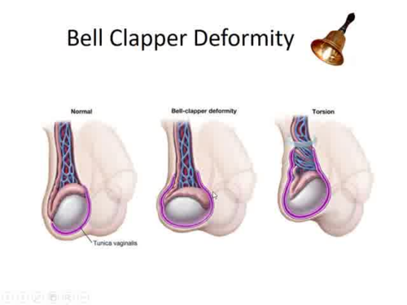
Testicular Torsion
Bell-clapper deformity — high tunica insertion, freely hanging testis, bilateral in most
Neonatal = extravaginal · adolescent = intravaginal
Salvage: >90% at <6 h · ≈50% at 12 h · <10% beyond 24 h
Doppler supports but never overrides clinical suspicion — do not delay exploration for imaging
Manual detorsion (“open the book,” lateral) temporizes only
Bilateral orchiopexy — the defect is bilateral

Slide 48
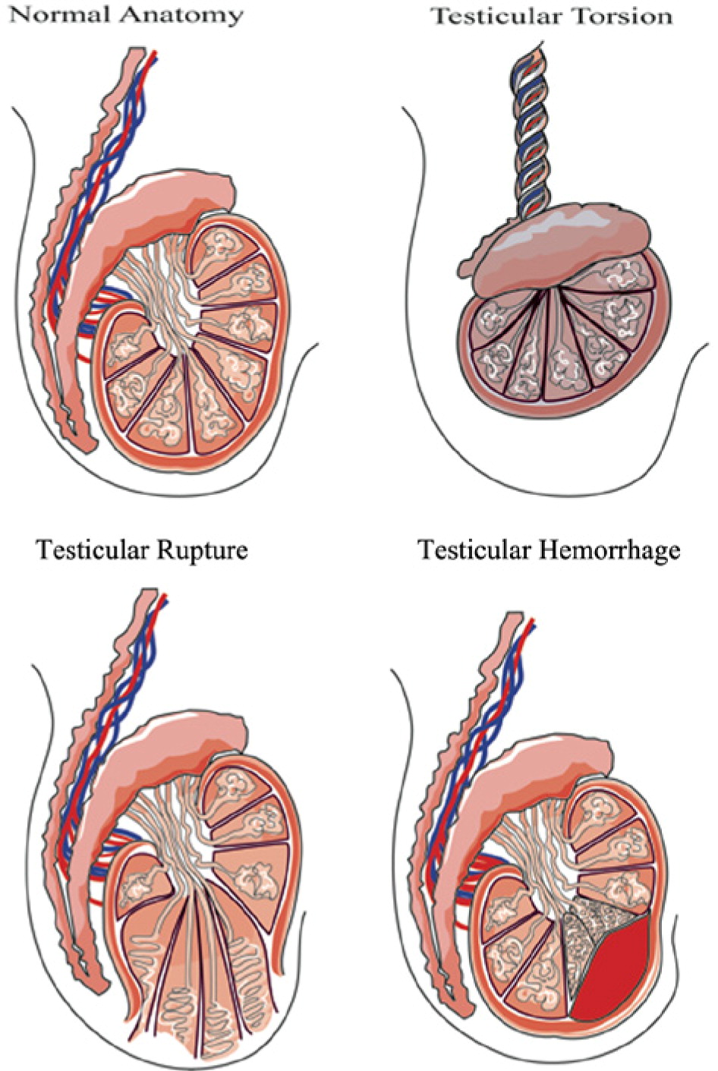
Testicular Rupture
Blunt trauma → tear of the tunica albuginea with extrusion of seminiferous tubules
Ultrasound: heterogeneous parenchyma, contour loss, tunical discontinuity, hematocele
Explore within 72 h → salvage >80–90%; delay → orchiectomy
A large hematocele is not always observed
Same trauma spectrum: hematoma, hematocele, dislocation
Notes:
The American Urological Association recommends scrotal ultrasonography for most blunt scrotal injuries with findings suggestive of testicular rupture, because clinical exam is limited by swelling and pain—and, critically, the hematocele is not the diagnostic anchor for rupture.
The most specific sonographic findings are loss of testicular contour and heterogeneous parenchymal echotexture, and these—not the size or presence of a hematocele—are what should prompt surgical repair.
Prompt exploration is indicated for sonographic rupture, equivocal imaging, a large hematoma, or clear physical findings, yielding salvage rates of 80–90%.
Surgeons should then perform exploration with debridement and tunical closure, or orchiectomy when non-salvageable

Slide 49
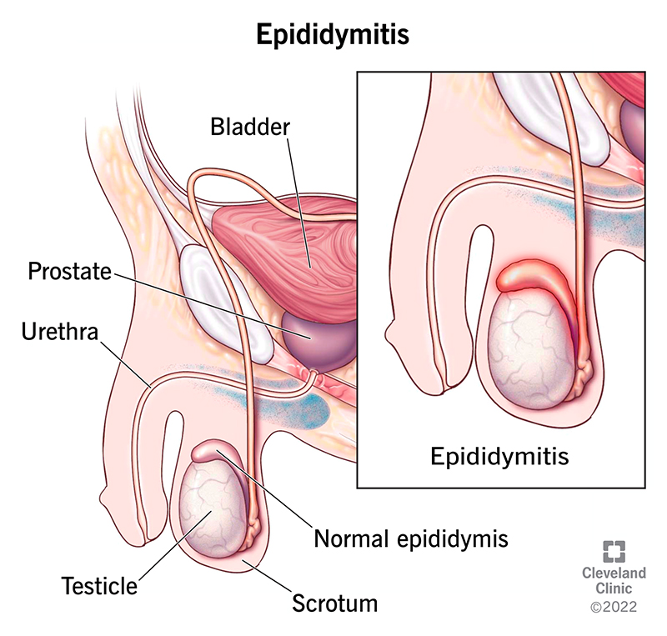
Epididymitis, Orchitis, Fournier Gangrene
Mechanism: retrograde ascent along the vas from urethra/bladder
Age pattern in one line: sexually active younger men vs coliform pattern with obstruction/instrumentation — organisms and treatment: Microbiology session
Mumps orchitis: post-pubertal; pressure necrosis inside the noncompliant tunica → tubular atrophy (blood-testis barrier callback)
Chronic granulomatous epididymitis → think TB
Fournier gangrene: perineal necrotizing fasciitis · diabetes/immunosuppression · pain out of proportion, crepitus · emergent debridement

Slide 50
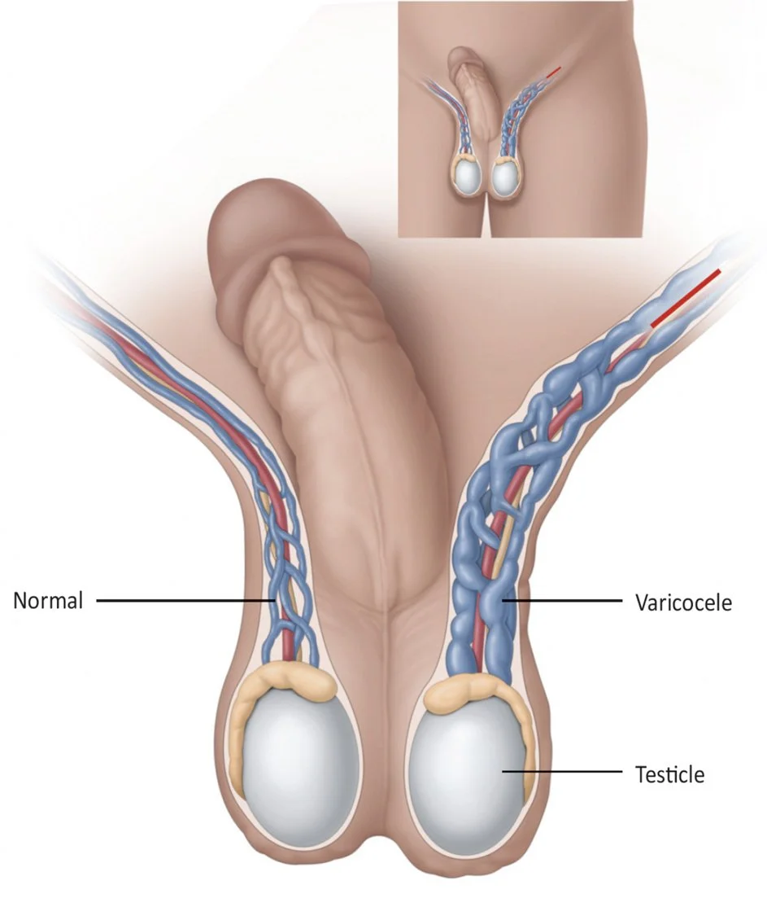
Varicocele
Dilated pampiniform plexus — ≈15% of men, ≈40% of men with primary infertility
Left-sided predominance: left gonadal vein → left renal vein at 90°, longer column, ± nutcracker compression
Grades: I Valsalva-only · II palpable · III visible · “bag of worms,” decompresses supine
Red flag: isolated right-sided, or fails to decompress supine → image the retroperitoneum
Infertility mechanism: hyperthermia, oxidative stress/DNA fragmentation, metabolite reflux
Most common surgically correctable cause of male infertility — do not repair subclinical (US-only) varicoceles
Notes:
Renal vein anatomy callback

Slide 51
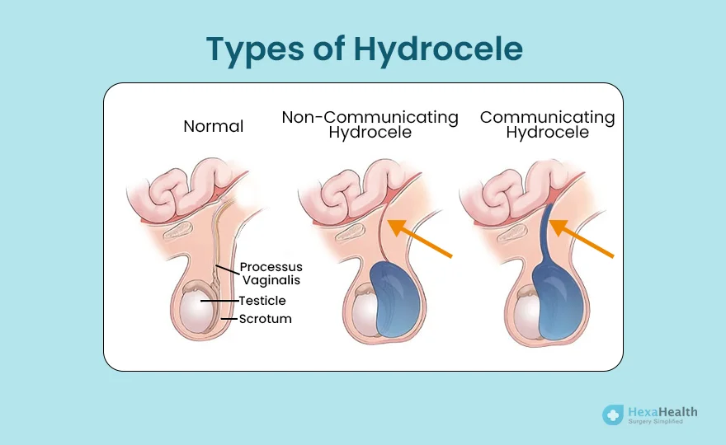
Hydrocele, Spermatocele, Epididymal Cyst
Hydrocele = fluid in the tunica vaginalis → transilluminates
  Communicating (patent processus, pediatric, fluctuates, hernia association) — most resolve by 12–24 months
  Non-communicating (adult) — may be reactive to infection, trauma, or tumor
Safety rule: every new adult hydrocele gets an ultrasound — it can conceal a tumor
Spermatocele / epididymal cyst: superior-posterior, separate from the testis, transilluminate, benign — excise only for pain
The discriminating finding is separability. A mass you cannot separate from the testis is a tumor until proven otherwise.

Slide 52
Cryptorchidism
Two-phase descent: transabdominal (INSL3, gubernaculum) → inguinoscrotal (androgen, genitofemoral/CGRP)
≈3% term, ≈30% preterm · spontaneous descent by 6 months or not at all
Infertility: germ cell degeneration begins ≈6 months (thermal)
Malignancy: RR ≈3–8× — and the contralateral descended testis is also at risk → this is a dysgenesis syndrome, not just position
Orchiopexy 6–18 months: improves fertility, makes the testis examinable, reduces but does not eliminate cancer risk
Distinguish retractile vs undescended vs ascending
Bilateral non-palpable ± hypospadias = DSD workup: karyotype, 17-OHP, electrolytes
Notes:
The contralateral-risk fact is the conceptual core — make it explicit.

Slide 53
Poll 3: Four Hours In
A 16-year-old has 4 hours of severe scrotal pain, an absent cremasteric reflex, and a high-riding testis. Ultrasound is available in 90 minutes.
What do you do?
  A. Order the ultrasound and analgesia
  B. Trial of antibiotics for epididymitis
  C. Emergent surgical exploration now
  D. Manual detorsion and discharge if pain improves
Notes:
Answer C. Reveal discussion: the 90-minute wait spends half the remaining salvage window.

Slide 54
Part 7: Testicular Tumors

Slide 55
The Painless Mass in a Young Man
Most common solid malignancy in men 15–35 — and highly curable, so delay is the enemy
Risks: cryptorchidism · prior contralateral tumor · family history · GCNIS · infertility
Presentation: painless, firm, non-transilluminating intratesticular mass
Ultrasound is highly sensitive — and every new adult hydrocele already bought one
Notes:
Case framing: 24-year-old with a firm painless mass
Testicular dysgenesis syndrome ties cryptorchidism, hypospadias, poor spermatogenesis, and GCT together as downstream effects of disrupted fetal androgen signaling — one in-utero mechanism, several phenotypes

Slide 56
Classification in One Slide
Germ cell ≈95%
  Seminoma: “fried-egg” cells + lymphocytes · radio/chemosensitive · never makes AFP
  Non-seminomatous: embryonal · yolk sac (AFP) · choriocarcinoma (hCG, hematogenous — hemoptysis) · teratoma (chemoresistant → resect)
Sex cord–stromal ≈5%: Leydig (androgen/estrogen secretion → precocious puberty or gynecomastia) · Sertoli
Lymphoma — the most common testicular tumor over 60

Slide 57
Tumor Markers — and the Rule That Gets Tested
Marker | Association
AFP | Yolk sac, embryonal. Elevated AFP excludes pure seminoma — manage as NSGCT regardless of histology report
β-hCG | Choriocarcinoma, embryonal — and up to ≈15% of seminomas (modest elevation acceptable)
LDH | Nonspecific; reflects tumor burden
Draw markers BEFORE orchiectomy
Draw markers AFTER orchiectomy even if normal pre-surgery
Post-orchiectomy decay to nadir is timed to hCG and AFP half-lives → defines the S category and IGCCCG risk
A marker falling slower than its expected half-life = residual / metastatic disease
LDH is prognostic at diagnosis, not a decay tracker — persistently elevated in ~30% of disease-free patients
Notes:
Quiz item 10.
β-hCG
~24–36 h (≤3 days)
Fastest; normalizes within ~1 week of orchiectomy
AFP
~5–7 days
Slower; may still be falling at a 2-week recheck
LDH
~1–3 weeks (variable)
No formal half-life assigned; too slow/nonspecific to track

Slide 58
Management Principles
Radical inguinal orchiectomy with high cord ligation
Never trans-scrotal — violating scrotal lymphatics redirects drainage from retroperitoneal to inguinal nodes (slide 12 payoff)
Offer sperm banking before orchiectomy, chemotherapy, radiation, or RPLND — a recurring real-world failure
Predictable spread: right → interaortocaval · left → left para-aortic → chest
Contrast: prostate cancer → osteoblastic bone metastases (Batson plexus, ↑alk phos)
Notes:
The lymphatic logic is the anatomy slide cashing out.

Slide 59
Part 8: Prostate

Slide 60
BPH: True Hyperplasia of the Transition Zone
Hyperplasia (cell number), not hypertrophy — stromal + epithelial, transition zone only
DHT-dependent: no BPH in 5-AR deficiency or pre-pubertal castration → the mechanistic license for 5-ARIs
Static component = adenoma bulk → treat with 5-ARI
Dynamic component = alpha-1a smooth-muscle tone (stroma, capsule, bladder neck) → treat with alpha-blocker
Size correlates poorly with symptoms — a 30 gram gland with high tone can obstruct more than a 90 gram one
Notes:
BPH obstructs in two ways — the physical bulk of the gland and the muscular squeeze around the urethra — so 5-ARIs shrink the bulk while alpha-blockers relax the squeeze.

Slide 61
LUTS and the Bladder’s Response
Storage (irritative) | Voiding (obstructive)
Frequency · urgency · nocturia · urge incontinence | Weak stream · hesitancy · intermittency · straining · incomplete emptying · terminal dribbling
Storage symptoms = secondary detrusor change → can persist after obstruction is relieved
Bladder arc: hypertrophy → trabeculation → diverticula → decompensation (rising PVR)
Endpoints: retention · UTI · stones · hematuria · bilateral hydronephrosis / post-renal azotemia
Mimics to exclude: anticholinergics/sympathomimetics · diabetes · neurogenic bladder · stricture · cancer
Notes:
Workup line: IPSS, UA, PSA, PVR, uroflow.

Slide 62
BPH Management Ladder
Watchful waiting + behavioral (evening fluids, caffeine, timed voiding)
Medical: alpha-blocker (days) · 5-ARI (months, larger glands) · combination · tadalafil 5 mg daily
MIST: water-vapor thermal therapy · prostatic urethral lift · Aquablation · temporary nitinol device · prostatic artery embolization
  The current shift favors ejaculation-preserving options
Surgical: TURP · HoLEP · simple prostatectomy for the largest glands
Sequencing per the 2026 AUA LUTS/BPH guideline (linked on the resource slide)

Slide 63
Prostatitis: The NIH Categories
Category | Name | Key features
I | Acute bacterial | Fever, rigors, exquisitely tender boggy prostate · abscess/sepsis risk · no vigorous massage
II | Chronic bacterial | Recurrent UTI, same organism — prostate as reservoir · prolonged therapy
III | CP/CPPS | >90% of prostatitis. IIIa inflammatory · IIIb non-inflammatory · frequently not infectious
IV | Asymptomatic inflammatory | Incidental on biopsy or semen analysis
Antibiotics need lipid solubility to reach prostatic fluid (fluoroquinolones, TMP-SMX)
Repeated antibiotic courses for category III is a common and harmful error → UPOINT phenotyping, multimodal care (reference slide R11)
Notes:
Category III framing prevents years of futile antibiotics.

Slide 64
Prostate Cancer in Five Points
Peripheral zone adenocarcinoma, usually multifocal · risks: age, African ancestry, family history, BRCA2, Lynch
PSA is organ-specific, not cancer-specific — raised by BPH, prostatitis, instrumentation, retention, ejaculation · halved by 5-ARIs → double the value
Pathway: risk assessment → mpMRI (PI-RADS) → targeted + systematic biopsy → Gleason / Grade Group 1–5 drives management
Spectrum: active surveillance → prostatectomy → radiation ± ADT → systemic therapy · mets are osteoblastic bone
Screening is shared decision-making — mortality benefit vs overdiagnosis; ≈55–69 window; earlier for high-risk groups

Slide 65
Part 9: ED, Premature Ejaculation, Infertility

Slide 66
Erectile Dysfunction: Six Etiologic Buckets
Category | Examples
Vasculogenic (most common) | Atherosclerosis · hypertension · diabetes · dyslipidemia · smoking · obesity
Neurogenic | Diabetic neuropathy · cord injury · MS · radical pelvic surgery · radiation
Hormonal | Testosterone deficiency · hyperprolactinemia · thyroid disease
Drug-induced | Thiazides · beta-blockers · spironolactone · SSRIs · antipsychotics · 5-ARIs · opioids
Anatomic | Peyronie · venous leak · post-priapism fibrosis
Psychogenic | Performance anxiety · depression · relationship factors
History sorts it:
Sudden + situational + preserved morning erections → psychogenic
Gradual + lost nocturnal erections → organic
Notes:
Slide 31’s localization logic applied.

Slide 67
ED Is a Cardiovascular Sentinel
Cavernosal arteries ≈ 1–2 mm · coronaries ≈ 3–4 mm
The same endothelial dysfunction is symptomatic in the smaller vessel first
ED commonly precedes a cardiac event by 3 years
A 50-year-old with new ED has handed you a screening opportunity: lipids, A1c, blood pressure, smoking
Do not just write for sildenafil

Slide 68
ED Treatment Ladder
Lifestyle + risk-factor modification (exercise improves erections with an effect size rivaling medication)
PDE-5 inhibitor — first line (details in pharmacology, next part)
Intracavernosal injection (alprostadil / bimix / trimix) or intraurethral alprostadil
Vacuum erection device (constriction ring ≤30 min)
Penile prosthesis — highest satisfaction of any ED therapy. The correct answer for refractory disease, not an act of desperation
Notes:
Injection/device detail on reference slide R6.

Slide 69
Premature Ejaculation — and the SSRI Two-Way Street
Most common male sexual dysfunction · defined by short latency (≈1 min lifelong), inability to delay, and distress
Mechanism: central serotonergic threshold (slide 35) + genetics + hypersensitivity + psychological factors
Treat comorbid ED first — rushing to beat a failing erection mimics PE
Behavioral (stop-start, squeeze) · topical lidocaine-prilocaine (condom protects the partner) · SSRIs off-label (paroxetine strongest) · clomipramine
The same serotonergic effect that treats PE is the adverse effect in patients on SSRIs for depression: delayed ejaculation, reduced libido — one mechanism, two framings (erections typically intact)
Notes:
The bidirectionality is the teaching point; it covers the SSRI objective.

Slide 70
Male Infertility: Framework and Reference Limits
≈15% of couples · male factor in ≈50% · evaluate both partners in parallel from day one
Three compartments:
  Pre-testicular (often reversible): central hypogonadism, hyperprolactinemia, exogenous T / anabolics, opioids, obesity
  Testicular: Klinefelter · Y-microdeletions (AZFa/b/c) · cryptorchidism · varicocele · mumps · gonadotoxins
  Post-testicular: vasectomy · CBAVD (CFTR — test patient AND partner) · ejaculatory duct obstruction · retrograde ejaculation
WHO 6th ed lower reference limits: volume 1.4 mL · conc 16 M/mL · total 39 M · motility 42% · progressive 30% · morphology 4%
These are population reference limits from recent fathers — not fertile/infertile thresholds.
Two samples, ≥1 month apart (AUA/ASRM), 2–7 days abstinence
  Exception: azoospermia is confirmed 1–2 weeks later with pellet analysis (centrifuge the specimen, examine the concentrate for rare sperm — finding any = cryptozoospermia, may permit ICSI without surgical retrieval)
Notes:
The reference-limit framing prevents the most common misread of a semen analysis.

Slide 71
Reading Azoospermia
 | Obstructive | Non-obstructive
Testis volume | Normal | Small, soft
FSH | Normal | Elevated
Vas deferens | May be absent (CBAVD) | Present
Sperm retrieval | Essentially always present | microTESE — variable yield
Low-volume + acidic + fructose-negative → ejaculatory duct obstruction or CBAVD (slide 8 payoff)
Post-ejaculatory urinalysis → retrograde ejaculation
Karyotype + Y-microdeletions if <5 M/mL or azoospermic
Complete AZFa/AZFb deletion predicts failed retrieval — changes counseling before surgery
A semen analysis is a general health biomarker — infertile men carry higher cancer and comorbidity rates
Notes:
The semen has no sperm either because the factory works but the pipes are blocked (obstructive: normal testis size, normal FSH) or
Because the factory itself has failed (non-obstructive: small soft testes, high FSH as the pituitary shouts at tubules that can't answer

Slide 72
Part 10: Pharmacology

Slide 73
PDE-5 Inhibitors: Mechanism and the Counseling Point
Inhibit PDE-5 → cGMP accumulates → amplify an existing NO signal — they do not create one
They require sexual stimulation. The most common “it didn’t work” is a counseling failure, not a drug failure
An adequate trial = maximal dose · correct timing · appropriate stomach · several attempts
Also treats: pulmonary arterial hypertension
Tadalafil 5 mg daily for LUTS ± ED — the one-drug answer to Case C

Slide 74
PDE-5 Agents, Contraindications, Rare Harms
Agent | Onset | Half-life | Distinguishing feature
Sildenafil | 30–60 min | ≈4 h | PDE-6 → blue-tinged vision · fatty meals delay absorption
Vardenafil | 30–60 min | ≈4 h | QT prolongation
Tadalafil | ≈2 h | ≈17.5 h | 36-h window · daily dosing · PDE-11 → back pain/myalgia · food-independent
Avanafil | ≈15 min | ≈5 h | Most selective, fastest onset
Absolute: nitrates in any form (including amyl nitrite) and Riociguat — same pathway, profound hypotension
Separate 24 h (sildenafil/vardenafil), 48 h (tadalafil)
Alpha-blockers: additive hypotension — stabilize the alpha-blocker first ·
Practical cardiac screen: can he climb two flights of stairs
Rare, board-relevant: NAION · sudden sensorineural hearing loss
Notes:
Non-Arteritic Anterior Ischemic Optic Neuropathy

Slide 75
BPH Drugs Mapped to Static and Dynamic
Class | Agents | What to counsel
Alpha-1 blockers (dynamic) | Doxazosin, terazosin (non-selective) · tamsulosin, silodosin (α-1a) · alfuzosin | Onset in days · orthostasis (non-selective) · retrograde/absent ejaculation (selective) · ask about cataract surgery — floppy iris
5-ARIs (static) | Finasteride (type 2) · dutasteride (1+2) | Gland shrinks 20–25% over 6 mo · PSA halves — double the value · sexual AEs · teratogenic (Cat X): no handling of broken tablets in pregnancy
Combination | α-blocker + 5-ARI | Best for progression in larger glands
Storage add-ons | Antimuscarinics · mirabegron | Check post-void residual first

Slide 76
Androgen Therapy — and the Fertility-Sparing Alternatives
Indication: consistent symptoms + two morning total T <300 ng/dL · get the LH (the fork), hematocrit, PSA if age-appropriate — and have the fertility conversation
Adverse effects (all predictable): erythrocytosis · azoospermia + testicular atrophy · gynecomastia · acne · worsened OSA
TRAVERSE (2023): CV non-inferior in at-risk hypogonadal men (MACE 7.0% vs 7.3%) — but more AF, PE, and AKI
Fertility-sparing instead of T:
  clomiphene/enclomiphene (SERM → ↑endogenous LH/FSH)
  hCG (LH analog, preserves intratesticular T)
Anabolic steroid users: axis recovery takes months to years, sometimes incomplete — screen non-judgmentally
FDA relabeled the class in early 2025:
  Boxed warning for cardiovascular risk removed
  TRAVERSE results added to all labels
  New warning for increased blood pressure, limitation-of-use for age-related hypogonadism retained.
Notes:
Formulation table incl. transdermal transference on reference slide R3.

Slide 77
ADT for Prostate Cancer — The GnRH Pulsatility Payoff
GnRH agonists (leuprolide, goserelin): continuous stimulation downregulates the receptor → castration ·
  Initial testosterone flare → cover with an antiandrogen in high-burden disease
GnRH antagonists (degarelix; oral relugolix): no flare, faster castration
AR antagonists:
  bicalutamide · flutamide (hepatotoxic)
  2nd-gen: enzalutamide (seizure signal), apalutamide, darolutamide (least CNS)
Abiraterone + prednisone: CYP17A1 blockade; prednisone prevents mineralocorticoid excess (HTN, hypokalemia)
Systemic ADT toll — bone, metabolic, cognitive — on reference slide R4
Notes:
Slide 22’s planted flag collected.

Slide 78
Three Cases — Revisited
Case A. 17-year-old male. Sudden severe left scrotal pain 3 hours ago during lacrosse. Nausea. One prior episode that resolved on its own.
Case B. 34-year-old male. 18 months of infertility. “Working out hard.” Taking a supplement from a men’s clinic. Semen analysis: azoospermia.
Case C. 68-year-old male. Nocturia ×3, weak stream, PSA 6.2. Mentions at the end of the visit that erections have declined over 2 years.

Slide 79
Cases Resolved
A — Torsion. Absent cremasteric reflex, high transverse lie, negative Prehn, prior intermittent episodes → emergent exploration + bilateral orchiopexy. No waiting for ultrasound if delayed
B — Exogenous testosterone. “Supplement” = androgen → LH suppressed → intratesticular T collapsed. Check LH/FSH/T/prolactin · stop the androgen · consider hCG + SERM · repeat SA ≥3 months
C — Transition-zone BPH + sentinel ED + independent PSA workup. IPSS, PVR, repeat PSA, MRI pathway · daily tadalafil treats LUTS and ED with one drug (no nitrates) · lipids, A1c, BP
Notes:
Tie each resolution to the slide where its concept was taught.

Slide 80
Ten Things to Remember
BPH is transition zone; prostate cancer is peripheral zone
Spermatogenesis takes 3 months — every fertility intervention runs on that clock
Intratesticular testosterone drives spermatogenesis; exogenous T is a contraceptive
LH separates primary from secondary hypogonadism — get it before prescribing
Testosterone builds the body; DHT builds the prostate and the hairline
Point (parasympathetic S2–4) and Shoot (sympathetic T10–L2; pudendal expels)
PDE-5 inhibitors amplify a signal — never with nitrates
Torsion is clinical. Six hours. Do not wait for imaging (if delayed)
Testis drains retroperitoneal → inguinal orchiectomy · penis drains inguinal · bank sperm first
10. Replace the foreskin after the catheter — and new ED is a cardiovascular workup

Slide 81
Resources
AUA Medical Student Curriculum (free account) — modules mapping to today: Acute Scrotum · BPH · Erectile Dysfunction · Male Infertility · Prostate Cancer/PSA · Urologic Emergencies
AUA Male GU Exam video module — testicular and digital rectal examination
StatPearls (free): Physiology of the Male Reproductive System · Physiology, Erection · Physiology, Testosterone
AUA Guidelines: LUTS/BPH (2026) · Erectile Dysfunction — skim the algorithms
Note: testicular cancer, penile cancer, cryptorchidism, Peyronie disease, prostatitis, and PE have no AUA student module — the reference slides that follow are your primary resource for those, but some of these topics available on ScholarRX
Notes:
Descriptive link text goes on the Canvas page; do not read URLs aloud.

Slide 82
Thank You
Vikas Desai, MD, FGPS
vikas.desai@carle.com

Slide 83
Reference Slides — Posted and Examinable

Slide 84
Reference R1 — Penile Cancer: Risk and Precursors
Squamous cell carcinoma in ≈95%. Uncommon in the US; substantially more common in parts of Africa, South America, and Asia.
Risk factors: phimosis and chronic inflammation, lichen sclerosus (BXO), smoking, HPV 16/18 (≈half of cases), absence of neonatal circumcision.
Premalignant lesions: penile intraepithelial neoplasia (PeIN); erythroplasia of Queyrat (glans); Bowen disease (shaft); verrucous carcinoma (locally destructive, rarely metastasizes).
Typical story: a non-healing glans or foreskin lesion with a long delay from embarrassment. Any non-healing penile lesion gets a biopsy.

Slide 85
Reference R2 — Penile Cancer: Spread and Treatment
Penile lymphatics drain to inguinal nodes — the exact opposite of the testis. Inguinal node status is the dominant prognostic factor.
Palpable nodes may be reactive or metastatic; imaging and sentinel/superficial dissection stage intermediate- and high-risk disease.
Treatment is organ-sparing where feasible: topical therapy or laser for PeIN, glansectomy or partial penectomy with margins for invasive disease, total penectomy for extensive tumors.
Chemoradiation and systemic therapy for advanced nodal or metastatic disease.
Notes:
Pairs with lecture slide 12’s drainage contrast.

Slide 86
Reference R3 — Testosterone Formulations
IM cypionate/enanthate: inexpensive, peak-trough swings, highest erythrocytosis rates.
IM undecanoate: long-acting; REMS program for pulmonary oil microembolism (POME) risk.
Subcutaneous auto-injector: steadier levels, self-administered.
Transdermal gel/solution: physiologic profile; counsel on skin-to-skin transference to women and children — wash hands, cover the site.
Patch (skin irritation), pellets (surgical insertion, months-long), oral undecanoate (lymphatic absorption), buccal, intranasal.
Monitor on any formulation: symptoms, trough or mid-interval T, hematocrit, PSA if age-appropriate.

Slide 87
Reference R4 — Systemic Consequences of ADT
Hot flashes; loss of libido and erectile function; gynecomastia; fatigue; mood and cognitive effects.
Body composition: sarcopenia with increased fat mass; insulin resistance and metabolic syndrome; anemia.
Bone: accelerated loss → baseline DEXA, calcium + vitamin D, and an antiresorptive (bisphosphonate or denosumab) for those at fracture risk.
QT prolongation with some agents; cardiovascular risk-factor management throughout.
Treat ADT like any systemic endocrine therapy: it needs its own survivorship plan.

Slide 88
Reference R5 — Drugs That Cause Male Sexual Dysfunction
Thiazides, spironolactone, beta-blockers: ED, decreased libido, gynecomastia (spironolactone).
SSRIs/SNRIs, TCAs: delayed or absent ejaculation, reduced libido, ED.
Antipsychotics: hyperprolactinemia → secondary hypogonadism.
Opioids: central suppression — opioid-induced androgen deficiency.
5-ARIs, antiandrogens, GnRH agents: ED, libido loss, ejaculatory dysfunction.
Alpha-1a blockers: retrograde/absent ejaculation
Cimetidine, ketoconazole: antiandrogen effects.
Anabolic steroids / exogenous T: azoospermia, atrophy
Alkylating chemo, pelvic RT: often permanent gonadotoxicity
Alcohol, tobacco

Slide 89
Reference R6 — Injections, Devices, Prosthesis
Intracavernosal alprostadil (PGE1): works via cAMP — a parallel pathway — so it works when PDE-5 inhibitors fail.
Bimix/trimix: papaverine (non-selective PDE inhibitor) + phentolamine (alpha-blocker) ± alprostadil.
Mandatory counseling for any injection: seek care for an erection lasting more than 4 hours.
Intraurethral alprostadil (MUSE) and topical formulations — less effective, needle-free.
Vacuum erection device: constriction ring ≤ 30 minutes.
Penile prosthesis (inflatable or malleable): highest satisfaction rates of any ED therapy — definitive treatment for refractory disease.

Slide 90
Reference R7 — The Supplement Problem
The FDA repeatedly finds over-the-counter “male enhancement” products adulterated with undeclared sildenafil or tadalafil analogs.
A patient on nitrates taking one of these is exposed to the full interaction — without knowing he took a PDE-5 inhibitor.
Ask about supplements with the same seriousness as prescriptions, especially in men with ED and cardiac disease.
Same vigilance for “testosterone boosters” and men’s-clinic injections — Case B’s lesson.

Slide 91
Reference R8 — Capacitation and the Acrosome Reaction
Ejaculated sperm are mature but not yet fertilization-competent.
Capacitation (female tract, hours): cholesterol efflux destabilizes the membrane; bicarbonate and calcium influx activate soluble adenylate cyclase → PKA signaling; tyrosine phosphorylation; hyperactivated motility.
Acrosome reaction (at the zona pellucida): exocytosis of acrosomal enzymes (acrosin, hyaluronidase) enabling zona penetration; membrane fusion follows at the equatorial segment.
Board distractor: neither event happens in the epididymis.

Slide 92
Reference R9 — Experiments of Nature
5-alpha-reductase type 2 deficiency (46,XY): normal Wolffian (internal) ducts; undervirilized external genitalia at birth; marked virilization at puberty from the testosterone surge; no BPH, no male-pattern balding in adulthood. The physiologic proof-of-concept for finasteride.
Complete androgen insensitivity (46,XY): defective androgen receptor; testes present (often inguinal); AMH intact → no uterus; external phenotype female; presents with primary amenorrhea or inguinal masses.
Together they dissect the axis: 5-AR deficiency separates testosterone’s jobs from DHT’s (what survives is testosterone; what fails is DHT), and CAIS shows both hormones act through one shared androgen receptor — the final common pathway.

Slide 93
Reference R10 — Worked Semen Analysis
34-year-old, 18 months infertility. SA #1: volume 0.8 mL · pH 6.6 · azoospermia · fructose negative. SA #2 confirms.
Step 1 — volume and pH: low-volume, acidic, fructose-negative → the seminal vesicle contribution is missing → ejaculatory duct obstruction or CBAVD.
Step 2 — exam: are the vasa palpable? Absent → CBAVD → CFTR testing for patient and partner.
Step 3 — labs: normal testis volume + normal FSH fits obstruction (contrast: small testes + high FSH = non-obstructive).
Step 4 — plan: surgical sperm retrieval + ICSI; genetic counseling.
The pattern recognition, not the numbers, is the skill.

Slide 94
Reference R11 — CPPS and UPOINT
Category III (CP/CPPS) is a phenotype-driven syndrome, frequently non-infectious — which is why serial antibiotics fail.
Urinary — LUTS → alpha-blocker, behavioral
Psychosocial — depression, catastrophizing → CBT, treatment of mood disease
Organ-specific — prostatic tenderness → anti-inflammatories, phytotherapy
Infection — documented → one targeted antibiotic course only
Neurologic/systemic — IBS, fibromyalgia overlap → neuromodulators
Tenderness — pelvic-floor myalgia → pelvic-floor physical therapy (often the highest-yield single intervention)
Multimodal beats monotherapy; set expectations for management, not cure.

Slide 95
Reference R12 — Circumcision: The Evidence in Brief
Protective associations:
  Reduced UTI in infancy
  Reduced HIV and some STI acquisition (strongest data from high-prevalence settings)
  Reduced penile cancer (largely via phimosis/chronic inflammation)
  Reduced HPV transmission.
Risks: bleeding, infection, meatal stenosis, rare glans injury; anesthesia considerations.
AAP position: benefits outweigh risks but are not large enough to recommend universally → parental shared decision-making.
Medical indications in adults: pathologic phimosis, recurrent balanitis, BXO.

