Slide 1
Cervical & Vaginovulvar Pathologies
Carla Rafferty, MD
Family Medicine Physician
Course Director for Human Development & Reproduction
Clinical Associate Professor CICOM

Slide 2
Objectives
Describe the screening guidelines for cervical cancer and how to implement them.
Explain how HPV affects cervical cells and how that progresses over time into cervical cancer.
Describe the impact of HIV’s additive risk for HPV infected individuals with respect to cervical and anal cancer screenings.
Describe the surveillance and possible treatments for abnormal cervical cytology in pre-cancerous abnormalities in addition to prevention measures.
Describe the various pathogens that can cause cervicitis and vulvovaginitis and how they develop, including a description of common symptomology, diagnostic workup, and treatment options.
Explain other vulvar non-cancerous pathologies including how to diagnose and treat.

Slide 3
Disclosures
None

Slide 4
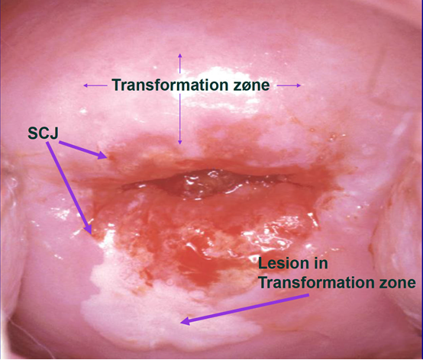
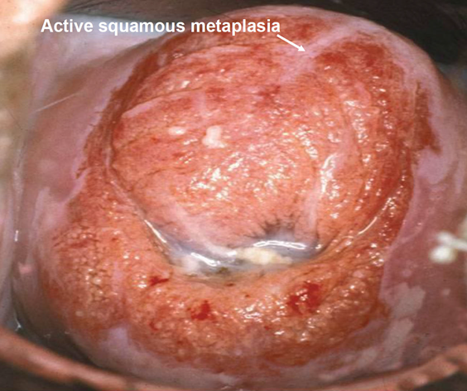
Cervical Path

Slide 5
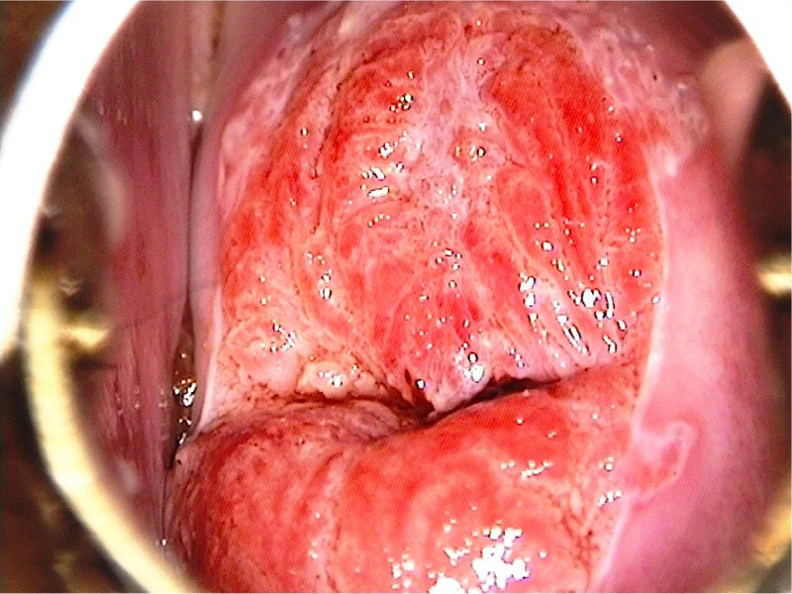
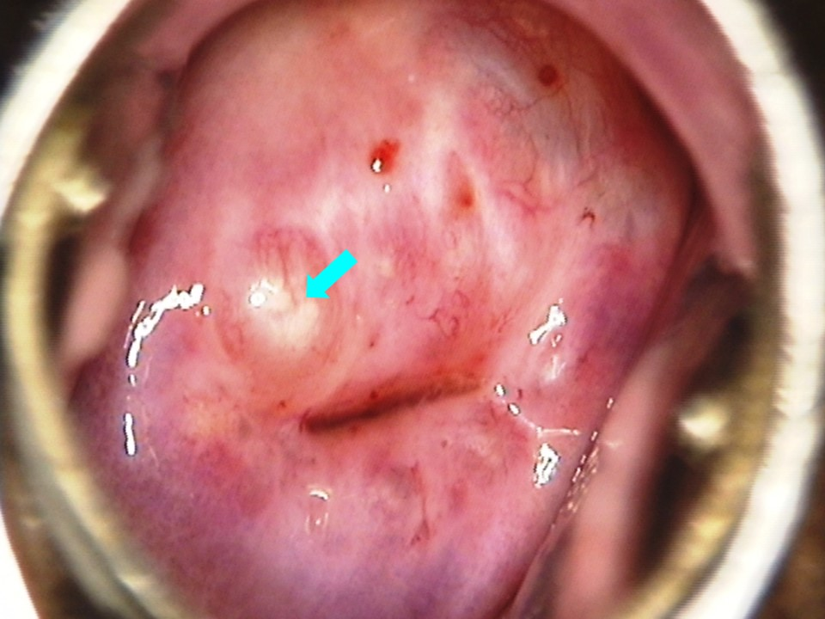
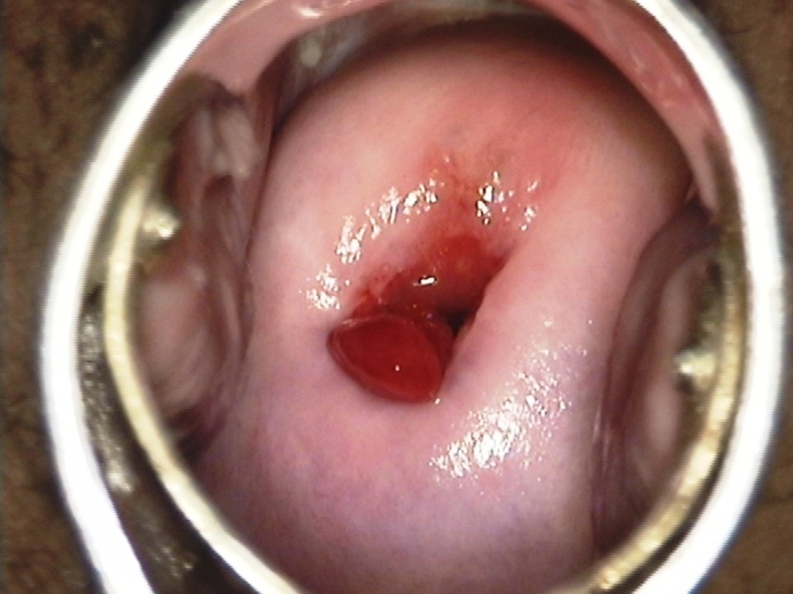
Benign Cervical Lesions
Cervical Ectropion – columnar epithelium extending onto the ectocervix due to hormonal changes; associated with OCPs and pregnancy
Nabothian Cysts – retention cysts from occluded endocervical glands
Cervical Polyps – a growth that develops on the cervix; usually asymptomatic, can cause intermenstrual or postcoital bleeding & polypectomy is the treatment for symptomatic cases
Atlas of visual inspection of the cervix with acetic acid for screening, triage, and assessment for treatment

Slide 6
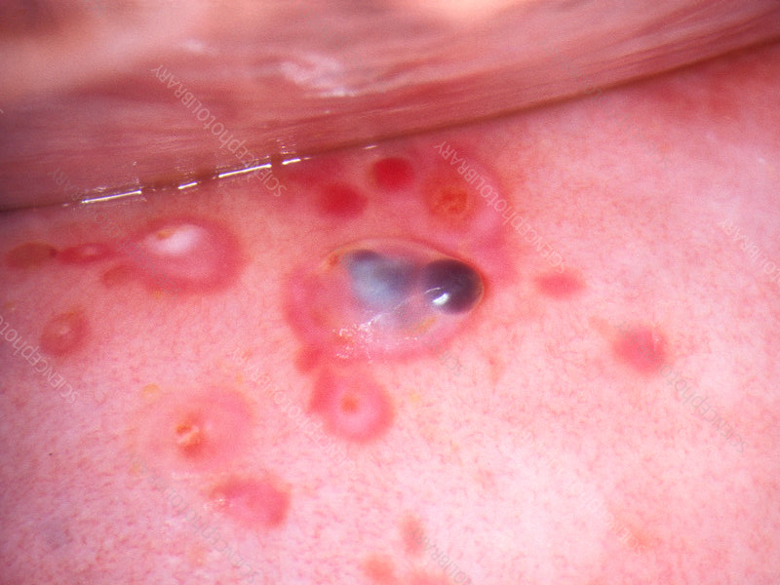
Benign Cervical Lesions – part 2
Cervical Leiomyomas – benign smooth muscle tumors that can arise from the cervical stroma
Cervicitis – usually caused by STIs (ie gonorrhea, chlamydia, trichomanias, etc), but can result from anything that changes the normal environment (ie douching, BV, chemicals, etc); can cause abnormal discharge, bleeding, & pain
  While benign, can lead to complications like PID, endometritis, ectopic pregnancy, infertility, & chronic pelvic pain
Cervical Endometriosis – ectopic endometrial
tissue on the cervix; may present as blue-black
lesions on speculum exam
Endometriosis of the cervix, colposcopy - Stock Image - C034/5643 - Science Photo Library

Slide 7
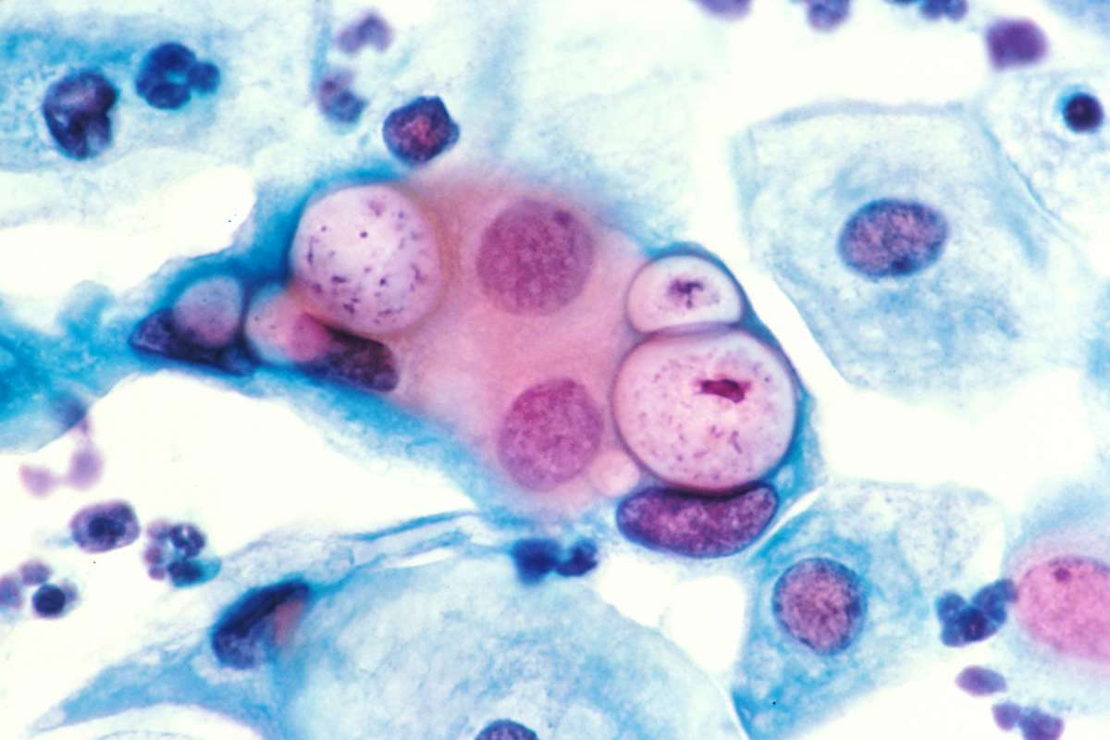
Chlamydia

Slide 8
Chlamydia – General Info
Is a genus of bacteria that are obligate intracellular parasites, Chlamydia trachomatis
Transmitted via oral, vaginal, or anal sex with an infected partner
Both men & women can contract it
It can also be transmitted to newborn during a vaginal delivery
Risk factors include
  Prior infection with chlamydia
  Positive for other STIs, esp HIV
  Have new or multiple sex partners
  Use condoms inconsistently
  Do commercial sex work
  Use illegal drugs
  Started sexual relationships early in adolescence
  Live in a detention facility
  Are a man who has had sex with men
Most common STI in the US

Slide 9
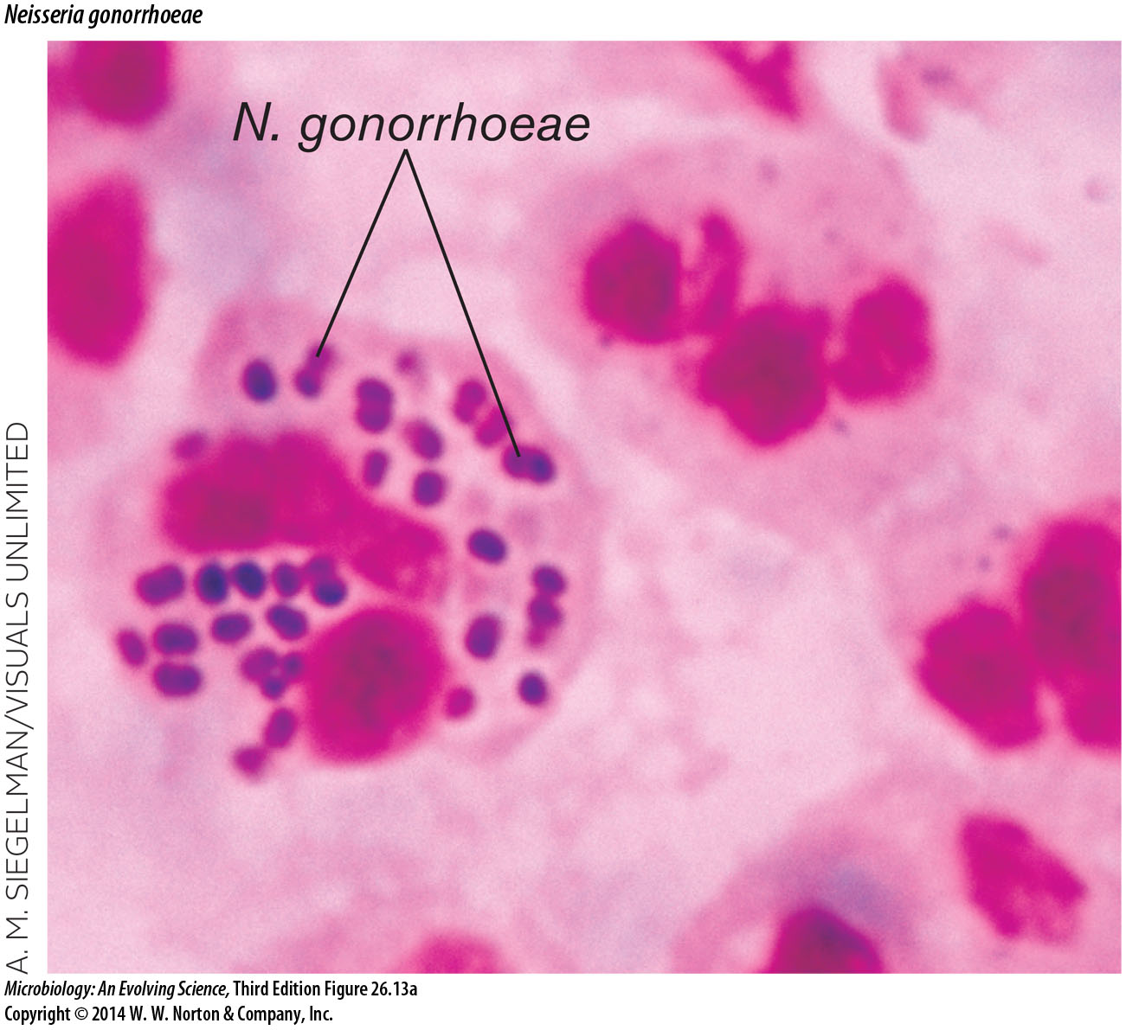
Gonorrhea
http://cdn.wwnorton.com/college/biology/microbiology3/micrograph/fig/C26/FIG26.13.A_MICROB3_CH26.jpg

Slide 10
Gonorrhea – General Info
Neisseria gonorrhea is a gram-negative intracellular Diplococci
Transmitted via oral, vaginal, or anal sex w/ an infected partner
Both men & women can contract it
It can also be transmitted to newborn during a vaginal delivery
Risk Factors
  Prior infection with gonorrhea
  Positive for other STIs, esp HIV
  Have new or multiple sex partners
  Use condoms inconsistently
  Do commercial sex work
  Use illegal drugs
  Started sexual relationships early in adolescence
  Live in a detention facility
  Are a man who has had sex with men
2nd most common bacterial STI in the US

Slide 11
Chlamydia & Gonorrhea Screening
The CDC,
The U.S. Preventive Services Task Force (USPSTF),
The American Academy of Family Physicians (AAFP), &
The American College of Obstetricians and Gynecologists (ACOG)
USPSTF 24 and younger
CDC & ACOG says age 25 and younger
For all other sexually active women who are at increased risk (ie multiple sex partners, new sex partner, prior STI, etc.)
CDC and ACOG specifically recommend annual screening.
These organizations do not recommend routine screening for sexually active, heterosexual males.

Slide 12
Chlamydia & Gonorrhea in Pregnancy
For pregnant women, the CDC recommends screening for chlamydia & gonorrhea during the 1st prenatal visit & again in the 3rd trimester for those 25 & younger or who are at increased risk of infection.
Pregnant women diagnosed with chlamydia &/or gonorrhea during the 1st trimester should be retested within 3 - 6 mon, preferably in the 3rd trimester.

Slide 13
Chlamydia & Gonorrhea – Prevention
Use condoms
Limit sexual partners
Practice abstinence
Refrain from intercourse if partner is positive for infection until they are treated

Slide 14
Chlamydia - Symptoms
Symptoms in women
Symptoms in men
Usually asymptomatic
Abnormal vaginal discharge that may have an odor
Bleeding between periods
Painful periods
Abdominal pain with fever
Pain when having sex
Itching or burning in or around the vagina
Pain when urinating
Usually asymptomatic
Small amounts of clear or cloudy discharge from the tip of the penis
Painful urination
Burning & itching around the opening of the penis
Pain & swelling around the testicles

Slide 15
Gonorrhea - Symptoms
Symptoms in women
Symptoms in men
Usually asymptomatic
  Even if symps, they are often mild & can be mistaken for a bladder or vaginal infection.
Painful or burning sensation when urinating
Increased vaginal discharge
Vaginal bleeding between periods or spotting after intercourse
Swelling of the vulva
Burning in the throat or swollen glands in the throat
Usually asymptomatic
A burning sensation when urinating
A white, yellow, or green discharge from the penis
Painful or swollen testicles (although this is less common)
Burning in the throat or swollen glands in the throat

Slide 16
Chlamydia – Diagnosis
Cervical Swab or Vaginal Swab or Urine Sample
Nucleic Acid Amplification Test (NAAT) is the preferred test
  Based on amplification of the DNA that is present in Chlamydia trachomatis.
  Generally more sensitive and specific than other chlamydia tests
  Can be performed on urine from both men & women
Other tests include
  Direct Fluorescent Antibody Stain (DFA), which detects chlamydia antigens, and
  DNA probe, another test that looks for chlamydia DNA but that is less sensitive than NAAT.
Chlamydia trachomatis is not visible with Gram stain

Slide 17

Gonorrhea – Diagnosis
Cervical Swab or Vaginal Swab or Urine Sample
Nucleic Acid Amplification Test (NAAT) is the preferred test
  Based on amplification of the DNA that is present in gonorrhea
  Generally more sensitive and specific than other culture tests
  Can be performed on urine from both men & women
Other tests include
  Direct Fluorescent Antibody Stain (DFA), which detects gonorrhea antigens, and
  DNA probe, another test that looks for gonorrhea DNA but that is less sensitive than NAAT.
N. Gonorrhea is visible on Gram stain
  Gram-negative intracellular Diplococci

Slide 18
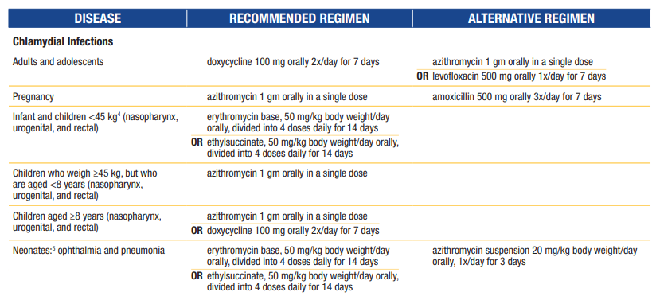
Chlamydia – Treatment
Doxycycline is efficacious for C. trachomatis infections of urogenital, rectal, and oropharyngeal sites. Although azithromycin maintains high efficacy for urogenital C. trachomatis infection among women, concern exists regarding effectiveness of azithromycin for concomitant rectal C. trachomatis infection, which can occur commonly among women as well as men who have sex with men & cannot be predicted by reported sexual activity.

Slide 19
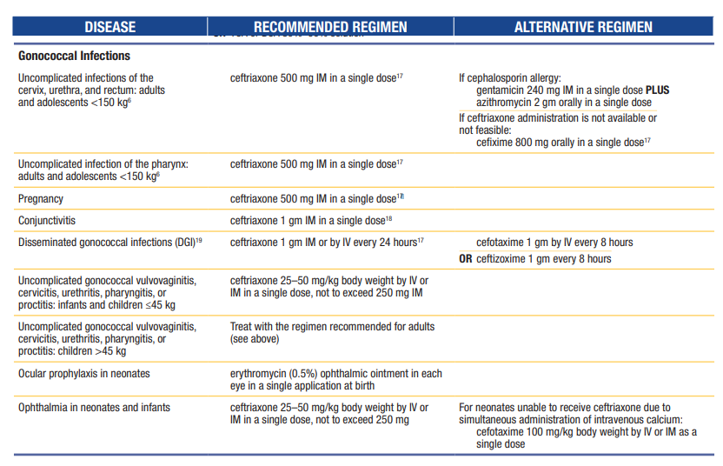
Gonorrhea – Treatment
  Drug-Resistant Gonorrhea: An Urgent Public Health Issue – YouTube
  (video 3.35 min)

Slide 20
Chlamydia & Gonorrhea Management
Treat sexual partner(s) (considered 60 days preceding the pt’s onset of symptoms or diagnosis)
  Expedited Partner Treatment (EPT) scripts can be written
    Chlamydia alone - Treat sexual partner(s) w/ oral doxycycline 100 mg 2 x/day x 7 days.
    Gonorrhea alone - Treat sexual partner(s) w/ cefixime 800 mg as a single dose
Abstain from intercourse (x1wk) until treatment regimen is completed & symptoms have resolved
Counsel patient on safe sexual practices & offer testing for additional STIs
Retesting
  Test of cure to detect treatment failure (i.e., repeat testing 4 wks after completing therapy) is not advised for nonpregnant persons treated w/ recommended or alternative regimens, unless therapeutic adherence is in question, symptoms persist, or reinfection is suspected.
    Could lead to false positives as well
    Most posttreatment infections are the result of reinfection rather than treatment failure
  Men & women who have been treated for chlamydia should be retested approximately 3 mon after treatment, regardless of whether they believe their sex partners were treated
Contact CDC/PHD if needed

Slide 21
Chlamydia – If left untreated
For women, complications include
For men, complications include
Cause PID, which can lead to damage of the fallopian tubes or even cause infertility
Increase the risk of ectopic pregnancy
May cause premature births & the infection can be passed along to delivering baby causing an eye infection, blindness, or pneumonia in the newborn
Cause nongonococcal urethritis (NGU) -- an infection of the urethra
Cause epididymitis -- an infection of the epididymis
Cause proctitis -- an inflammation of the rectum

Slide 22
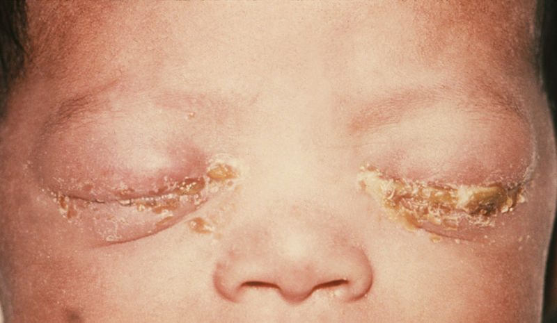
Gonorrhea – If left untreated
For women, complications include
For men, complications include
Cause painful condition of the testicles called epididymitis
In rare cases, this may cause a man to be sterile
Can also affect the prostate leading to scarring inside the urethra making urination difficult
Cause PID, which can lead to damage of the fallopian tubes or even cause infertility
Increase the risk of ectopic pregnancy
Long-term pelvic/abdominal pain
May cause premature births & the infection can be passed along to delivering baby causing an eye infection, blindness, joint infection, or life-threatening blood infection in the newborn.

Slide 23
Gonorrhea – If left untreated (cont)
Can’t See, Can’t Pee, Can’t Climb a Tree
  Reiter’s Syndrome
Rarely, gonorrhea can also spread to your blood or joints. This condition can be life-threatening.
Untreated gonorrhea may increase your changes of getting/giving HIV.

Slide 24
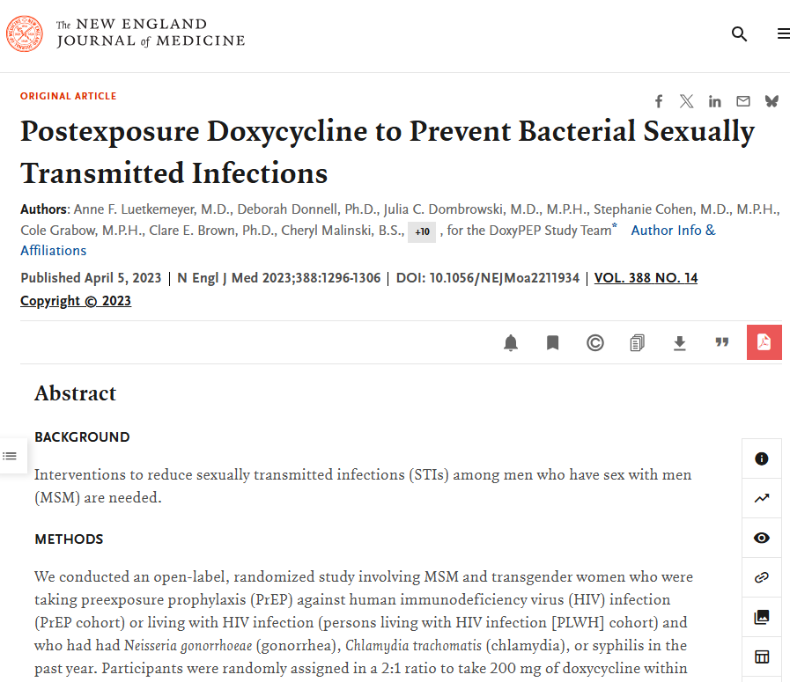
Doxy-Pep
Take doxycycline 200 mg as soon as possible, w/in 72 hours, after anal, oral, or vaginal sex.
Don't take more than 1 dose of doxy in a 24-hr period, regardless of how many times you have sex in a day.
You can take Doxy-PEP as often as every day if you need.
Can help some people reduce chances of getting (STI).
Patients should see their provider again q 3-6 months.

Slide 25
Bacterial STI Prophylaxis: Doxy-PEP
Indication:
  Post-exposure prophylaxis (PEP) to prevent bacterial STIs—specifically Chlamydia trachomatis, Syphilis (Treponema pallidum), and to a lesser extent, Gonorrhea—following condomless sexual exposure in high-risk populations.
Mechanism of Action:
  Doxycycline is a tetracycline antibiotic.
    Reversibly binds to the 30S ribosomal subunit, blocking the binding of aminoacyl-tRNA to the mRNA-ribosome complex, thereby inhibiting bacterial protein synthesis (bacteriostatic).
Adverse Effects:
  Pill Esophagitis: Can cause severe esophageal mucosal irritation and ulceration. Should be taken with a full glass of water and remain upright for at least 30 minutes before lying down.
  Photosensitivity: Increased risk of exaggerated sunburns on sun-exposed skin.
  GI Distress: Nausea, vomiting, and abdominal discomfort.
Notes:
Dr. Alefishat

Slide 26
Doxy-PEP-Warnings
Critical Drug Interactions:
  Avoid taking concurrently with divalent or trivalent cations (calcium, iron, magnesium, aluminum, prenatal vitamins, or antacids). These agents chelate doxycycline in the GI tract, significantly reducing its absorption and systemic efficacy.
  Pregnancy Warning: Not recommended in pregnancy due to fetal risks, including deposition in calcifying teeth (leading to permanent discoloration) and bone growth inhibition.
Notes:
Dr. Alefishat

Slide 27
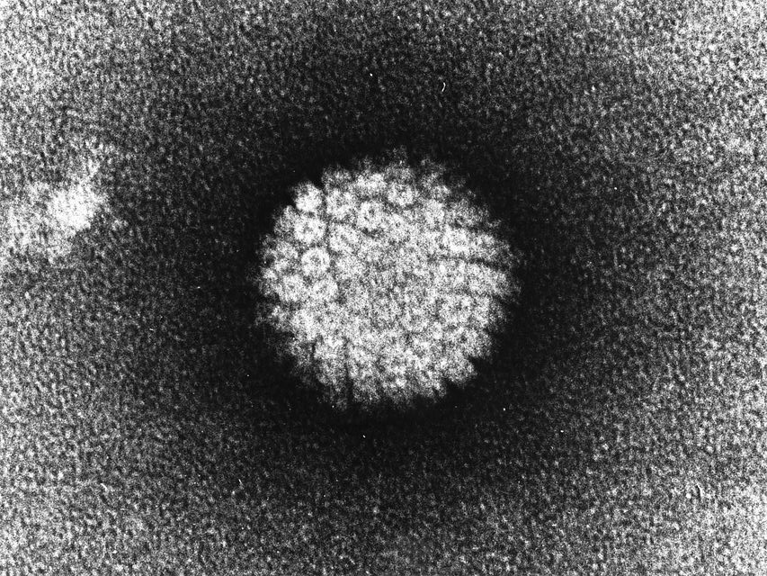
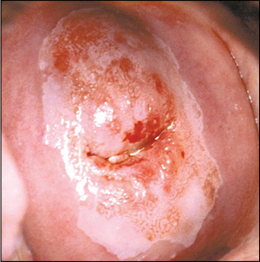
Cervical Dysplasia
HPV mediated
  Usually types 16 & 18, but there are many high-risk types
  Transformation Zone is where HPV likes to invade as there is high cell turnover
  99.7% of all cervical cancers have HPV
  Sexually transmitted
  Prevention through Vaccination (approved 9-45 yrs old in men & women)
    2 or 3 dose series depending on age when series is started
http://www.aafp.org/afp/2013/0615/afp20130615p836-f1.jpg

Slide 28
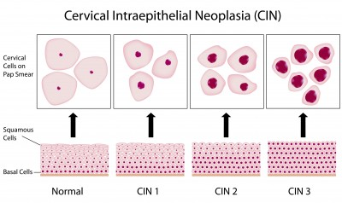
Cervical Dysplasia cont
  Surveillanced with HPV testing & cervical cytology sampling (ie Pap Smear)
    Results classified via Bethesda Classification System

Slide 29
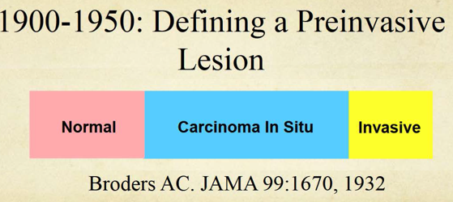
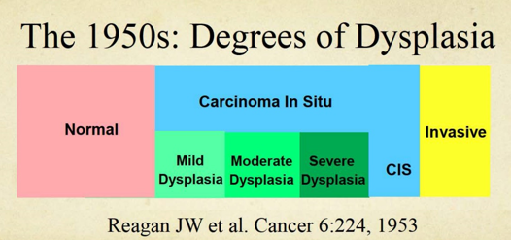
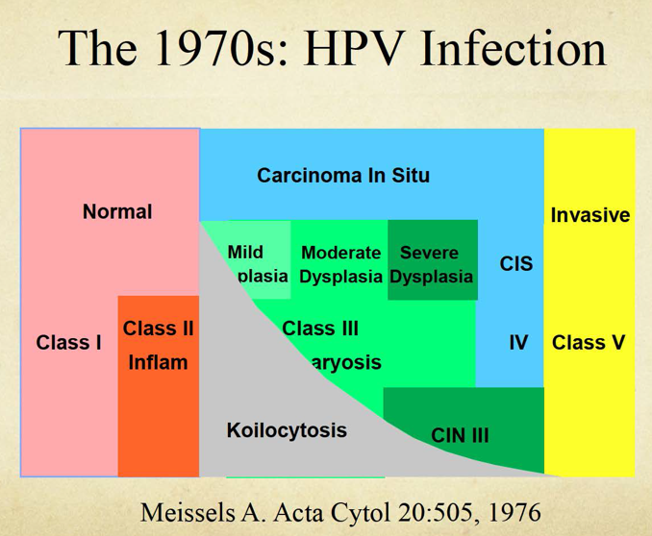
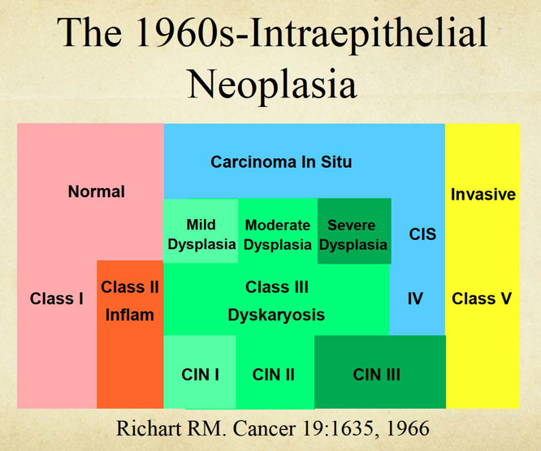
Bethesda evolution

Slide 30
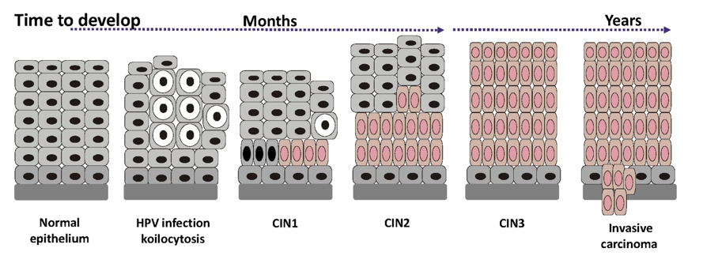
Koilocytes
HPV infected cells in which the HPV DNA is incorporated into the host cell DNA leading to precancerous changes; Enlarged nucleus and perinuclear halo

Slide 31
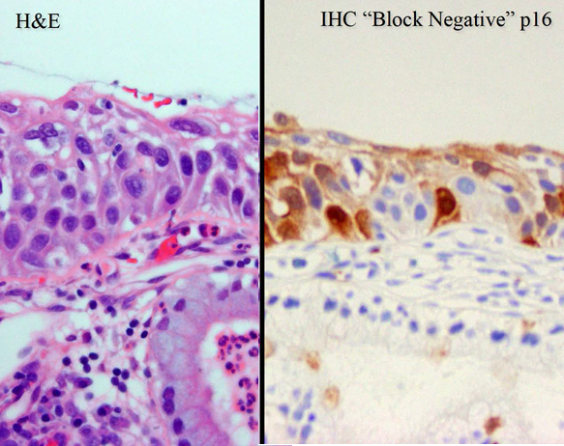
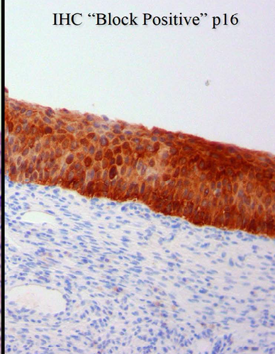
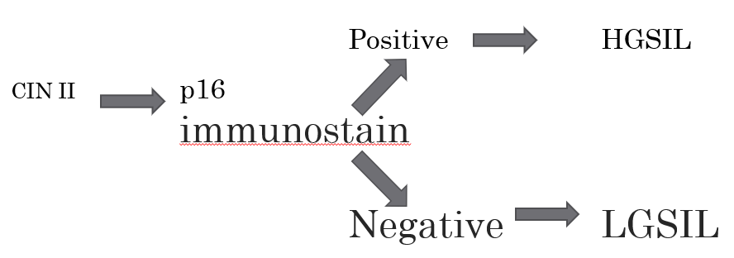
P16 Stain helps differentiate CIN II

Slide 32
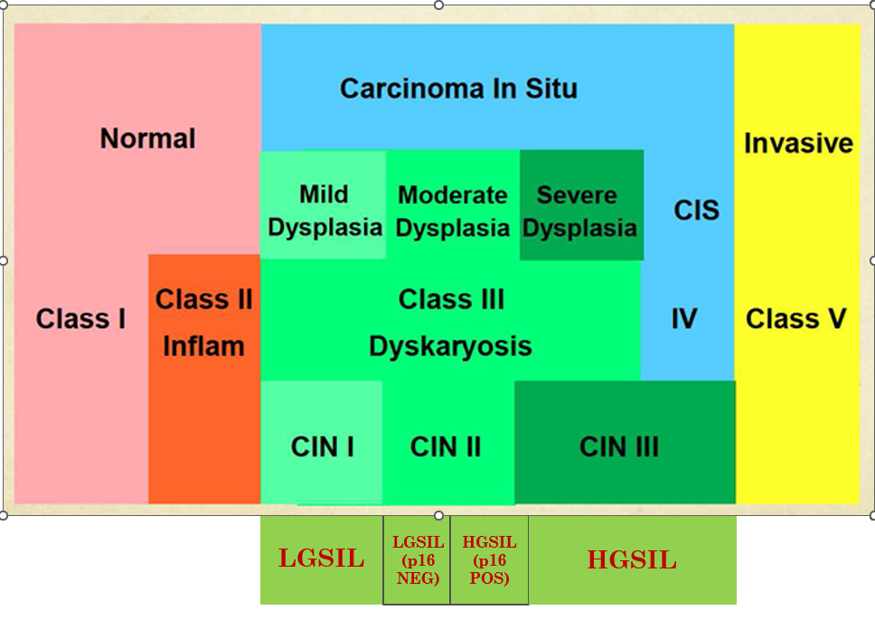
Final Bethesda System
Lower
Anogenital
Squamous
Terminology
LAST Standardization Project in 2012

Slide 33

Cervical Cancer Screening Guidelines

Slide 34
HPV Screening & Treatment of the cervix
Follow ASCCP 2019 recommendations (Get the App)
Cervical Intraepithelial Neoplasm Treatments
  Monitoring (ie repeat pap more frequently and/or Colposcopy)
  Cryotherapy (fallen out of favor)
  LEEP
  CONE
  Hysterectomy

Slide 35
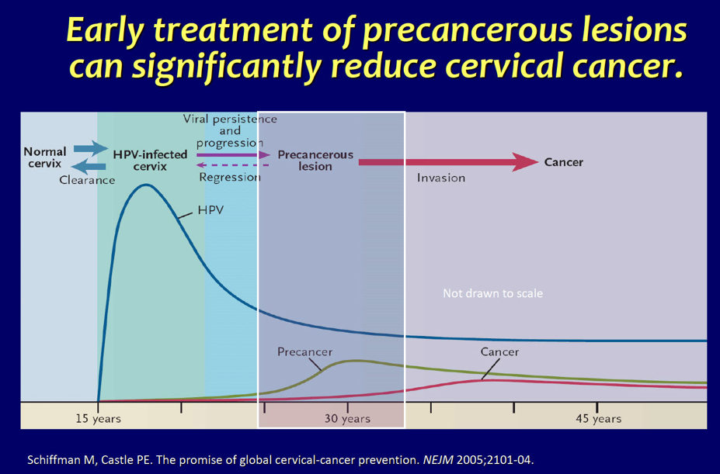
Cervical Precancer Monitoring & Treatment
CIN 1 often regresses spontaneously while CIN 2/3 carries significant risk of progression to cancer
ASCCP 2019 guidelines direct shorter pap/HPV testing intervals vs colposcopy vs treatment (ie LEEP, etc)

Slide 36
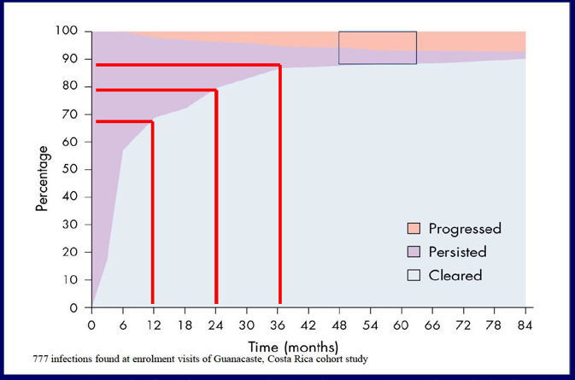
Natural History of HPV
The longer HPV infection persists, the greater risk for CIN 2/3 & cancer
ASCCP guidelines are risk based with a >4% 5 yr risk of CIN 3 being the threshold for diagnostic evaluation (Colposcopy) or treatment (LEEP)
Schiffman, Castle et al. (2007) Lancet

Slide 37
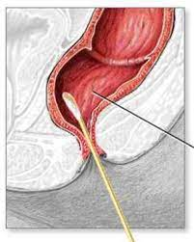
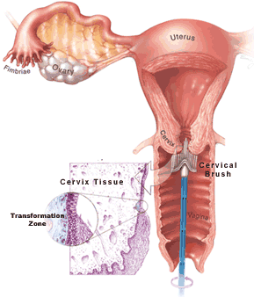
HPV Cancer Screening & HIV
Individuals with HIV start screening earlier and screen more often for cervical cancer with pap smears
Individuals with HIV also are recommended to undergo anal pap smears as HPV can cause rectal cancers & HIV increases that risk

Slide 38
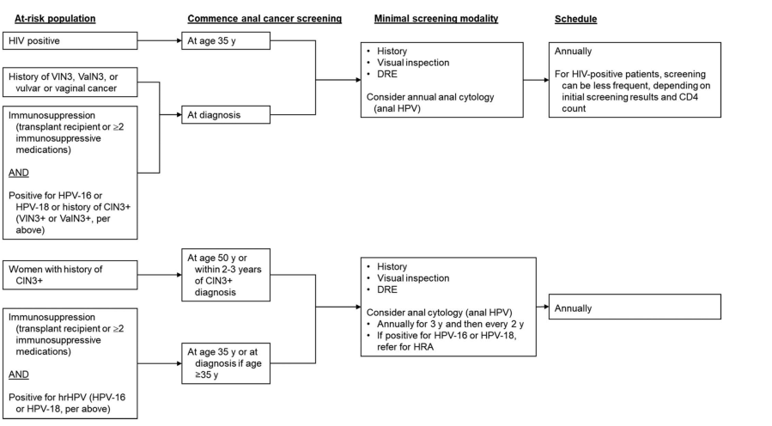
Anal Pap Smear Screening Guidelines in Women

Slide 39
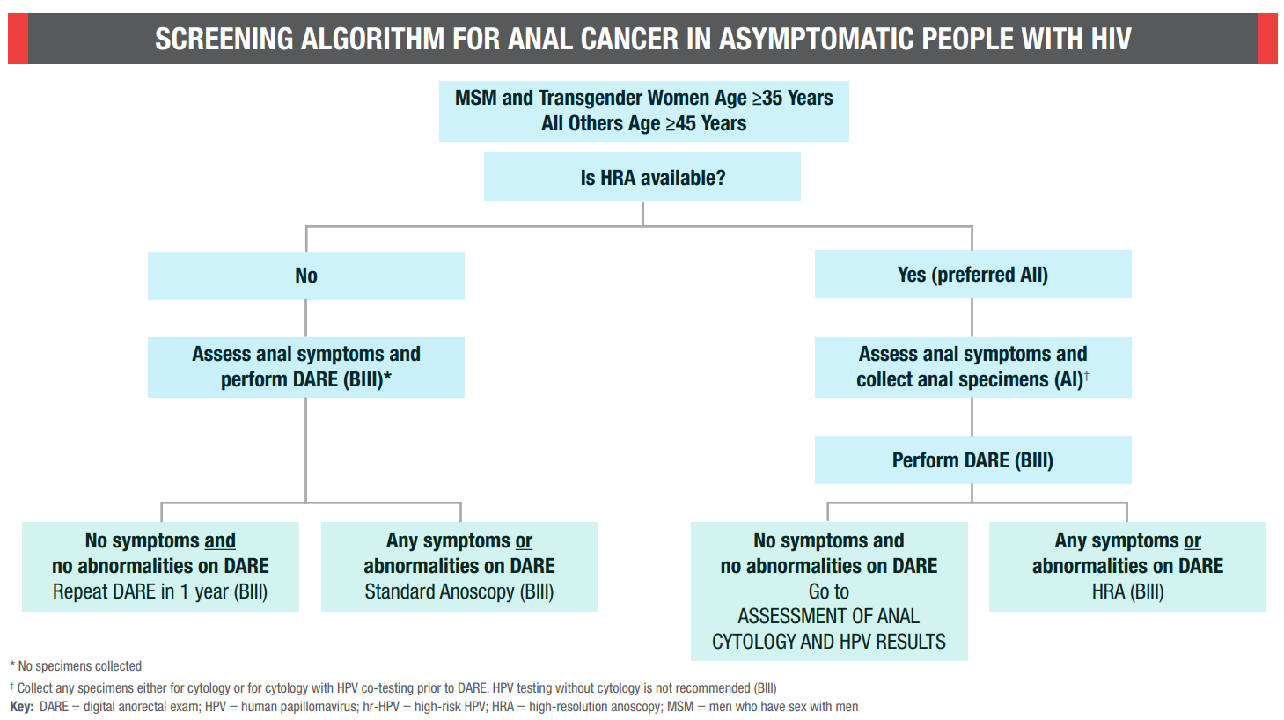
Anal Pap Smear Screening Guidelines in Men

Slide 40
Prevention - HPV Vaccination – CDC 2020
Gardasil has types 6, 11, 16, 18, 31, 33, 45, 52, 58
    Types 16 & 18 account for 70% of all cervical cancers
    Types 31, 33, 45, 52, 58 account for another 10%
    Types 6, 11 cause genital warts
Routine vaccination
  HPV vaccination recommended for all adults through age 26 years: 2- or 3-dose series depending on age at initial vaccination or condition:
    Age 15 years or older at initial vaccination: 3-dose series at 0, 1–2, 6 months (minimum intervals: 4 weeks between doses 1 and 2/12 weeks between doses 2 and 3/5 months between doses 1 and 3; repeat dose if administered too soon)
    Age 9 through 14 years at initial vaccination and received 1 dose or 2 doses less than 5 months apart: 1 dose
    Age 9 through 14 years at initial vaccination and received 2 doses at least 5 months apart: HPV vaccination complete, no additional dose needed.
Shared clinical decision-making
  Age 27 through 45 years based on shared clinical decision-making:
    2- or 3-dose series as above

Slide 41
Vaginovulvar Path

Slide 42
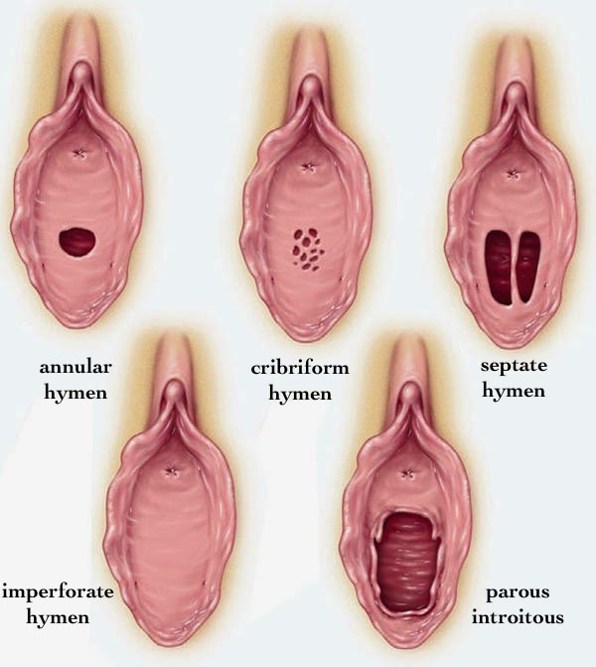
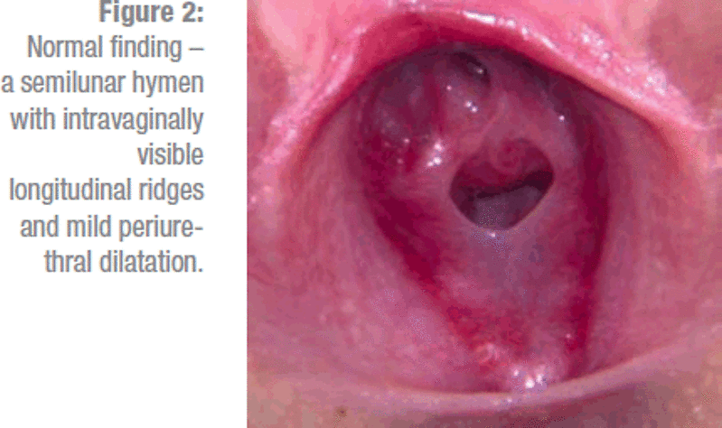
Hymen
https://vulvovaginaldisorders.org/annotation/annotation-n/

Slide 43
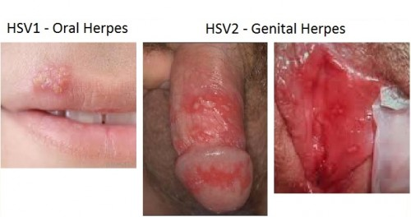
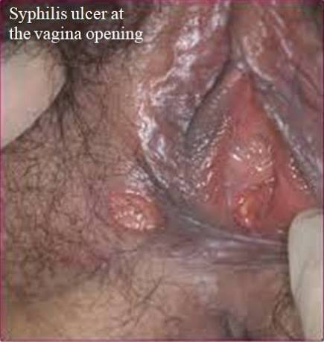
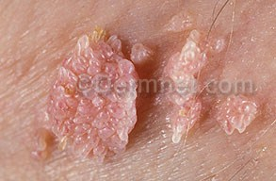
Infectious - STIs
Herpes simplex (HSV)
Syphilitic chancre
Condylomata acuminata (HPV)
Molluscum contagiosum
Trichomoniasis
http://thescienceofeating.com/wp-content/uploads/2015/02/Genital-Herpes-HV1-e1423608033412.jpg

Slide 44
Vulvovaginal Candidiasis - General Info
Due to a fungus/yeast, Candida Albigans & non-candida albigans species (ie Candida glabrata)
  Fungal overgrowth due to an imbalance of the naturally occurring yeast in the vagina
Risk factors include
  Diabetes or HIV
  Douching
  New or multiple sex partners
  Antibiotics/antifungals or Other Medication Side Effects (think SGLT2i)
  Using a copper IUD (whereas hormonal IUDs may have a protective effect) or Condoms
  Frequent Menses
40% of all vaginal infection in women of reproductive age & 75% of all women have had one

Slide 45
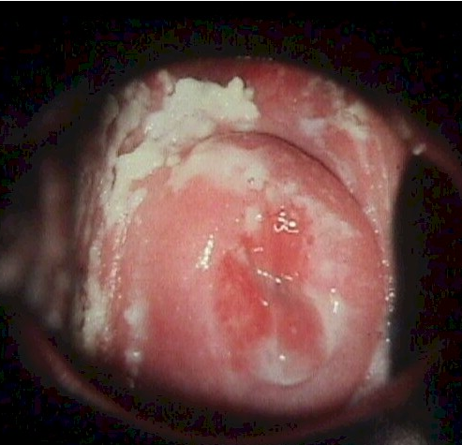
Vulvovaginal Candidiasis - Symptoms
Increased vaginal discharge
  chunky white discharge
Itching
Asymptomatic

Slide 46
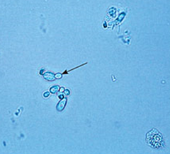
Vulvovaginal Candidiasis - Diagnosis
pH paper or PhemAlert
  pH <4.5 (normal vaginal pH)
Wet Prep/KOH Prep
  hyphae, pseudohyphae, budding yeast
Fungal Culture
  Candida albicans is most common cause
  can help determine if a different candida species is present & can guide antifungal treatment
Molecular Testing - PCR

Slide 47
Vulvovaginal Candidiasis - Treatment
Oral or Topical antifungals
  Azoles for Albicans species
    Clotrimazole & Miconazole are OTC intravaginal agents
      MOA – alters cell membrane permeability (binding with phospholipids) causing cellular constituents to leak
    Fluconazole is an oral prescription
      150 mg as a single dose
      MOA – fungistatic - highly selective inhibitor of fungal cytochrome P450 dependent enzyme lanosterol 14-alpha-demethylase
  Non-Azoles for non-Albicans species
    Nystatin 1 intravaginal suppository (100,000 units) at bedtime x14-30 days
      MOA – binds to fungal cell membrane sterols disrupting the selective barrier causing cellular constituents to be lost
    600 mg of Boric Acid in a gelatin capsule administered vaginally once daily x 3 wks
      Clinical & mycologic eradication rates of approximately 70%
      MOA – weak anti-infective agent
No need to treat sexual partners

Slide 48
Vulvovaginal Candidiasis in Pregnancy
Topical Azoles are the recommended treatment
Oral single dose Fluconazole can be associated with spontaneous abortion & congenital anomalies

Slide 49
Recurrent Vulvovaginal Candidiasis
Defined as 3+ episodes in 1 year
Fluconazole is an oral prescription at an increased dose and/or for a longer course

Slide 50
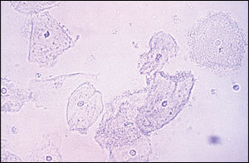
Bacterial Vaginosis – General Info
New evidence this might be an STI
Due to a bacteria, Gardnerella vaginitis
  Bacteria overgrowth due to an imbalance of the naturally occurring bacteria in the vagina
Risk factors include
  Smoking,
  Douching,
  New or multiple sex partners,
  Antibiotics/antifungals, and
  Using a copper IUD (whereas hormonal IUDs may have a protective effect) or Condoms
  Frequent Menses
Increases risk of other STIs/PID, mucopurulent cervicitis, CIN on pap, HIV, and premature delivery in pregnant women
Most common vaginal infection in women of reproductive age

Slide 51
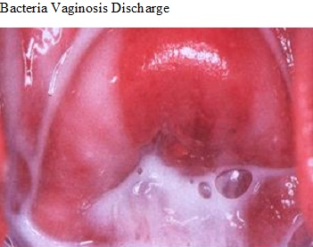
Bacterial Vaginosis - Symptoms
Increased vaginal discharge
  white or gray in color
  smells like fish
Itching is uncommon
1/3 of patients are asymptomatic

Slide 52
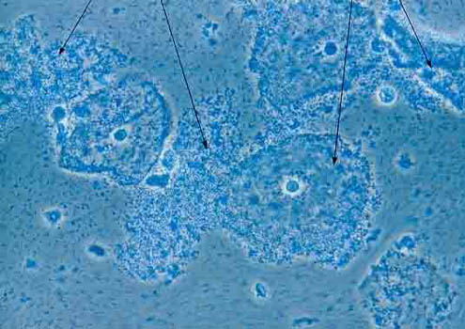
Bacterial Vaginosis – Diagnosis
AMSEL’s Criteria – must have 3 out of 4 present
  Discharge – thin, homogenous, white-gray, adherent to vaginal walls, milky
  pH > 4.5
  KOH “whiff test” is positive
  Wet prep – Clue Cells >20%, coccoid bacteria, no WBCs, decrease in Lactobacilli
Sensitivity 37-70% and Specificity 94-99%

Slide 53
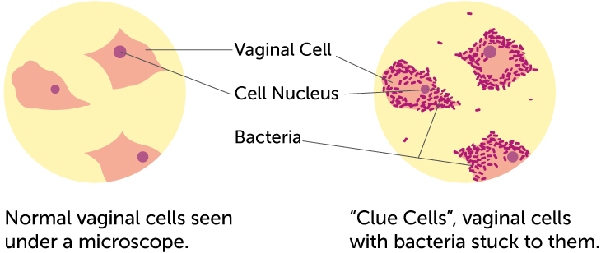
Bacterial Vaginosis – Diagnosis cont
Wet prep – Clue Cells >20%, coccoid bacteria, no WBCs, decrease in Lactobacilli

Slide 54
Bacterial Vaginosis – Other Tests
OSOM BV Blue Test – 10-15 min POC
  90.3% sensitivity & 96.6% specificity
Pap Smear – low sensitivity but high specificity
Gram Stain – Nugent Score
    Calculated by assessing for the presence of large Gram + rods (Lactobacillus morphotypes; decrease in Lactobacillus scored as 0 to 4), small Gram-variable rods (Gardnerella vaginalis morphotypes; scored as 0 to 4), & curved Gram-variable rods (Mobiluncus spp. morphotypes; scored as 0 to 2) & can range from 0 to 10. A score of 7 to 10 is consistent w/ BV.

Slide 55
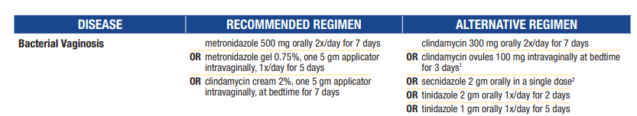
Bacteria Vaginosis – Treatment
Metroniazole MOA - After diffusing into the organism, interacts with DNA to cause a loss of helical DNA structure & strand breakage resulting in inhibition of protein synthesis & cell death in susceptible organisms
Clindamycin MOA - Reversibly binds to 50S ribosomal subunits preventing peptide bond formation thus inhibiting bacterial protein synthesis; bacteriostatic or bactericidal depending on drug concentration, infection site, and organism
Clindamycin cream is oil based and might weaken latex condoms and diaphragms for 5 days after use

Slide 56
Bacteria Vaginosis in Pregnancy
Diagnosis & Treatment before 20 wks of symptomatic BV or those at risk of premature birth is recommended
  Routine screening of asymp pregnant women is not recommended
Recommended Regimens
  Metronidazole 250 mg po tid x 7 days
  Metronidazole 500 mg po bid x 7 days
  Clindamycin 300 mg po bid x 7 days
  Metronidazole gel 0.75% for 5 days
Recheck in 1 month

Slide 57
Recurrent Bacterial Vaginosis
Retest and Rethink
Use a different recommended treatment regimen
Retreatment with same recommended regimen is an acceptable approach for treating persistent or recurrent BV after 1st occurrence
For multiple recurrences, either
  0.75% metronidazole gel or 750 mg metronidazole vaginal suppository 2x/wk x >3 mon has been reported to reduce recurrences, although this benefit does not persist when suppressive therapy is discontinued
Treat Partner (some evidence in same sex couples)

Slide 58
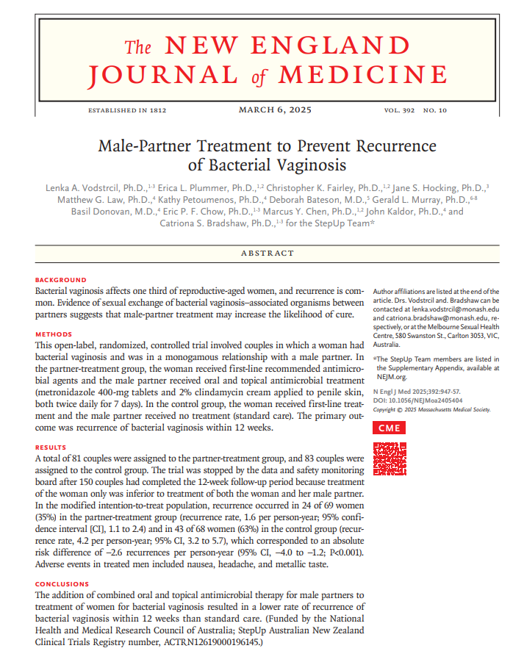
Recurrent Bacterial Vaginosis cont
Combined oral & antimicrobial therapy (metronidazole 400 mg BID x7d & 2% clindamycin cream applied to penis BID x7d) for male partners to tx women for BV results in lower rate of recurrence of BV w/in 12 wks compared to not treating male partners

Slide 59
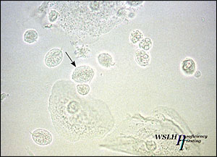
Trichomonas Vaginitis - General Info
Due to a protozoan parasite, Trichomonas vaginalis
Sexually transmitted
Risk factors include
  New or multiple sex partners
  Not using condoms
  HIV & other STIs
Complications
  HIV & other STIs
  PID & Infertility
  Prostate Cancer
  Fistulas in the reproductive tract
http://www.aafp.org/afp/2011/0401/afp20110401p807-f2.jpg

Slide 60

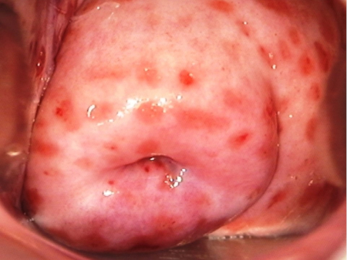
Trichomonas Vaginitis - Symptoms
Increased vaginal discharge
  Profuse frothy yellow-green discharge
Vulvar irritation in women
Urethritis, Epididymitis, Prostatitis in men
Asymptomatic
Cervicitis - Symptoms, diagnosis and treatment | BMJ Best Practice US
http://jacobimed.org/public/images/ambulatory_content/trich%20discharge.jpg

Slide 61
Trichomonas Vaginitis - Diagnosis
pH paper or PhemAlert
  pH >4.5 (normal vaginal pH is <4.5)
Wet Prep/KOH Prep
  Motile trichomonads
  Youtube video showing motile trichomonads
  Youtube video showing motile trichomonads
Molecular Testing - PCR

Slide 62
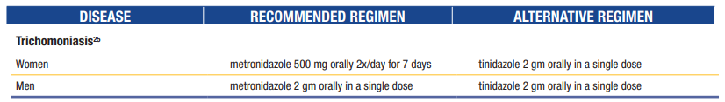
Trichomonas Vaginitis - Treatment
Treat sexual partners
  Expedited Partner Treatment (EPT) scripts can be written
Due to high rate of re-infection, CDC recommends women be retested after treatment about 3 months later

Slide 63
Trichomonas Vaginitis in Pregnancy
Transmission to baby during delivery causing oral or vaginal infections in baby (rare)
Premature Birth & LBW babies (unclear mech)

Slide 64
HPV – Genital Warts
Low risk types (6 & 11) that do not cause cancer
Can be sexually transmitted & not always prevented by condom usage
Treatments
  Patient applied
  Clinician provided

Slide 65
Patient-Applied (Self-Administered) Wart Treatments:
  Imiquimod: Acts as a Toll-like receptor 7 (TLR7) agonist, inducing local cytokines (Interferon-\alpha, TNF-\alpha) to stimulate a cell-mediated immune response. External application.
  Podophyllotoxin: A purified mitotic inhibitor that causes metaphase arrest in dividing cells. External application. Contraindicated in pregnancy.
Notes:
Dr. Alefishat

Slide 66
Clinician-Administered Wart Treatments:
  Trichloroacetic acid (TCA) / Bichloroacetic acid (BCA): Caustic agents that chemically cauterize the lesion. These are preferred in pregnancy as they have no systemic absorption.
  Podophyllum Resin: A crude, non-purified version of the mitotic inhibitor. Requires a mandatory wash-off within 1–4 hours of application to prevent systemic neurotoxicity.
  Intralesional interferon-α: Reserved for refractory genital warts; limited by adverse effects and poor tolerability. Induces host cell enzymes that inhibit viral RNA translation and degrade viral mRNA.
  Procedurally, these can also be frozen with liquid nitrogen, cauterized off at the base, or treated with a laser.
Notes:
Dr. Alefishat

Slide 67
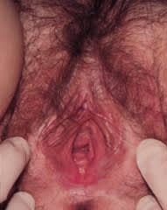
Inflammatory - Vaginal
Desquamative inflammatory vaginitis – uncommon chronic purulent vaginitis occurring mostly in perimenopausal Caucasians
  Symp – abnormal discharge
  Diagnosis of exclusion – on microscopy, increase in inflammatory & parabasal epithelial cells (immature squamous cells), pH >4.5
  Treatment with topical clindamycin or corticosteroids
Atrophic vaginitis / Genitourinary syndrome of menopause – hypoestrogenic state
  Symp – decreased vaginal lubrication, dyspareunia, burning, pressure, itching, change in discharge, freq infections, pale vulvar appearance, loss of vaginal rugae, fusion of labia minora, introital stenosis, bleeding
  Diagnosis – r/o infections, chemical irritants, peri/menopause
  Treatment with vaginal estrogen & moisturizers

Slide 68
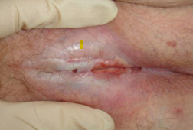
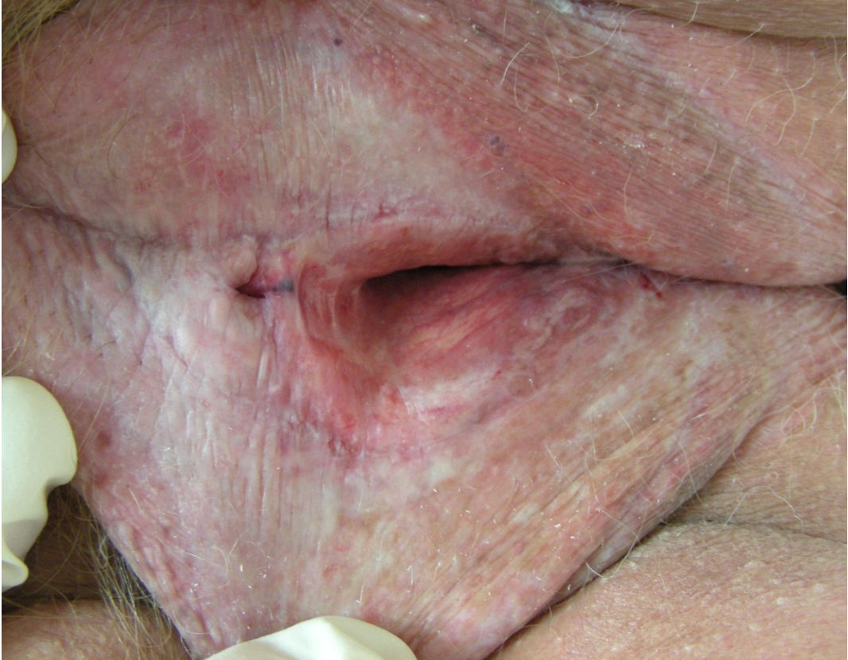
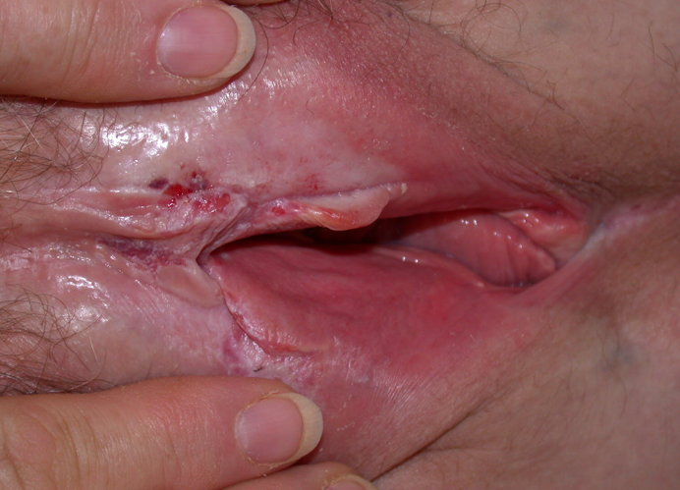

Inflammatory - Vulvar
Lichen sclerosis – chronic inflammatory
dermatitis affecting the vulva & anogenital
regions (figure of 8 pattern)
  Symp – white atrophic plaques, intense pruritus, dyspareunia, dysuria, labia minora regression & clitoral scarring
  Risk of progression to SCC
  Treatment with ultrapotent topical steroids
Lichen planus – T cell–mediated inflammatory autoimmune condition affecting skin & mucosa that can affect genital & oral regions
  Symp – pain, burning, scarring, well-demarcated bright-red vestibular patches with a hyperkeratotic border or a net-like plaque known as Wickham striae
  Risk of scarring and developing vaginal stenosis if untreated
  Treatment with ultrapotent topical & intravaginal suppositories of steroids, may need vaginal dilatation

Slide 69



Inflammatory – Vulvar cont
Lichen simplex chronicus – itch-scratch cycle causing thickened leathery skin usually due to underlying eczema, asthma, or allergies usually in 60 yo+ or those with anxiety disorders
  Symp – intense pruritus even disturbing sleep, excoriations on vulva
  Treatment is breaking the cycle with steroids
Contact dermatitis (irritant and allergic)
Psoriasis of the vulva
Hidradenitis suppurativa – inflammatory skin condition/folliculitis due to increased cytokine & chemokine secretion resulting in hyperkeratosis, follicular occlusion, & cyst development in apocrine gland–bearing skin (axilla, pubic)
  Symp - painful lumps & tunnels leading to scarring & recurrent abscesses, open double “tombstone” comedones
  Risk – female, black, FH, tobacco, obesity, DM, Crohn’s
  Diagnosis – clinical, Hurley classification staging system (I-III)
  Treatment – loose clothing, lose weight, stop tobacco, topical clindamycin, oral tetracyclines, spironolactone, biologics, surgery
Hidradenitis Suppurativa (Acne Inversa): A Complete Picture - DermNet

Slide 70
Other Vulvar Pathologies
Vulvodynia – vulvar pain without an identifiable cause that persists for at least three months (diagnosis of exclusion)
  Can occur alone or in association with another disorder like interstitial cystitis, fibromyalgia, irritable bowel syndrome, pelvic myofascial pain, psychosocial conditions, & sexual dysfunction
  Symp – localized or generalized pain, random or provoked, intermittent or constant
  Most common cause of dyspareunia in premenopausal (12% prevalence)
  Diagnosis – pressure point testing using a cotton swab in a circumferential fashion along the vulvar vestibule, which will elicit pain with even light touch in a patient with vulvodynia
  Multimodal treatment – pelvic floor physical therapy, cognitive behavioral therapy, neuropathic pain modulators, vestibulectomy

Slide 71


Other Vulvar Pathologies cont
Bartholin gland cyst/abscess –
blockage of lubricating duct can lead
to mucous entrapment & infection
  Symp – pain, fever, dyspareunia
  Treatment – management requires a Word catheter or marsupialization, antibiotics
Gartner duct cysts – benign fluid filled pouch that develops along the side wall of the vagina due to embryonic development
Behçet disease – rare autoimmune disease that can cause painful recurrent oral & genital ulceration
Lipschütz ulcers – nonsexually acquired painful genital ulceration in young, non–sexually active patients often preceded by flu-like or mononucleosis-like illnesses (ie Epstein-Barr virus)
Bartholin Gland Cyst: Care Instructions | Kaiser Permanente
Word catheter for Bartholin’s abscess — Chelsea and Westminster Hospital NHS Foundation Trust

Slide 72
Questions?

Slide 73
References
Cervical Cancer Prevention & HPV Management | ASCCP
Home page | United States Preventive Services Taskforce
CDC
https://labtestsonline.org/understanding/analytes/chlamydia/tab/test
Male-Partner Treatment to Prevent Recurrence of Bacterial Vaginosis
Desquamative inflammatory vaginitis – PubMed
Diagnosis and Treatment of Atrophic Vaginitis | AFP
Common Benign Chronic Vulvar Disorders | AFP
Hidradenitis Suppurativa: Rapid Evidence Review | AFP

