Slide 1
Menopause
Carla Rafferty, MD
Family Medicine Physician
Course Director for Human Development & Reproduction
Clinical Associate Professor CICOM

Slide 2
Objectives
Define the stages of the reproductive life cycle
Explain the pathophysiology of common menopausal symptoms (vasomotor, genitourinary, sleep, mood, cognition, and sexual dysfunction)
Explain the health effects of estrogen deficiency on bone health, cardiovascular health, cognition, and GU health
Describe pathophysiology of osteoporosis
Describe bleeding pattern changes during perimenopause & menopause
Characterize the evidence-based medicine labwork in menopause diagnosis/care
Explain preventative health items in menopause: osteoporosis prevention & monitoring, cardiovascular risk reduction, cancer screening and immunizations.
Describe how to evaluate postmenopausal bleeding
Describe menopause mimics and other conditions to rule out
Explore the impact of the Women’s Health Initiative study on menopause education & training and subsequent care of menopausal women
Describe disparities in the care of menopausal symptoms
Explore how the impact of wellness/influencers intersects with evidenced based medicine

Slide 3
Disclosures
None

Slide 4

Stages of the Reproductive Cycle
Prepubertal – the time period between birth and when puberty ends & menses start, fertility is not yet started
  Ages 0 going up to about 9-14 yrs of age
  About 1 million follicles are present at birth
Fertile – the time period in which a pregnancy could occur and is from the start of the first menses to 1 year after the last menses
  About 10-14 yrs of age going up to about 45-56 yrs of age
  250,000-400,000 follicles remain at puberty
Postmenopausal – 1 year after the last menses until death, fertility has ended during this time period
  About 45-56 yrs age until death
  Medium age in the US is 51

Slide 5
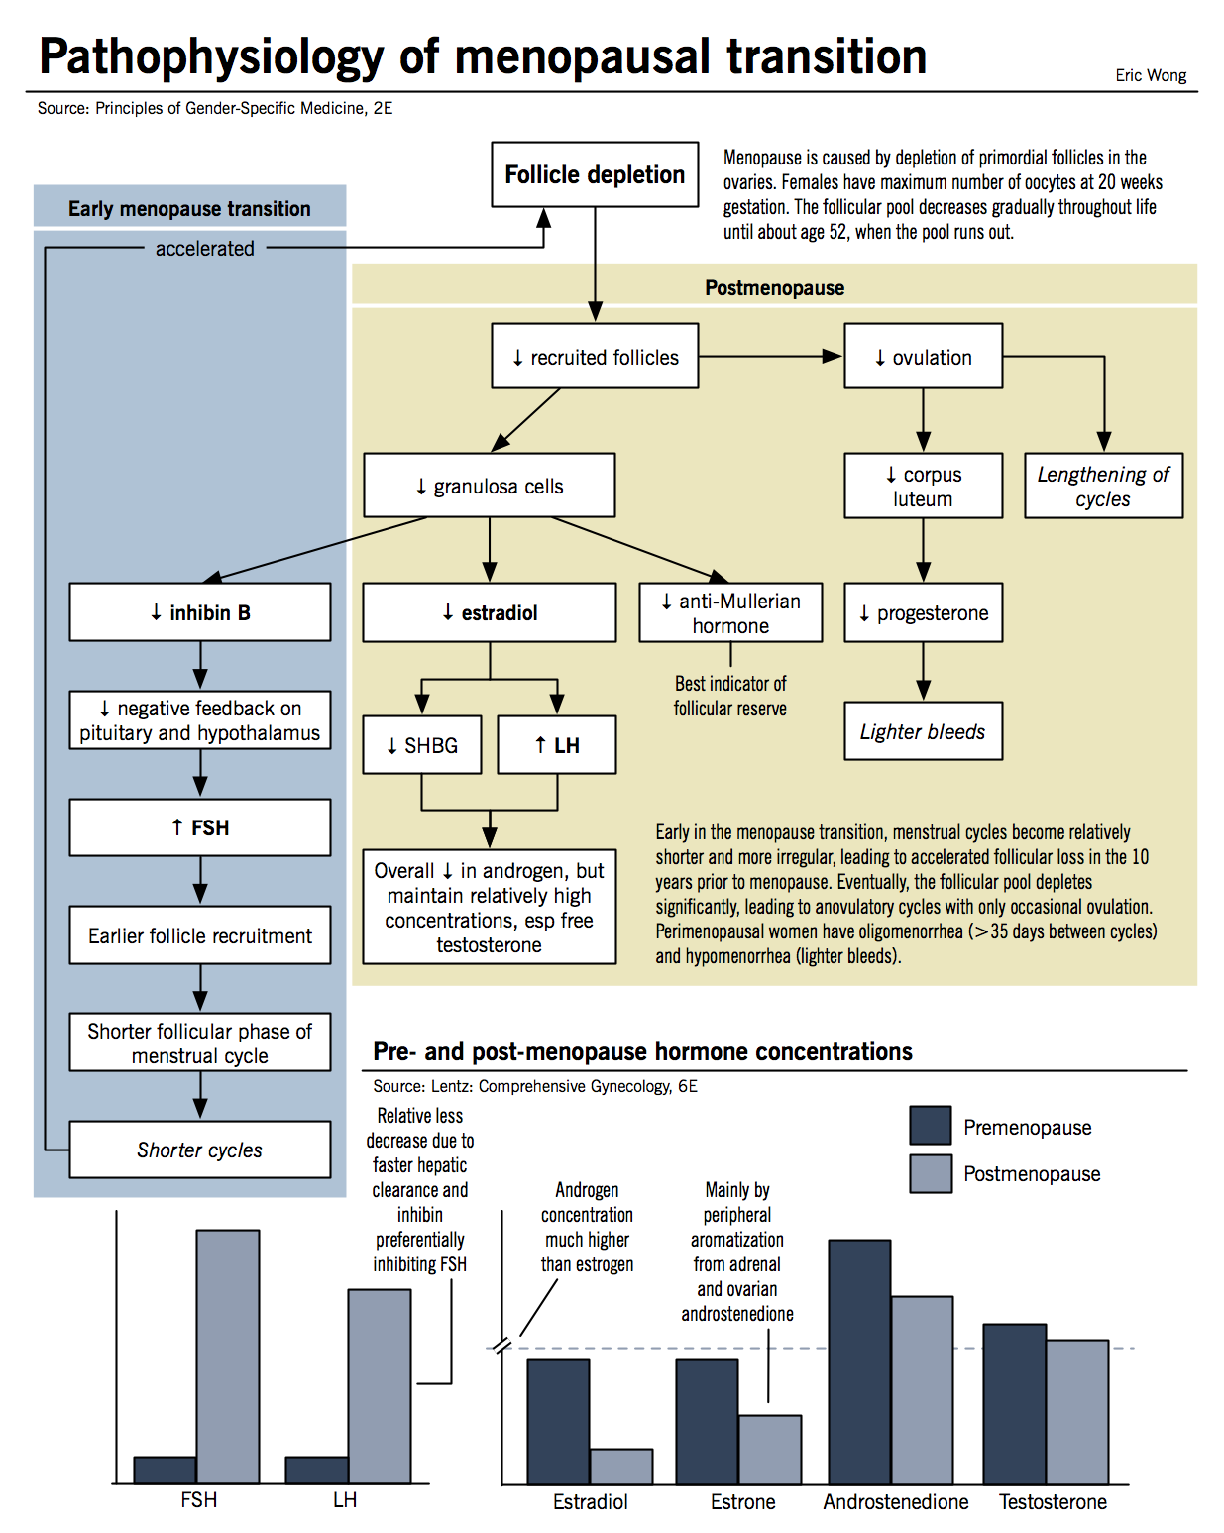
Physiology of Menopause
Depletion of Ovarian Follicles
Reduces Granulosa Cell Activity
Lowers Estradiol, Inhibin, & AMH
Increasing FSH & LH
Disruption of HPO axis
Impair normal endometrial
development
Irregular Cycles &
Ultimately Cessation of Menses

Slide 6
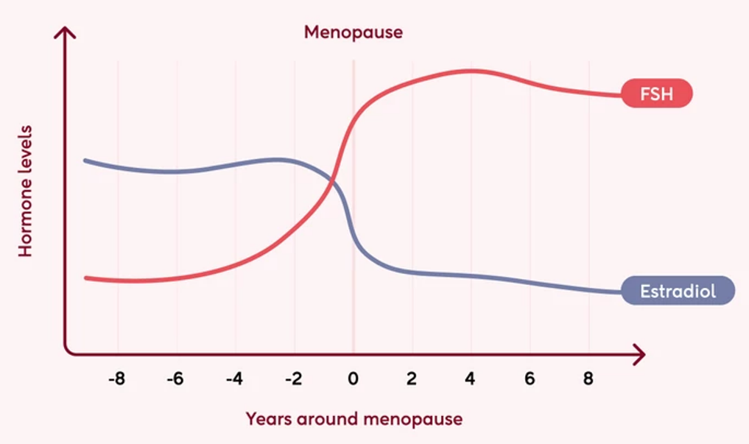
Menopause Hormone Changes
Ovarian reserve also drops and can be measured by Anti-Mullerian Hormone (AMH) which will be low
Estradiol falls
Follicle Stimulating Hormone (FSH) increases
https://gpexams.com/menopause/

Slide 7
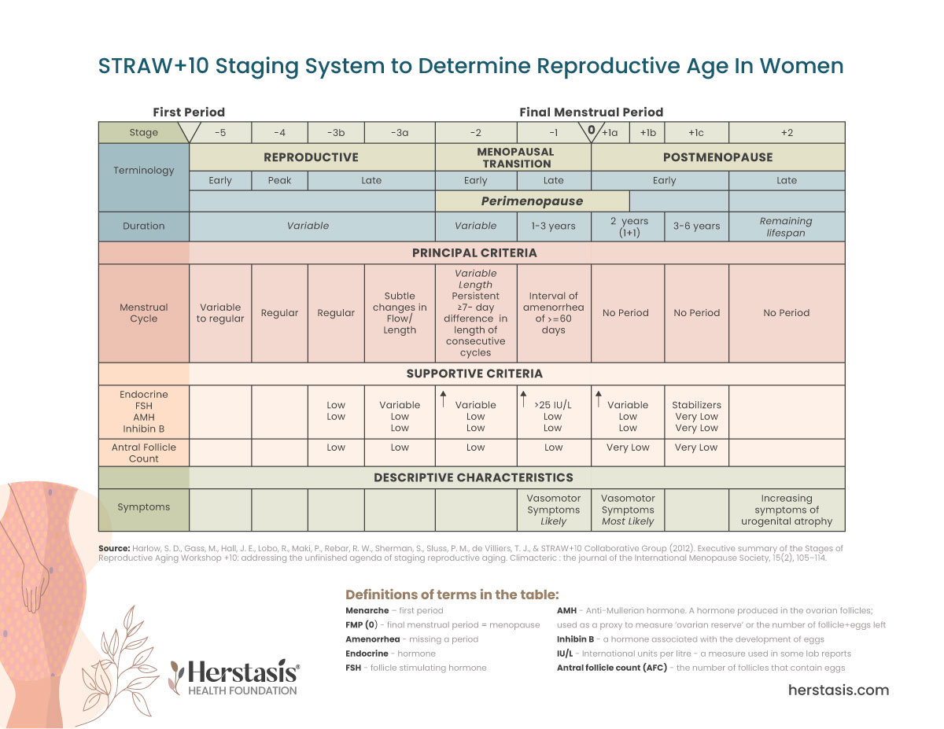
Staging of Menopause
STRAW +10 staging system with Menopause designated as 0
https://www.herstasis.com/menopause-primer/

Slide 8
Causes of Menopause
Natural
Surgical (removal of ovaries)
Chemotherapy or Radiation Therapy related to cancer treatments
Chronic illnesses like HIV-AIDs
Anti-estrogenic agents
Remember Primary Ovarian Insufficiency
Note:
MHT = Hormone Therapy started after natural menopause
HRT = Hormone Replacement Therapy started when menopause comes early for whatever reason

Slide 9
Perimenopause
Can occur 10 years before an individual is considered postmenopausal
Hormones fluctuate in irregular patterns causing symptoms
  Menses can be variable
    Usually follicular phase is shortened which leads to frequent menses then longer cycles
    Cycles are anovulatory
  Vasomotor - hot flashes, night sweats
  Genitourinary - vaginal dryness, itching, painful intercourse, urinary incontinence, nocturia, frequent UTIs
  Emotional lability - anxiety, depression
  Low libido
  Sleep disturbances - fatigue
  Cognitive decline - brain fog, memory impairment

Slide 10
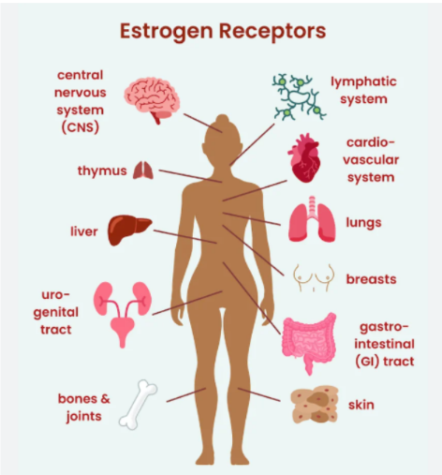
Estrogen Receptors are
Everywhere!
Symptoms
are
Everywhere!

Slide 11
Symptoms of Menopause
Menses have stopped for 12 months
Vasomotor Symptoms (VMS) - hot flashes, night sweats
  80% of women worldwide
  Can last 7-8 years
Genitourinary Symptoms of Menopause (GSM) - vaginal dryness, itching, painful intercourse, urinary incontinence, nocturia, freq UTIs
  50% of women worldwide
  Progressive if left untreated
Emotional lability - anxiety, depression
  70% of women
Low libido
Sleep disturbances - fatigue

Slide 12
Vasomotor Symptoms of Menopause (VMS)
Rapid decreases in estrogen
Increased norepinephrine stimulation
Increased serotonin activation
Increased central opioid peptide activity
Narrows the thermoneutral zone (range of core temps) in the thermoregulatory center (hypothalamus)
WITHDRAWAL
Upper temp limit decreases so small increases in core temp trigger mechanisms to dissipate heat (ie vasodilation & sweating)
Lower temp limit increases so small drops in core temp trigger mechanisms to preserve heat (ie shiver & chills)

Slide 13
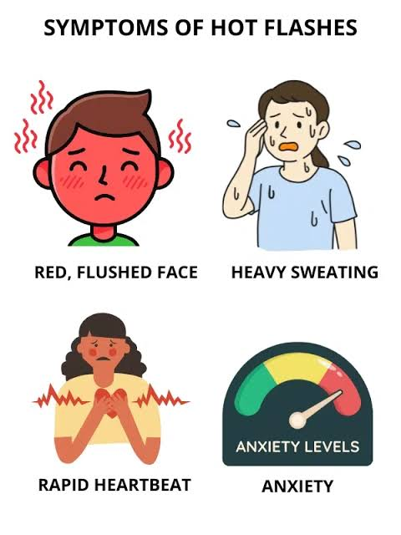
VMS cont
Hot flashes can be unpredictable & occur day & night
Typically last 3-4 minutes
Begin with a sensation of hot flushing that spreads across the upper body followed by chills
Persist for 1-6 yrs most commonly, but can go 15 yrs in 10-15%
Factors that worsen symp
  EtOH, Tobacco,
  Obesity, Sedentary,
  Emotional Stress, Mood Disorder
  Black, Lower SES, Lower Edu
Women with greater VMS burden have
  More adverse lipid profiles, greater insulin resistance, elevated risk of HTN & DM, great atherosclerosis (carotids, aorta, cerebral small vessels), increased risk of dementia, OSA
Migraines can be triggered by estrogen fluctuations so they can worsen in early menopause & resolve later in menopause
When symptoms can affect sleep (ie insomnia), there is an assoc with negative CVD outcomes
MHT leads to 70-80 % improvement in VMS, relief starts within 2-4 wks

Slide 14
Genitourinary Symptoms of Menopause (GSM)
Declining estrogen levels cause thinning of the vaginal mucosa & reduced elasticity via decreased muscle & increased fatty deposits leading to Dryness, Burning, Itching, & Irritation of the vagina
Urinary frequency, urgency, dysuria, & nocturia can occur as there are estrogen receptors in the bladder & urethra
Vaginal & Urethral atrophy can occur as well
Declining estrogen levels lead to less glycogen & lactic acid increasing the vaginal pH (4.5 -> 7.0) promoting bacterial colonization of the vagina
Increases risk & frequency of UTIs
  MHT (vaginal estrogen) confers relative risk reduction of 42% in UTIs
Urinary incontinence & pelvic structure prolapse due to muscle weakness & reduction in ligamentous laxity affecting pelvic floor muscles
These symptoms can affect sleep
Vaginal estrogen is 1st line & may be needed even with systemic MHT
  Vaginal estrogen has little systemic absorption & can be used in women in which system MHT is contraindicated

Slide 15
Sexual Dysfunction
Estrogen decline leads to
  Reduced sexual desire
  Diminished sexual function
  GSM causing pain with intercourse
MHT is not contraception so if there is a pregnancy risk, can use COC or estrogen MHT + Mirena IUD

Slide 16
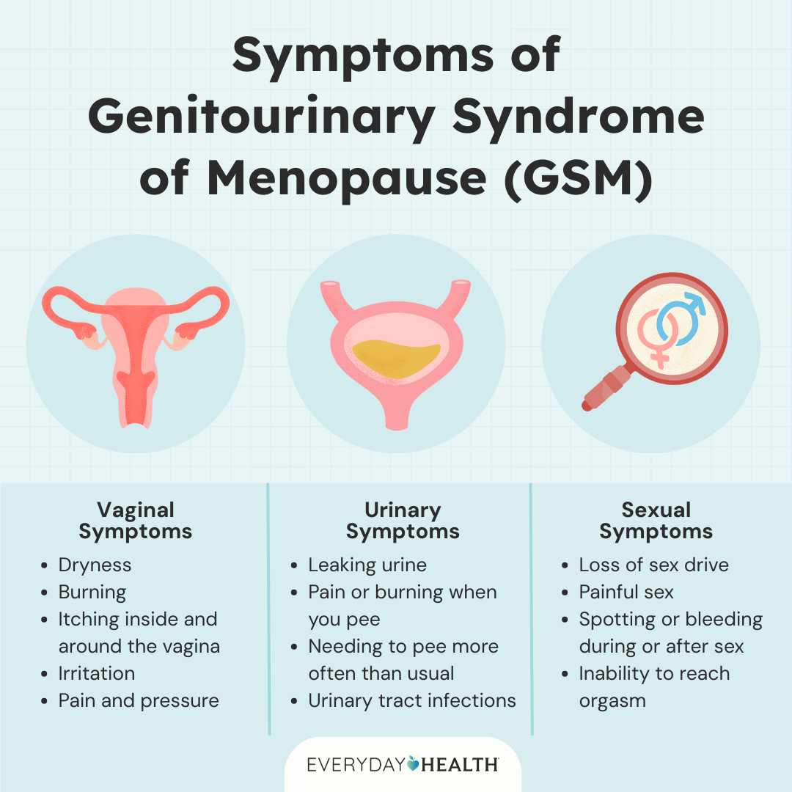
https://www.everydayhealth.com/womens-health/genitourinary-syndrome-of-menopause/

Slide 17
Breast changes
Volume loss due to decreasing levels of estrogen which affects ductal structures and decreasing levels of progesterone which affects lobular structures
Ultimately replacement of dense breast tissue with soft adipose tissue

Slide 18
Mood disorders
Anger or irritability, Anxiety or tension, Depression, Reduced Self Esteem or confidence, Impaired Concentration
Estrogen receptors are also present in the brain regions involved in mood & cognitive regulation
Estrogen also modulates serotonin & noradrenaline secretion
These symptoms can affect sleep
MHT is just as effective as antidepressants in perimenopause, but not in postmenopause

Slide 19
Sleep disturbance
Difficulty falling asleep
Early morning awakening
Repeated nighttime awakening
  Hot flashes?
  Night sweats?
  Nocturia?

Slide 20
Cognitive Decline
Temporary decline during perimenopause, but improves in postmenopausal years
In women who undergo early surgical menopause, HRT does seem to have a protective effect when started immediately

Slide 21
Cardiovascular Complications
Alterations in autonomic regulation
Relative high proportion of androgens leads to truncal obesity which is an independent CV risk (decreased estrogen + insulin resistance)
Estrogen is cardioprotective as it increases HDL & decreases LDL so a drop in estrogen reverses this
Impaired arterial endothelial function & renin-angiotensin system activation
CAD rates 2-3x higher than same aged premenopausal women
Oral MHT can increase risk of VTE – thought to be related to 1st pass effect & activation of coagulation system increasing liver biosynthesis of procoagulant factors – however transdermal does not appear to

Slide 22
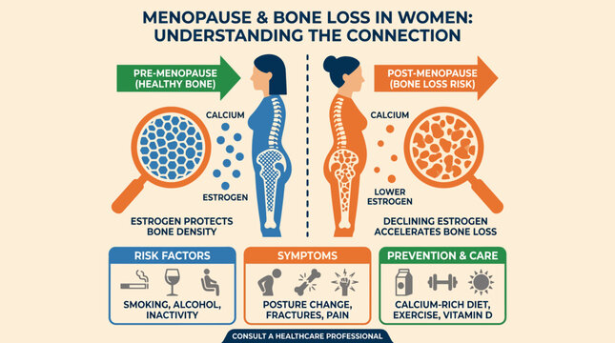
Bone changes
Osteoporosis increases – thinning of the bones
  This process can start years before menopause
  Estrogen decline increases osteoclastic activity compared to osteoblastic activity (so bone is broken down faster than it is rebuilt)
  Increases risk of fracture
Joint pain & stiffness
  Women with longer reproductive life spans have reduced risk of total knee replacements
https://stock.adobe.com/search?k=osteoporosis+infographic

Slide 23
Skin changes
Thinning of skin & loss of elasticity due to decreased collagen
Thinning hair/hair loss could be due to decreased collagen, less oil from sebaceous glands, reduction in estrogen without similar reduction in testosterone or DHT

Slide 24
Gastrointestinal changes
Oral estrogen, but not transdermal estrogen, increases risk of symptomatic gallstones
Remember the 4 Fs?

Slide 25
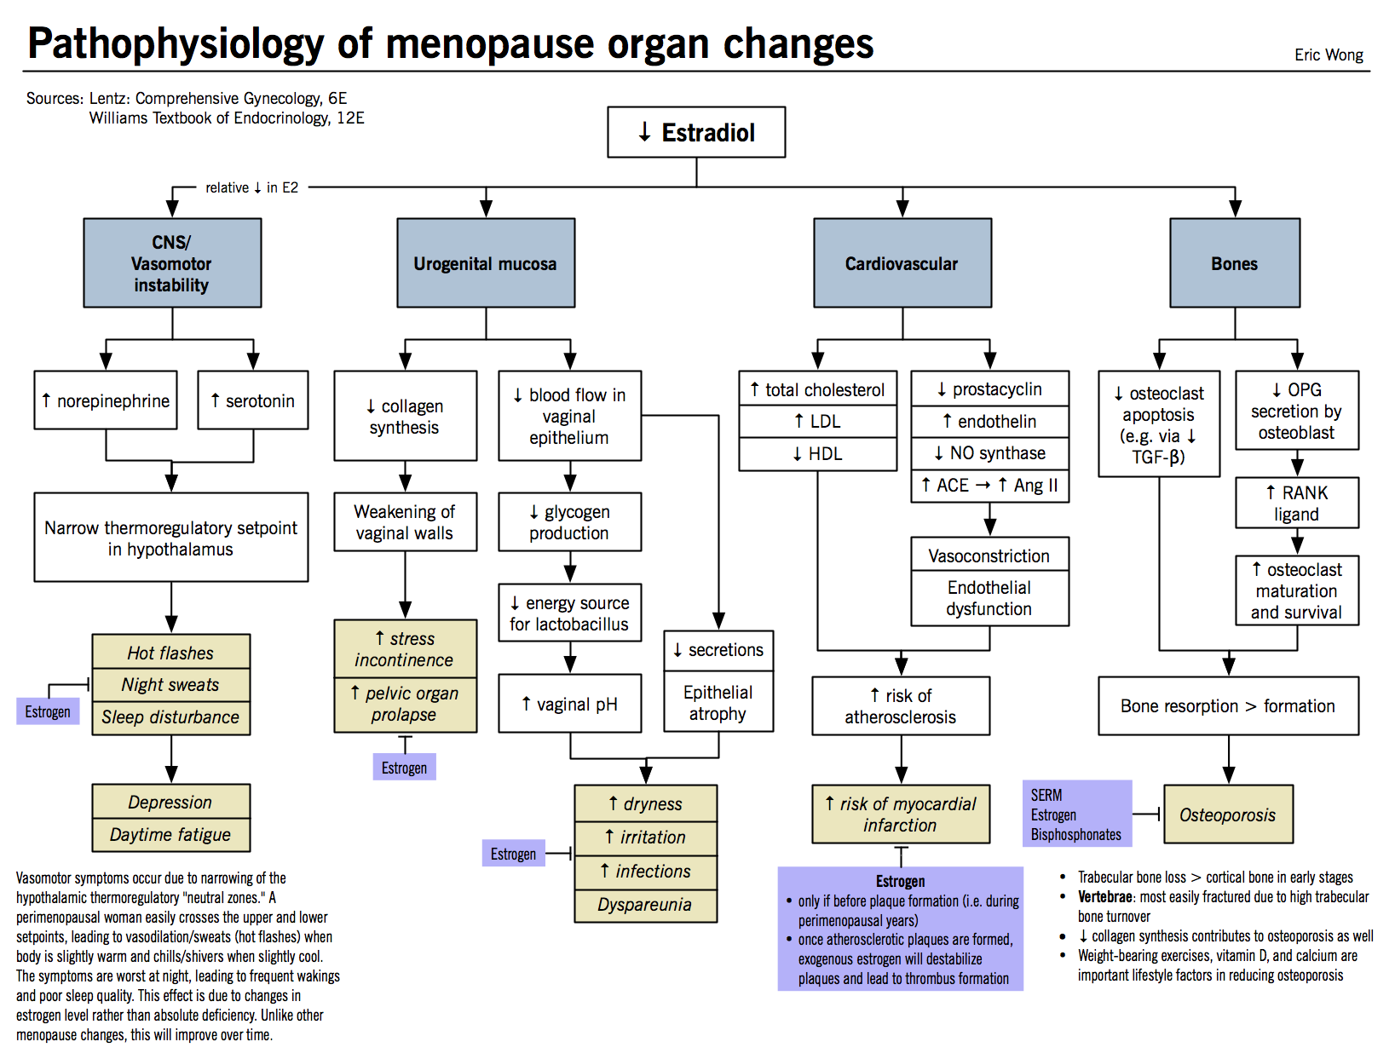

Slide 26
Physical Exam in Menopause
High BP due to arterial constriction
Weight gain (avg 5 lbs/2kg)
Height reduction (related to BMD loss)
Fatty deposition of breast tissue
Thinning hair
Vaginal dryness & urogenital atrophy

Slide 27
Evaluation of Menopause
Clinical diagnosis – based on history >> physical exam
Laboratory evaluation is unnecessary in most cases
  FSH > 30
    May transiently rise after pelvic surgery, wait 3 mon to test
    Hormonal medications can alter values, wait 2 wks after discontinuation
  Estradiol? < 20
    Rises in perimenopause
    Hormonal medications can alter values, wait 2 wks after discontinuation
  AMH??
    The variation of decline between individuals makes reliable values difficult to determine

Slide 28
Differential Diagnosis
Pregnancy
Thyroid disorders
PMOS (PCOS)
Depression, Anxiety, Eating disorders
Chronic Illnesses – IBD, CKD, Cancer
Poor nutrition or excessive exercise
Stress
UTIs
Sheehan Syndrome or Pituitary adenoma
Ovarian tumors
Premature Ovarian Insufficiency

Slide 29
Treatments for Menopause Symptoms
Hormone Therapy (MHT)
  Estrogen is first line therapy
  Must add progesterone if the individual still has a uterus OR endometriosis even s/p hysterectomy (reduces risk of endometrial cancer)
  Testosterone is needed for treatment of low libido & other sexual dysfunction
SSRIs/SNRIs - Citalopram, Escitalopram, Paroxetine, Desvenlafaxine, Venlafaxine
Selective Estrogen Receptor Modulator (SERMs) - Ospemifene, Tamoxifen, Bazodoxifene, Raloxifene
Neurokinin 3 Receptor Antagonist - Fezolinetant
Gabapentin/Pregabalin
Clonidine
Cognitive Behavioral Therapy (CBT)
Hypnosis
Black cohosh
Soy/isoflavones
DHEA
Oxybutynin
Vaginal moisturizers/lubricants
Bisphosphonates – alendronate
Denosumab
Calcium + Vitamin D

Slide 30
Treatment Considerations
Consider what symptom(s) need treating & which treatment provides most benefit with least risk
Initiate hormone therapy near onset of symptoms, delayed initiation of therapy increases risk
  Generally within 10 years of symptoms onset and ideally younger than 60
  Risk/Benefit eval for continuing past 60 yrs of age
  No universal recommendation for when to discontinue HT
Estrogen-only therapy may reduce risk of breast cancer in women w/o a uterus while Estrogen+Progesterone therapy may increase the risk of breast cancer in women with a uterus
Smoking with estrogen therapy increases risk
Nov 2025, FDA recommended removal of black box warning for estrogen therapy for CV disease, breast cancer, and dementia while maintaining warning for endometrial cancer with estrogen only therapy
Sequential MHT (daily estrogen + progesterone 12-14 days/mon) vs Continuous (combined) MHT
  Produces predictable withdrawal bleeding with the former vs breakthrough bleeding with the latter (transdermal>oral)

Slide 31
Treatment Considerations cont
Bioidenticals have no evidence to suggest superiority & may be riskier as they are compounded in small batches and not regulated for safety or effectiveness
CBT & Hypnosis – evidence for short term efficacy for VMS & sleep
Supplements – effective compared to placebo, but not superior to HT & there are concerns for safety due to lack of standardization & regulatory oversight

Slide 32
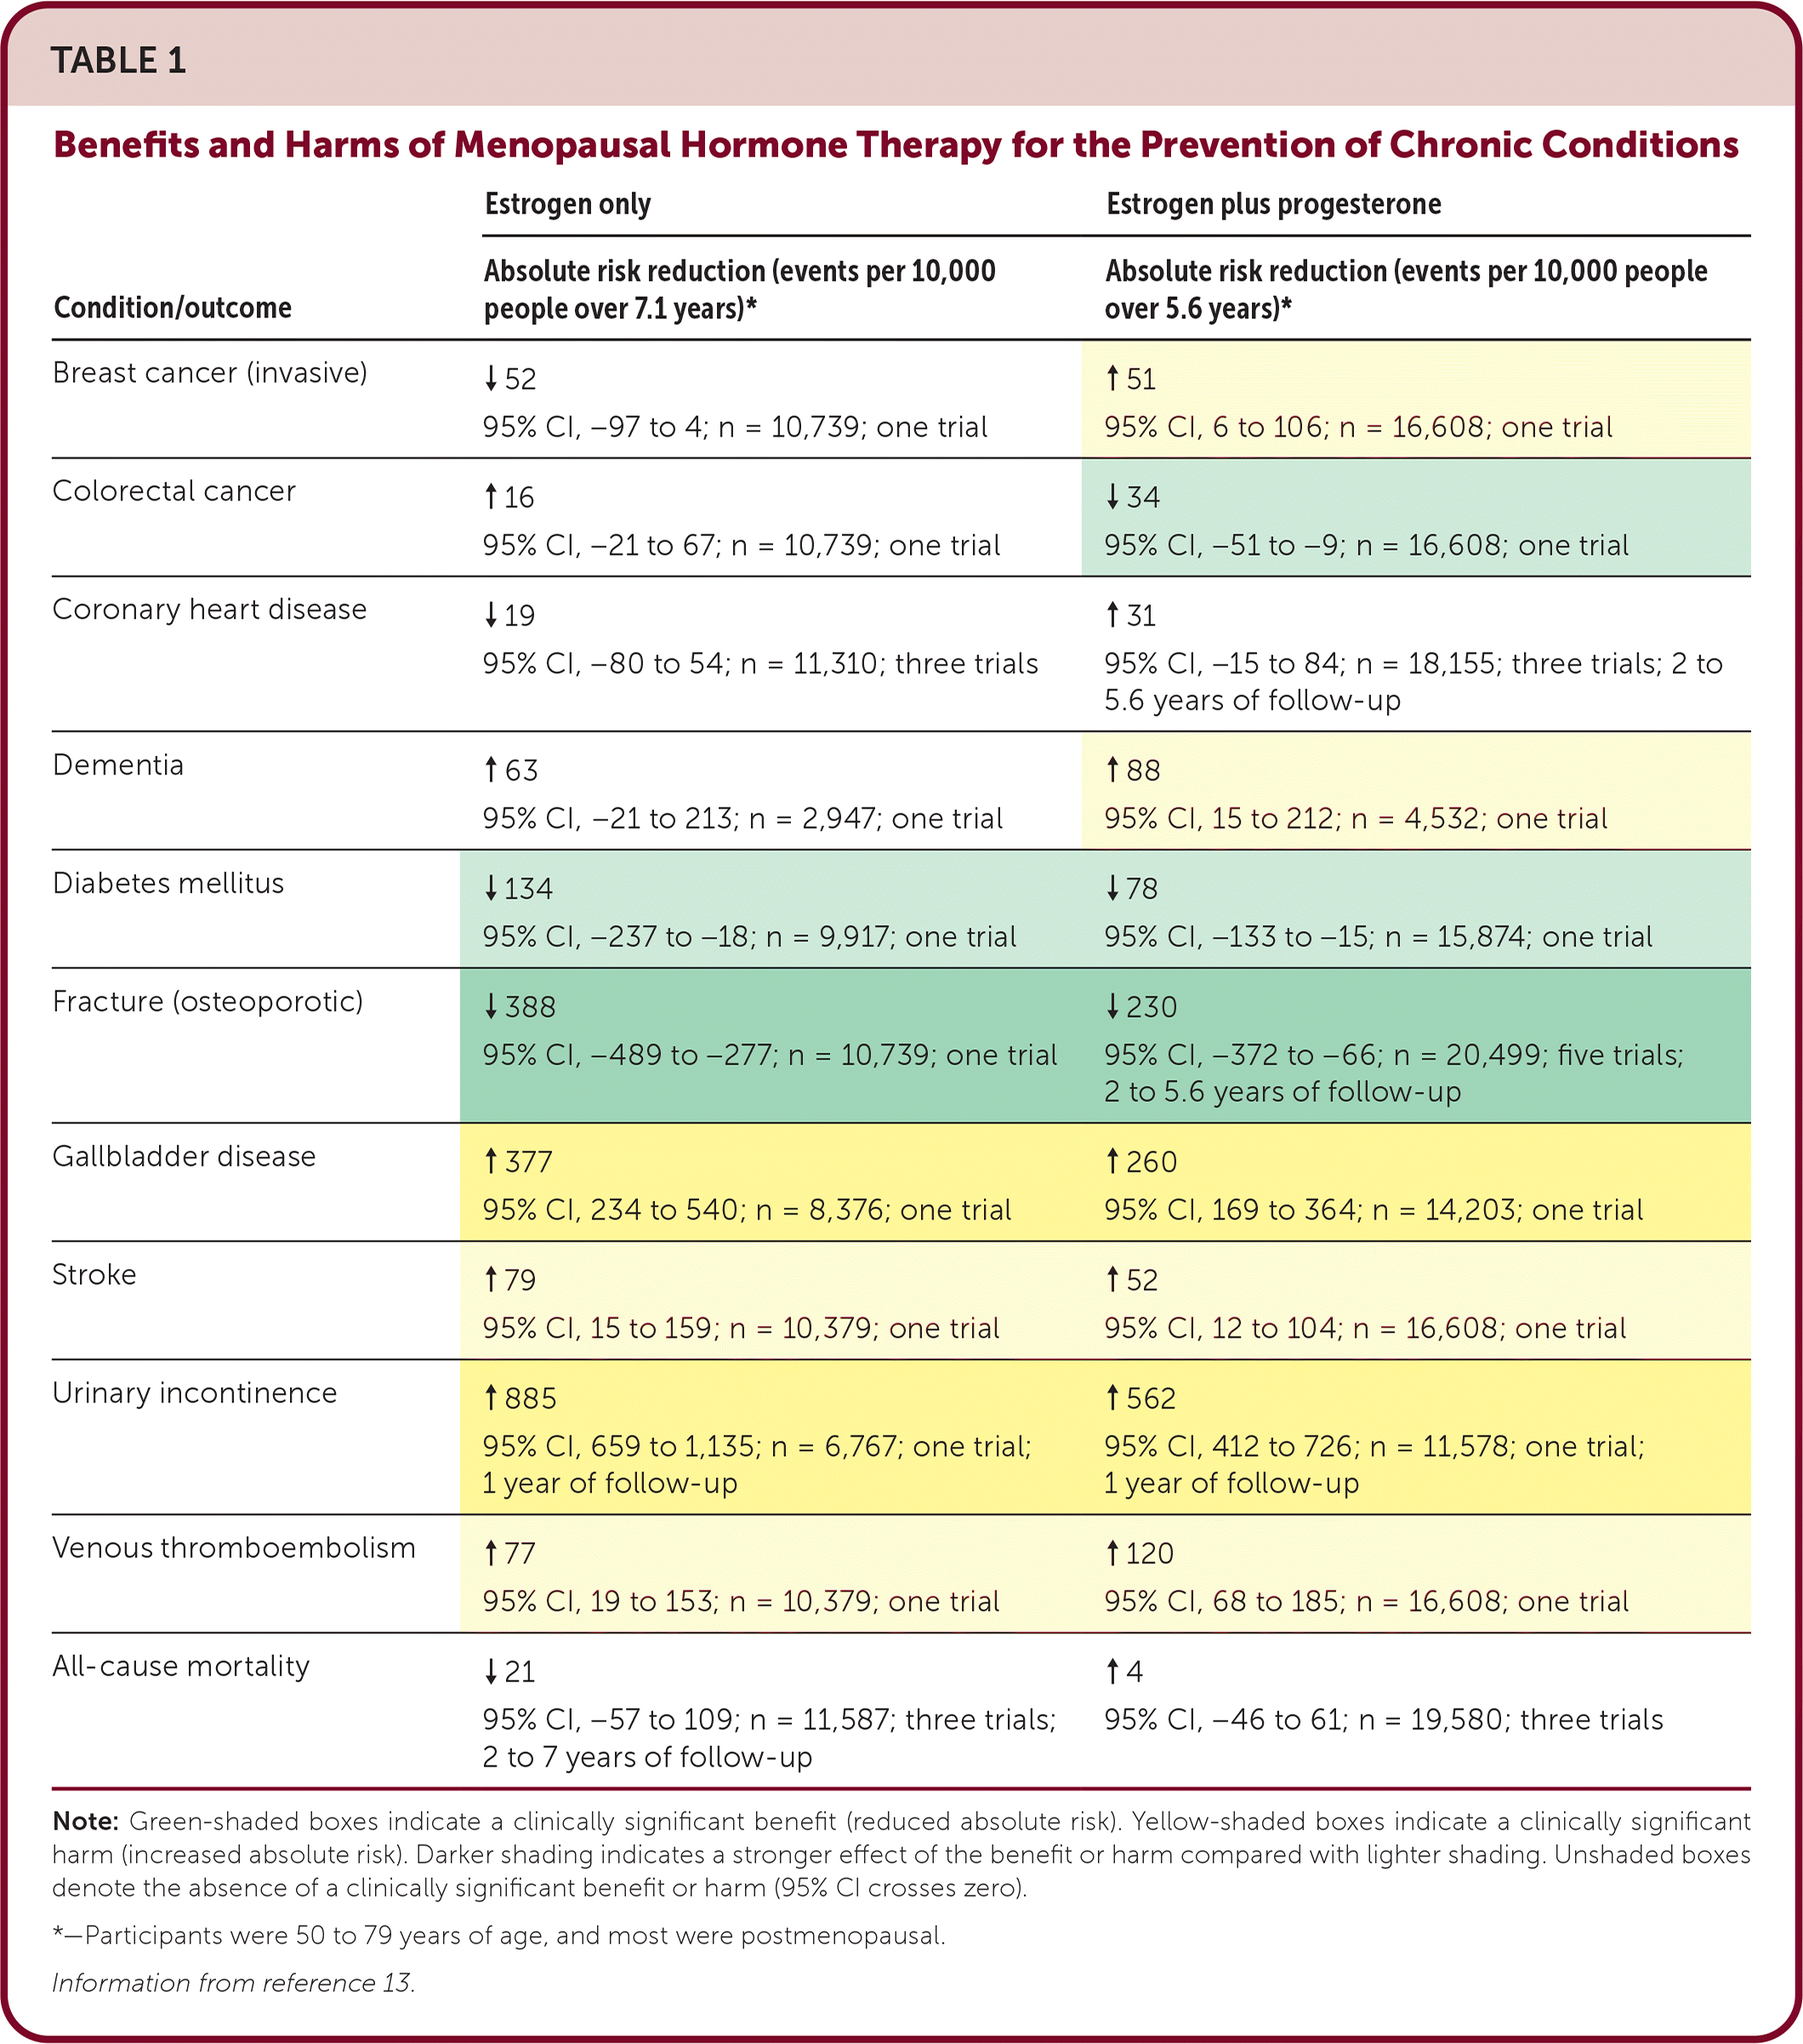
Benefits/Harms of MHT
Data reviewed in 2022 from 20 RCTs & 3 large Cohort studies

Slide 33
Treatment Guidelines
Society/ Guideline | Yr/Latest Update | Main Indications | Key Recommendations | Warnings/ Contraindications
NAMS (The Menopause Society) | 2022–2024 | Moderate–severe VMS, GSM, prevention of bone loss and fractures | Initiation <60 years or <10 years since menopause → best benefit–risk ratio ('timing hypothesis’) MHT is most effective treatment for VMS & GSM Prefer transdermal route in women at increased VTE risk Progestogen required if uterus present Continuation >65 years may be acceptable in selected women | Periodic benefit–risk re-assessment Avoid oral estrogen in active/recent VTE, stroke, or breast cancer

Slide 34
Society/ Guideline | Yr/Latest Update | Main Indications | Key Recommendations | Warnings/ Contraindications
IMS (International Menopause Society) | 2016–2024 | Relief of menopausal symptoms, prevention of osteoporosis | MHT is most effective for VMS & GSM Benefits outweigh risks when started before age 60 or within 10 years of menopause Transdermal minimizes VTE risk Tailor dose & duration individually | Unexplained vaginal bleeding Acute liver disease Active or recent VTE, ischemic heart disease, or breast cancer
ACOG (American College of Obstetricians & Gynecologists) | 2014–2021 | Vasomotor symptoms, genitourinary symptoms, prevention of bone loss | Individualize treatment based on risk profile Use lowest effective dose for shortest duration Transdermal route preferred for women with hypertension or high VTE risk | History of breast cancer or estrogen-dependent neoplasia Active VTE or arterial thromboembolic disease

Slide 35
Society/ Guideline | Yr/Latest Update | Main Indications | Key Recommendations | Warnings/ Contraindications
BMS / WHC (British Menopause Society / Women's Health Concern) | 2020–2024 | Control of menopausal symptoms, prevention of osteoporosis | Optimize lifestyle factors alongside MHT No arbitrary limits on treatment duration Annual review required Transdermal estrogen + micronized progesterone represents safest profile | Active thromboembolic or cardiovascular disease Current or suspected breast or endometrial cancer
EMAS (European Menopause and Andropause Society) | 2022–2024 | Vasomotor symptoms, prevention of bone loss, management of premature ovarian insufficiency (POI) | Early initiation maximizes cardioprotective & bone benefits Transdermal therapy is the safer first-line approach for metabolic risks Non-hormonal options recommended if MHT contraindicated | Prior estrogen-dependent malignancies Active liver disease or high-risk thrombophilia

Slide 36

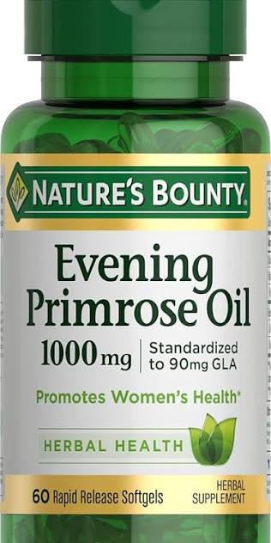
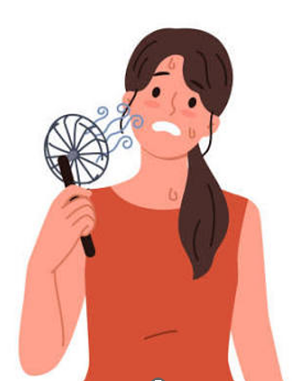
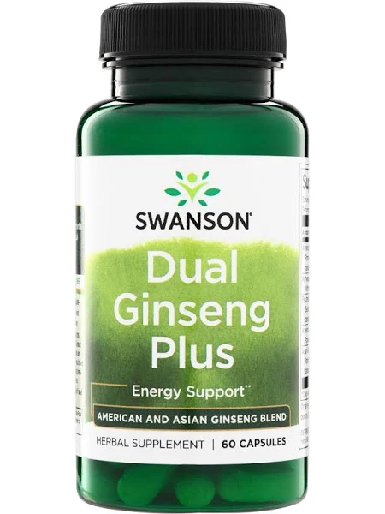
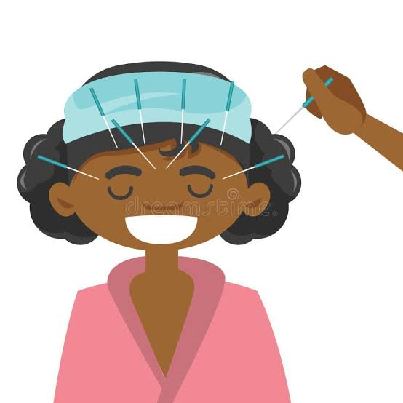

Notable treatments that don’t work for Menopause
Exercise
Yoga
Cooling solutions
Cannabinoids
Acupunction
Primrose Oil
Ginseng
Relaxation Therapy

Slide 37
Preventative Care Recommendations in Menopause
Stop smoking, especially if considering MHT/HRT
Exercise can reduce CV risk (150 min/wk)
Weight bearing exercise can reduce Osteoporosis risk (2-3 days/wk)
Heart healthy diet (Mediterranean diet low in saturated fats, DASH)
Contraception is recommended until menopause (MHT is not contraception)
Screening tests like Bone Mineral Density, Mammography, Colon Cancer Screening, Cervical Cancer Screening
Clinician should survey perimenopause/menopause symptoms as not all women will report symptoms

Slide 38
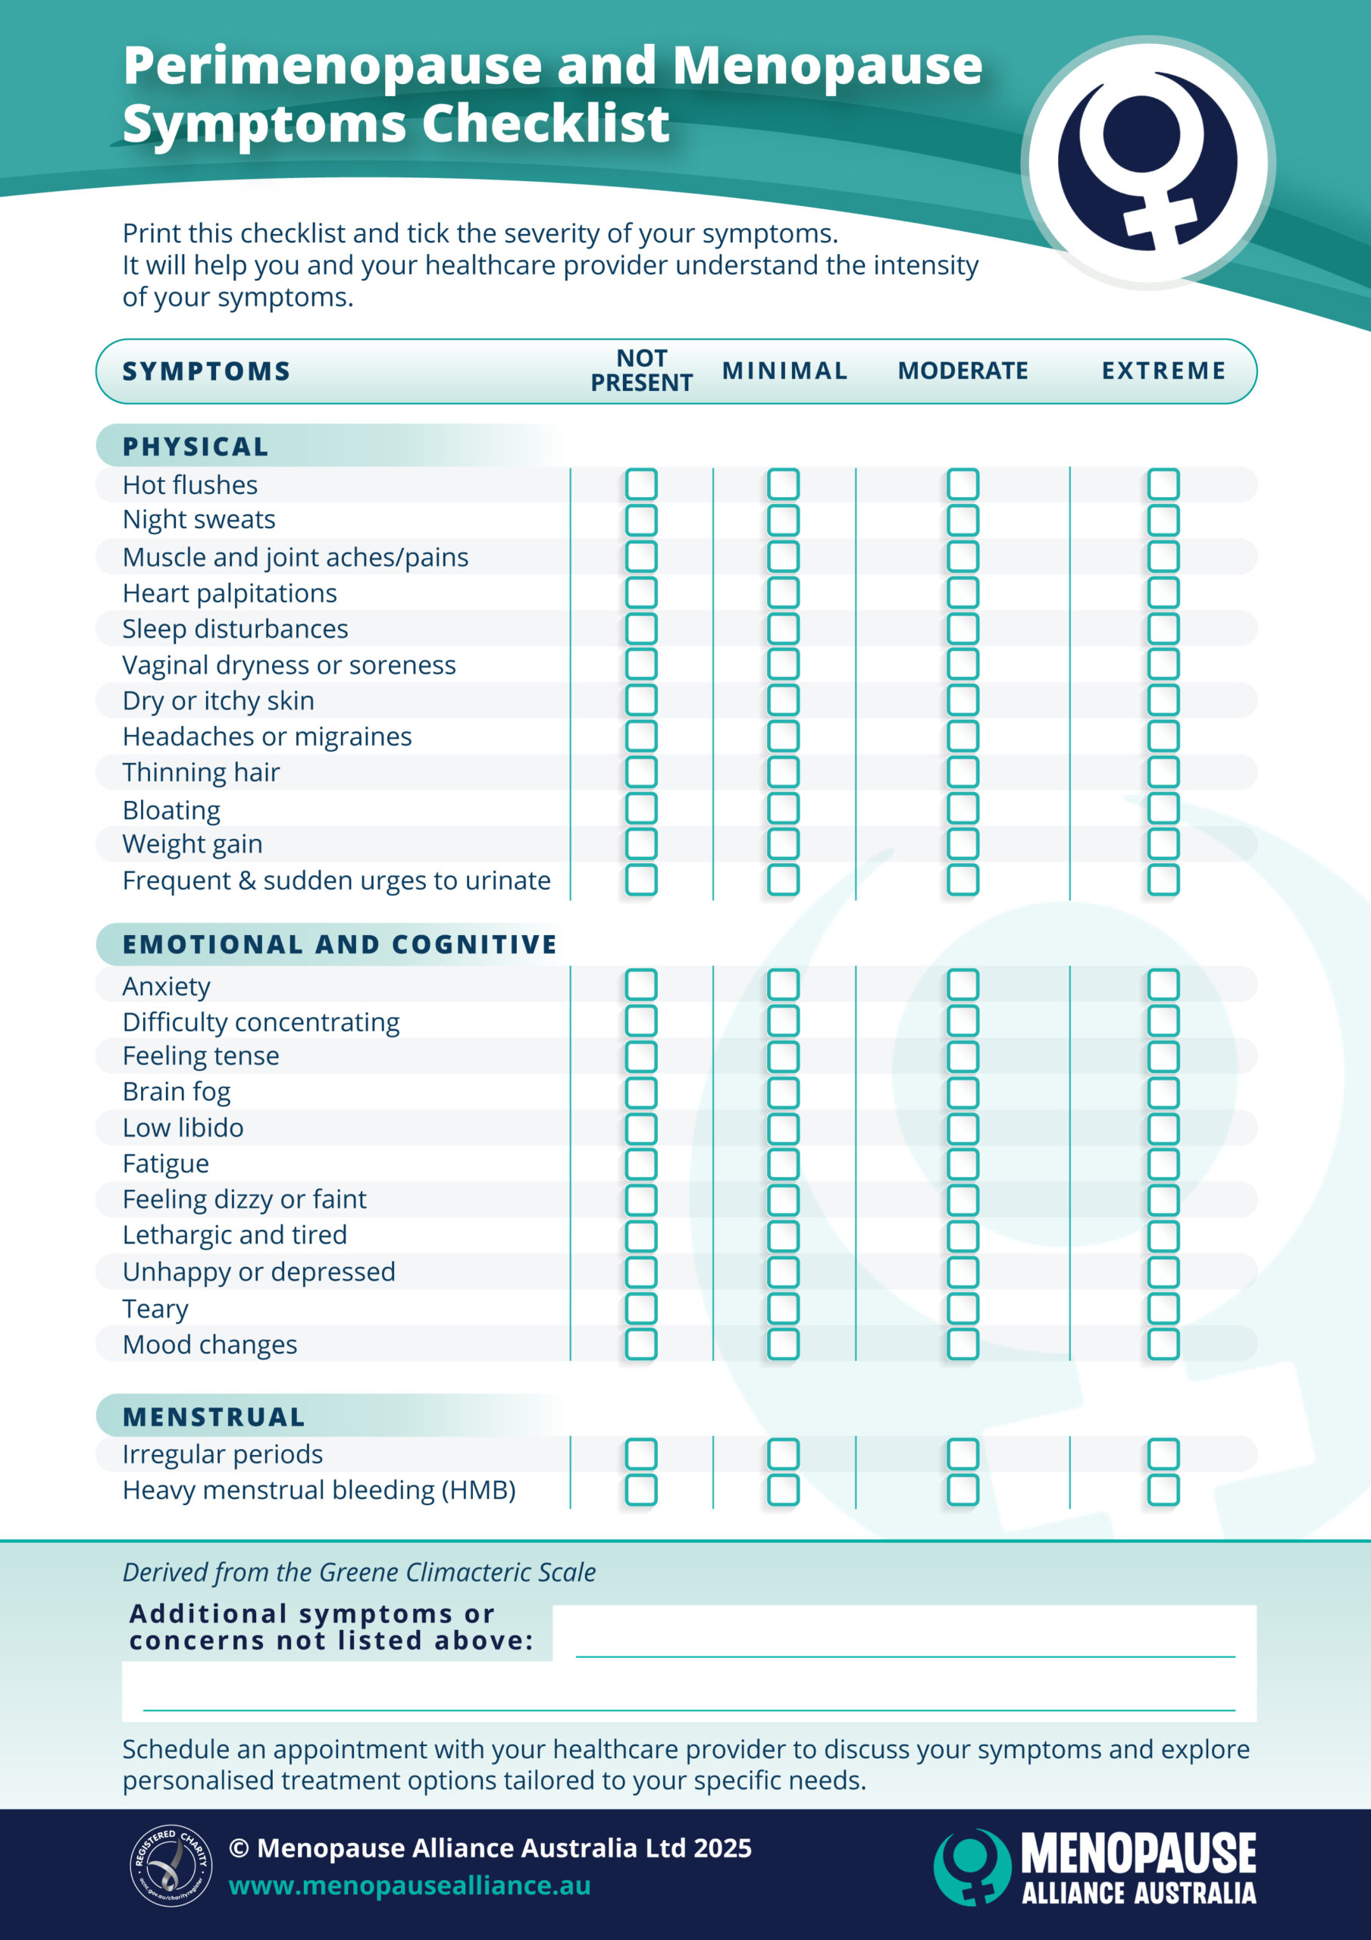
Menopause Symptom Survey
https://menopausealliance.au/menopause/menopause-symptoms-checklist2/

Slide 39
Women’s Health Initiative - Background
1992-2005, recruitment of 161,000 postmenopausal women between 1993-1998 with an age range of 50-79
  Mean age was 63-64 yrs old
40 centers across the US
  68,000 in RCTs & 93,676 in observational study
HT included conjugated equine estrogen (0.625 mg/day) +/- medroxyprogesteone acetate (2.5 mg/day) & measured as it’s end point
  Coronary Heart Disease
  Breast Cancer
  Stroke
  Pulmonary Embolism
  Endometrial Cancer
  Colorectal Cancer
  Hip Fracture
  Death from other causes

Slide 40
Women’s Health Initiative - Outcomes
Trial stopped early in 2002 because risks were higher than benefits in combined therapy group vs placebo
  29% higher CHD risk
  41% higher CVA risk
  2+ higher risk of PE
  26% higher breast cancer risk
  37% fewer colorectal cancers
  34% fewer hip fractures
Trial stopped in 2004 for estrogen only arm vs placebo
  No significant CHD reduction
  39% higher CVA risk
  39% fewer hip fractures
  Lower incidence of breast cancer (no defined stat given) & was later found to have significantly lower incidence and mortality
  No significant total mortality difference
Lots of confounding factors
  Age, time since menopause, duration of treatment, baseline CV risk, & hormone types & route of administration

Slide 41
Women’s Health Initiative - Review
Average age of women was 63, older than the start of menopause
  1/5 to 1/4 were 70-79 yrs old which possibly contributed to increase in CV risk
Only oral MHT was tested & only 1 estrogen & 1 progesterone
  Transdermal estrogen has been shown to be safer
  Multiple doses of each hormone are available & multiple types
  Current research suggests this matters particularly for VTE risk
The basis for WHI was to see if HT could prevent disease & did not really test if MHT was effective at treatment of symptoms
  Don’t use MHT to reduce CV risk or as 1st line for Osteoporosis treatment
  Timing matters, starting earlier at onset may not increase risks as high
  Dose, route, and type of hormone also matters

Slide 42
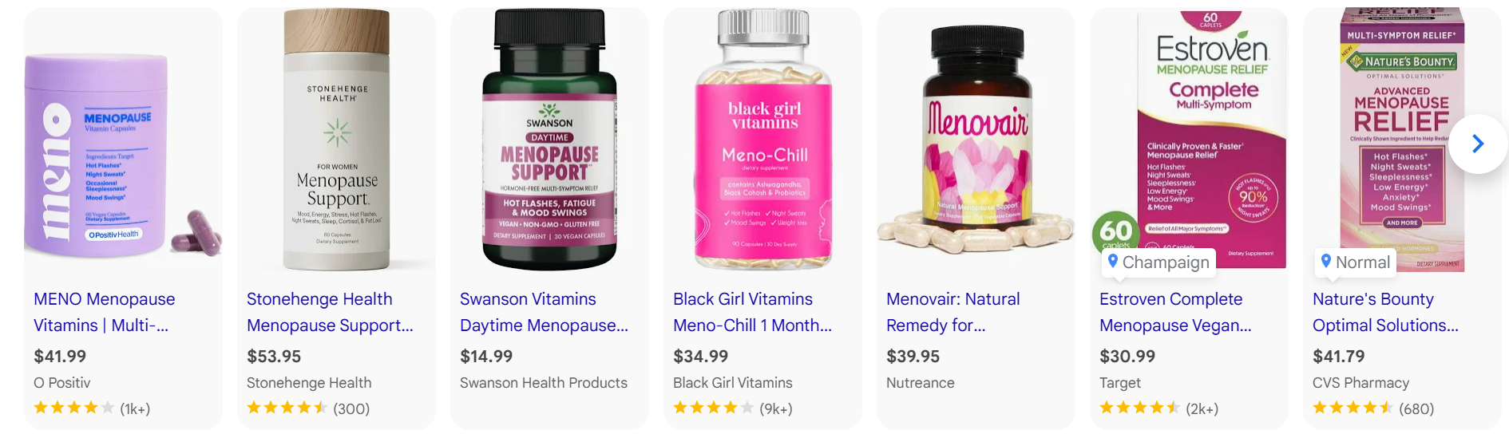
Combating Misinformation
Wellness influencers
  Credentials, Evidence, Regulation
Supplement industry
  Evidence, Regulation

Slide 43
Postmenopausal Bleeding (PMB)
Uterine bleeding 12 months or more after their final menses (ie menopause)
90% of patients diagnosed with endometrial cancer have PMB
2026 updated ACOG guideline
  Combination of both transvaginal US and endometrial tissue sampling is recommended as part of the initial eval in most patients with PMB
  Transvaginal US w/o endometrial biopsy may be used during the initial eval of select patients with a single episode of PMB & US showing a fully visualized endometrium that is <4mm in thickness & no risk factors for endometrial cancer, educated on f/u for recurrent bleeding, & no barriers to f/u
Risk factors - HT, SERM, BMI>30, G0, AA, DM, or genetic (ie Lynch or Cowden syndromes or FH of endometrial cancer), etc

Slide 44
Guideline Rational for PMB workup
Incidence increased from 23.5/100,000 women in 2000 to 28.8 in 2022
Death rate increased from 4.1/100,000 women per year in 2019 to 5.3 in 2023
Incidence role disproportionately for non-Hispanic Black women at 2.7% per yr through 2022 compared to 0.7% increase for white women
Death rate in non-Hispanic Black women was 9.8/100,000 women per year compared to 4.8/100,000 women per year in non-Hispanic White
Technique requires cervical to fundal measurement & measurement could be affected by uterine orientation, adenomyosis, and leiomyomas (the latter assoc with higher incidence in Black women)

Slide 45
Differential Diagnosis for PMB
GU Atrophy
Polyps, either Endometrial or Cervical
Uterine leiomyomas
Endometrial Hyperplasia with or without atypia
Exogenous HT
Endometrial Cancer (DO NOT MISS!)
Cervical Cancer
Other Cancers of the Genital Tract
Infections – endometritis, cervicitis, vaginitis, cystitis
Medications – anticoagulants, HT, SERMs
GI causes or Urinary causes

Slide 46
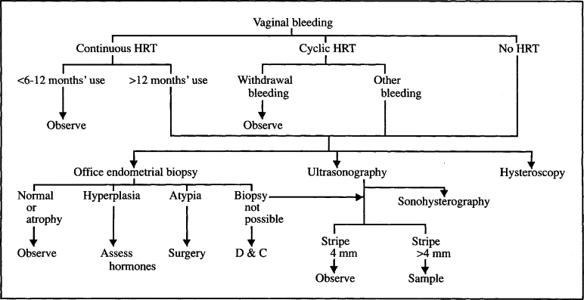
Diagnostic workup & Treatment for PMB
https://www.mayoclinicproceedings.org/article/S0025-6196%2811%2963335-1/fulltext

Slide 47
Questions?

Slide 48
References
American Academy of Family Physicians (AAFP)
https://www.ncbi.nlm.nih.gov/books/NBK507826/
https://pmc.ncbi.nlm.nih.gov/articles/PMC12652300/
https://www.pathophys.org/menopause/
American College of Obstetrics and Gynecology (ACOG)

