Slide 1
Menopause
Pharmacology

Slide 2
Session Objectives
Differentiate the clinical indications, contraindications, and adverse effects of estrogen-only versus combined estrogen-progestin therapy.
Explain the main mechanisms, risks, and clinical utility of some non-hormonal pharmacological therapies utilized for menopausal vasomotor symptoms.
Select the most appropriate menopausal pharmacotherapy for a patient by analyzing comorbid conditions and individual risk stratification.

Slide 3
Session Roadmap: Menopausal Pharmacotherapy
Pharmacological Principles & Hormone Regimens
Evidence-Based Safety & Risk Stratification-The WHI Vs. E3N
Special Populations & Non-Hormonal Pharmacology
Applications-Questions (lecture day)

Slide 4
Why Treat?

Slide 5
Why Not Treat?
The 2002 WHI Misinterpretation

Slide 6
Estrogen and Progestogen in Menopause

Slide 7

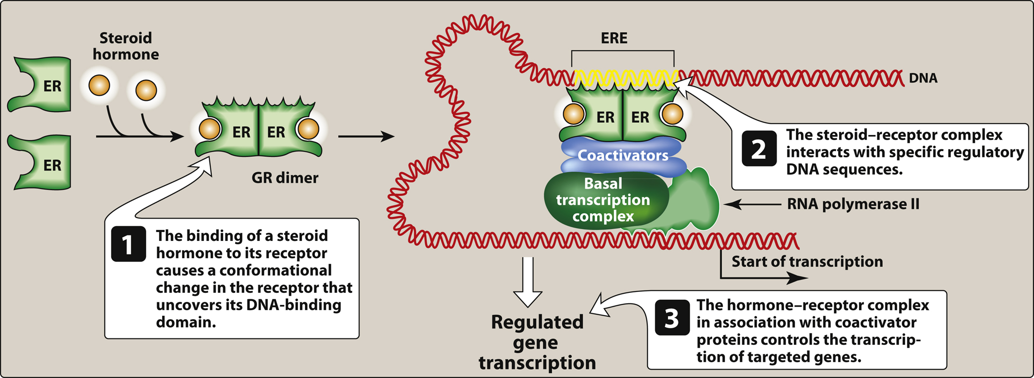
Legend:
From: 25 Estrogens, Progestogens, and Androgens
Lippincott ® Illustrated Reviews: Pharmacology, 8e, 2023
Transcriptional regulation by intracellular steroid hormone receptors.

Slide 8
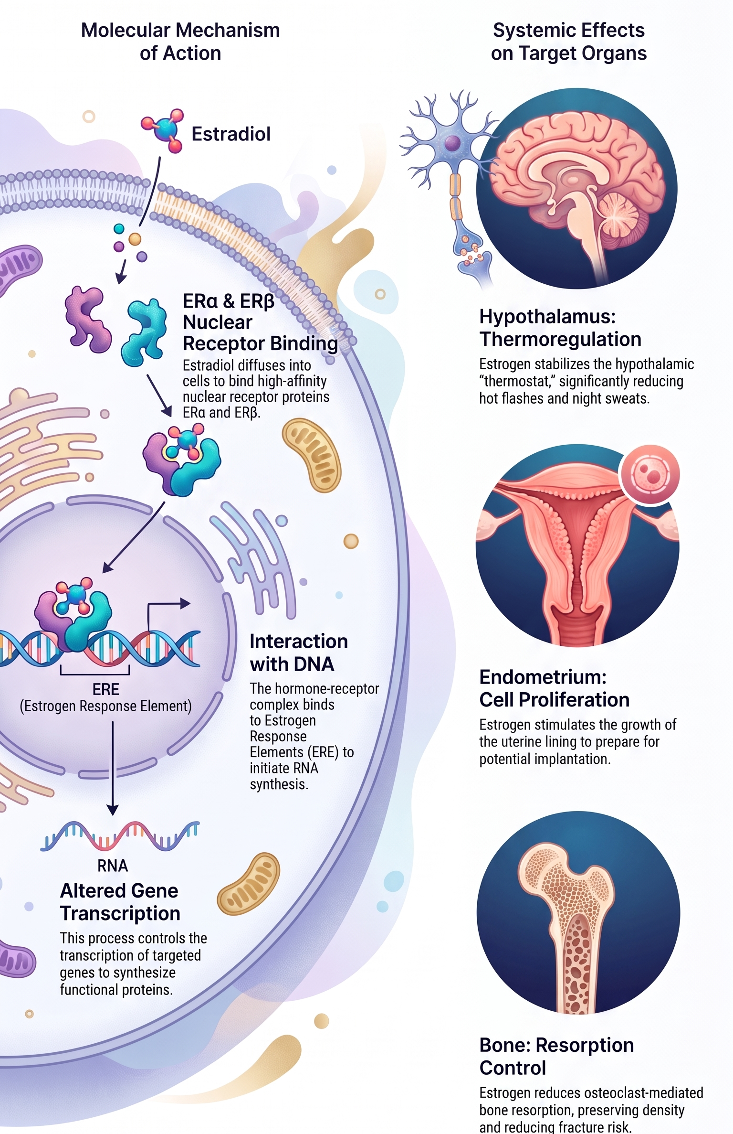
Estrogen
Binds intracellular estrogen receptors ERα and ERβ.
The hormone–receptor complex binds DNA response elements and alters transcription.
Stabilizes hypothalamic thermoregulation.
Stimulates endometrial proliferation.
Reduces osteoclast-mediated bone resorption.

Slide 9
Progestogen
Progestogen includes endogenous progesterone and synthetic progestins such as medroxyprogesterone acetate.
Binds intracellular progesterone receptors.
Opposes estrogen-induced endometrial proliferation.
Promotes secretory endometrial differentiation.

Slide 10
Characteristic
Estrogen only
Estrogen plus progestogen
Characteristic | Estrogen only | Estrogen plus progestogen
Appropriate patient | Prior hysterectomy | Intact uterus
Primary indication | Moderate-to-severe VMS when systemic HT is appropriate | Same, with endometrial protection
Major benefit | Most effective VMS treatment without unnecessary progestogen exposure | VMS relief while preventing endometrial hyperplasia
Principal unique risk | Endometrial hyperplasia and cancer if used with an intact uterus | Additional bleeding, breast tenderness, bloating, and possible mood effects

Slide 11
Endometrial protection
Continuous combined: estrogen and progestogen daily
Cyclic: estrogen daily with progestogen for approximately 12–14 days each month
Conjugated estrogen plus bazedoxifene: bazedoxifene acts as the endometrial antagonist
Levonorgestrel intrauterine system may provide endometrial protection in selected patients, depending on product and clinical context
Cyclic regimens usually produce scheduled withdrawal bleeding. Continuous regimens may cause initial unscheduled bleeding followed by amenorrhea.

Slide 12
Estrogen routes
Oral estradiol or conjugated equine estrogen
Transdermal estradiol patch, gel, or spray
Vaginal estrogen for GSM, not VMS

Slide 13
Local (Vaginal) Estrogen & Genitourinary Syndrome of Menopause (GSM)
Clinical Indication:
Specifically indicated for GSM: vaginal dryness, dyspareunia, urinary urgency, and recurrent UTIs
Pharmacokinetics & Systemic Exposure:
Low-dose vaginal formulations (creams, inserts/tablets, low-dose rings) maintain serum estradiol within the postmenopausal basal range (4-14pg/mL)
Negligible systemic absorption; no observed increased risk of VTE, stroke, CHD, or breast cancer recurrence
Endometrial Safety:
Opposing progestogen therapy is NOT required for low-dose local vaginal estrogen.
Clinical Utility:
Can be continued long-term and used safely even when systemic MHT is contraindicated or discontinued

Slide 14
Transdermal therapy
It may be preferred when systemic HT remains appropriate in patients with:
Hypertriglyceridemia
Gallbladder disease
Migraine
Moderate cardiometabolic or VTE risk

Slide 15
Oral and transdermal estrogen
Oral estrogen | Transdermal estradiol
Undergoes hepatic first-pass metabolism | Largely bypasses hepatic first-pass exposure
Increases hepatic clotting-factor production | Less hepatic effect on coagulation proteins
Increases triglycerides | Less effect on triglycerides
Increases SHBG, TBG and CBG | Smaller effect on binding proteins
Greater gallbladder effect | Lower observed gallbladder risk
Higher observed VTE risk | Lower VTE risk in observational studies
Transdermal estrogen as risk-free. The route evidence comes mainly from observational studies.

Slide 16
Modern MHT Dosing Strategy: "Start Low, Titrate Up”
Shift in Clinical Practice: Historical Approach: Fixed "standard" starting doses (e.g., CEE 0.625mg/day or oral estradiol 1mg/day).
Current Guideline Approach: Initiate therapy at lower doses (e.g., transdermal estradiol 0.025mg/day or oral estradiol 0.5 mg/day) and titrate upward based on symptom response

Slide 17
Modern MHT Dosing Strategy: "Start Low, Titrate Up”- (Continued)
Clinical Advantages of Low-Dose Initiation:
  Effectively eliminates or reduces vasomotor symptoms in the majority of patients.
  Lower adverse effect profile: Significantly reduces rates of breast tenderness, fluid retention, and unscheduled vaginal bleeding.
  Improved safety markers: Exerts fewer effects on hepatic coagulation factors and inflammatory markers.
Duration & Tapering:
Re-evaluate periodically; when discontinuing, taper gradually (e.g., reducing by 1 pill/patch increment per week) to minimize rebound hot flashes

Slide 18
Contraindications to systemic hormone therapy
Systemic HT should generally be avoided with:
  Current or previous breast cancer
  Known coronary heart disease
  Previous stroke or TIA
  Previous VTE or a major thrombophilia
  Active liver disease
  Unexplained vaginal bleeding until evaluated
  High-risk endometrial cancer
  Pregnancy

Slide 19
Contraindications to systemic hormone therapy-
A different route does not automatically overcome a major contraindication.
Low-dose vaginal estrogen has low, formulation-dependent systemic absorption. It should be distinguished from systemic therapy, but decisions in patients with estrogen-dependent cancer require individualized discussion.

Slide 20
Adverse effects and monitoring
Common estrogen effects
  Breast tenderness
  Nausea
  Headache
  Fluid retention
  Vaginal bleeding

Slide 21
Adverse effects and monitoring-
Progestogen-related effects
  Breakthrough or withdrawal bleeding
  Breast tenderness
  Bloating
  Mood symptoms

Slide 22
Risks
VTE and pulmonary embolism
Ischemic stroke
Gallbladder disease
Endometrial hyperplasia or cancer with unopposed systemic estrogen
Regimen- and duration-dependent breast-cancer risk
New or persistent bleeding after initial treatment adjustment requires evaluation rather than automatic attribution to hormone therapy

Slide 23
What the WHI actually tested
WHI hormone trial | Population | Tested regimen
Combined trial | Intact uterus | Oral CEE 0.625 mg + MPA 2.5 mg daily
Estrogen-alone trial | Prior hysterectomy | Oral CEE 0.625 mg daily

Slide 24
WHI outcomes in women aged 50–59
Outcome | CEE + MPA | CEE alone
Coronary events | +2.5 | −5.5
Invasive breast cancer | +3 | −2.5
Stroke | +2.5 | −0.5
Pulmonary embolism | +3 | +1.5
All-cause mortality | −5 | −5.5

Slide 25
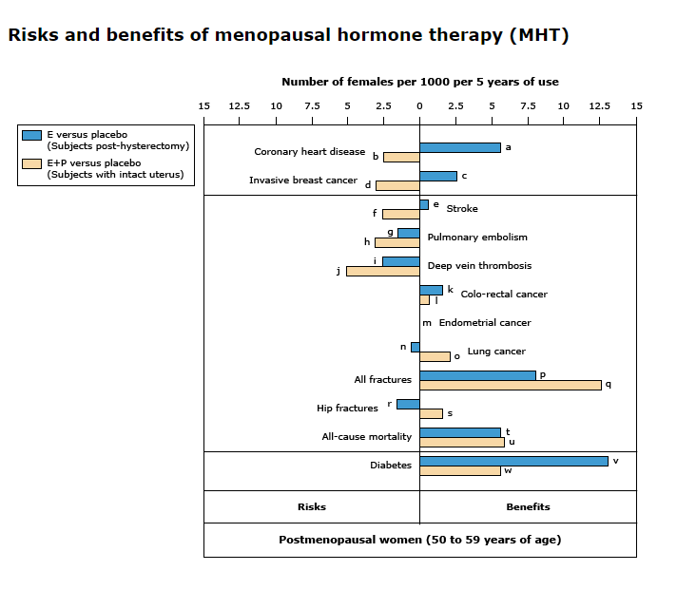
Risks and Benefits of MHT

Slide 26
Breast cancer and formulation evidence
WHI randomized trial
Regimen | Breast-cancer incidence | Breast-cancer deaths
CEE alone after hysterectomy | 30 vs 37 with placebo: approximately 7 fewer cases | 3 vs 5 with placebo: approximately 2 fewer deaths
CEE + MPA with an intact uterus | 45 vs 36 with placebo: approximately 9 additional cases | 5 vs 4 with placebo: approximately 1 additional death, but this difference was not statistically significant

Slide 27
E3N observational cohort
Estrogen plus micronized progesterone:
Estrogen plus dydrogesterone
Estrogen plus other progestogens
Progestogen type may matter but cannot establish that micronized progesterone carries no breast-cancer risk.

Slide 28
Custom-Compounded Bioidentical Hormone Therapy (cBHT)
Defining Terms:
FDA-Approved Bioidenticals: Structurally identical to endogenous human hormones (17beta-estradiol, micronized progesterone) available in regulated commercial products
Custom-Compounded (cBHT): Non-FDA-approved multi-hormone mixtures (creams, pellets, sublinguals) adjusted via salivary testing
Safety & Quality Concerns:
Lack of regulatory oversight for purity, potency, and batch consistency (tested potencies range from 67.5% to 268%of labeled strength)
Unpredictable bioavailability and variable progestogen absorption, predisposing patients to unintended endometrial hyperplasia and carcinoma
Professional Guidelines:
The Menopause Society, Endocrine Society, and ACOG strongly advise against cBHT when FDA-approved options are available

Slide 29
Individual risk stratification
Before systemic HT:
  Confirm that symptoms warrant systemic treatment.
  Determine uterine status.
  Evaluate unexplained bleeding.
  Review breast-cancer and cardiovascular history.
  Measure blood pressure.
  Assess smoking, diabetes and lipid profile.
  Review VTE history and thrombophilia.
  Assess liver disease.
  Review current medications and interactions.

Slide 30
General principle:
For appropriate candidates, benefit–risk is generally most favorable before age 60 or within 10 years of menopause.
Age and timing do not override contraindications.
10-year CVD risk below 5%: generally low
5–10%: intermediate; consider transdermal therapy if HT remains appropriate
Above 10%: generally favor nonhormonal treatment

Slide 31
Special Populations: Primary Ovarian Insufficiency (POI) & Surgical Menopause
Clinical Definitions:
  Primary Ovarian Insufficiency (POI): Loss of ovarian function before age 40.
  Early/Surgical Menopause: Menopause or bilateral oophorectomy before age 45
Dosing & Therapeutic Goals:
Require higher replacement doses (e.g., transdermal estradiol 0.1mg/day or oral estradiol 2mg/day) to restore physiological premenopausal levels.
Terminology: Classically termed Hormone Replacement Therapy (HRT) rather than MHT
Recommended Duration:
Continue therapy until at least the average age of natural menopause ( 50-51years).
Primary Indications:
Essential for primary prevention of premature bone loss, coronary heart disease, ischemic stroke, and cognitive impairment.
Crucial Distinction: WHI safety risks in older women (mean age 63) do NOT apply to POI

Slide 32
Selective Estrogen Receptor Modulators (SERMs)
Mechanism of Action:
Bind intracellular estrogen receptors, displaying tissue-selective agonism or antagonism depending on target organ expression.
High-Yield SERM Agents:
Raloxifene: Estrogen agonist in bone (increases bone mineral density, reduces vertebral fractures) and antagonist in breast & endometrium. Approved for postmenopausal osteoporosis and breast cancer risk reduction. (No increased risk of endometrial cancer).
Tamoxifen: Estrogen antagonist in breast, but partial agonist in endometrium and bone. Used in ER+ breast cancer. (Carries increased risk of endometrial hyperplasia/carcinoma and VTE).
Bazedoxifene (+ CEE): Estrogen antagonist in the uterus; protects the endometrium without requiring a progestogen.
Clomiphene: Hypothalamic estrogen receptor antagonist; blocks negative feedback to increase GnRH, LH, and FSH to induce ovulation.
Shared Adverse Effects:
Increased risk of venous thromboembolism (VTE) and hot flashes (except bazedoxifene + CEE)

Slide 33
Menopause, MHT, & Bone Health
Bone Loss Trajectory:
  Estrogen depletion accelerates RANKL-mediated osteoclast resorption, leading to a loss of 15–20% of bone density in the 5–7 years surrounding the menopausal transition.
Fracture Reduction Efficacy:
  Systemic MHT reduces vertebral, hip, and total osteoporotic fractures by 30–50% during active treatment.
Guideline :
  Secondary Benefit: Bone preservation is a valuable secondary benefit when treating VMS.
  Not First-Line Solely for Osteoporosis: MHT is not recommended as first-line primary therapy solely for isolated chronic osteoporosis prevention in asymptomatic women (bisphosphonates preferred).
  Rebound Loss: Discontinuing MHT leads to rapid resumption of bone loss, returning to untreated baseline trajectory within a few years.
Selective Estrogen Receptor Modulators (SERMs):
  Raloxifene: Estrogen agonist in bone (increases BMD, reduces vertebral fractures) and antagonist in breast/endometrium.
  CEE + Bazedoxifene: Preserves bone density and protects the endometrium without requiring a progestogen

Slide 34
Androgen Therapy in Menopausal Pharmacology
Physiologic Context:
  Endogenous testosterone levels decline gradually with age and sharply after bilateral oophorectomy.
Primary Clinical Indication:
  Hypoactive Sexual Desire Disorder (HSDD) in postmenopausal women when MHT alone provides incomplete relief.
Regulatory Status & Prescribing:
  No FDA-approved female testosterone product currently exists in the US (approved in UK/Australia).
Clinical practice utilizes off-label micro-dosing of transdermal male preparations or compounded products under specialist care.
Adverse Effects & Safety:
Potential Effects: Acne, hirsutism, fluid retention, and adverse lipid changes (decreased HDL, increased LDL).

Slide 35
Non-Hormonal Therapies

Slide 36
SSRIs and SNRIs
Therapy | Mechanism and utility | Important risks
Paroxetine | Serotonin reuptake inhibition; low-dose paroxetine is FDA-approved for VMS | Sexual dysfunction, nausea, withdrawal; strong CYP2D6 inhibition
Escitalopram or citalopram | Serotonin reuptake inhibition | Sexual dysfunction, nausea, QT concerns with higher citalopram doses
Venlafaxine or desvenlafaxine | Serotonin and norepinephrine reuptake inhibition | Nausea, BP elevation, withdrawal
Notes:
Joffe trial, n=339

Slide 37
Gabapentin
Binds the auxiliary subunit of voltage-gated calcium channels.
The precise mechanism for VMS relief remains uncertain.
Useful for predominantly nocturnal VMS, insomnia, or concurrent neuropathic pain.
Risks: sedation, dizziness and ataxia.
Requires renal dose adjustment.
It is not a GABA-receptor agonist.

Slide 38
Oxybutynin
Competitive muscarinic-receptor antagonist.
Can reduce VMS and may benefit concurrent overactive bladder.
Risks: dry mouth, constipation, urinary retention and cognitive adverse effects.
Avoid or minimize in older adults with high anticholinergic burden.

Slide 39
Clonidine
Central α2-adrenergic agonist.
Modest efficacy with hypotension, dry mouth, sedation and rebound hypertension.
Generally not recommended routinely for VMS.

Slide 40
Neurokinin-receptor antagonists
Drug | Pharmacology | Major safety considerations
Fezolinetant | NK3-receptor antagonist | Hepatotoxicity warning, CYP1A2 interactions, cirrhosis and severe renal impairment
Elinzanetant | Dual NK1/NK3 antagonist | Sedation, hepatic-enzyme elevation, CYP3A4 interactions, pregnancy contraindication and seizure warning

Slide 41
Comorbidity-based treatment selection
Clinical situation | Most appropriate direction
Healthy patient with prior hysterectomy | Estrogen alone
Intact uterus and appropriate HT candidate | Estrogen plus endometrial protection
Previous breast cancer | Nonhormonal treatment
Tamoxifen treatment | Venlafaxine, gabapentin, or appropriate neurokinin antagonist; avoid paroxetine/fluoxetine
Previous VTE, stroke, or CHD | Generally avoid systemic HT
Hypertriglyceridemia or gallbladder risk | Transdermal rather than oral estrogen if HT remains appropriate
Uncontrolled hypertension | Control BP before systemic HT; use SNRIs cautiously
Liver disease | Avoid systemic HT; assess restrictions for neurokinin antagonists
Severe renal impairment | Renally adjust gabapentin; avoid fezolinetant
High anticholinergic burden | Avoid oxybutynin
Nocturnal VMS with neuropathic pain | Gabapentin may be useful

Slide 42
Questions?

