Slide 1
Clinical Embryology
Wessam Ibrahim, MD, PhD, MEHP
(For use only by CIMED students)

Slide 2
Learning Objectives
Differentiate between embryonic/fetal age & gestational age.
Describe the major events of the first three weeks of human development, including fertilization, cleavage, implantation, and gastrulation.
Explain the formation and derivatives of the three germ layers while correlating them with clinically relevant congenital anomalies.
Describe the development and functions of extraembryonic membranes and the placenta during early pregnancy.
Explain the establishment of maternal-fetal circulation and the endocrine functions of the placenta.
Apply embryologic principles to interpret abnormalities of implantation and placentation, including ectopic pregnancy, placenta previa, and placenta accreta.
Describe the embryologic origins of the gonads, genital ducts, and external genitalia.
Explain the molecular and hormonal mechanisms of sex determination and sexual differentiation, including the roles of SRY and AMH.
Differentiate the derivatives of the mesonephric (Wolffian) and paramesonephric (Müllerian) ducts in males and females.
Analyze the embryologic basis of common congenital malformations of the reproductive system, including cryptorchidism, hypospadias, Müllerian anomalies, and disorders of sexual development
Integrate embryologic, placental, and reproductive developmental concepts to solve clinical and USMLE Step 1-style questions involving congenital abnormalities and reproductive disorders.

Slide 3
Question 1
A 30-year-old woman presents with 2 years of unexplained infertility. Evaluation of her partner reveals normal sperm concentration, morphology, and motility. During assisted reproductive testing, sperm successfully reach and surround the secondary oocyte but are unable to bind effectively to the zona pellucida or undergo the acrosome reaction. Further studies demonstrate failure of the biochemical changes that normally occur as sperm transit through the female reproductive tract. Which of the following processes is most likely defective in this patient?
A. Completion of meiosis II by the secondary oocyte
B. Capacitation of spermatozoa
C. Cortical granule exocytosis
D. Formation of the male pronucleus
E. Fusion of the male and female pronuclei

Slide 4

Question 2
A 34-year-old woman undergoes evaluation for recurrent implantation failure following multiple cycles of in vitro fertilization. Genetic testing demonstrates a normal embryo karyotype, and embryo development progresses appropriately to the blastocyst stage. Endometrial biopsy reveals inadequate invasion of maternal endometrial tissue by trophoblastic cells, preventing establishment of normal maternal-fetal exchange. Which of the following embryonic cell populations is primarily responsible for invasion of the endometrium and establishment of implantation?
A. Cytotrophoblast
B. Epiblast
C. Syncytiotrophoblast
D. Hypoblast
E. Extraembryonic mesoderm

Slide 5
Question 3
A 38-year-old woman, gravida 4 para 3, presents in labor at 39 weeks' gestation. Her obstetric history is significant for two prior cesarean deliveries. Following an uncomplicated vaginal delivery, the placenta fails to separate spontaneously. Attempts at manual extraction result in massive postpartum hemorrhage requiring emergent surgical intervention. Histologic examination demonstrates chorionic villi abnormally attached directly to the myometrium.
Which of the following is the most likely diagnosis?
A. Placenta accreta
B. Placental abruption
C. Placenta previa
D. Velamentous placenta
E. Membranous placenta

Slide 6
Question 4
A 28-year-old primigravid woman at 29 weeks' gestation presents with a 2-week history of worsening headaches, lower-extremity edema, and visual disturbances. Her blood pressure is 170/110 mm Hg, and urinalysis demonstrates 4+ proteinuria. Fetal ultrasonography reveals growth restriction. Following delivery, placental histopathology demonstrates inadequate remodeling of the maternal spiral arteries. Failure of which of the following developmental processes most likely contributed to this patient's condition?
A. Formation of the bilaminar embryonic disc
B. Migration of neural crest cells into the pharyngeal arches
C. Trophoblastic invasion of maternal vessels
D. Gastrulation and formation of the trilaminar embryonic disc
E. Development of the allantois and urachus

Slide 7
Question 5
A newborn phenotypic female is evaluated for primary gonadal failure. Genetic testing reveals a 46-XX karyotype. Pelvic ultrasonography demonstrates small, poorly developed ovaries with a marked deficiency of germ cells. The physician explains that normal ovarian development depends on the migration of primordial germ cells during early embryogenesis. Failure of this migration can result in gonadal dysgenesis and infertility. Primordial germ cells normally migrate to the developing gonadal ridges from which of the following structures?
A. Cloaca
B. Mesonephric duct
C. Paramesonephric duct
D. Yolk Sac
E. Genital ridge

Slide 8
Question 6
A newborn is evaluated for ambiguous genitalia. Karyotype analysis demonstrates 46,XY chromosomes. Pelvic ultrasonography reveals the absence of a uterus and fallopian tubes. Genetic testing identifies a mutation in the SRY gene that prevents expression of its protein product during embryogenesis. Failure of expression of the SRY gene product would most directly disrupt which of the following developmental processes?
A. Descent of the testes into the scrotum
B. Regression of the mesonephric (Wolffian) ducts
C. Conversion of testosterone to dihydrotestosterone (DHT)
D. Fusion of the paramesonephric (Müllerian) ducts
E. Differentiation of Sertoli cells within the primitive sex cords

Slide 9
Question 7
A 19-year-old male is evaluated for infertility. Physical examination is unremarkable. Semen analysis demonstrates markedly decreased sperm volume and absent fructose. Pelvic MRI reveals bilateral absence of the seminal vesicles, while the testes and epididymides are present and normally developed. The absent structures are derived from which embryologic structure?
A. Paramesonephric (Müllerian) duct
B. Mesonephric (Wolffian) duct
C. Urogenital sinus
D. Genital tubercle
E. Genital ridge

Slide 10
Question 8
A 6-year-old child with a 46, XY karyotype is evaluated for bilateral cryptorchidism. During laparoscopic orchiopexy, the surgeon unexpectedly identifies a uterus and fallopian tubes. Histologic examination confirms normal testes. Serum testosterone is normal for age. Failure of regression of which embryologic structure is responsible for the persistence of the additional reproductive organs found in this patient?
A. Mesonephric ducts
B. Genital tubercle
C. Urogenital sinus
D. Paramesonephric ducts
E. Genital ridge

Slide 11
Question 9
A 26-year-old woman with a history of recurrent pregnancy loss undergoes hysterosalpingography. Imaging demonstrates two separate uterine horns, each connected to its own cervix. The ovaries appear normal bilaterally. The abnormality most likely resulted from failure of which developmental process?
A. Differentiation of the gonadal ridge
B. Fusion of the paramesonephric ducts
C. Regression of the mesonephric ducts
D. Formation of the urogenital sinus
E. Migration of primordial germ cells

Slide 12
Question 10
A 17-year-old adolescent is evaluated for primary amenorrhea. Physical examination reveals normal breast development, sparse pubic and axillary hair, and a blind-ending vaginal pouch. Pelvic U/S demonstrates the absence of a uterus and fallopian tubes. Laboratory studies show elevated serum testosterone levels within the normal male range. Karyotype analysis reveals 46,XY. Which of the following is the most likely diagnosis?
A. Müllerian agenesis (Mayer-Rokitansky-Küster-Hauser syndrome)
B. Androgen insensitivity syndrome (AIS)
C. 5α-reductase deficiency
D. Cryptorchidism
E. Congenital adrenal hyperplasia

Slide 13
Question 11
A child is assigned female at birth because of female-appearing external genitalia. Over the next several years, the child prefers traditionally male activities and experiences difficulty fitting in with female peers. At age 12, puberty is marked by rapid enlargement of the phallus, increased muscle mass, deepening of the voice, and male-pattern body hair growth. Physical examination reveals a blind-ending vaginal pouch and palpable gonads in the inguinal canals. Karyotype analysis demonstrates 46-XY. Which of the following is the most likely cause of this patient's condition?
A. Androgen insensitivity syndrome
B. Congenital adrenal hyperplasia
C. 5α-reductase deficiency
D. Persistent Müllerian duct syndrome
E. Gonadal dysgenesis

Slide 14
Question 12
A 2-week-old male infant is brought for a routine newborn examination. The left testis is palpated within the scrotum, but the right testis is not palpable in either the scrotum or inguinal canal. Ultrasonography confirms an undescended intra-abdominal right testis. The parents are counseled regarding the potential long-term consequences if the condition is not corrected. Which of the following is the most important long-term complication associated with this condition?
A. Infertility due to heat-induced damage to both testes
B. Hypospadias resulting from abnormal urethral development
C. Increased risk of testicular germ cell malignancy (especially seminoma)
D. Primary adrenal insufficiency due to impaired androgen production
E. Persistent Müllerian duct syndrome

Slide 15
Question 13
During an anatomy lab session, a medical student learns that in females, a certain embryonic structure persists as the ovarian ligament and the round ligament of the uterus. These ligaments play an essential role in maintaining the anatomical position of the ovaries and uterus within the pelvis. Which structure gives rise to both of these ligaments in female development?
Paramesonephric ducts
Urogenital sinus
Genital tubercle
Gubernaculum
Labioscrotal swellings

Slide 16
Question 14
A full-term male infant is noted at birth to have an abnormally positioned urethral opening on the ventral surface of the penis near the penoscrotal junction. Physical examination also demonstrates ventral curvature of the penis (chordee). The parents ask whether routine neonatal circumcision can be performed before discharge. Which of the following is the most appropriate recommendation?
A. Circumcision can be performed routinely at 6 to 8 weeks of age.
B. Circumcision should be delayed until puberty.
C. Circumcision should not be performed because the foreskin may be required for definitive surgical repair.
D. Circumcision will help correct the abnormal location of the urethral opening.
E. Circumcision should be performed immediately to reduce the risk of urinary obstruction

Slide 17
Question 15
A researcher is studying the embryologic development of the external genitalia. During the indifferent stage of development, paired labioscrotal swellings are present in both male and female embryos. In the absence of significant androgen stimulation, these structures develop into a normal female anatomical structure. Which of the following structures is derived from the labioscrotal swellings in a genetically normal 46, XX fetus?
A. Clitoris
B. Labia minora
C. Vestibule of vagina
D. Greater vestibular (Bartholin) glands
E. Labia majora

Slide 18
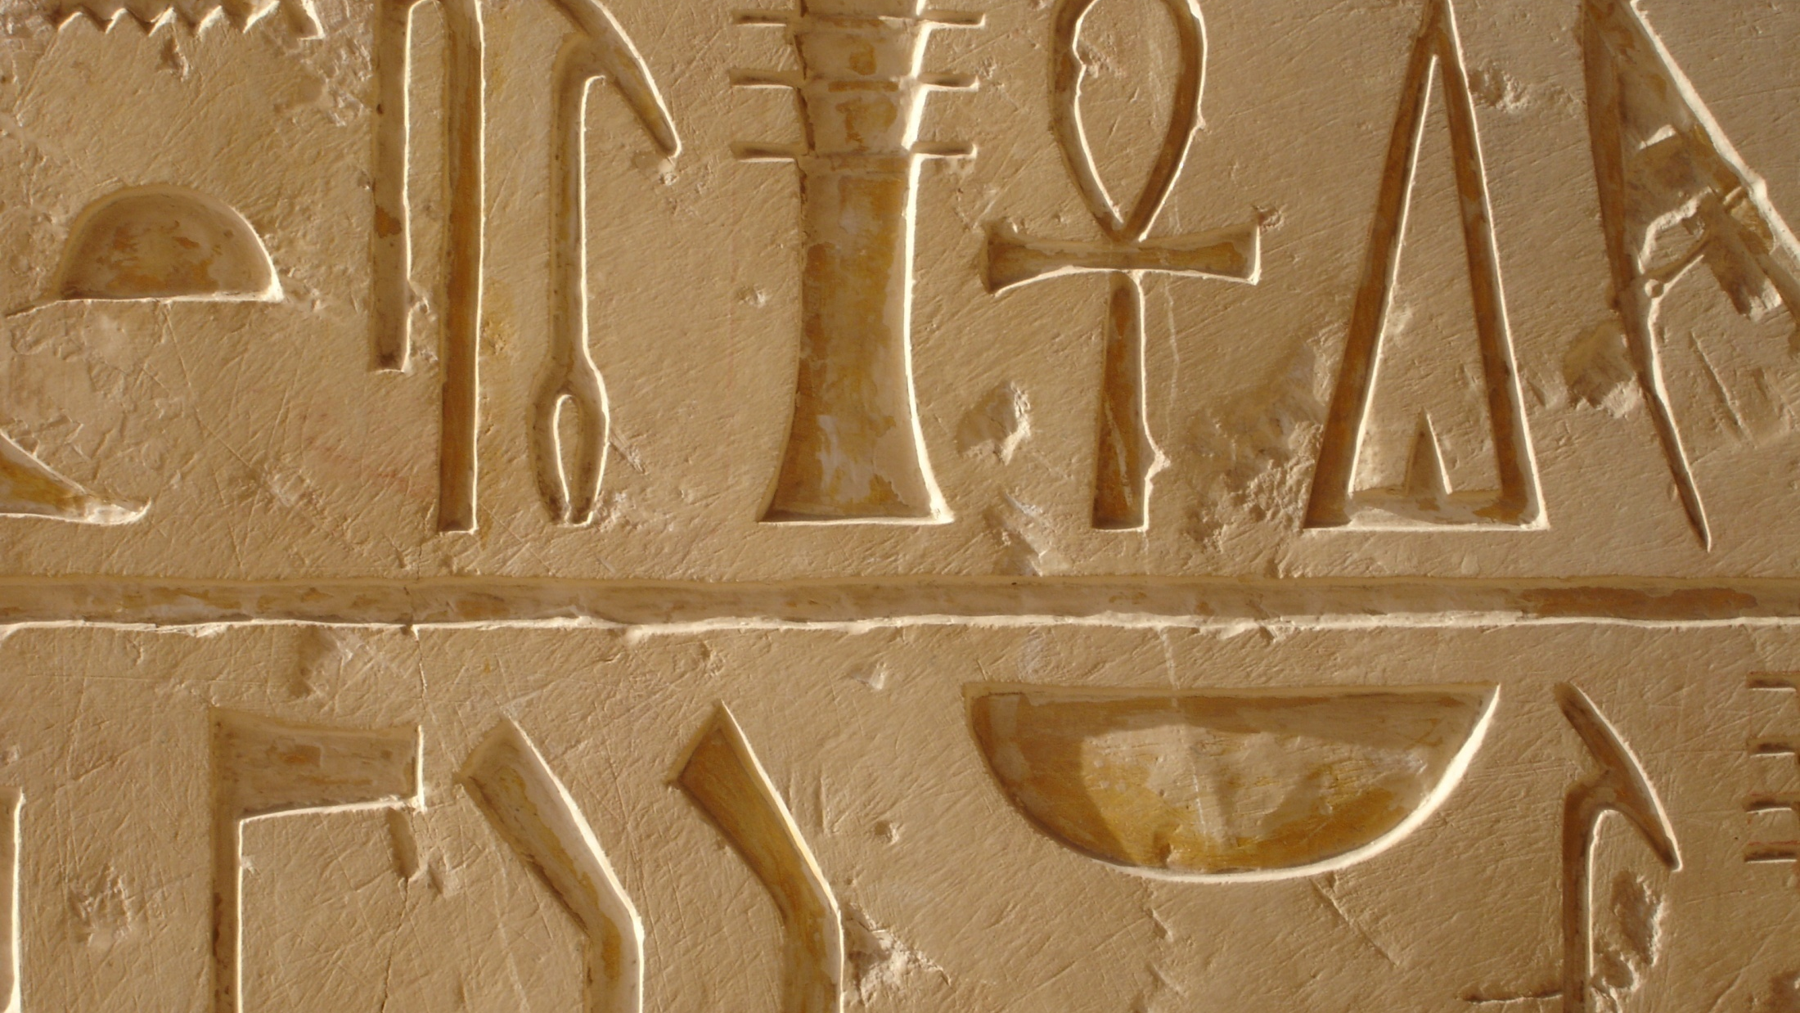
Thank You
THANK YOU

