Slide 1

Puberty
TBL

Slide 2

APPLICATIONS

Slide 3
CASE 1(1)
A 15 year old boy is seen by a primary care physician for short stature and delayed sexual development. His PMH is remarkable only for asthma in early childhood, which has been well controlled. He uses no medications.
He is an average student in the 9th grade and smallest in his class. His older classmates harass him about his size. His parents are concerned because he is becoming withdrawn and a “loner”.
Pregnancy and delivery were uncomplicated. H5 was born 8.5 lbs and 20 inches long. Head circumference was 35 cm. Immunizations are current.
Adapted from: Case Based Pediatrics for Medical Students and Residents, Department of Pediatrics, University of Hawaii John A. Burns School of Medicine, Sherrel L. Hammar, MD. March 2002

Slide 4
CASE 1 (2)
FH: Mother 48 yo, in good health. Ht is 167 cm (50th %ile) and underwent menarche at age 13. Father 51 yo, in good health, Ht 184 cm (75th %ile). He was shaving regularly by age 15. One older male sibling in good health began puberty at age 11. No FH of smoking, alcoholism, mental illness, drug abuse, or learning disabilities.
Exam: VS T 37.1, P 110, R 32, BP 100/60, HT 158 cm (3rd %tile) Wt. 42 kg (10th %tile). He is pale and anxious but cooperative. HEENT, Chest, Heart, and pulse exams normal. No abdominal tenderness or mass. Genitalia: normal circumcised phallus, Tanner pubic hair stage 1, genital stage 2. Testes firm, 2.5 cm in length and 4 ml in volume. Scrotum reddened and stippled. Otherwise physical exam is normal.
Lab: CBC, Hb 13, WBC 9.5, normal differential, platelets 350,000, UA normal.
Adapted from: Case Based Pediatrics for Medical Students and Residents, Department of Pediatrics, University of Hawaii John A. Burns School of Medicine, Sherrel L. Hammar, MD. March 2002

Slide 5
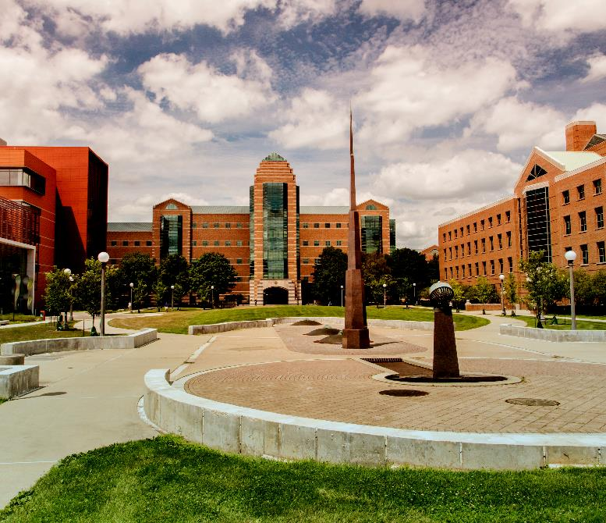
CASE 1 (3)
QUESTION
TO ANSWER
If you could only request one test, what would it be? You may list the tests you want and put an asterisk by the one you think will be most helpful.

Slide 6
CASE 1 (4)
QUESTION
TO ANSWER
Bone age (left hand and wrist) is 12.0 years. LH and FSH are decreased but normal for SMR stage 1-2. Given this information, what is the most likely diagnosis?

Slide 7
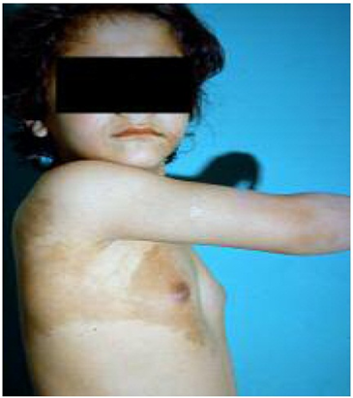
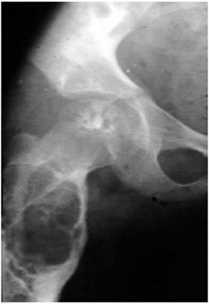
CASE 2 (1)
A 6-year girl is brought for evaluation of breast enlargement. She weighs 25 kg (90th percentile) and is 128 cm (>95th percentile). She has enlarged breasts, sexual maturity rating 2-3, with pigmentation of the areola and hyperpigmented macules.
A pelvic ultrasound reveals a left ovarian cyst 3.7 x 3.4 cm. The uterus is enlarged with a length of 4.6 cm (normal < 3 cm) with a prominent endometrium.
Bone age is consistent with age 8 years. Estradiol is elevated at 113 pg/ml (normal <36 pg/ml), and LH 1.7 mIU/ml (normal <1 mIU/ml). DHEAS and FSH are normal. The patient complains of pain in her lower limb. Area radiographs are shown.
Adapted from: Moein Mobini; Rahim Vakili; Saba Vakili, International J Pediatr Volume 2, Issue 2.2, April 2014, pp 153-156

Slide 8
CASE 2 (2)
QUESTIONS
TO ANSWER
What is the most likely diagnosis?
  Central nervous system tumor
  Kisspeptin gain-of-function mutation
  McCune-Albright Syndrome
  Tuberous sclerosis
  Turner Syndrome

Slide 9
CASE 2 (3)
Of the choices given for this case, which diagnosis/diagnoses may cause gonadotropin-dependent precocious puberty?
  Central nervous system tumor
  Kisspeptin gain-of-function mutation
  McCune-Albright Syndrome
  Tuberous sclerosis
  Turner Syndrome
QUESTIONS
TO ANSWER

Slide 10
CASE 3 (1)
A 12-year-old boy is concerned about a lack of pubertal development during a recent annual physical exam. Although he is currently healthy, his medical history is notable for lack of midfacial fusion, including cleft lip and palate involving the nasal structure at birth, for which he underwent multiple surgeries. He was found to be anosmic postoperatively in early childhood.
His growth chart reveals he has been consistently along the 10th percentile for height. As he approached the usual age of the pubertal growth spurt (12 years), he continue to grow 5 cm annually.
His current height and weight are at the 25th and 10th percentiles for age, respectively. Vital signs and physical exam are normal, demonstrating good results from his facial surgeries. He has small, firm testes, 1 cc in volume bilaterally, and < 1 cm in length. His penis is prepubertal, and he has no sexual hair.
Adapted from: Medscape Pediatrics, authors PA Lee and CP Houk

Slide 11
CASE 3 (2)
QUESTIONS
TO ANSWER
What is the best approach to the care of this patient at this time?
  Acknowledge his concerns, reexamine in 6 months
  Obtain bone age films, ask additional family history
  Refer to Endocrinology for further workup
  Send a karyotype to rule out Klinefelter syndrome

Slide 12
CASE 3 (3)
Laboratory testing was notable for luteinizing hormone (LH), follicle stimulating hormone (FSH), and testosterone levels below detectable limits. CBC and complete metabolic panel were normal.
Adapted from: Medscape Pediatrics, authors PA Lee and CP Houk
Sources, date

Slide 13
CASE 3(4)
QUESTIONS
TO ANSWER
Given these results, what is the most likely diagnosis?
  Androgen Insensitivity Syndrome
  Autoimmune polyglandular syndrome
  Constitutional delay of puberty
  Hypergonadotropic hypogonadism
  Kallman’s Syndrome

