Slide 1

TRANSGENDER
AND
GENDER DIVERSE CARE
Beverly London, MD, FACOG, MSCP

Slide 2
Objectives
Definitions
Legal Transition challenges
Medical Transition: including Puberty Blocker and Reproductive challenges
Surgical Transition
Preventative

Slide 3

Transgender people comprise
< 1 % of the US Population
But:
Up to 26% of patients are refused care

Slide 4
How many Transgender people are in the US?
1.4 million Transgender Adults
150,000 Transgender Adolescents (Age 13 – 17)
1.2 million Non-Binary US Adults (42% identify as transgender)

Slide 5

Barriers to Health Care:
1. Health Care Bias
2. Knowledge Deficit
3. Health Insurance Coverage - Hormone Therapy - Supplies - Mental Health Coverage - Gender Affirmation surgery

Slide 6
Who provides care for Transgender individuals?
General Healthcare needs
Gender –Affirming Hormone care
Gender –Affirming Surgical care
Other Team Members
Primary care
Plastic Surgery
Urology
Ob/Gyn
Speech Pathology
Mental Health Providers
Social work
Primary care
Endocrinology
Ob/Gyn & Repro Endo

Slide 7
DEFINITIONS

Slide 8


Slide 9
Personal Pronouns
He
They
Hers
She
Their
Zie (Ze)
Him
His
Them
Her
Hir

Slide 10
ACCEPTED GENDER TERMINOLOGY
NO LONGER ACCEPTED
1. Transsexual
2. Cross dresser
3. Personal Pronouns
4. Gender Affirming Surgery
5. Gender Incongruence
1. Transgender
2. Transvestite
3. Preferred Pronouns
4. Gender Reassignment Surgery
5. Gender Dysphoria

Slide 11
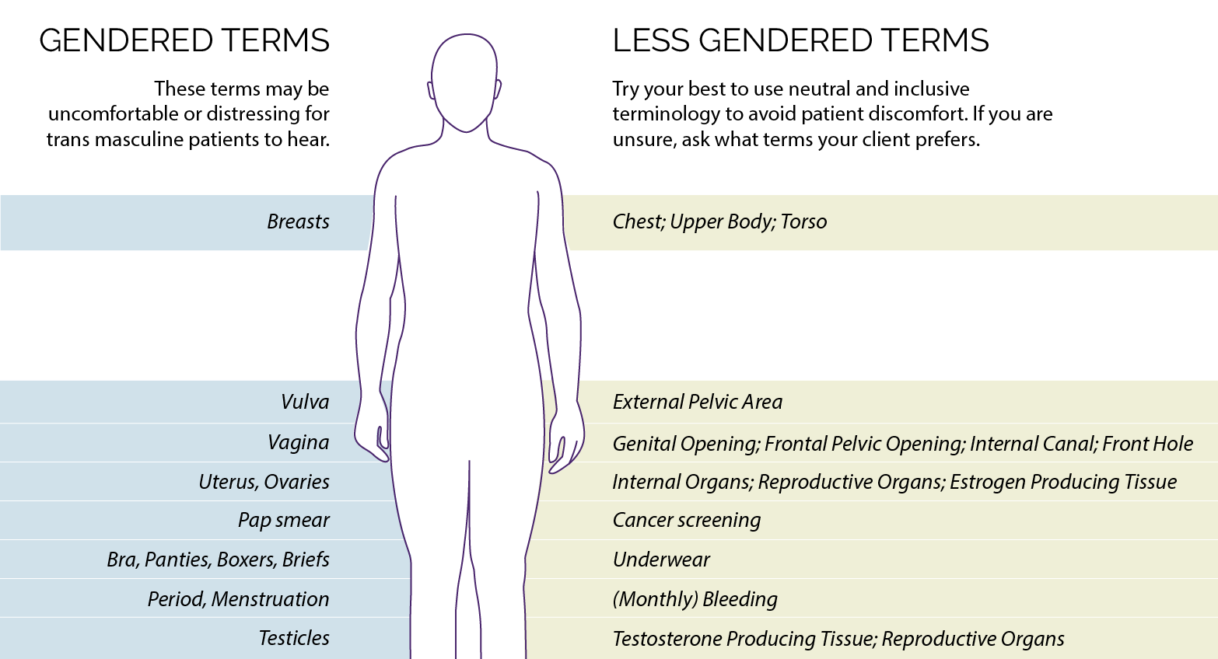

Slide 12
Which one of these terms is no longer accepted?
Transvestite
Transgender
Gender Incongruence
Cross Dresser

Slide 13
LEGAL TRANSITION CHALLENGES

Slide 14

Gender Transition: Individualized
Each Person desires different Outcomes
Medication + Surgery-Not required Parts of Transition
Legal Name Change: (Medications + Surgery not required)
Legal Transition varies by State Law
Name/Driver's License/Birth Certificate

Slide 15


Slide 16
4 States Not Recommended for Transgender People -2026
Texas
Florida
Idaho
Kansas

Slide 17
Comparison- Legal Policies
Texas
Birth Certificate: No gender change unless resolving a clerical error from birth
Medicaid coverage for Gender therapy:
Banned (surgery, hormone therapy)
Drivers License: Gender change prohibited
ID must match sex assigned at Birth
Illinois
Birth Certificate: Self Attestation
Medicaid coverage for Gender therapy is Mandated
Drivers License: Self select: M F X (non-binary)

Slide 18
Transgender Diagnostic Classifications
DSM 5 – Gender Dysphoria
(previously Gender Identity Disorder)
World Heath Organization (WHO)
Gender Incongruence ICD –F64.9

Slide 19
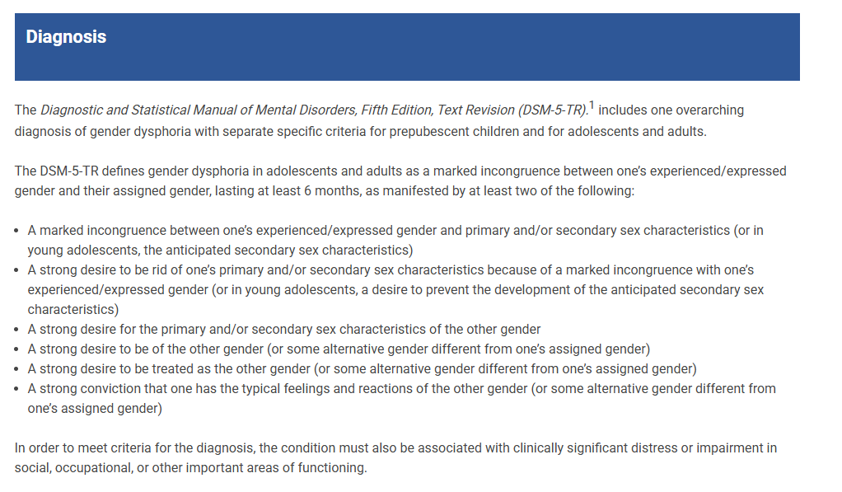

Slide 20
MEDICAL TRANSITION

Slide 21

TRANSGENDER HISTORY +EXAM

Slide 22
Sexual and Reproductive History:
TOP:
BOTTOM:
Right sized binder
1. Ask about Nipple discharge
2. Any Lumps or Bumps
3. Binding History
Binding:
Right sized binder
Breathable fabric
Dry well after bathing-towel dry then blow dry on cool
Wrong Binder:
Can restrict blood flow
Can make it hard to breathe
Causes Rashes & Bruising, Broken Ribs- especially Yeast
Breathable fabric
Dry well after bathing-towel dry then blow dry on cool
Wrong Binder:
Can restrict blood flow
Can make it hard to breathe
Causes Rashes & Bruising, Broken Ribs- especially Yeast
Genital itching , burning, unusual discharge
Pelvic pain/Pelvic Pressure
Burning w/Urination/Leakage
Diarrhea /Constipation or Leakage of Stool
Bleeding Pattern history
Cervical Cancer Screening
HPV Vaccination discussion
STD Screening history

Slide 23

Sexual History:
1. Who do you have Sex with?
2. What parts (Anatomy) do they have?
3. Have you been intimate in a way that includes: Exchange of Genital body fluids?
4. Do you have Oral or Anal sex?

Slide 24
Sexual History:
5. Is there a possibility that any of your partners:
Could get you Pregnant or you could get them Pregnant?
6. Pregnancy Plans or Contraception needed?
7. RADAR: Ask about Abuse
Remember to ask routinely
Ask directly about violence
Document
Assess your patient’s safety
Review Resource options with your patient

Slide 25

PHYSICAL EXAM:
1. Delay exam-Develop Rapport 1st
2. Exam - Based on Organs present
3. Discuss: Purpose of the exam

Slide 26
PHYSICAL EXAM:
Testosterone use:
Beard growth
Clitoromegaly
Acne
Androgenic alopecia
Estrogen use:
Breast tenderness
Loss of muscle tone
Urinary symptoms (prostate)

Slide 27
PHYSICAL EXAM:
Testosterone use:
Beard growth
Clitoromegaly
Acne
Androgenic alopecia
Estrogen use:
Breast tenderness
Loss of muscle tone
Urinary symptoms (prostate)

Slide 28

Binder Considerations
Need the right sized Binder / Breathable Fabric
Can reduce Skin Elasticity
Can cause Breathing issues
Can cause Rashes(Yeast), Broken ribs, Bruising
Towel dry / Blow dry on cool

Slide 29

Correct Binding

Slide 30
PELVIC EXAM : TRANSGENDER PATIENTS
Pelvic
Fam Hx Ovarian Cancer
As indicated
Anal
Vulva
Cervix
> Age 40
PMOS
Uterine Ca Risks
Diabetes or Hypertension
Unexplained Bleeding
PMOS
Obesity
Over 40
Older Transgender Patients
High Risk HPV testing
Testosterone causes Atrophy
Blind Pap- Label as Transgender
Can use Vaginal Estrogen

Slide 31
PUBERTY BLOCKERS

Slide 32
Gender Care for Adolescents
Menstrual suppression
Medical transition
Surgical Transition

Slide 33
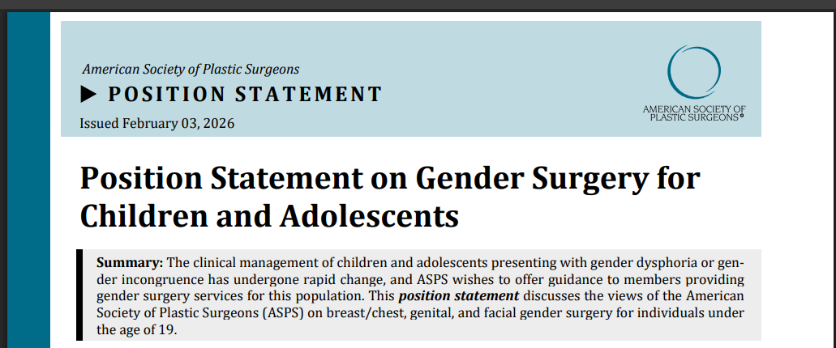

Slide 34
Puberty blocking therapy is Permanent?
True
False

Slide 35
Tanner Stage 2
Females – Age 8 -11
Males – Age 11
Breast buds
Areola
Sparse Pubic hair
Testicles enlarge
Sparse Pubic hair
Scrotum enlarges

Slide 36
Gender Care for Adolescents
GNRH Agonists – Main puberty blocker
Inhibits LH & FSH secretion
Decreased gonadal sex steroids- Pre puberty
Decreased risk to bones – If using Cross Sex Hormones
Cross sex Hormones are usually started Age 13

Slide 37
When is it appropriate to start medical therapy for a transgender adolescent?
After reaching Tanner Stage 2 development
After establishing a diagnosis of Transgender identity
After an established diagnosis of Transgender identity and has reached Tanner Stage 2 development

Slide 38
True or False? Transgender Male adolescents can develop medical complications of their gynecologic organs and may also become pregnant.
True (breasts, uterus, ovaries)
False

Slide 39

MENSTRUAL SUPPRESSION
GOAL:
Decrease Frequency + Volume of Menses
Complete Amenorrhea may be difficult
Hormone Therapy doesn’t affect Future Fertility
Hormone Therapy doesn’t increase Cancer risk

Slide 40
MEDICAL OPTIONS: MENSTRUAL SUPPRESSION
Combined OCPS: Daily up to 88% Amenorrhea
Transdermal: Weekly Adhesive problems
Vaginal Ring: Monthly High Amenorrhea rate
Oral Progestins: Daily
Depo Provera: 11-13 weeks Weight gain Affects Bones
Nexplanon: 3 – 5 yrs Only 22% Amenorrhea rate
Progestin IUD: 5-8 years Cost/Insertion Pain 60%
GNRH agonist: Daily to 3 mo High Amenorrhea rate

Slide 41
Testosterone Effects on the Menstrual Cycle
1. Cycles will stop within a few months of starting Testosterone
2. For Continued Bleeding – Use Progesterone
3. Testosterone causes Vaginal Atrophy
-Increased Risk: Bacterial vaginosis, Cystitis, Cervicitis, Dyspareunia
-Use Topicals – Lubricants, Vaginal moisturizers, Topical Estrogen

Slide 42

Medications
Majority of Meds are Common
Specific Certification Not needed to Prescribe
Know the Risks & Side Effects

Slide 43
When should fertility preservation be discussed?
3 months after starting Hormone therapy
6 months after starting Hormone therapy
Before starting Hormone therapy

Slide 44

MEDICAL TRANSITION- Masculinizing Therapy
SIDE EFFECTS: Hormone Therapy
Increased Libido
Change in Sweat/Odor
SubQ Fat Redistribution
Recessed Hairline/Baldness
Cessation of Menses
Vaginal Atrophy
Increased Clitoral Size
GOALS:
Facial Hair
Deeper Voice
Increasing Body Hair
Muscle Mass

Slide 45
Medical Transition-Masculinizing
CONTRAINDICATIONS:
1.Unstable Coronary Artery Disease 2.Polycythemia (HCT > 55%) 3.Current Pregnancy
LAB STUDIES:
1. Lipid panel: HDL + Triglycerides
2. Hematocrit q 3 mo x 1 yr/ Then q 6 mo
3. Testosterone level-q 3 mo x 1 yr Goal: 320-1000 ng/dl

Slide 46
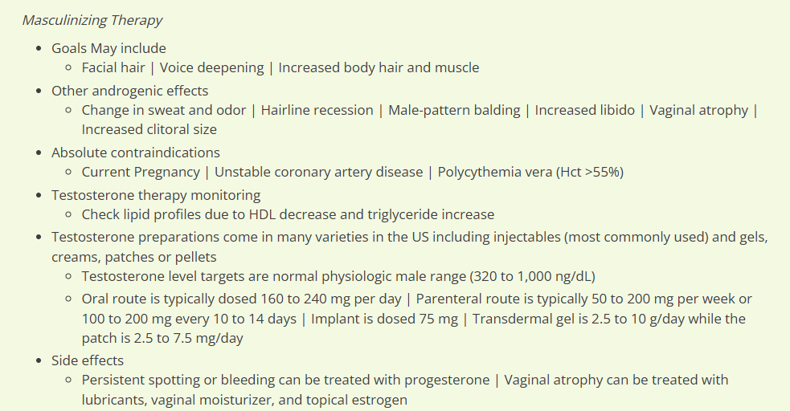

Slide 47
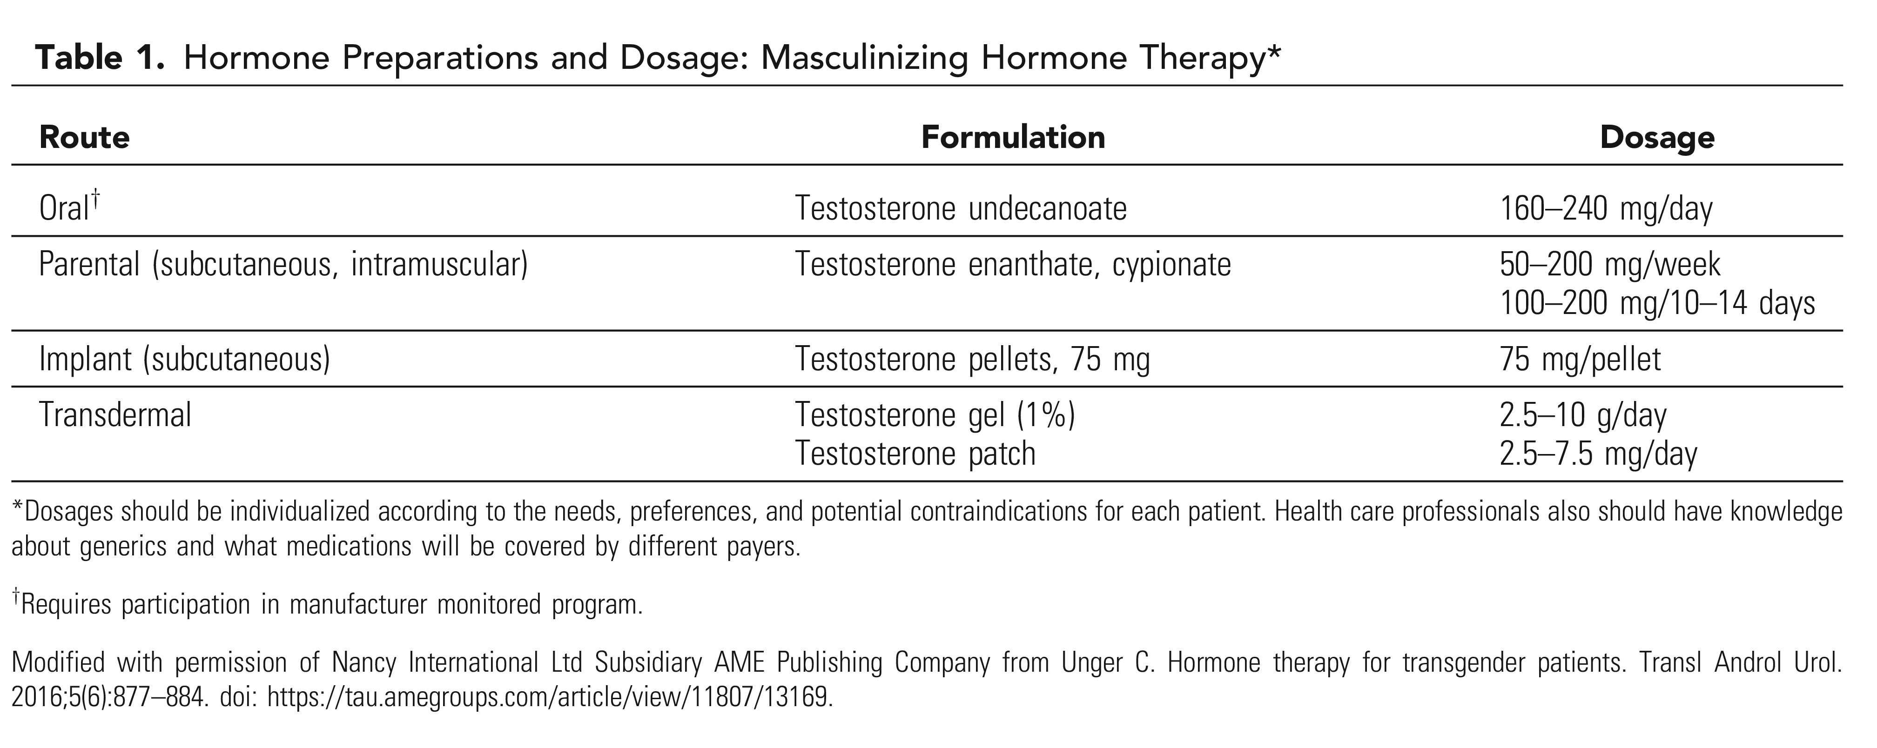

Slide 48
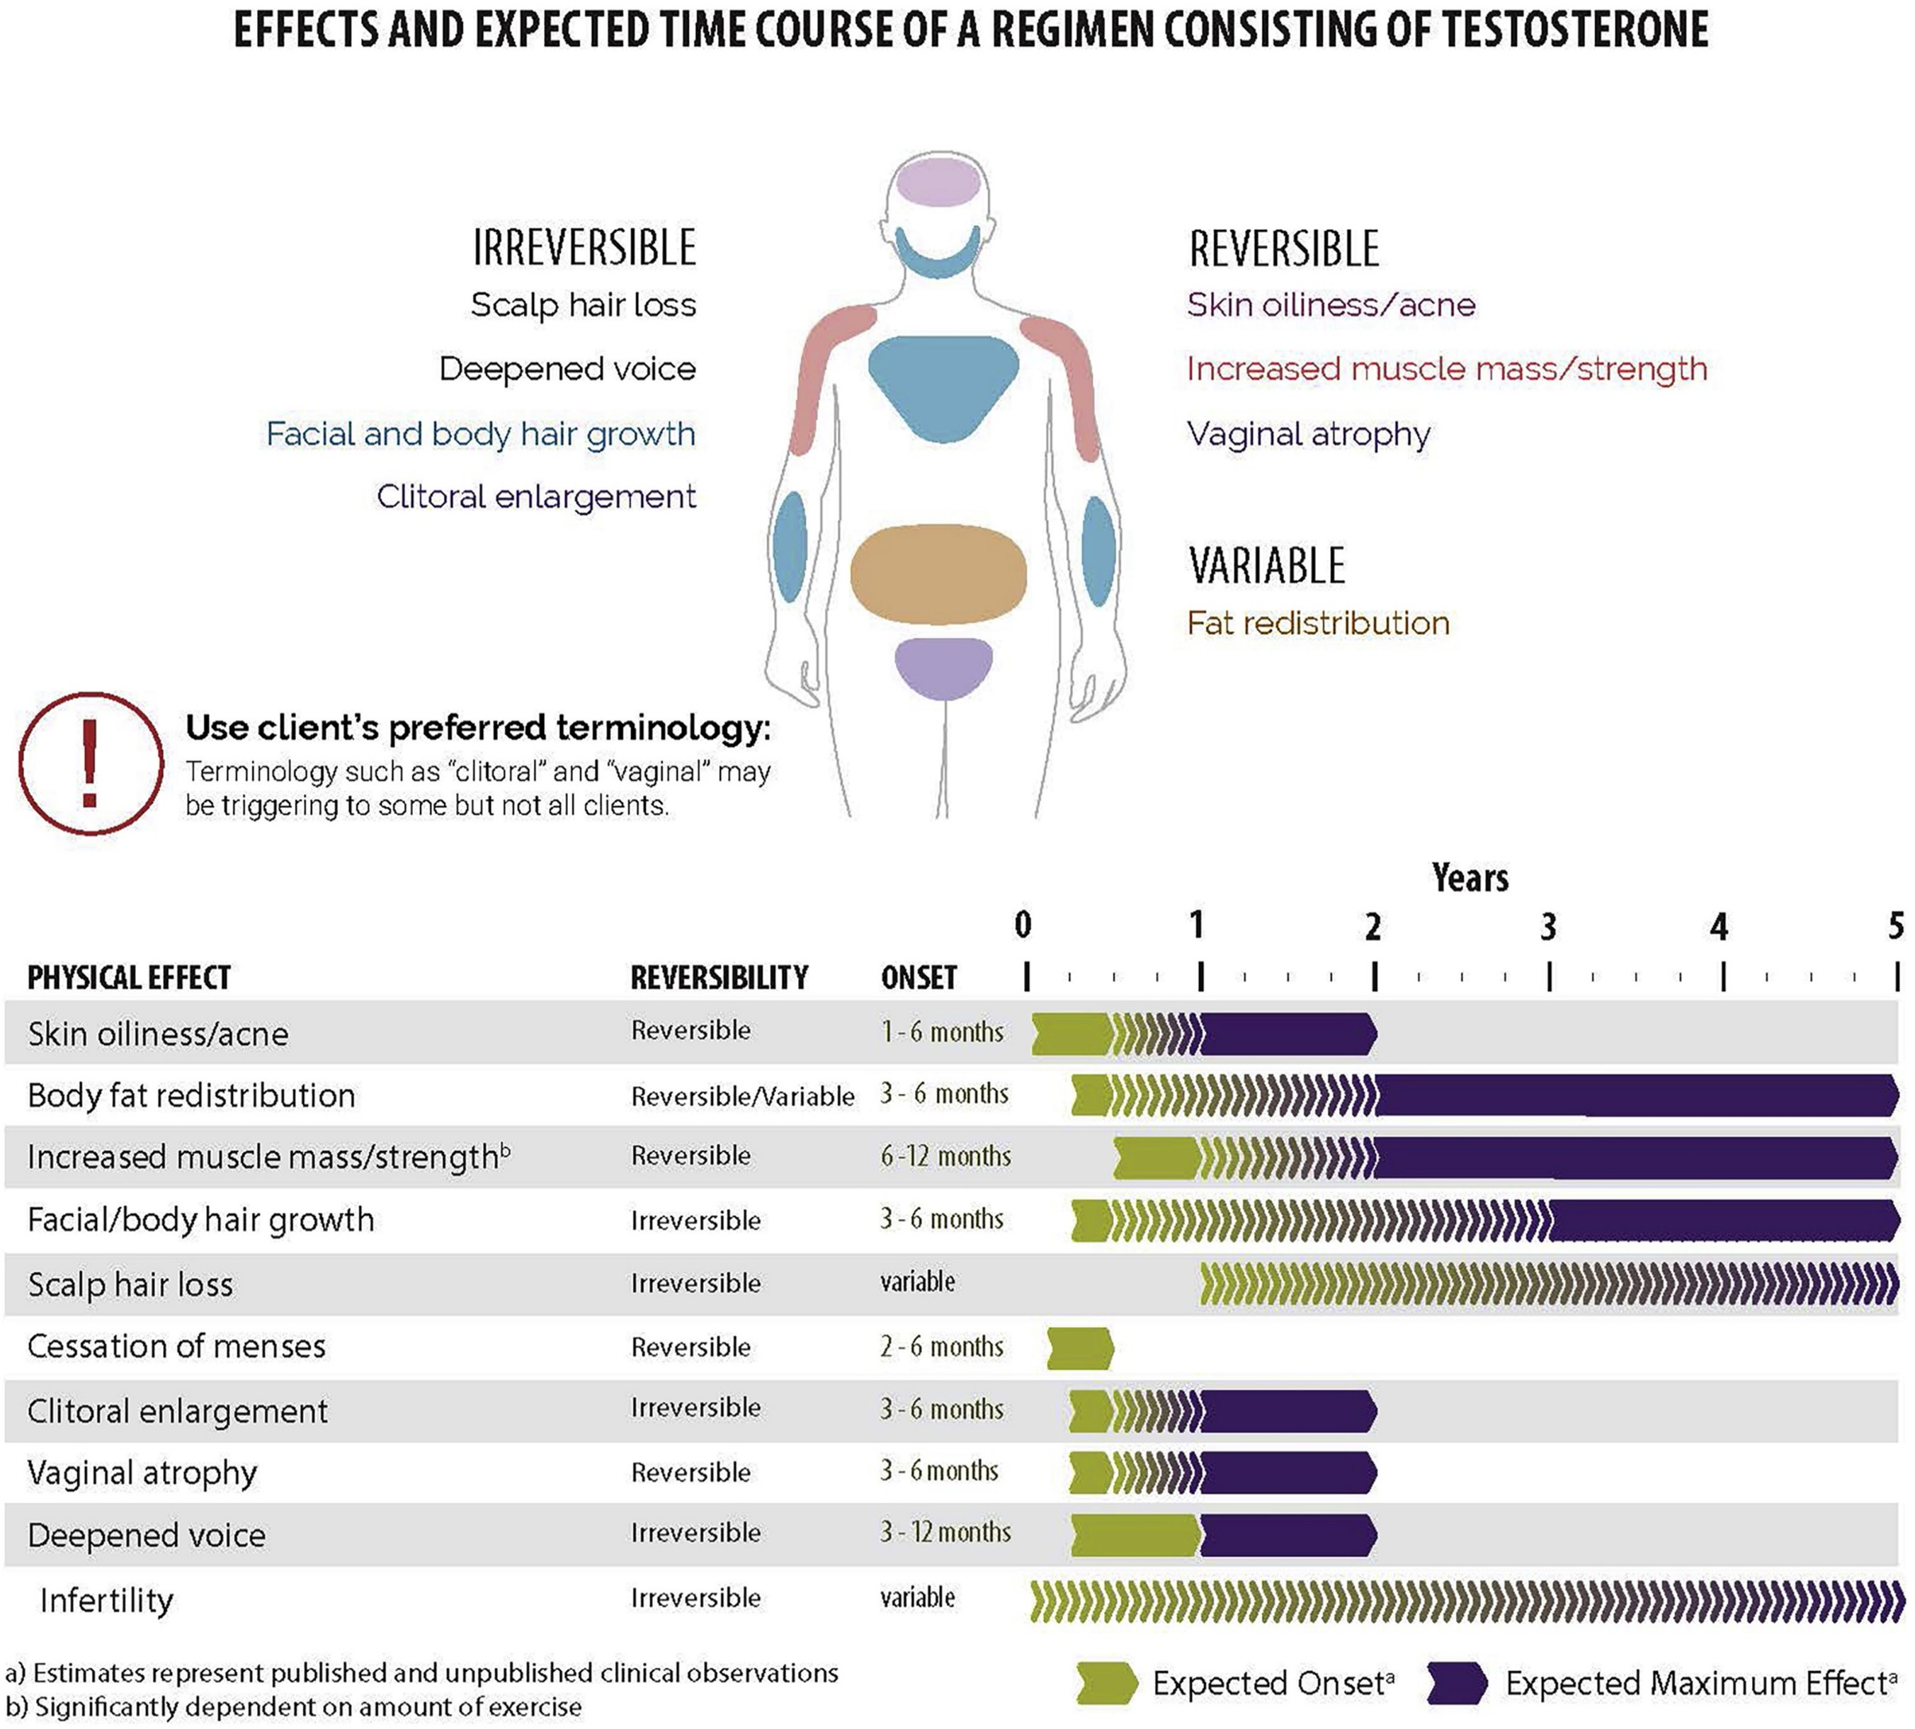

Slide 49

Can achieve pregnancy : Stop Testosterone 1st
Partner Insemination/Donor Sperm
Carry pregnancy themselves or
IVF with embryo transfer to a Partner / Surrogate
Pregnancy: Can Trigger Dysphoria or Isolation
No Testosterone - Chest feeding planned
Transmasculine: Fertility and Pregnancy

Slide 50


Feminizing Therapy
SIDE EFFECTS:
Breast Growth
Decreased Erectile Function
Increased Body Fat
Decreased Testicular Size

Slide 51
Medical Transition –Feminizing Therapy
Transdermal Estrogen is the safest /Best dosing
Oral Estrogen – use 17-B Estradiol
Antiandrogens/Hormone Blockers: decrease Testosterone, less Estrogen needed - Spironolactone - monitor BP and Potassium - GNRH Agonists (expensive – Lupron) - Progesterone - (insufficient breast growth data)
-Finasteride – less safe, questionable efficacy

Slide 52
Medical Transition-Feminizing
CONTRAINDICATIONS:
Cardiovascular –possibly VTE
LAB STUDIES:
1. Estradiol
2. Total Testosterone
3. Sex Hormone Binding Globulin

Slide 53
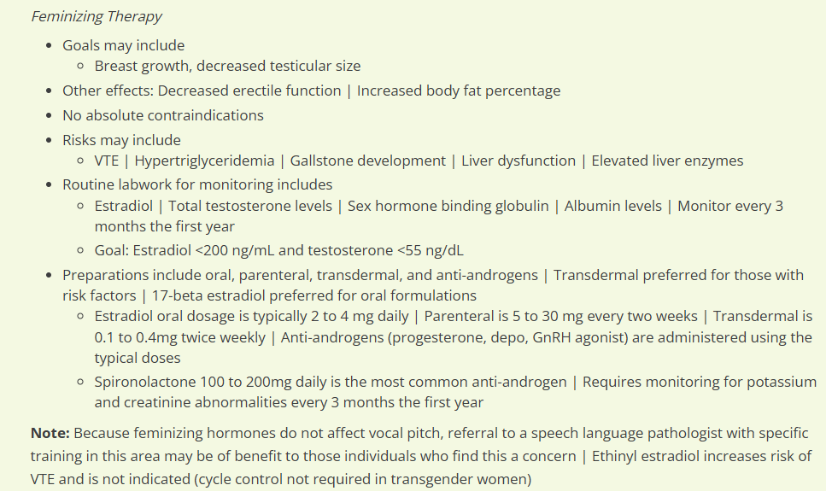

Slide 54
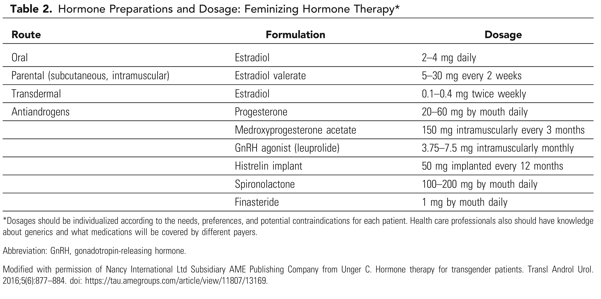

Slide 55
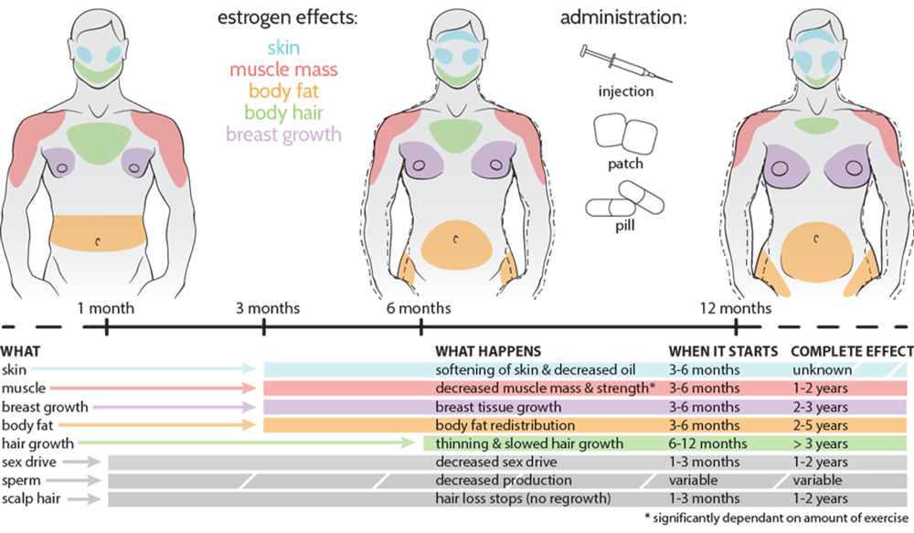

Slide 56
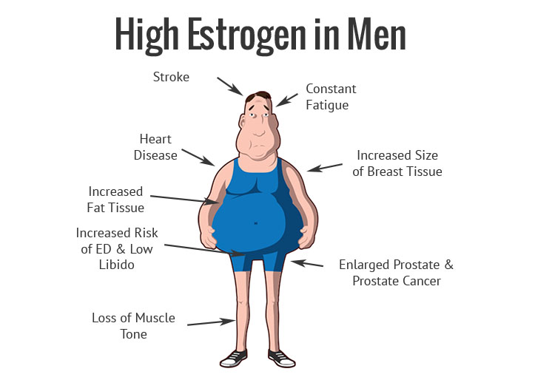
Medical Transition: Feminizing Therapy
RISKS:
Venous Thromboembolism
High Triglycerides
Gallstone development
Elevated Liver Enzymes
Try to decrease cardiovascular risks – Like Smoking

Slide 57
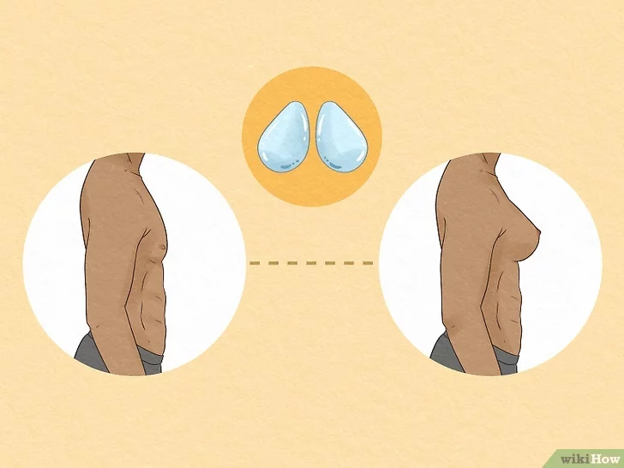
TRANSFEMININE: Fertility/Pregnancy/Contraception
If Gonads are retained - May need Assisted Reproduction
Fertility may return after stopping Hormone therapy
Long term Estrogen can cause Testicular damage
Do Sperm Banking before Starting Hormones

Slide 58
SURGICAL TRANSITION

Slide 59

SURGICAL TRANSITION

Slide 60

SURGICAL TRANSITION
Health Assessment Letter- Required by some Insurance plans
Sample Letter- University of San Francisco Center for Excellence for Transgender Health

Slide 61
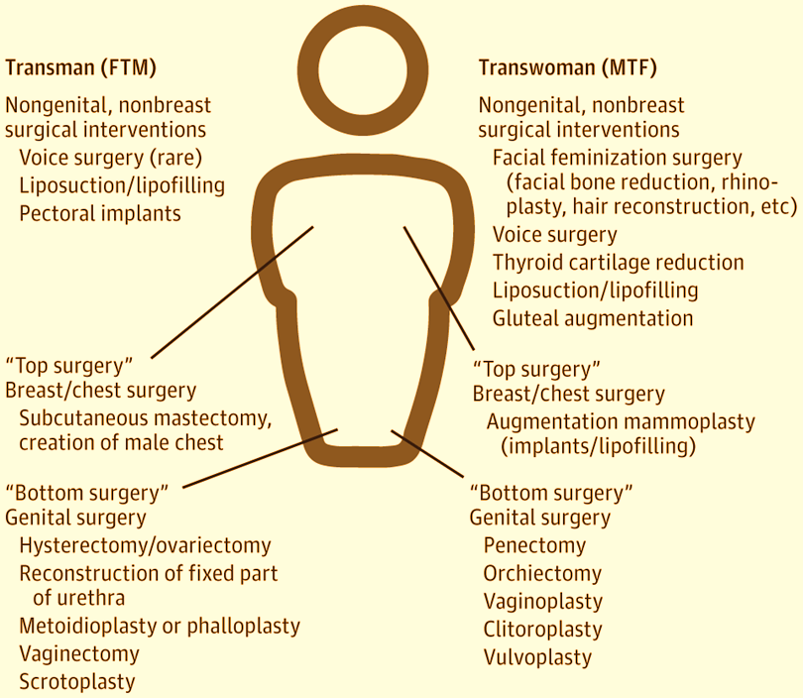

Slide 62
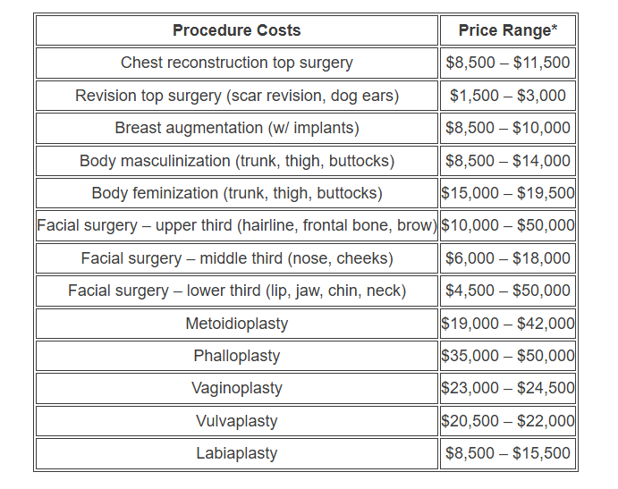
Transgender Surgery Costs

Slide 63
Gender Affirming Hormone Therapy & Surgery
No need to stop Hormone therapy
Before or After Surgery

Slide 64
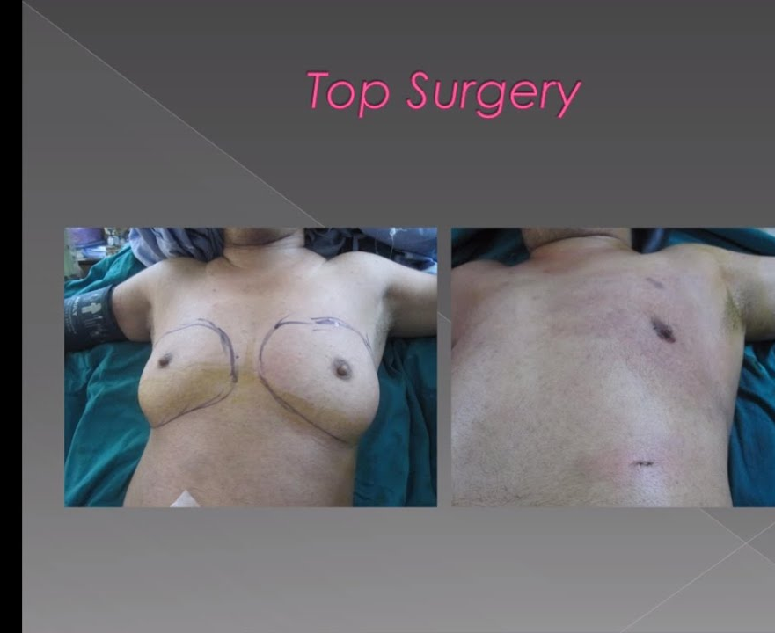
Bilateral Mastectomy or
Top Surgery
Observe scar line if surgery done.
Chest & axillary exam (some Breast tissue will remain)
Testosterone doesn’t increase Breast cancer risk.

Slide 65
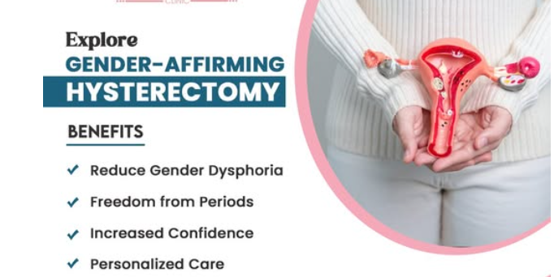
Hysterectomy with/without Ovary removal
Necessary if Gender incongruence is present
Consider Vaginal hysterectomy
Ovarian removal depends on Fertility desire /Pt choice
Cardiovascular Health: No studies have found increased Cardiovascular risk in the Transmasculine
Bone Health: Testosterone can prevent Bone demineralization

Slide 66
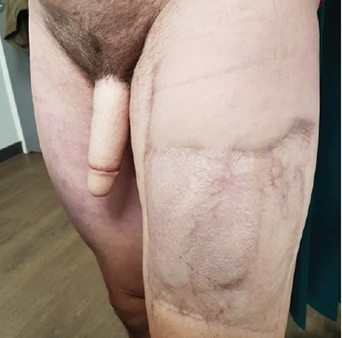
Bottom Surgery
- tissue is taken from a donor site
(anterolateral thigh, radial forearm, latissimus dorsi)
- tissue is shaped into a phallus
- Later: Penile implant

Slide 67
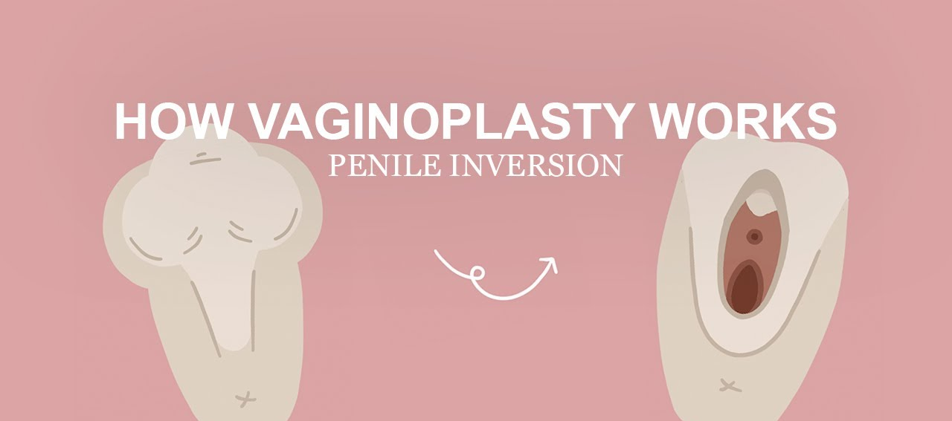
Vaginoplasty

Slide 68
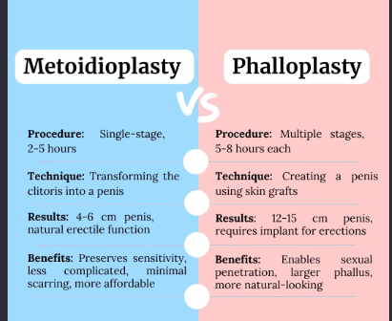

Slide 69
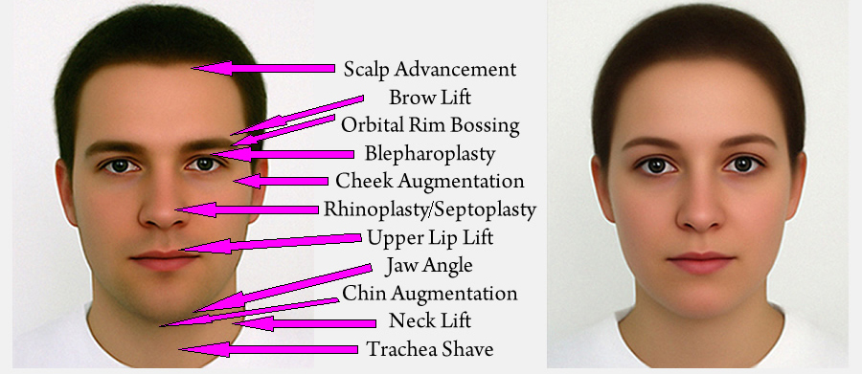
Surgical Transition – Aesthetic Procedures

Slide 70
PREVENTATIVE CARE

Slide 71

Preventive Care
Mental Health
Depression
Substance Abuse
Cancer
STD screening
Immunization –including HPV
40% of Transgender pts – Attempt Suicide
Screen for Intimate Partner Violence

Slide 72
Cancer screening for a Transgender patient should be based on:
A. Present Anatomy
B. Gender identity
C. Sex assigned at birth

Slide 73

Transmasculine Cancer Screening
Cancer Screening:
A Neovagina doesn’t need Cervical ca screen
Prostate Cancer screening:
Higher risk: Hormone therapy after Age 50
Breast Cancer screening
After Age 50 + 5 yrs- Feminizing hormones

Slide 74

Cancer Screening: Transmasculine
Breast cancer screening
Genetic counseling-Fam hx Breast/Ovarian ca
Cervical cancer screening
Self collection (>Age 30)
Primary HPV testing
Uterine Ca Screening:
Endometrium atrophic with Testosterone
Hx mastectomy vs Breast reduction
Not needed

Slide 75

The Aging Transgender Male
1. Consider Sex assigned at Birth + Anatomy
2. Length of Hormone use
3. Type of Hormone regimen
4. Switch to Transdermal Estrogen
5. Lifelong Anticoagulation -VTE Hx

Slide 76

The Aging Transgender Female
BREAST CANCER RISKS:
Same guidelines as Cisgender
CAVEATS:
1. Current Estrogen dosage
2. When were Hormones started?
3. Hx-Augmentation Mammoplasty?

Slide 77
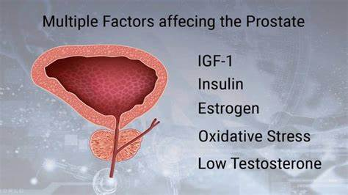
The Aging Transgender Patient: Transgender Female
PROSTATE CANCER RISKS
The prostate is not removed with Gender Affirming surgery
General screening Age 55- 69
Digital Prostate exam
-done through the neovaginal canal

Slide 78
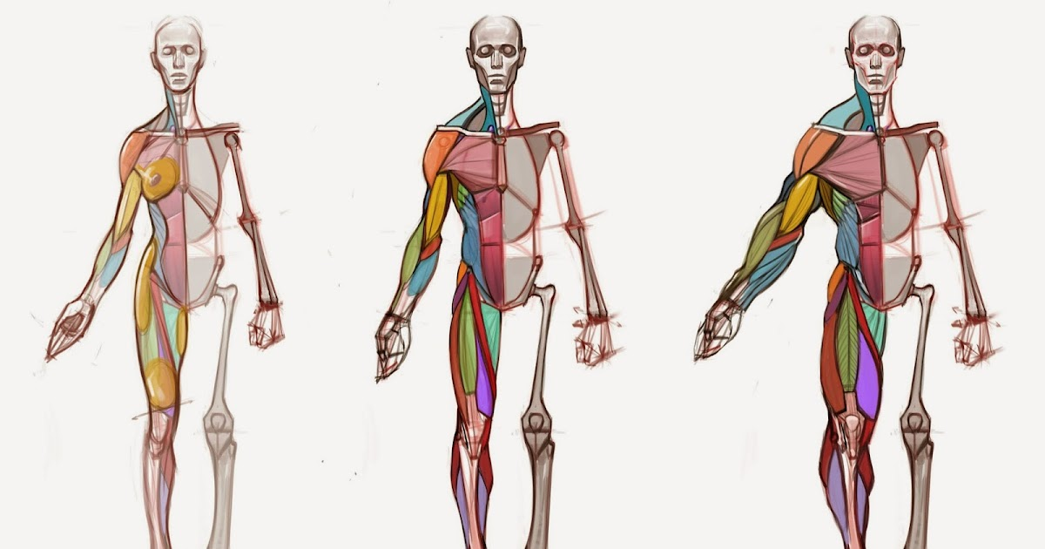
REFERENCES:
Transgender and Gender diverse care: A committee opinion. Practice Committee of the American Society for Reproductive Medicine. Vol 126 No 2/August 2026
Primary Care for the LGBTQ Community. GIBLIB;2022.
Gender Dysphoria: A Urologist’s Perspective.GIBLIB;2022.
Gender Dysphoria: A Fireside Chat. GIBLIB; 2022.
Testosterone Replacement in Men & Women: Who Should Use it? GIBLIB; 2022.
Health Care for Transgender and Gender Diverse Individuals. ACOG Committee Opinion Number 823. American College of Obstetrics and Gynecologists; 2021;137, 75-88.
American Society of Plastic Surgeons Position Statement on Gender Surgery for Children and Adolescents, Issued February 3, 2026.

