Slide 1
Introduction to Reactive Programming with RxCpp

Slide 2
Agenda
Definition?
Observer pattern
RxCpp
RxCpp Tasks

Slide 3
Definition?
Respond (or fail) within the specified timeframe
Resilent to failure
Responsive under load
Based on message-passing
….
We...

Slide 4
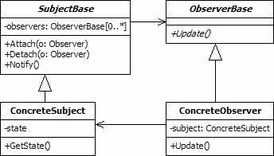
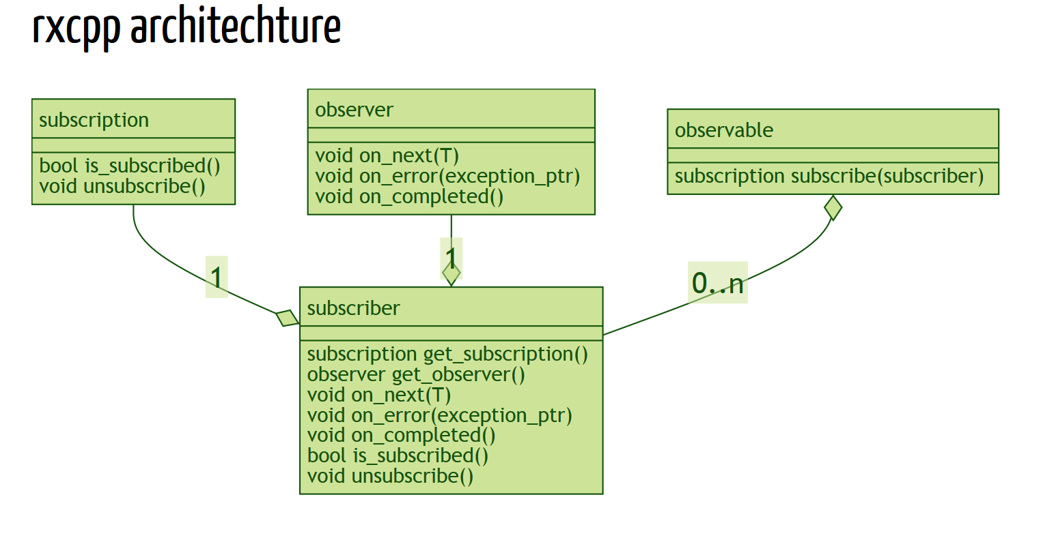
Observer Pattern
http://www.blackwasp.co.uk/Observer.aspx
https://kirkshoop.github.io/introductionToRxcpp/#88

Slide 5
RxCpp
http://reactive-extensions.github.io/RxCpp/
Apache License 2.0
(c) Microsoft Open Technologies
Uses push (like any Rx) to deliver events… and we ...

Slide 6
RxCpp Tasks
Subscribe to events
Transform events
Make asynchronous requests (e.g. retrieve url)
Handle backpressure
Distribute execution between multiple threads
Error handling
  Exception
  Retry
  Timeout

Slide 7
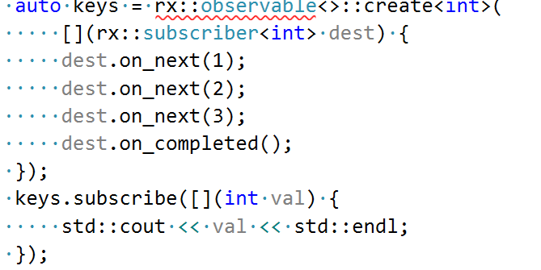

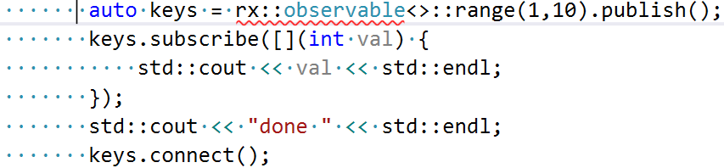
RxCpp Tasks:Subscribe to events

Slide 8
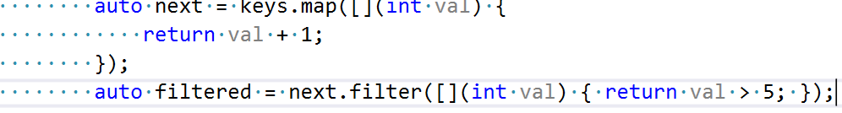
RxCpp Tasks: Transform/Filter/Combine Events
Map
Filter
Merge
Zip
http://reactivex.io/documentation/operators.html
http://reactivex.io/documentation/operators/zip.html

Slide 9
RxCpp Asynchronous Requests
Adapt existing sources. Generally not easy:
https://github.com/kirkshoop/twitter/blob/master/rxcurl.h
May use . Subscribe (side-effect), filter, zip

Slide 10
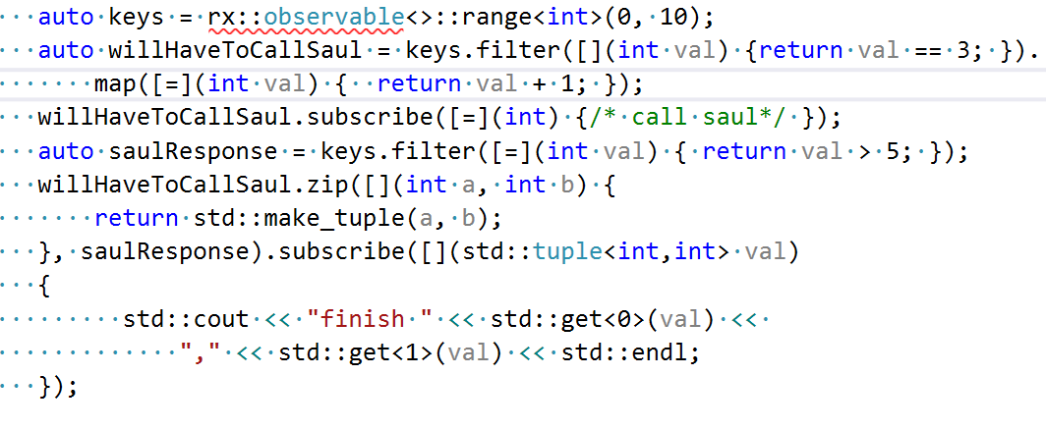
RxCpp Async Example

Slide 11
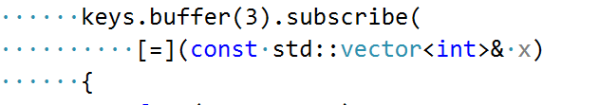
RxCpp Tasks: Backpressure
Debounce
Buffer
Window
Sample

Slide 12
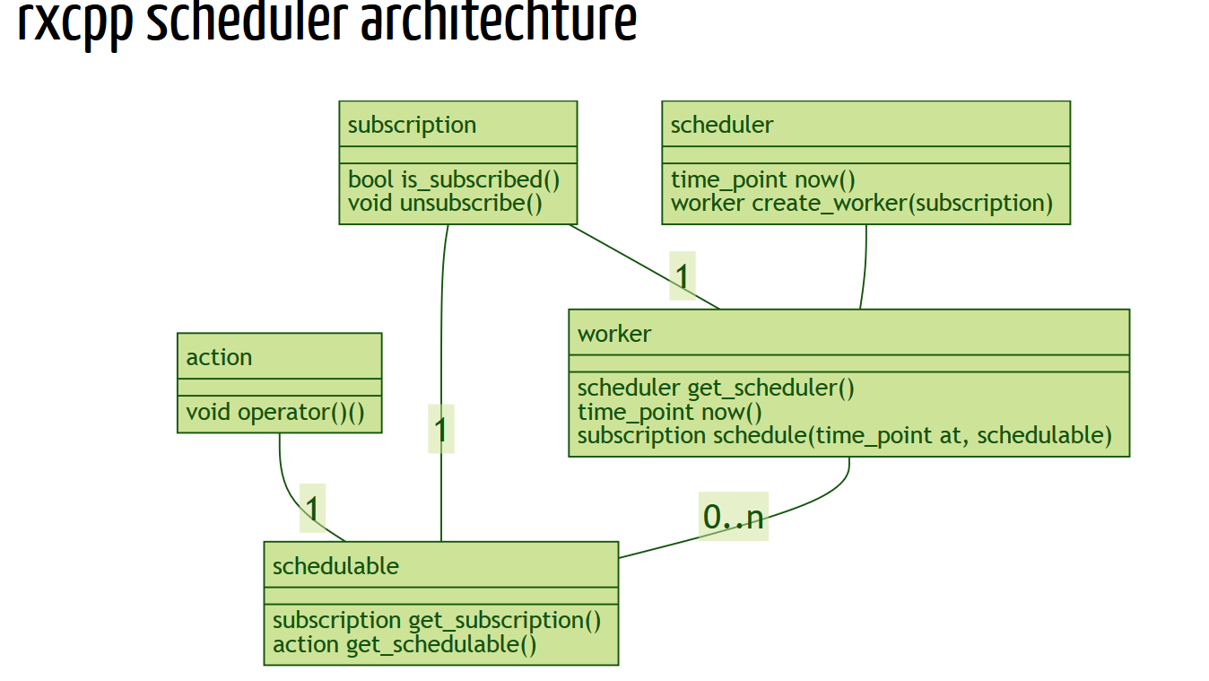
RxCpp parallelism
Single threaded
Need to use explicit scheduler to have concurrency
https://kirkshoop.github.io/introductionToRxcpp/#89

Slide 13
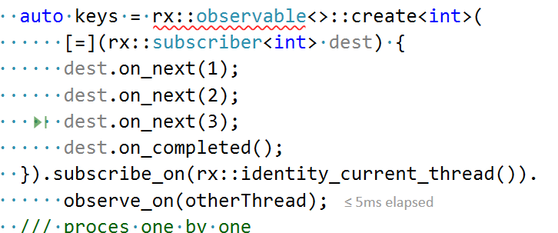
RxCpp parallelism
Need to specify Coordination – something that handles synchronization:
The goal of coordination is to remove all synchronization from the 'join' and time operators. Re-implementing an optimized serialization of calls to multiple subscribers in each operator obscures the functionality, duplicates the same work over and over again and slows down the cases where all the sources are already serialized (UI events etc..).
An operator passes all the sources through the optional coordination and uses the returned observables instead. These are expected to never overlap calls across all the observers subscribed to them.

Slide 14
RxCpp Tasks: Handling errors
Exceptions: Just throw, Every active subscriber gets OnError() called
Retry: rxcpp::observable<>::timer, takeUntil(success)
Timeout -> Timeout

Slide 15
Conclusions
Fits well within controller architecture
Can be a replacement for part mechanism, will allow to easier trace call flow in the code
- Convolved scheduling
- Potential for hilarious leaks
- Death by auto
- Strange error messages
- Can not use now (need VS2013 min)

