Slide 1


Slide 2
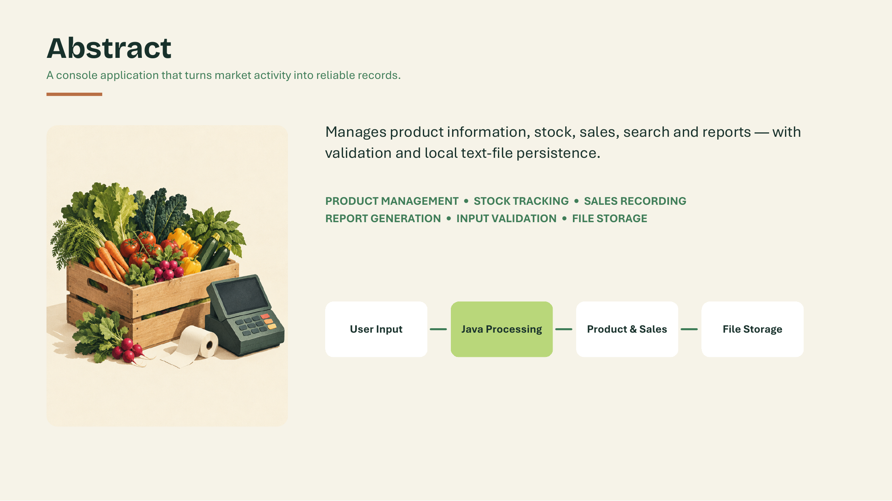

Slide 3
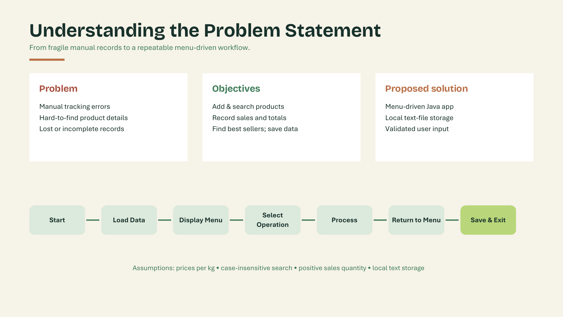

Slide 4
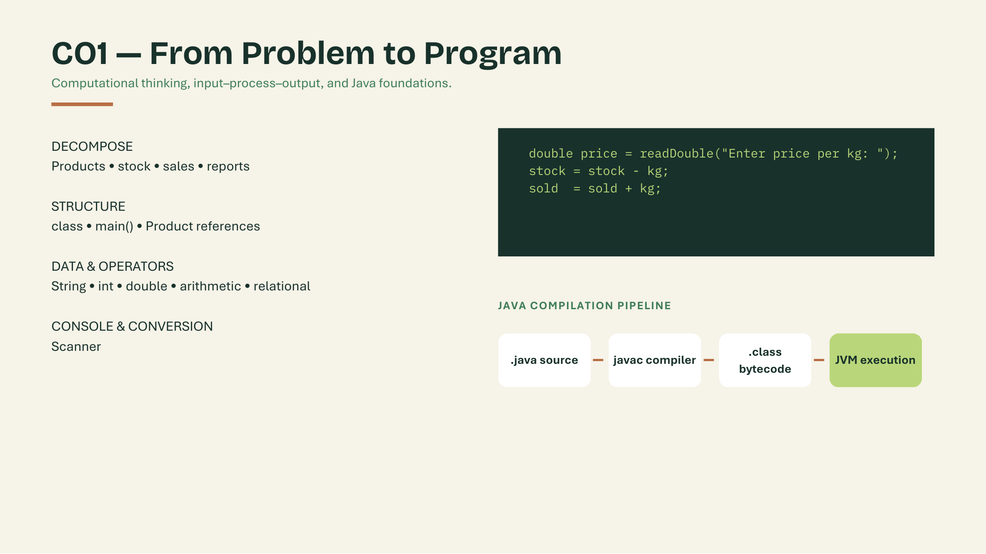

Slide 5
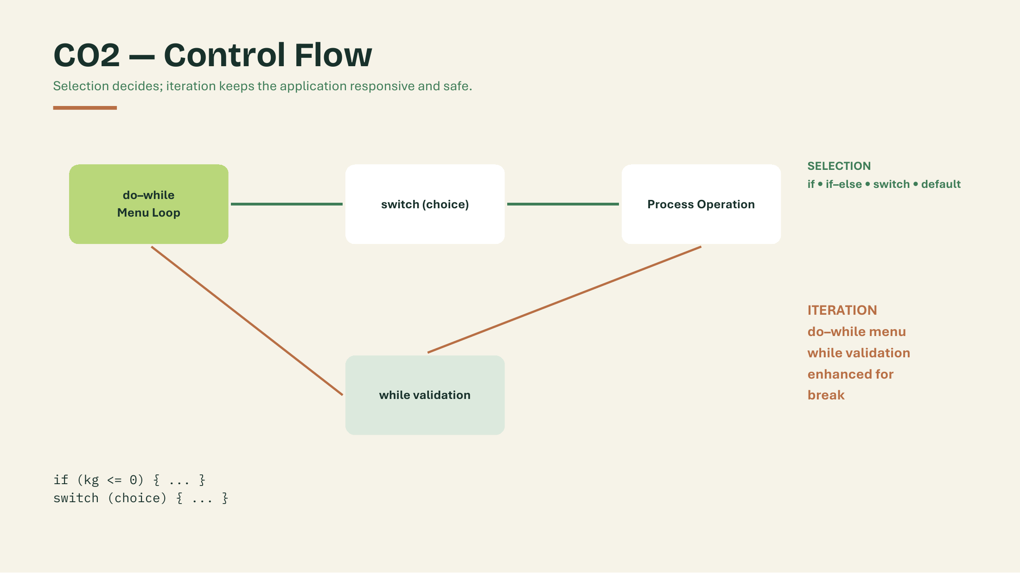

Slide 6
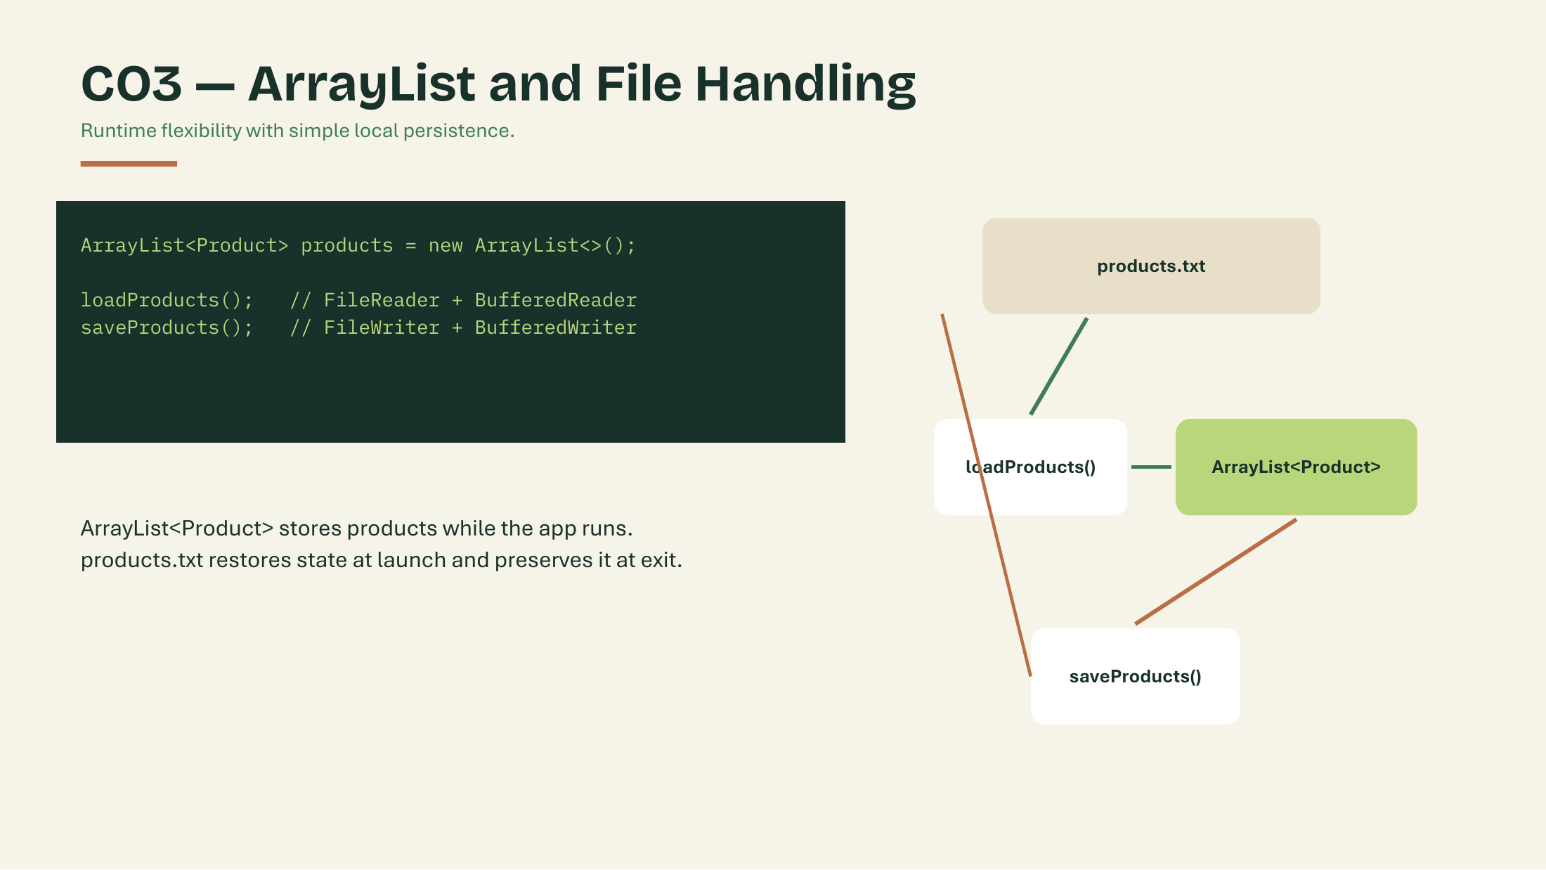
CO3 — ArrayList and File Handling
Runtime flexibility with simple local persistence.
products.txt
FILE METHODS IN main()
loadFromFile(); // Files.newBufferedReader(file)
saveToFile(); // Files.newBufferedWriter(file)
↓
loadFromFile()
ArrayList<Product> stores products while the app runs. products.txt restores them at launch and saves them on exit.
↓
ArrayList<Product>
↓
ONE LINE IN products.txt
saveToFile()
mango,100.0,20.0,0.0 (name, price, stock, sold)
saveToFile() writes back to products.txt

Slide 7
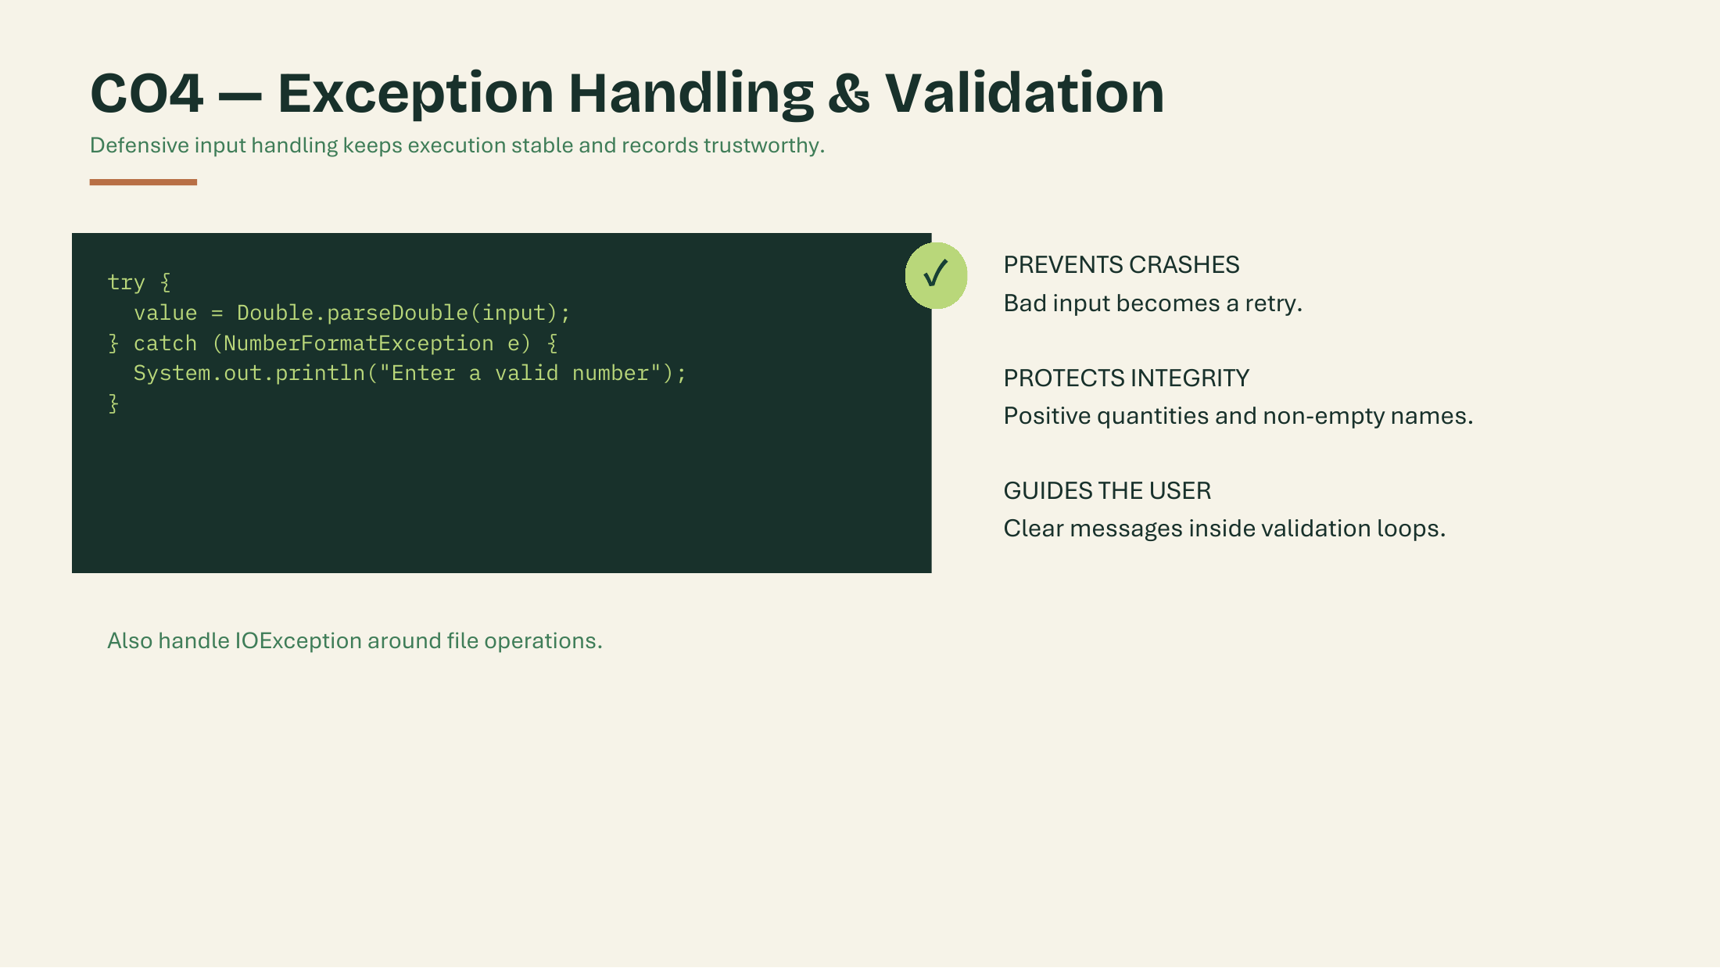
CO4 — Exception Handling & Validation
Defensive input handling keeps execution stable and records trustworthy.
PREVENTS CRASHES
Bad input becomes a retry.
PROTECTS INTEGRITY
Positive quantities and non-empty names.
CUSTOM EXCEPTION
InsufficientStockException stops a sale larger than the stock.
readDouble() — INPUT VALIDATION
try {
return Double.parseDouble(sc.nextLine().trim());
} catch (NumberFormatException e) {
System.out.println("Please enter a valid number.");
}
sell() — CUSTOM EXCEPTION
if (kg > stock) {
throw new InsufficientStockException("Not enough stock.");
}
Also handle IOException around file operations.

Slide 8
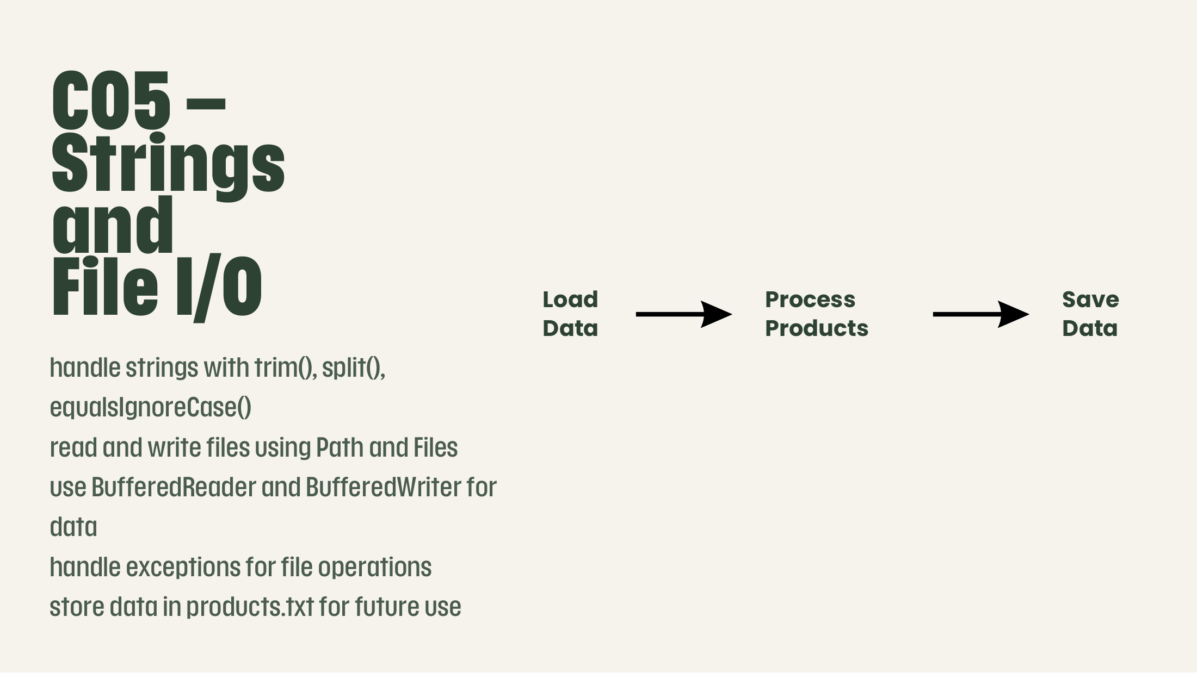
CO5 – Strings
and File I/O
CASE-INSENSITIVE SEARCH • findProduct()
if (p.getName().equalsIgnoreCase(name)) {
return p;
}
STRINGS AND TEXT-FILE HANDLING
trim() and split() process strings.
equalsIgnoreCase() searches product names without considering uppercase or lowercase.
BufferedReader and BufferedWriter read and write product data.
Exception handling manages file errors.
Load
Data
Process
Products
Save
Data
→
→

Slide 9
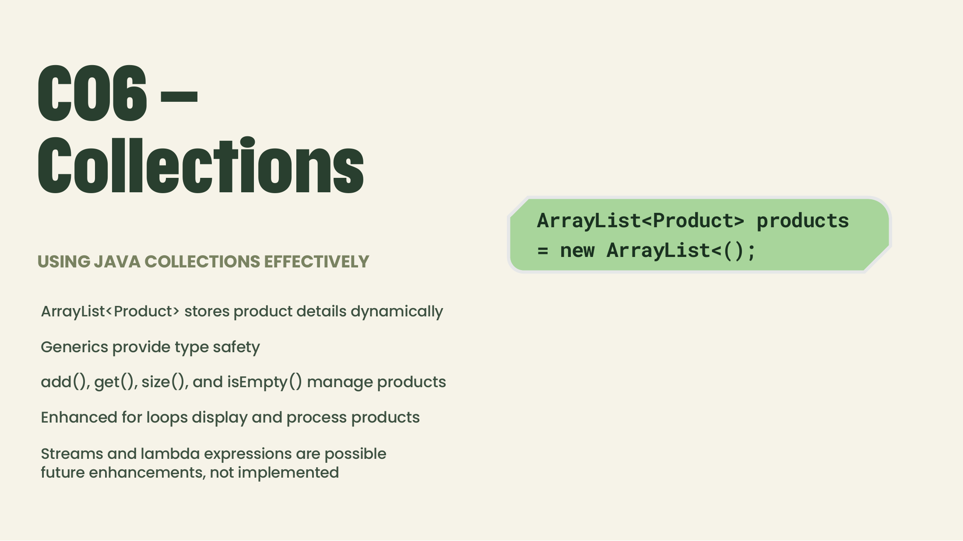
CO6 –
Collections
PRODUCT LIST • declare and add
static ArrayList<Product> products = new ArrayList<>();
products.add(new Product(name, price, kg, 0));
USING JAVA COLLECTIONS EFFECTIVELY
ArrayList<Product> stores product objects dynamically.
Generics provide type safety.
add(), size(), and isEmpty() manage the product list.
Enhanced for loops process product objects.
FUTURE ENHANCEMENT (NOT IMPLEMENTED)
Streams and lambda expressions could simplify searching and reporting.

Slide 10
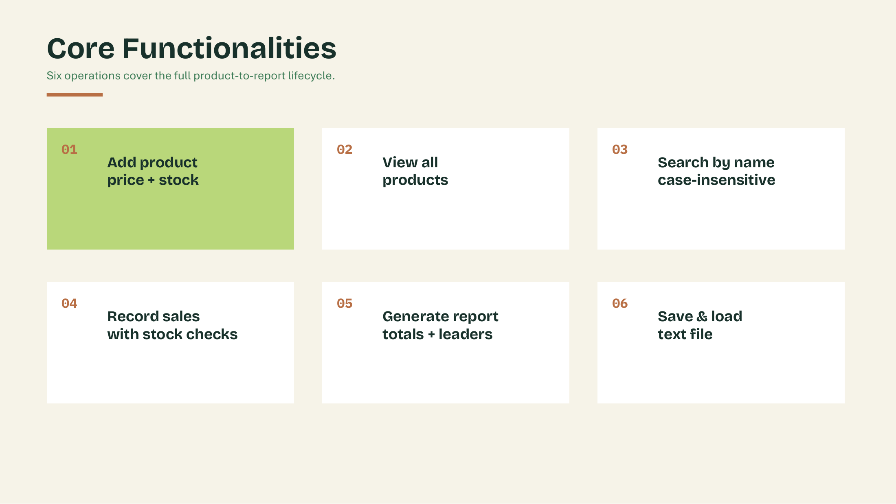

Slide 11
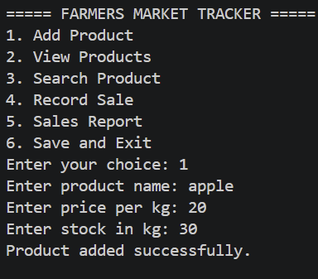
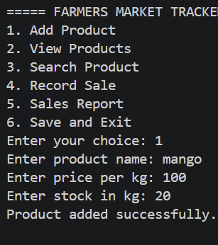
Program Output: Add Product
Option 1 stores each product with its price per kg and stock.
Adding 'apple'
Adding 'mango'

Slide 12
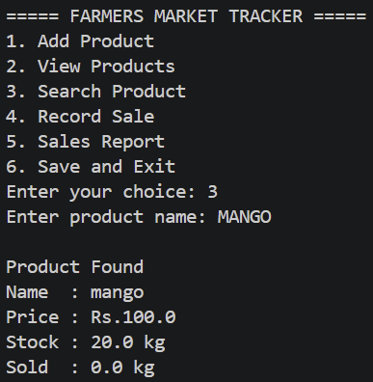
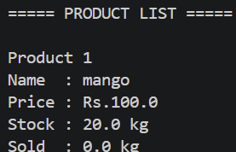
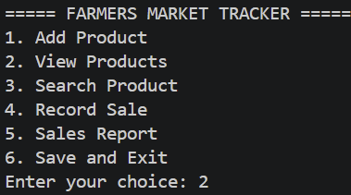
Program Output: View & Search
Options 2 and 3 list all products and find one by name, ignoring case.
Menu choice 2
Product list
Search 'MANGO'

Slide 13
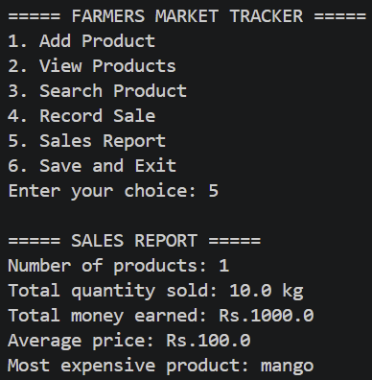
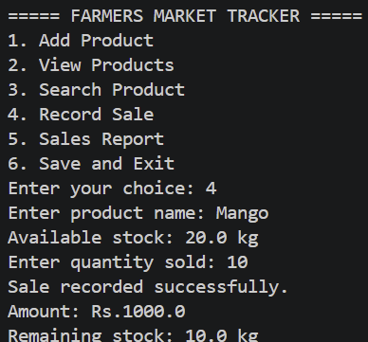
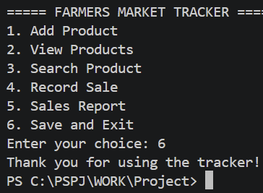
Program Output: Sale, Report & Exit
Options 4, 5 and 6 record a sale, summarise sales and save on exit.
Record sale
Sales report
Save and exit

Slide 14
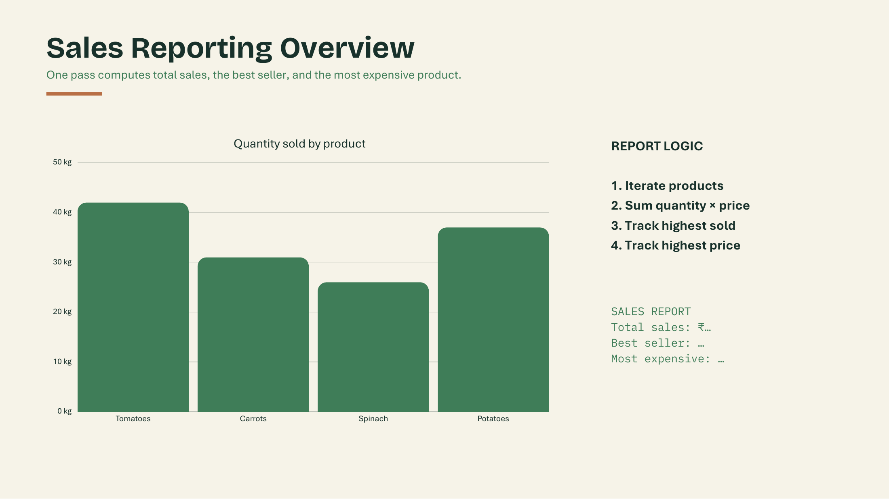
Sales Reporting Overview
One pass computes total sales, the best seller, and the most expensive product.
REPORT LOGIC
1. Loop through all products
2. Add up sold kg and sold × price
3. Average price = total price ÷ products
4. Track the highest sold (best seller)
5. Track the highest price
6. Show “No sales yet” if nothing sold
SALES REPORT OUTPUT
===== SALES REPORT =====
Number of products: 1
Total quantity sold: 10.0 kg
Total money earned: Rs.1000.0
Average price: Rs.100.0
Most expensive product: mango
Best selling product: mango

Slide 15
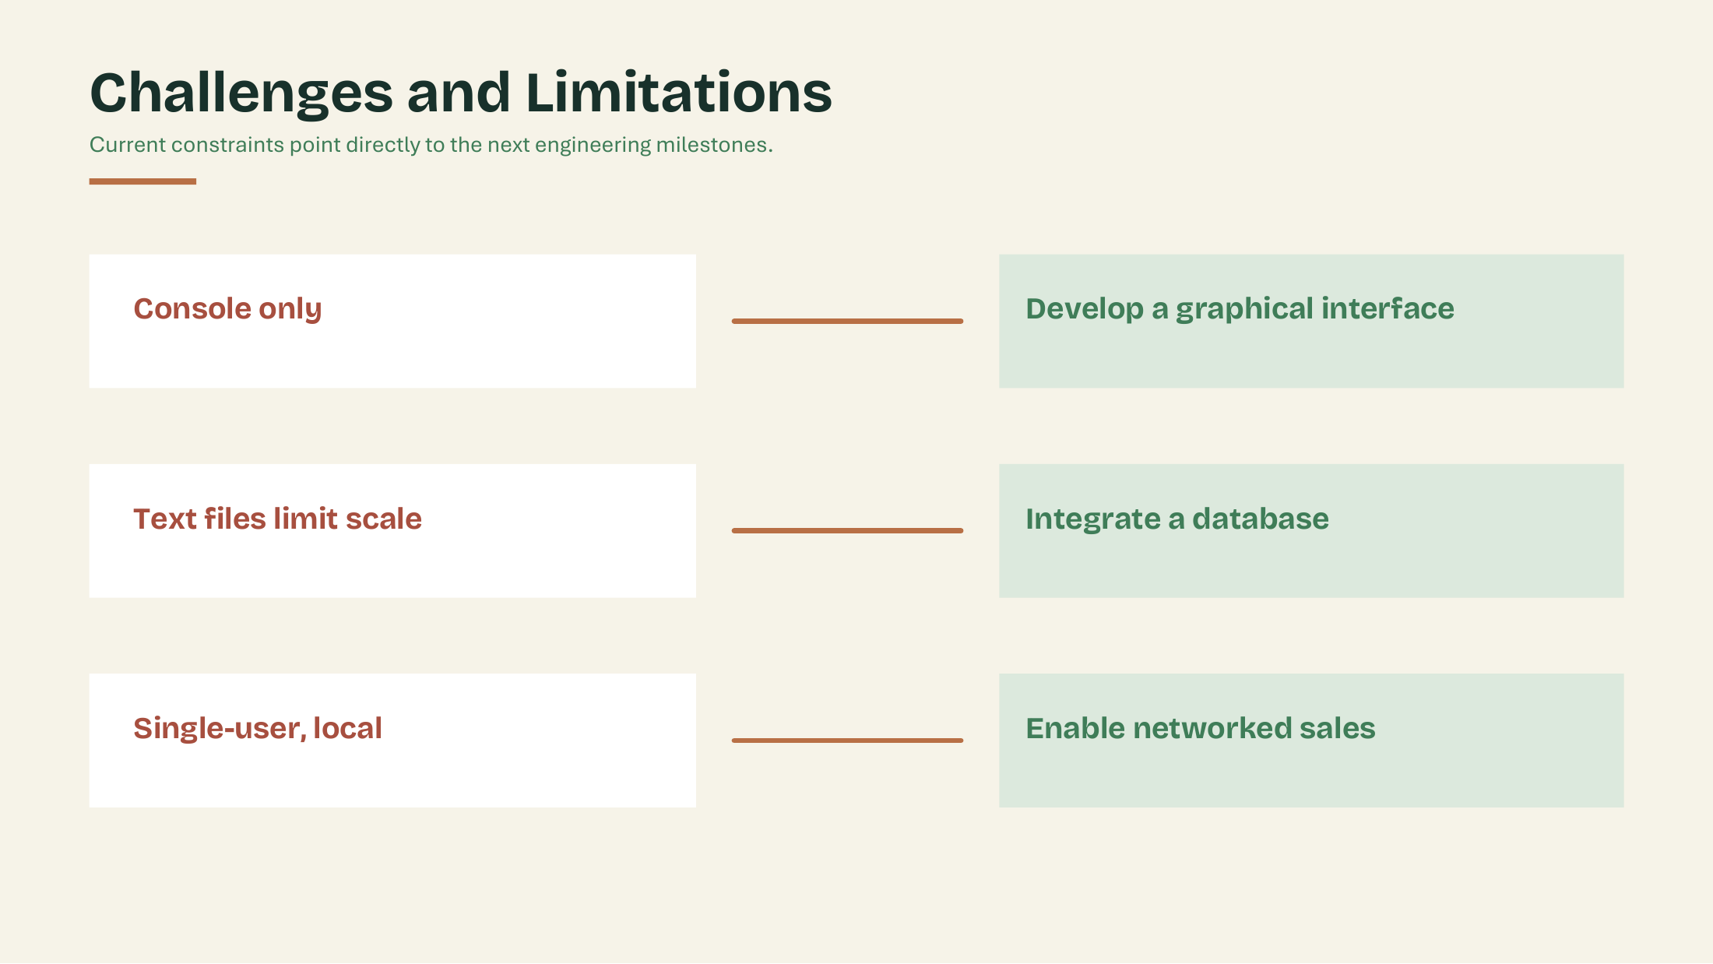

Slide 16


