Slide 1
Brick Breaker game
short preview
By Vasil & Viktor

Slide 2
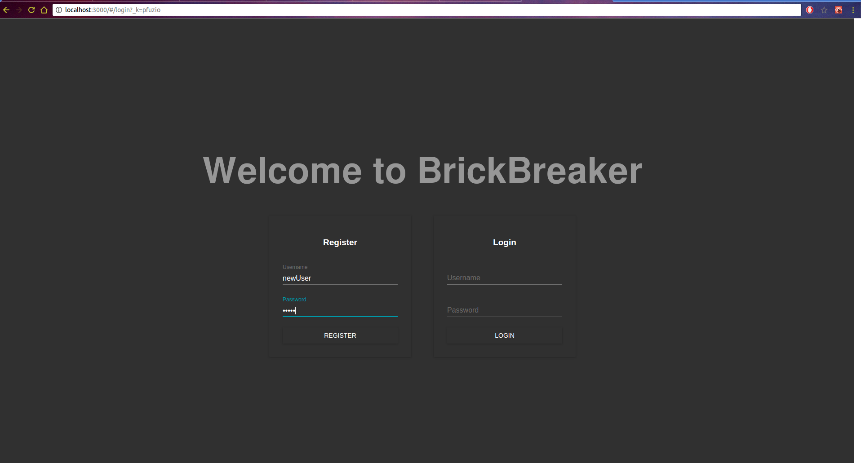
Login & Registration screen

Slide 3
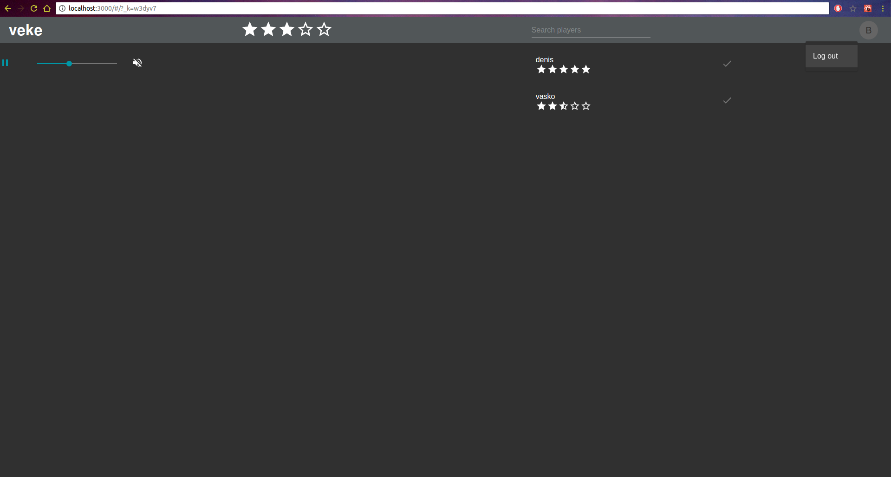
Home screen

Slide 4
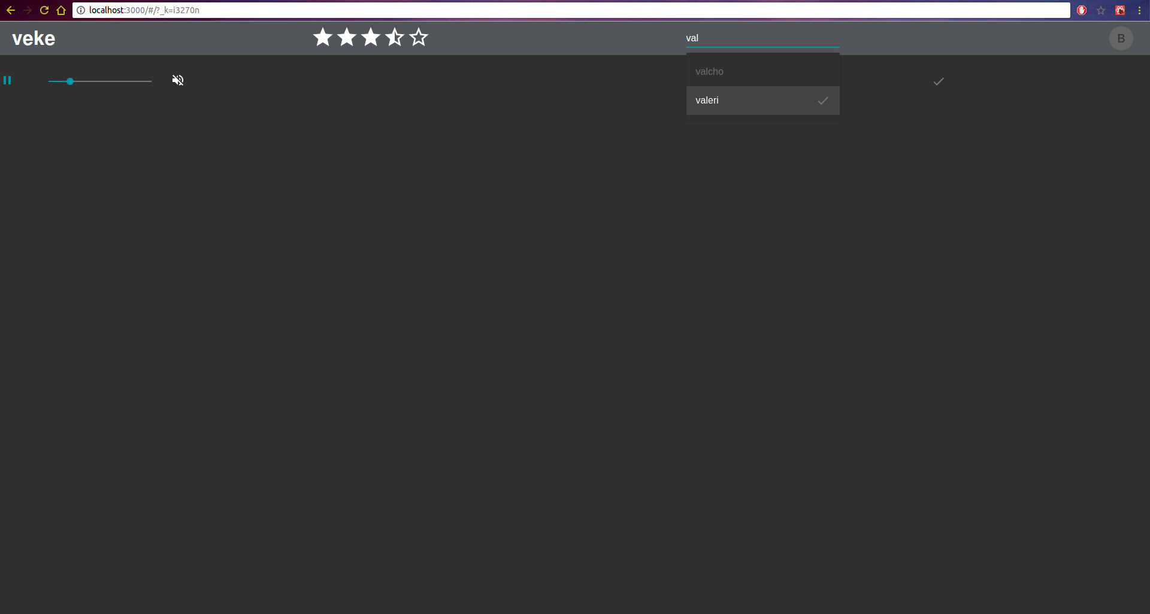
Home screen

Slide 5
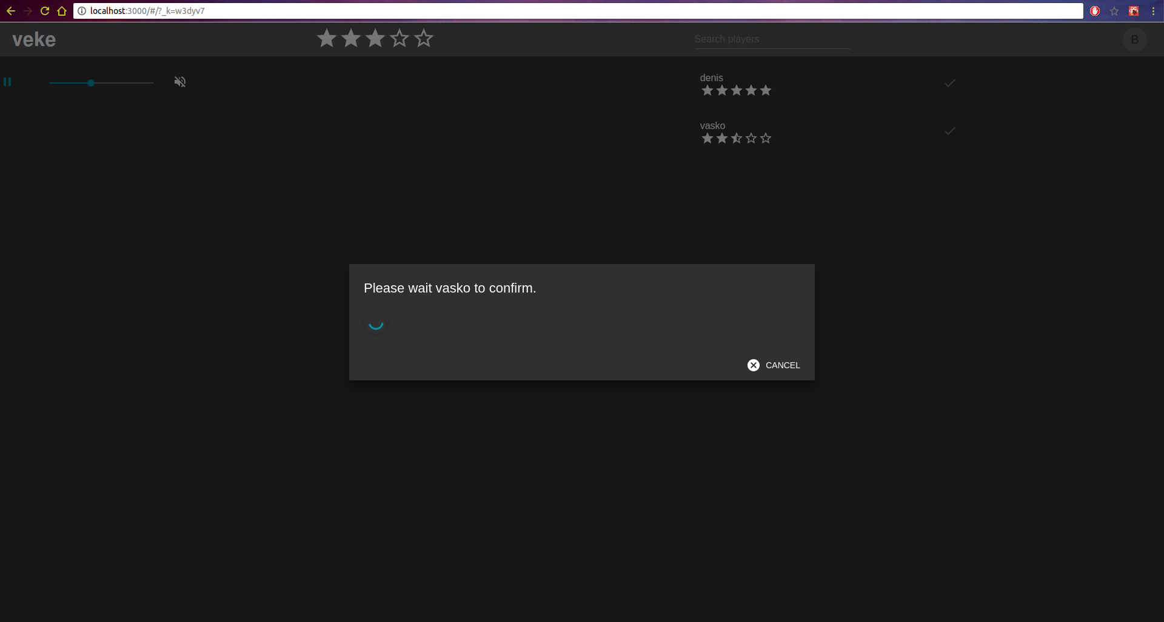
Invitations

Slide 6
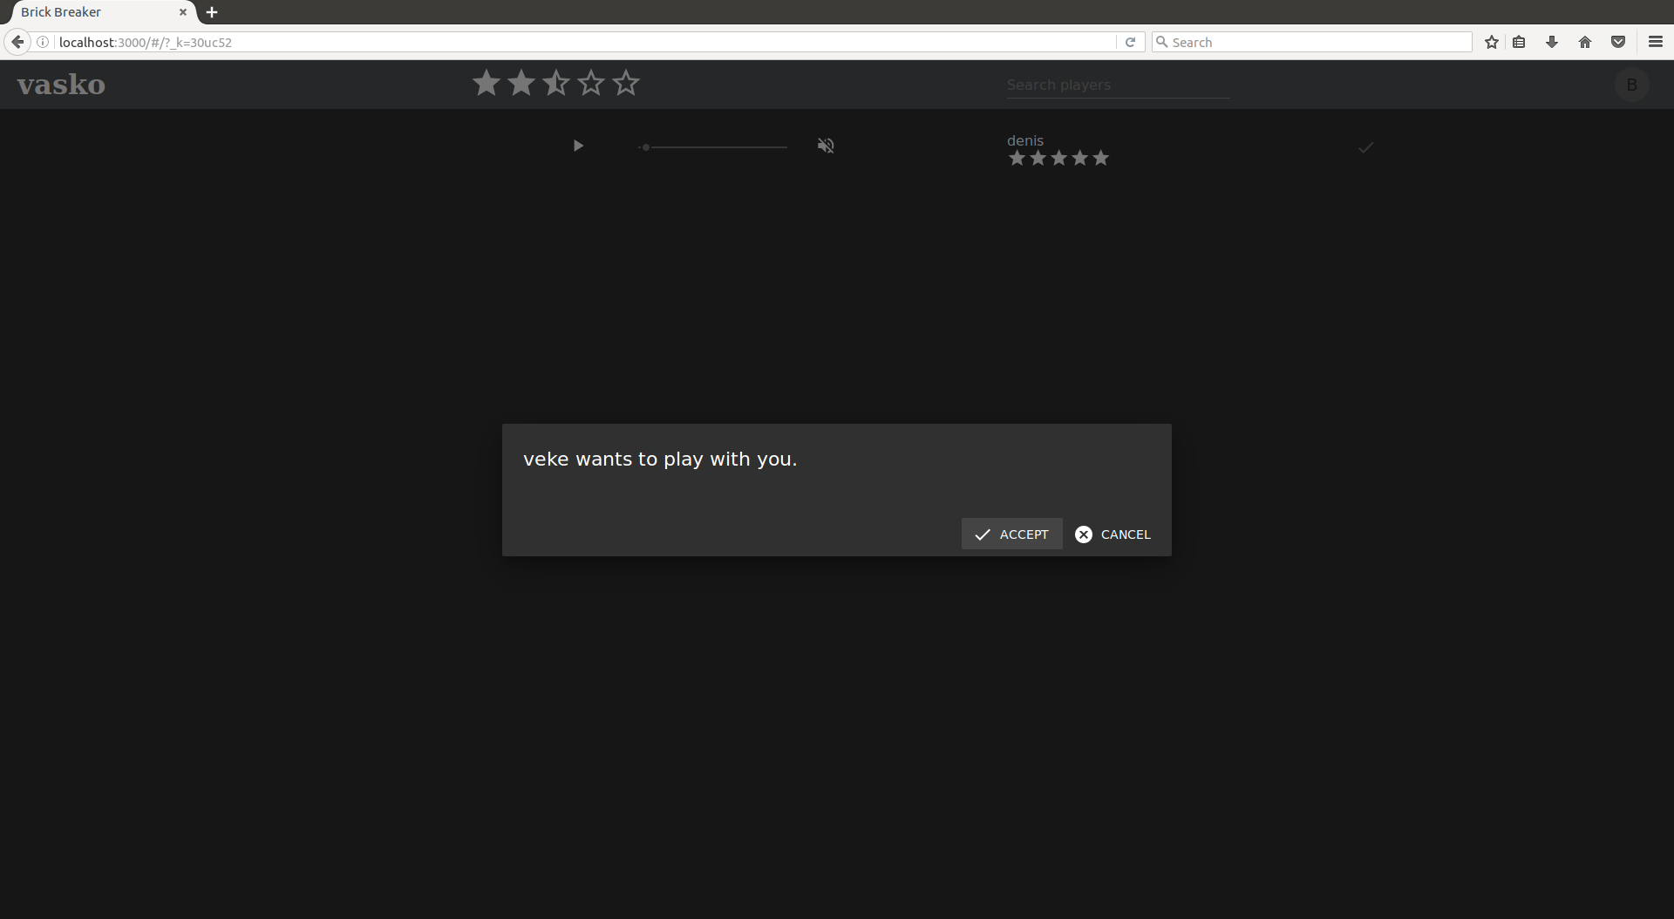
Invitations

Slide 7
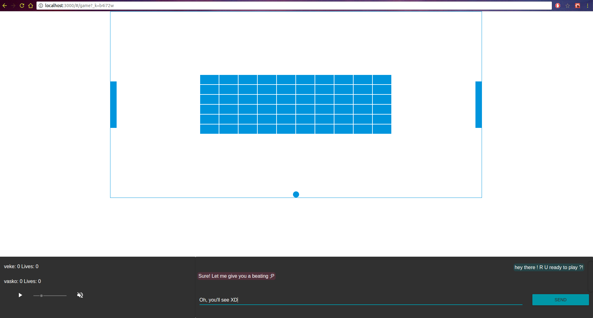
Game screen

Slide 8
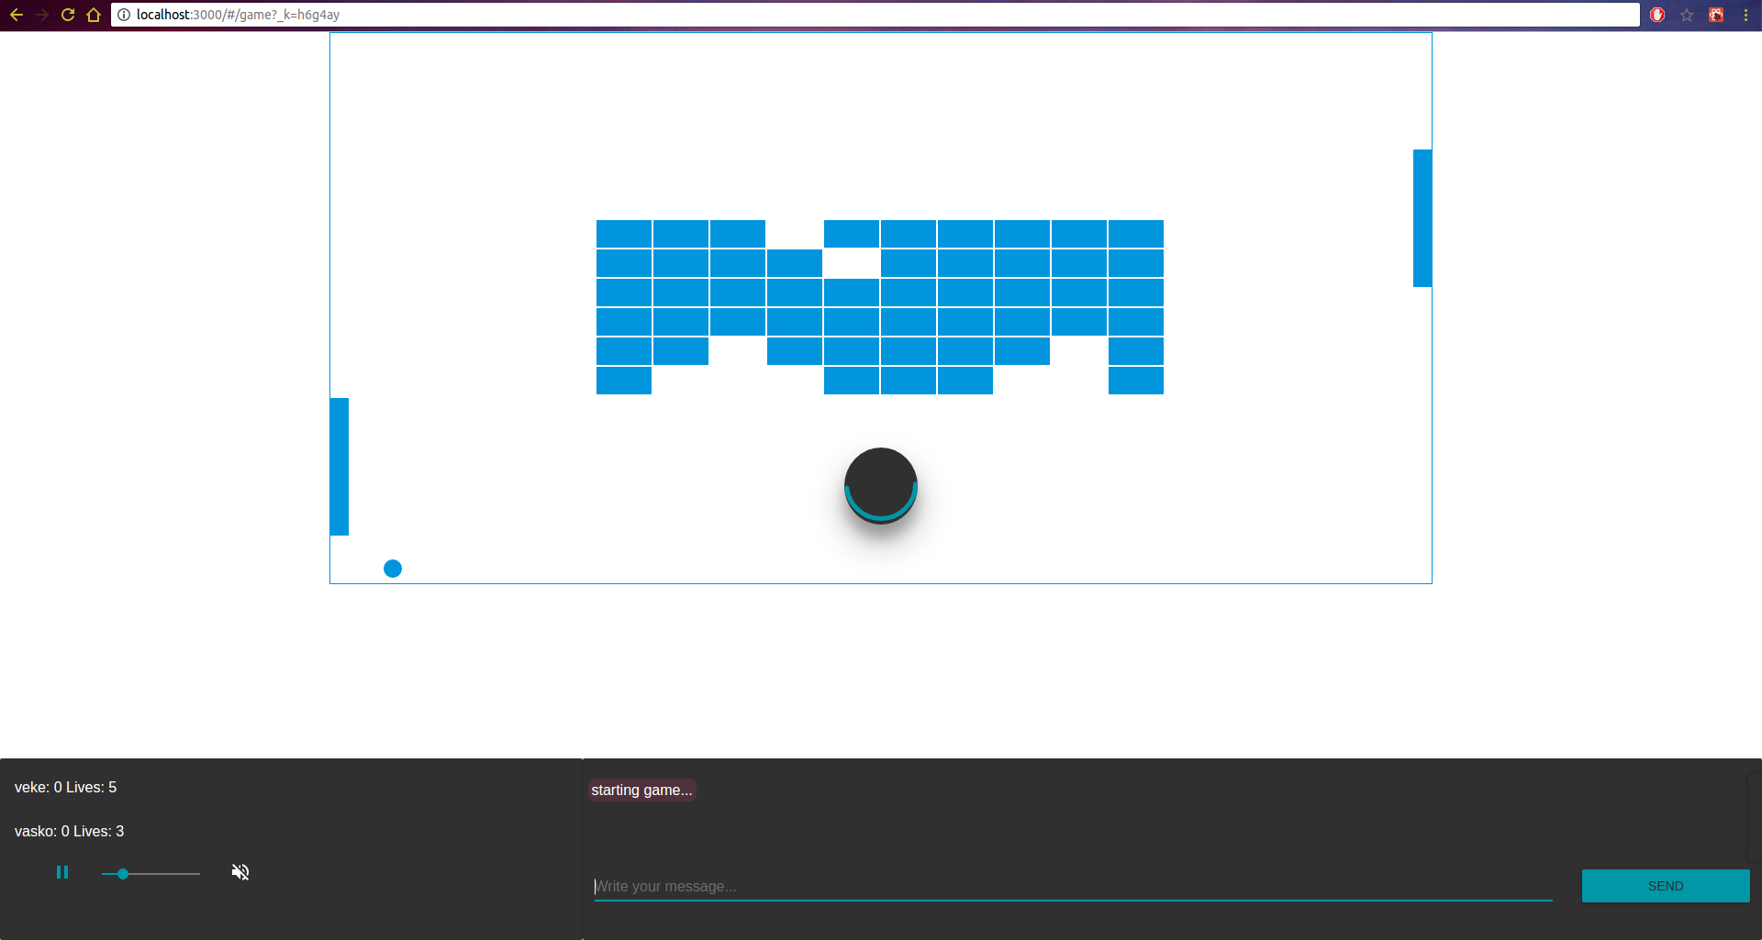
Game screen

Slide 9
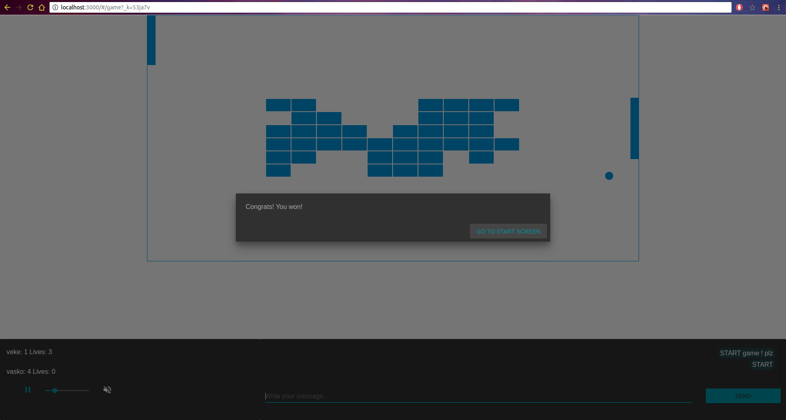
Game screen

Slide 10
Thank you !
next: live demo
By Vasil & Viktor

